Slide 1
Week 1
Insurance Database

Slide 2
PERSON
CAR
driver_id | name | address
reg_num | model | year
ACCIDENT
report_num | accident_date | location
driver_id | reg_num
OWNS
driver_id | reg_num | report_num | damage_amount
PARTICIPATED
Notes:
PERSON (driver_ id: String, name: String, address: String)
CAR (reg_num: String, model: String, year: int)
ACCIDENT (report_num: int, date: date, location: String)
OWNS (driver_id: String, reg_num: String)
PARTICIPATED (driver_id: String,reg_num: String, report_num: int, damage-amount: int)

Slide 3
PERSON
CAR
driver_id | name | address
reg_num | model | year
ACCIDENT
report_num | accident_date | location
driver_id | reg_num
OWNS
driver_id | reg_num | report_num | damage_amount
PARTICIPATED
Notes:
PERSON (driver_ id: String, name: String, address: String)
CAR (reg_num: String, model: String, year: int)
ACCIDENT (report_num: int, date: date, location: String)
OWNS (driver_id: String, reg_num: String)
PARTICIPATED (driver_id: String,reg_num: String, report_num: int, damage-amount: int)

Slide 4
PERSON
CAR
driver_id | name | address
A01 | Richard | Srinivas nagar
A02 | Pradeep | Rajaji nagar
A03 | Smith | Ashok nagar
A04 | Venu | N R Colony
A05 | Jhon | Hanumanth nagar
reg_num | model | year
KA052250 | Indica | 1990
KA031181 | Lancer | 1957
KA095477 | Toyota | 1998
KA053408 | Honda | 2008
KA041702 | Audi | 2005
OWNS
driver_id | reg_num
A01 | KA052250
A02 | KA053408
A03 | KA031181
A04 | KA095477
A05 | KA041702

Slide 5
PARTICIPATED
driver_id | reg_num | report_num | damage_amount
A01 | KA052250 | 11 | 10000
A02 | KA053408 | 12 | 50000
A03 | KA095477 | 13 | 25000
A04 | KA031181 | 14 | 3000
A05 | KA041702 | 15 | 5000
ACCIDENT
report_num | accident_date | location
11 | 01-JAN-03 | Mysore Road
12 | 02-FEB-04 | South end Circle
13 | 21-JAN-03 | Bull temple Road
14 | 17-FEB-08 | Mysore Road
15 | 04-MAR-05 | Kanakpura Road

Slide 6
Insurance Database
PERSON (driver_id: String, name: String, address: String)
CAR (reg_num: String, model: String, year: int)
ACCIDENT (report_num: int, accident_date: date, location: String)
OWNS (driver_id: String, reg_num: String)
PARTICIPATED (driver_id: String,reg_num: String, report_num: int, damage_amount: int)
Create the above tables by properly specifying the primary keys and the foreign keys.
Enter at least five tuples for each relation
Display Accident date and location
Update the damage amount to 25000 for the car with a specific reg_num (example 'K A053408' ) for which the accident report number was 12.
Add a new accident to the database.
To Do
Display Accident date and location
Display driver id who did accident with damage amount greater than or equal to Rs.25000

Slide 7
SQL> create table person (driver_id varchar(10),
name varchar(20), address varchar(30), primary key(driver_id));
Table created.
SQL> desc person
Name Null? Type
------------------------ -------- ------------------------------
DRIVER_ID NOT NULL VARCHAR2(10)
NAME VARCHAR2(20)
ADDRESS VARCHAR2(30)

Slide 8
create table car(reg_num varchar(10),model varchar(10),year int, primary key(reg_num));
create table accident(report_num int, accident_date date, location varchar(20),primary key(report_num));
create table owns(driver_id varchar(10),reg_num varchar(10),
primary key(driver_id, reg_num),
foreign key(driver_id) references person(driver_id),
foreign key(reg_num) references car(reg_num));

Slide 9
create table participated(driver_id varchar(10), reg_num varchar(10),
report_num int, damage_amount int,
primary key(driver_id, reg_num, report_num),
foreign key(driver_id) references person(driver_id),
foreign key(reg_num) references car(reg_num),
foreign key(report_num) references accident(report_num));

Slide 10
QUERY 2: Enter at least five tuples for each relation
ACCIDENT
report_num | accident_date | location
Example of inserting into accident table
insert into accident values (11, '2003-01-01','Mysore Road’);
insert into accident values (12,'2004-02-02','South end Circle’);
insert into accident values (13,'2003-01-21','Bull temple Road’);
insert into accident values (14,'2008-02-17','Mysore Road’);
insert into accident values (15,'2004-03-05','Kanakpura Road’);

Slide 11
QUERY 2: Enter at least five tuples for each relation
Similarly insert values for other remaining tables

Slide 12
Update the damage amount to 25000 for the car with a specific reg-num (example 'KA053408' ) for which the accident report number was 12.
PARTICIPATED
driver_id | reg_num | report_num | damage_amount
A01 | KA052250 | 11 | 10000
A02 | KA053408 | 12 | 50000
A03 | KA095477 | 13 | 25000
A04 | KA031181 | 14 | 3000
A05 | KA041702 | 15 | 5000

Slide 13
Update the damage amount to 25000 for the car with a specific reg-num (example 'KA053408' ) for which the accident report number was 12.
PARTICIPATED
driver_id | reg_num | report_num | damage_amount
A01 | KA052250 | 11 | 10000
A02 | KA053408 | 12 | 50000
A03 | KA095477 | 13 | 25000
A04 | KA031181 | 14 | 3000
A05 | KA041702 | 15 | 5000
update participated set damage_amount=25000
where reg_num='KA053408' and report_num=12;

Slide 14
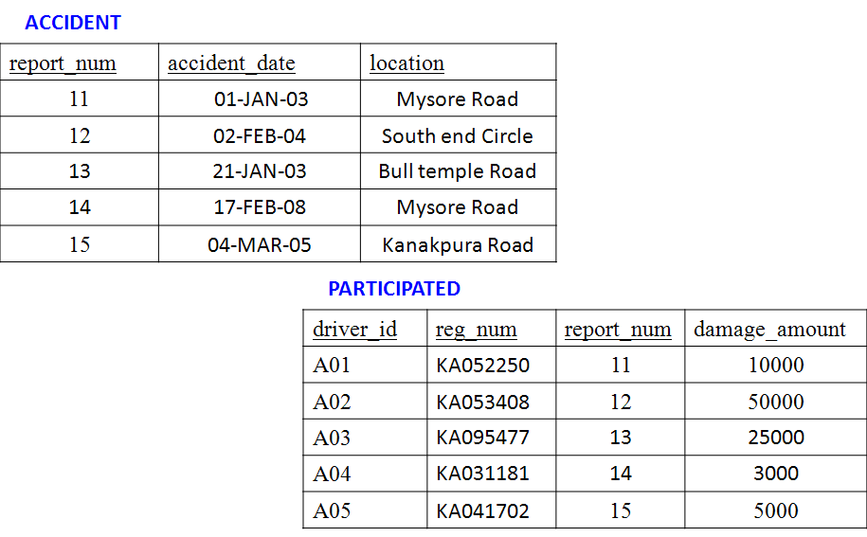
Find the total number of people who owned cars that were involved in accidents in 2008.
Notes:
select count(distinct driver_id) CNT from participated a, accident b where a.report_num=b.report_num and b.accident_date like '%08';

Slide 15
Find the total number of people who owned cars that were involved in accidents in 2008.
select count(distinct driver_id) CNT
from participated a, accident b
where a.report_num=b.report_num and b.accident_date like '%08';
Notes:
select count(distinct driver_id) CNT from participated a, accident b where a.report_num=b.report_num and b.accident_date like '%08';

Slide 16
Add a new accident to the database.
SQL> insert into accident values(16,’2008-03-08','Domlur');
SQL> select * from accident;

Slide 17
To Do
Display Accident date and location
Display driver id who did accident with damage amount greater than or equal to Rs.25000

Slide 18
ADDITIONAL QUERIES
LIST THE ENTIRE PARTICIPATED RELATION IN THE DESCENDING ORDER OF DAMAGE AMOUNT.
SQL> SELECT * FROM PARTICIPATED ORDER BY DAMAGE_AMOUNTT DESC;
FIND THE AVERAGE DAMAGE AMOUNT
SQL> SELECT AVG(DAMAGE_AMOUNTT) FROM PARTICIPATED;
DELETE THE TUPLE WHOSE DAMAGE AMOUNT IS BELOW THE AVERAGE DAMAGE AMOUNT
SQL> DELETE FROM PARTICIPATED WHERE
DAMAGE_AMOUNTT < (SELECT AVG (DAMAGE_AMOUNT) FROM PARTICIPATED);
LIST THE NAME OF DRIVERS WHOSE DAMAGE IS GREATER THAN THE AVERAGE DAMAGE AMOUNT.
SQL> SELECT NAME FROM PERSON A, PARTICIPATED B WHERE A.DRIVER_ID = B.DRIVER_ID AND DAMAGE_AMOUNT > (SELECT AVG(DAMAGE_AMOUNT) FROM PARTICIPATED);
FIND MAXIMUM DAMAGE AMOUNT.
SQL>SELECT MAX(DAMAGE_AMOUNT) FROM PARTICIPATED;

