Slide 1

Python3
By a peer

Slide 2
“It’s one small step for man, one giant leap for mankind.”
- Neil Armstrong

Slide 3
What is Python?

Slide 4
Software
Engineers
Mathematicians
Data Analysts
Scientists
Accountants
Network Engineers

Slide 5
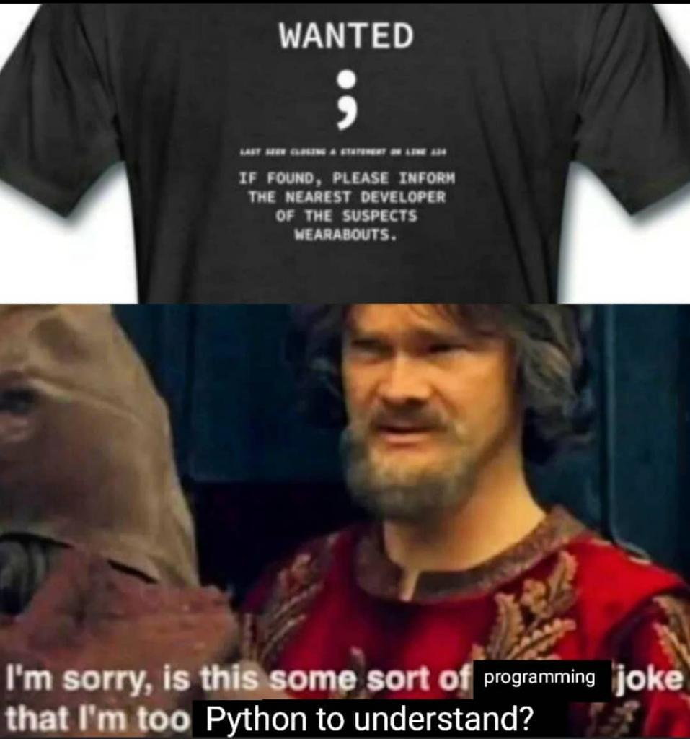
Also No Semicolon or Parenthesis

Slide 6
Why do we need a
Programming language?

Slide 7



10110
10101
Translator

Slide 8
Bytecode
Machine Code
Translator
Depending on the OS

Slide 9
Tools
EDITORS
IDE
Visual Studio Code
Sublime Text
Atom
Integrated Developer Environment
Pycharm
spyder

Slide 10
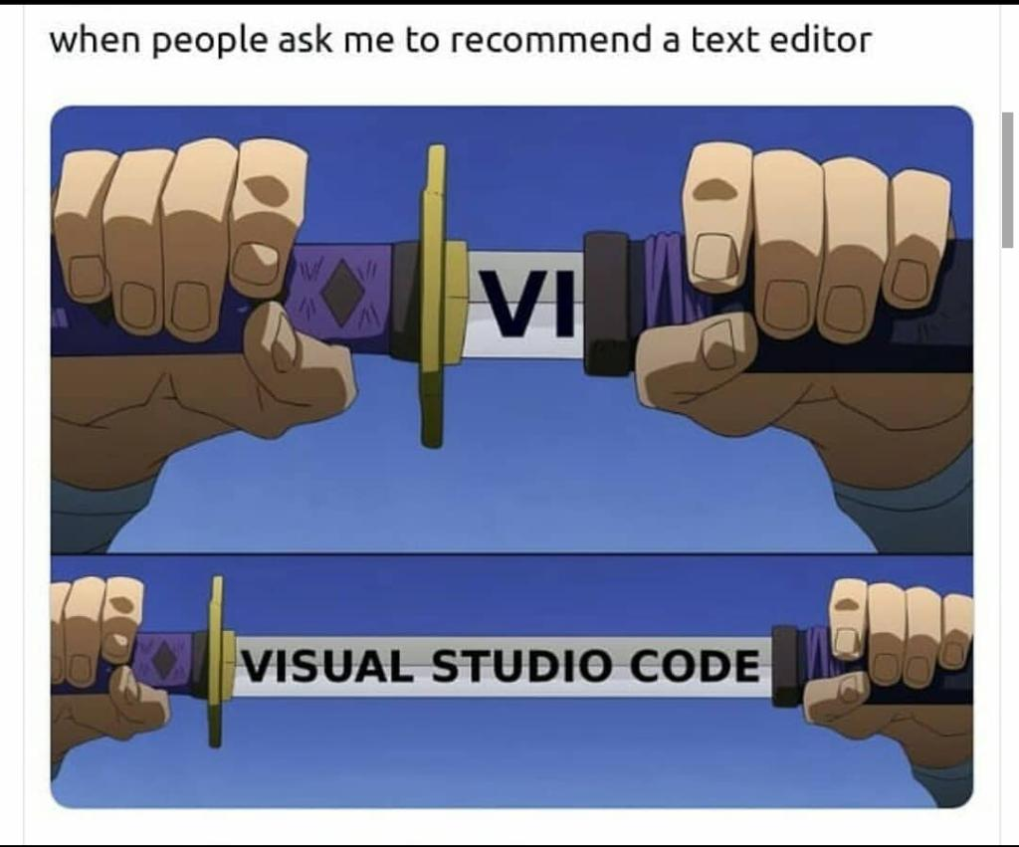

Slide 11
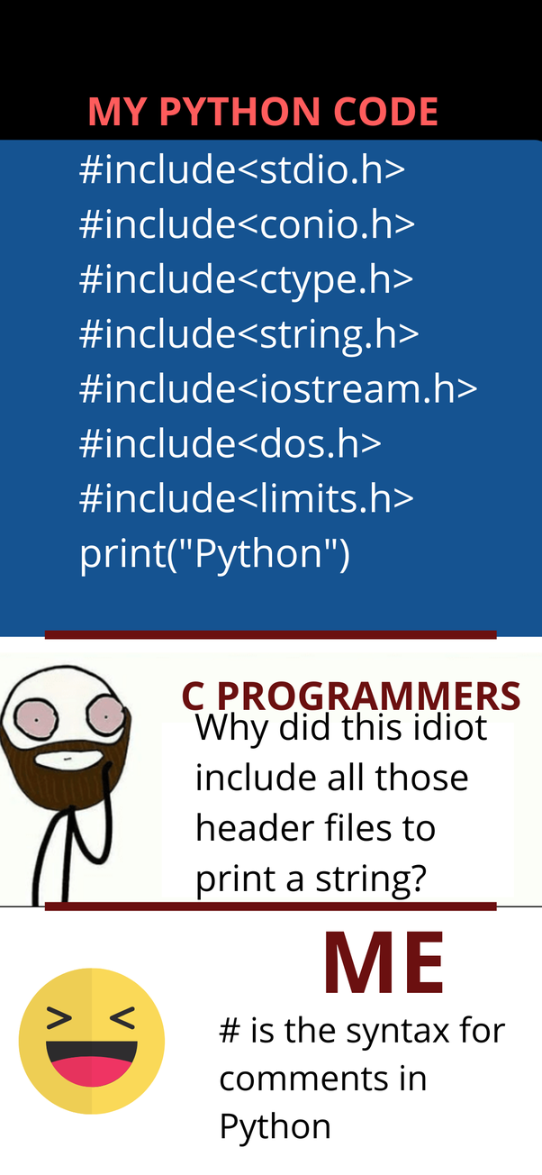
Comments

Slide 12
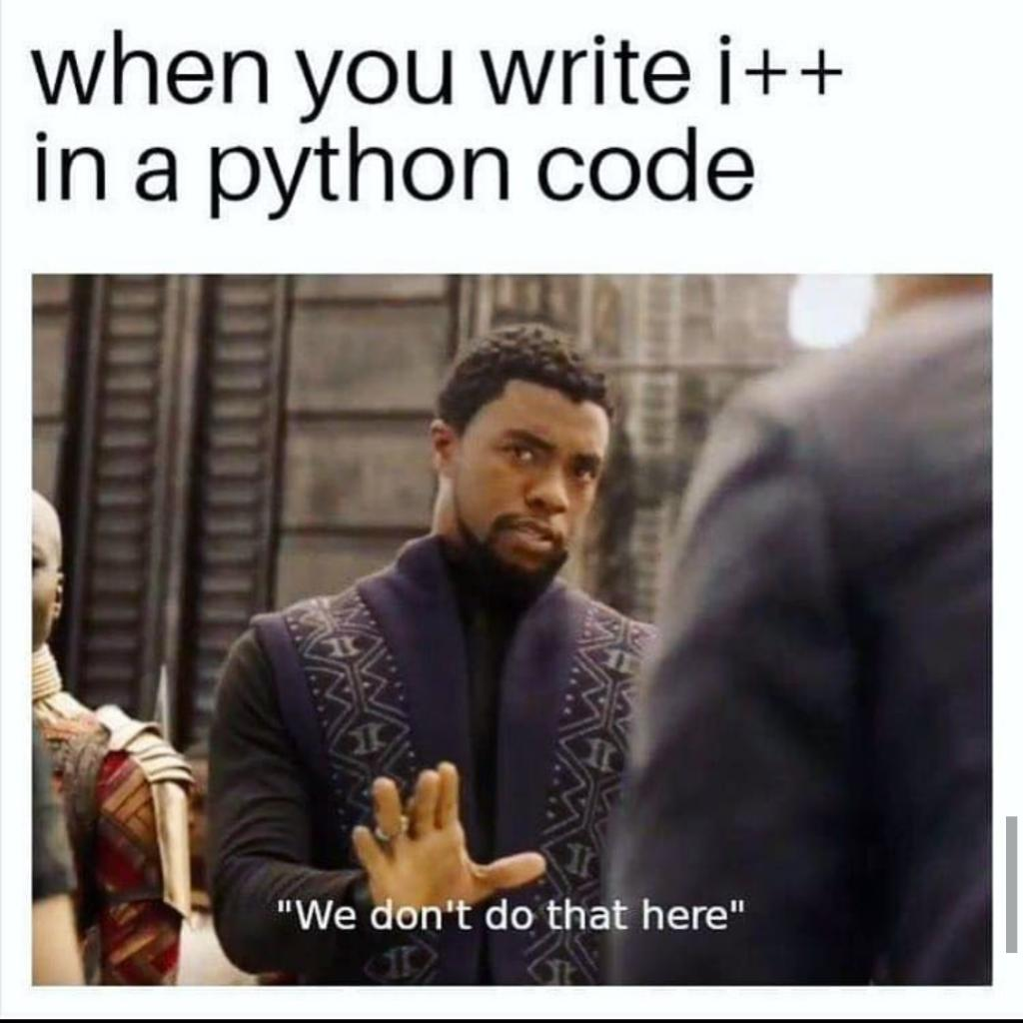
No increment
or
decrement operator

Slide 13
Basics
Variables
Mutable and immutable types
Strings
Escape sequences
String formatting
Numbers
Arithmetic operations
Type conversions
Conditional statements and logical operators
Loops
Functions and arguments
Scope

Slide 14
Variables
Variables are containers for storing data values.
Unlike other programming languages, python has no command for declaring a variable.
A variable is created the moment you first assign a value to it.
Python is a dynamically typed language so variables can change their type anytime in the code.
Primitive data types in python ( str, int, float, list, tuple, dict, bool, None ).

Slide 15
Mutable & Immutable types
Mutable types do not change their addresses when altered , until they are entirely changed.
Immutable types entirely change and create a copy if altered.
Id() operator helps us check their addresses.

Slide 16
Strings
String literals in python are surrounded by either single quotation marks, or double quotation marks. 'hello' is the same as "hello". You can display a string literal with the print().
Use of len() function.
Accessing particular element using [ ] brackets.
Immutability of strings.

Slide 17
Escape Sequences
The programmers refer to the “backslash (\)” character as an escape character. in other words, it has a special meaning when we use it inside the strings. as the name suggests, the escape character escapes the characters in a string for a brief moment to introduce unique inclusion.
\”
\’
\\
\n etc

Slide 18
String Formatting
Methods to format the string in the way we want, like concatenating two strings etc.
Different ways of concatenation.
‘,’ operator for primitive types

Slide 19
Numbers
There are 3 types of numbers in python:
int
float
Complex
For constants we use capitalized convention.
Math module

Slide 20
Arithmetic Operations
They are to perform basic math on numbers.
Difference of assignment operator from arithmetic operator.
( + , - , * , / , // , % , ** )

Slide 21
Type Conversions
How to take input in python.
As python is strongly typed language it does not do any implicit type conversions, we have to tell it to explicitly do the type conversions.
Truthy and Falsy values.

Slide 22
Conditional Statements
& Logical Operators
Logical operators always return a Boolean value. ( >, <, >=, <=, ==, !=, and, not, etc)
Conditional statements are formed using logical operators which are most commonly used to run ‘if statements’ and ‘loops’.
If else statements and their nesting.
Ternary operator

Slide 23
Loops
A loop statement allows us to execute a statement or group of statements multiple times.
Loops run till the conditions passed are true and stops when the conditions are false.
Python has 2 types of loops:
1. while loop : repeats a statement or group of statements while a given condition is true. it tests the condition before executing the loop body.
2. for loop : executes a sequence of statements multiple times and abbreviates the code that manages the loop variable.

Slide 24
Functions & Arguments
A function is a block of code which only runs when it is called, you can pass data, known as parameters, into a function. A function can return data as a result.
Using def function_name() .
Arguments are the values passed in the function.

Slide 25
Scope
A variable is only available from inside the region it is created, this is called scope.
Local scope : a variable created inside a function belongs to the local scope of that function, and can only be used inside that function.
Global scope : a variable created in the main body of the python code is a global variable and belongs to the global scope.

Slide 26
Thanks a lot guys

