Slide 1

ELK STACK

Slide 2
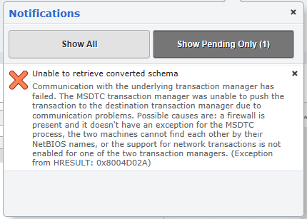
In today’s world tasks are done by various applications.
For eg: An applications which deals with various transaction.
So many transactions happen and we have to maintain logs for these transaction;
if anything goes wrong, we have to look for this and fix this issue.
Searching the issue can be a tedious task.
Transaction failed
Lets see searching over logs which has some error occurred in last few days!

Slide 3
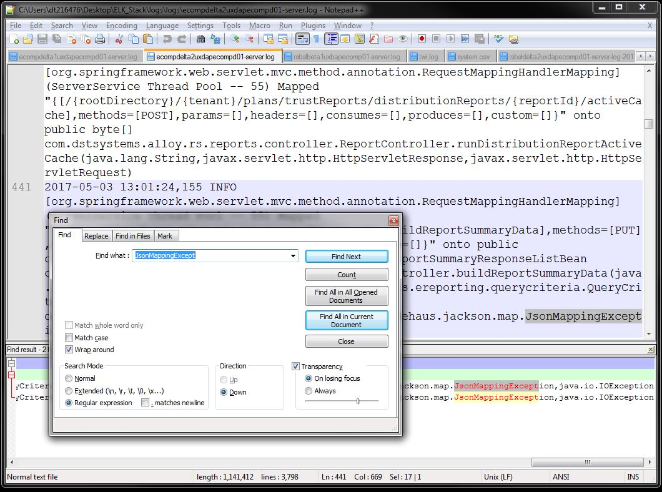


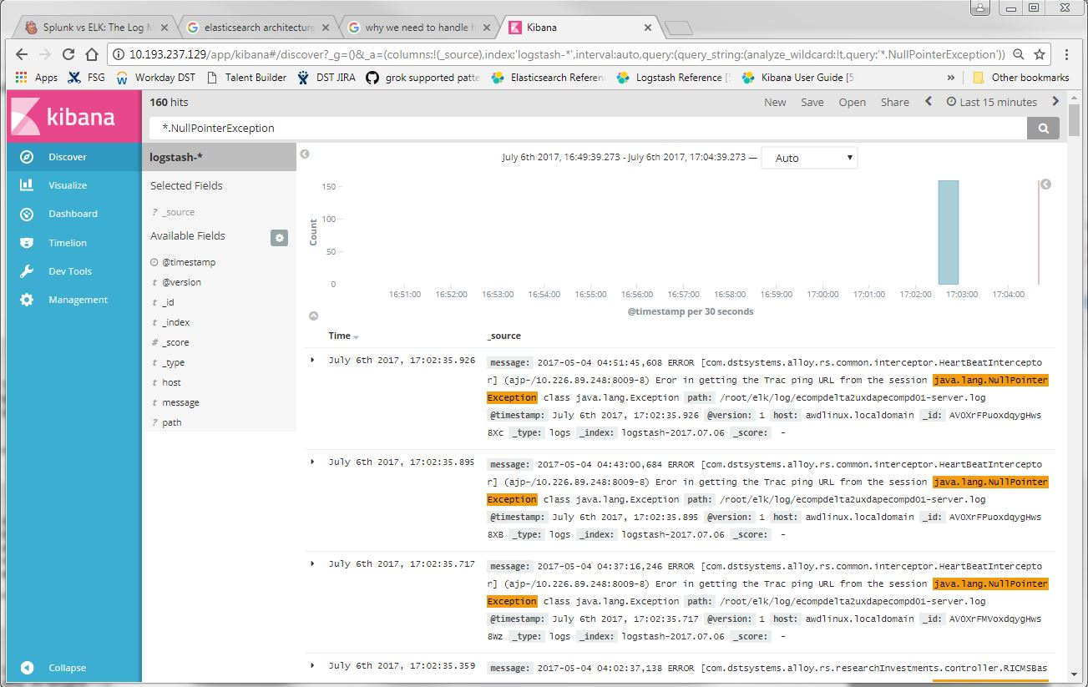
I am searching all JsonMappingException
from all logs occurred on this date.
-------------------------------------------------------------------------------------------------------------
Wow! It’s so easy, and saves a lot of time.

Slide 4
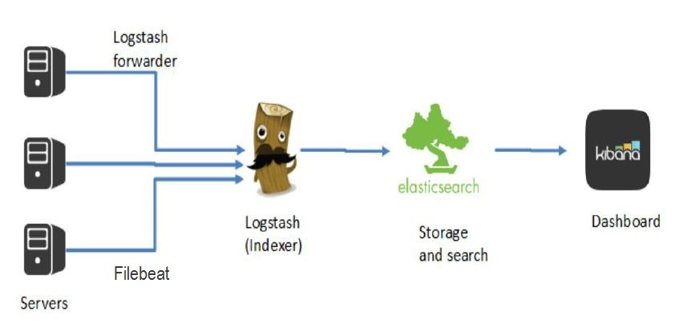
Search and analyze
(User Interface)
Index and Store
Parse logs Filter it &
pass it to the elasticsearch
(central logstash server)
Read file(s) push to Logstash
(light-weight Shippers)

Slide 5
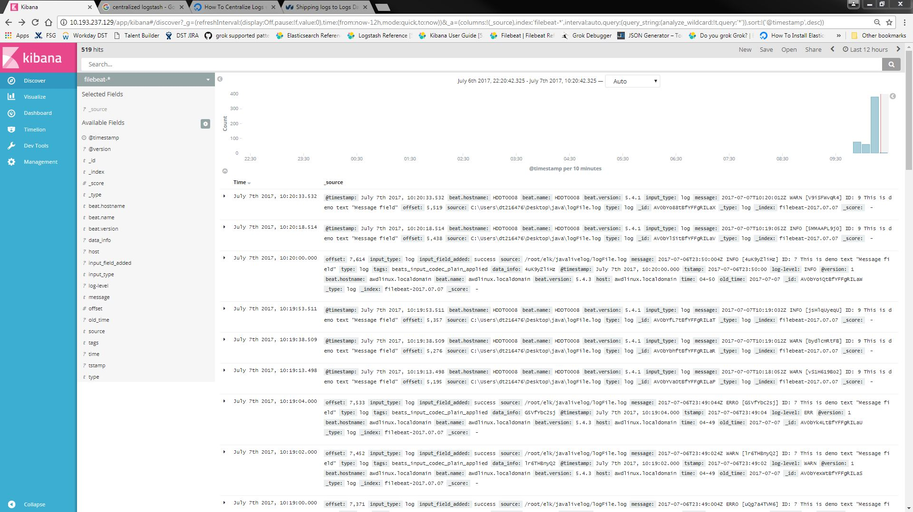
Kibana UI

Slide 6
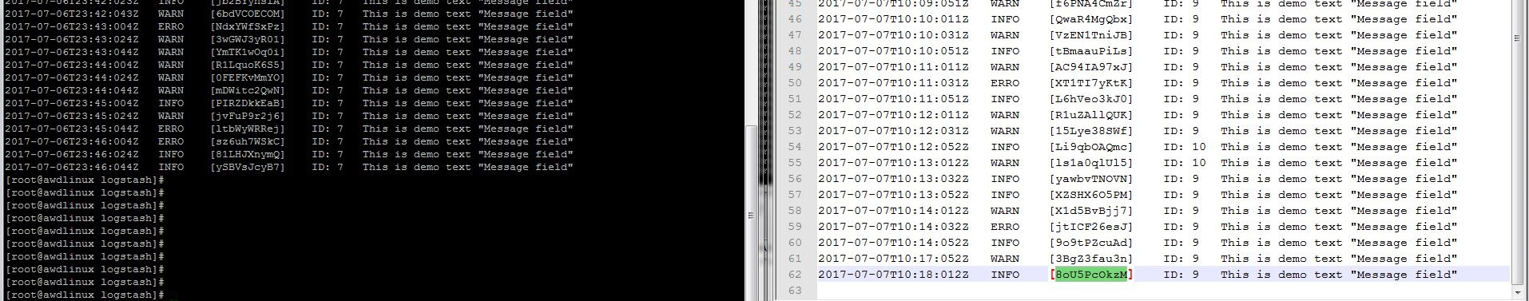
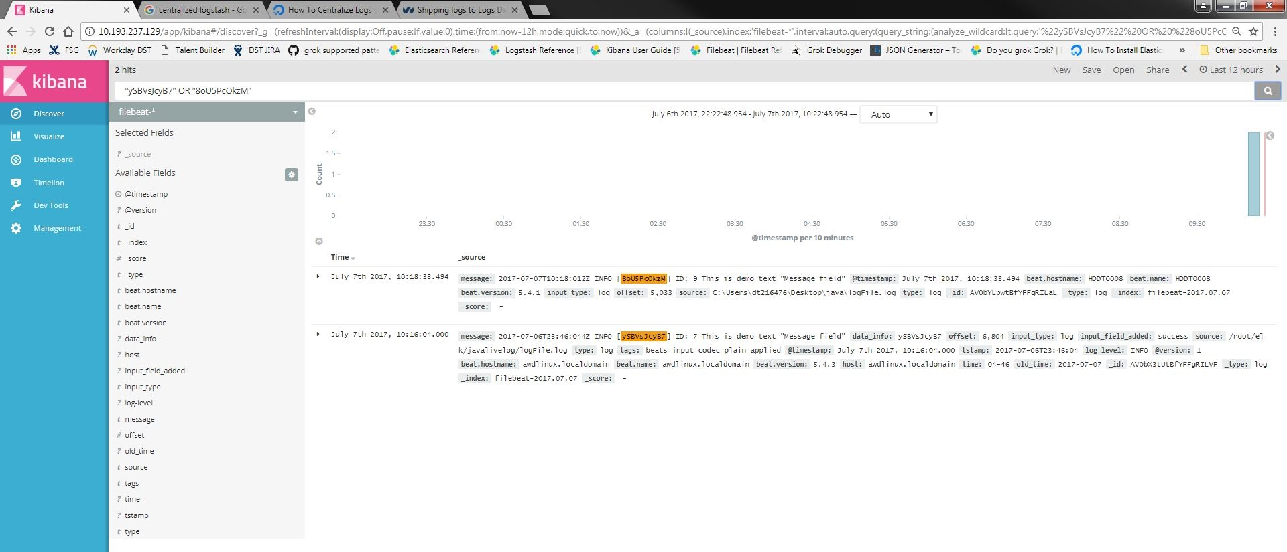
Linux Machine logs
Windows Machine logs
Kibana UI

Slide 7
Thank you

