Slide 1
P – 405 – CUSTOMER SEGMENTATION ANALYSIS

Slide 2
Team Introduction
Mentors
Mr. Karthik Muskula
Ms. Pallavi Bapuram
List of Team Members – GROUP 2
Prajwal Dhananjay Pawar
Nithya Balaji
Abhay Arshid
Shanmugam
Ajay Bhosale
Hemalatha
Uday Singh Rana

Slide 3
Agenda
Customer Personality Analysis is a detailed analysis of a company’s ideal customers. It helps a business to better understand its customers and makes it easier for them to modify products according to the specific needs, behaviour’s and concerns of different types of customers.
Customer personality analysis helps a business to modify its product based on its target customers from different types of customer segments. For example, instead of spending money to market a new product to every customer in the company’s database, a company can analyze which customer segment is most likely to buy the product and then market the product only on that particular segment.
Hence the Objective is To perform customer personality analysis to better understand ideal customers and help the business tailor products and marketing strategies according to customer segments.

Slide 4
WORKFLOW
Define Objectives: Clearly outline goals for customer segmentation (e.g., improve marketing ROI, personalize customer experiences).
Data Collection: Gather comprehensive customer data: demographics, household details, purchase behavior, response to promotions, and website interactions.
Data Cleaning and Preparation: Clean data, handle missing values, and transform variables (encode categorical, scale numerical).
Exploratory Data Analysis (EDA): Visualize data distributions, correlations, and initial insights using charts.
Feature Engineering: Create new features (e.g., total spending, recency of purchases) to enhance clustering.
Clustering Analysis: Apply clustering algorithms (e.g., K-means) to segment customers based on similarities.
Cluster Validation: Evaluate cluster quality using metrics (e.g., silhouette score) to ensure meaningful segments.
Interpretation and Profiling: Interpret segment characteristics and create customer personas for each cluster.
Strategic Recommendations: Recommend targeted strategies for marketing, product offerings, and customer service based on cluster insights.
Implementation and Monitoring: Implement tailored strategies and monitor performance metrics.

Slide 5
Attributes
People: Describe demographic and behavioral characteristics of customers. These include ID, birth year, education, marital status, income, household composition (children and teenagers), enrollment date, recency of purchases, and complaints.
Product: Detail customers’ spending habits on various products. Includes expenditures on wine, fruits, meat, fish, sweets, and luxury items like gold products over a two-year period.
Promotion: Track customer response to marketing campaigns. This encompasses the number of purchases made with discounts, acceptance of offers across five campaigns, and response to the latest campaign.
Place: Capture customer purchasing behavior across different channels. This includes the number of purchases made online through the company’s website, via catalogs, in-store, and monthly visits to the website.

Slide 6
Process Flow
Libraries Used:
import pandas as pd
import seaborn as sns
pd.set_option('display.max_columns', None)
import matplotlib.pyplot as plt
import numpy as np
Data Preprocessing and EDA
Feature Engineering
Model Evaluation
Model Feedback
Deployment
Model Building

Slide 7
Data Cleaning
Check for null values - Income column has 24 missing values - As no of missing values is less (<5%) , we can remove the rows containing missin values.
Check for duplicates - There are no duplicates values present.
Shape of present file - (2216,29)
Removal of insignificant columns –
ID column has 2216 unique columns does not provide any significance to the clustering.
Z_CostConstact and Z_revenue – The values are same throughout the data.
Dt_customer - gives the date of enrollment
Conversion of column - Year_Birth column has been dropped and converted to Age column
Merging Kidhome and Teenhome to Total_children

Slide 8
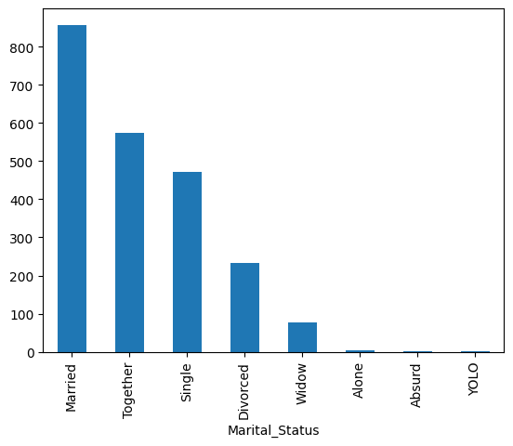
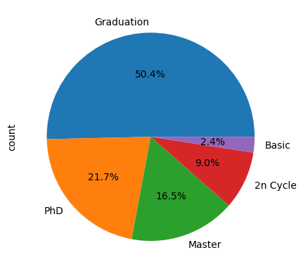
Data Preprocessing and EDA
Modification of Columns -
Converting 5 classes of education into 3 – namely - Undergraduate, Graduate and Post Graduate.
Marital Status Column - Converting 8 columns to 2 - Married, Single
Marital status and Education was converted into 0,1 and 0,1,2 with the use of label encoder

Slide 9
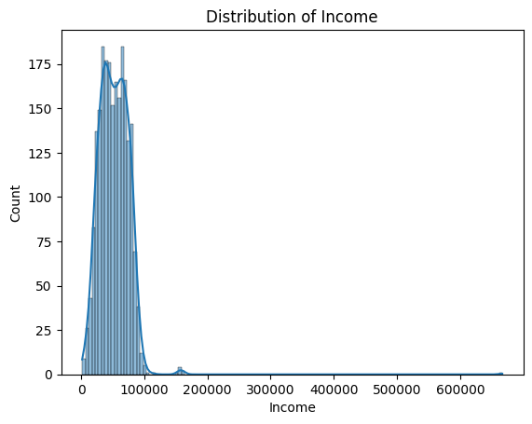
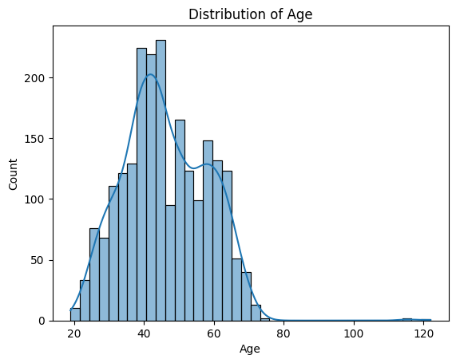
Description of Numerical Data
The average Age of customers is approximately 46 years, with a wide range from young adults(19) to elderly individuals(122).
Most individuals either have one child (50.41%) or none (28.56%), with fewer having two (18.77%) and seldom three children (2.26%).
The "Income" column shows diverse household earnings, averaging $52,247, ranging widely from $1,730 to $666,666.
The spending per customer varies widely from $27 on sweets to $305 on wines, with meat products reaching up to $1,725 and gold products up to $321.
Customers typically make 2-6 purchases, varying by deals, online, catalog, or store, and visit websites around 5 times monthly.

Slide 10
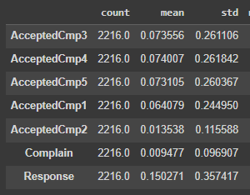
Description of Categorical Data
AcceptedCmp3:
Percentage of customers accepting offers in the 3rd campaign. Mean: 7.36%, Std: 0.26, Min: 0, Max: 1.
AcceptedCmp4:
Percentage of customers accepting offers in the 4th campaign. Mean: 7.40%, Std: 0.26, Min: 0, Max: 1.
AcceptedCmp5:
Percentage of customers accepting offers in the 5th campaign. Mean: 7.31%, Std: 0.26, Min: 0, Max: 1.
AcceptedCmp1:
Percentage of customers accepting offers in the 1st campaign. Mean: 6.41%, Std: 0.24, Min: 0, Max: 1.
AcceptedCmp2:
Percentage of customers accepting offers in the 2nd campaign. Mean: 1.35%, Std: 0.12, Min: 0, Max: 1.
Complain:
Proportion of customers who made complaints. Mean: 0.95%, Std: 0.10, Min: 0, Max: 1.
Response:
Percentage of customers responding positively. Mean: 15.03%, Std: 0.36, Min: 0, Max: 1.
Acceptance rates for campaigns 3 through 5 range from 7.36% to 7.40%,
while campaign 1 saw a 6.41% acceptance rate, and campaign 2 had
1.35%, showing consistent trends with minimal variation.
● Complaints were made by approximately 0.95% of customers on
average.
● On average, customers respond positively at a rate of 15.03%,
highlighting their active engagement.

Slide 11
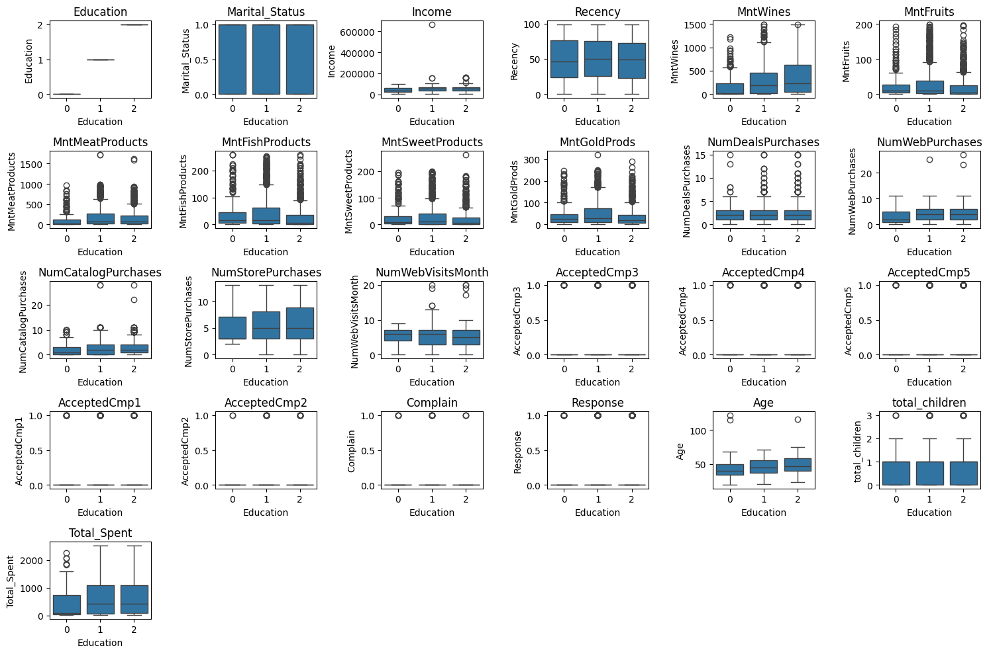
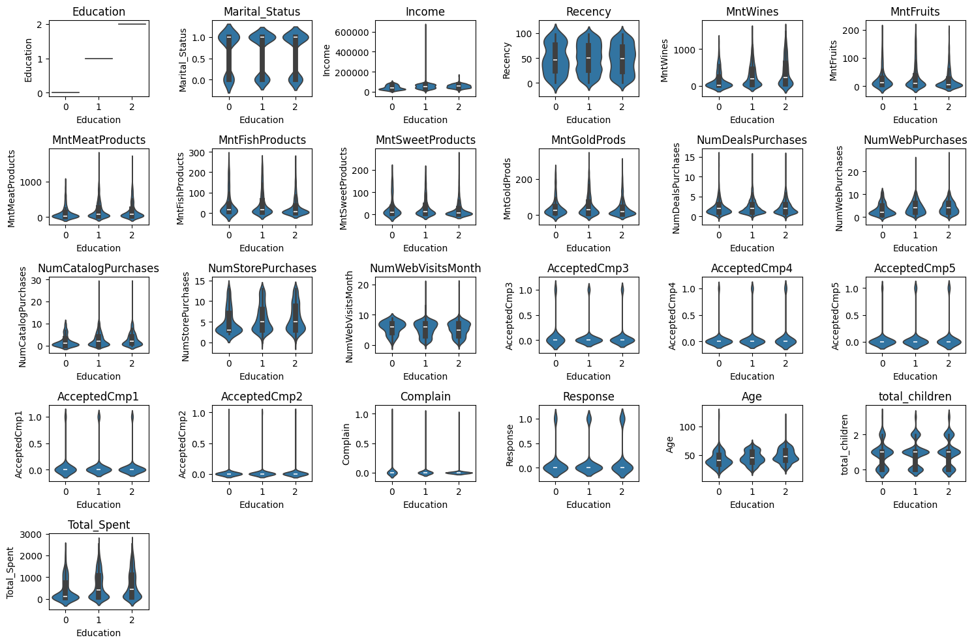
Univariate, bivariate and Multivatriate Analysis

Slide 12
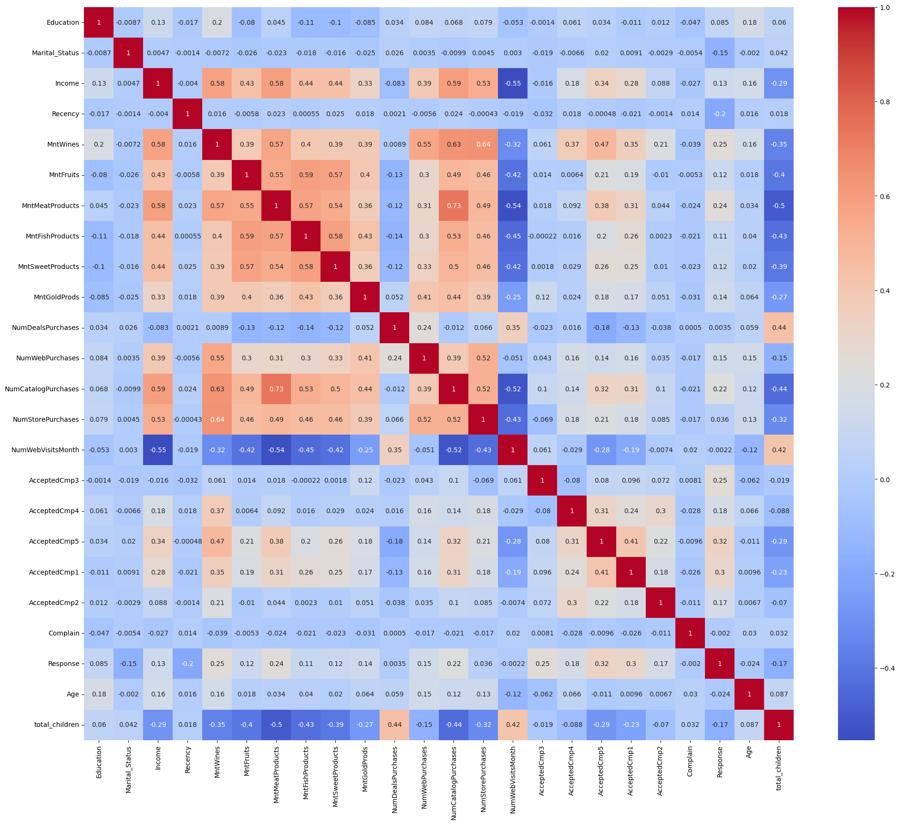
CORRELATION OF THE DATA
Strong Positive Correlations:
1. Spending Patterns:
- `MntWines` is strongly correlated with `MntFruits` (0.58), `MntMeatProducts` (0.63), `MntFishProducts` (0.52), and `MntSweetProducts` (0.57).
- This indicates that customers who spend a lot on wine also tend to spend more on other products.
2. Purchase Channels:
- `NumStorePurchases` correlates with `NumWebPurchases` (0.32) and `NumCatalogPurchases` (0.41).
- Customers who buy more in-store also tend to make more online and catalog purchases.
Strong Negative Correlations:
1. Website Visits vs Spending:
- `NumWebVisitsMonth` has negative correlations with `MntWines` (-0.35), `MntFruits` (-0.32), `MntMeatProducts` (-0.42), `MntFishProducts` (-0.35), and `MntSweetProducts` (-0.32).
- Frequent website visitors spend less on these products.
Income and Age:
1. Income:
- `Income` correlates positively with `MntWines` (0.33), `MntMeatProducts` (0.30), and `NumCatalogPurchases` (0.28).
- Higher-income customers spend more on wine and meat products and use catalog purchases more frequently.
2. Age:
- `Age` shows a positive correlation with `NumWebVisitsMonth` (0.12) and negative correlations with `MntWines` (-0.29) and `MntSweetProducts` (-0.20).
- Older customers visit the website more but spend less on wine and sweets.

Slide 13
CORRELATION OF THE DATA
Acceptance of Campaigns:
1. Campaign Acceptance:
- `AcceptedCmp1` to `AcceptedCmp5` show positive correlations with each other, such as `AcceptedCmp1` with `AcceptedCmp2` (0.32), `AcceptedCmp3` (0.17), and `AcceptedCmp4` (0.18).
- Customers who accept one campaign are likely to accept others, indicating a segment of responsive customers.
Weak Correlations:
1. Education and Marital Status:
- `Education` and `Marital_Status` have generally weak correlations with most spending and purchase variables, indicating these factors do not significantly influence spending behaviors.
### Specific Insights:
1. Total Children:
- `total_children` has negative correlations with `Income` (-0.29) and positive correlations with `NumWebVisitsMonth` (0.15).
- More children in the household are associated with lower income and more frequent website visits.
2. Recency:
- `Recency` (how recent the last purchase was) has weak correlations with most variables, showing it does not strongly affect spending patterns or purchase frequency.
These detailed points highlight specific relationships within the dataset, useful for deeper customer behavior analysis and strategic planning. If you need more specific details or analysis, please let me know!

Slide 14
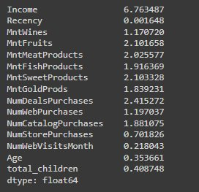
Skewness and outlier detection
Skewness of Income:
The income column exhibits a very high skewness, indicating a significant asymmetry in its distribution.
Outlier Removal:
The columns Income and Age have a relatively small number of outliers.
These outliers can be removed to clean the dataset and improve the accuracy of the analysis.

Slide 15
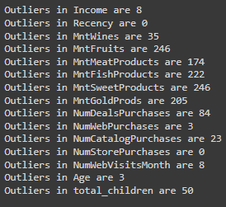
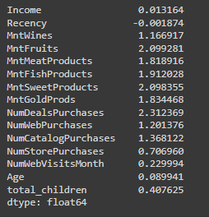
Skewness and Outliers detection
Log Transformation:
Log transformations are performed on specific columns to address skewness.
This transformation helps in stabilizing the variance and making the data more normally distributed.
Post-Transformation Skewness:
After removing outliers and applying log transformations, the skewness of the dataset is controlled.
The data is now more balanced and better suited for statistical analysis and modeling.

Slide 16
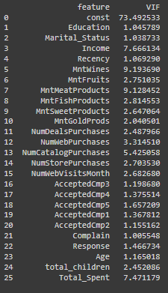
Multicollinearity Check
There are no target variables in this dataset.
A Constant term has been created and added to the data representing the intercept
Since all variables except the constant have VIFs below 10, there is no immediate need to remove any variables due to multicollinearity concerns.
StandardScaler from sklearn.preprocessing is used to standardize the numerical features in DataFrame df, ensuring each feature has a mean of 0 and a standard deviation of 1.

Slide 17
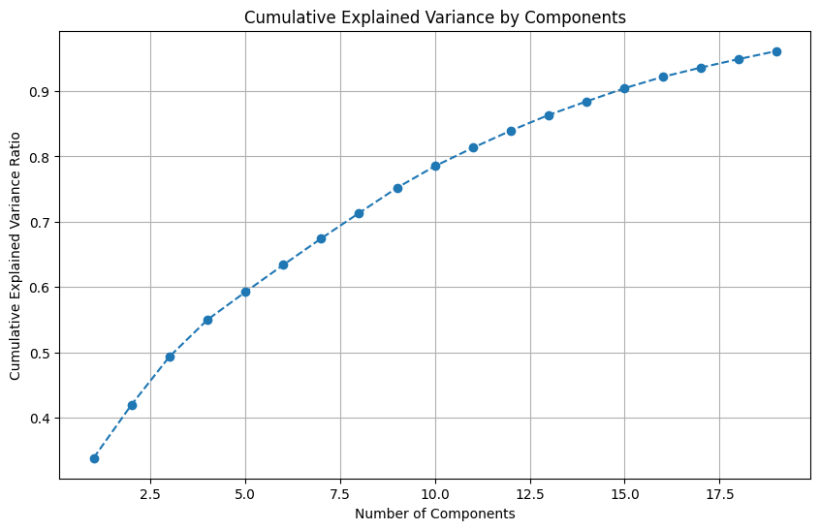
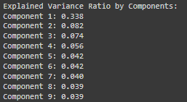
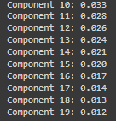
Principal Component Analysis
PCA has been done to reduce the dimensionality while retaining 95% of the variance
PCA has determined that 19 principal components are needed to retain this level of variance.
Also, the explained variance ratio has also been calculated

Slide 18
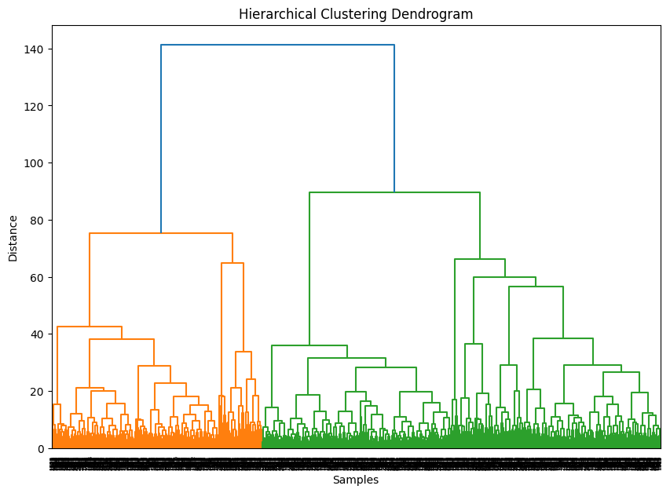
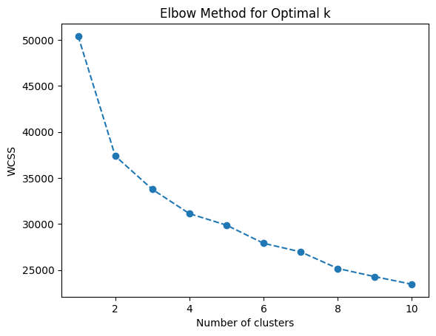
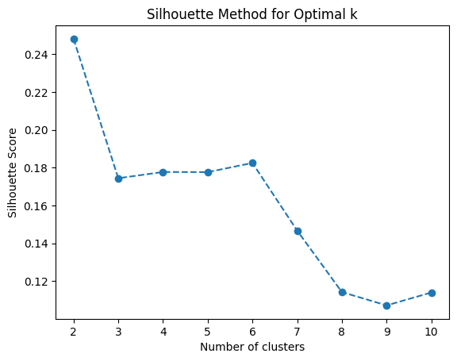
Clustering
Elbow method and Silhouette Method have been done in which: K in Elbow – 3 , K in Silhouette - 2.
Taking k = 3 into consideration
For Cluster model - The following types methods were done - KNN ,Hierarchical, Gaussian, DBScan and Spectral Clustering.
The Following metrics were Calculated -
Silhouette Score: Measures how well-defined and distinct the clusters are. Higher scores indicate well-separated clusters.
Davies-Bouldin Index: Measures cluster separation and cohesion. Lower values indicate better-defined clusters.
Calinski-Harabasz Index: Measures cluster compactness and separation. Higher values indicate well-separated and compact clusters.
For Hierarchical - using Ward's method to visualize how clusters are merged based on their distances in a dendrogram.
For DBScan - The best eps and min_samples were calculated to be 1.5 and 10 respectively. And the k-distance graph has been plotted for the db scan metric calculation

Slide 19
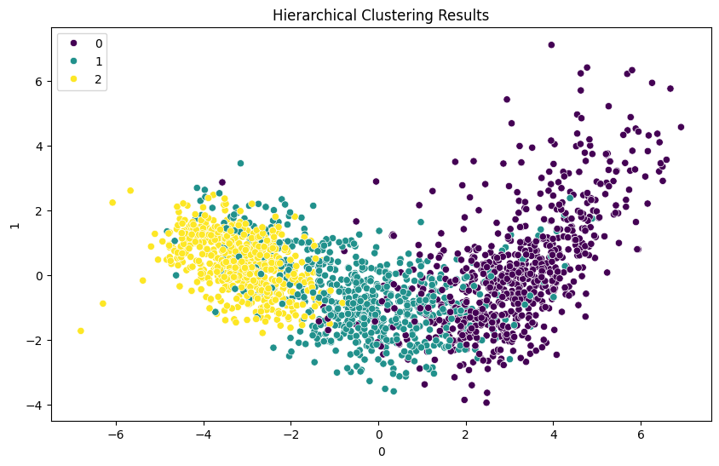
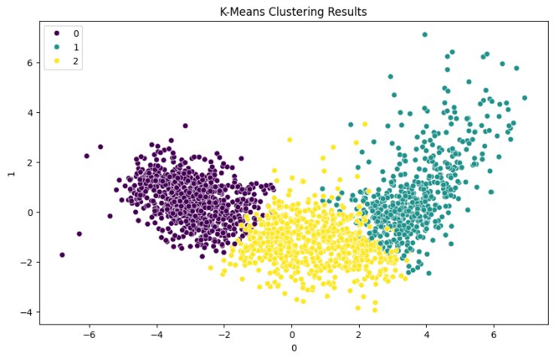
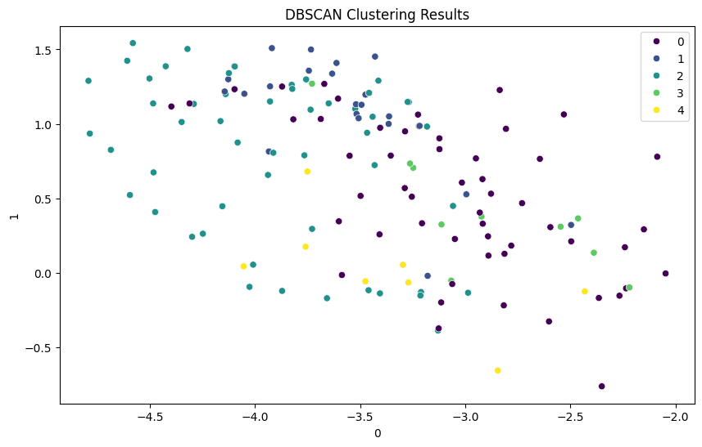
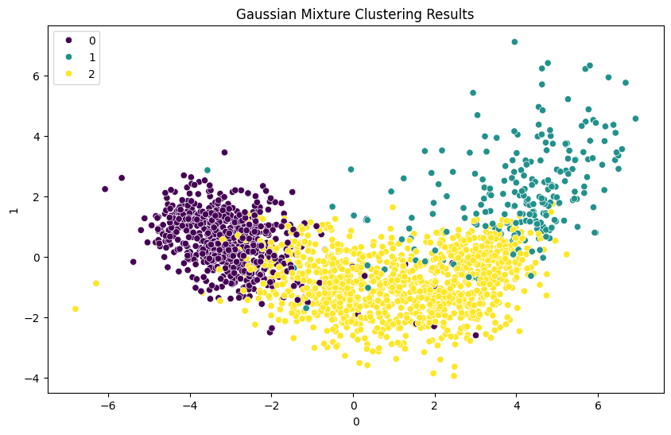
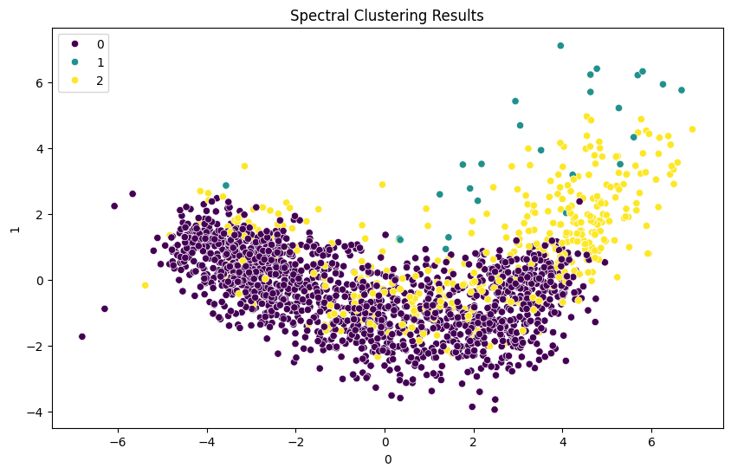
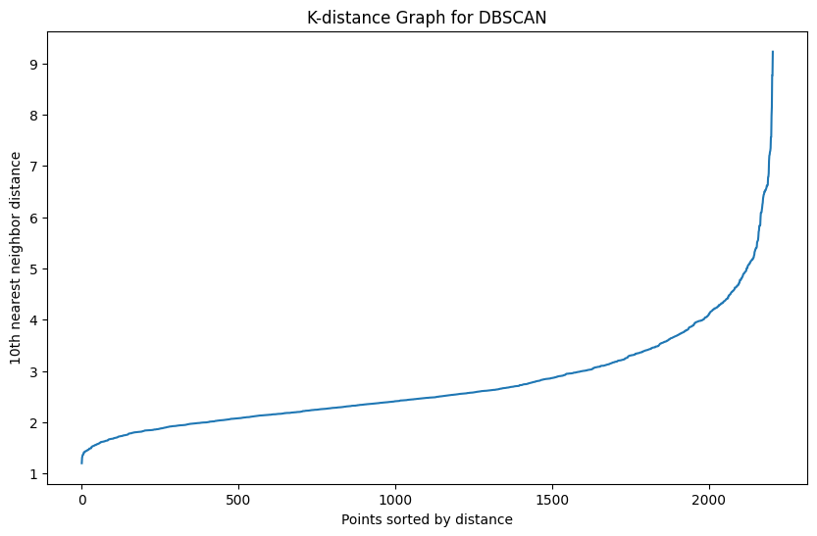
Clustering Visualizations
The uniform Distribution of the clusters in K-means lets us understand how the same proves to be the best clustering technique

Slide 20
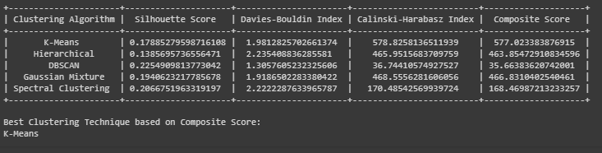
Comparison of the Clustering techniques
The metrics of all the clustering methods were tabulated.
Composite score was found by combining the metrics
Finally the best model was found out to be K-Means clustering
Customer Analysis has been done with the clustered data to understand the customers in a better manner

Slide 21
Customer Analysis
Clusters | Cluster 0 | Cluster 1 | Cluster 2
Demographics | Cluster 0 consists of customers with relatively higher income and education levels compared to other clusters. They are generally married, with a moderate number of children. | Cluster 1 comprises customers with moderate income and education levels. They are also predominantly married, with a higher number of children compared to other clusters. | Cluster 2 represents younger customers with lower income and education levels compared to other clusters. They have fewer children on average.
Preferences | This segment shows a preference for premium products such as wines, meat products, and gold products. They spend more on these luxury items compared to other clusters. | This segment shows a preference for affordable products such as fruits and sweet products. They spend less on luxury items like wines and gold products. | This segment shows a preference for basic necessities and low-cost products such as fish and fruits. They have the lowest spending on luxury items.
Behavior | They tend to make more store purchases and have a higher engagement in catalog and web purchases. They also visit the website moderately and respond positively to campaign offers. | They participate actively in marketing campaigns and show moderate engagement across various purchase channels. | They engage less in marketing campaigns and exhibit lower participation in purchasing through web and catalog channels.

Slide 22
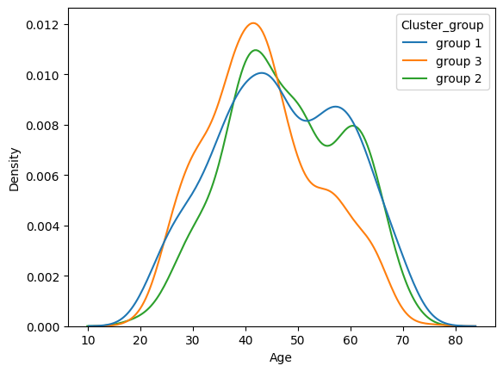
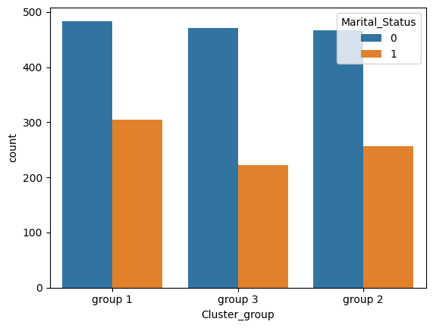

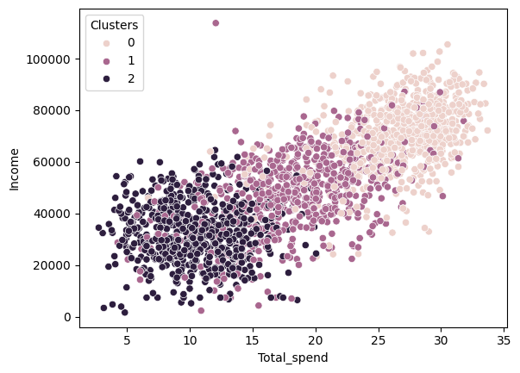
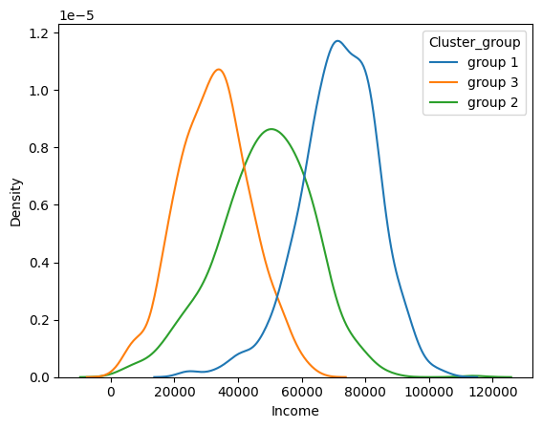
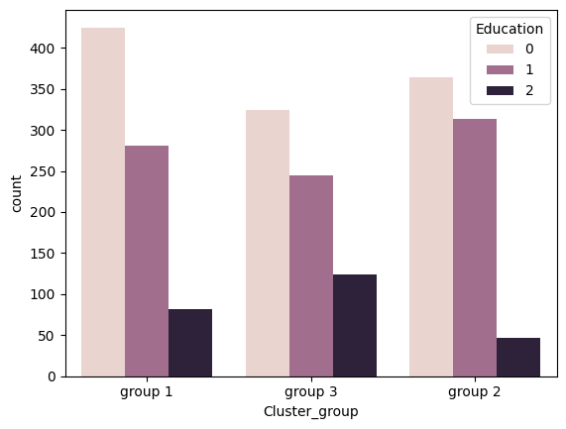
Customer Analysis Visualizations

Slide 23
Strategic Recommendations
Clusters | Cluster 0 | Cluster 1 | Cluster 2
Affordability | Focus on premium products and personalized services to cater to their higher income and educational background. | Focus on value-oriented pricing strategies and promotions that appeal to their budget-conscious nature. | Emphasize affordability and value in product offerings and promotions to align with their budget constraints.
Marketing | Implement exclusive loyalty programs and rewards to retain their high spending and engagement levels. | Tailor marketing messages to resonate with their family-oriented lifestyle and preferences for affordable yet quality products. | Encourage online engagement by improving user experience on the website and offering exclusive online promotions.
Promotional Strategy | Utilize their interest in multiple product categories (like wines and gold products) to cross-sell related items and increase average order value. | Utilize their responsiveness to promotions by offering discounts and incentives to drive conversions. | Engage with local community events and initiatives to build brand awareness and trust among this segment.
Customer Service | Provide enhanced customer service and personalized experiences to maintain satisfaction and loyalty. | Provide clear product information and benefits to enhance their understanding and encourage purchases. | Streamline purchasing processes to make transactions quick and straightforward, catering to their convenience preferences.

Slide 24
Classification and Model Building
Classification of the data has been done and the data is used for model building.
For Classifiation model - The following model were done - "Logistic Regression", "Decision Tree", "Random Forest", "Gradient Boosting", "XGBoost", "KNN", "SVM", "Naive Bayes"
The Following metrics were Calculated -
Accuracy: Measures overall correctness of predictions.
Precision: Proportion of true positives out of all predicted positives.
Recall: Proportion of true positives correctly identified.
F1 Score: Harmonic mean of precision and recall, balancing both.
ROC AUC: Area under the ROC curve, assessing class separation ability.
Log Loss: Penalizes incorrect confident predictions.
Confusion Matrix: Summarizes model's performance with counts of true/false predictions.

Slide 25
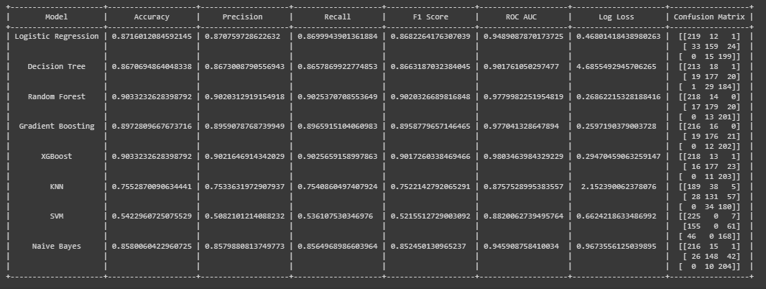
Comparison of Classification Model
Random Forest Classification achieves an impressive 90% accuracy and has the least log loss, showcasing its strong predictive power and effectiveness in handling complex datasets.

Slide 26
Model Deployment
Initialization and Setup:
Imports necessary libraries: Streamlit, Pickle, NumPy, Pandas, Matplotlib, and Seaborn.
Loads pre-trained model, scaler, and label encoders from pickle files.
Mapping Definitions:
Defines mappings to translate categorical variables (education and marital status) to numerical values and vice versa.
User Input Form:
Creates a form in Streamlit to collect user inputs for attributes like education, marital status, income, spending, purchases, campaign responses, age, and total children.
Data Preprocessing:
Encodes categorical inputs and scales numerical inputs using the pre-loaded label encoders and scaler.

Slide 27
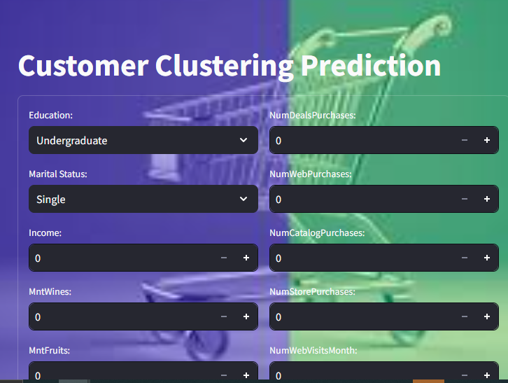
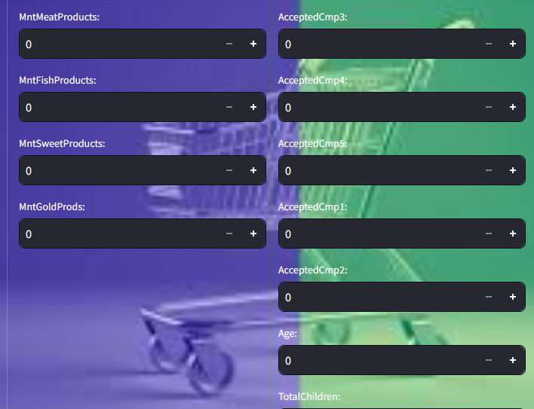
1. The pre-processed input data is passed to the pre-trained model to predict the customer's cluster. This involves cleaning the data, encoding categorical variables, and scaling numerical features to prepare it for analysis.
2. The model, trained on historical data, assigns the customer to a cluster based on their characteristics. This helps businesses understand the customer profile and tailor marketing strategies to each segment.

Slide 28
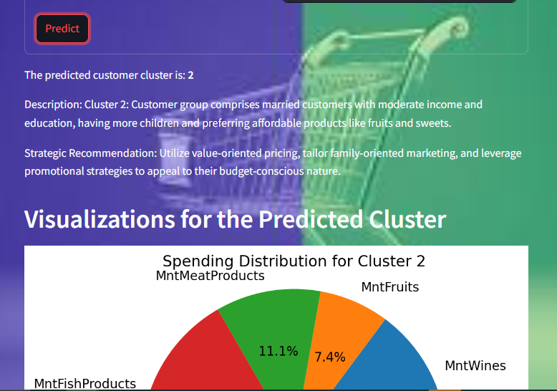
Display Results:
The app displays the predicted cluster, cluster description, and strategic recommendation as to how we can handle the customer in the future.
It also presents visualizations specific to the predicted cluster, helping users understand their spending habits, purchase behavior, and demographic distribution within the cluster.

Slide 29
Challenges faced
Preprocessing, EDA, and Data Cleaning: - Handling missing data and deciding on imputation strategies , Detecting and managing outliers. , Ensuring data consistency and quality.
Feature Engineering: - Selecting relevant features for clustering, Creating informative new features, Managing feature complexity.
PCA (Principal Component Analysis): - Determining optimal components , Interpreting principal components. , Managing multicollinearity.
Clustering: - Choosing the right algorithm, Determining the number of clusters, Evaluating cluster quality.
Modeling: - Selecting evaluation metrics, Tuning algorithm parameters, Handling computational efficiency.
Deployment: - Integrating the model into production, Ensuring scalability and robustness, Creating user-friendly interfaces.

Slide 30
Thank you

