Slide 1
EV Charging Demand Prediction Using Machine Learning and Time-Series Analysis
24-hour forecasting, rolling-origin evaluation and calibrated prediction intervals
Abhishek Dombale | Harshwardhan Gangarde
Guide: Prof. Gopal Deshmukh
Vishwakarma Institute of Technology
Notes:
Introduce the project title, the two team members, the guide and the college. One sentence on what the project is: forecast hourly EV charging demand 24 hours ahead for a Caltech site, test how stable the forecasts are, and check how trustworthy the uncertainty ranges are.

Slide 2
Why forecast EV charging demand?
1
2
3
Station operators
Grid and peak load
Planning and allocation
Plan staffing, maintenance and charging policies around expected usage.
High-demand hours drive capacity needs and can only be managed if anticipated.
Share limited power between vehicles and size future infrastructure.
The problem: predict hourly demand for the next 24 hours, and state how uncertain that prediction is.
Notes:
Open with the motivation. Operators, the grid and planners all need to know how much demand to expect. The hard part is that charging demand is bursty: it has many zero hours and a few big peaks. So we forecast the next 24 hours AND say how uncertain each forecast is.

Slide 3
Six objectives, all implemented
Build an hourly demand series from ACN-Data sessions
Engineer leakage-free lag, rolling and calendar features
1
2
Forecast 24 hours ahead and compare five approaches
Test stability over 91 rolling daily windows
3
4
Measure and calibrate 90% prediction intervals
Explain drivers with SHAP; study peaks and horizons
5
6
Notes:
Walk through the six objectives quickly. Stress that each one corresponds to a script and a result folder in the repository, so nothing here is a plan: all of it was done and measured.

Slide 4
Real data: Caltech ACN-Data, about ten months
7,288
16,972
10
486
hourly observations, no gaps
charging sessions used
months of data: 25 Apr 2018 to 22 Feb 2019
hours with zero demand
Source: ACN-Data (Lee, Li and Low, e-Energy 2019), one Caltech site with 54 stations.
Hourly demand is reconstructed: session energy spread evenly over its charging time (not metered load).
Mean 21.35 kWh per hour, maximum 136.36 kWh; weekdays average 24.05 vs weekends 14.53 kWh.
Notes:
The data is the open ACN-Data set from the Caltech Adaptive Charging Network, cited as Lee, Li and Low, e-Energy 2019. We used 16,972 usable sessions out of 17,000 downloaded (28 removed for missing or invalid times). Each session's energy is spread evenly over its charging time and summed per clock hour, so the hourly demand is RECONSTRUCTED, not metered. Raw data is not in the GitHub repo because redistribution terms are unclear; the download script is.

Slide 5
17 features, built only from the past
Lags (6)
Rolling stats (4)
lag_1, lag_2, lag_24, lag_48, lag_168, lag_336
Mean and std over 24 h and 168 h, shifted by one hour
Calendar (5)
Flags (2)
hour, day of week, day of month, month, week of year
is_weekend, is_business_hour (08:00 to 18:00)
Leakage check: features rebuilt from history alone matched the stored features (300 random rows).
Notes:
Explain the four feature groups. Lags tell the model what happened 1 hour, 1 day, 1 week ago. Rolling statistics summarise the recent level and variability and are shifted by one hour so the current value is never included. Calendar features give time of day and day of week. We verified there is no leakage: rebuilding features from history alone matched the stored features on 300 random rows.

Slide 6
Chronological split, not random
Sessions
Hourly demand
17 features
Models
24-hour forecast
Time order: oldest on the left, newest on the right
Train
5,101 rows (70%)
Valid.
1,093 (15%)
Test
1,094 (15%)
Train: fit models. Validation: choose settings and calibrate intervals. Test: final evaluation only.
Train to 23 Nov 2018 | Validation 24 Nov 2018 to 8 Jan 2019 | Test 8 Jan to 22 Feb 2019 (45 windows, 1,080 h)
Notes:
Show the pipeline left to right. Then the split: 70 percent training, 15 percent validation, 15 percent test, always in time order, because random splitting would put future data into training. Validation is used to choose model settings and, later, to calibrate the prediction intervals. The test period is touched only for the final evaluation: 45 windows of 24 hours, which is 1,080 hours.

Slide 7
Recursive 24-hour forecasting
1
2
3
4
Known history
Predict hour 1
Append prediction
Predict hour 2 ... 24
Demand up to the forecast start
Features built from the history
Hour 1 joins the history
Repeat for all 24 hours
Rule
Trade-off
Only the model's own predictions are fed back; actual values in the window are never used.
Errors can accumulate over 24 steps; predictions are clipped at 0 kWh.
Notes:
Explain recursion simply: the model predicts one hour at a time. The prediction for hour 1 becomes part of the history used to build the features for hour 2, and so on up to hour 24. Only the model's own predictions are fed back; the actual values inside the forecast window are never used. The trade-off is that errors can accumulate over the 24 steps, which is one reason the raw prediction intervals were too narrow.

Slide 8
Five forecasting approaches compared
1
2
3
4
5
XGBoost
Random Forest
Linear Regression
Seasonal Naive
SARIMAX + Fourier
200 boosted trees, depth 4
Average of many decision trees
Simple linear baseline
Same hour one week earlier
ARMA errors with daily and weekly seasonality
Settings chosen on validation windows, models refit on train + validation, tested once.
Notes:
Five approaches were compared on identical test windows. Seasonal Naive is the simplest baseline: copy the same hour from one week earlier. Linear Regression is a simple model on the same features. Random Forest and XGBoost are tree ensembles. SARIMAX with Fourier terms is the classical time-series model. Candidates for each model were compared on the validation windows, the chosen ones refit on train plus validation, and tested once. XGBoost settings: 200 trees, depth 4, learning rate 0.05, subsample 0.8, column sample 0.8, seed 42.

Slide 9
Point forecasts: XGBoost and Random Forest are close
Model | MAE | RMSE | R²
XGBoost | 6.49 | 9.06 | 0.682
Random Forest | 6.38 | 9.10 | 0.679
Linear Regression | 7.52 | 9.94 | 0.617
Seasonal Naive | 7.14 | 10.52 | 0.572
SARIMAX + Fourier | 11.06 | 13.73 | 0.270
Diebold-Mariano, XGBoost vs Random Forest: p = 0.81, no significant difference
Notes:
Test period: 45 windows, 1,080 hours. XGBoost: MAE 6.49, RMSE 9.06, R-squared 0.682. Random Forest: 6.38, 9.10, 0.679. The Diebold-Mariano test finds no significant difference between them, p = 0.81, so we do NOT claim XGBoost is better than Random Forest. Both are significantly better than Seasonal Naive and the SARIMAX configuration. Say clearly that SARIMAX result applies to the simple configuration we used.

Slide 10
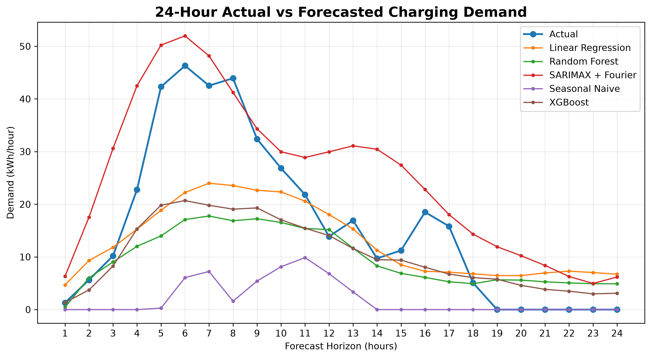
One forecast window: shape captured, peak missed
Daily shape is captured
Morning peak is under-predicted by most models
SARIMAX overshoots it
Test window 1 (8 Jan 2019, forecast start 05:00 local). One window, not typical performance.
Notes:
This figure shows only ONE illustrative test window, the first one, not the whole test period and not typical performance. The models follow the daily shape of demand but underestimate the morning peak; the SARIMAX curve overshoots it. This foreshadows the peak-hour problem we quantify later.

Slide 11
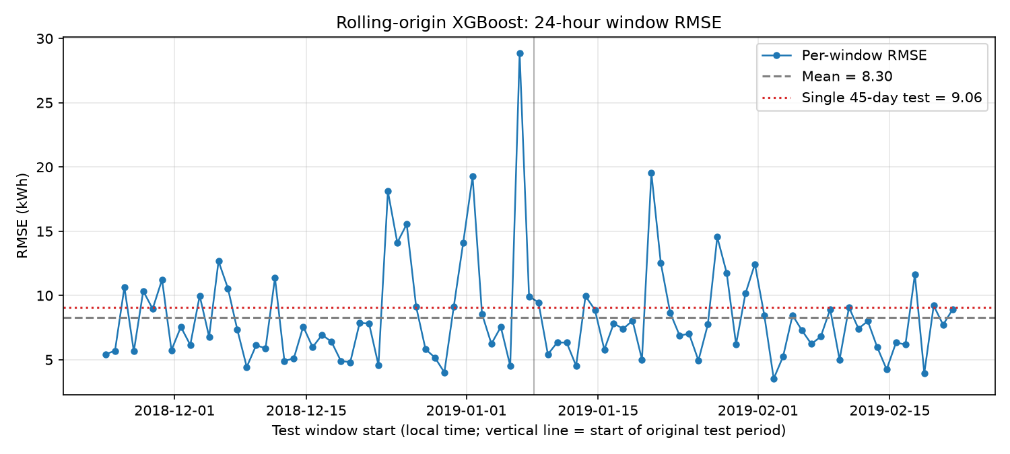
Rolling origin: stable on average, volatile by day
91
daily 24-hour windows
5.70 / 7.42
median MAE / RMSE (kWh)
0.672
pooled R² over all folds
Worst day: RMSE 28.87 kWh. Single-day R² can reach -134 on low-variance days, so use the pooled R².
Notes:
Rolling-origin means we move the forecast start forward one day at a time, retrain on everything before it, and forecast the next 24 hours. 91 daily windows. Median MAE 5.70 and median RMSE 7.42, close to the single-test figures; pooled R-squared 0.672. But single days vary a lot: the worst day had RMSE 28.87, often around holidays. Important: do not compare the mean per-window R-squared (-1.87) with the pooled R-squared, because on low-variance days like 26 December R-squared collapses to -134 even with a moderate error.

Slide 12
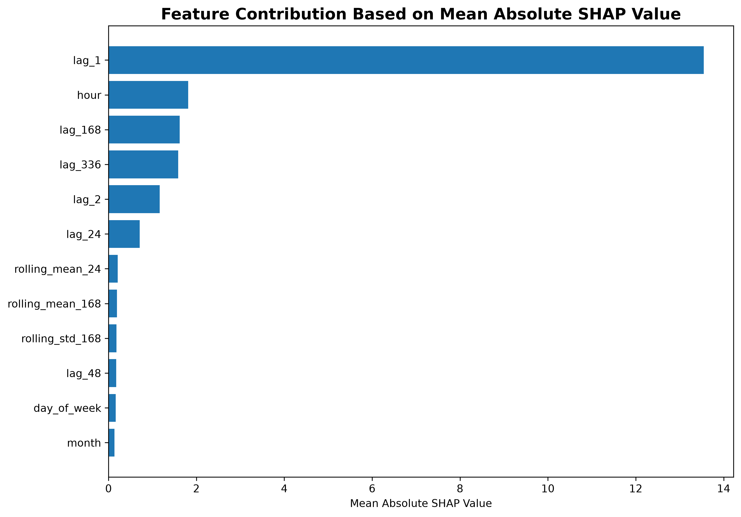
SHAP: the previous hour dominates
lag_1 is about 59% of XGBoost importance
Next: hour of day, then the same hour 1 and 2 weeks earlier
Rolling stats and flags add little
Shows what the model uses, not causes
Figure averages Random Forest and XGBoost; percentages are XGBoost only.
Notes:
SHAP tells us how much each feature moves the predictions. For XGBoost, lag_1, the demand one hour earlier, carries about 59 percent of the total importance. Then hour of day and the same hour one and two weeks earlier. Rolling statistics and calendar flags add little. Note: the figure plots the average of Random Forest and XGBoost; the percentages quoted are from XGBoost alone. SHAP shows what the model uses, not what causes demand, and it was computed in a one-step setting with true past lags.

Slide 13
Raw 90% intervals covered only 71.2%
Why it under-covered
One recursive path: error build-up over 24 steps is ignored
Zero-demand night hours fall just below the lower bound
Peaks are under-predicted
1,080 test hours; average width 29.46 kWh
23.4% fell below the lower bound, 5.4% above the upper bound.
Notes:
A point forecast hides uncertainty, so we trained XGBoost to predict the 5th, 50th and 95th percentiles. The 5th to 95th range should be a 90 percent interval. We measured how often the actual demand fell inside it: only 71.2 percent. This is UNDER-coverage, not a success. Reasons: the intervals come from a single recursive path and ignore error building up over 24 steps; on many night hours the actual demand was exactly zero while the lower bound sat slightly above zero; and peaks were under-predicted. The first reason is plausible but we did not test it separately.

Slide 14
Conformal calibration lifts coverage to 90.9%
Fit the quantile model on training data only
1
Score validation windows: how far actual values fall outside the interval
2
Take the 90% quantile of the scores: 2.63 kWh
3
Widen test intervals by 2.63 kWh each side
4
Width 29.46 to 34.45 kWh (+17%). Empirical, not guaranteed.
Notes:
Conformal calibration uses past errors on held-out data to correct the interval. Step 1: fit the quantile model on training data only. Step 2: on the validation windows, measure how far each actual value fell outside the interval. Step 3: take the 90 percent quantile of those distances: 2.63 kWh. Step 4: widen every test interval by 2.63 kWh each side. The test set was never used for calibration. Result on the test period: 90.9 percent empirical coverage, with average width rising from 29.46 to 34.45 kWh, about 17 percent wider. Say EMPIRICAL coverage; it is not a theoretical guarantee because time series are not exchangeable.

Slide 15
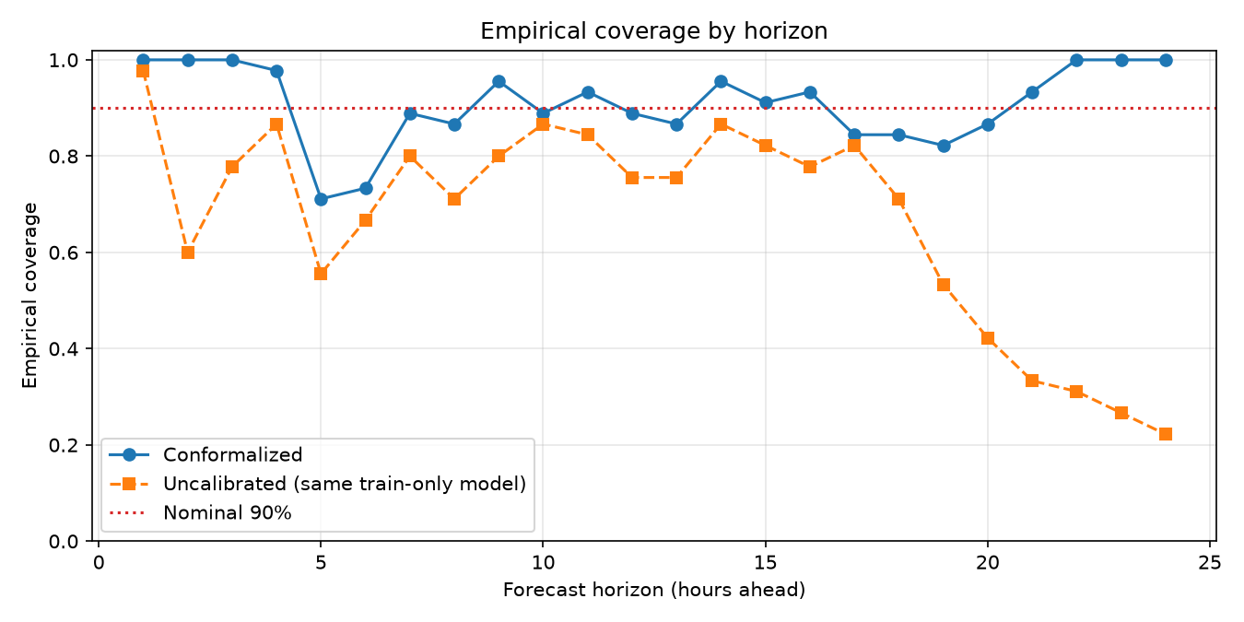
Peaks and some horizons remain the weak spots
100% at h = 1 to 3 and 22 to 24, but 71% to 73% at h = 5 and 6 (morning ramp).
One global offset fixes average coverage, not peak- or hour-specific error.
Notes:
Peak hours are those where the actual demand is at or above the test-period 90th percentile, 37.46 kWh: 108 hours. After calibration, non-peak coverage is 93.0 percent but peak coverage is only 72.2 percent, and all peak misses were above the upper bound, meaning peaks are under-predicted. A single global offset cannot fix a peak-specific error, and because peak is defined by the actual value being high it is harder for any interval to contain. By horizon, coverage ranges from 71 to 100 percent: 100 percent at horizons 1 to 3 and 22 to 24, but only 71 to 73 percent at horizons 5 and 6, which is the morning arrival ramp at 9 to 10 am local time. We do not hide the poor horizons.

Slide 16
Integrity: the leakage audit passed
What we verified
Caveats we report
Chronological split
Features use only past data
Rolling stats exclude the current hour
Rolling folds train on earlier data only
Calibration used validation data only
Test targets never used for fitting
Baseline re-run: MAE 6.46 vs 6.49 (library versions)
Two legacy result files superseded, not used
Calibration and test windows start at different clock times
XGBoost variants differ in loss and training rows: not comparable on MAE/RMSE
Notes:
We audited every experiment. Verified: chronological split; features use only past data (checked on 300 random rows); rolling statistics exclude the current hour; every rolling-origin fold trains only on earlier data; calibration used validation data only; test targets were never used for fitting or calibration. We also report caveats honestly: an independent re-run of the baseline gave MAE 6.46 instead of 6.49, most likely a library-version difference; two legacy result files hold superseded numbers and are not used; calibration windows and test windows start at different clock times; and the three XGBoost variants are not directly comparable on MAE or RMSE.

Slide 17
Limitations and future work
Limitations
Future work
One site, about ten months of data
45 test days; neighbouring days are not independent
Peak hours still under-covered (72.2%)
Conformal assumptions may not strictly hold
No weather or traffic data
Weather and traffic or event data
More charging sites, longer history
Horizon-specific calibration
Time-series-aware conformal methods
Notes:
Be upfront about limitations: one site, about ten months, only 45 test days that are not independent, peaks still under-covered, and the conformal assumptions may not strictly hold for time series. Future work stays realistic: weather and traffic or event data, more sites and a longer history, horizon-specific calibration, and conformal methods designed for time series and distribution shift. We deliberately did not add more models just for complexity.

Slide 18
What the project demonstrates
1
2
3
Forecastable
Stable on average
Check uncertainty
XGBoost: MAE 6.49 kWh, RMSE 9.06, R² 0.682, on par with Random Forest (p = 0.81).
Median daily MAE 5.70 kWh over 91 windows; some days are much harder.
Raw 90% intervals covered 71.2%; calibration gave 90.9% empirical coverage. Peaks stay hard (72.2%).
Thank you. Questions?
One site, about ten months of data.
Notes:
Three take-aways. One: hourly EV charging demand can be forecast 24 hours ahead from its own history and calendar features with a typical error of about 6 to 7 kWh per hour; XGBoost and Random Forest perform similarly. Two: accuracy is stable on average but variable from day to day, worst on holiday-like days. Three: uncertainty needs checking: raw intervals covered 71.2 percent for a 90 percent target; validation-only calibration brought empirical coverage to 90.9 percent, with peaks still harder. Close by repeating that results are specific to one site and about ten months of data, then invite questions.

