Slide 1
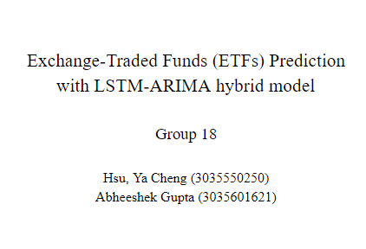

Exchange-Traded Funds (ETFs) Prediction
with LSTM-ARIMA hybrid model
Group 18
Hsu, Ya Cheng (3035550250)
Abheeshek Gupta (3035601621)

Slide 2
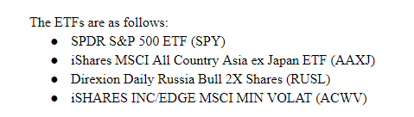

Slide 3
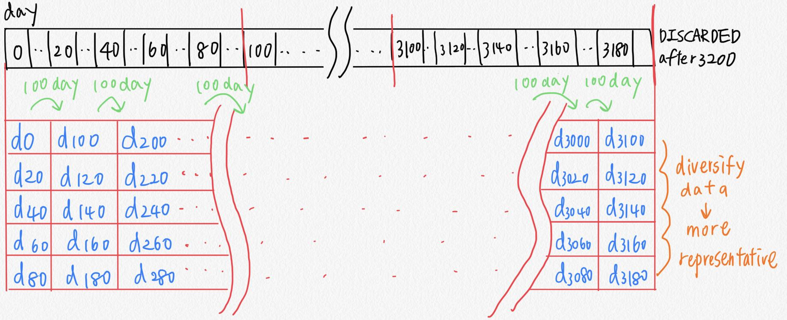
Data preprocessing - volatility reduction & diversity

Slide 4
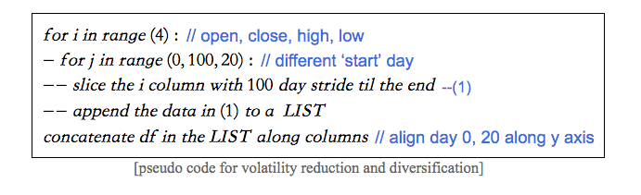
Data preprocessing - volatility reduction & diversity

Slide 5
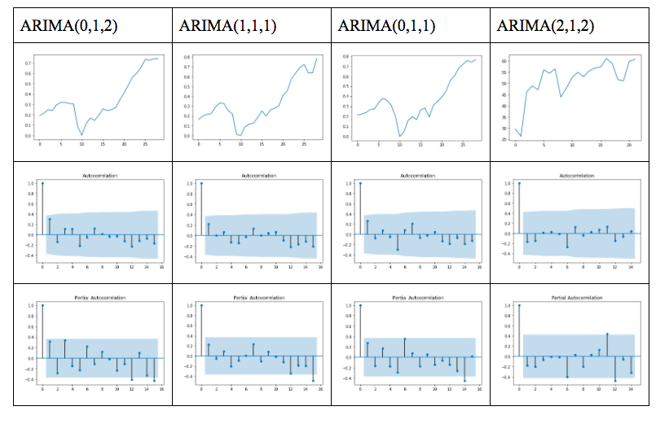
ARIMA - determining parameters

Slide 6
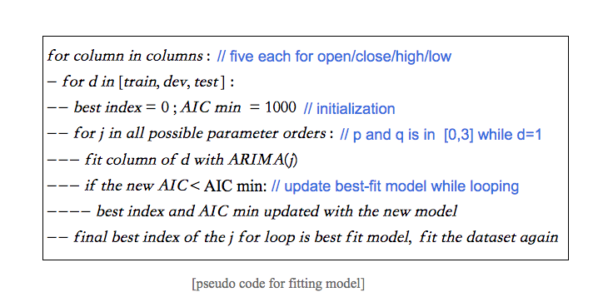
ARIMA - find best fit model for each column

Slide 7
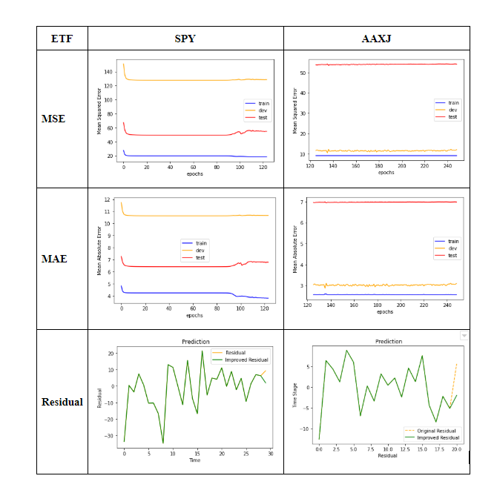
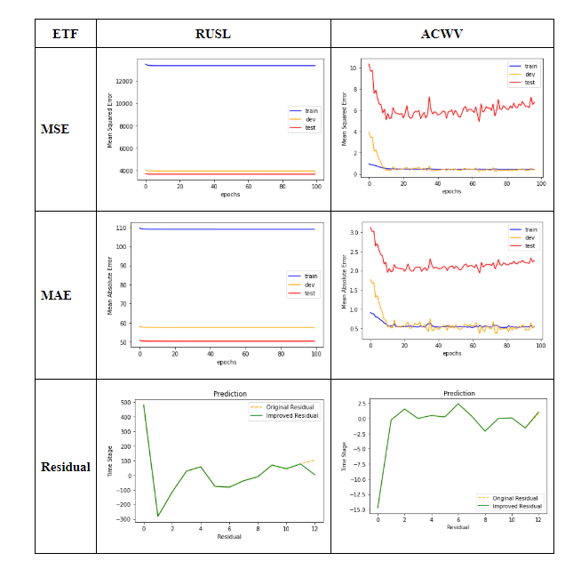

Slide 8
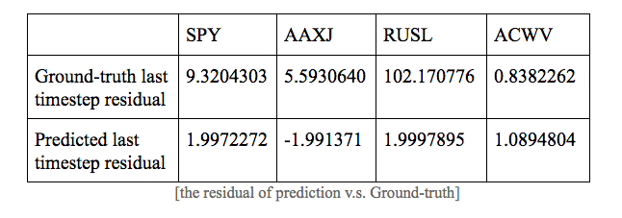
Residual

Slide 9

THE END

