Slide 1

E-retail factors for customer activation and retention: A case study from Indian e-commerce customers
Data Analysis Project
Submitted by-
Abhijeet Deshpande

Slide 2
Problem Statement
Customer retention refers to the activities and actions companies and organizations take to reduce the number of customer defections .The goal of customer retention study is to help companies retain as many customers as possible, often through customer loyalty and brand loyalty initiatives.
Retaining customers is less expensive than attracting new customers, and to retain customers retailers must give them reasons to be loyal. A study from Harvard Business School showed that an increase in customer retention rates of 5% can increase profits by 25–95%.
Customer Retention in e-commerce -
91 Percent of the customers are likely to purchase from the brands that recognize them and send them personalized & contextual offers.
On average, 65 percent of the e-commerce revenue comes from repeat customers.
New customer acquisitions can cost five times more than that of retaining the existing customer base.
86 Percent of the customers prefers to purchase from a brand that offers a great customer experience.

Slide 3
Customer retention dataset
The dataset contains information about survey conducted on online retail customers, several questions were asked and data was collected for total 269 customers.
Dataset is non-null dataset with only one numerical column
Dataset is consists of 269 rows and 71 different columns.
Detailed analysis was carried out on dataset containing information gathered from 269 customers in anaconda Jupiter notebook with Python, various libraries used for analysis are –
Numpy
Pandas
Seaborn
Matplotlib
Plotyl.express

Slide 4
Summery of dataset
Dataset contains 71 different columns few of them are tells information about customer –
Gender
Age
Shopping city
Internet used
Medium Used
Operating system used
Mode used to reach online store
Time Spent on store website
Browser used to reach website
Frequency of items purchased / abandoned

Slide 5
Summery of dataset
Some columns tells information about app/website features they are-
Payment modes available
Countian of website understandable
Product comparison offered
Complete information about seller listed on website
Ease of navigation of website
Loading speed
Guarantee of keeping privacy of customers
Visual appearance of website
Delivery speed
Fast loading of webpage
Wide verity of products offered

Slide 6
Summery of dataset
Some columns tells information about User experience hedonic values they are-
User friendly website
Enjoyment derived from the online shopping
Value for money
Trust developed for the retail store
Satisfaction derived from online shopping
Gratification derived from online shopping
Enhancement of social status
Adventure derived from shopping online

Slide 7
Analysis of city of customer
Most customers are derived from following cities –
Delhi
Noida
Bangalore
Whereas least used cities are -
Solan
Gurgaon
Buladshahr

Slide 8

Analysis of gender of customer
Analysis show that 68 % of the the customers are females and only 33 % are the males

Slide 9
Old/New customers.
Above plot shows that 37 % of customers are using online shopping for more than 4 years whereas 25 % of customers says that they have been doing online shopping since 2 to 3 years and then the percentage keep on decreasing with years. This confirms our earlier fact thar 95 % customers are likely to shop again after there first purchase.

Slide 10
Verity of products offered
It is found that 48 % of customers thinks that Amazon and Flip Cart offers a wide range of products. Also, Myntra is third rated in case of product verity and flowed by Paytm. Snapdeal has limited verity of products.

Slide 11
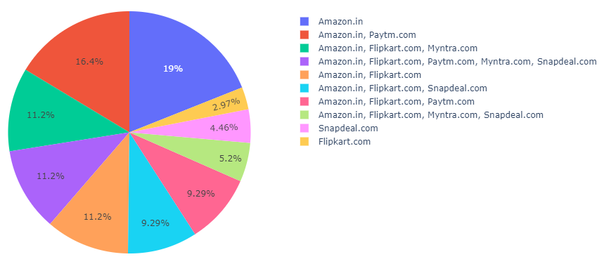
Loading Speed of the website
Most People voted for the Amazon for the fastest loading website.
We have listed the website name according to their loading speed:-
1.Amazon.in
2.Paytm.com
3.Flipkart.com
4.Myntra.com
5.Snapdeal.com

Slide 12
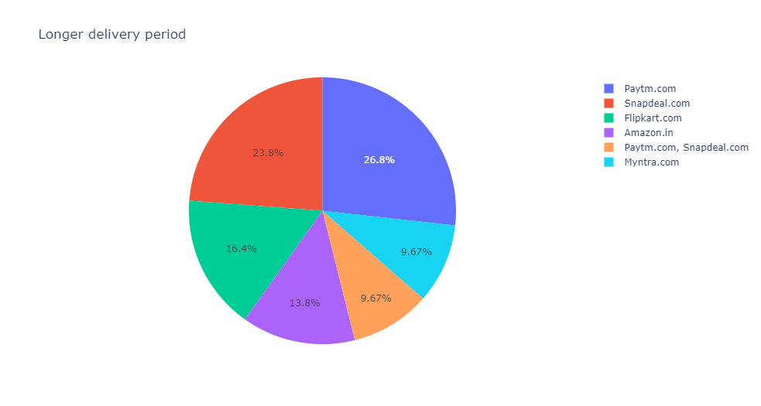
Longer Delivery Periods
Most lately delivering online retail store is “Paytm.com”.
We are giving the list of the online retail store according to their longer delivery periods:-
1.Paytm.com
2.Snapdeal.com
3.Flipkart.com
4.Amazon.in

Slide 13
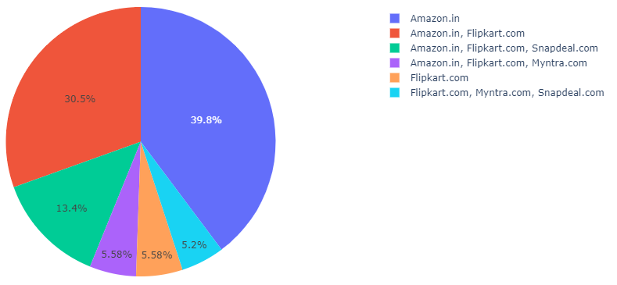
Fastest Order Delivering Store
Fastest order delivering website is the “Amazon.in” followed by the “Flipkart.com”.
Slowest order delivering website is the “Snapdeal.com” followed by the “Myntra.com”.

Slide 14
Age group of customer -
From the plots we can clearly see that most of the respondents fall into the following three categories: -
1. 31-40 years
2. 21-30 years
3. 41-50 years
Very few respondents fall into this categories -
4. Less than 20 years
5. 51 years and above.

Slide 15
Type of internet and medium used
Above plot shows that more than 70 % of customers used mobile internet to reach out to their favorite online retail store , can be concluded that customers may shop from various locations such as office, home , hotels and being out with friends.

Slide 16
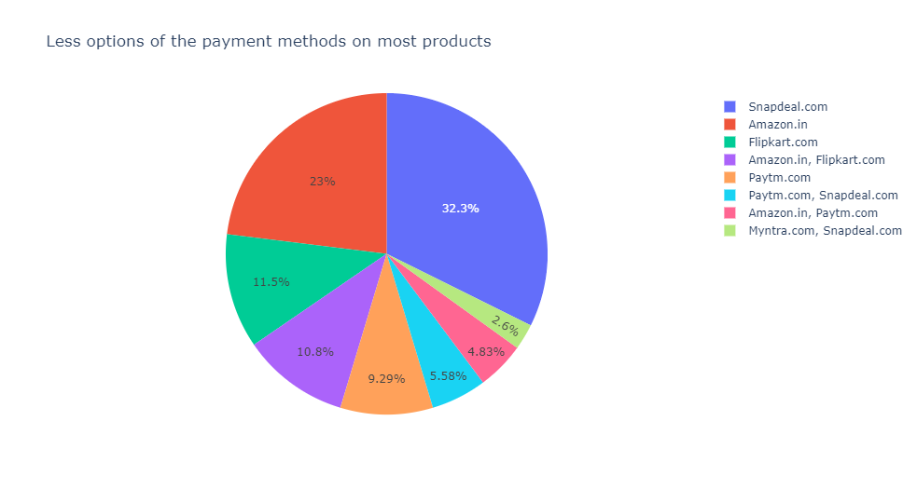
Restricted Payment method Options
Website which offers many payment method restrictions on most of the products are in the following order.
1.Snapdeal.com
2.Amazon.in
3.Flipkart.com
4.Paytm.com
5.Myntra.com

Slide 17
Payment modes used
Above plot shows that more than 72 % of times online payments were used by the customers. Also 28 % of the users use cash on delivery as their Payment option.

Slide 18
Product abandoned by customer
It was found that more than 50 % of users abalone the product because they get a better alternative offer on the other store or with the different seller. Also 21 % of users says that they don’t found promocode applicable that is they didn’t get offer od their choice for the selected product nearly 14 % of peoples say that price was changed

Slide 19
Hedonic/Utilitarian values for the Customer-
Similar information displayed for comparison helps to buy
Almost 90% customers thinks that loading speed affects the purchase
Almost 80% of customers found that they find shopping more exiting , enjoyable .4
more ever 70 % of users thinks that shopping online increases their social status and finds adventure in it.

Slide 20
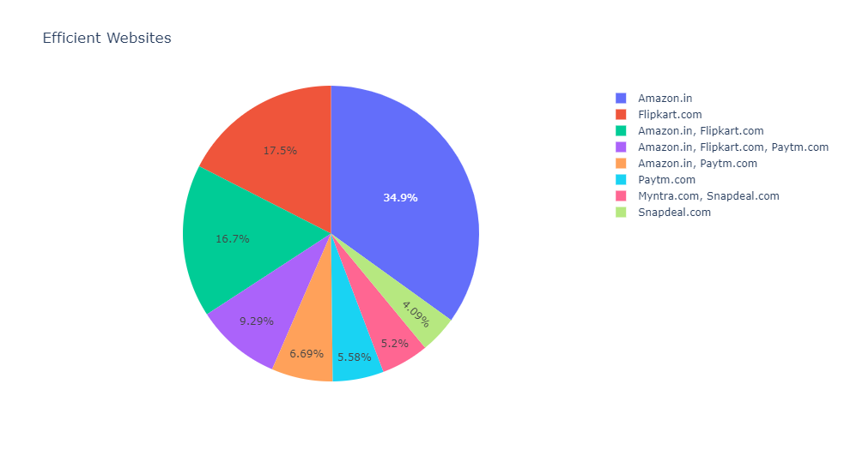
Efficient Website
Data says most Efficient Website is “Amazon.in”
After Amazon its “Flipkart.com”
Least efficient website is “Snapdeal.com”.

Slide 21
Time spend at website
Above plot shows that very few customers spend less than five min when the reach to a online retail store while most of the customers visit the website or app for more than 10 to 15 min.

Slide 22
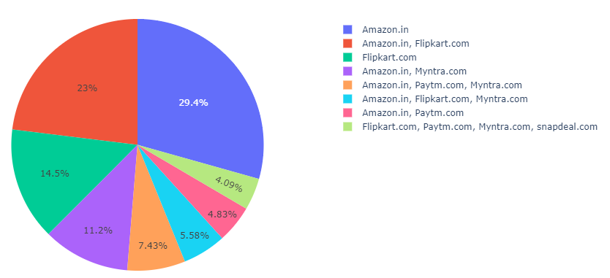
Online Retailer Recommendation.
Most people are recommending the “AMAZON.IN” to others.
After Amazon people’s favorite is “FLIPKART.COM”.
Least recommended website is “SNAPDEAL.COM”.

Slide 23
conclusions
Study shows that Amazon is most popular brand among the customers due to following reasons –
Faster loading speed of website
Better design and visual appearance of the website
Verity of product categories offered
Relevant information about the product is displayed
Faster checkouts / more payment options available
Faster speed of delivery/less delivery period.
Amazon maintains customer privacy
Flip Kart is second favorite brand after Amazon for the customers as it is being following Amazon in almost every above listed quality.
Myntra is third favorite brand for the customers as it is lagging behind in delivery speed, website loading speed and verity of products.
Paytm is has been being fourth preferred brand due to slower delivery speeds and least verity of product Paytm even outperforms Myntra in serval aspects like availability of several payment options but it has father scope to improve.
Snapdeal is lagging behind in almost all of the aspect among all other brands.

