Slide 1

Ratings prediction project
Submitted by:
Abhijeet Deshpande
Data Science Intern
Flip Robo Technologies

Slide 2
INTRODUCTION
Millions of people use Amazon and Flipkart to buy products. For every product, people can rate and write a review. If a product is good, it gets a positive review and gets a higher star rating, similarly, if a product is bad, it gets a negative review and lower star rating. The aim of this project is to predict star rating automatically based on the product review.
The range of star rating is 1 to 5 which means if the product review is negative, then it will get low star rating (possibly 1 or 2), if the product is average then it will get medium star rating (possibly 3), and if the product is good, then it will get higher star rating (possibly 4 or 5).

Slide 3
PROBLEM STATEMENT
Websites and online stores increasingly rely on rating systems and interactive elements for visitors and customers: users leave ratings on websites or give their opinions on products and companies using the comment boxes embedded on the page. The added value for users is clear: Customers and website visitors often gain important information through ratings and can read other user’s experiences before investing in a product, service, or company. Since it’s not possible to take a closer look at products online, these ratings and reviews fill information gaps. Online shopping is convenient, practical, and fast, but nonetheless there’s a distance between the provider and the customer. However, if a website contains ratings or a comment box, this can help to close the distance between the provider and the customer: Customers can then use the feedback to help each other decide whether to go ahead with the purchase by providing information on the function, range, and value of a product.
There are two main methods to approach this problem. The first one is based on review text content analysis and uses the principles of natural language process (the NLP method). This method lacks the insights that can be drawn from the relationship between costumers and items. The second one is based on recommender systems, specifically on collaborative filtering and focuses on the reviewer’s point of view.

Slide 4
Motivation for the Problem Undertaken
This model will be used by the websites where reviews are available but not the corresponding rating(s). This will help in assigning particular rating(s) for the given reviews.

Slide 5
DATA COLLECTION PHASE
You have to scrape at least 20000 rows of data. You can scrape more data as well, it’s up to you. More the data better the model. In this section you need to scrape the reviews of different laptops, Phones, Headphones, smart watches, Professional Cameras, Printers, monitors, home theatre, router from different e-commerce websites.
Basically, we need these columns:
1) reviews of the product.
2) rating of the product.
Fetch an equal number of reviews for each rating, for example if you are fetching 10000 reviews then all ratings 1,2,3,4,5 should be 2000. It will balance our data set. Convert all the ratings to their round number as there are only 5 options for rating i.e., 1,2,3,4,5. If a rating is 4.5 convert it 5.

Slide 6
MODEL BUILDING PHASE
After collecting the data, you need to build a machine learning model. Before model building do all data pre-processing steps involving NLP. Try different models with different hyper parameters and select the best model. Follow the complete life cycle of data science. Include all the steps mentioned below:
Data Cleaning
Exploratory Data Analysis and Visualization
Data Pre-processing
Model Building
Model Evaluation
Selecting the Best classification model

Slide 7

PROJECT LIFE CYCLE
Web Scraping
EDA
Ensure that the webpages allow legal scraping of data
Extract the product URL’s from Amazon and Flipkart
Check for missing values
Data Preprocessing steps
Create a dataframe with Reviews and Ratings columns
Save the dataframe in CSV format
Handle outliers and class imbalance to avoid model biasness
Visualization
Create various visualization plots and Word Cloud
Model Building
Function for Classification Models and Evaluation Metrics

Slide 8
TECHNOLOGY USED
Hardware technology used-
RAM: 8 GB
CPU: AMD A8 Quad Core 2.2 Ghz
GPU: AMD Redon R5 Graphics
Software technology used-
Programming language : Python
Distribution : Anaconda Navigator
Browser based language shell : Jupyter Notebook
Libraries/Packages specifically being used.
Pandas, NumPy, matplotlib, seaborn, scikit-learn, NLTK, Wordcloud.

Slide 9
DATA PREPROCESSING
Importing the necessary libraries
Checking dataset dimensions and null value details
Taking a look at various label categories using the Unique method
Performing data cleaning and then visualization steps
Making Word Clouds for loud words in each label class
Handling the class imbalance issue manually and fixing it
Converting text into vectors using the TF-IDF Vectorizer
Splitting the dataset into train and test to build classification models
Evaluating the classification models with necessary metrics

Slide 10
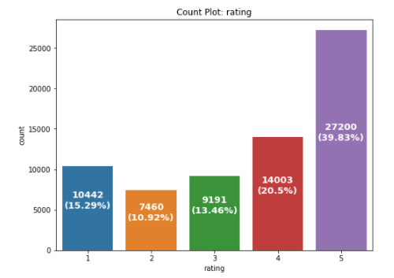
Exploratory Data analysis (EDA) & visualization
Univariate Analysis
Univariate analysis is the simplest form of data analysis where the data being analyzed contains only one variable. In this project, distribution plot, count plot, box plot and bar plot has been used.
Count Plot:
Observation:
There are records available for all ratings i.e., from 1 to 5.
There are highest number of 5 star ratings followed by 4 star ratings present in the dataset.
We can see a high 1 star rating as well compared to 2 and 3 star rating reviews
.

Slide 11
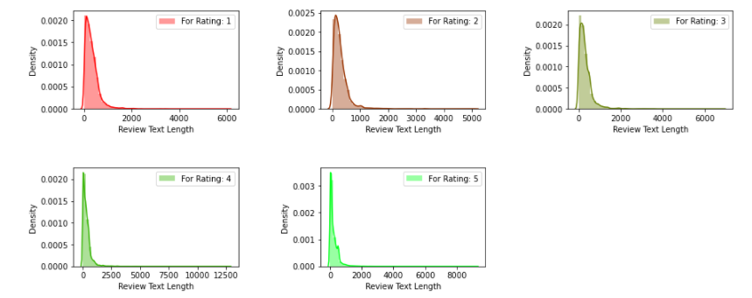
Review text length Distribution Plot BEFORE DATA CLEANING
Observation:
Rating 1, 3, 5 has almost similar review text length.
Rating 4 has the highest review text length.
Rating 2 has the lowest review text length.

Slide 12
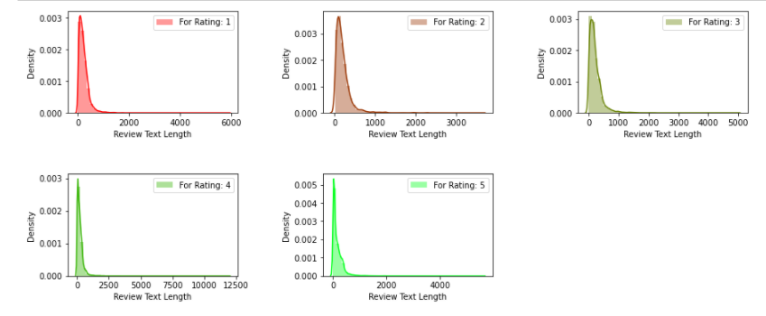
Review text length Distribution Plot After Data Cleaning
Observation:
Review text length reduced by almost 1000 characters for Rating 1 to 5.

Slide 13
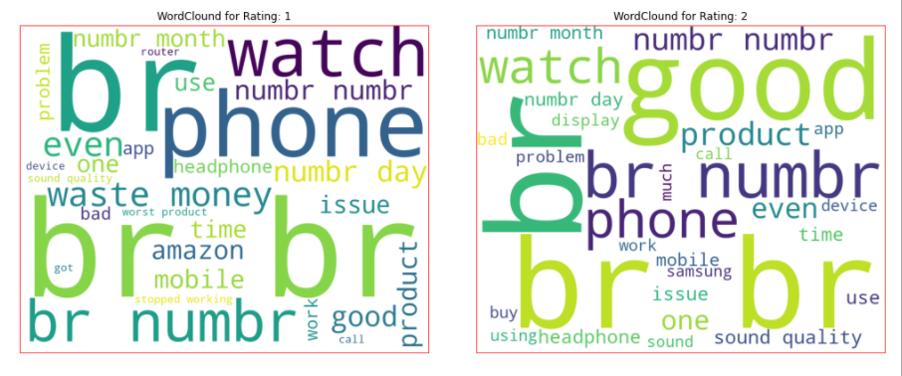
Word Cloud : Display

Slide 14
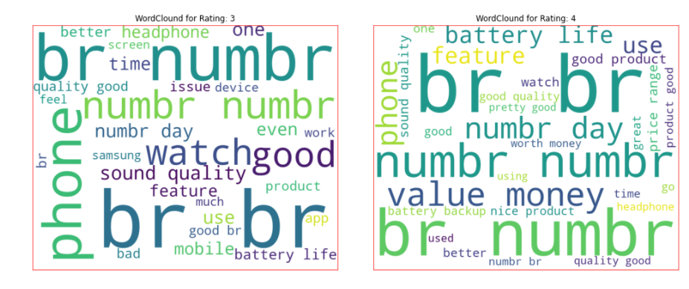
Word Cloud : Display

Slide 15
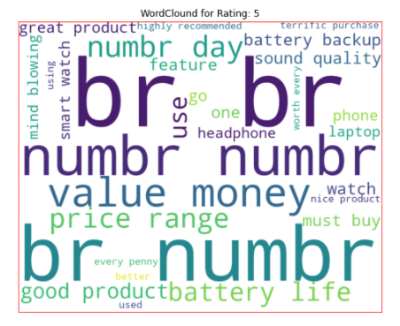
Word Cloud : Display

Slide 16
Word Cloud : Observations
for Rating: 1
It is mostly consists of words like phone, headphone, waste, money, slow, worst, issue etc.
for Rating: 2
It is mostly consists of words like phone, good, watch, product, problem, issue, bad etc.
for Rating: 3
It is mostly consists of words like phone, good, watch, problem, sound, feature, quality etc.
for Rating: 4
It is mostly consists of words like phone, good, value, money, nice product, battery backup, great etc.
for Rating: 5
It is mostly consists of words like value, money, must buy, great, perfect, better,terrific purchase, mind blowing etc.

Slide 17
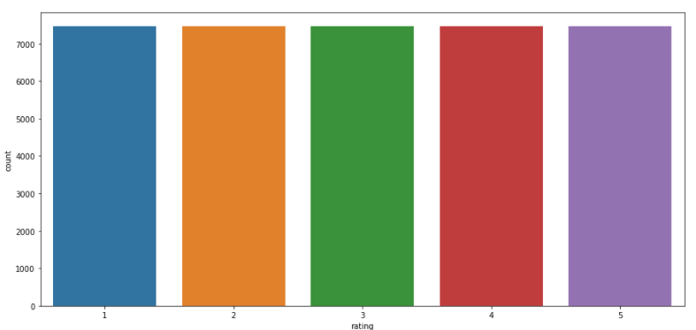
Note:
Count plot generated after balancing the dataset.

Slide 18
EDA Concluding Remarks
Starting with univariate analysis, with the help of countplot, it was found that the data consists of highest number of 5 star rating followed by 4 star ratings. Moving further with the removal and replacement of certain terms (like, punctuations, extra spaces, numbers, money symbols) as well as removal of stop words, it was evident that the length of review text decreases by a large amount. This was also dipcted by using distribution plot.
With the help of wordcloud, it was found that the rating 1 consists of words like phone, headphone, waste, money, slow, worst, issue etc, rating 2 consists of words like problem, issue, bad, etc, rating 3 consists of words like problem, sound, quality etc, rating 4 consists of word like good, value, money, nice, etc. and rating 5 consists of words like must buy, great, perfect, mind blowing etc.

Slide 19
MODEL DEVELOPMENT ALGORITHMS
The complete list of algorithms that were used in training and testing the classification model are listed below:
SGDClassifier
Multinomial Naïve Bayes
KNeighborsClassifier
DecisionTreeClassifier

Slide 20
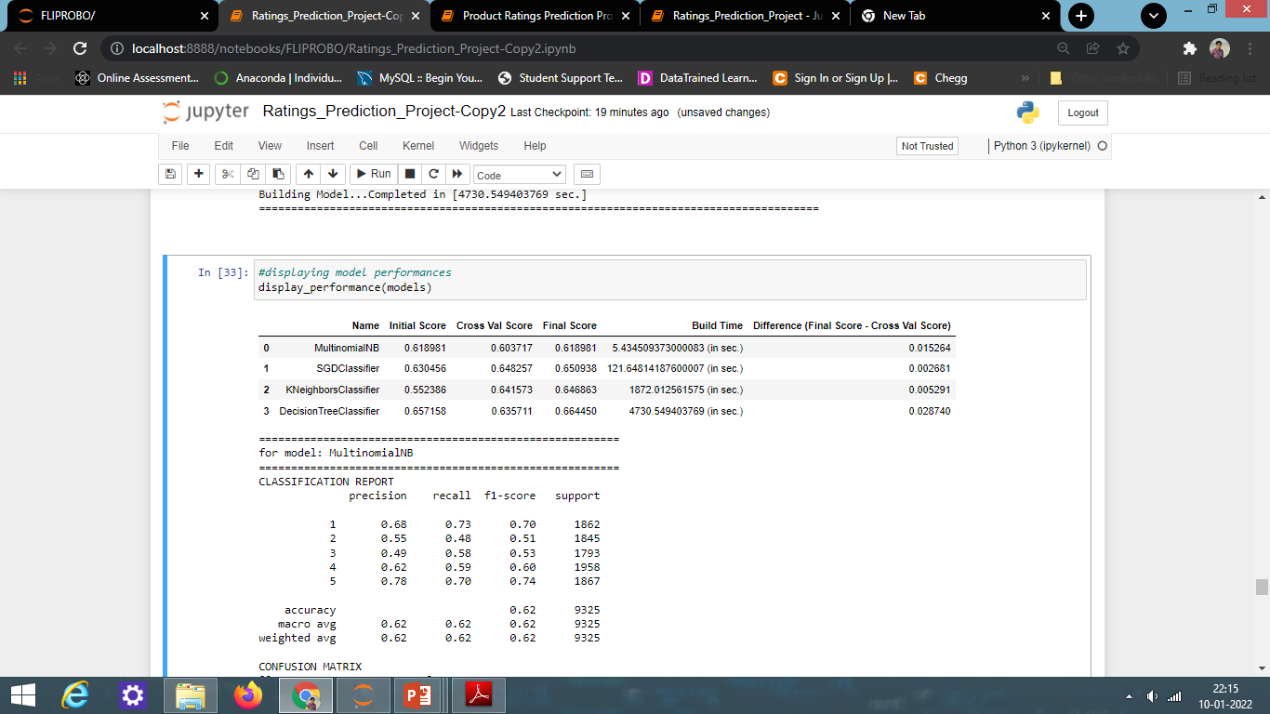
Model/s Development and Evaluation
Run and Evaluate selected models

Slide 21
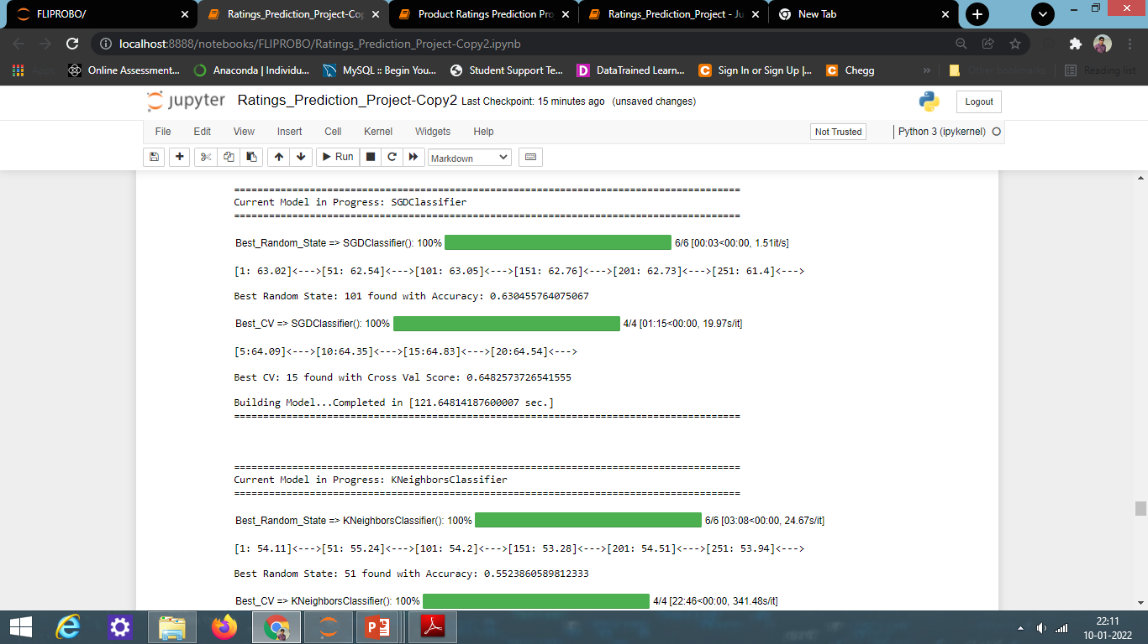
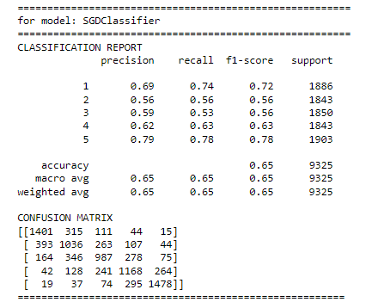
MODEL EVALUATION

Slide 22
Conclusion
Key Findings and Conclusions of the Study
From the model performance comparison, it is clear that SGDClassifier performs well with accuracy_score of 65.09% and lowest difference between accuracy_score and cross_val_score, hence proceeding with SGDClassifier as our final model.

Slide 23
CONCLUSION
Learning Outcomes of the Study in respect of Data Science
During the data analysis, review_text feature contains null values which have been dropped, but these values can also be replaced with some other values which might impact the model performance either in positive or negative way. As of now, I am finishing this project with my current approach which gives the final accuracy score of 65.09% and cross_val_score: 64.82% and this can be further improved by training with more specific data.

Slide 24
CONCLUSION
Limitations of this work and Scope for Future Work
Current model is limited to technical product rating(s) and reviews data but this can further be improved for other sectors of ecommerce rating(s) prediction by training the model accordingly. The overall score can also be improved further by training the model with more specific data.
As we know the content of text in reviews is totally depends on the reviewer and they may rate differently which is totally depends on that particular person. So it is difficult to predict ratings based on the reviews with higher accuracies. Still we can improve our accuracy by fetching more data and by doing extensive hyper-parameter tuning.

Slide 25
THANK YOU

