Slide 1
Generic Products of AEDs:
Is it an Issue?
Prof. Meir Bialer
Hebrew University
Jerusalem, Israel
Singapore-IEC, European Chapters Convention (8.7.2007)

Slide 2
New Drug - NDA
Generic Product - ANDA
A new drug has to prove efficacy & safety (NDA)
A generic product of an existing drug has to be bioequivalent to the brand (reference) product by demonstrating the same in vivo (absorption) performance (ANDA)

Slide 3
Bioequivalence
Bioequivalence studies are designed to assess the relative bioavailability of a drug from test (generic) and reference (brand) formulations
Ideally, the test and reference formulations should give essentially superimposable plasma concentration versus time profiles, but practically it is impossible
Bioequivalent generics are regarded as essentially similar to the brand product
Midha et al, Eur J Pharm Sci, 1996

Slide 4
Practical Considerations
In practice, within-subject variability ensures that perfect superimposability is rarely achieved, even when the same formulation is given on two occasions
In practice, limited analytical sensitivity and compromises in study design, place constraints on accuracy and/or precision in the determination of Cmax, tmax & AUC
Midha et al, Eur J Pharm Sci, 1996

Slide 5
Pharmacokinetics (PK) - ADME
Absorption
Distribution
Metabolism
Excretion

Slide 6
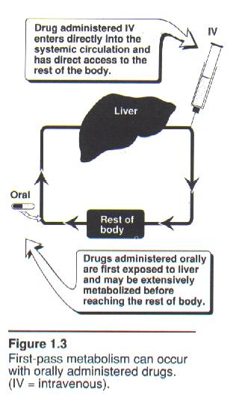

Slide 7
Distribution vs Elimination
Drug at site of administration
1
Absorption (input)
Drug in plasma
2
Distribution
Drug in tissues
Metabolism
Metabolite(s) in tissues
3
Elimination (output)
4
Drug and/or metabolite(s)
in urine, feces, bile

Slide 8
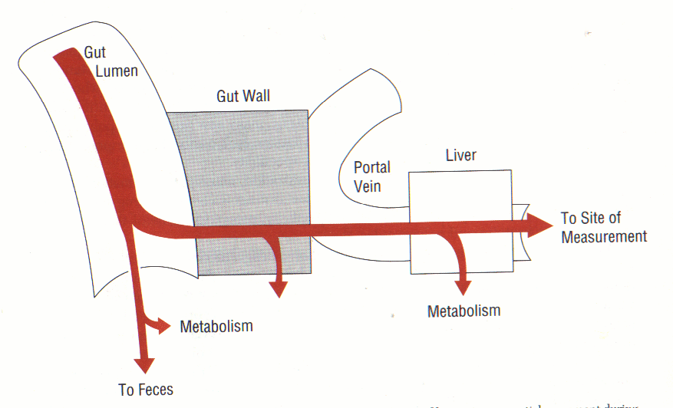
First Pass Effect (Liver)
Rowland & Tozer, Clinical Pharmacokinetics, 1995

Slide 9
PK Parameters of Drug Disposition & Absorption
Disposition=Distribution+Elimination
  Clearance (CL)
  Volume of distribution (V)
  Half life ( t_{1/2} )
Absorption
Extent (F) and Rate (ka, Cmax, tmax) of Absorption
  Absolute bioavailability or oral availability (F)
  Absorption rate constant (ka)
  ka, Cmax, tmax & F depend not only on the drug but also on the formulation (drug product)

Slide 10
Generic Products - ANDA
A generic product has to be bioequivalent to the brand (reference) product by demonstrating the same in vivo (absorption) performance

Slide 11
1) AUC - extent of absorption
2) Cmax - rate (but also extent) of absorption
3) tmax - rate of absorption
The Three Major PK Parameters to
Assess Bioequivalence are:

Slide 12
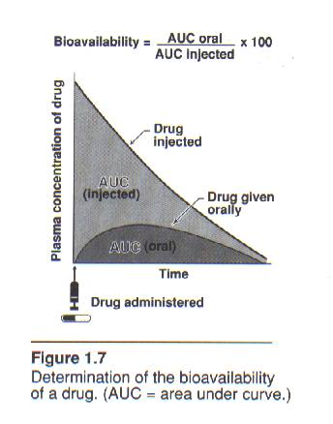
AUC & Bioavailability

Slide 13
Area Under the Curve (AUC)
AUC is a robust parameter which takes into consideration all the experimental points collected in each phase of a bioequivalence study
AUC is the principal criterion to characterize the extent of absorption and to assess bioequivalence
This applies to single and to multiple dose studies of immediate and CR formulations

Slide 14
Bioavailability & Bioequivalence
AUCpo / Dpo
AUCiv / Div
Absolute bioavailability F =
Relative bioavailability AUCtest / Dtest
F’ =
(Bioequivalence)
AUCref / Dref
AUC is calculated by numeric (non-compartmental) method
Absorption rate : Cmax and tmax are determined by visual inspection of the experimental plasma data

Slide 15
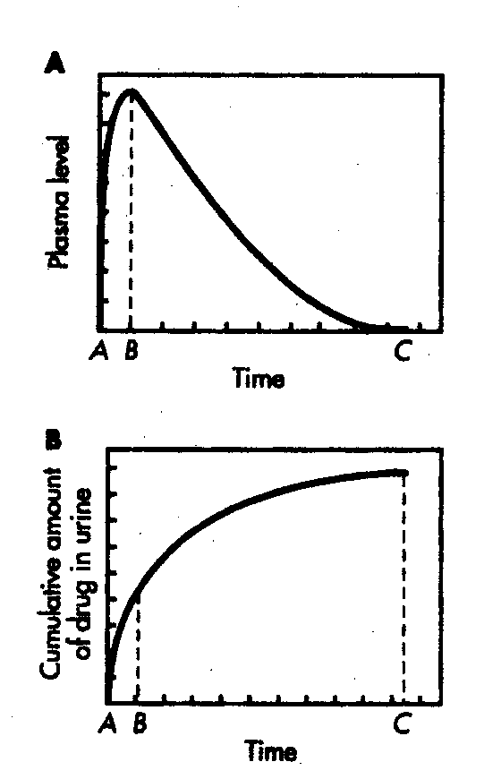
Bioequivalence – Extent of Absorption
Plasma data-AUC
Urine data-
Cumulative amount excreted unchanged in urine (Ae)

Slide 16
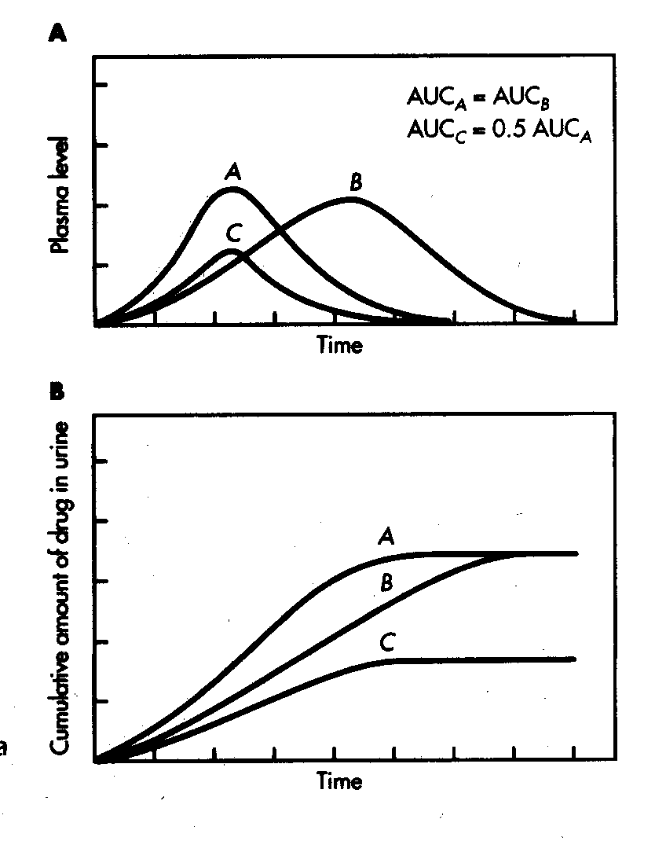
Bioequivalence – Extent of Absorption
Plasma data
Urine data

Slide 17
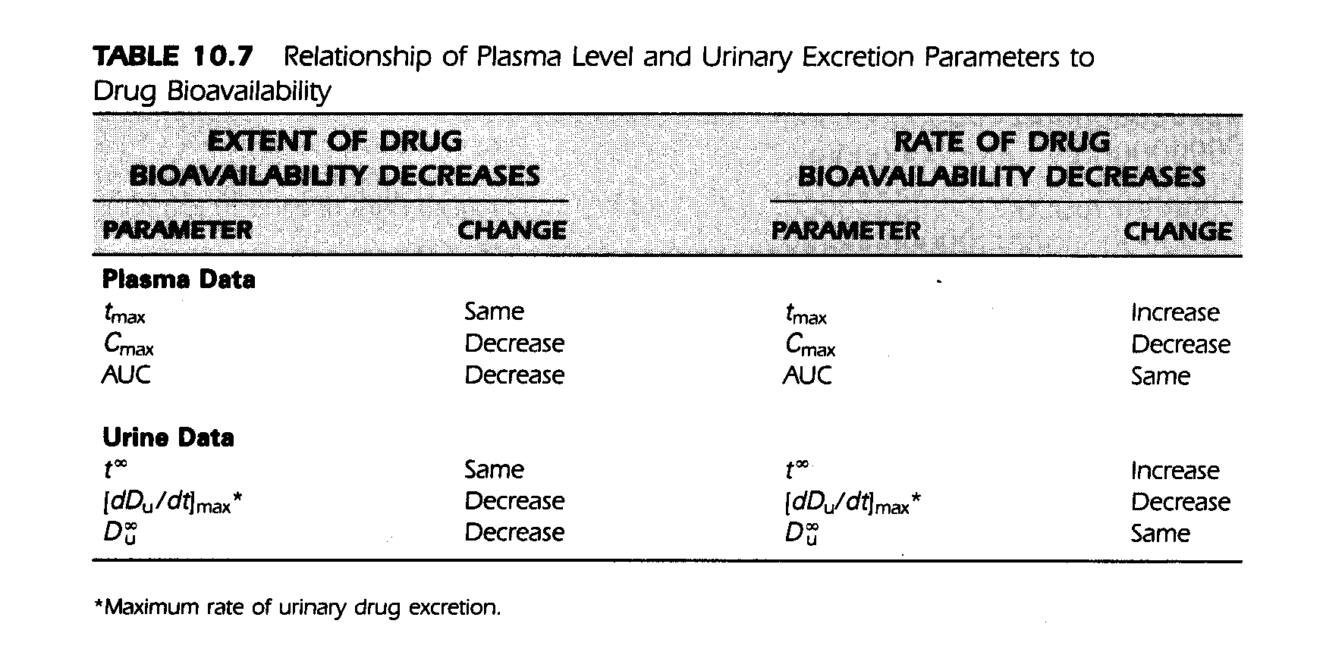
Changes in Extent or Rate of Absorption
Shargel et al, Applied Biopharmaceutics & Pharmacokinetics, 2005

Slide 18
Concern persists that the criteria used to establish bioequivalence of generic drug products may not adequately guarantee the interchangeability of drugs, particularly CR formulations
Physicians’ Concern

Slide 19
Bioequivalence is a More Demanding
Criterion than Therapeutic Equivalence
“The present requirements to prove bioequivalence, at least in the US and Canada, are already so rigorous and constrained that there is very little possibility, even for NTI drugs, that dosage forms meeting regulatory criteria could lead to therapeutic problems”
Benet & Goyan, Pharmacotherapy, 1995

Slide 20
“The Clay Feet of
Bioequivalence Testing”
The concept of bioequivalence applies equally to generic and brand products
Changes in formulation, manufacturing equipments and site may affect the bioequivalence of the brand products
Levy, J Pharm Pharmacol, 1995

Slide 21
Pros & Cons for Generic CBZ
Conflicting reports regarding therapeutic equivalence & bioequivalence of brand & generic CBZ products
Con: Sachdeo et al, Lancet, 1987 & Epilepsia, 1987: Breakthrough seizure due to a switch to generics
Pro: Richens, CNS Drugs, 1997: Bioequivalence is a negligible source for variation in therapeutic response

Slide 22
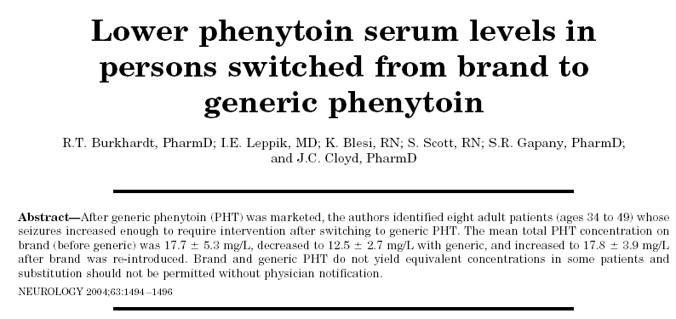
Against a Switch to Generic PHT
PHT is a highly variable drug with nonlinear PK & a narrow therapeutic window
PHT has been utilized as a weapon against generic AEDs with linear PK (VPA, CBZ, LTG)

Slide 23
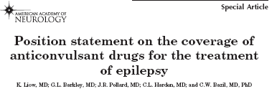

Bioequivalence & Generic AEDs
Problems with generic AEDs, Is it anecdotal or true?

Slide 24
Interchangeability = Prescribability + Switchability
Bioequivalent generic product must be interchangeable with the original brand AED
Prescribability: Patients treated for the first time with either the brand or generic AED (new patients)
Switchability: A brand AED is switched to a bioequivalent generic of the same AED (old patients)

Slide 25
Average Bioequivalence (BE)
Average BE- Compares population means between the test (generic) and reference (brand) products
80% < 95% CI of mean AUCtest/AUCref < 125%
Individual BE Concept: Each patient has an individual therapeutic window & intrasubject variability
Individual BE models are more complicated

Slide 26
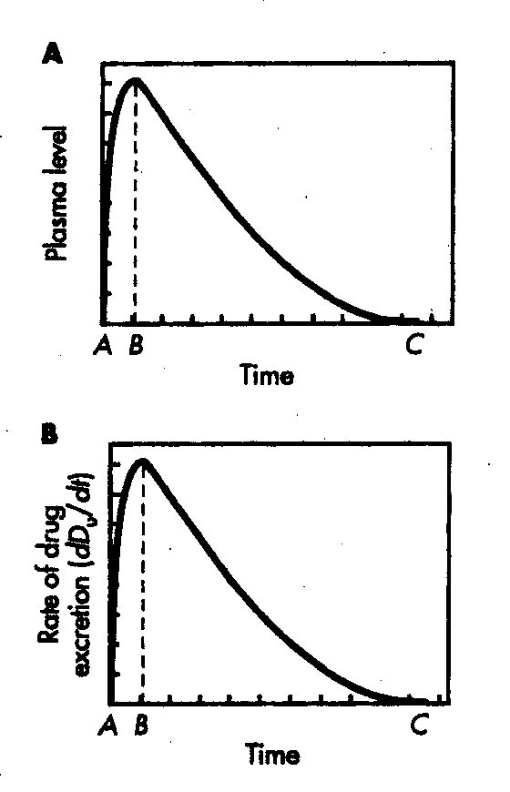
Extent & Rate of Absorption
Plasma
Urine

Slide 27
Bioequivalence: Extent & Rate of Absorption
AUCtest / Dtest
AUCref / Dref
Relative bioavailability F’ =
(Extent of absorption)
Relative bioavailability Cmaxtest / Dtest
F’’ =
(Rate of Absorption)
Cmaxref / Dref
80%<F’ & F”<125%
Absorption rate : Cmax and tmax are determined by visual inspection of the experimental plasma data

Slide 28
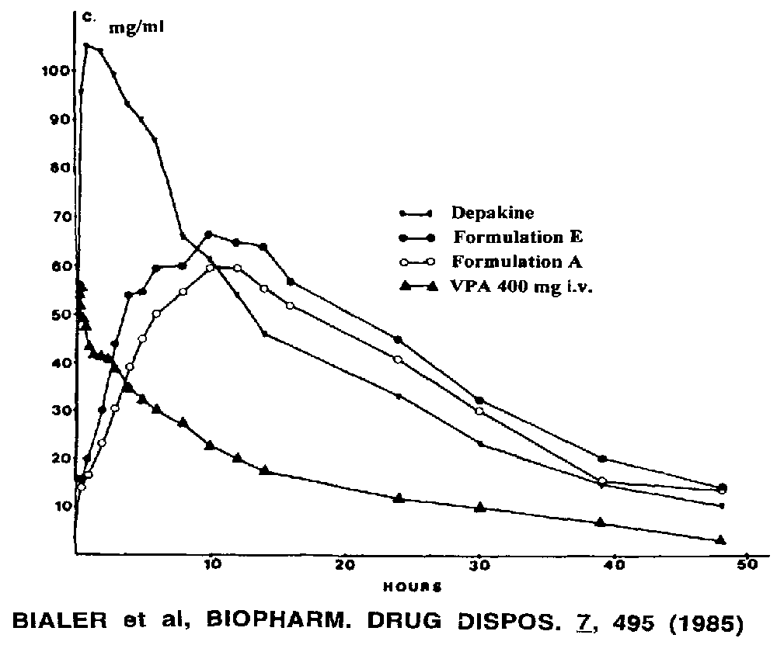
ER vs IR Formulation
Similar AUC, lower Cmax and longer tmax: Flatter is Better
Bialer et al, Biopharm Drug Dispos, 1985

Slide 29
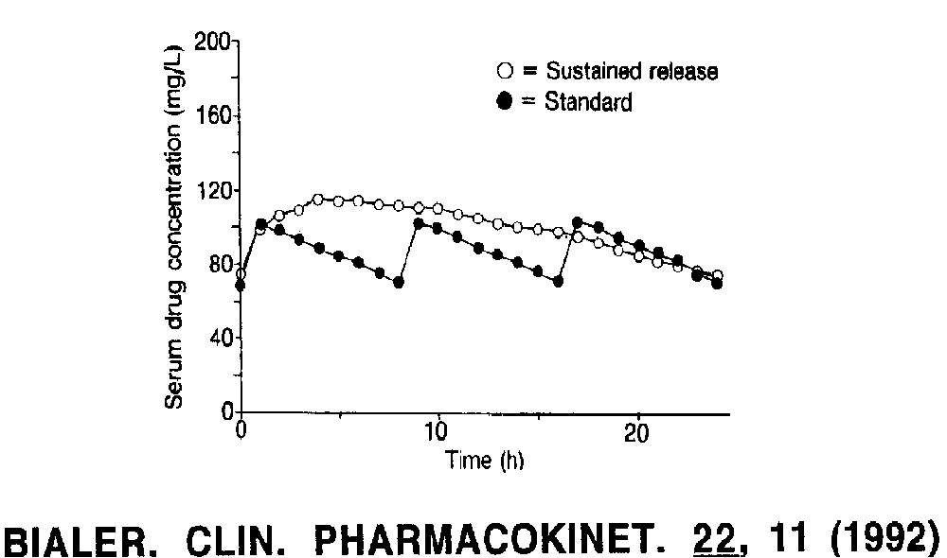
ER vs IR VPA:Similar Exposure &Fluctuations
Bialer, Clin Pharmacokinet, 1992

Slide 30
Average vs Individual Bioequivalence (BE)
Average BE- Compares population means between the test (generic) and reference (brand) products
Individual BE- can evaluate switchability
Individual BE Concept: Each patient has an individual therapeutic window & intrasubject variability
Individual BE models are more complicated

Slide 31
Individual Bioequivalence (BE)
Individual Difference Ratio
IDR=T-R/R-R
Difference in bioequivalence metric (AUC, Cmax) between test & reference
Difference between reference & reference
Replicate Design
For individual BE analysis the generic and brand products must be administered twice to the same group of subjects
Chen & Lesko, Clin Pharmacokinet, 2001

Slide 32
Individual Bioequivalence (BE)
Individual BE integrates three elements
(Difference of means)²+Interaction+ Difference of variances ≤ (Preset limit)²
Average BE assesses the mean and total variability of the BE metrics (AUC, Cmax)
Lower preset limit (80%) ≤ Difference of means ≤ Upper preset limit (125%)
Schall & Luus, Stat Med, 1993; Endrenyi et al, Eur J Pharm Sci,1998

Slide 33
Individual & Average Bioequivalence (BE)
Individual BE
(Difference of means)²+Interaction+ Difference of variances ≤ (Preset limit)²
Average BE
Lower preset limit (80%) ≤ Difference of means ≤ Upper preset limit (125%)
When the within subject variances of the generic &
brand products are the same and there is no interaction: Individual BE=Average BE
Schall & Luus, Stat Med, 1993; Endrenyi et al, Eur J Pharm Sci,1998

Slide 34
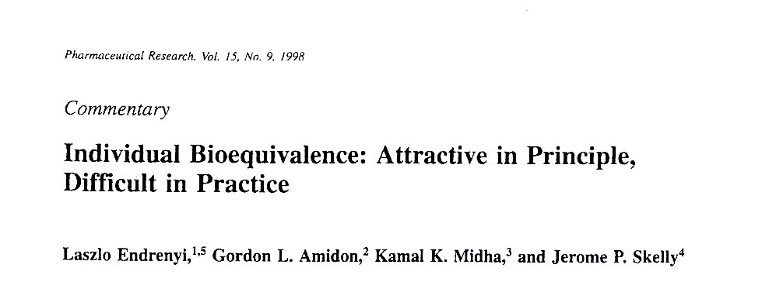
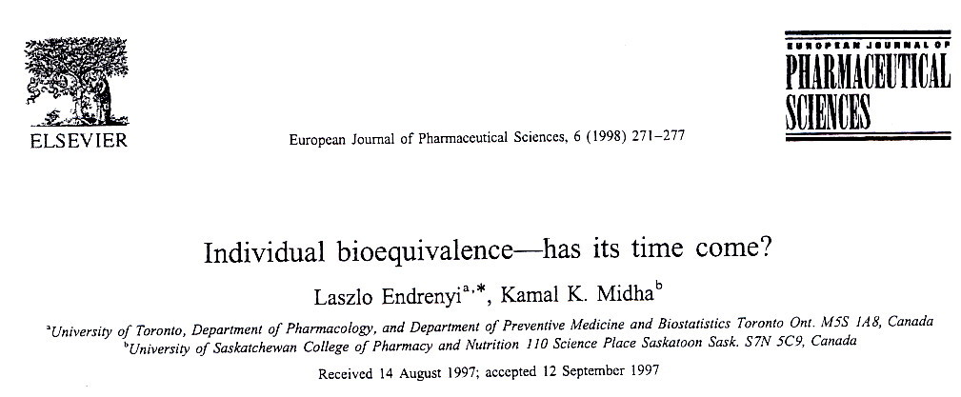
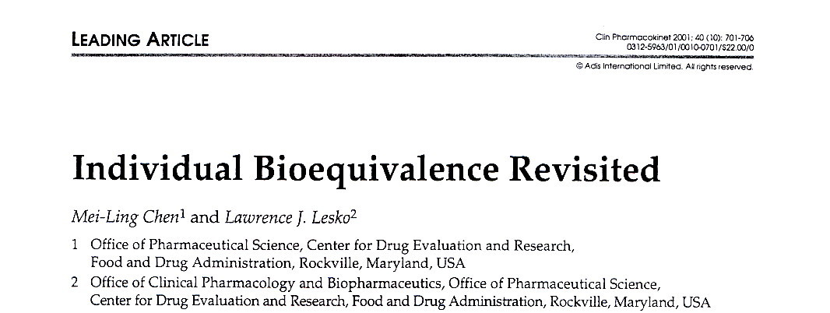
Individual Bioequivalence - Has its Time Come?

Slide 35
Individual Bioequivalence & Generic AEDs
Would it Help in Assessing AED Generic Products?
Would it Reduce Physicians’ Concern?

Slide 36
Issues Specific to Epilepsy & Generic Products of AEDs
Epileptic patients require consistency in their AED treatment
This is particularly true for seizure-free patients
The generic switch itself may cause breakthrough seizures as patients are averse to changes
Patients prescribed with generics may face switches from one generic product to another
In an unpredictable subset of epileptic patients generics may have a higher intrasubject variability than the brand AEDs

Slide 37
Italian League’s Recommendations on Generic AEDs
Generic AEDs represent a valuable choice in patients starting treatment
A switch of AED products (brand or generic) is not recommended in seizure-free patients
A switch to generic might be rational in patients with incomplete seizure control, but they should be informed and monitored
Avoid substitution with products in patients treated with generics
IR & ER AED formulations cannot be used interchangeably
Perucca et al, Epilepsia 2006

Slide 38
AAN Position Statement on Generic AEDs
AEDs differ from other classes of drugs that make generic substitution problematic
Small variations in AED concentrations between brand bioequivalent generics can cause toxic effects and seizures
AAN opposes legislation that would impede physicians’ ability to determine which AED to prescribe
Liow et al, Neurology 2007

Slide 39
AAN Position Statement on Generic AEDs
AAN believes that formulary policies should support complete physician autonomy in prescribing & epileptic patients in accessing, the full range of AEDs
AAN opposes policies that would result in arbitrary switching among AEDs
AAN supports legislation that would require informed consent of physicans and patients before generic substitutions of AEDs are made at the point of sale
Liow et al, Neurology 2007

Slide 40
AAN Position Statement on Generic AEDs
AAN believes that the use of AEDs in epilepsy should be distinguished from their use in other disorders
Unlike other diseases, a single breakthrough seizure due to change in delivered medication dose (formulation) can have devastating consequences including loss of driver’s license, injury, and even death
Liow et al, Neurology 2007

Slide 41
Average vs Individual Bioequivalence (BE) - Conclusions
Approved generic AEDs with documented average BE data are prescribable & represent a valuable choice for drug “naïve” patients
The switch to generic is well tolerated by many patients and is cost-effective
Until we have individual BE data or the tool to apriori identify susceptible patient, seizure- free patients shoul not be switched

Slide 42
Average vs Individual Bioequivalence (BE): Questions
Did average BE fail to assess BE of generic AEDs, aside from anecdotal reports?
Is subject-by-formulation interaction important in BE analysis?
What is the right population for individual BE, healthy subjects or patients?
Is the within subject variability of patients to a switch from a brand to generic greater than from one batch to another?

Slide 43
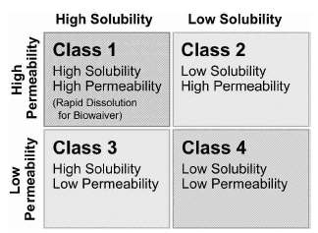
Biopharmaceutics Classification
System (BCS)
The FDA used the BCS system to allow waiver of
bioavailabity and bioequivalence testing of Class 1 IR drug products
Amidon et al, Pharm Res, 1995; FDA Guidelines for Industry, 2000

Slide 44
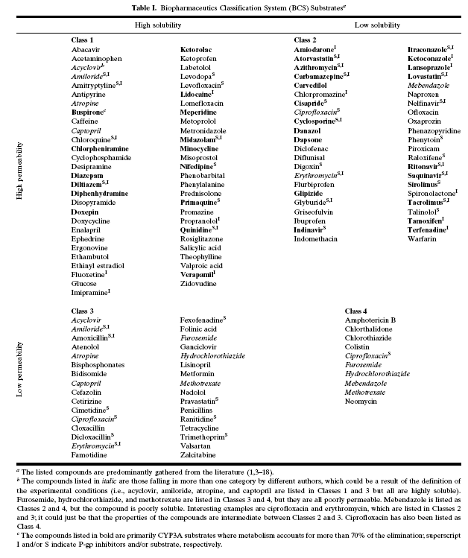
Biopharmaceutics Classification
System (BCS)

Slide 45
Biopharmaceutics Classification
System (BCS)

Slide 46
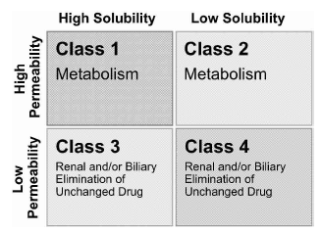
Predominant Drug Elimination
by BCS Class
Wu & Benet, Pharm Res, 2005

Slide 47
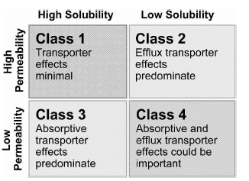
Transport Effect on Drug
PK by BCS Class
Wu & Benet, Pharm Res, 2005

Slide 48
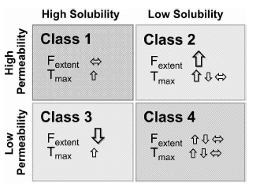
Predictability of high-fat meal
effects by BCS Class
Wu & Benet, Pharm Res, 2005 after Fleisher et al, CPK, 1999

Slide 49
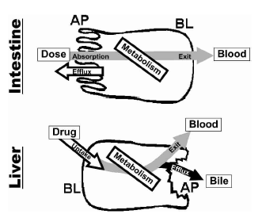
Enzymes & Transporters –
Intestine & Liver
Benat et al., Curr Drug Metab, 2003; Wu & Benet, Pharm Res, 2005

Slide 50
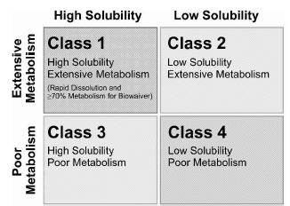
Biopharmaceutics Drug Disposition
Classification System (BDDCS)
Wu & Benet, Pharm Res, 2005

