Slide 1
Automation Demo
Symphony
Presenter: Abheet Singh Jamwal

Slide 2
Content
Scope Details
Tools Used
Solution Showcase
Workaround
Q&A

Slide 3
Scope Details
Automation Scope
Signup
Signin
Forget password

Slide 4
Tools Used
Selenium webdriver
Pytest (Python)
VSCode
Twilio Message serivce
Fake mail serivce

Slide 5
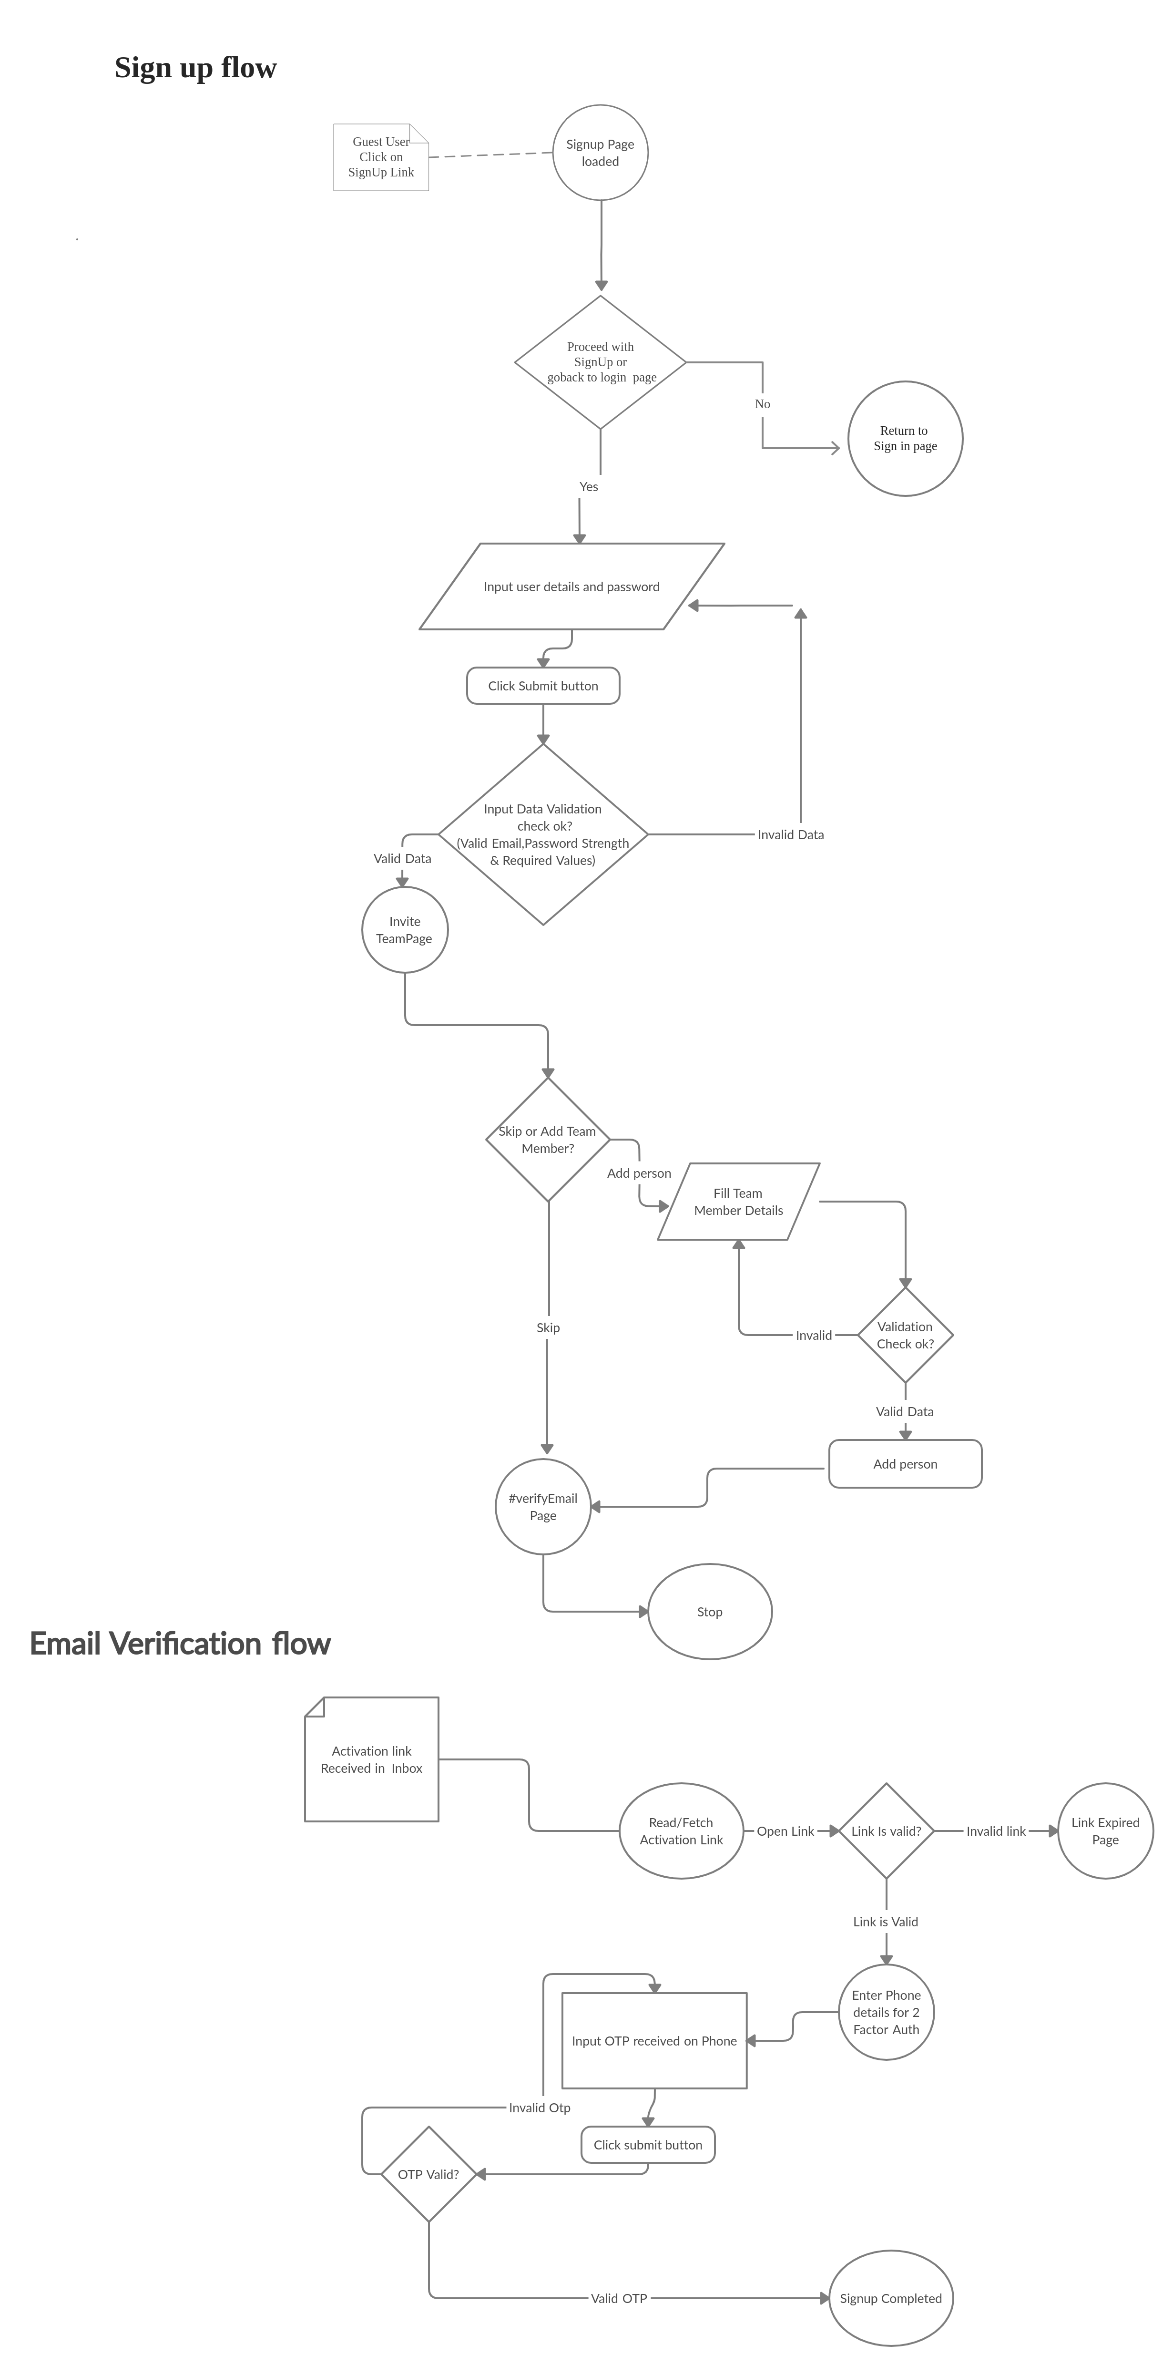
SignUp flow

Slide 6
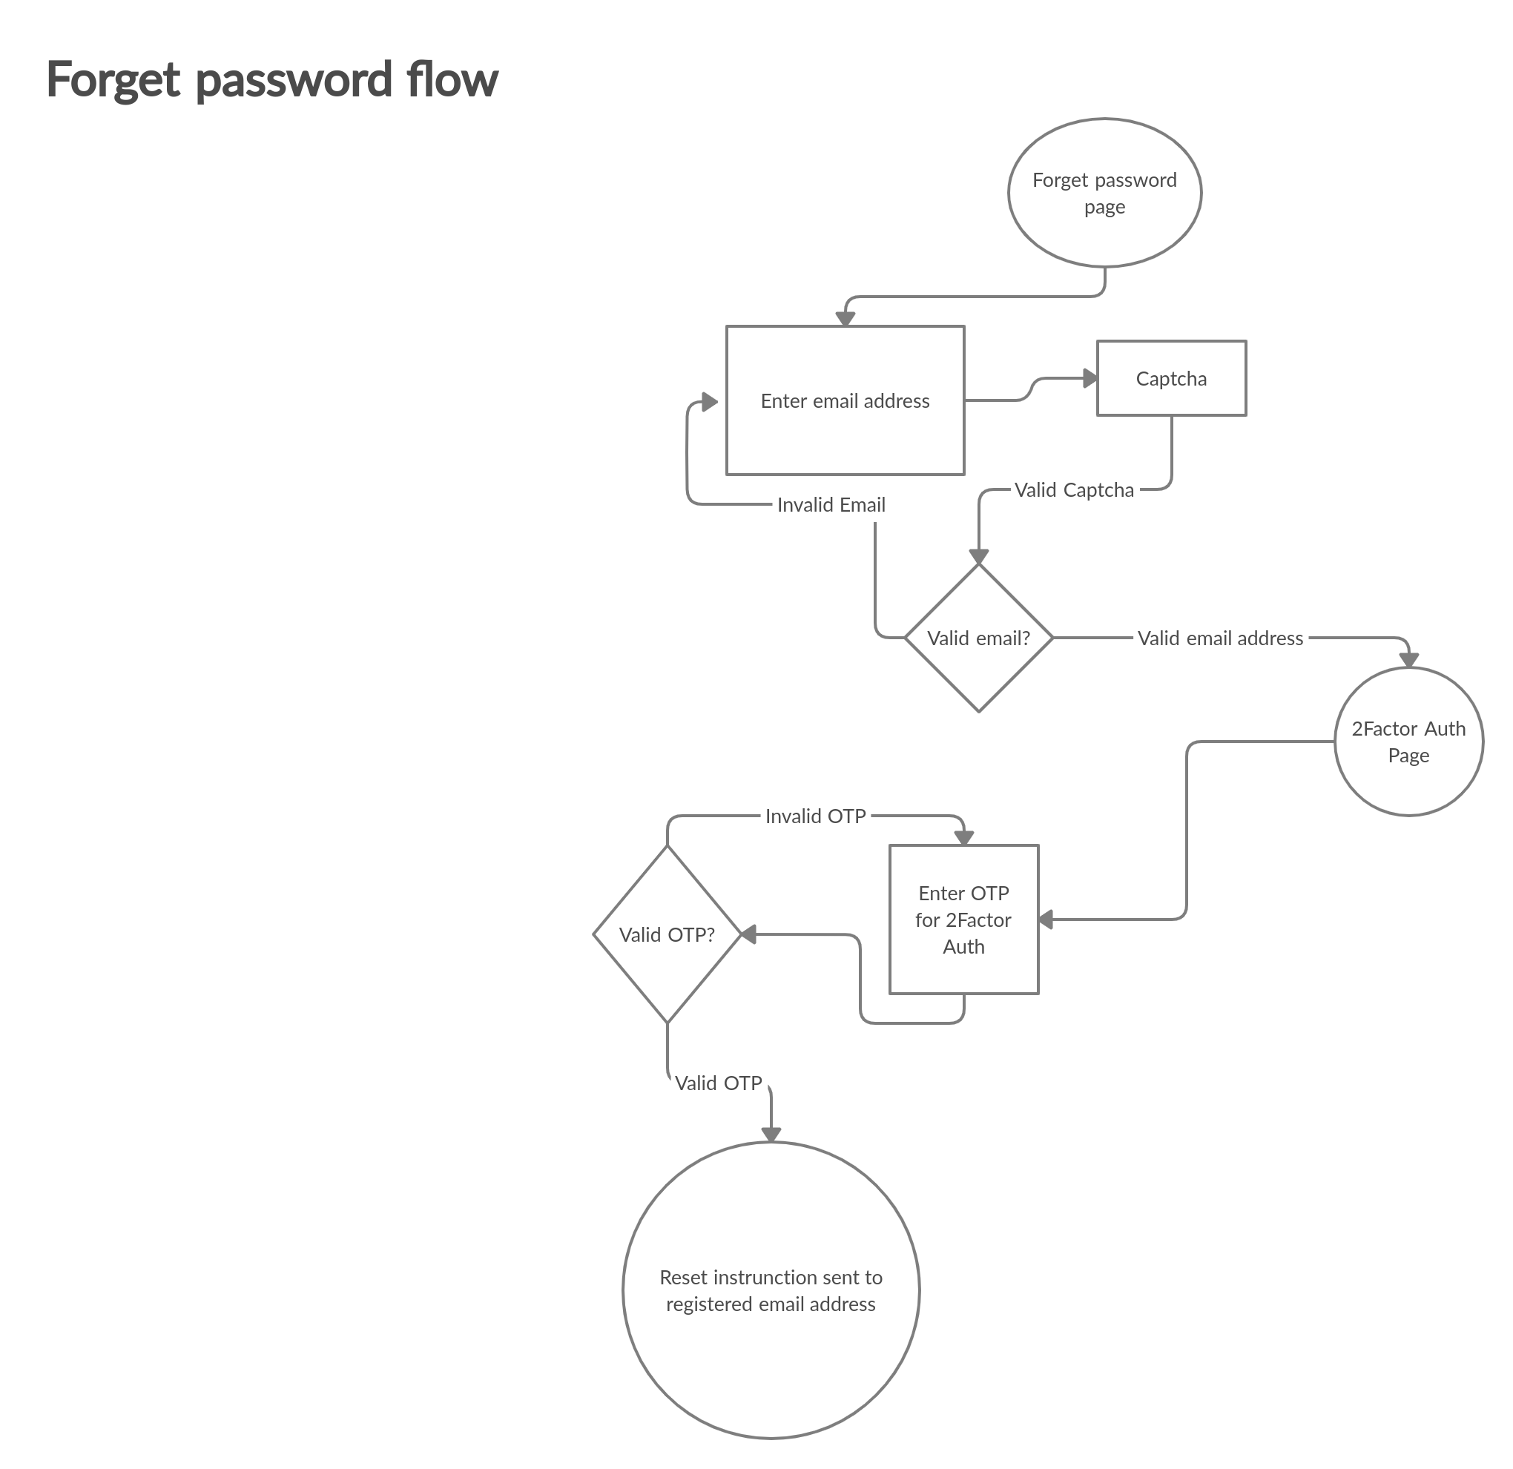
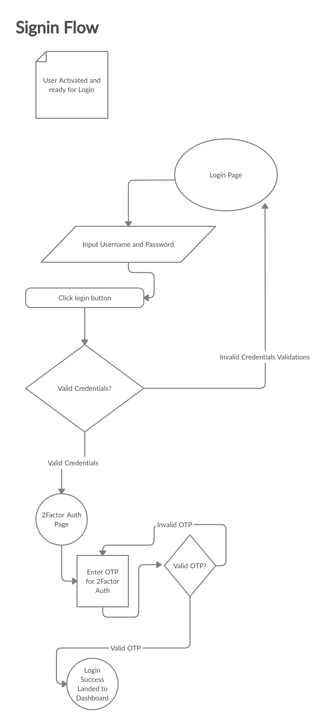
SignUp flow

Slide 7
SignUp flow

Slide 8
Solution Showcase
Demo

Slide 9
Workaround
Forget Password
Captcha related workaround
Since automation is in house so we can disable the Captcha from Captcha2 API (disable functionality) and by pass it
We can use voice recoganization APIs/thirdparty modules to read the text (voice to text) and punch into Captcha.

Slide 10
Workaround
Signin activation
Email Activation/Verification
For automation purpose we can create serivce to fetch activation link directly and activate the account.
Can directly update/mark account as active in database itself.
2Factor Auth
Thirdpart API services (Twilio) (Costly)
Directly read the db or create and call internal service to read the OTP
Disable 2-factor

Slide 11
Q&A
Q&A
Thankyou,
Abheet

