Slide 1
OCR for handwritten text
Abhey Arora
Project Partners – Ganesh Anbhule
Priyanka Sahana
Ankur Biswal

Slide 2
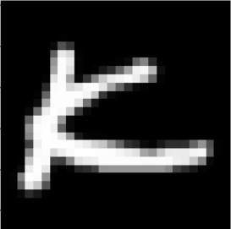
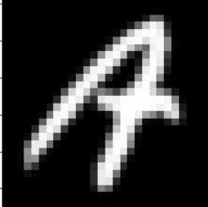
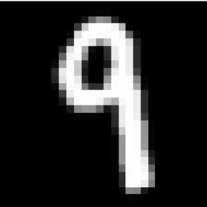
EMNIST and character recognition
Object detection algorithm to detect characters in input image
Character recognition model to predict the character

Slide 3
Drawbacks of this approach
Couldn’t find a dataset to train the object detection algorithm performed on characters
This approach will not work for cursive handwriting

Slide 4
New workflow chart
Pre-processing
Line segmentation
Word Segmentation
Word prediction

Slide 5
Pre-processing
Converting image to grayscale
Increasing contrast of the image
Otsu Thresholding binarization

Slide 6
Line Segmentation Algorithm-1
Calculate the row sums for the input image
Locate its peaks
Use A* search algorithm to find a path from [0,peak] to [img.ncolumns,peak]
Repeat this for all the identified peaks in the image

Slide 7
Can the same algorithm be used for word segmentation
Expectation
Reality

Slide 8
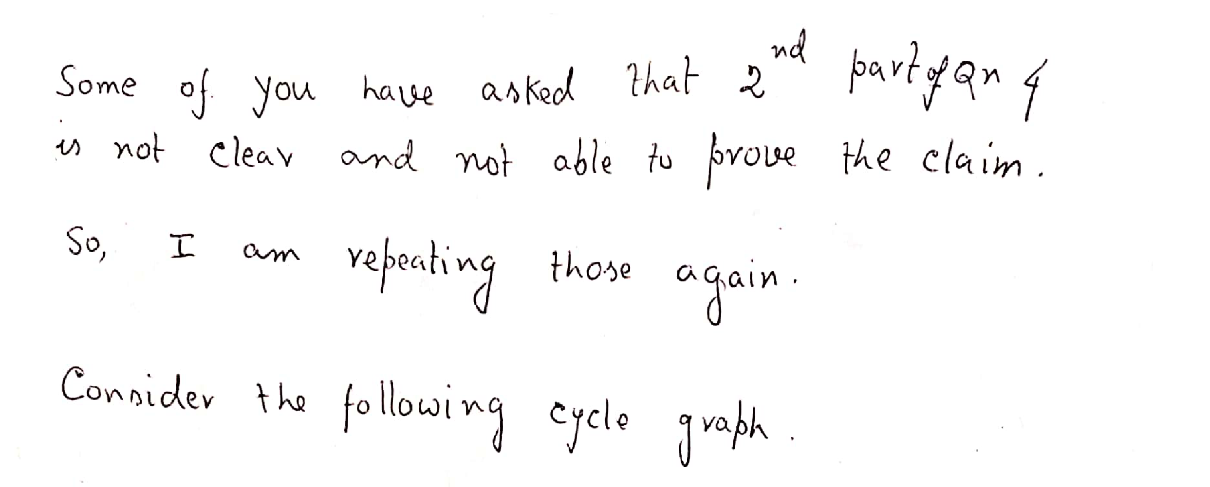
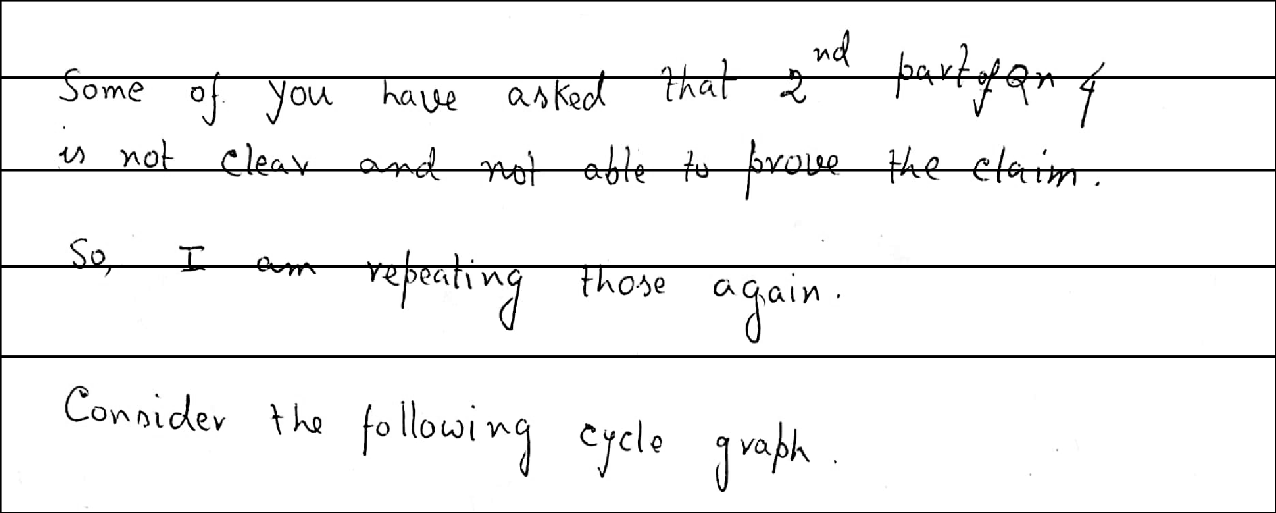
Skew correction

Slide 9
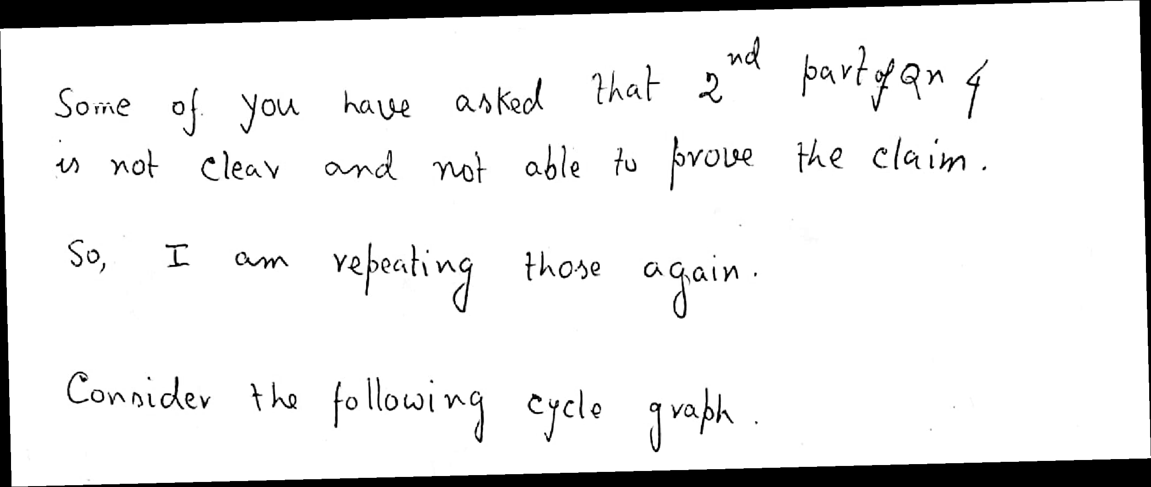
Skew correction
Using canny lines and hough transform, we can determine the angle with which image should be rotated.

Slide 10
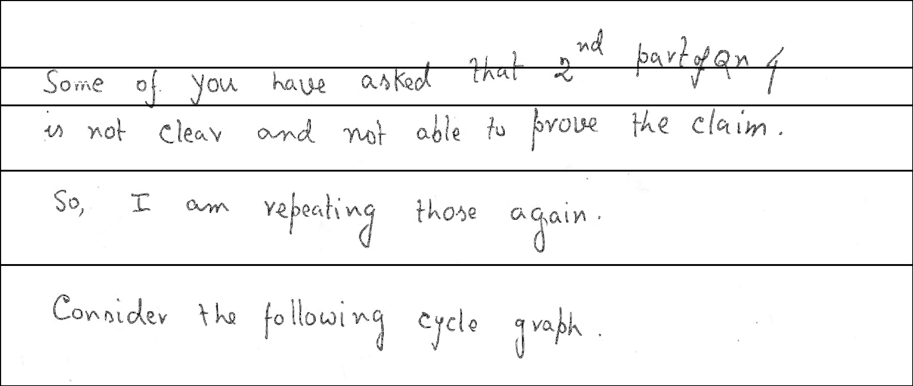

Slide 11
Drawbacks
Some lines may be skewed and some may be not
Need to look for a generalised way for line segmentation

Slide 12
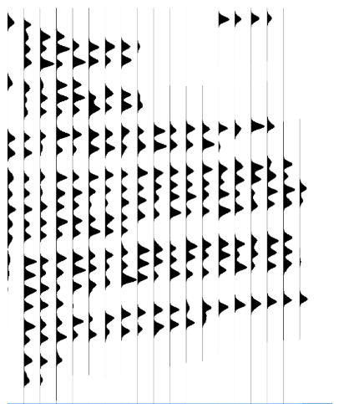
Line segmentation algorithm 2
Divide the image into 20 chunks and create smoothed projection profiles for each chunk.
Join valleys in between the peaks with valleys of other chunks to form lines

Slide 13
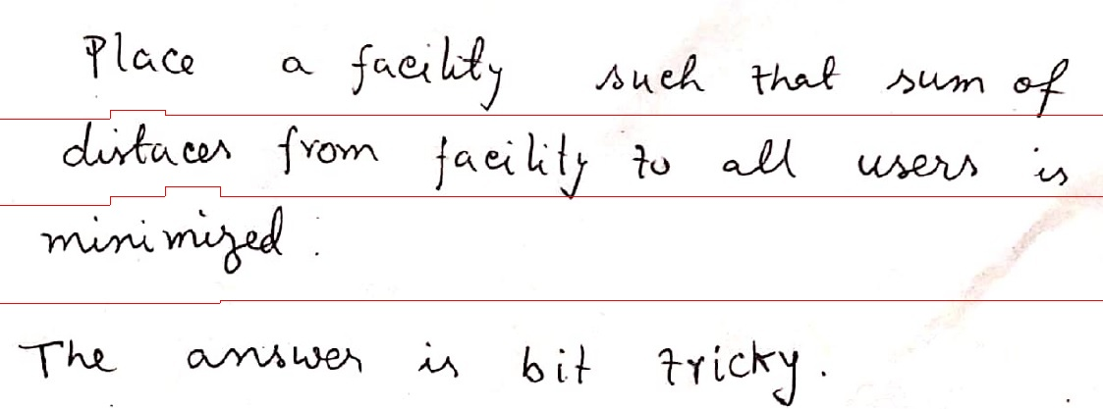
Some examples

Slide 14
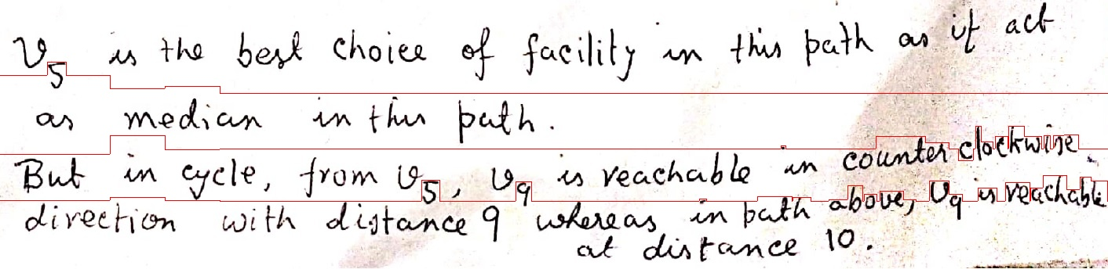
Some examples

Slide 15
Word segmentation
Simply finding contours in image of a line segments the image into different words.

Slide 16

Issue with word segmentation
The dot in “i” was usually missed in vertically small words like ‘in’, ‘is’
Word images are resized to be an input for the neural network model

Slide 17
Text prediction part: Model architecture
Model is trained on IAM dataset which contains different words written by various authors
CNN layers
32 X 256
RNN layers
128 X 32 word image
32 X 80
CTC layer

Slide 18
CNN and RNN layers
Input is a 128 X 32 image
Converted to 32 X 256 using 5 X 5 and 3 X 3 convolutional filters along with max pooling
2 cells of LSTM implementation of RNN is used to get an output sequence of 32 X 80
Output can be interpreted as probability of 80 characters at each time step

Slide 19
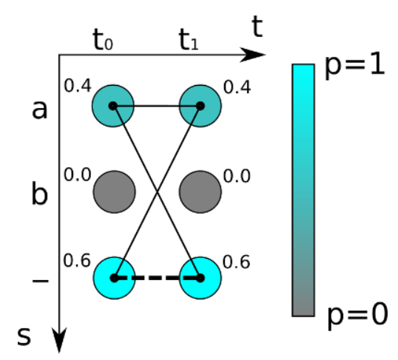
CTC layer
This layer decodes the RNN output
Let us understand by taking an example:
“to” → “---ttttttooo”, or “-t-o-”, or “to”
“too” → “---ttttto-o”, or “-t-o-o-”, or “to-o”, but not “too”
P(a) = P(“-a”)+P(“aa”)+P(“a-”) = 0.64
P(-) = P(“--”) = 0.36

Slide 20
CTC layer
During training, the layer calculates the probability of true word and tries to maximize it
Given a batch, loss function is negative of log sum of probabilities of true words
During validation or testing, this layer decodes the path using a greedy approach by selecting the most likely character at each time step.

Slide 21
Performance metrics
Character error rate: The number of errors in predicting a word is calculated by calculating the edit distance of predicted word and actual word.
Word accuracy: The proportion of words which are predicted accurately

Slide 22
Performance of various models
7 layer model Adam optimizer 1
Character error rate: 23.774510%. Word accuracy: 29.729730%.
7 layer model Adam optimizer 2
Character error rate: 24.641176%. Word accuracy: 30.324324%.
7 layer model
Character error rate: 24.754902%. Word accuracy: 31.081081%.
6 layer model
Character error rate: 24.754902%. Word accuracy: 31.081081%.
5 layer model
Character error rate: 33.333333%. Word accuracy: 14.864865%.

Slide 23
Some examples
Predictions:
[ERR:2] "surprise" -> "surforise“ [OK] "although" -> "although"
[ERR:1] "out" -> "ouct“ [ERR:1] "lived" -> "lised"
[OK] "and" -> "and"
Predictions:
[ERR:1] "recurred" -> "recursed“ [ERR:2] "exercise" -> "ercercise"
[OK] "laughing" -> "laughing“ [OK] "may" -> "may"
[ERR:4] "you" -> "spore"

Slide 24
Performance of various models with Spell checker
7 layer model Adam optimizer 2
Character error rate: 18.382353%. Word accuracy: 51.351351%.
7 layer model Adam optimizer 1
Character error rate: 18.382353%. Word accuracy: 52.702703%.
7 layer model
Character error rate: 22.058824%. Word accuracy: 47.297297%.
6 layer model
Character error rate: 23.529412%. Word accuracy: 50.000000%.
5 layer model
Character error rate: 31.862745%. Word accuracy: 31.081081%.

Slide 25
Some examples
Predictions:
[OK] "surprise" -> "surprise” [OK] "although" -> "although"
[OK] "out" -> "out” [OK] "lived" -> "lived"
[OK] "and" -> "and"
Predictions:
[OK] "recurred" -> "recurred“ [OK] "exercise" -> "exercise"
[OK] "laughing" -> "laughing“ [OK] "may" -> "may"
[ERR:4] "you" -> "spore"

Slide 26
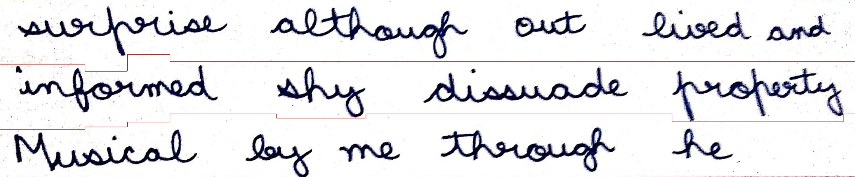
Final Example
Predictions:
“surprise", "although", "out", "lived", "and", "informed", "why", "dissuade", "puberty", "musical", "by", "me", "tough", "he"

