Slide 1
SalesInsightDashboard
File created on: 15-08-2023 23:41:02

Slide 2
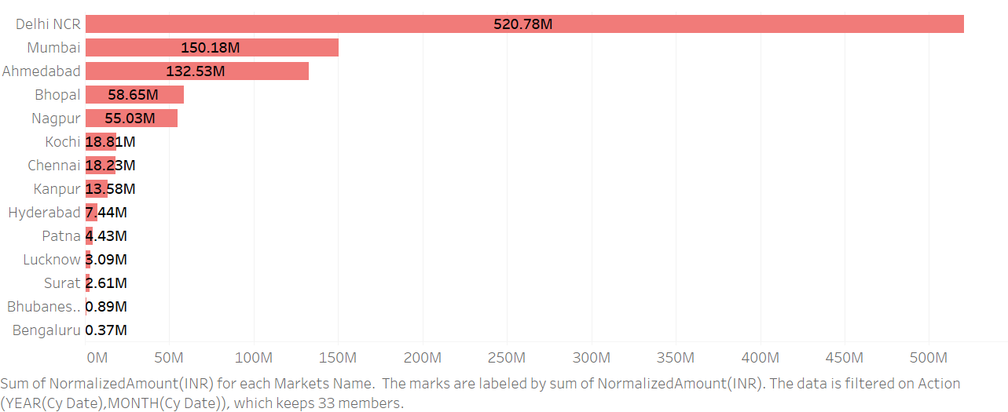

Slide 3
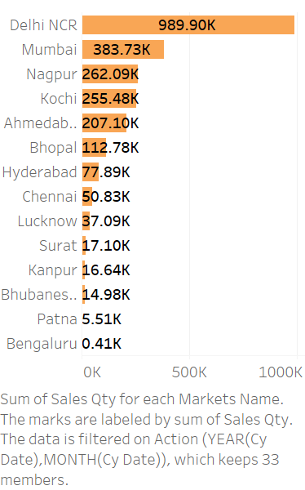

Slide 4


Slide 5


Slide 6
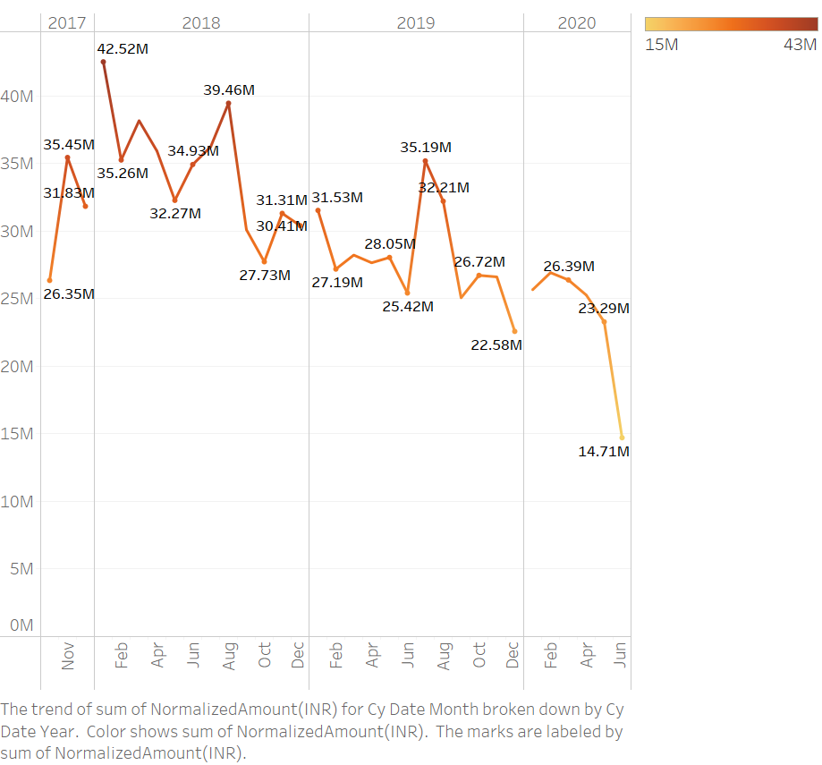

Slide 7
