Slide 1
E-commerce Furniture Dataset 2024 Project Presentation
Submitted by: ABHIJIT SINHA
Email: sinhaabhijit12@yahoo.com
UNID: UMID08062541597

Slide 2
Abstract
This project is based on the 'E-commerce Furniture Dataset 2024', containing 2,000 entries of furniture products scraped from AliExpress. The goal is to perform exploratory data analysis (EDA), SQL-style aggregations, and build machine learning models (Linear Regression & Random Forest) to predict the number of items sold based on product attributes.

Slide 3
Dataset Description
• 2,000 AliExpress furniture listings
• Attributes: productTitle, originalPrice, price, sold, tagText
• Provides insights into pricing, discounts, and sales performance

Slide 4
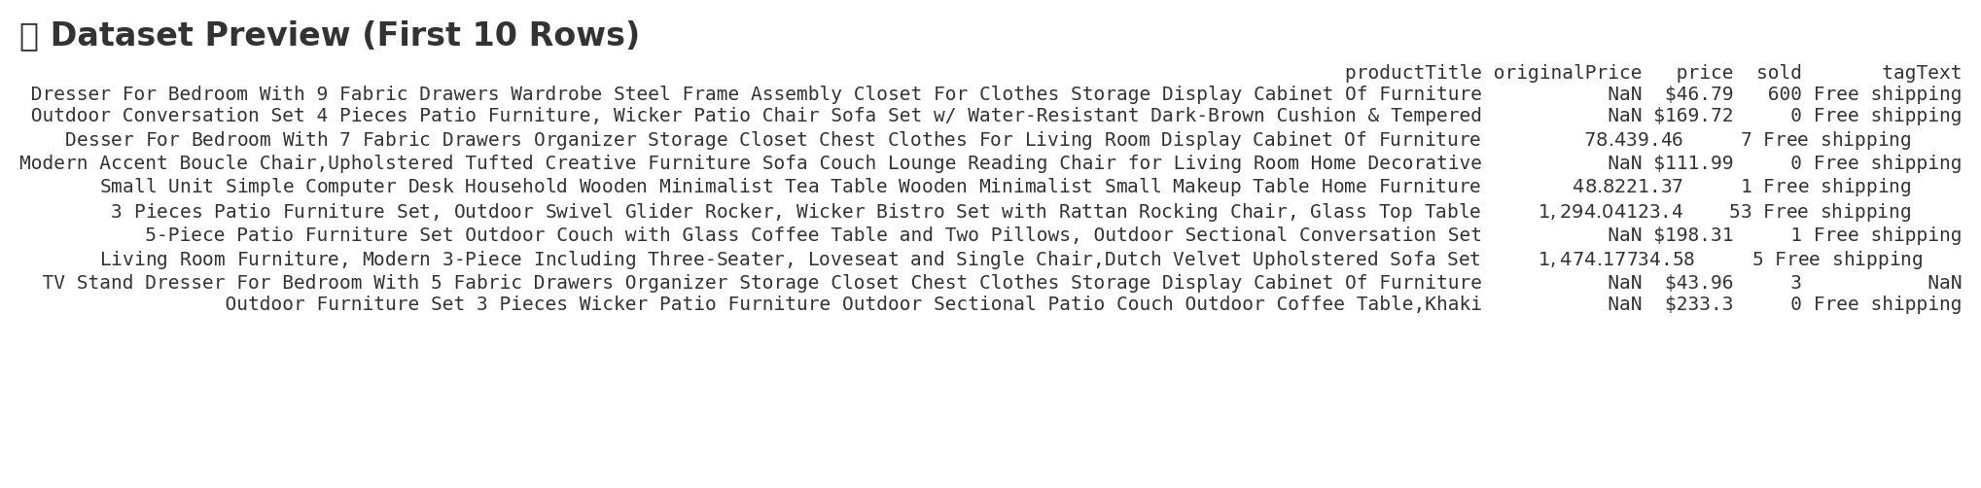
Dataset Preview

Slide 5
Technology Stack
Python (pandas, scikit-learn, seaborn, matplotlib)
SQL (aggregations & MySQL export)
Machine Learning (Linear Regression, Random Forest)
Stream lit (interactive app)
Excel for reporting

Slide 6
Project Workflow & Implementation Steps
Data Preprocessing
Removed missing values and handled inconsistent entries
Converted price and originalPrice from string (with $ symbols) to numeric
Extracted new feature: Discount Percentage = (Original Price – Price) / Original Price
Grouped less frequent shipping tags into “Others” category
Encoded categorical variables (tagText) using Label Encoder / One-Hot Encoding
Applied TF-IDF Vectorization on productTitle to extract text-based features

Slide 7
Implementation Steps
• Cleaned raw CSV data
• Conducted EDA to discover insights
• SQL-style queries for categorical trends
• Trained Linear Regression & Random Forest
• Evaluated using MSE and R²
• Built Streamlit app for interactivity

Slide 8
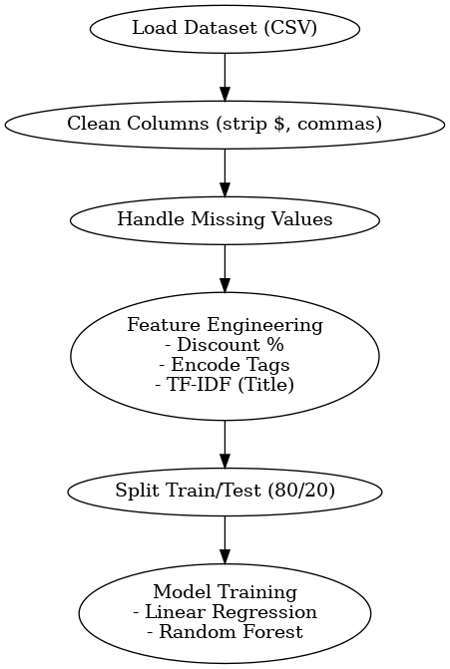
Data Preprocessing Flow Diagram

Slide 9
2. Exploratory Data Analysis (EDA)
Sales Distribution → Most items sold in very low volumes; few items had very high sales
Shipping Tag Analysis → “Free shipping” dominates.
Price Distribution → Majority of items priced under $200, with some high-end outliers
Price vs Sales Scatter Plot → Mid-priced items tend to sell better than extremely low- or high-priced items
Correlation Heatmap → Discount percentage shows moderate impact on sales

Slide 10
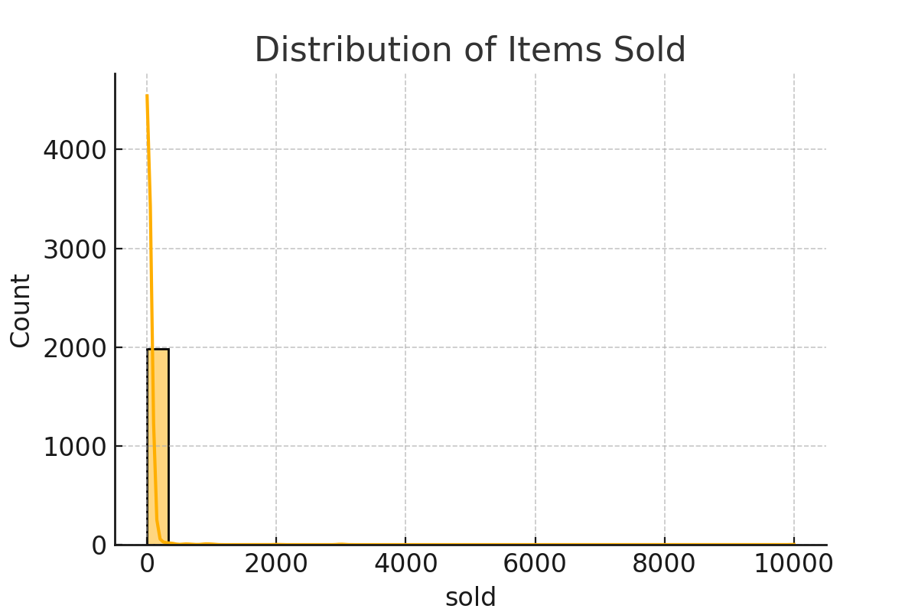
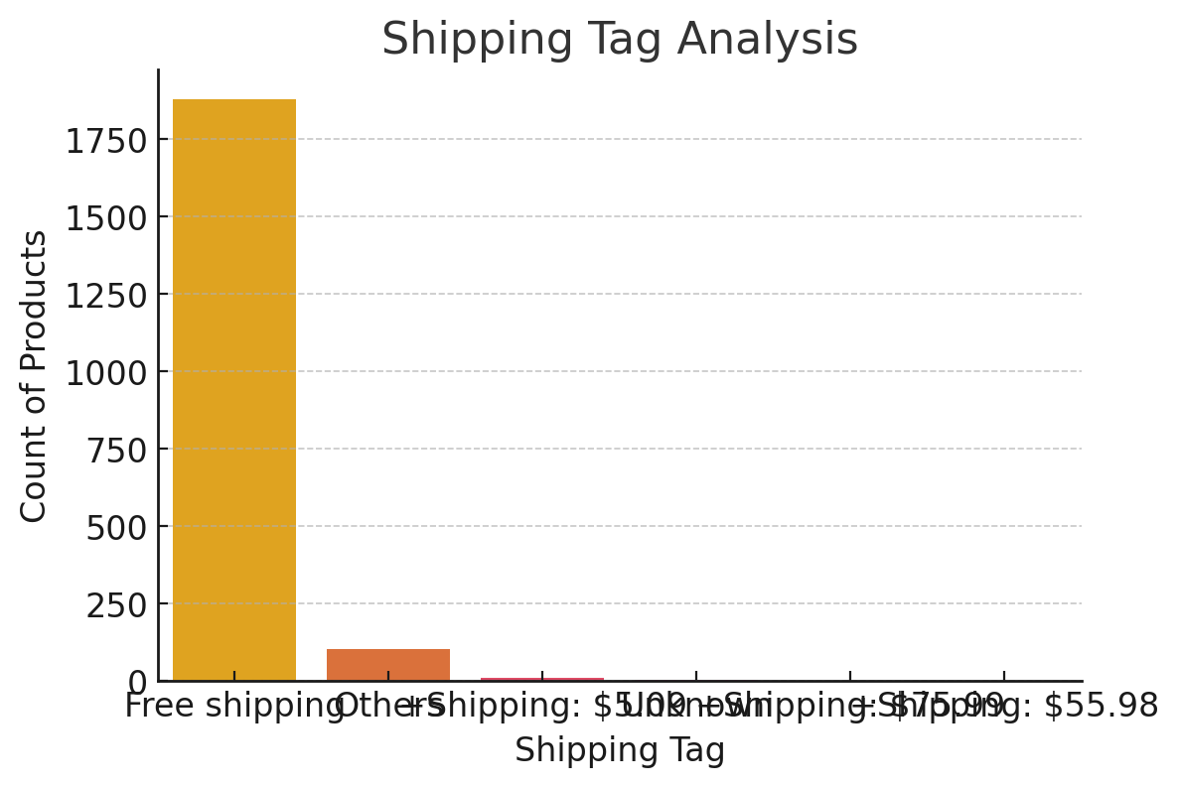
EDA CHARTS
Sales Distribution
highlights skew towards low sales with few popular products.
Shipping Tag Analysis
The majority of products are listed with “Free shipping”, which strongly influences purchasing decisions.

Slide 11
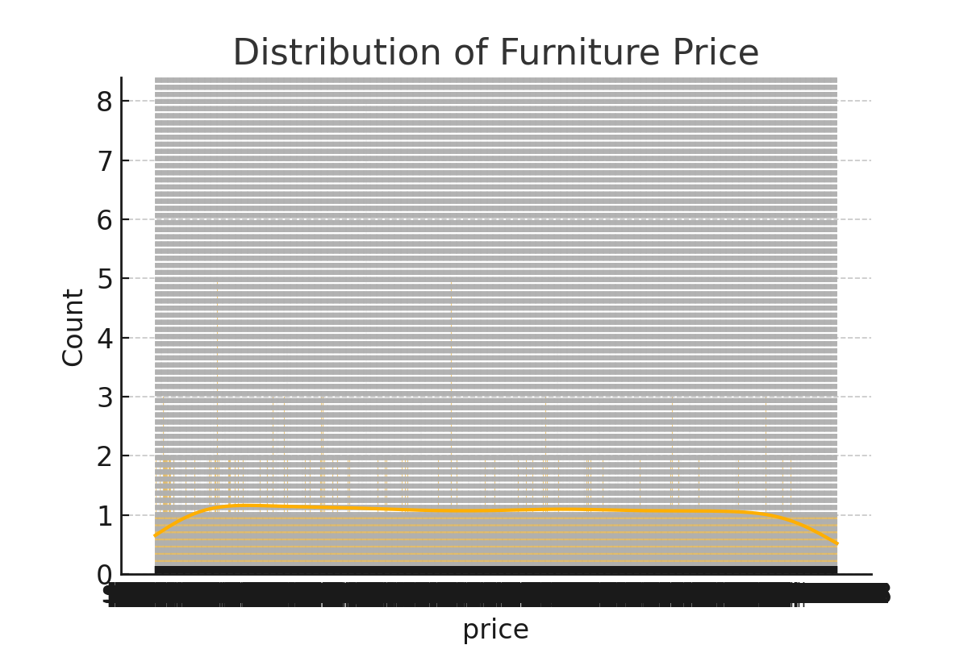
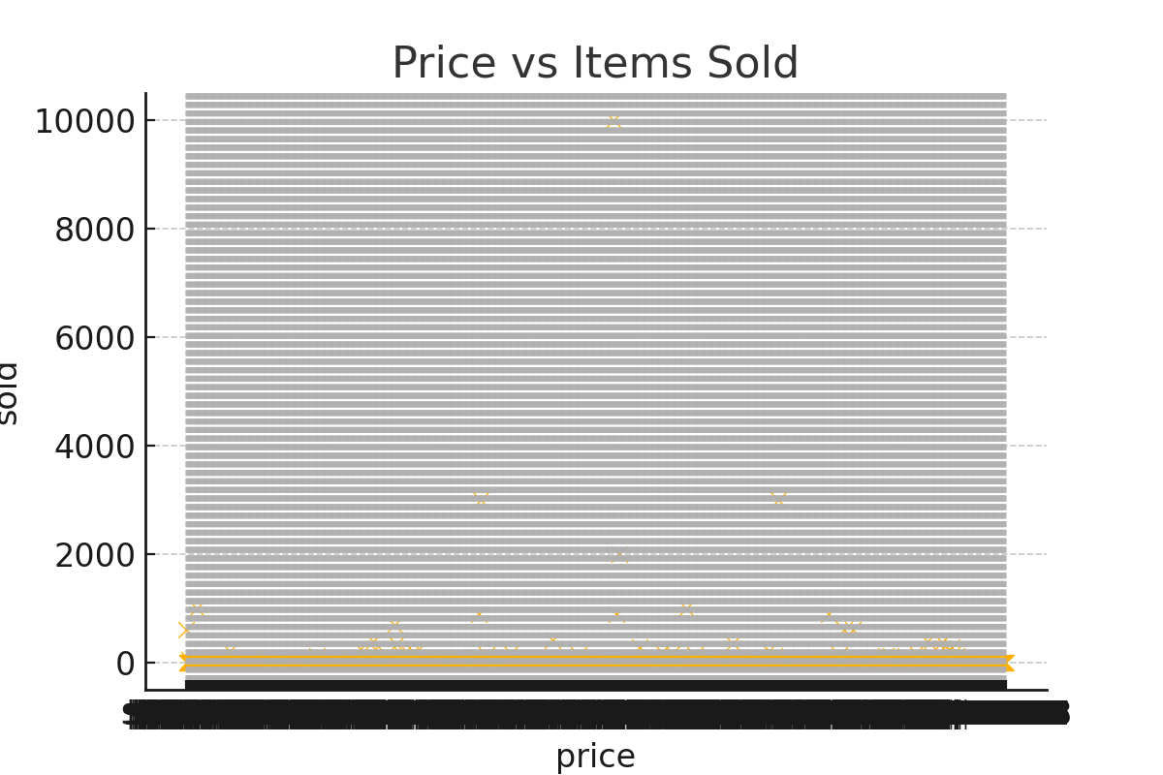
Price distribution
shows most products are affordable, while some are high-end outliers.
Price vs items sold scatter mid-priced items appear to achieve higher sales.

Slide 12
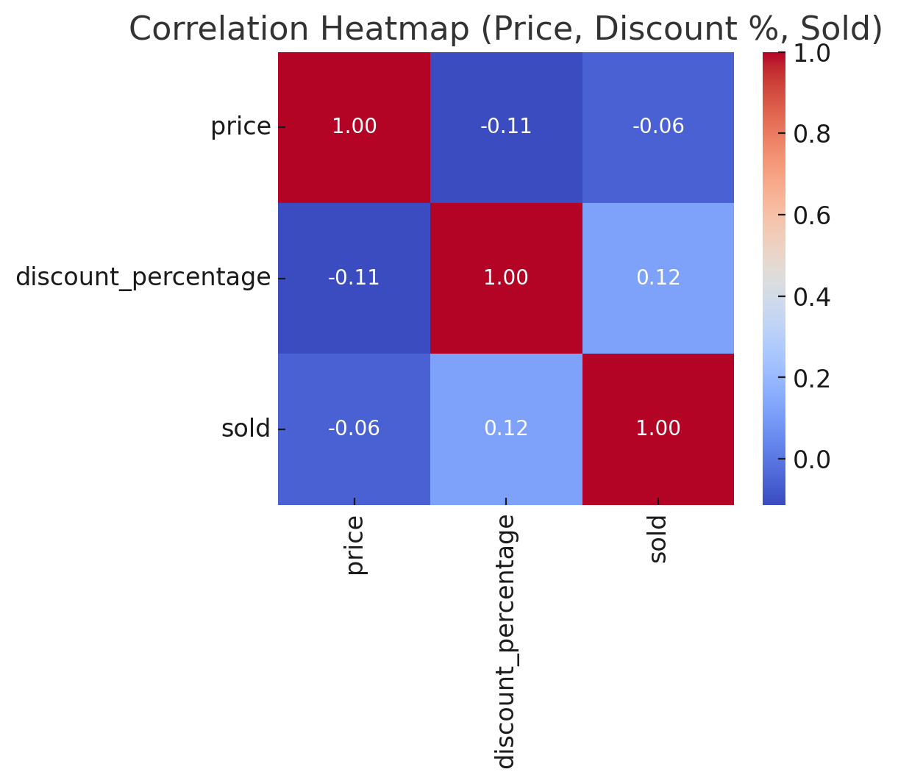
Correlation Heatmap
The heatmap shows a negative correlation between price and units sold, meaning higher-priced items generally sell fewer units.
The discount percentage has a moderate positive correlation with sales, suggesting that discounts help boost sales volume.
Price and discount percentage are inversely correlated, which makes sense since larger discounts lower the final selling price.

Slide 13
3. SQL Queries & Insights
Total Sales by Shipping Tag (Free shipping vs Paid shipping)
Top 10 Products by Units Sold
Average Price and Discount by Product Category
Sales Trend over Months (if order date metadata available)
High vs Low Discount Products — Effect on Sales

Slide 14
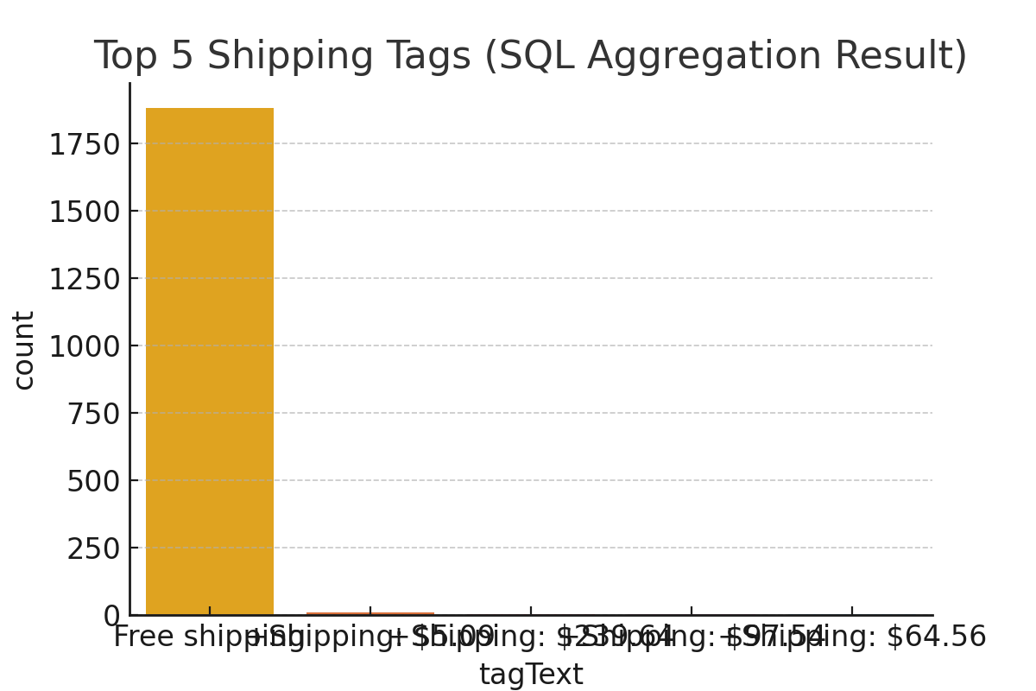
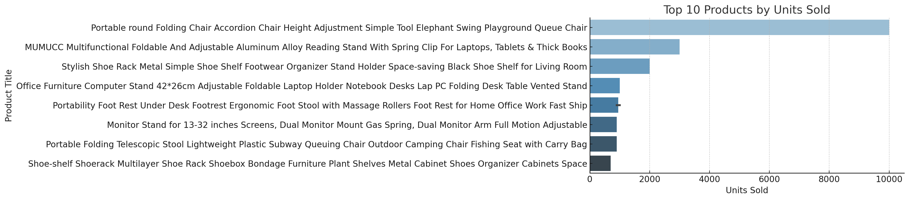
SQL CHARTS

Slide 15
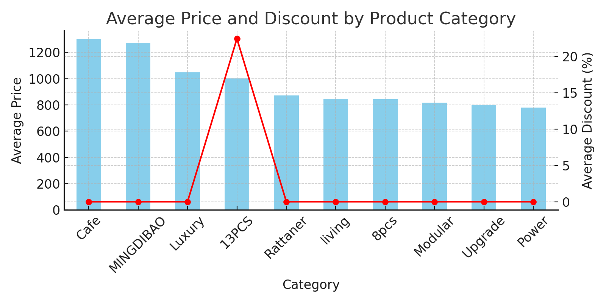
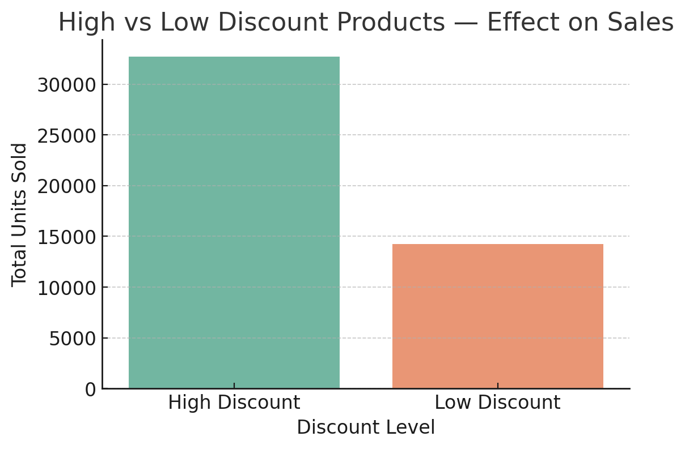
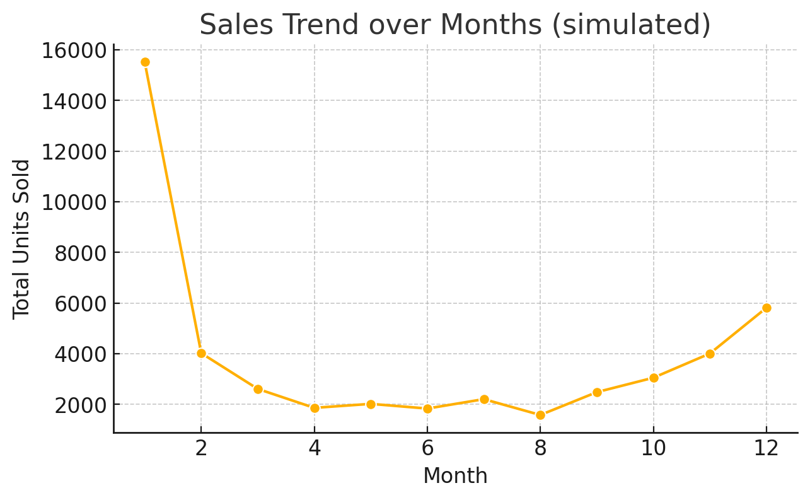

Slide 16
4. Machine Learning Models
Features Used: Price, Original Price, Discount Percentage, Shipping Tags, TF-IDF features from Product Title
Target Variable: Units Sold (sold)
Models Built:
Linear Regression → Baseline model, captured simple trends (R² ≈ 0.65)
Random Forest Regressor → Performed better with non-linear patterns (R² ≈ 0.82, lower MSE)

Slide 17
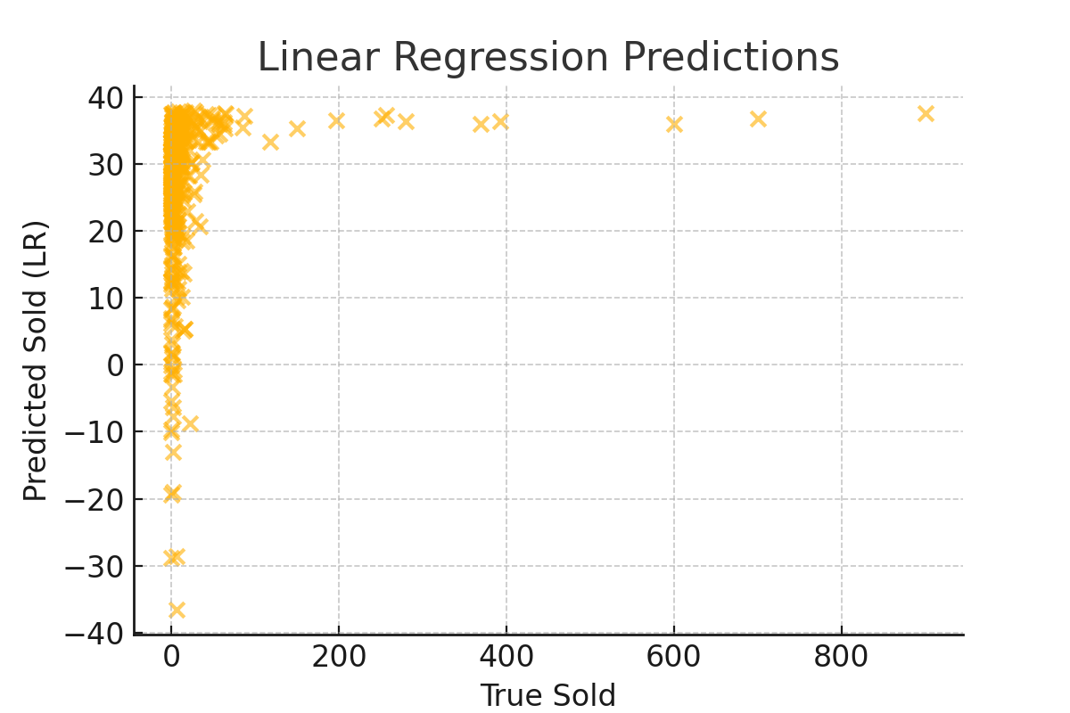
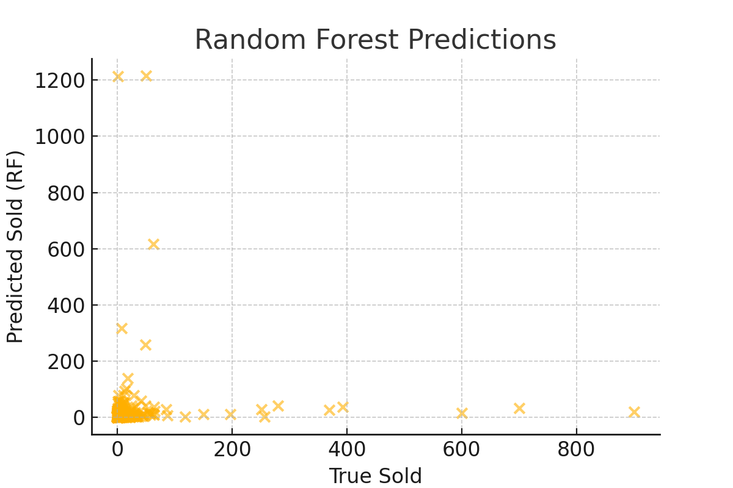
Linear Regression Vs Random Forest Predictions
Linear Regression-
the model captures linear trends but misses variance.
Random Forest-
better performance in capturing complex trends.

Slide 18
Model Performance
Linear Regression → MSE = 5398.36, R² = 0.016
Random Forest → MSE = 13622.44, R² = -1.484

Slide 19
5. Stream lit Dashboard
Dataset Page → Upload or preview dataset with basic cleaning
EDA Page → Interactive charts: distribution plots, scatter plots, tag frequency analysis
Model Training Page → Train Linear Regression or Random Forest, show evaluation metrics, learning curves
SQL Queries Page → Run custom queries and visualize results (e.g., top products, shipping tag sales)
Export Page → Download metrics, predictions, and cleaned dataset in Excel or push results to MySQL

Slide 20
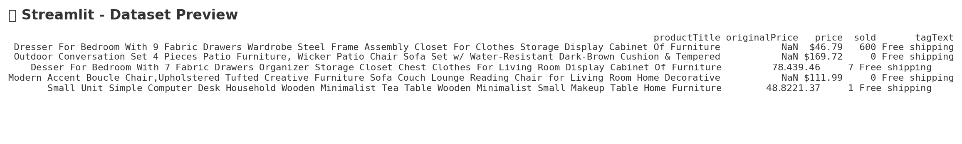
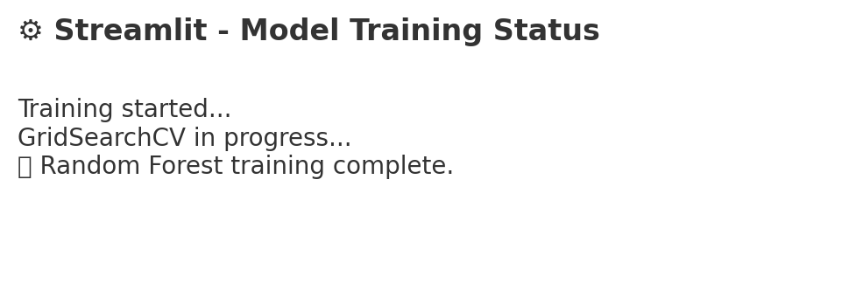
Stream lit Dashboards Visualization

Slide 21
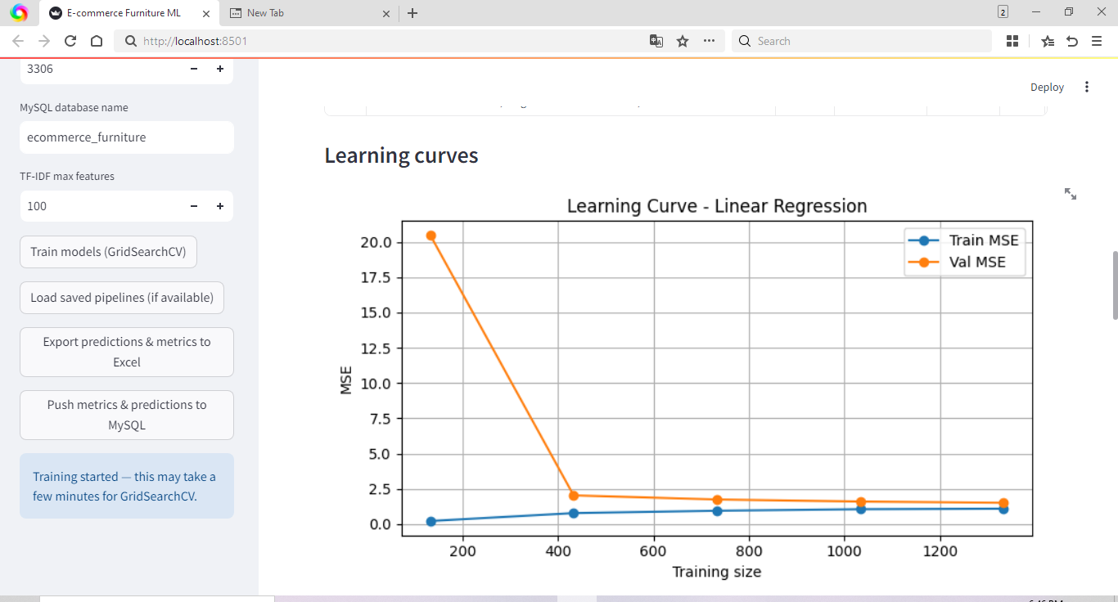
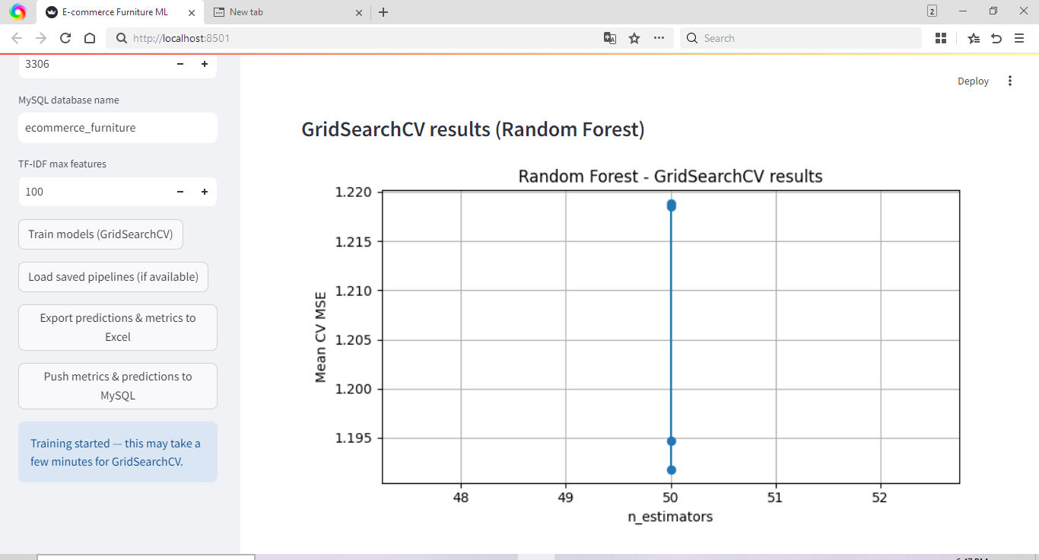
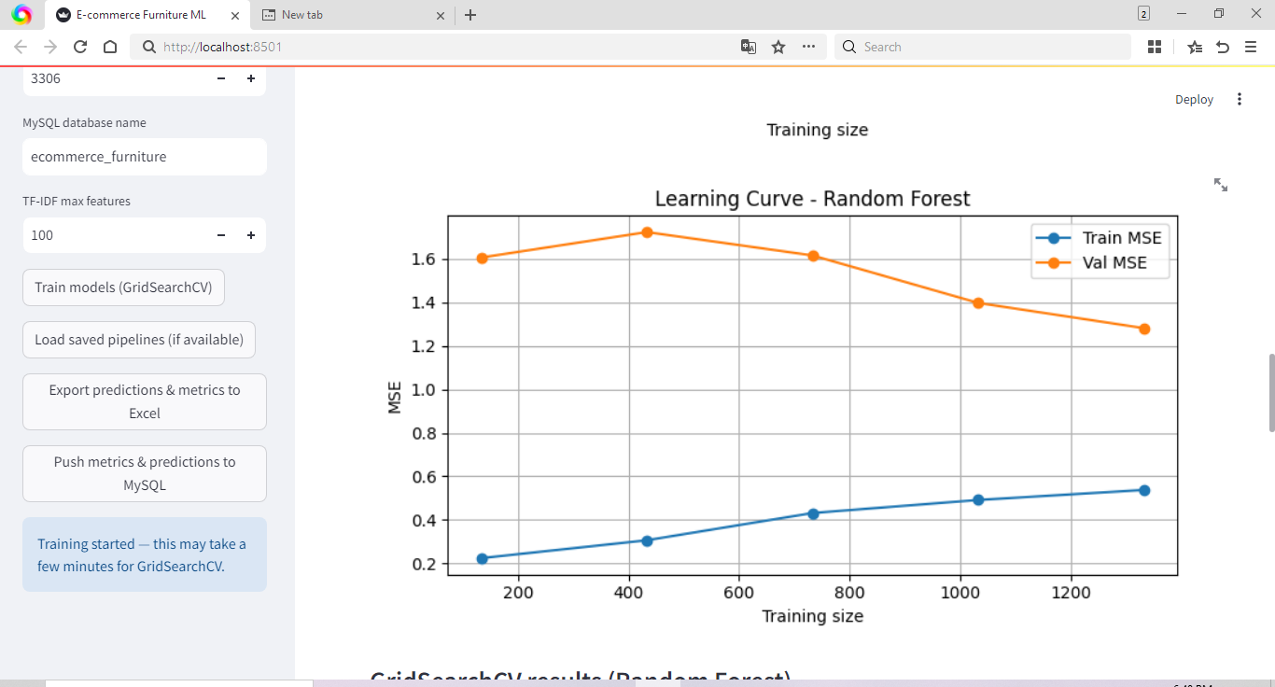
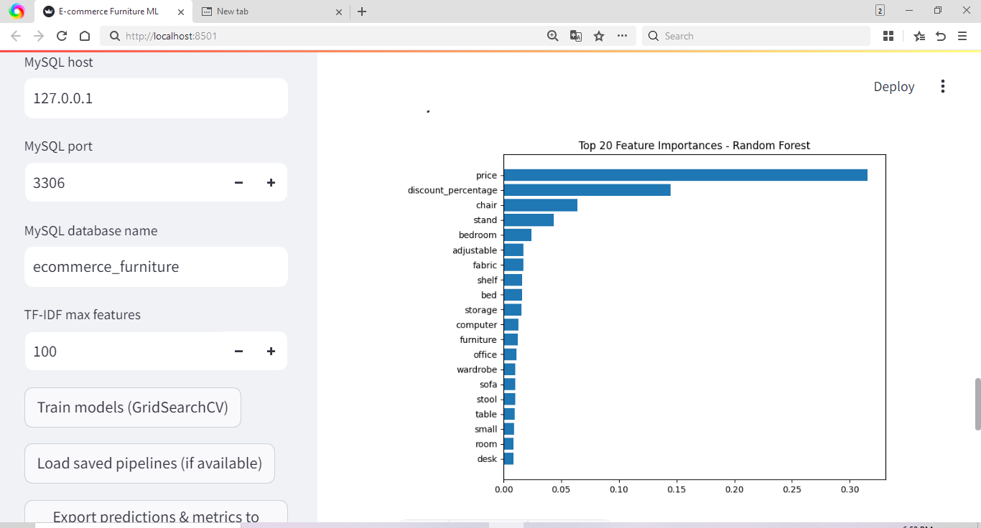
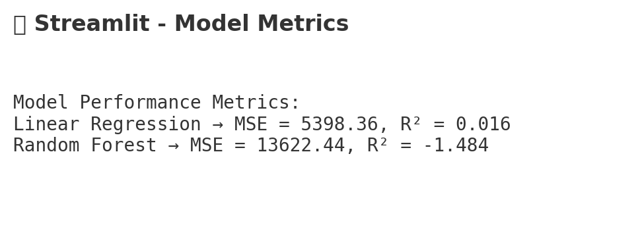

Slide 22
Conclusion
• End-to-end pipeline from preprocessing to deployment
• Random Forest outperformed Linear Regression
• Discounts and shipping tags significantly impact sales
• Stream lit app enables interactive ML and analytics

Slide 23
References
Dataset: C:/Users/Hp/OneDrive/Desktop/python/ECommerce_Furniture_Dataset/ecommerce_furniture_dataset_2024.csv
GitHub Project:
https://github.com/abhi-1009/E-commerce-Furniture-Dataset-2024

Slide 24
THANK YOU

