Slide 1
IBM HR Analytics Employee Attrition & Performance
Submitted by: ABHIJIT SINHA
Email: sinhaabhijit12@yahoo.com
UNID: UMID08062541597

Slide 2
Project Overview
This project analyses the IBM HR Analytics Employee Attrition & Performance Dataset to uncover key factors influencing employee attrition.
The analysis includes data cleaning, SQL queries, exploratory data analysis (EDA), machine learning modelling, and an interactive Stream lit dashboard.

Slide 3
Dataset Description
Source: IBM HR Analytics dataset (fictional dataset created by IBM data scientists).
Rows: 1470 employees
Columns: 35 features (demographics, job satisfaction, income, work-life balance, etc.)
Target Variable: Attrition (Yes/No)

Slide 4
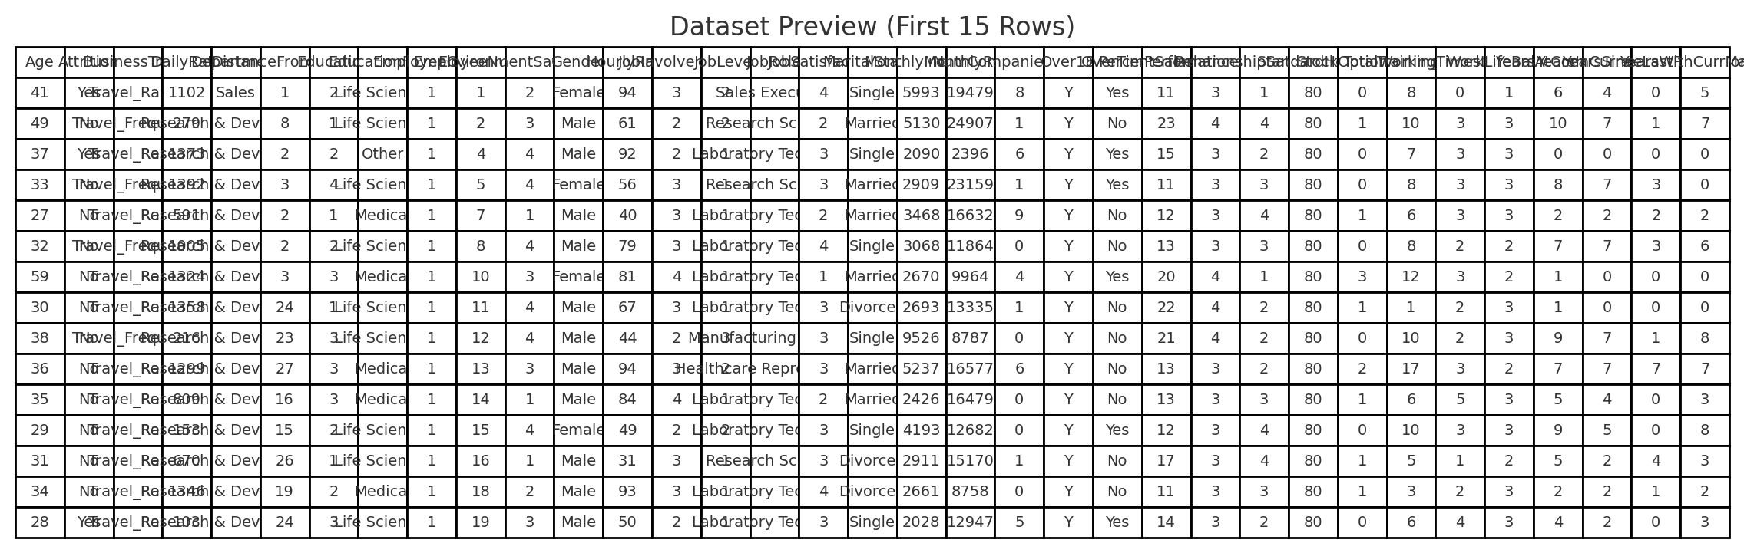

Slide 5
Technology Stack
Python (pandas, NumPy, matplotlib, seaborn, scikit-learn)
SQL (MySQL) – to query attrition by department, gender, etc.
Machine Learning Models: Logistic Regression, Decision Tree, Random Forest, Gradient Boosting
Stream lit – Interactive dashboard for visualization & prediction
Excel Export – Business-friendly reports

Slide 6
Project Workflow and Implementation Steps
1.Data Preprocessing
Dropped irrelevant columns (`Employee Count`, `Employee Number`,
`Standard Hours`, `Over18`)
Checked for missing values (none found)
Encoded categorical variables using Label Encoding
Scaled numerical features with `Standard Scaler`

Slide 7
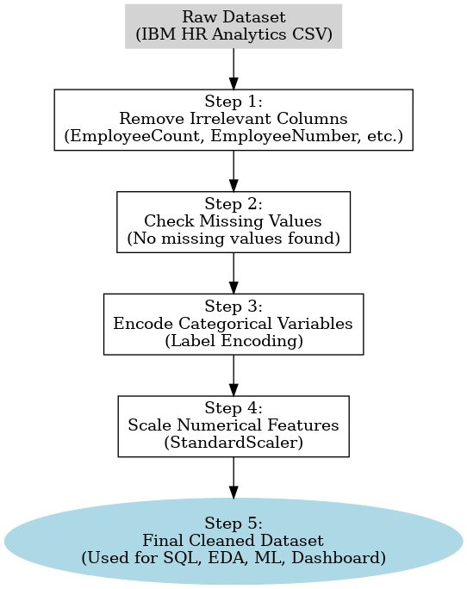

Slide 8
2. Exploratory Data Analysis
Attrition Distribution — About 16% of employees have left the company, indicating a moderate attrition rate.
Correlation Heatmap — Reveals relationships between features, highlighting key dependencies like Job Satisfaction, Monthly Income, and Over Time.
Attrition by Department — Highlights that attrition is highest in Sales, followed by Human Resources.

Slide 9
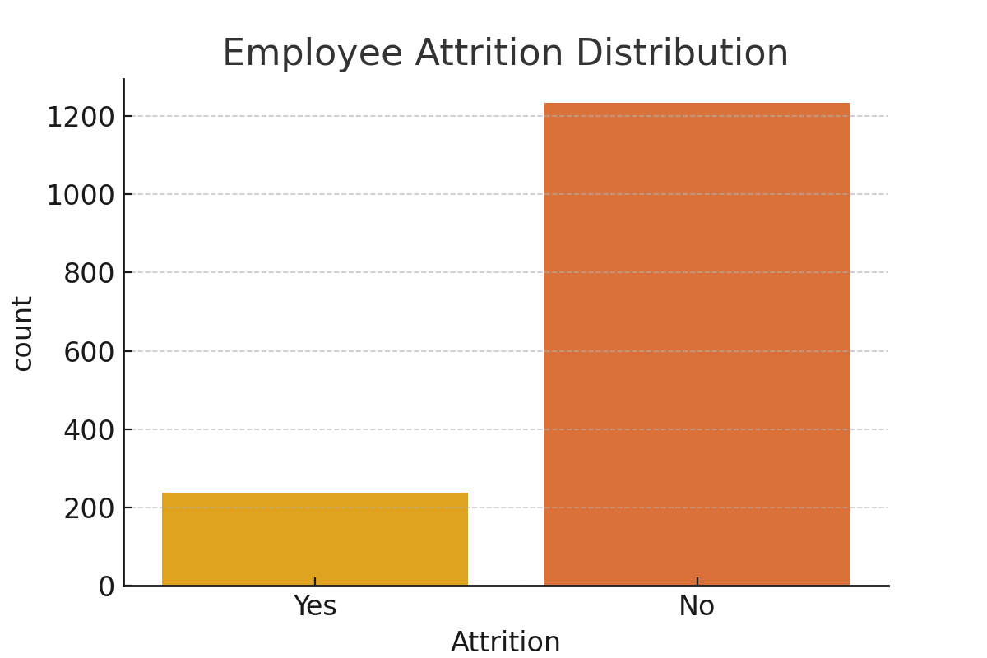
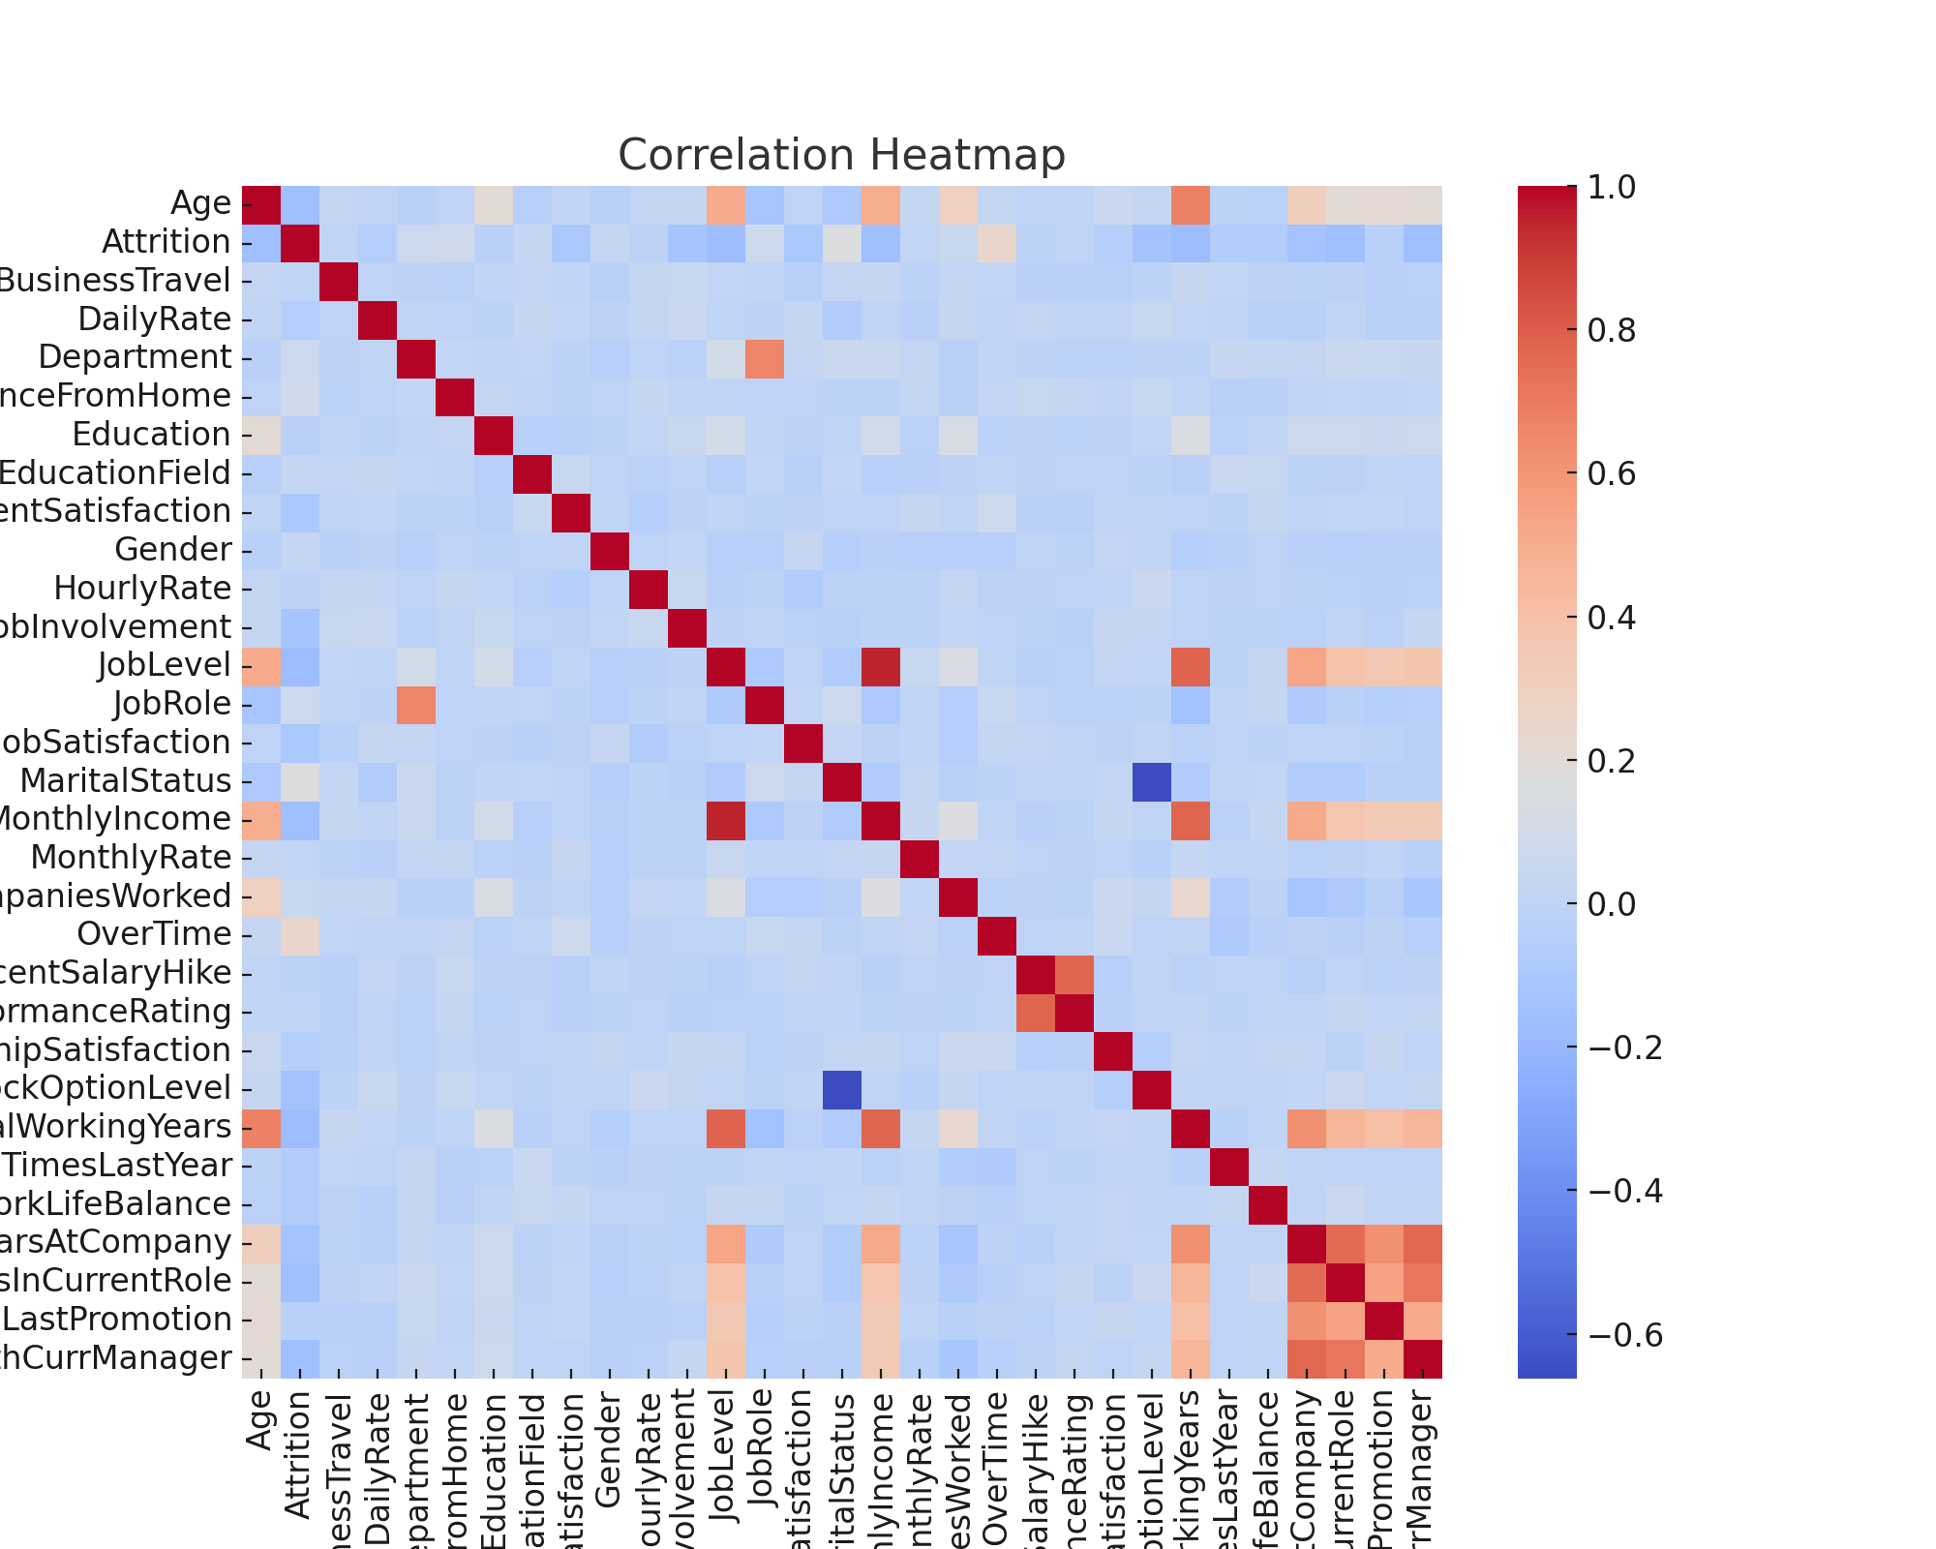
Exploratory Data Analysis charts

Slide 10
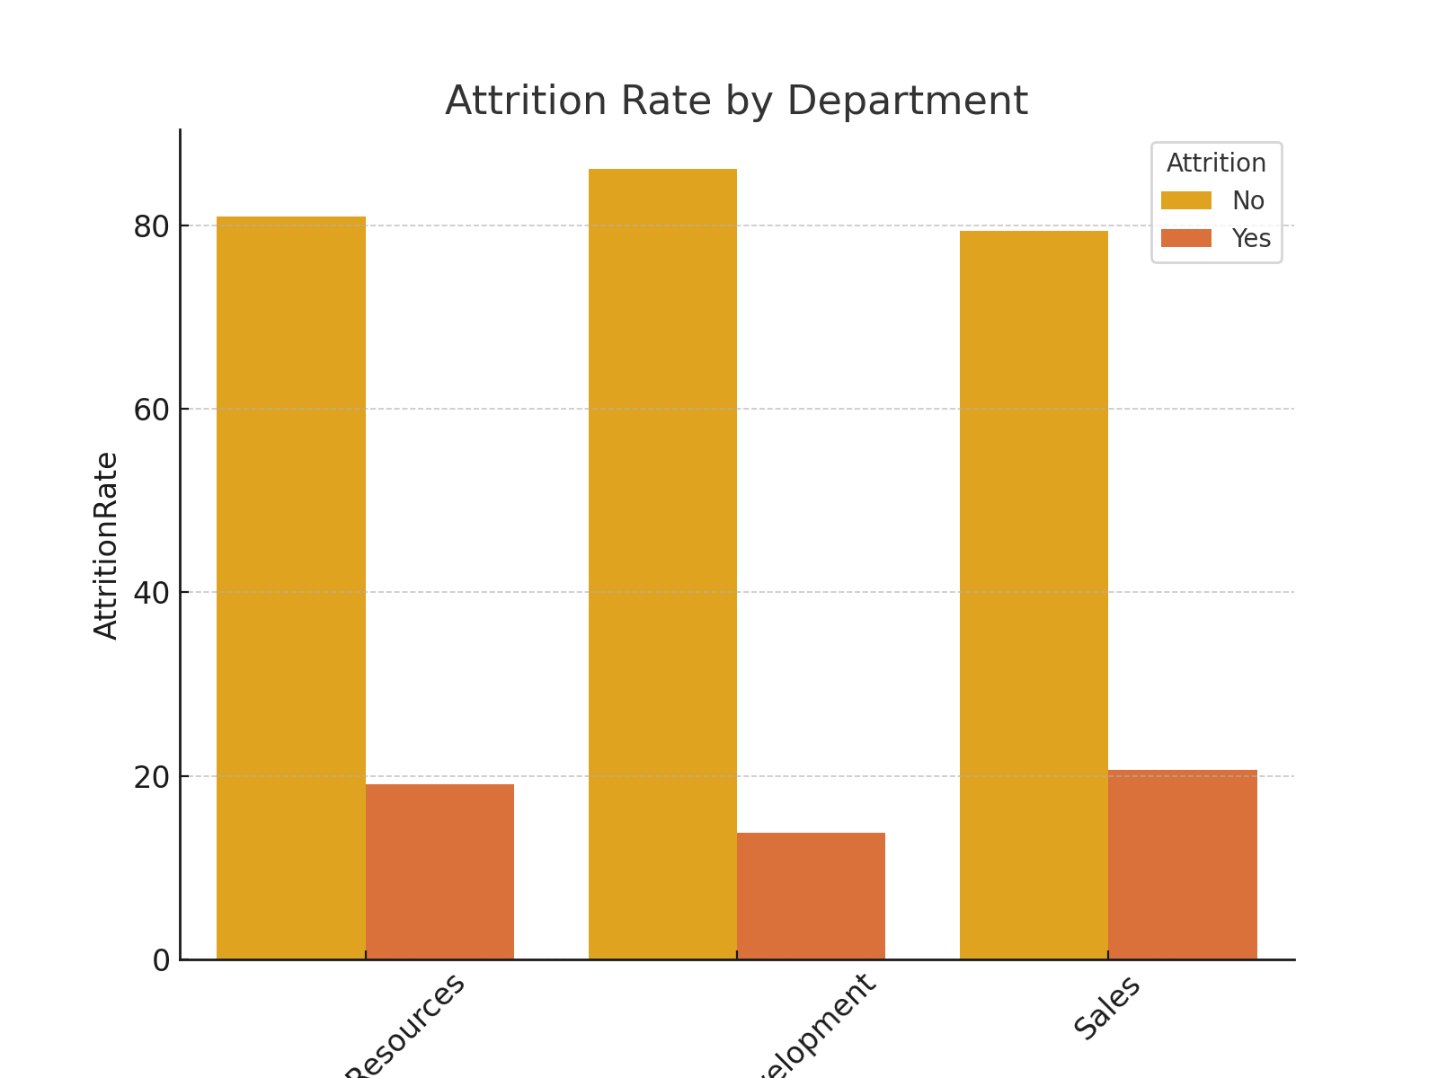

Slide 11
3. SQL Queries
Overall Attrition Rate
Attrition by Department
Attrition by Gender

Slide 12
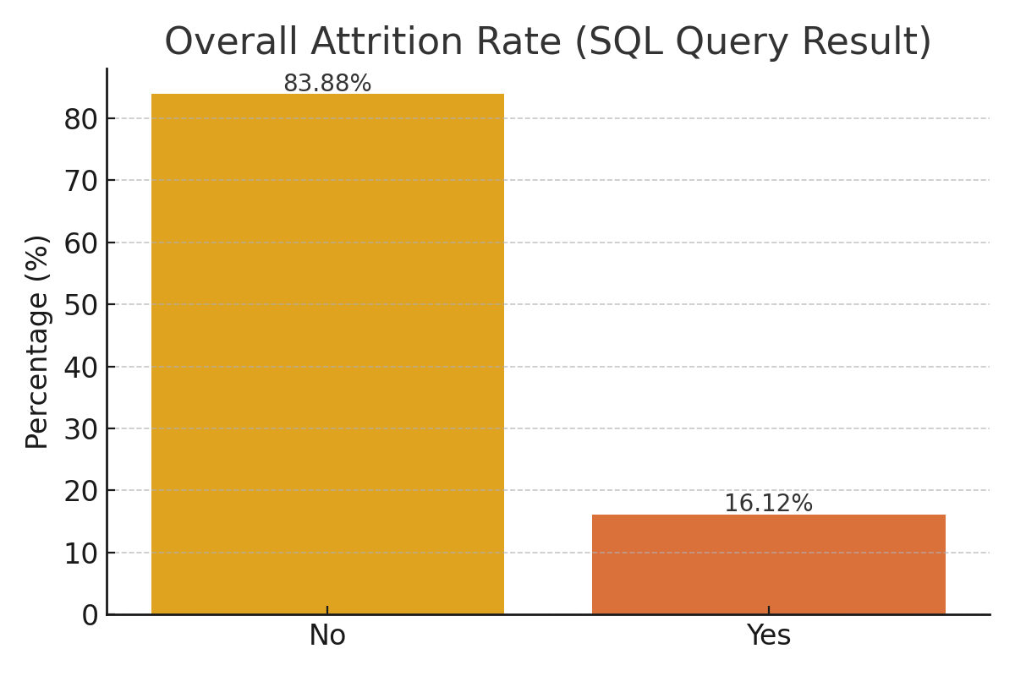
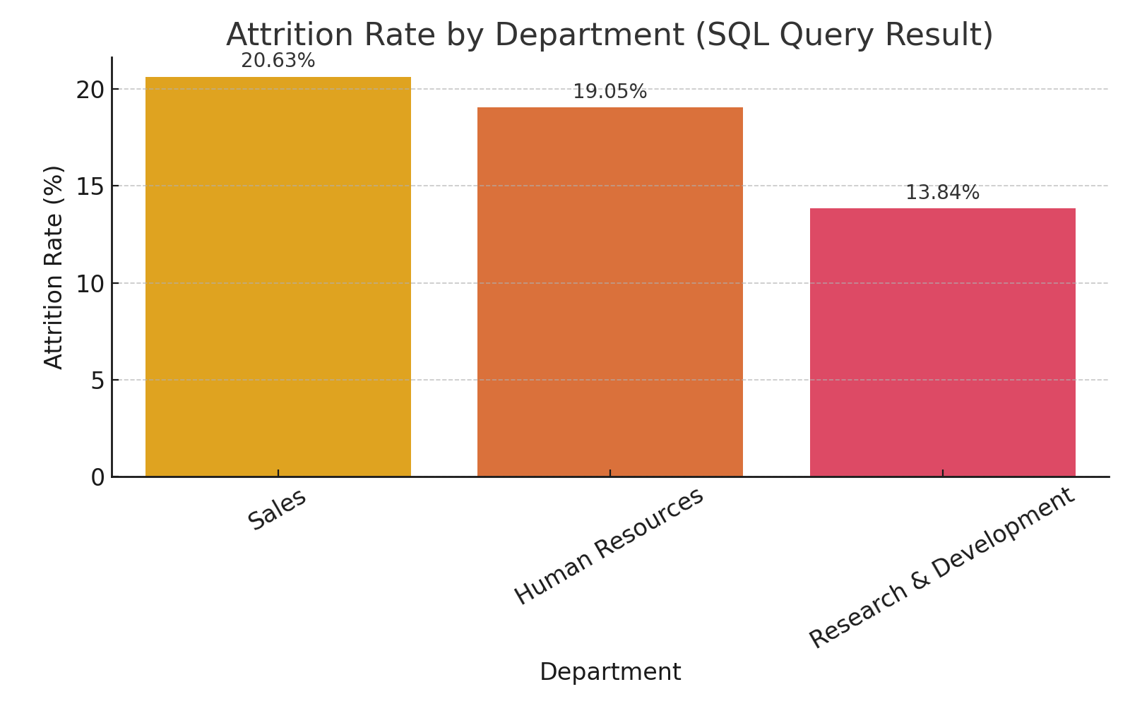
SQL Query Charts

Slide 13
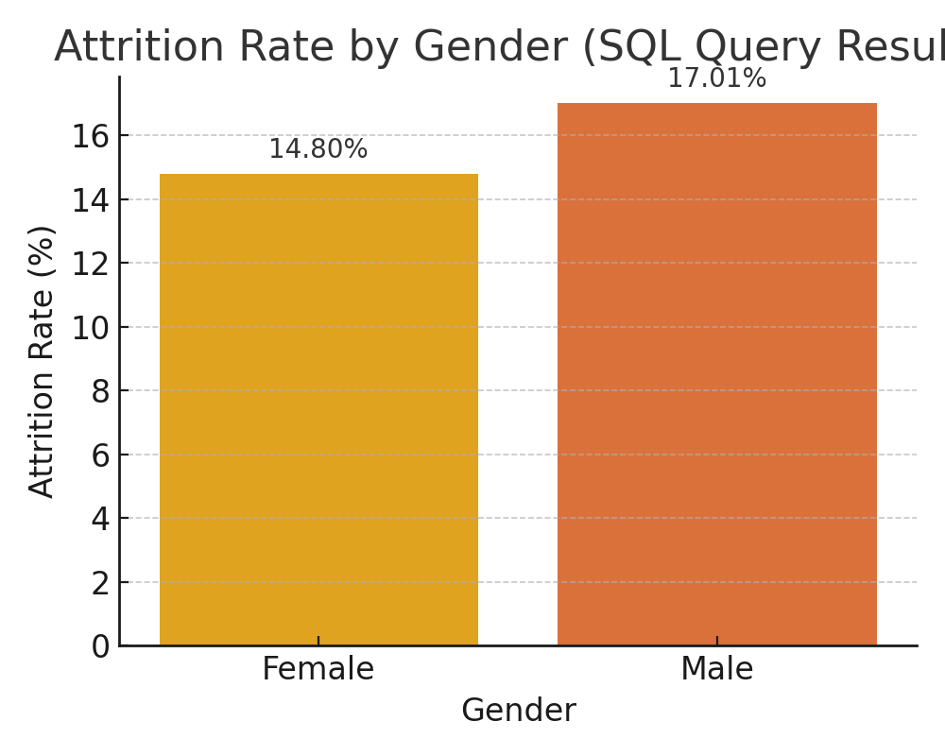

Slide 14
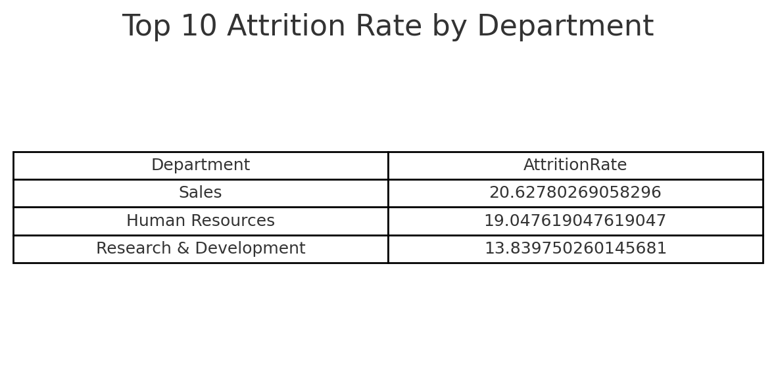
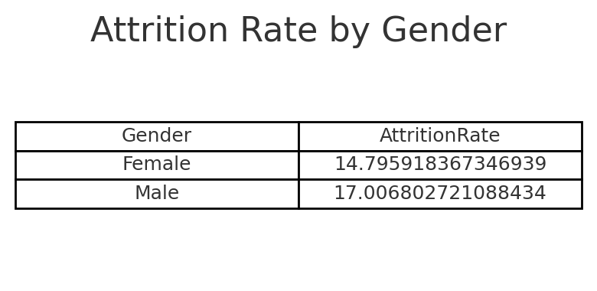
SQL Query Tables

Slide 15
4. Machine Learning Models
Logistic Regression
Decision Tree
Random Forest (Best performance)
Gradient Boosting
Random Forest provided the most reliable results. Feature importance showed Over Time, Monthly Income, Job Satisfaction, and Work Life Balance as key drivers.

Slide 16
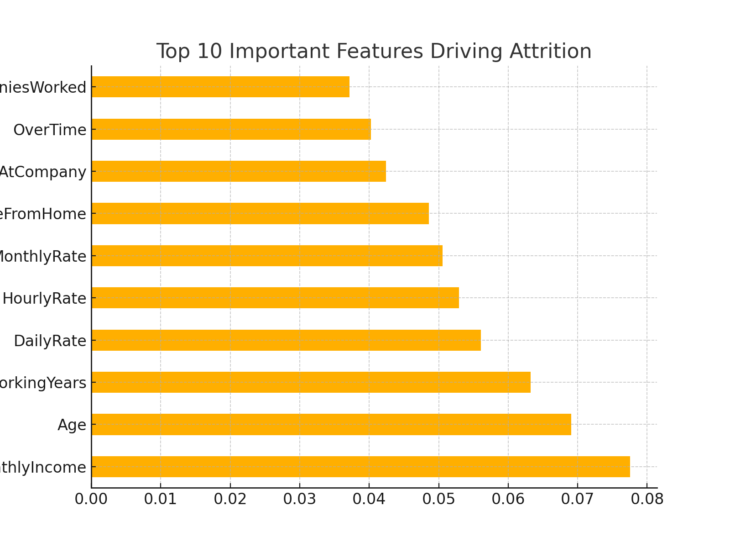
Machine Learning Models & Feature Importance

Slide 17
5. Stream lit Dashboard
Dataset Overview
Attrition Distribution & Correlation Heatmap
Attrition by Department (interactive)
Model Accuracy Comparison
Predict Attrition for a New Employee (user input form)

Slide 18
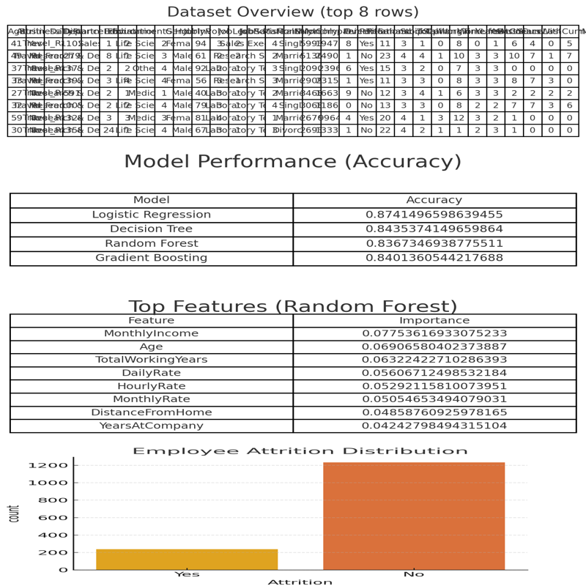
Stream lit Dashboard Screenshots

Slide 19
Results and Insights
Attrition Rate: ~16% of employees left the company.
Key Drivers of Attrition: Overtime, low Job Satisfaction, low Monthly Income, poor Work-Life Balance.
Model Accuracy: Random Forest & Gradient Boosting performed the best.
Stream lit Dashboard: Provided HR teams with interactive tools for analysis and prediction.

Slide 20
Conclusion
The analysis of the IBM HR Analytics dataset revealed key insights:
• Attrition rate is around 16%, with Sales and HR departments showing the highest rates.
• Key factors influencing attrition include Over Time, Job Satisfaction, Monthly Income, and Work Life Balance.
• Random Forest and Gradient Boosting were the most effective predictive models.
• The Streamlit dashboard provides HR professionals with an interactive tool to monitor attrition risk and explore employee data.
Overall, this project demonstrates the integration of SQL, EDA, ML models, and dashboards to derive actionable insights for employee retention strategies.

Slide 21
References
Dataset: C:/Users/Hp/OneDrive/Desktop/python/IBMHRANALYTICS/WA_Fn-UseC_-HR-Employee-Attrition.csv
GitHub Project: https://github.com/abhi-1009/IBM-HR-Analytics-Employee-Attrition-Performance

Slide 22
THANK YOU

