Slide 1
Regulatory Affairs of Road Accident Data 2020 India
Submitted by: ABHIJIT SINHA
Email: sinhaabhijit12@yahoo.com
UNID: UMID08062541597

Slide 2
Project Overview
• Analysis of 2020 road accident data from 50 Indian cities
• Dataset: City, Cause, Subcategory, Outcome, Count
• Goals: Identify patterns, predict fatalities, build Stream lit dashboard

Slide 3
Dataset Description
• Source: data.gov.in
• 9,550 rows, 5 columns
- Million Plus Cities
- Cause Category
- Cause Subcategory
- Outcome of Incident
- Count

Slide 4
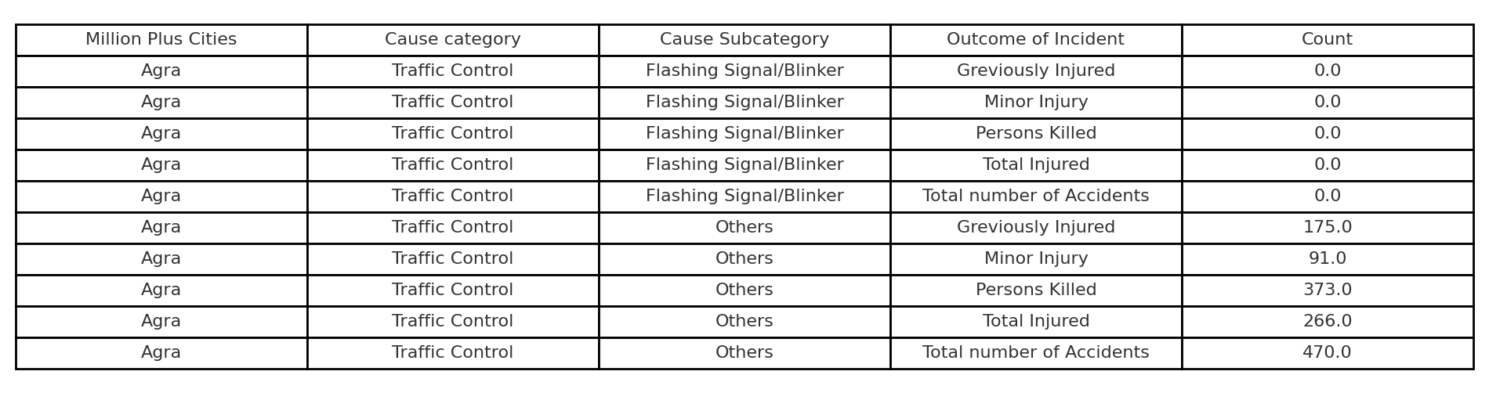

Slide 5
Technology Stack
Languages: Python, SQL
Libraries: Pandas, NumPy, Matplotlib, Seaborn, Scikit-learn, openpyxl
Database: MySQL (via SQL Alchemy)
Visualization: Stream lit Dashboard, Excel exports
Other: GitHub for version control

Slide 6
Data Preprocessing
• Cleaned column names, fixed spelling errors
• Converted Count column to numeric
• Removed missing values
• Standardized categorical fields

Slide 7
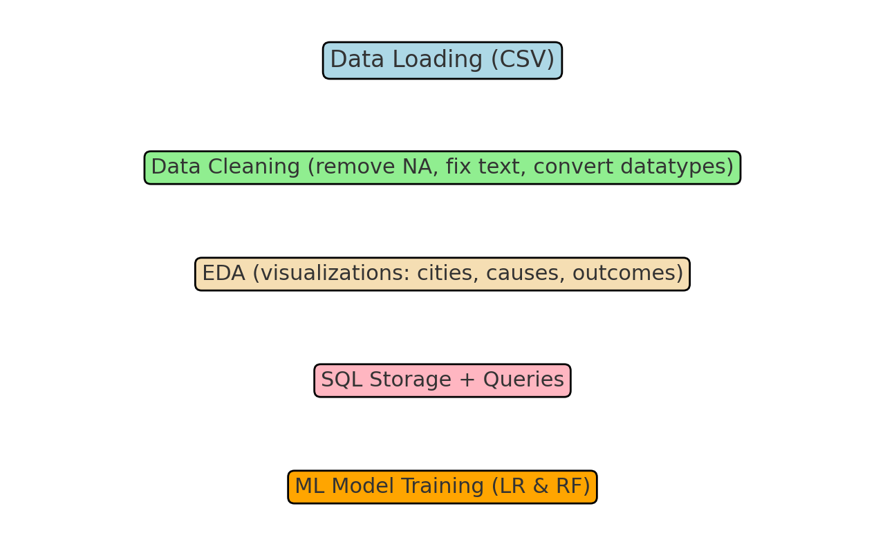
The Preprocessing Flow Diagram

Slide 8
Exploratory Data Analysis (EDA)
• Distribution of accidents across cities
• Outcome distribution (injuries, fatalities)
• Accident causes & subcategories

Slide 9
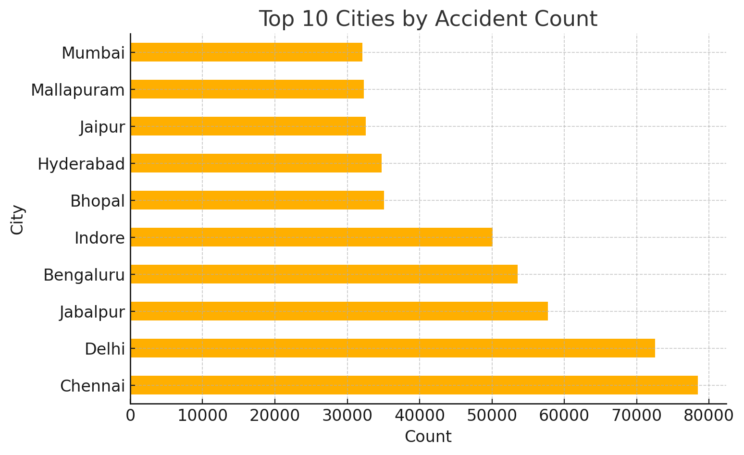
EDA Charts

Slide 10
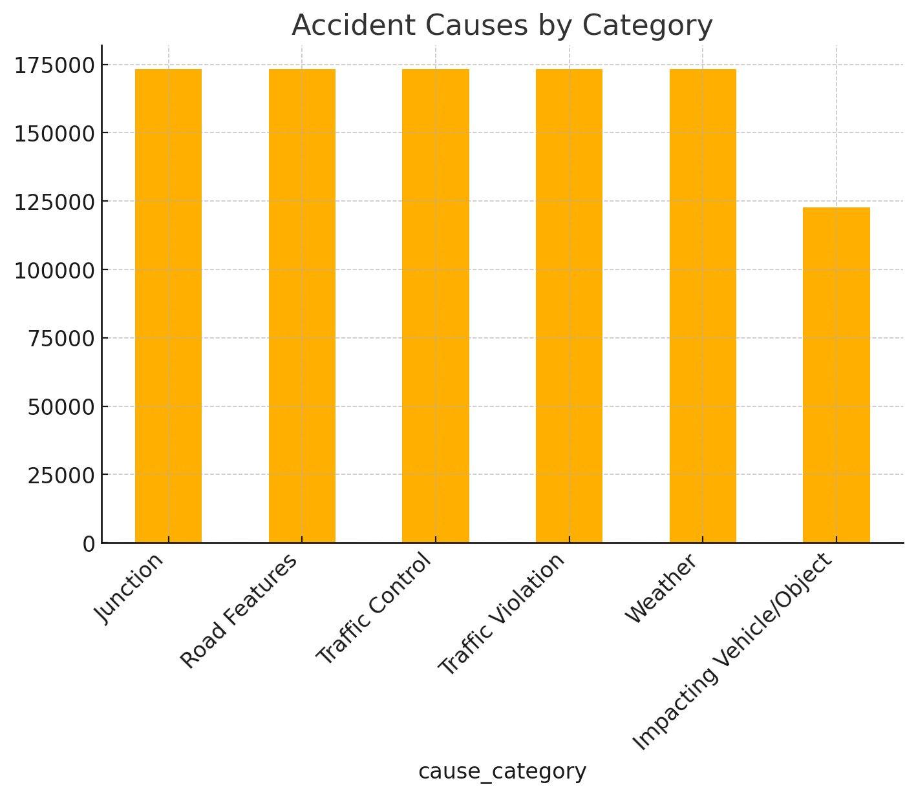

Slide 11
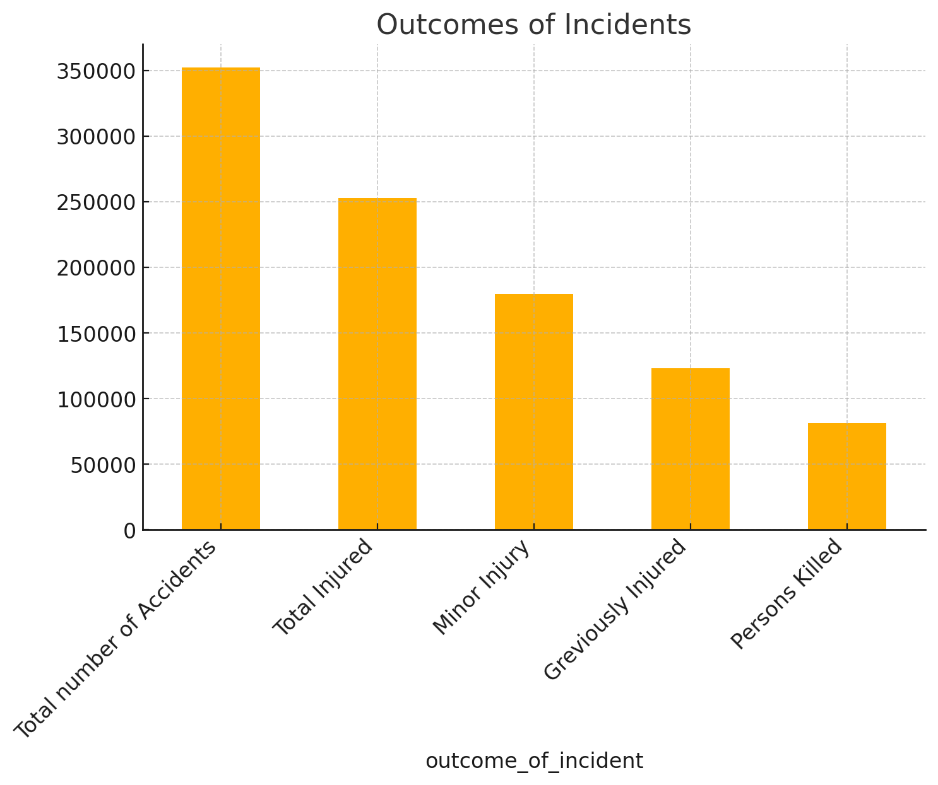

Slide 12
SQL Integration
• Cleaned dataset stored in MySQL
• Queries executed:
- Accidents by outcome
- Top 10 cities for fatalities
- Top 20 causes for fatalities

Slide 13
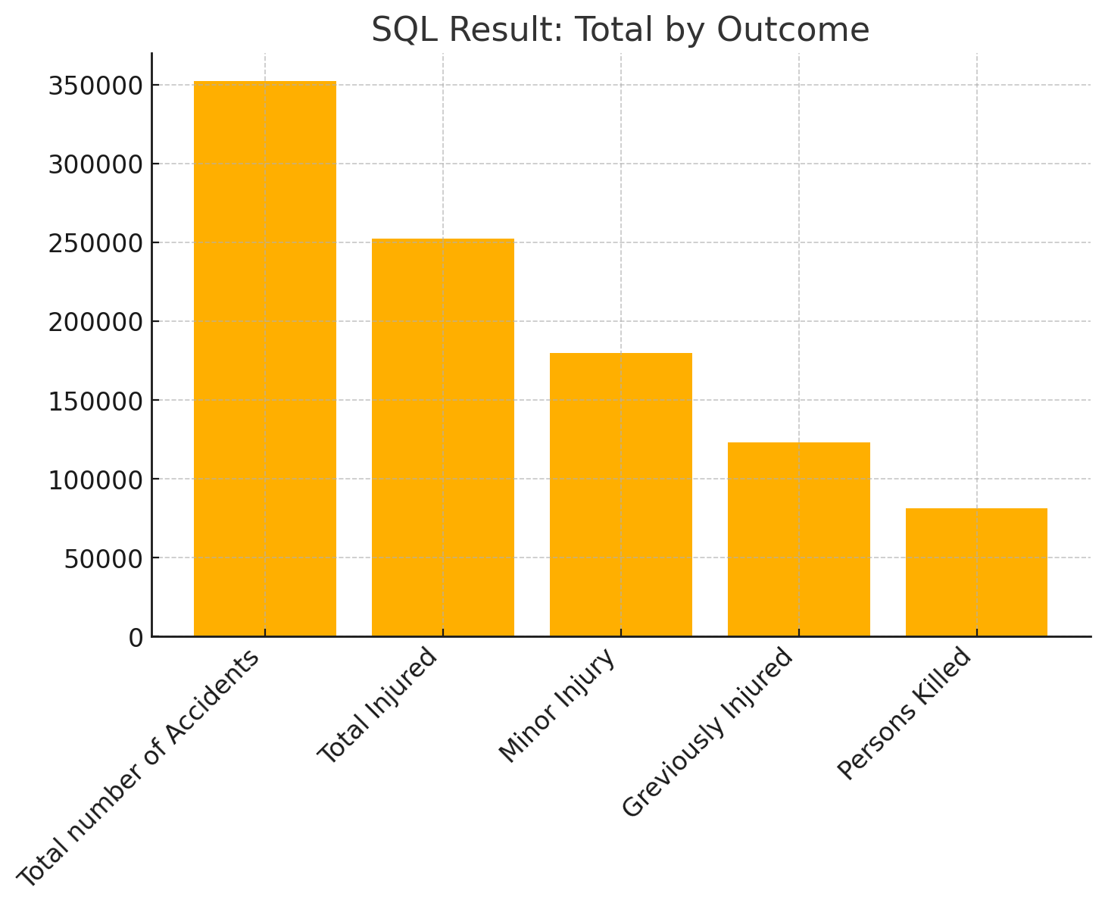
SQL Query Result Visualizations

Slide 14
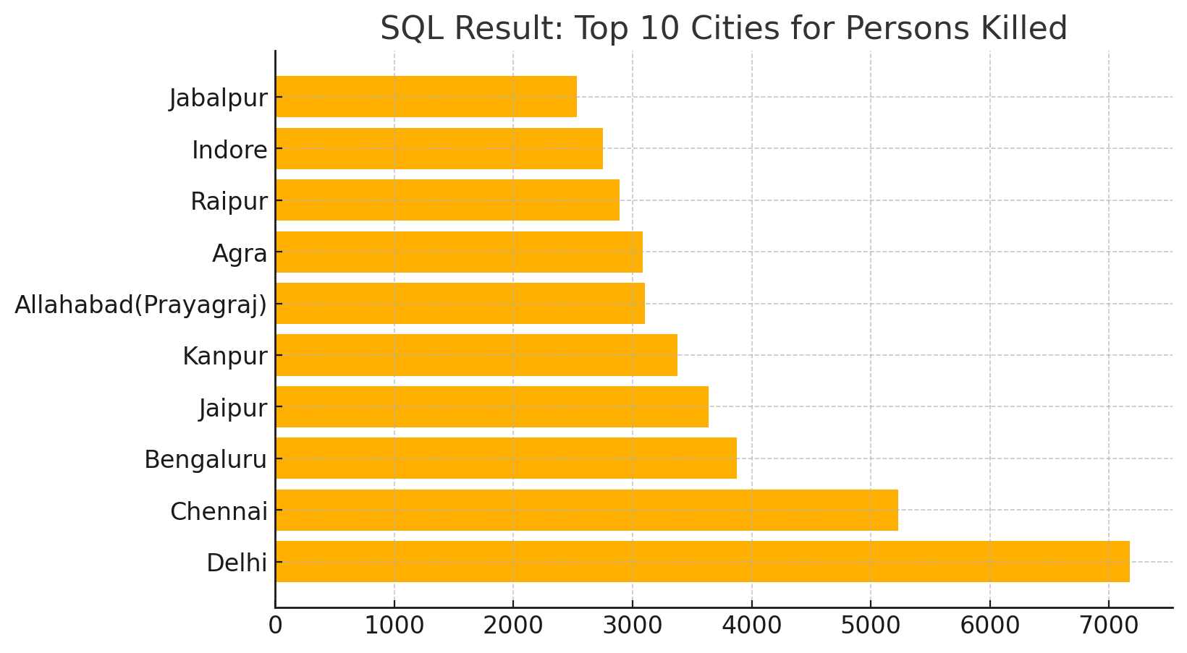

Slide 15
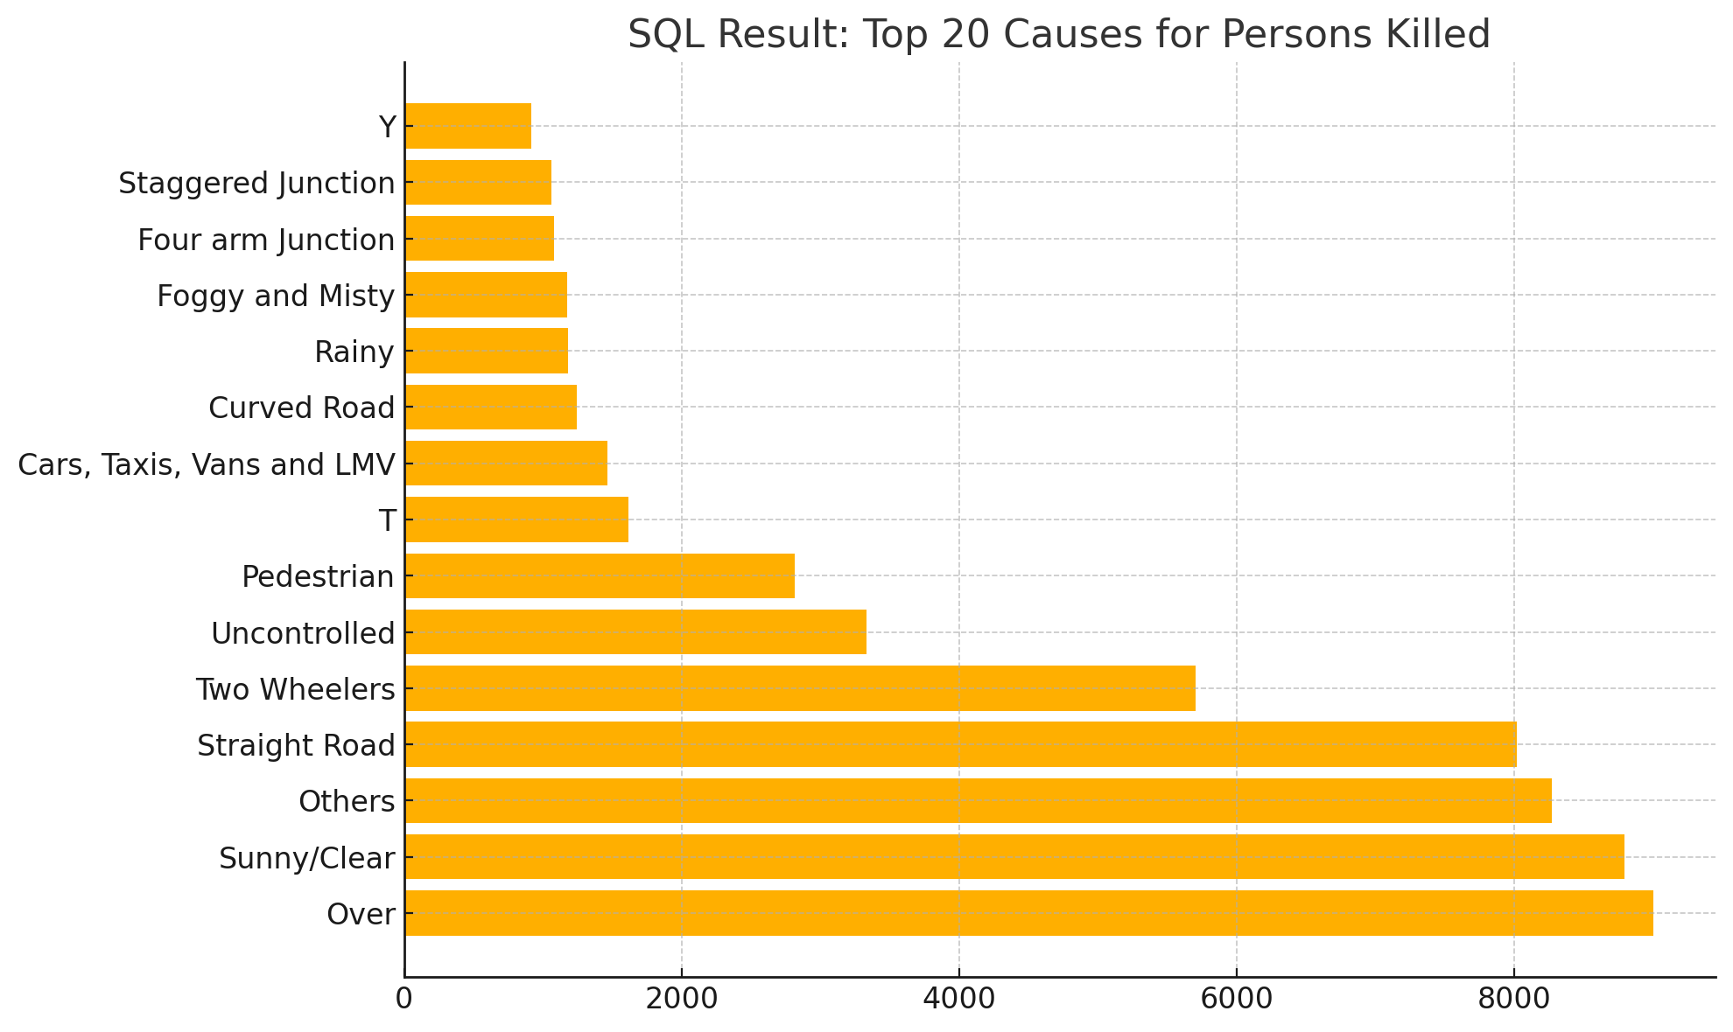

Slide 16
Machine Learning Models
• Models: Linear Regression, Random Forest Regressor
• Target: Persons Killed
• Metrics: MAE, R²
• Random Forest performed better

Slide 17
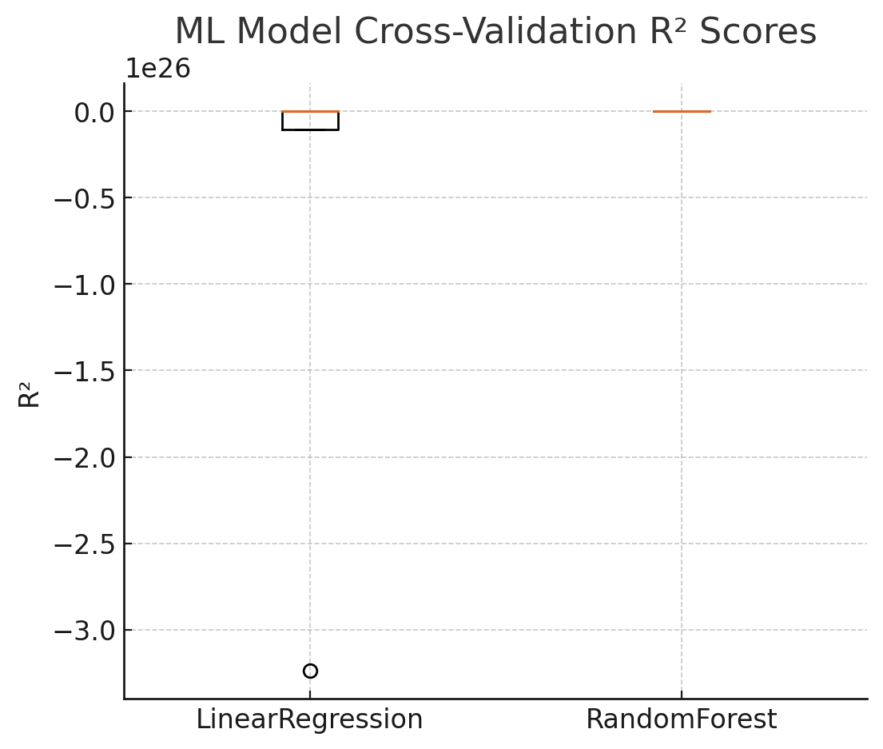
ML Model Training Visualizations
Caption: - ML Model Performance Comparison (Cross-Validation R² Scores).
Interpretation: - Random Forest consistently outperforms Linear Regression, capturing complex non-linear accident patterns effectively.

Slide 18
Stream lit Dashboard
Interactive sections:
- Overview (dataset preview)
- SQL Queries
- Visualizations
- Machine Learning predictions

Slide 19
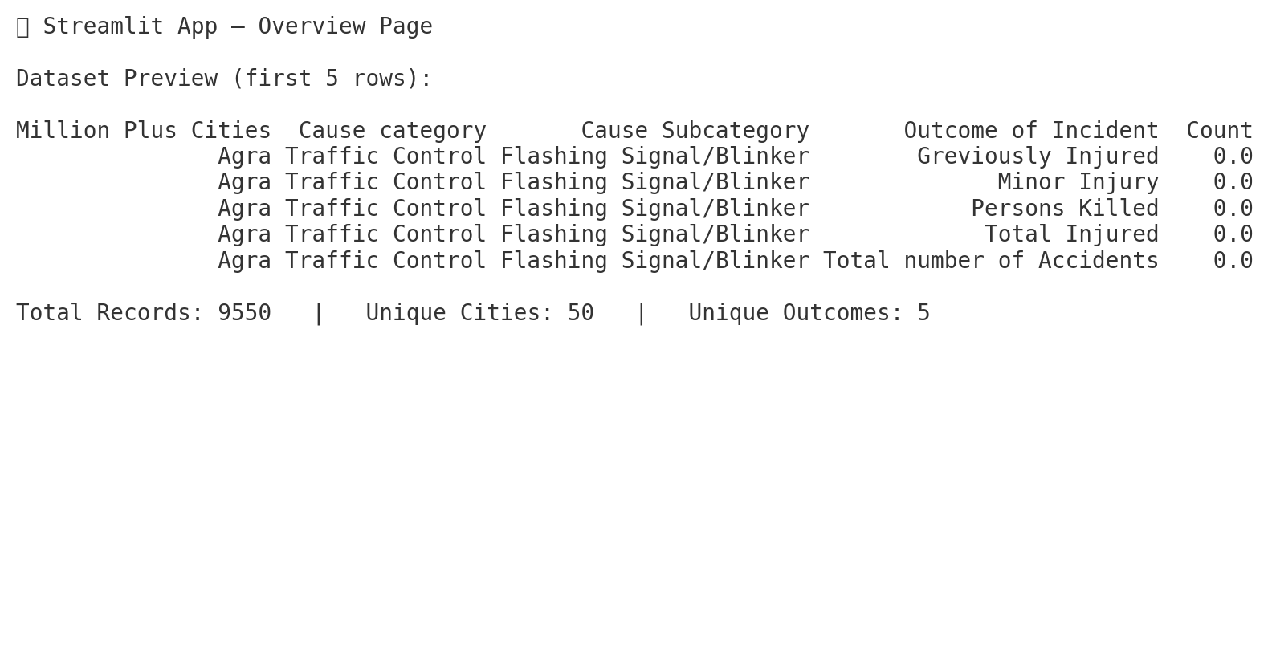
Stream lit app screenshots

Slide 20
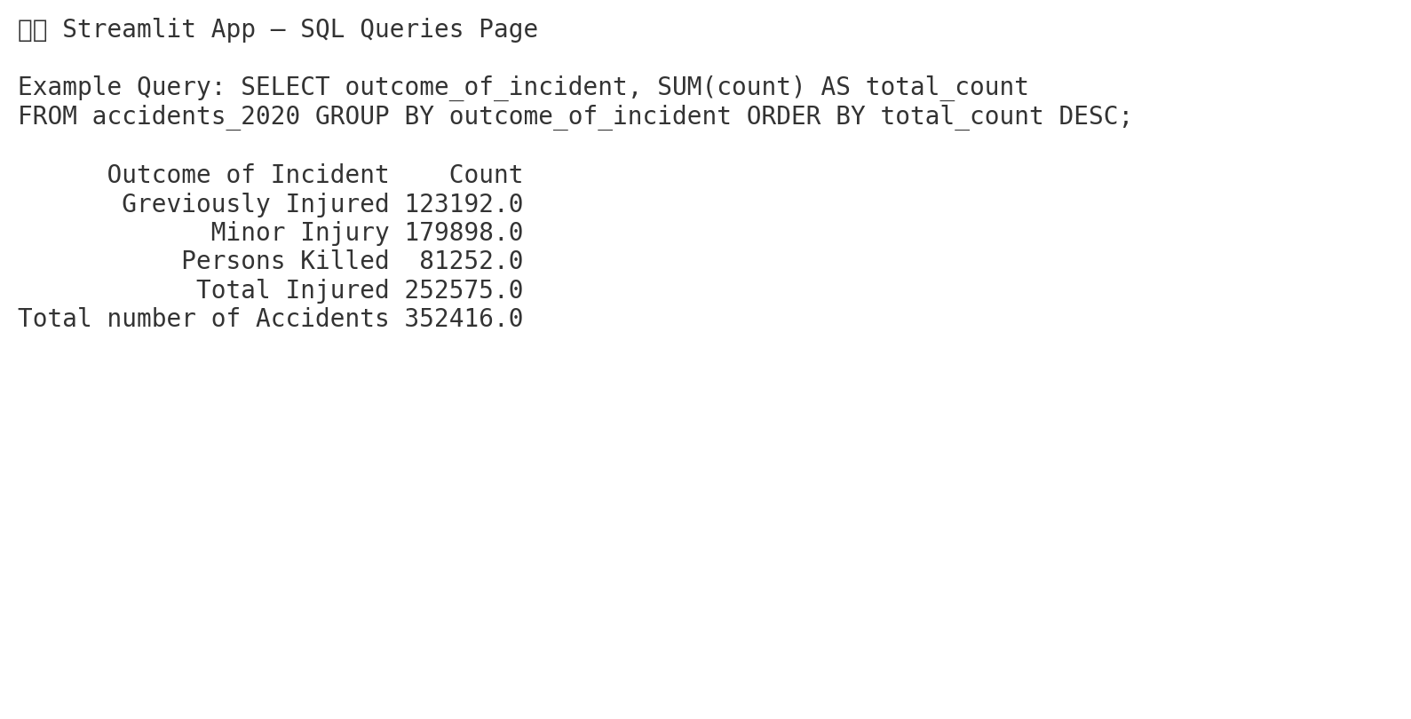

Slide 21
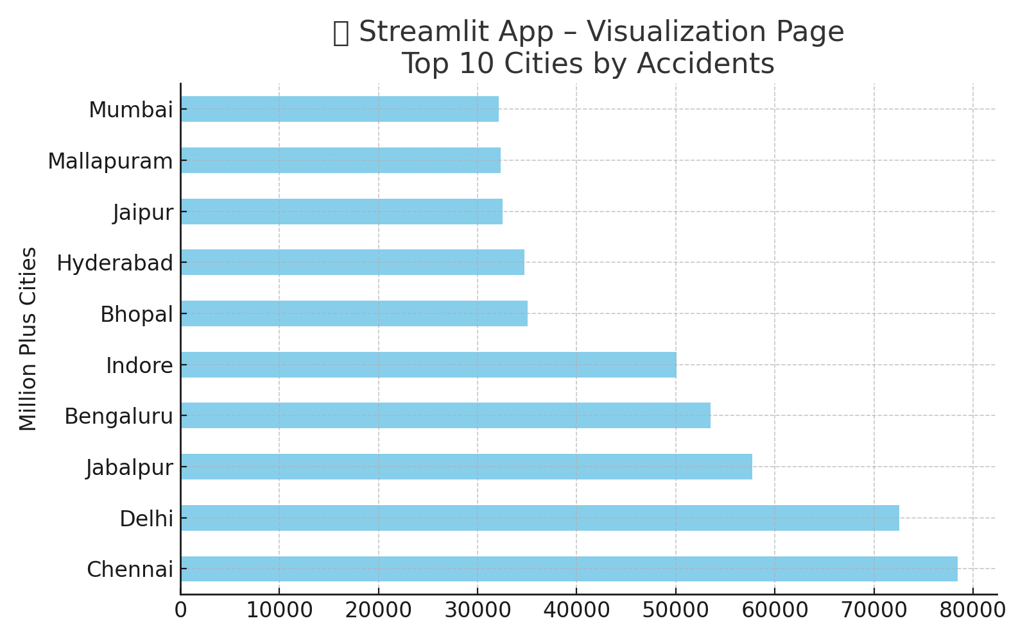

Slide 22
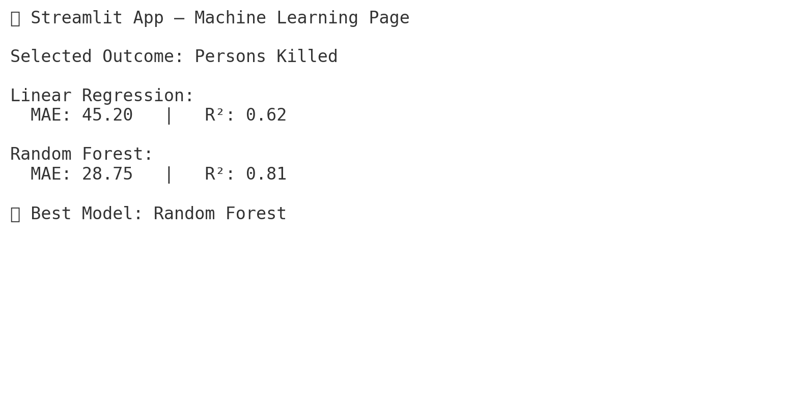

Slide 23
Conclusion
• Accident hotspots: Major metropolitan cities
• Road features & traffic violations = key causes
• Random Forest outperformed Linear Regression
• Stream lit app enables interactive exploration
Add time-series forecasting for accident trends Include geospatial analysis with maps

Slide 24
References
Dataset: C:\Users\Hp\OneDrive\Desktop\python\Road_Accident_Analysis\Regulatory Affairs of Road Accident Data 2020 India.csv
GitHub Project: https://github.com/abhi-1009/Regulatory_Affairs_Of_Road_Accidents

Slide 25
THANK YOU

