Slide 1
Sales Data Analysis and Reporting for a Retail Chain
Submitted by: ABHIJIT SINHA
Email: sinhaabhijit12@yahoo.com

Slide 2
Abstract
The main objective of this project is to analyze sales performance, identify high-value customers, study customer response patterns, and provide business recommendations using data analytics tools like
Python, SQL, Excel, EDA.

Slide 3
Technology Stack
Languages: Python, SQL.
Libraries: Pandas, NumPy, Matplotlib, Seaborn, SciPy.
Database: SQL(MySQL).
Visualization: Visual Studio Code.

Slide 4
Dataset Description
Source: Provided dataset (CSV) from Kaggle
Two datasets: Transaction dataset containing customer purchase records and Response dataset containing customer marketing response information.
The dataset contains retail transaction data including:
Customer ID
Transaction Date
Transaction Amount
Customer Response
Transaction Data and Customer Response Data merged using Customer ID.

Slide 5
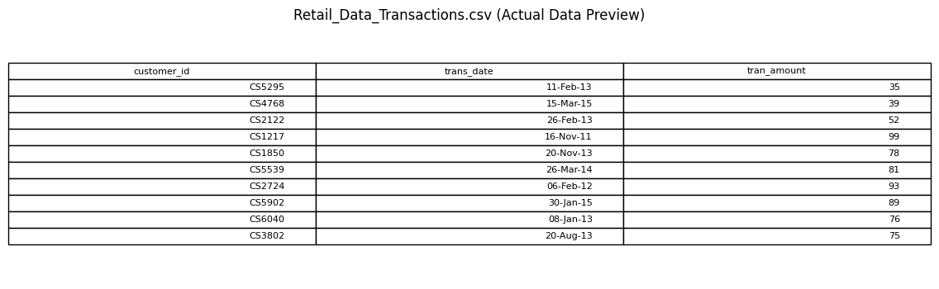
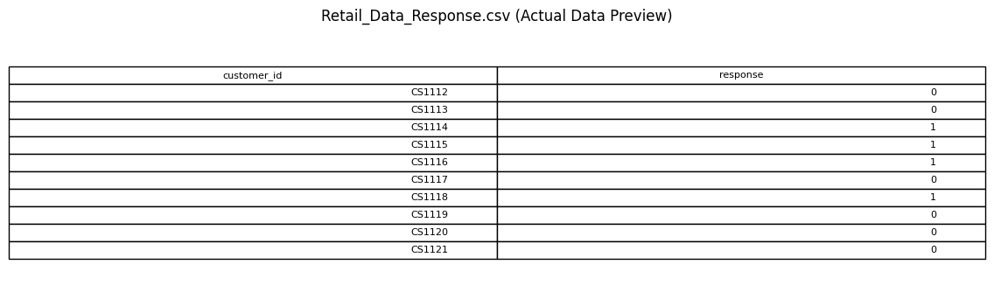
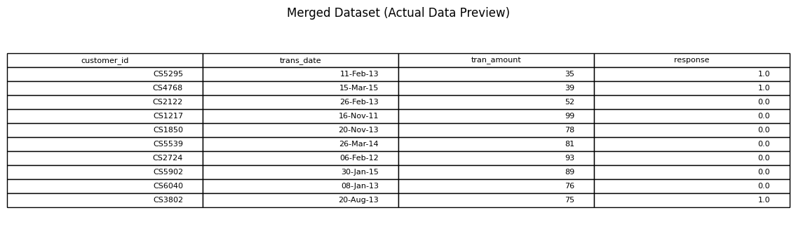
Dataset

Slide 6
Project Workflow and Implementation Steps
Phase 1: Data Collection and Database Setup
Downloaded dataset from Kaggle
Stored data in CSV format
Created database in MySQL
Created tables and loaded data

Slide 7
Phase 2: Data Cleaning and Preparation
Merged transaction and response datasets
Removed missing values
Converted data types
Created derived columns like year, month, and quarter
Checked and removed outliers

Slide 8
Phase 3: Data Analysis
Performed exploratory data analysis
Identified customer spending patterns
Analyzed customer response behavior
Studied transaction trends
Identified repeat customers and purchasing frequency patterns.
Segmented customers based on Recency, Frequency, and Monetary value.

Slide 9
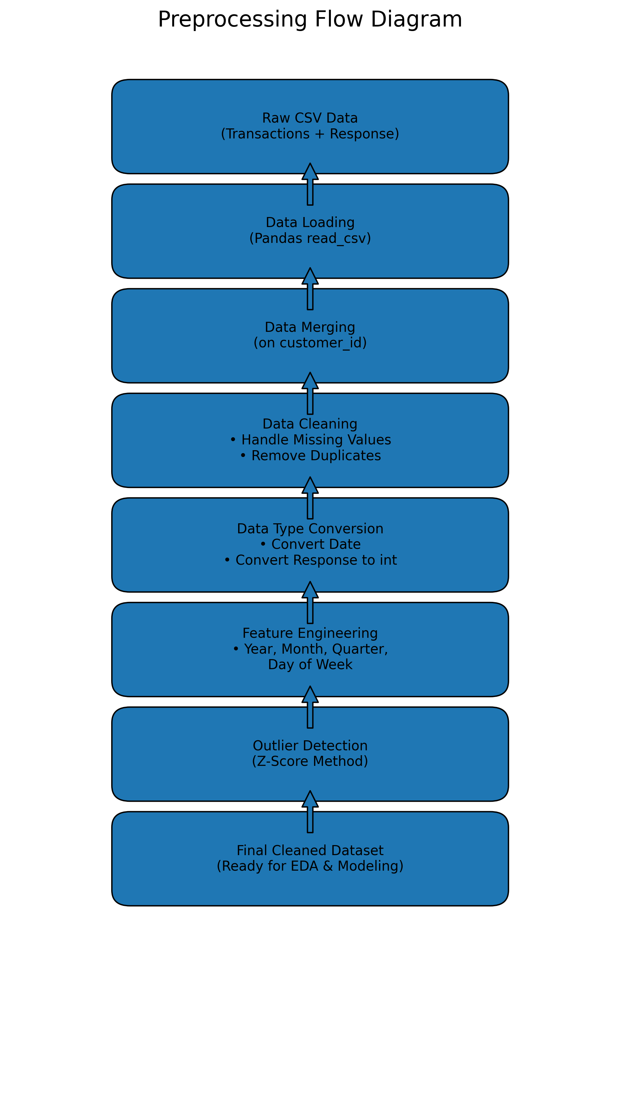

Slide 10
Key Findings Key Business Insights
Identified high value customers.
Observed response behavior patterns.
Detected outliers in transaction amounts.
Found transaction trend insights.
High-value customers contribute major revenue.
Focus on retention programs, targeted marketing, and seasonal inventory planning.

Slide 11
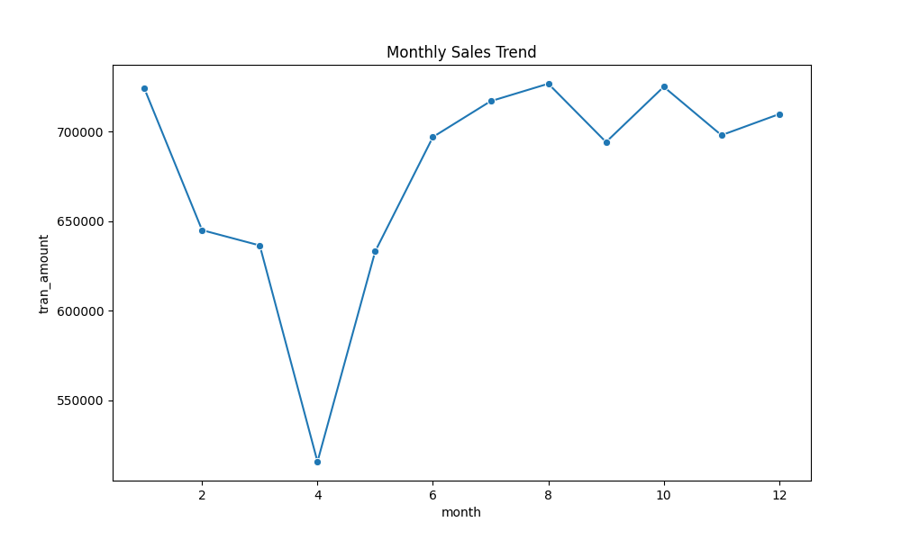
EDA CHARTS
Monthly Sales Trend
Identifies peak months

Slide 12
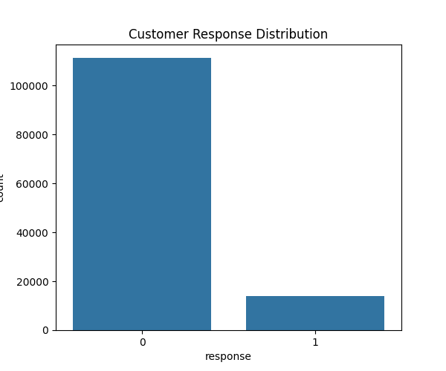
Customer Response Analysis
Marketing campaigns should be refined to improve customer participation and conversion rates.

Slide 13
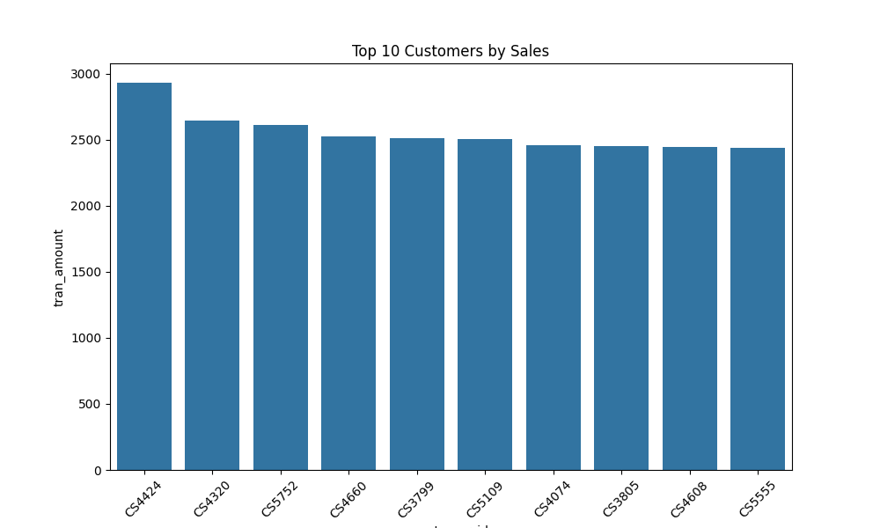
Top Customers Analysis
Retention strategies, loyalty programs, and personalized offers should be targeted toward high-value customers to maximize revenue growth.

Slide 14
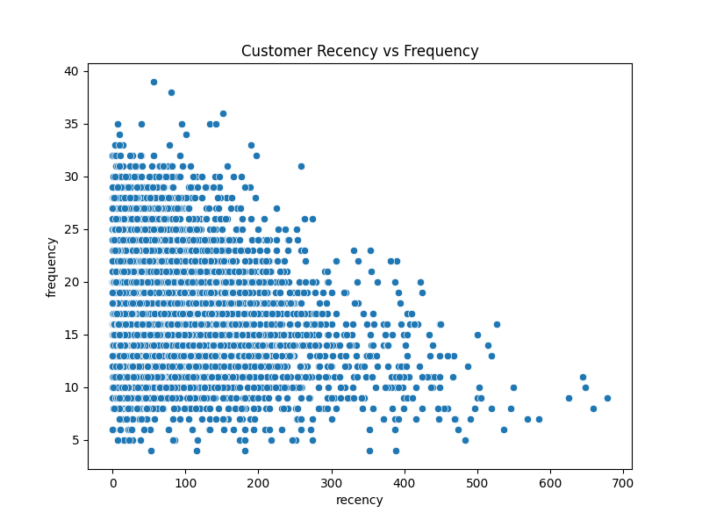
Customer Segmentation (RFM)
Customer Recency vs Frequency
Scatter Plot
The scatter shows that customer engagement is not evenly distributed.
Opportunity for customer segmentation
Need for retention strategy differentiation

Slide 15
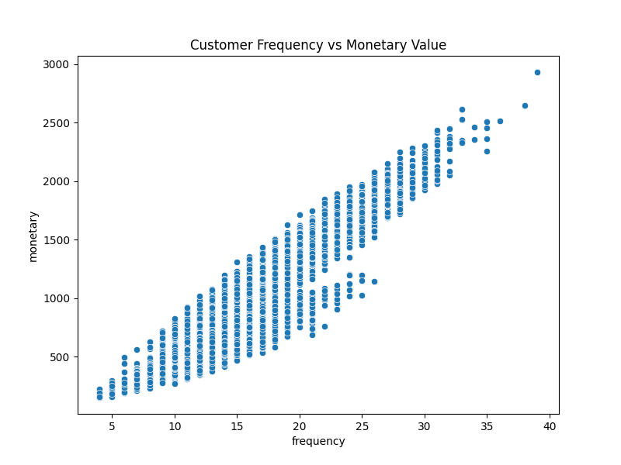
Customer Frequency vs Monetary Value Scatter Plot
The scatter plot shows a clear upward trend
Retaining these customers is critical for business stability.
Increasing average transaction value here can lift total revenue.

Slide 16
EXCEL DASHBOARD SCREENSHOT

Slide 18
Key Business Insights and
Business Recommendations
Key Business Insights
The business shows stable long-term growth with mild seasonal variation.
Sales are relatively stable throughout the year, reducing seasonal risk.
Customer retention plays a bigger role than new acquisition.
Current campaign strategy has low conversion efficiency.
There is major scope for targeted marketing.
Different customer segments require different marketing strategies.
Revenue is partially concentrated among high-value customers.
Business Recommendations
Focus on Customer Retention Programs (Top Priority)
Create VIP Customer Program
Improve Campaign Targeting
Upselling & Cross-Selling Strategy
Reactivate Dormant Customers
Data-Driven Marketing Strategy
Implement customer segmentation dashboard.
Targeted marketing
Seasonal inventory planning.
Focus on Peak Sales Months
Reduce Revenue Dependency on Few Customers

Slide 19
Conclusion
This project successfully analyzed retail transaction data and provided valuable insights that can help businesses improve customer engagement and sales performance.
Data analytics helps improve customer engagement and business profitability.
This project demonstrates how data analytics helps businesses make data-driven decisions and improve customer engagement and revenue growth.
Overall, data-driven decision-making can significantly enhance revenue, customer retention, and business growth.

Slide 20
Future Scope
Customer segmentation using machine learning
Predictive sales analysis
Automated dashboard reporting
Marketing strategy optimization
Sales Forecasting, Churn Prediction, and AI Recommendation Systems.

Slide 21
THANK YOU

