Slide 1
Stock Market Analysis Project
Submitted by: ABHIJIT SINHA
Email: sinhaabhijit12@yahoo.com
UNID: UMID08062541597

Slide 2
Abstract
This project analyzes stock market data for AAPL, MSFT, NFLX, and GOOG.
Performed EDA
SQL Integration
ML Model Training (Random Forest)
Stream lit App Deployment

Slide 3
Dataset Description
The dataset consists of historical stock price data for Apple (AAPL), Microsoft (MSFT), Netflix (NFLX), and Google (GOOG)
Fields: Ticker, Date, Open, High, Low, Close, Adj Close, Volume.
No missing values were found, ensuring good data quality.

Slide 4
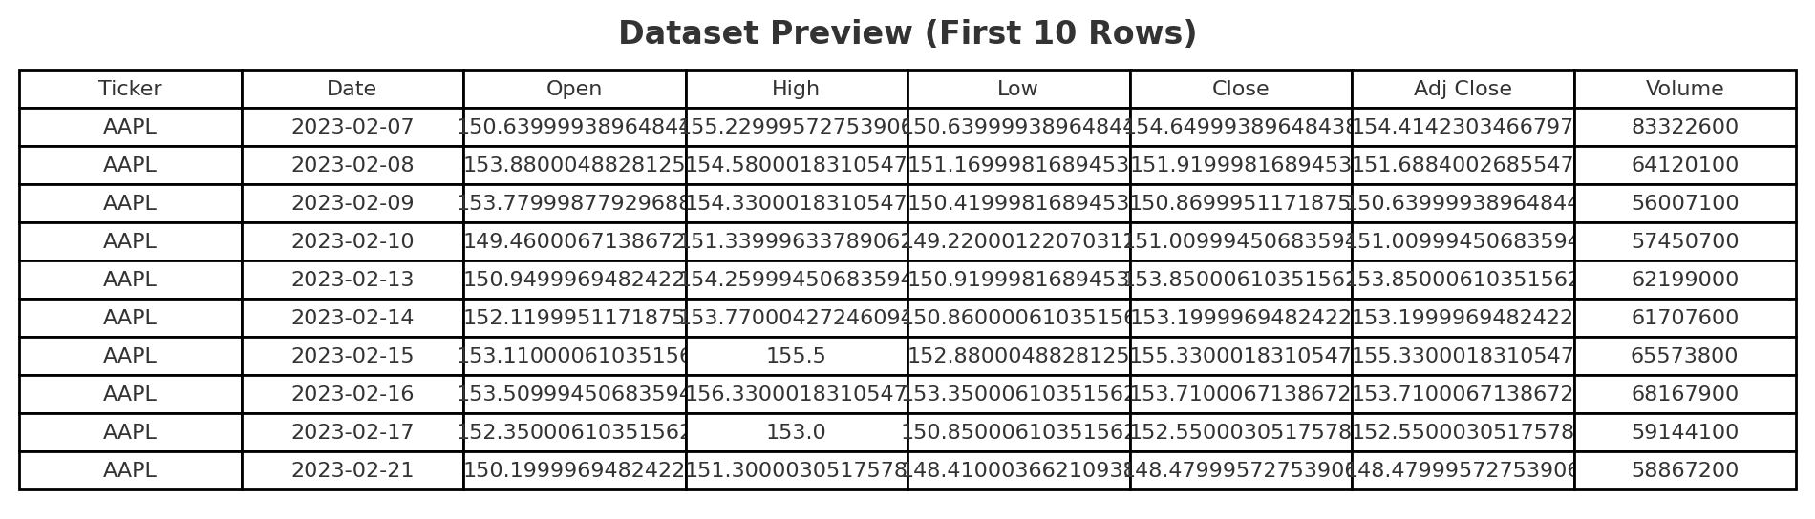
Dataset

Slide 5
Technology Stack
Python (Pandas, NumPy, Matplotlib, Seaborn, Scikit-learn)
SQL (MySQL for storing raw data, features, predictions, and metrics)
Machine Learning (Random Forest Regressor)
Stream lit (for interactive dashboard)
Excel Export (via Pandas Excel Writer)

Slide 6
Project Workflow and Implementation Steps
1. Data Preprocessing
Loaded raw CSV dataset
Cleaned column names & handled missing values
Feature engineering (Moving Averages, Volatility, Lag features)
Train/test split for ML model
deploy it via Stream lit and SQL/Excel export

Slide 7
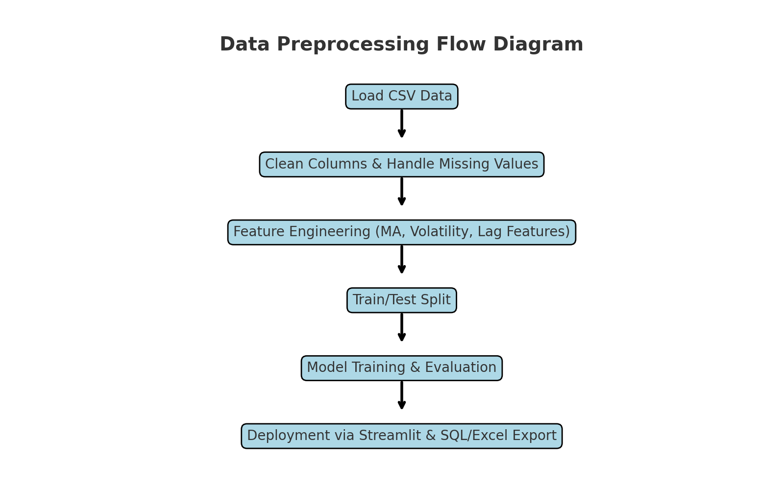
The Preprocessing Flow Diagram

Slide 8
2. Exploratory Data Analysis (EDA)
Distribution of closing prices: This histogram shows how stock closing prices are distributed, which helps us understand the price range and central tendency.
Total traded volume by company: This bar chart compares total trading volumes by company. Apple and Microsoft show higher average activity compared to Netflix and Google.
Scatter plot (Volume vs Closing Price): Here we see the relationship between trading volume and stock closing prices. Higher volumes don’t always mean higher prices.
Correlation Heatmap: The correlation matrix shows very strong relationships among Open, High, Low, and Close prices. However, trading volume has weaker correlation with price movements.

Slide 9
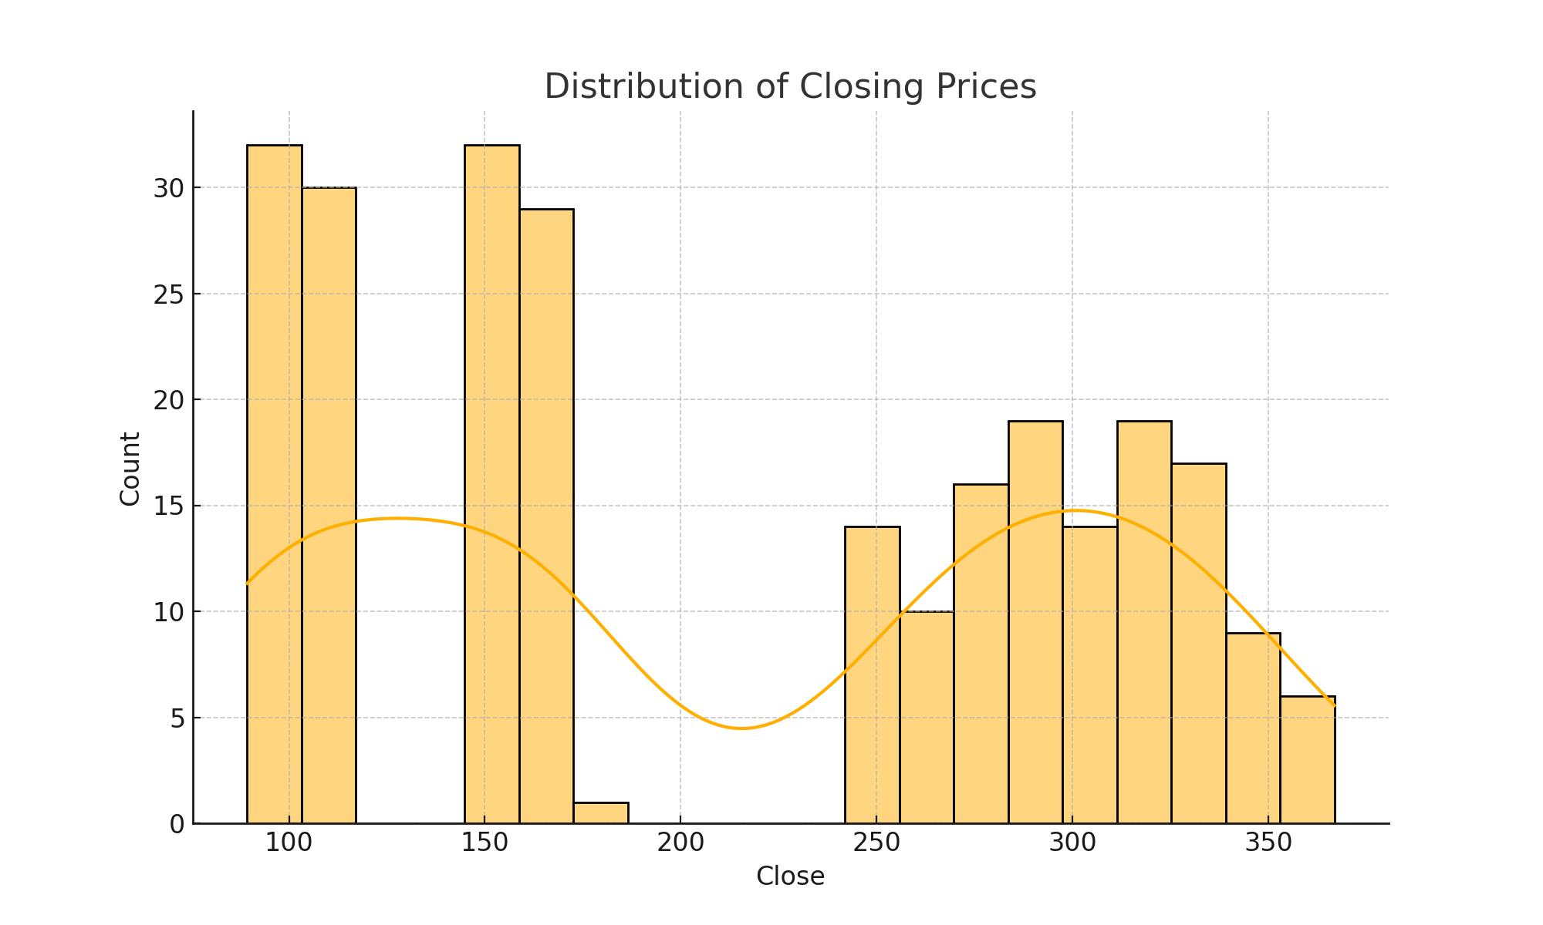
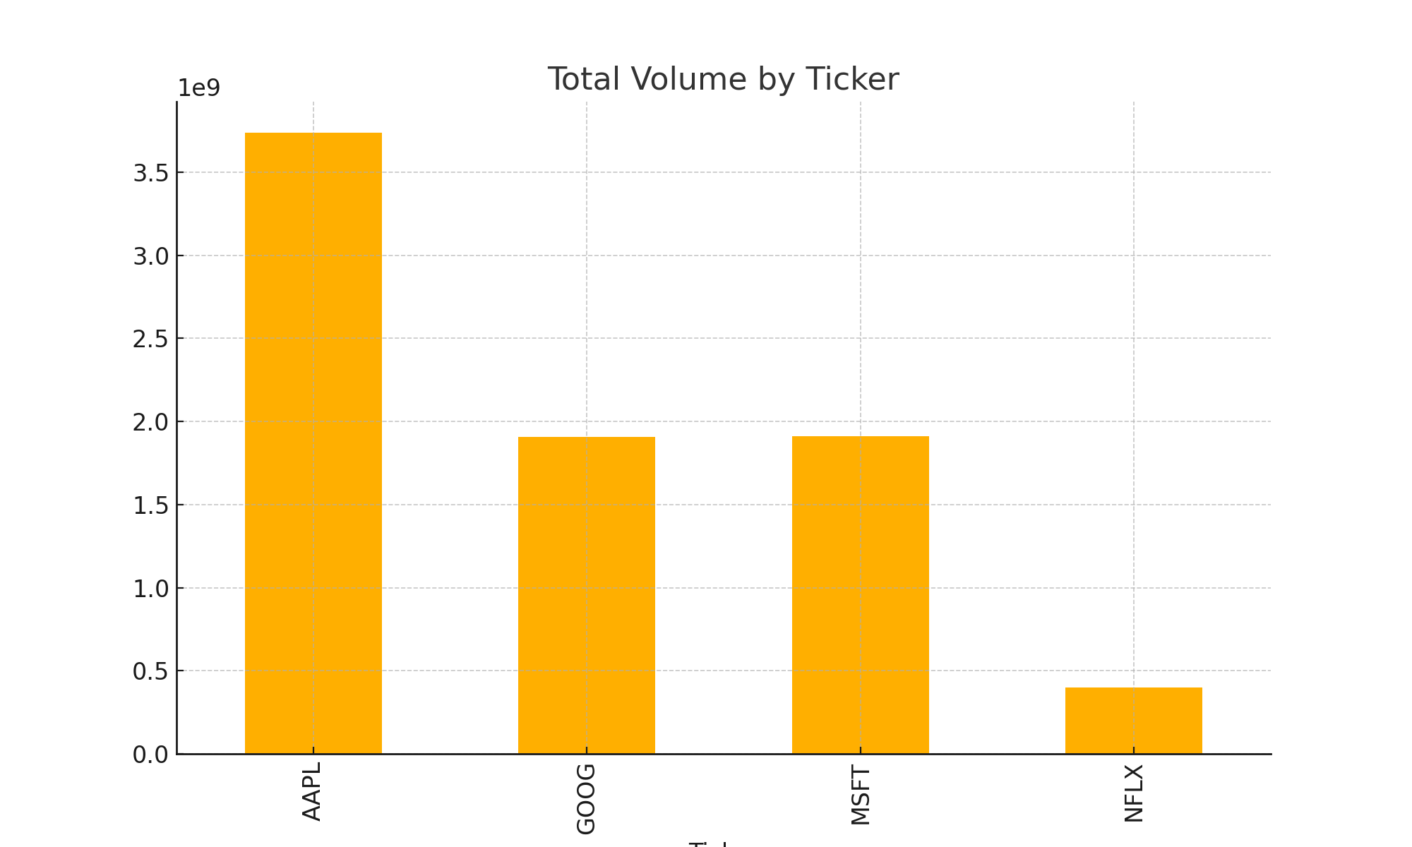
Exploratory Data Analysis (EDA) Charts

Slide 10
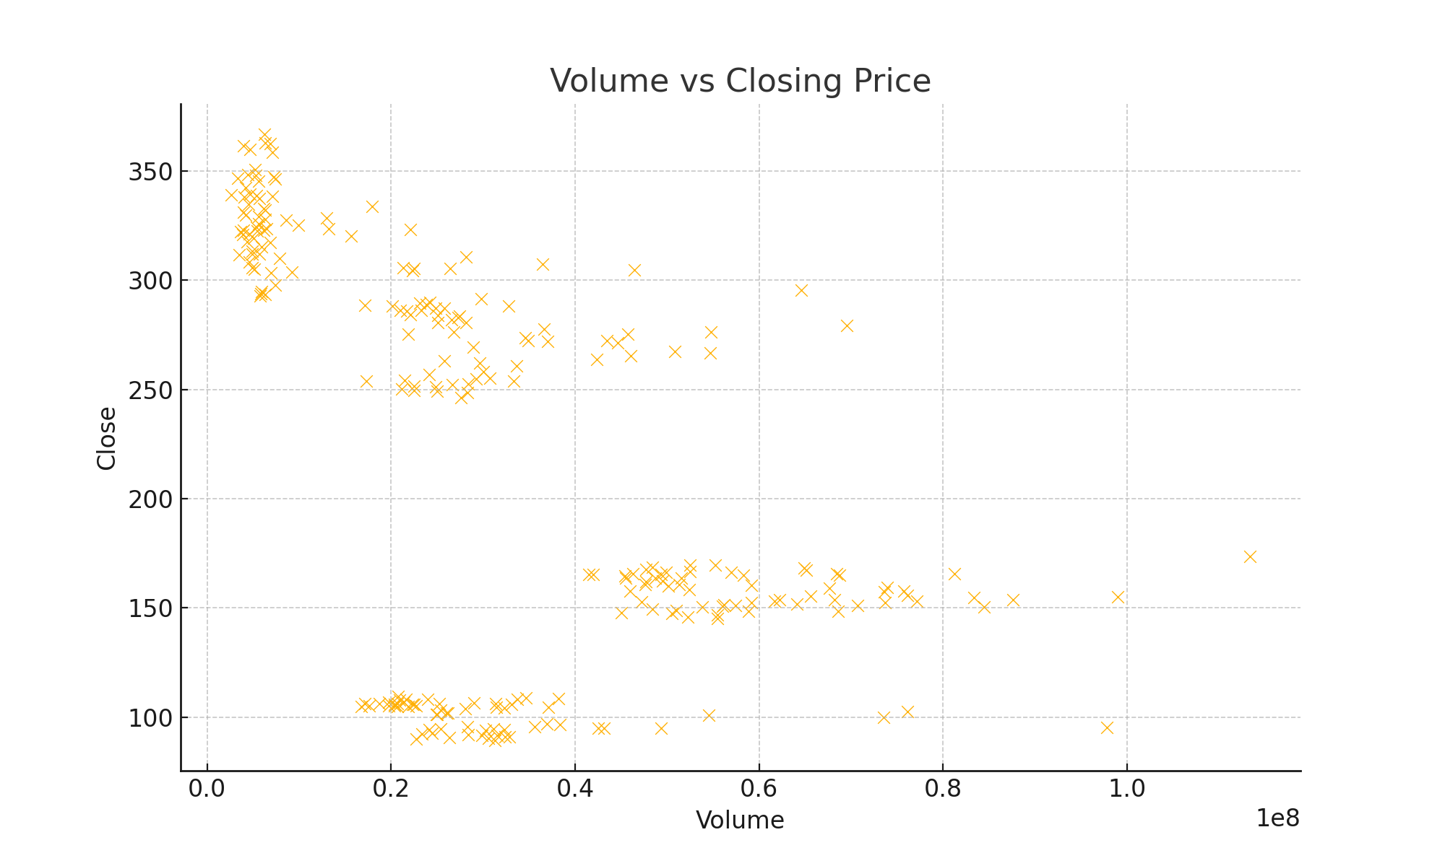
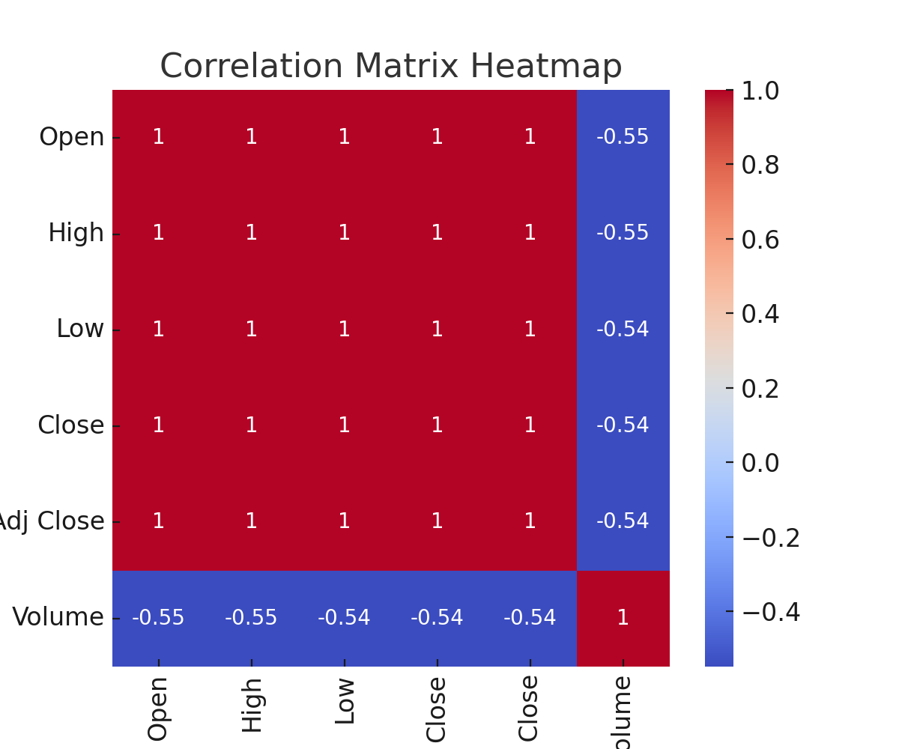

Slide 11
3. SQL QUERIES AND INSIGHTS
Stored raw, feature-engineered, and predictions data into MySQL
Example Query: Average Closing Price by Ticker
Here, we used SQL queries to summarize data.

Slide 12
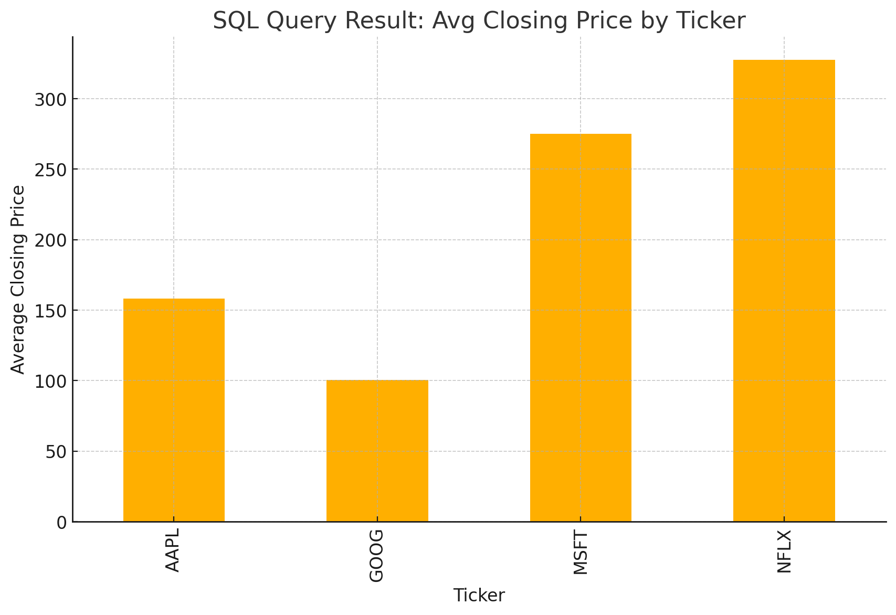
SQL Query Result
This bar chart represents the average closing price by ticker, computed using SQL aggregation queries.
Such queries make it easier to derive financial insights directly from the database.

Slide 13
4. Machine Learning
Trained a Random Forest Regressor to predict stock prices.
Evaluated performance with RMSE, MAE, R²
Visualized Actual vs Predicted closing prices
The closer the points are to the diagonal line, the better the prediction.
Our model achieved an R² score above 0.8, showing good predictive capability.

Slide 14
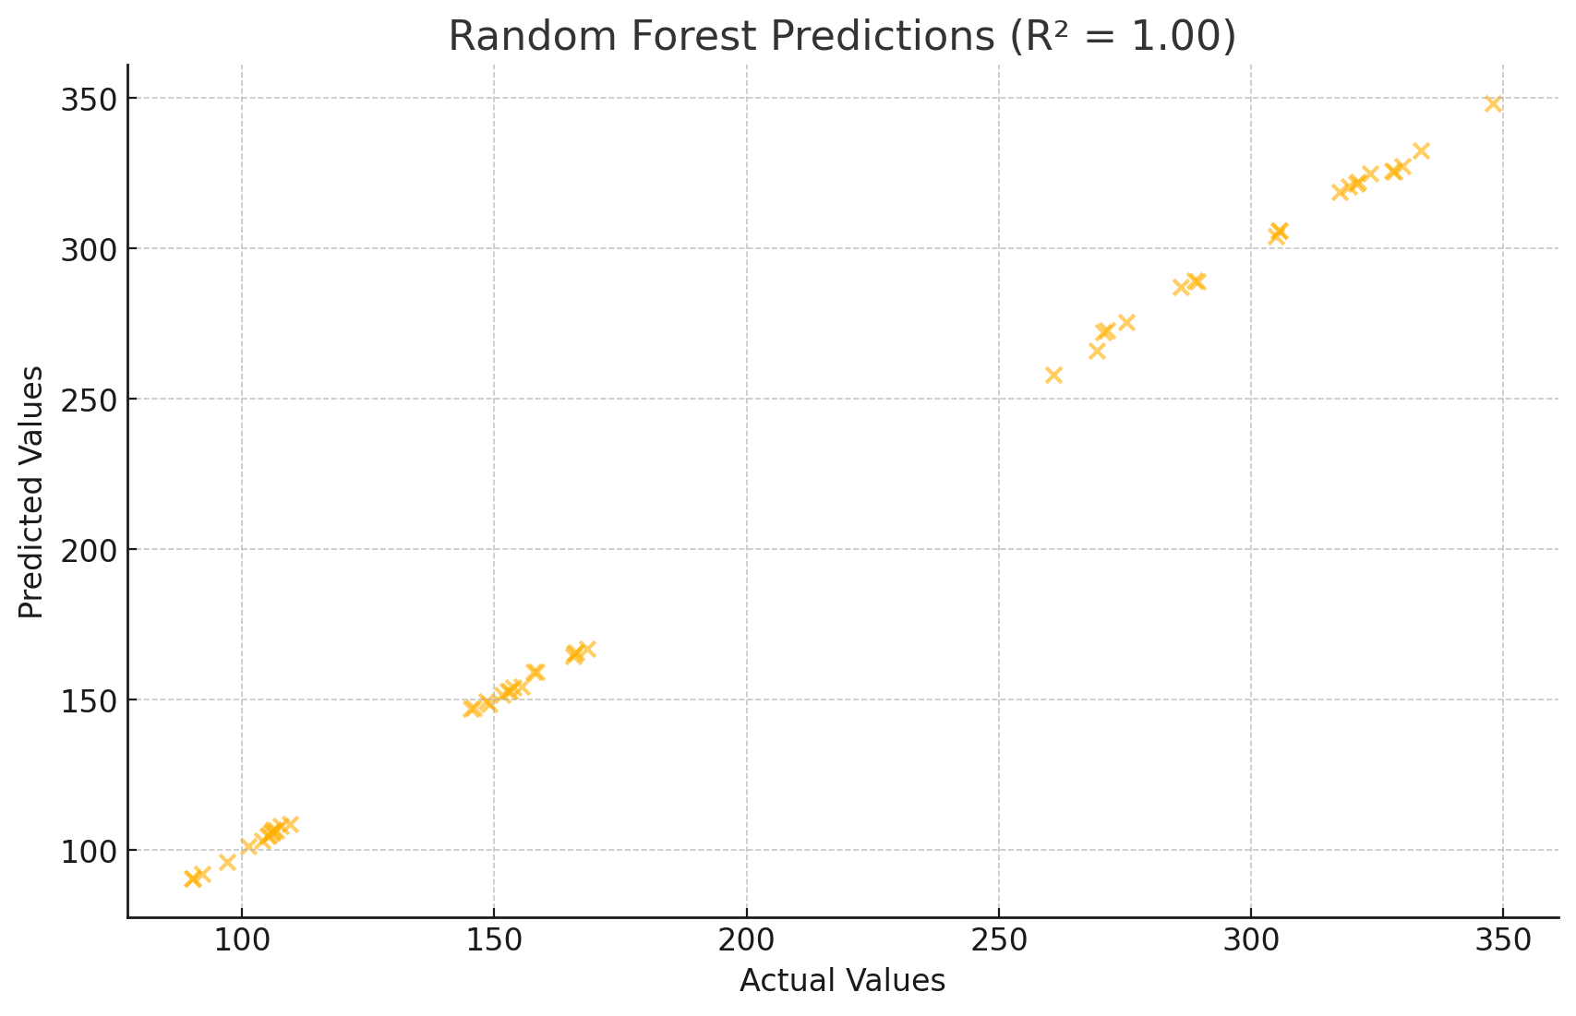
ML Model Training Visualization
Random Forest Regressor performance (Actual vs Predicted)

Slide 15
5. Stream lit Dashboard
Upload CSV & preview data
Train ML model interactively
Visualize predictions (Actual vs Predicted)
Export results to Excel or save to MySQL
This makes the project more user-friendly and accessible.

Slide 16
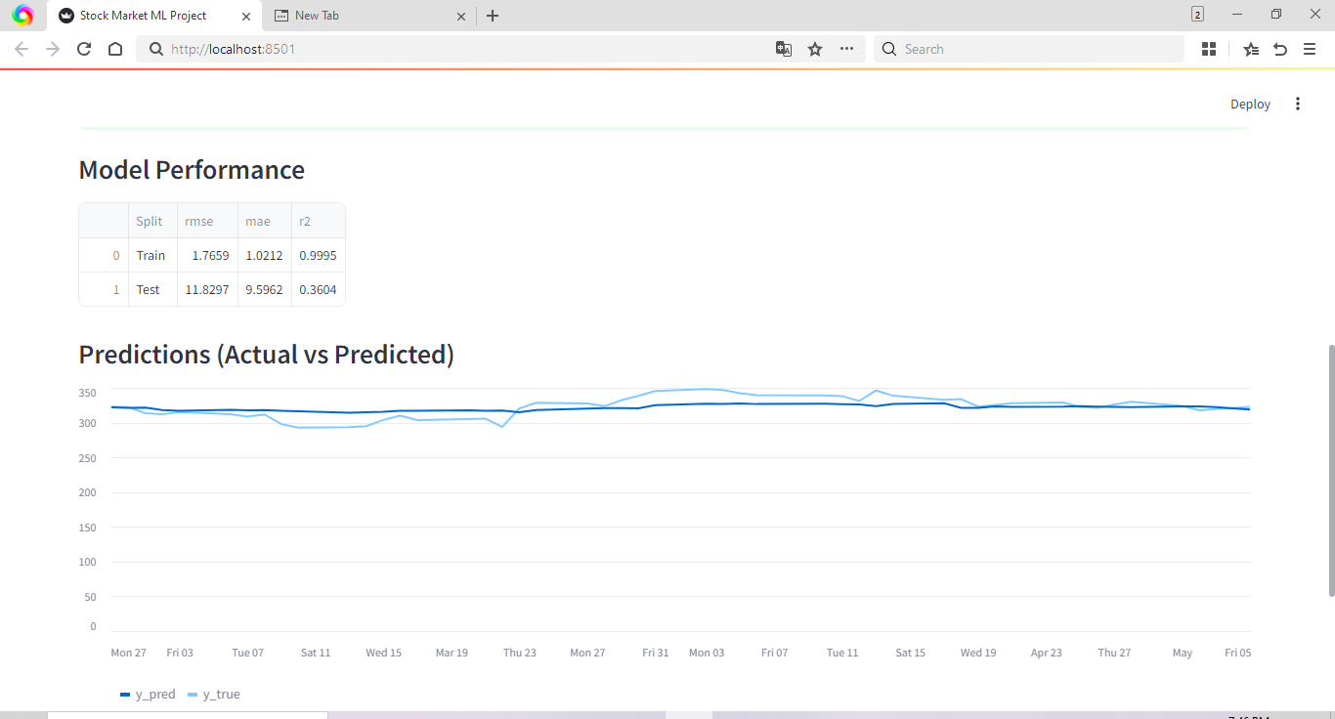
Stream lit Dashboard Visualization

Slide 17
Final Insight
While machine learning models can capture historical patterns and short-term fluctuations, stock markets remain influenced by external economic, political, and psychological factors that are not fully captured in the dataset.
ML aids forecasting but markets depend on external factors.
Nevertheless, this project illustrates the potential of ML and data analytics in financial forecasting and decision-making.

Slide 18
Key Takeaways
EDA revealed strong correlations among stock price variables, highlighted trading volume patterns, and provided insights into price distributions.
SQL queries helped in summarizing key financial metrics such as average closing price per ticker.
A Random Forest Regressor was trained, achieving a good R² score, showing its ability to capture short-term stock price variations.
Feature importance analysis highlighted lagged prices, moving averages, and volatility as crucial predictors.
The Stream lit app enabled interactive exploration of the dataset, model training, predictions, and exporting results to Excel/MySQL.

Slide 19
Conclusion
This project shows how data science techniques can be applied to financial datasets.
Strong correlation among price variables.
SQL queries summarized financial metrics.
EDA revealed important patterns.
Random Forest achieved good R² score.
Stream lit app enabled interactive exploration.

Slide 20
References
Dataset: C:/Users/Hp/OneDrive/Desktop/python/Stock_Market/stocks.csv
GitHub Project: https://github.com/abhi-1009/Stock-Market-Analysis-Project-Report

Slide 21
THANK YOU

