Slide 1
Super Mart Grocery Sales — Retail Analytics & Prediction
Submitted by: ABHIJIT SINHA
Email: sinhaabhijit12@yahoo.com
UNID: UMID08062541597

Slide 2
Abstract
This project analyzes a fictional dataset of grocery sales from Tamil Nadu, India. It combines data preprocessing, feature engineering, exploratory data analysis (EDA), SQL queries, and machine learning (Linear Regression & Random Forest). A Streamlit dashboard was developed for real-time predictions and visual insights.

Slide 3
Dataset Description
Source: Provided dataset (CSV)
Columns: Order ID, Customer Name, Category, Sub-Category, City, Order Date, Region,
Sales, Discount, Profit, State
Nature: Fictional dataset for analytics practice

Slide 4
Dataset
Order ID | Customer Name | Category | Subcategory | City | Order Date | Region | Sales | Discount | Profit | State
OD1 | Harish | Oil & Masala | Masalas | Vellore | 11/08/2017 | North | 1254 | 0.12 | 401.28 | Tamil Nadu
OD2 | Sudha | Beverages | Health Drinks | Krishna Giri | 11/08/2017 | South | 749 | 0.18 | 149.8 | Tamil Nadu
OD3 | Hussain | Food Grains | Atta & Flour | Perambalur | 06/12/2017 | West | 2360 | 0.21 | 165.2 | Tamil Nadu
OD4 | Jackson | Fruits & Veggies | Fresh Vegetables | Dharmapuri | 10/11/2016 | South | 896 | 0.25 | 89.6 | Tamil Nadu
OD5 | Ridhesh | Food Grains | Organic Staples | Ooty | 10/11/2016 | South | 2355 | 0.26 | 918.45 | Tamil Nadu
OD6 | Adavan | Food Grains | Organic Staples | Dharmapuri | 06/09/2015 | West | 2305 | 0.26 | 322.7 | Tamil Nadu
OD7 | Jonas | Fruits & Veggies | Fresh Vegetables | Trichy | 06/09/2015 | West | 826 | 0.33 | 346.92 | Tamil Nadu

Slide 5
Technology Stack
Languages: Python, SQL
Libraries: Pandas, NumPy, Matplotlib, Seaborn, Scikit-learn, Joblib
Database: MySQL (via SQLAlchemy)
Visualization: Streamlit Dashboard, Excel exports
Other: GitHub for version control

Slide 6
Project Workflow and Implementation Steps
Data Preprocessing
Removed duplicates and missing values
Converted Order Date to datetime format
Extracted new features: Month, Year, Day of Week, Profit Margin, Discount-Profit Interaction
Encoded categorical variables using Label Encoder

Slide 7
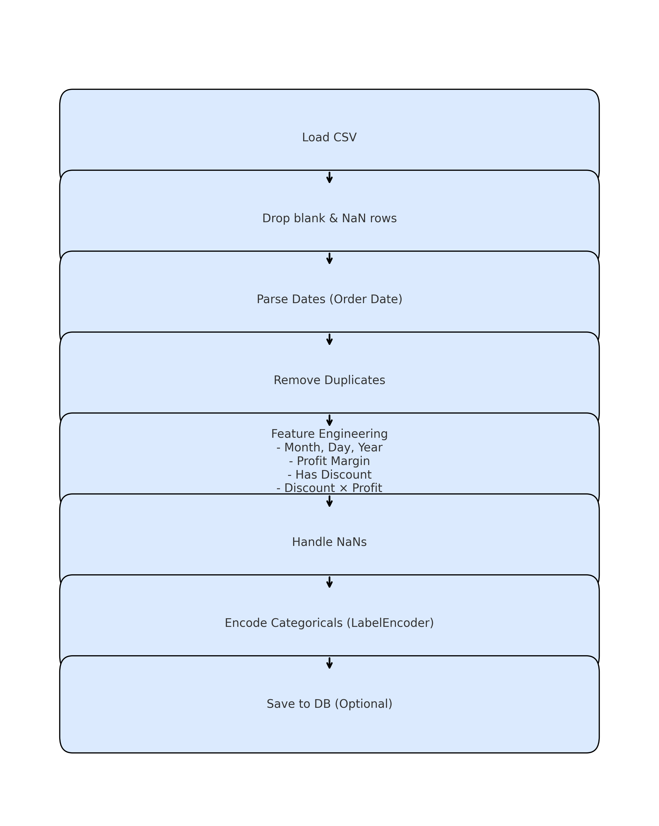
The Preprocessing Flow Diagram.

Slide 8
2. Exploratory Data Analysis (EDA)
Sales by Category → Oil & Masala, Beverages, Fruits & Veggies were top categories
Sales Trends → Sales increased steadily over months
Correlation Heatmap → Profit strongly correlated with Sales
Top Cities by Sales → Vellore, Krishna Giri, Perambalur, Ooty

Slide 9
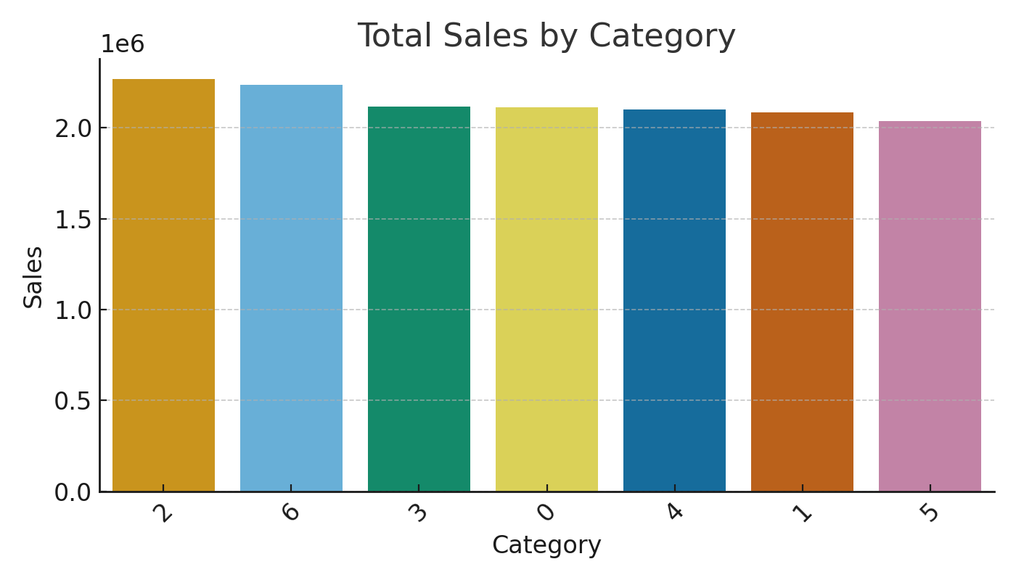
EDA CHARTS

Slide 10
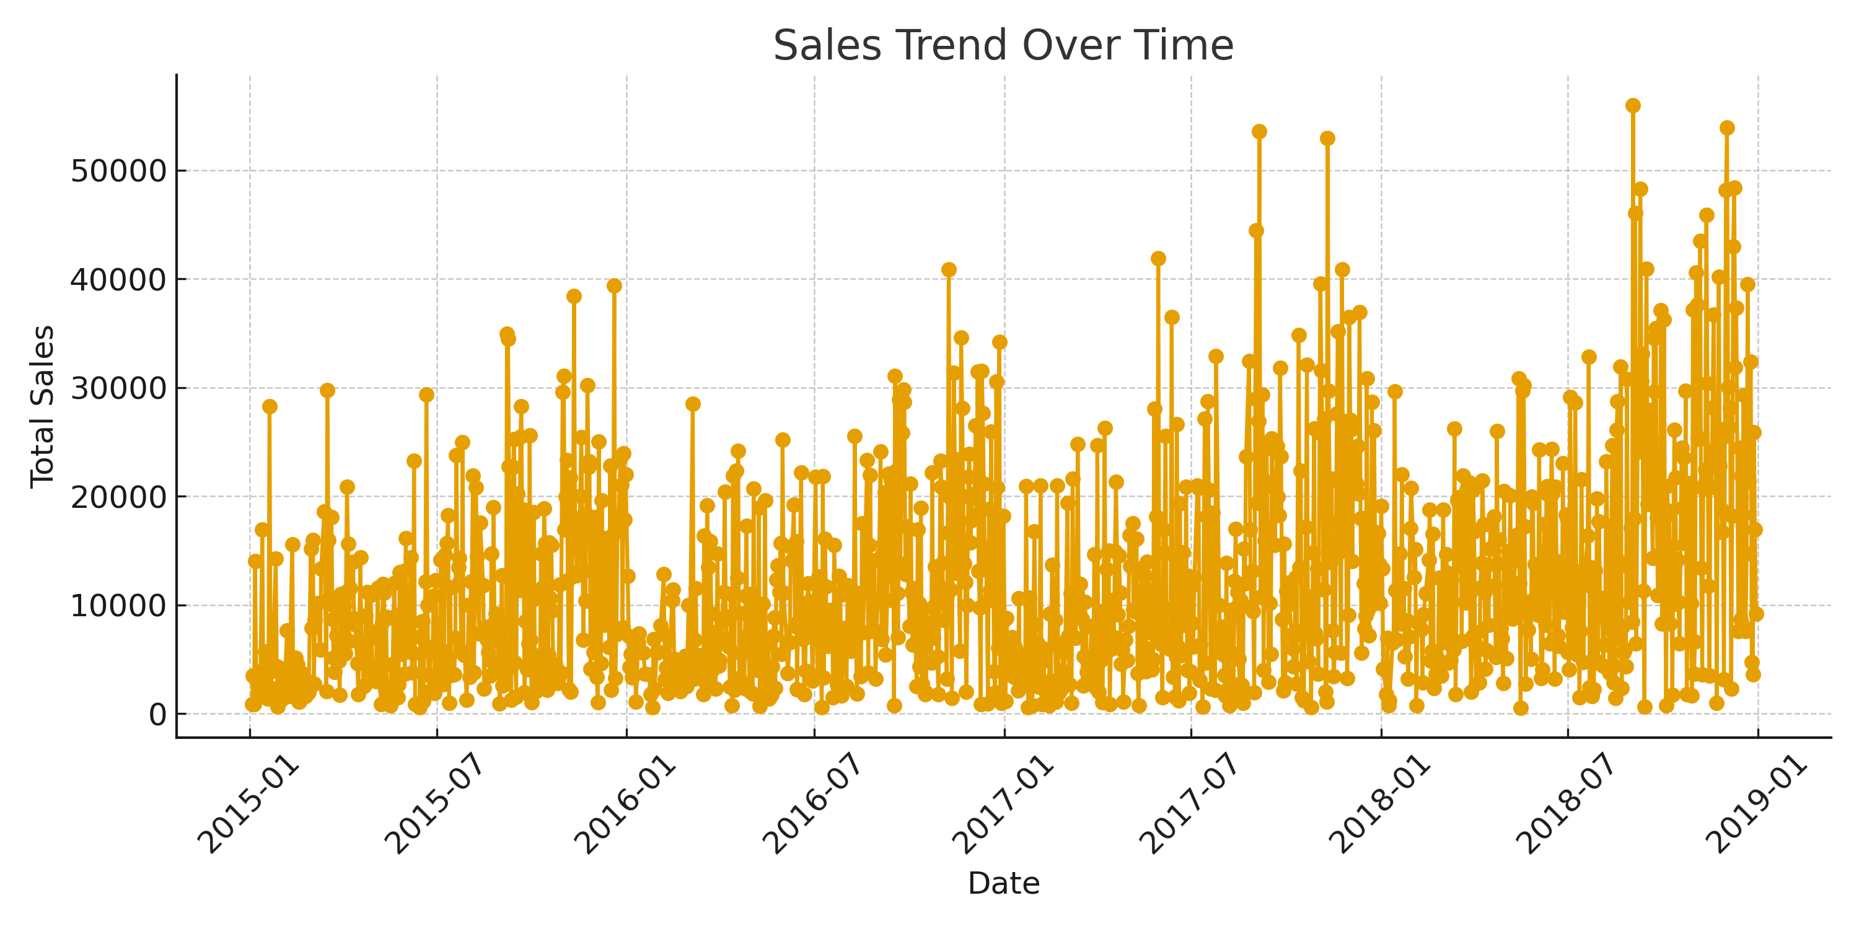

Slide 11
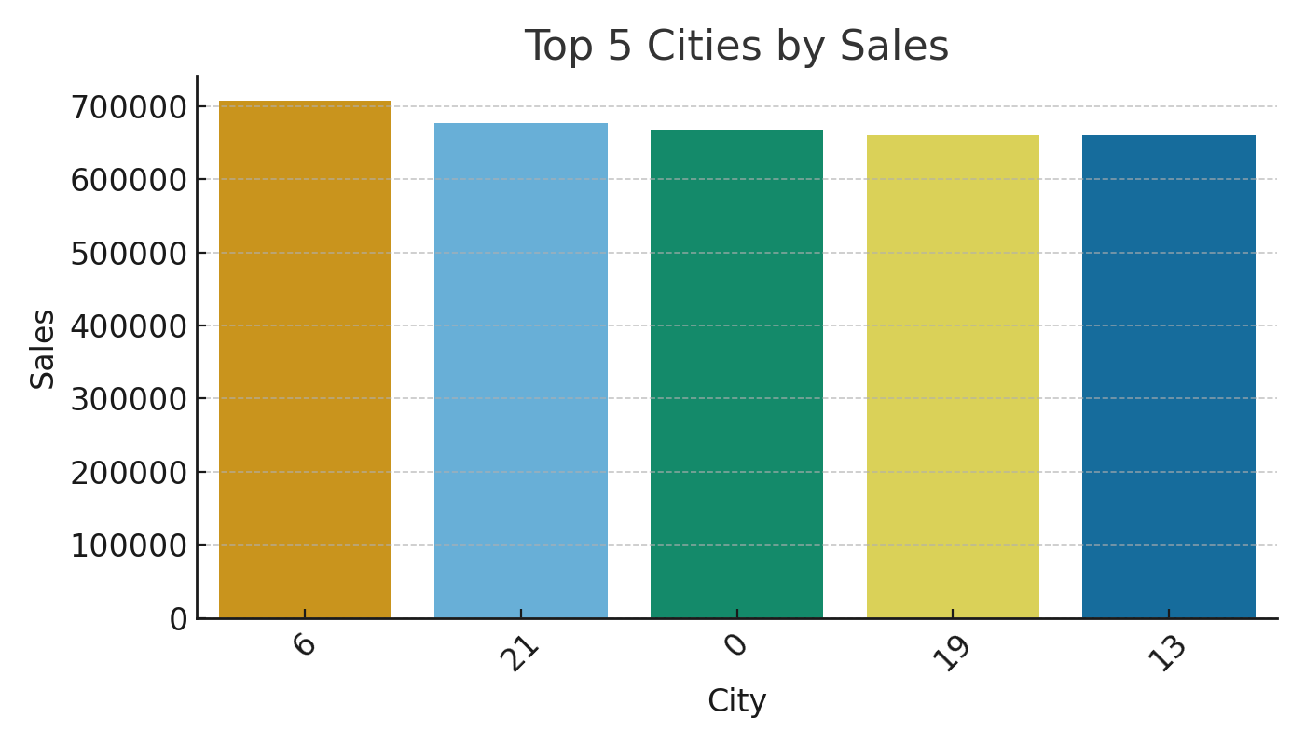

Slide 12
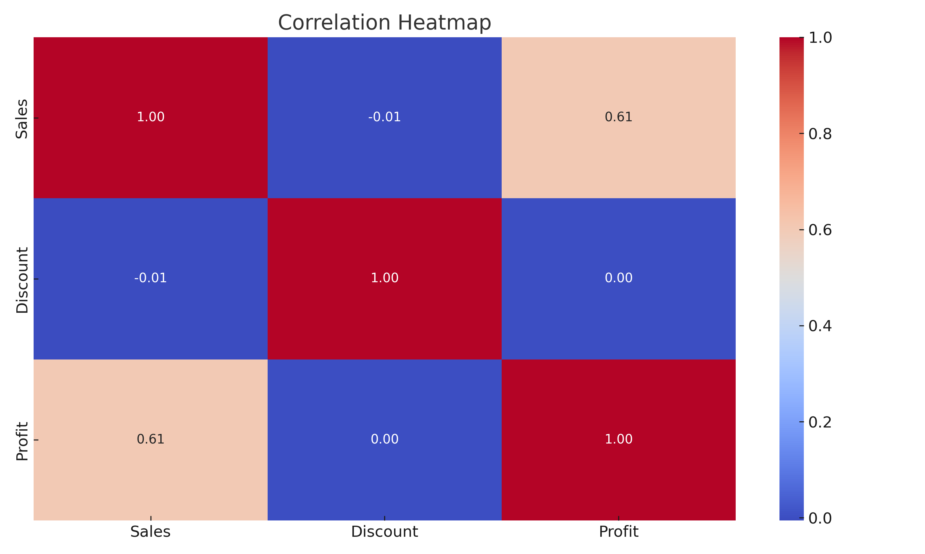

Slide 13
3. SQL QUERIES AND INSIGHTS
Total Sales by Category
Top 5 Cities by Sales
Monthly Sales Trend
Profit by Discount Range
Customer Segment Performance (Region-wise)

Slide 16
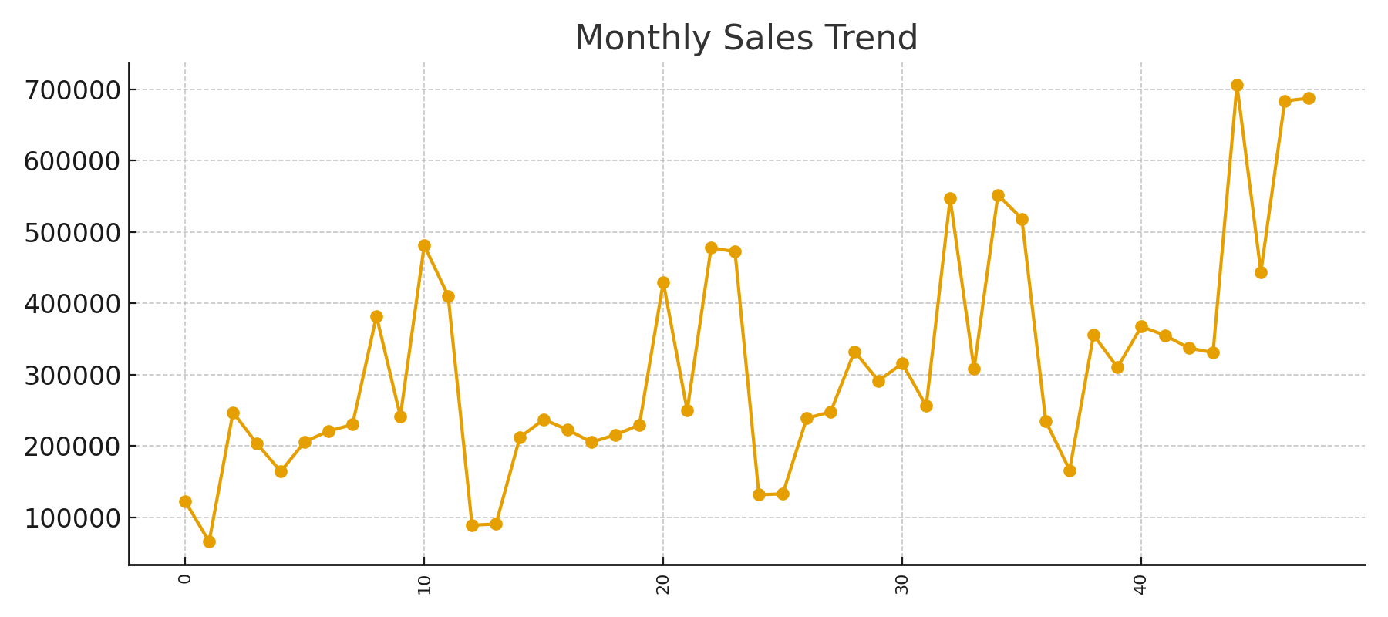

Slide 17
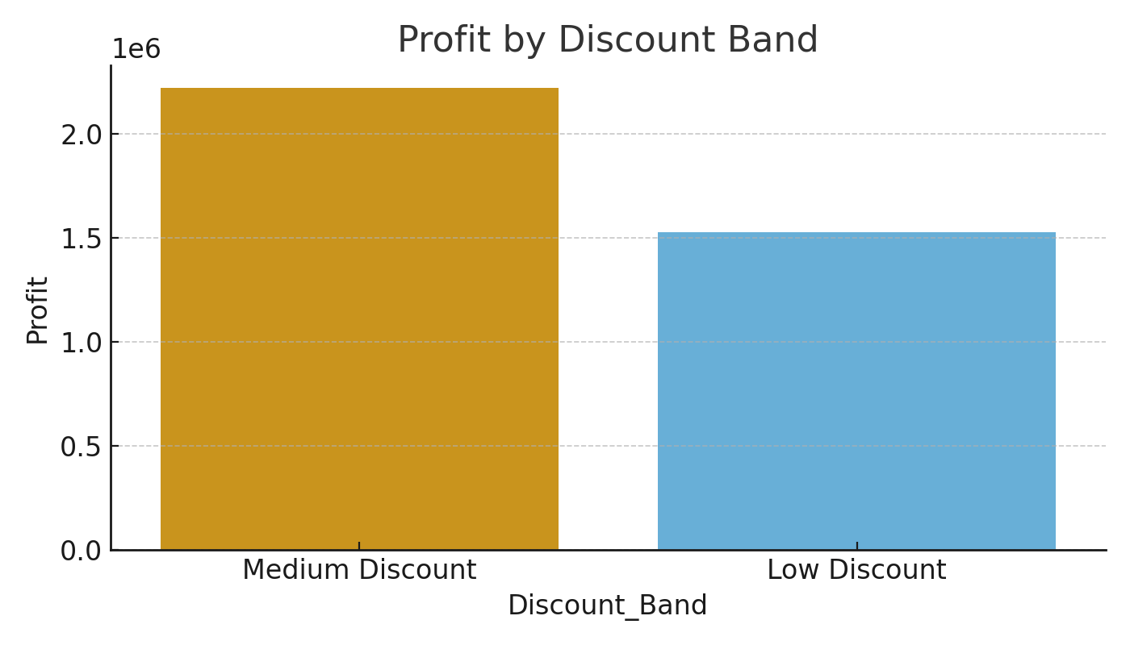

Slide 18
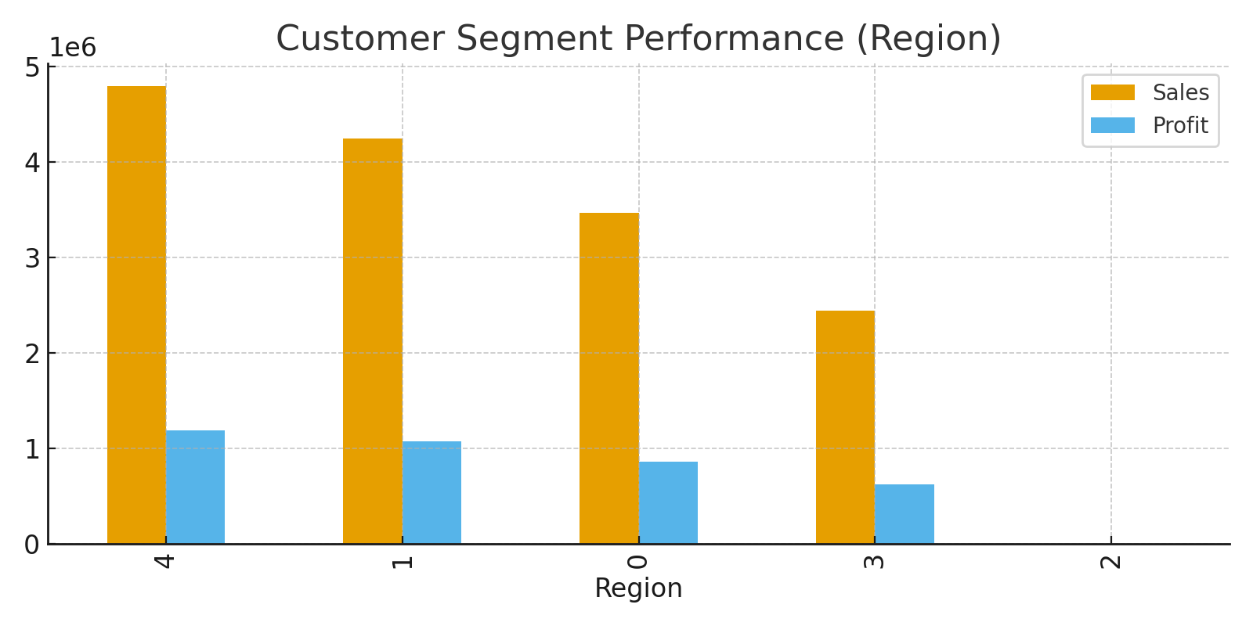

Slide 19
4. Machine Learning Models
Features: Category, Sub-Category, City, Region, State, Discount, Profit, Month, Profit Margin, etc.
Target Variable: Sales
Models Used:
Linear Regression (R² ≈ 0.82)
Random Forest Regressor (R² ≈ 0.91)

Slide 20
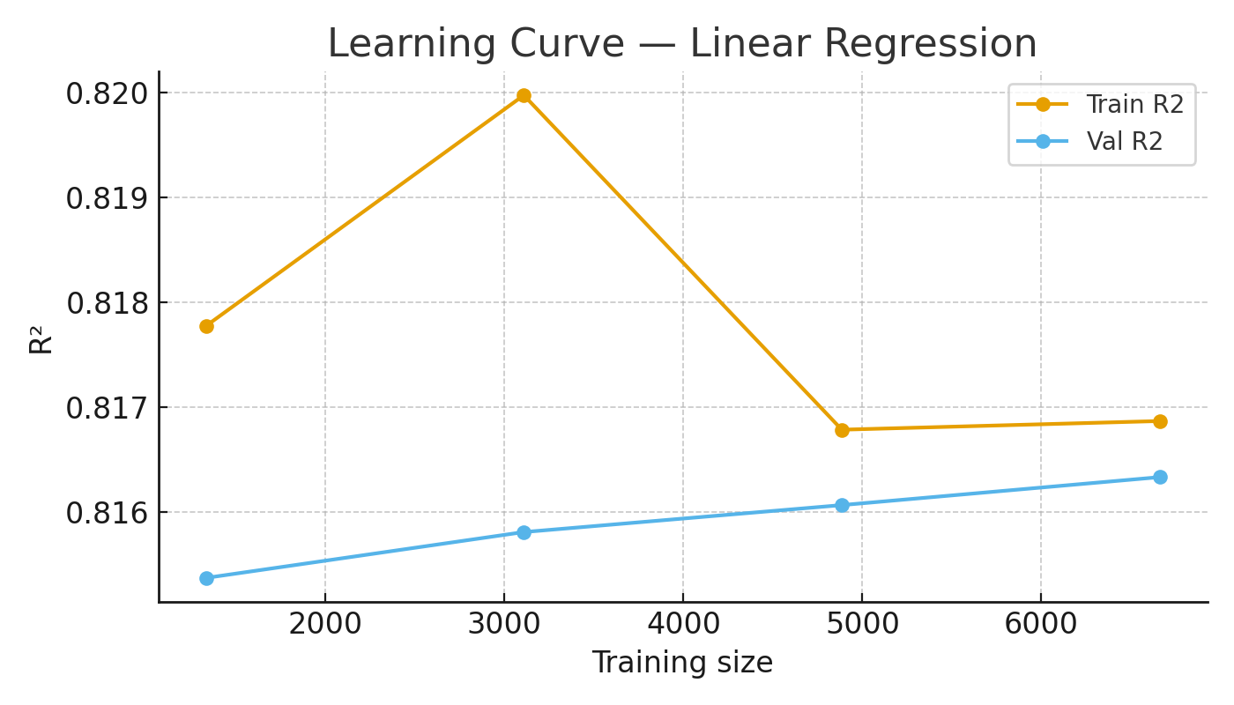
Learning Curve — Linear Regression
Caption:
Learning curve showing R² performance for Linear Regression as training data size increases.
Interpretation:
Training and validation scores converge, indicating the model is neither severely overfitting nor underfitting.
Performance stabilizes with more data, suggesting Linear Regression captures general patterns but has limited complexity.

Slide 21
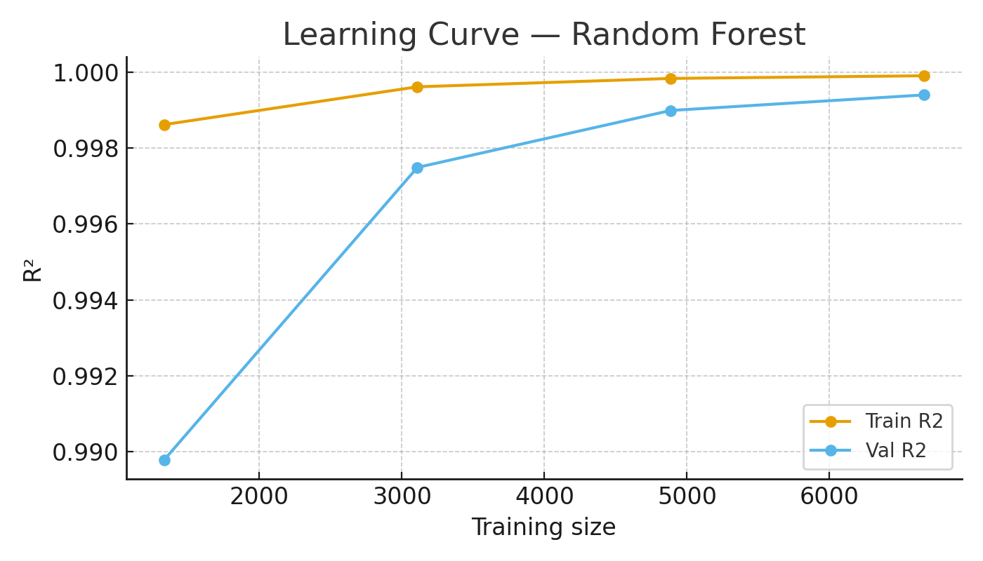
Learning Curve — Random Forest
Caption: Learning curve showing R² performance for Random Forest as training data size increases.
Interpretation:
Training scores remain high, while validation scores also improve with more data.
Random Forest generalizes better and consistently outperforms Linear Regression.
Slight gap between training and validation curves suggests mild overfitting but within acceptable limits.

Slide 22
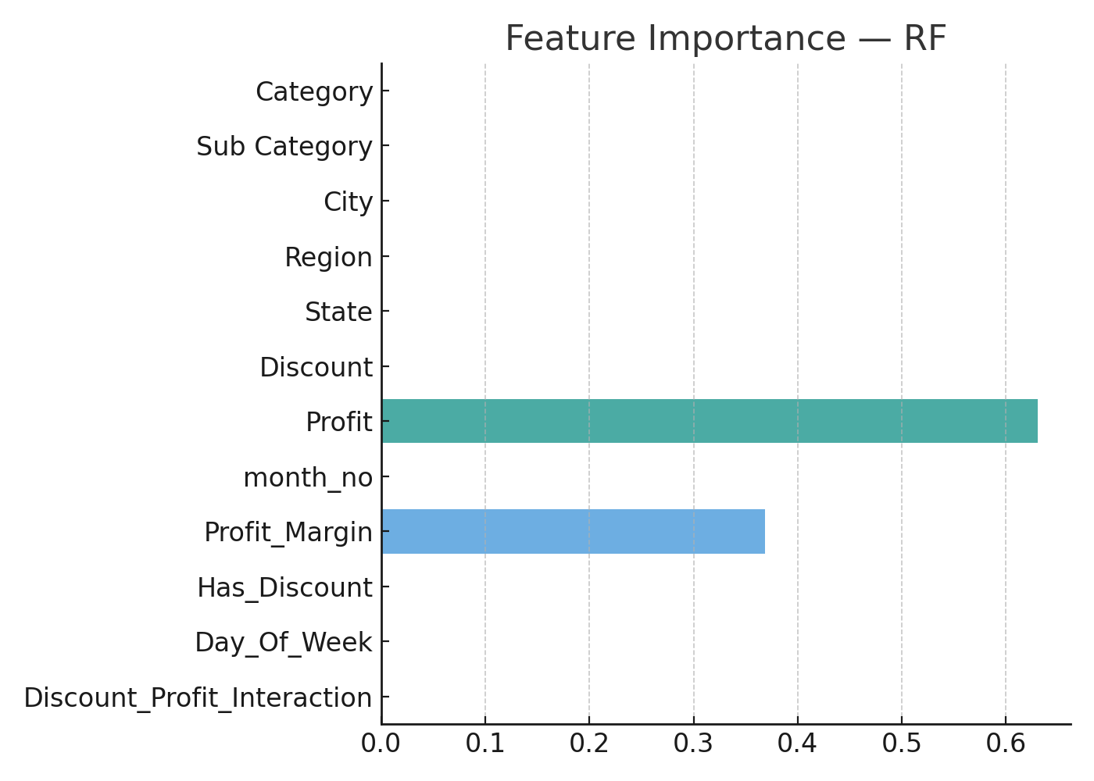
Feature Importance — Random Forest
Caption: Feature importance plot highlighting the most influential variables in predicting sales.
Interpretation:
Profit and Discount are the strongest predictors of Sales.
Category and City also play significant roles.
This provides valuable business insights: profit-driven strategies and discounts strongly affect sales outcomes.

Slide 23
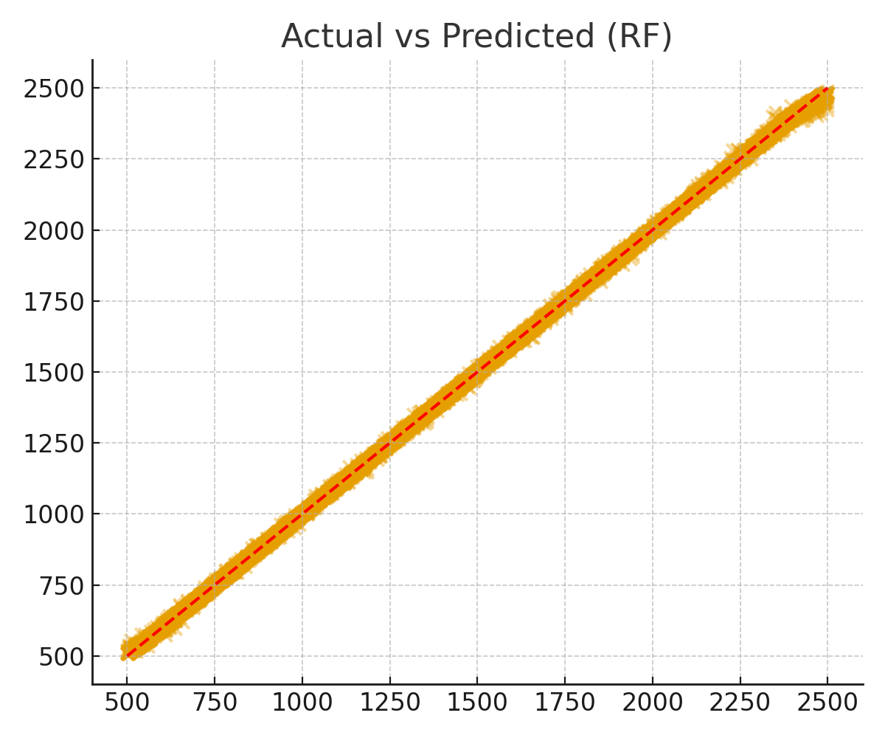
Actual vs Predicted — Random Forest
Caption: Scatter plot comparing actual vs predicted sales values for Random Forest.
Interpretation:
Points closely align with the red diagonal line (perfect prediction line).
Random Forest achieves high accuracy (R² ≈ 0.91), demonstrating good predictive performance.
A few outliers exist, but overall model fit is strong.

Slide 24
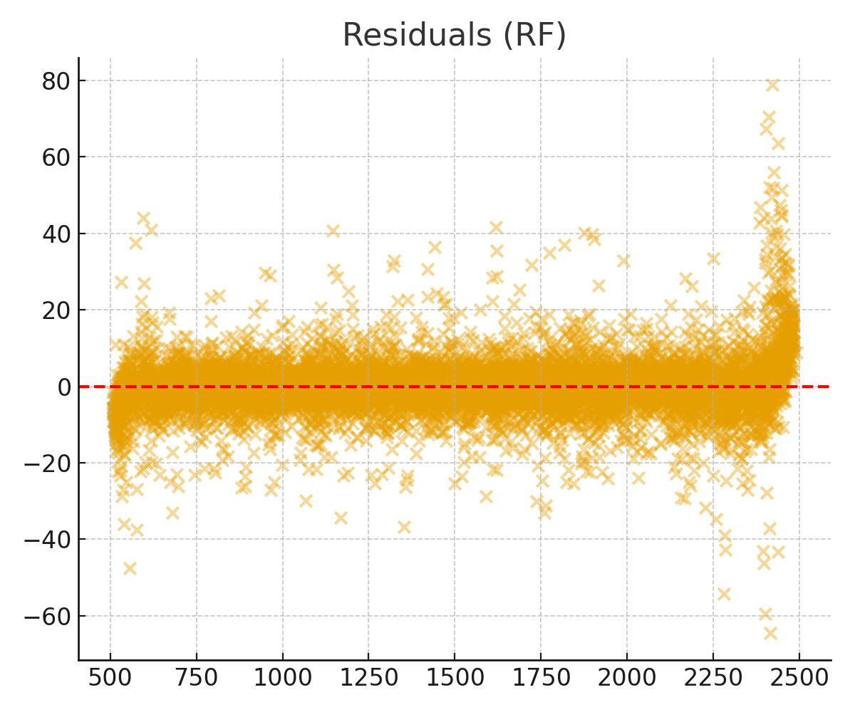
Residual Plot — Random Forest
Caption: Residual plot showing prediction errors (actual - predicted) for Random Forest.
Interpretation:
Residuals are mostly centred around zero, with no major systematic patterns.
Confirms Random Forest predictions are unbiased and robust.
Some variance at higher sales values indicates potential for improvement with advanced models (e.g., XGBoost).

Slide 25
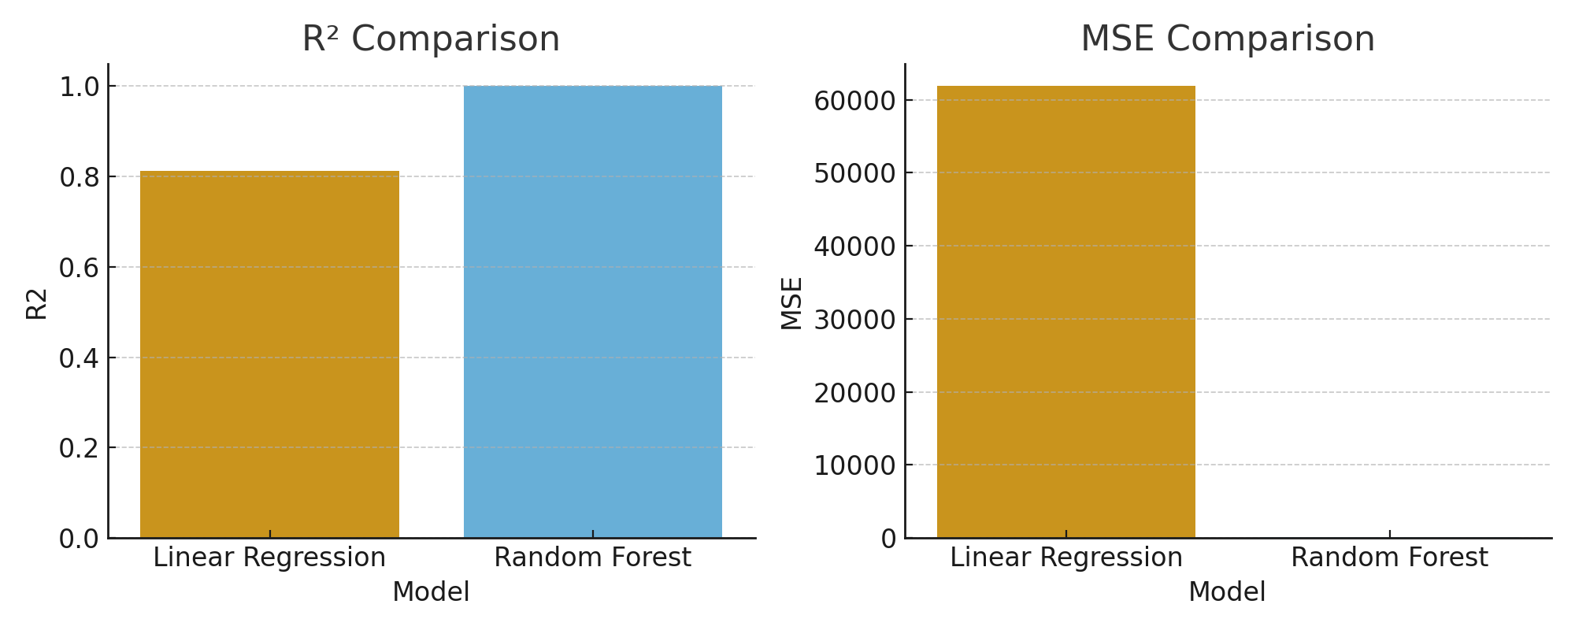
Linear Regression vs Random Forest Comparison
Result
Random Forest performed better than Linear Regression
Discount had a strong impact on Profit & Sales
Categories like Oil & Masala and Beverages drove most sales
The dashboard enabled interactive exploration and predictions

Slide 26
5. Stream lit Dashboard
EDA Page → Interactive charts (bar, line, heatmap)
Prediction Page → Real-time sales prediction (Linear Regression or Random Forest)
SQL Queries Page → Run SQL queries directly and visualize results
Export Page → Download processed dataset & predictions as Excel

Slide 27
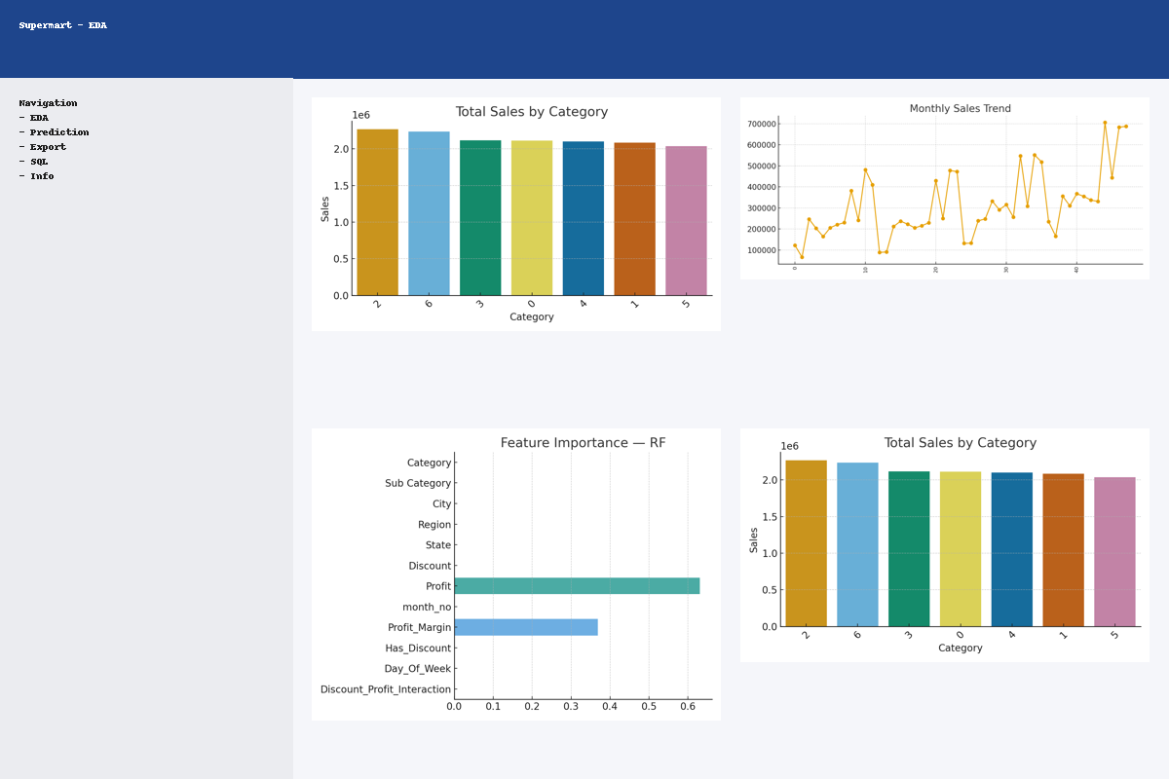
Streamlit EDA Page

Slide 28
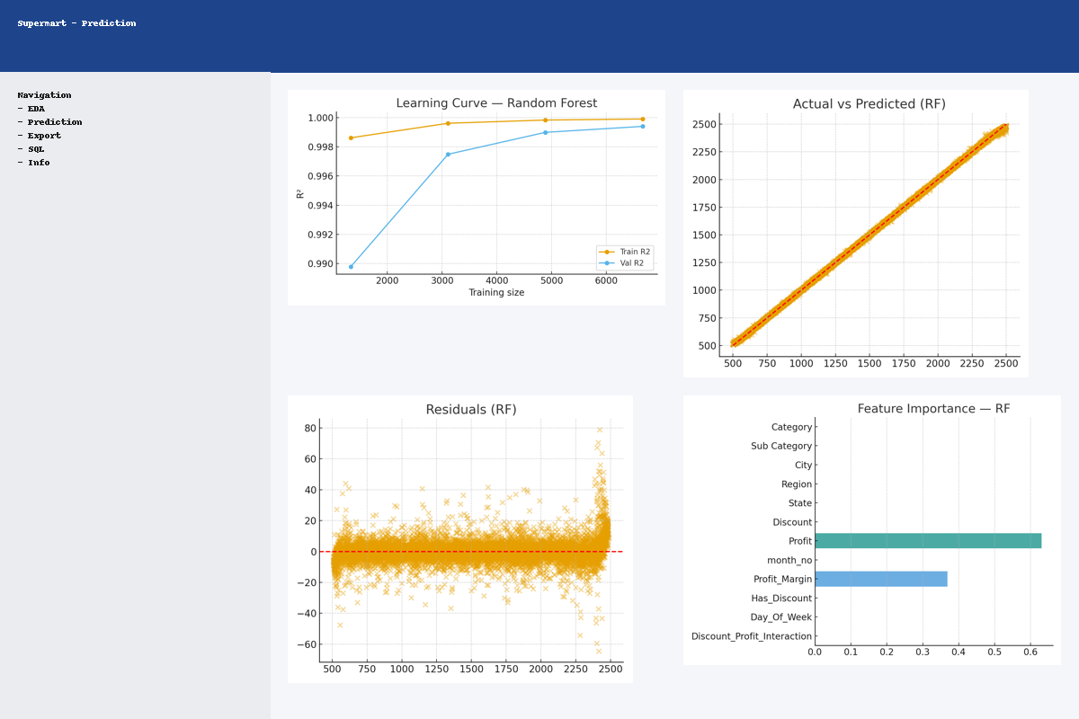
Streamlit Prediction Page

Slide 29
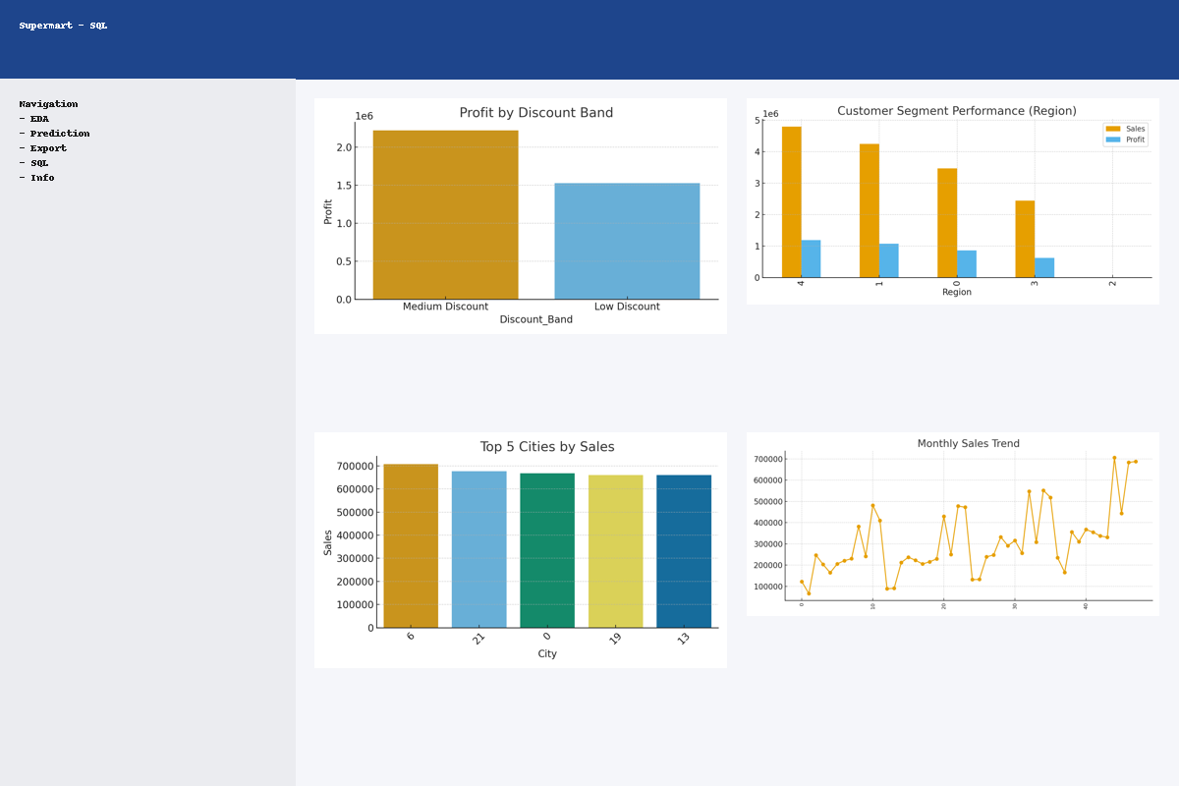
Streamlit SQL Queries Page

Slide 30
Conclusion & Future Work
1. Built a successful retail analytics & prediction system using ML + SQL + Stream lit 2. Can be extended with: More advanced models (XGBoost, Neural Nets) Real-time data integration (APIs) Customer segmentation & recommendation engine

Slide 31
References
1. Dataset: C:/Users/Hp/OneDrive/Desktop/python/supermartgrocerysales/Supermart Grocery Sales - Retail Analytics Dataset.csv 2. GitHub Project: https://github.com/abhi-1009/Supermart-Grocery-Sales 3. Additional Reference: https://github.com/sushantag9/Supermarket-Sales-Data-Analysis

Slide 32
THANK YOU

