Slide 1
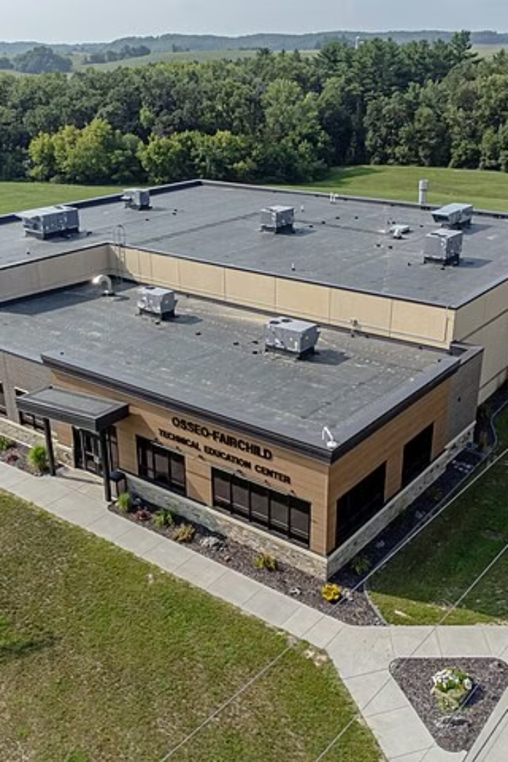
Introduction to Technical Education
Technical education plays a crucial role in preparing individuals for the demands of the modern workforce. It equips students with practical skills and knowledge essential for various industries.
by
AMAN SINGH KANWAL
AMAN KUMAR
AMIT CHAUHAN
ANJALI UPRETI
BHAVESH PANT
DHRUV KUMAR
DIKSHA BISHT
ANUJ THAPA

Slide 2
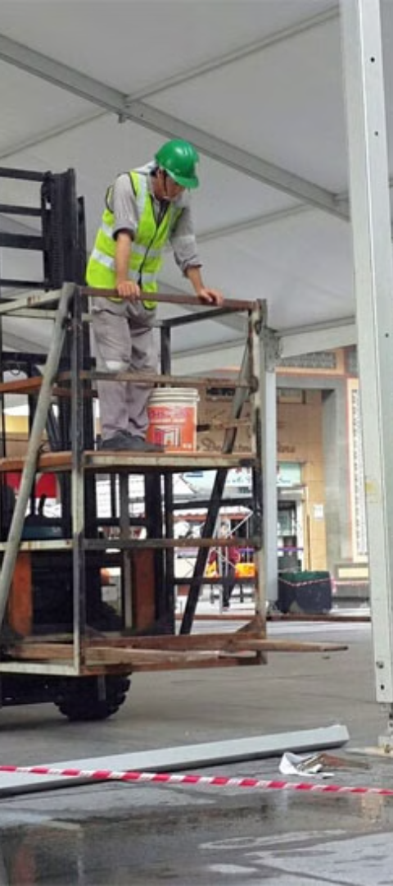
Importance of Technical Education
1
Skills Development
Technical education fosters the development of specialized skills required for specific occupations.
2
Career Opportunities
It opens doors to diverse and rewarding career paths that contribute to economic growth.
3
Economic Advancement
It is a cornerstone for innovation and economic progress in industrial and technological fields.

Slide 3

Current Industrial Scenario
1
Technological Advancements
2
Market Demand
Industries are embracing cutting-edge technologies to enhance productivity and efficiency.
There is a growing need for highly skilled professionals in multiple industrial sectors to meet market demands.
3
Sustainable Practices
Industries are shifting towards sustainable practices and environmentally friendly production methods.

Slide 4
The Need for Skilled Workforce
Industry Relevance
Economic Growth
Quality Output
The industry requires a skilled workforce to drive innovation and maintain global competitiveness.
Skilled workers contribute to increased productivity and economic development in various sectors.
Qualified workforce ensures high-quality outputs, meeting customer needs effectively and efficiently.

Slide 5
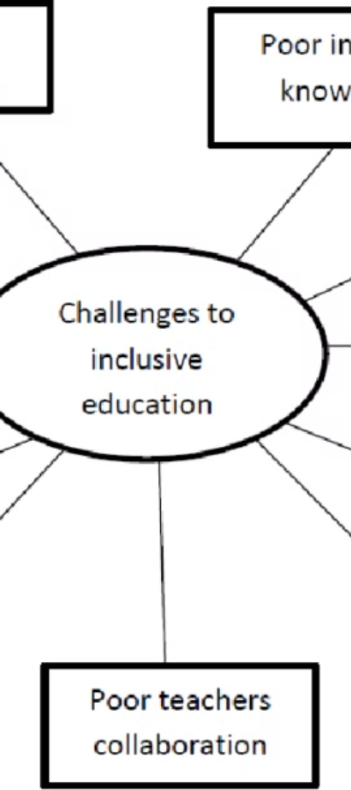



Challenges in Technical Education
Technology Integration
Integrating modern technologies into education presents numerous challenges.
Skill Gap
Addressing the gap between industry requirements and current skill sets proves to be challenging.
Curriculum Development
Developing an up-to-date and relevant curriculum to meet industry needs is a complex task.

Slide 6
Industry-Academia Collaboration
Internship Programs
Research Collaborations
Curriculum Alignment
Industry-academia partnerships offer valuable real-world experiences through internships.
Collaborations promote research initiatives and technological advancements for industry needs.
Aligning educational programs with industry requirements enhances the employability of graduates.

Slide 7




Future Trends in Technical Education
Innovation
Globalization
Automation
Diversity & Inclusion
Embracing new technologies and innovative teaching methods for enhanced learning experiences.
Adopting a global perspective in curriculum and skills development for a connected world.
Preparing students for the impact of automation and the future of work.
Promoting diversity and inclusivity in technical education to support a diverse workforce.

Slide 8
Conclusion and Recommendations
Continuous Learning
Adapting to new industry requirements through continuous skill development
Policy Advocacy
Advocating for policies that support technical education and industry collaboration
Industry Partnerships
Forming strong alliances between academic institutions and industries for mutual benefit

