Slide 1
5-2 Two-Way Selection
The decision is described to the computer as a conditional statement that can be answered either true or false. If the answer is true, one or more action statements are executed. If the answer is false, then a different action or set of actions is executed.
Topics discussed in this section:
if…else and Null else Statement
Nested if Statements and Dangling else Problem
Simplifying if Statements
Conditional Expressions
Computer Science: A Structured Programming Approach Using C

Slide 2
FIGURE 5-7 if...else Logic Flow
Computer Science: A Structured Programming Approach Using C

Slide 3
Table 5-2
Syntactical Rules for if…else Statements
Computer Science: A Structured Programming Approach Using C

Slide 4
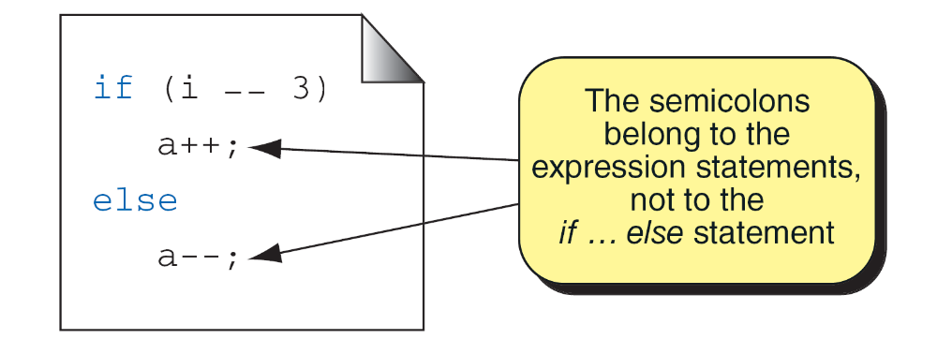
FIGURE 5-8 A Simple if...else Statement
Computer Science: A Structured Programming Approach Using C

Slide 5
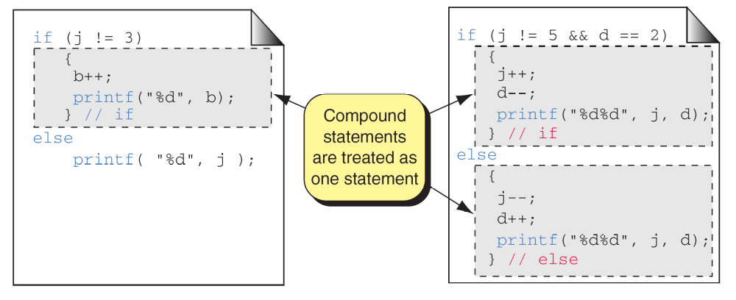
FIGURE 5-9 Compound Statements in an if...else
Computer Science: A Structured Programming Approach Using C

Slide 6
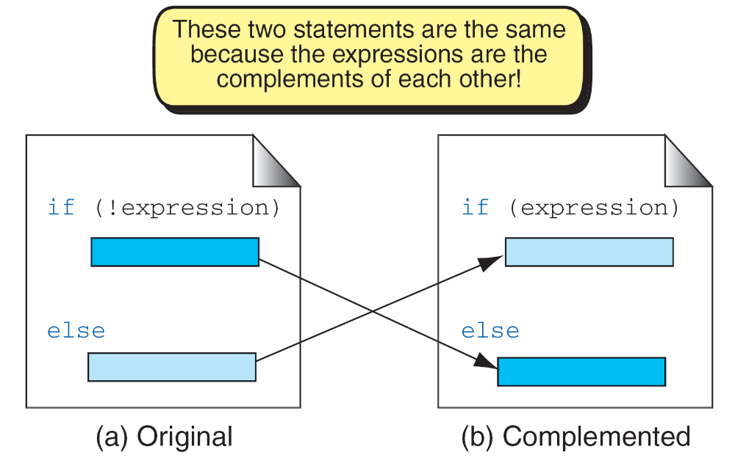
FIGURE 5-10 Complemented if...else Statements
Computer Science: A Structured Programming Approach Using C

Slide 7
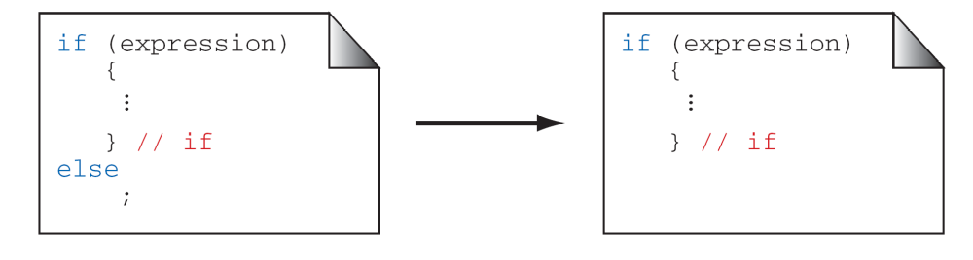
FIGURE 5-11 A Null else Statement
Computer Science: A Structured Programming Approach Using C

Slide 8
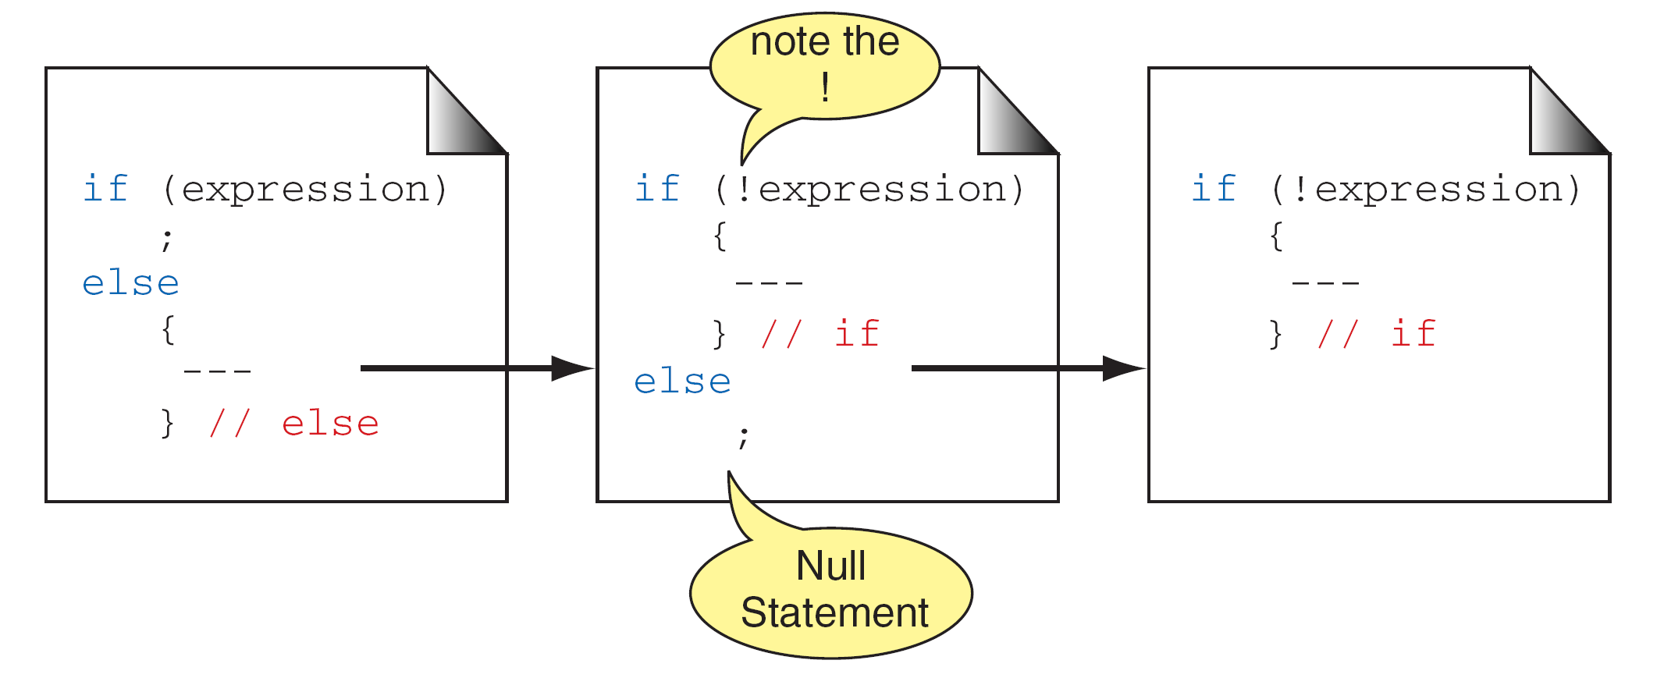
FIGURE 5-12 A Null if Statement
Computer Science: A Structured Programming Approach Using C

Slide 9
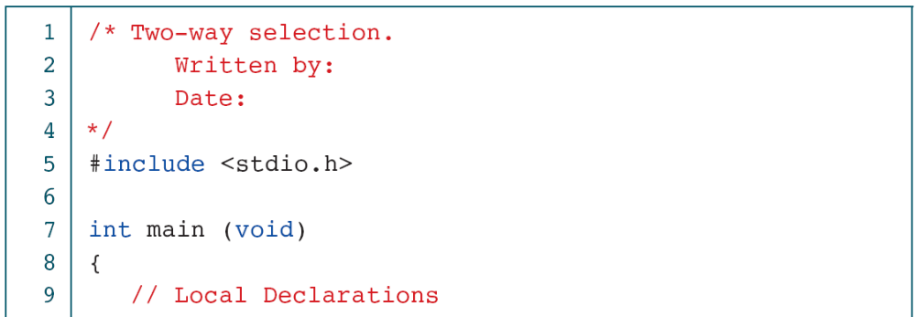
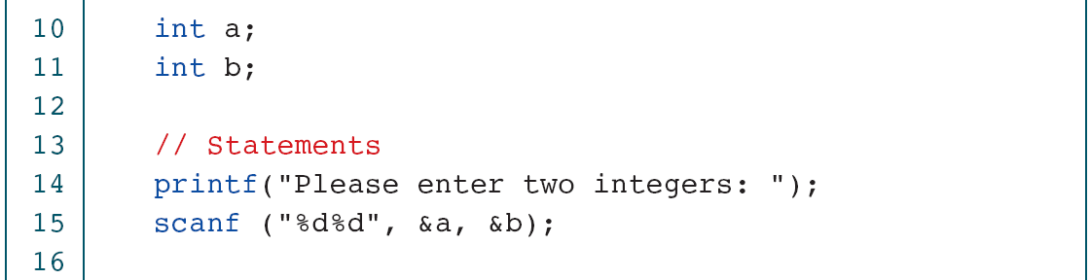
PROGRAM 5-3
Two-way Selection
Computer Science: A Structured Programming Approach Using C

Slide 10
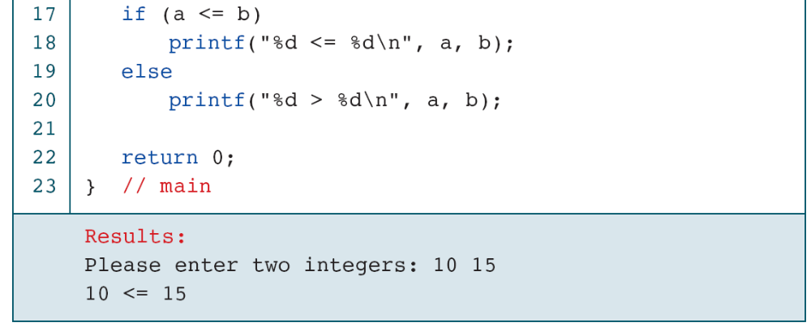
PROGRAM 5-3
Two-way Selection
Computer Science: A Structured Programming Approach Using C

Slide 11
FIGURE 5-13 Nested if Statements
Computer Science: A Structured Programming Approach Using C

Slide 12
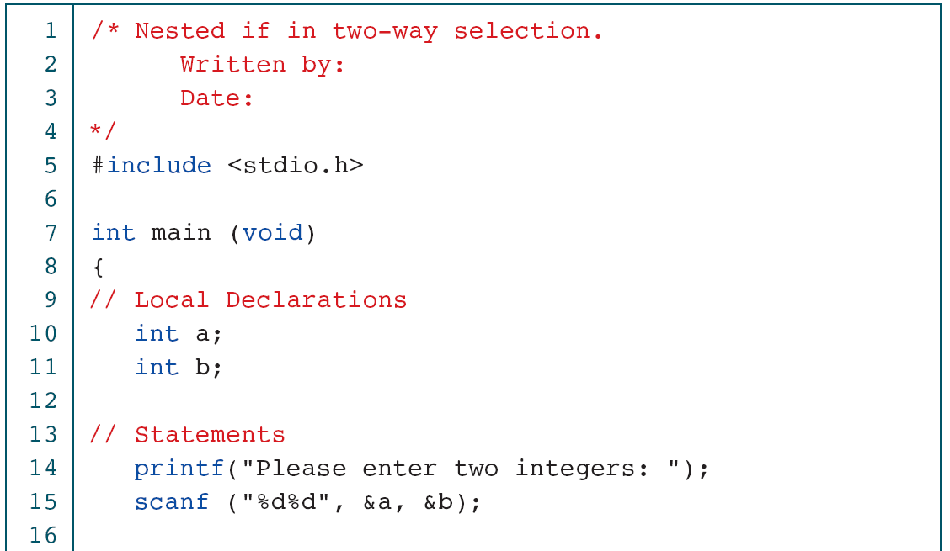
PROGRAM 5-4
Nested if Statements
Computer Science: A Structured Programming Approach Using C

Slide 13
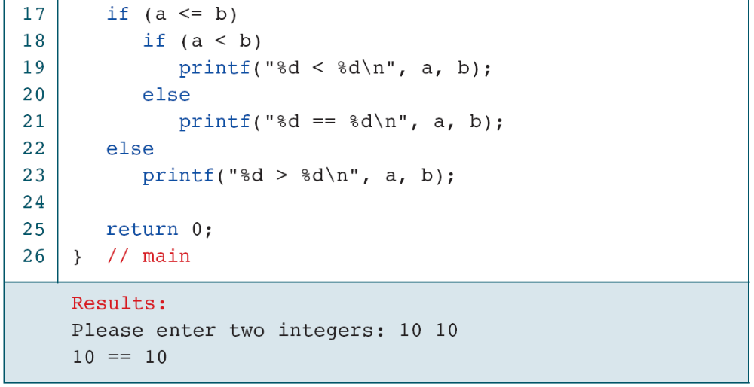
PROGRAM 5-4
Nested if Statements
Computer Science: A Structured Programming Approach Using C

Slide 14
Note
else is always paired with the most recent unpaired if.
Computer Science: A Structured Programming Approach Using C

Slide 15
FIGURE 5-14 Dangling else
Computer Science: A Structured Programming Approach Using C

Slide 16
FIGURE 5-15 Dangling else Solution
Computer Science: A Structured Programming Approach Using C

Slide 17
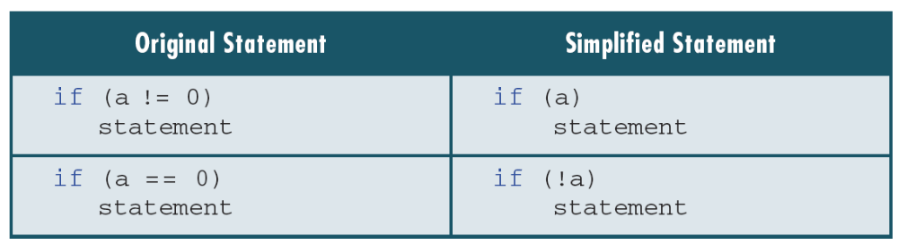
Table 5-3
Simplifying the Condition
Computer Science: A Structured Programming Approach Using C

Slide 18
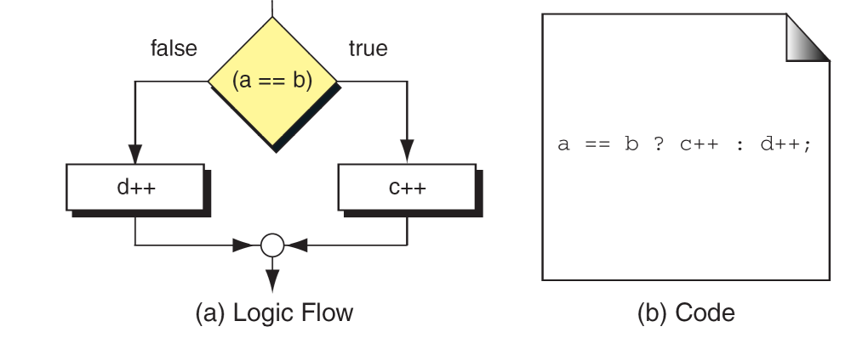
FIGURE 5-16 Conditional Expression
Computer Science: A Structured Programming Approach Using C

Slide 19
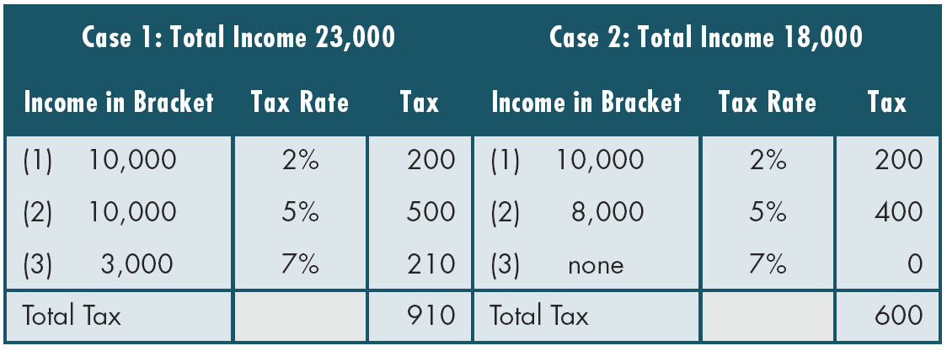
Table 5-4
Examples of Marginal Tax Rates
Computer Science: A Structured Programming Approach Using C

Slide 20
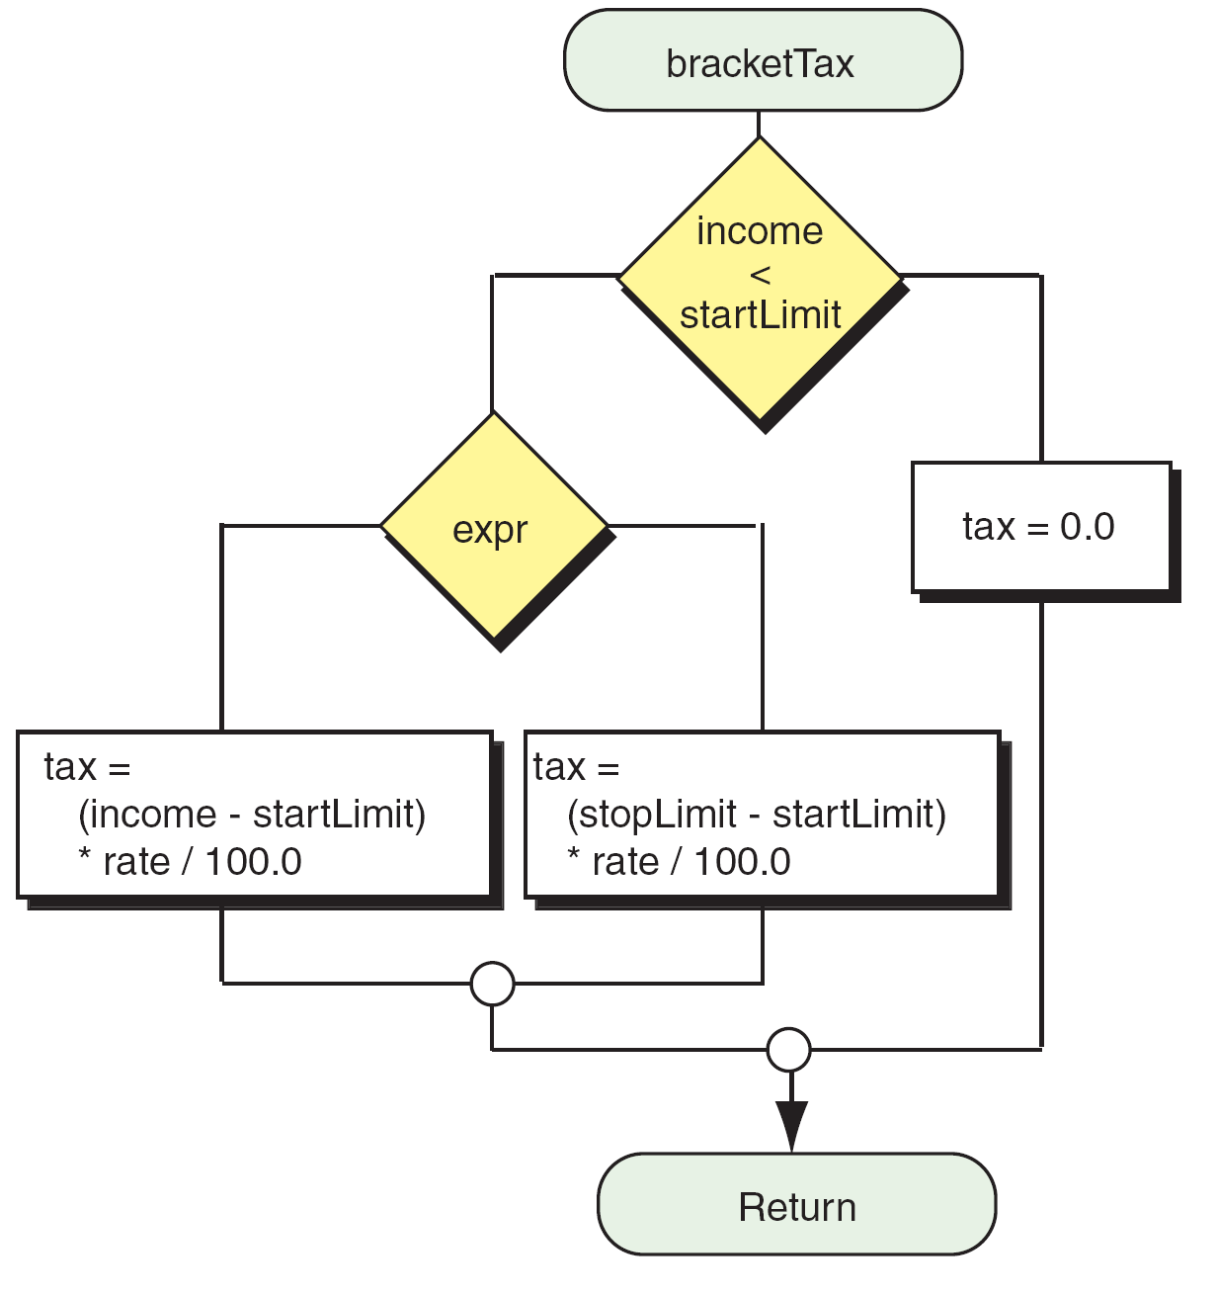
FIGURE 5-18 Design for Program 5-5 (Part III)
Computer Science: A Structured Programming Approach Using C

Slide 21
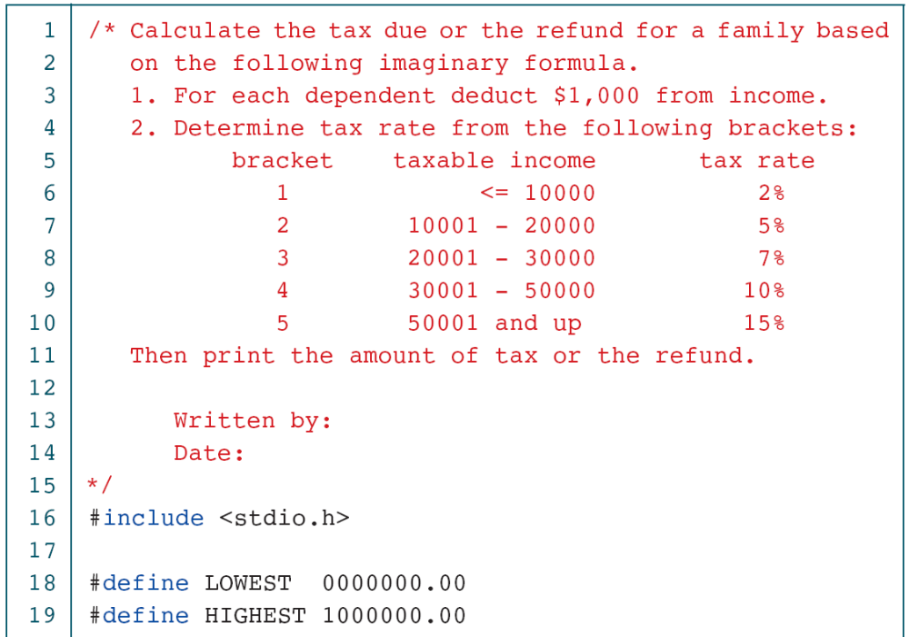
PROGRAM 5-5
Calculate Taxes
Computer Science: A Structured Programming Approach Using C

Slide 22
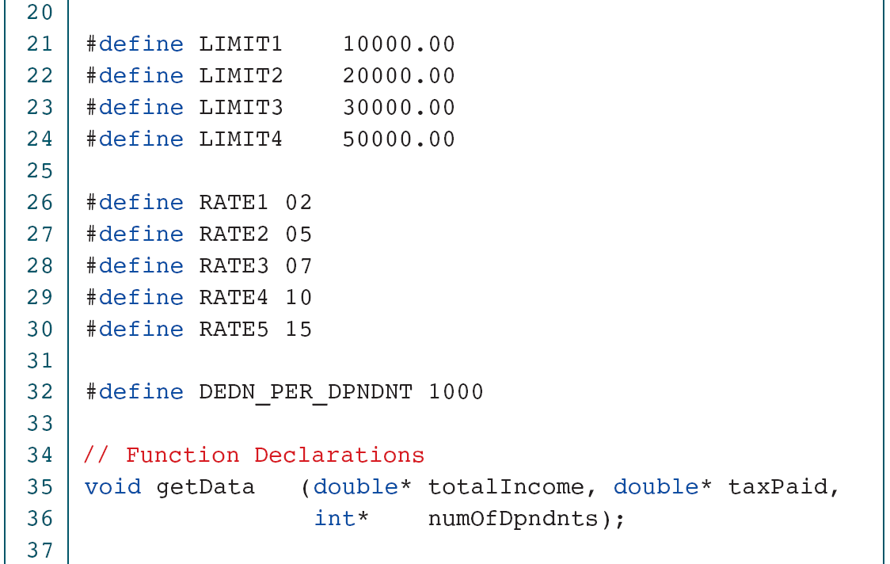
PROGRAM 5-5
Calculate Taxes
Computer Science: A Structured Programming Approach Using C

Slide 23
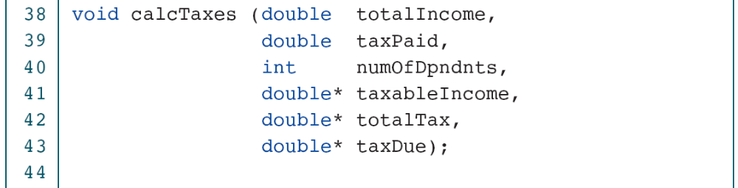
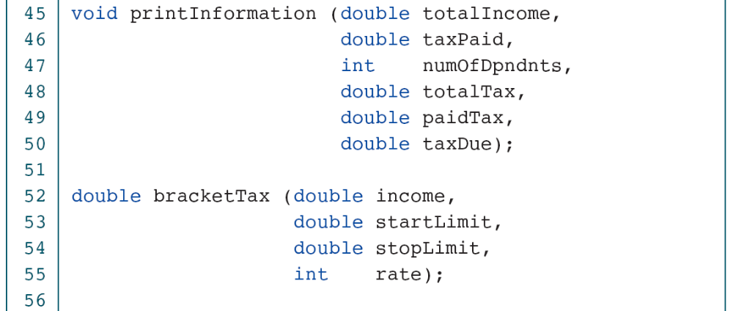
PROGRAM 5-5
Calculate Taxes
Computer Science: A Structured Programming Approach Using C

Slide 24
PROGRAM 5-5
Calculate Taxes
Computer Science: A Structured Programming Approach Using C

Slide 25
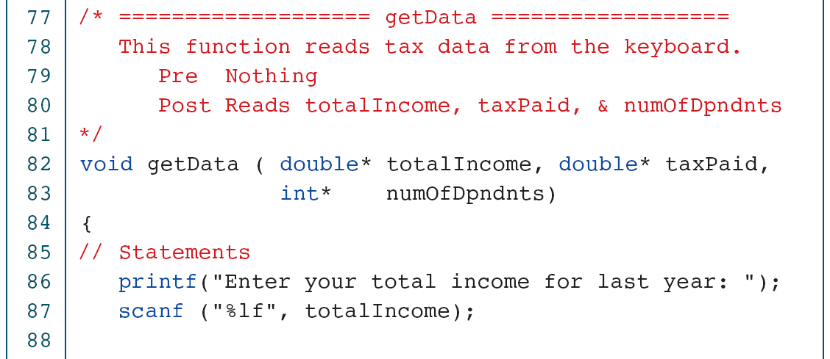
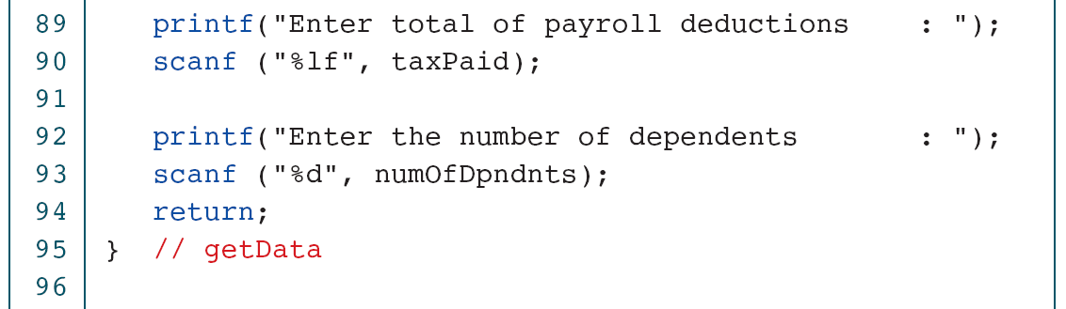
PROGRAM 5-5
Calculate Taxes
Computer Science: A Structured Programming Approach Using C

Slide 26
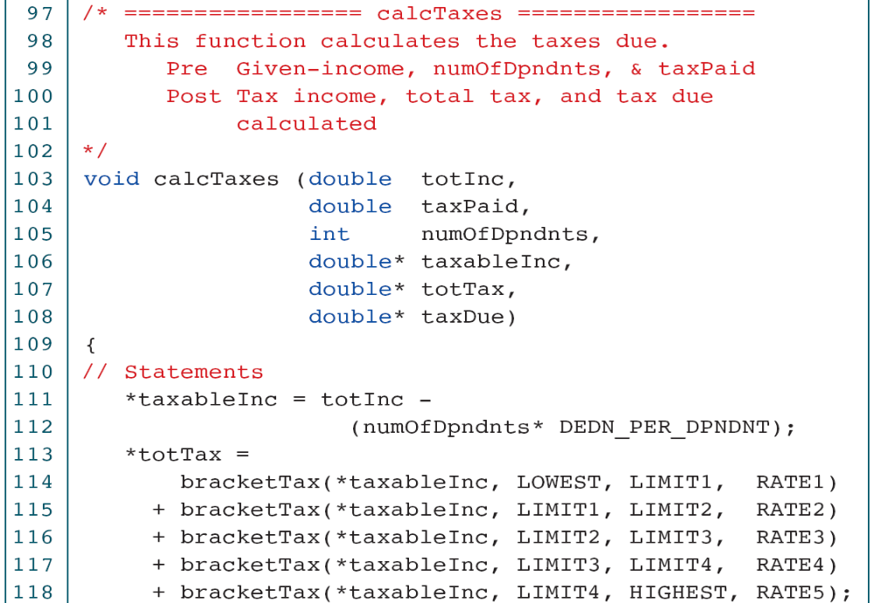
PROGRAM 5-5
Calculate Taxes
Computer Science: A Structured Programming Approach Using C

Slide 27
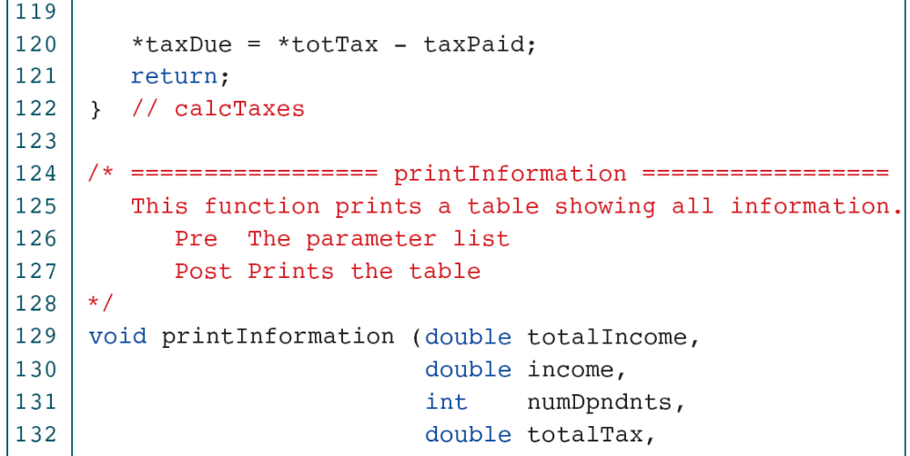
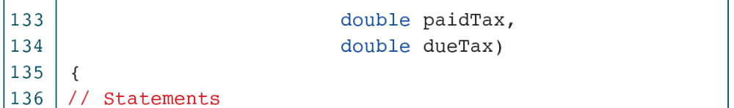
PROGRAM 5-5
Calculate Taxes
Computer Science: A Structured Programming Approach Using C

Slide 28
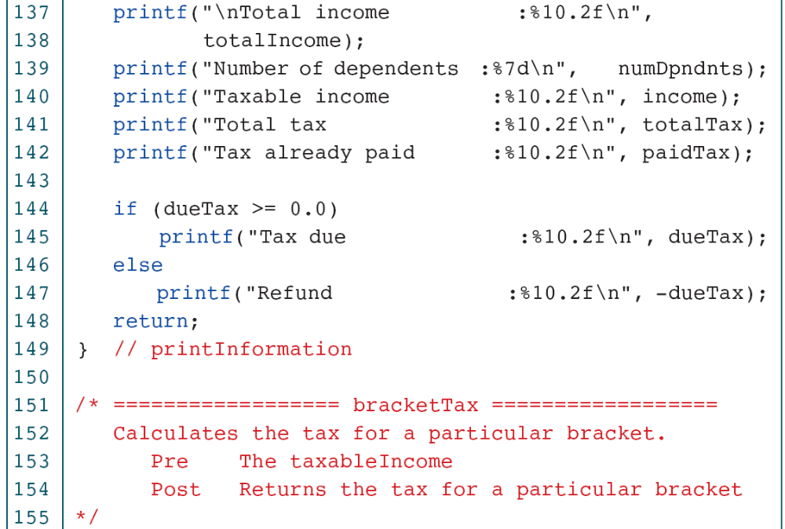
PROGRAM 5-5
Calculate Taxes
Computer Science: A Structured Programming Approach Using C

Slide 29
PROGRAM 5-5
Calculate Taxes
Computer Science: A Structured Programming Approach Using C

Slide 30

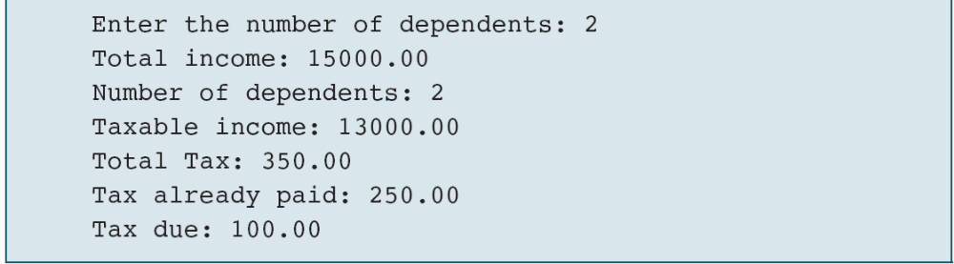
PROGRAM 5-5
Calculate Taxes
Computer Science: A Structured Programming Approach Using C

