Slide 1

Introduction
1

Slide 2
Human-based computing
In the Second World War, one of the challenges for each side was to try to crack the codes used by the opposition.
This became urgent for the British as the German Uboat fleet was decimating British convoys in the Atlantic.
The Admiralty desperately needed to know where the U-boats were, and this could only be achieved by intercepting their communications.
In Britain the code-breaking work was done at Bletchley Park, where originally teams of people worked to decipher messages.
Many did not understand the purpose of their work, as they only worked on small parts and did not see the bigger picture.
They just did the calculations needed by blindly following the instructions they were given.
2

Slide 3
Machine based computing
The instructions being followed were devised by a team of Mathematicians led by Alan Turing: the original human computer programmers.
They of course had to understand what was going on to devise the
instructions.
However, the mass of communications that were being intercepted meant that the teams of people could not work fast enough.
Gradually machines were designed that could do some of the routine parts.
These machines were the precursors to the modern computer (Hodges,
1985).
Machine-based computers thus just took over the things that human-based computers had previously done.
Their speed and accuracy mean they can tackle bigger problems and do
3

Slide 4
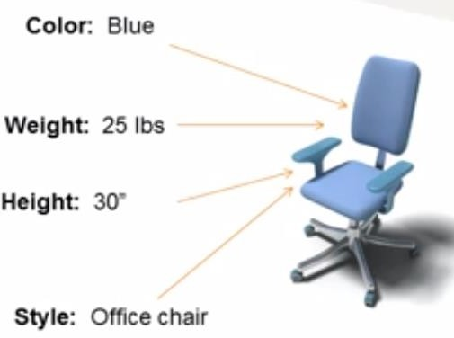
Data around us
Our world is made of all kinds of objects or things that we like to be informed of.
Each object is described by a number of attributes (characteristics).
Figure: An object’s characteristics
become data
 Each attribute can have a value and that value is data.
In the given example, how many types of data do you see?

Slide 5
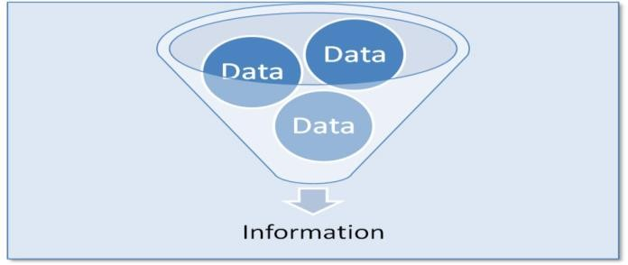
Data and Information
Data- Raw unorganized facts that need to be processes.
It can be something simple, seemingly random and useless until it is organized.
Each student’s text score is one piece of data.
Information-Data when processed, organized, structured or presented in a given context so as to make it useful.
Average score of a class department derived from the data.
  Can you give some examples of data and associated information?

Slide 6
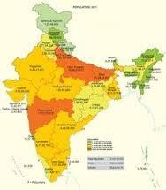
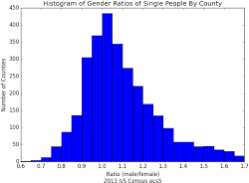
Census Report (Total population, Literacy Rate, Male / Female ratio etc.)
Census data is used to get report/information about total population of a country and literacy rate etc.

Slide 7
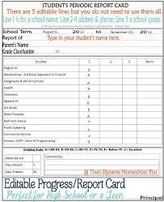
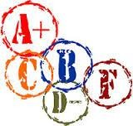
Result Cards of Individual Students, Result sheets of a particular Class
In examination system collected data (obtained marks in each subject) is processed to get total obtained mark of a student.
Total obtained mark is Information. It is also used to prepare result card of a student.

Slide 8


Merit List
After collecting admission forms from candidates, merit is calculated on the basis of obtained marks of each candidate.
Normally, percentage of marks obtained is calculated for each candidate.
Now all the candidates names are arranged in descending order by percentage.
This makes a merit list.
Merit list is used to decide whether a candidate will get admission in the college or not.

Slide 9
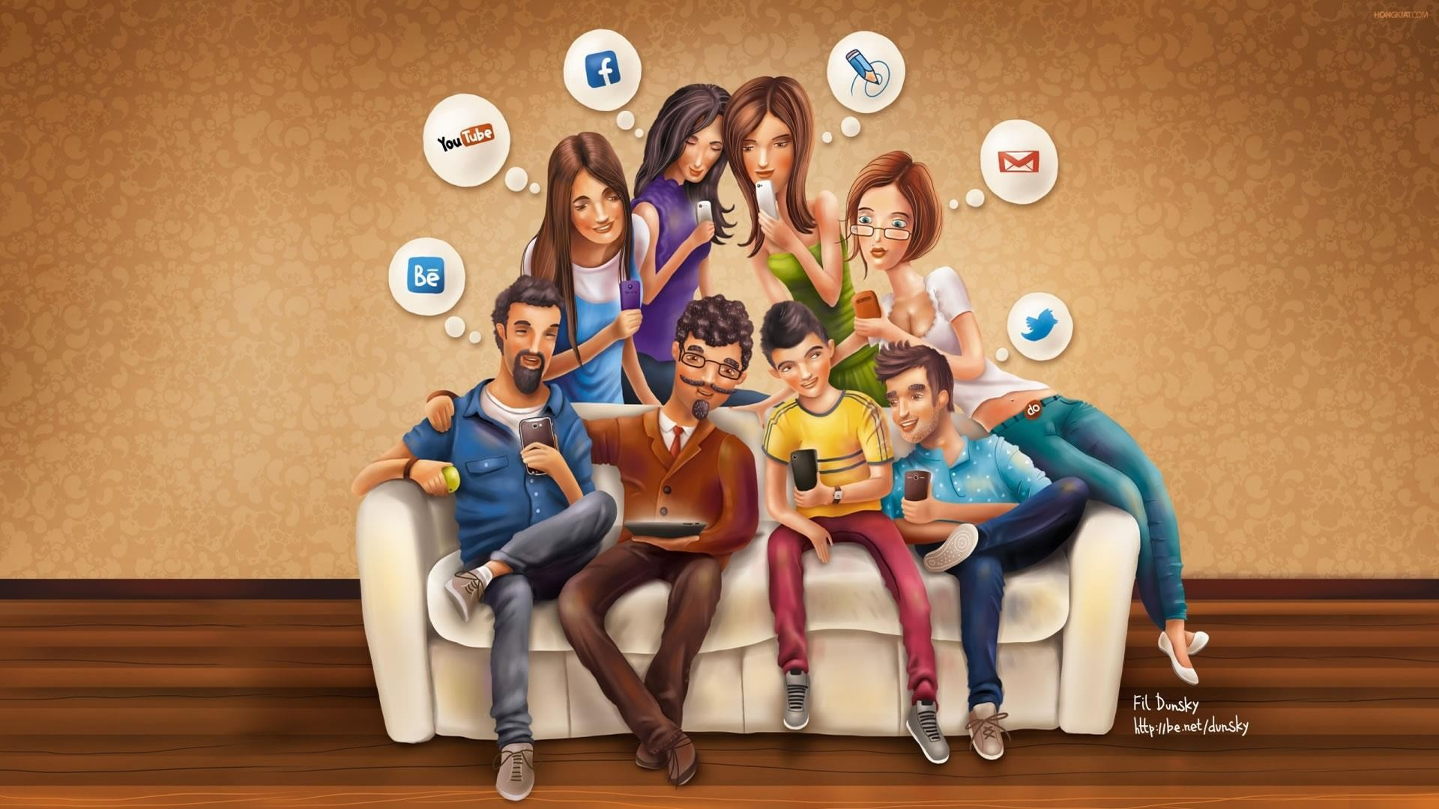
There is more to technology than mere social media & networking
Figure:Technology enabled connectedness through social media
Can you name some (software) technologies that have impacted you?

Slide 10
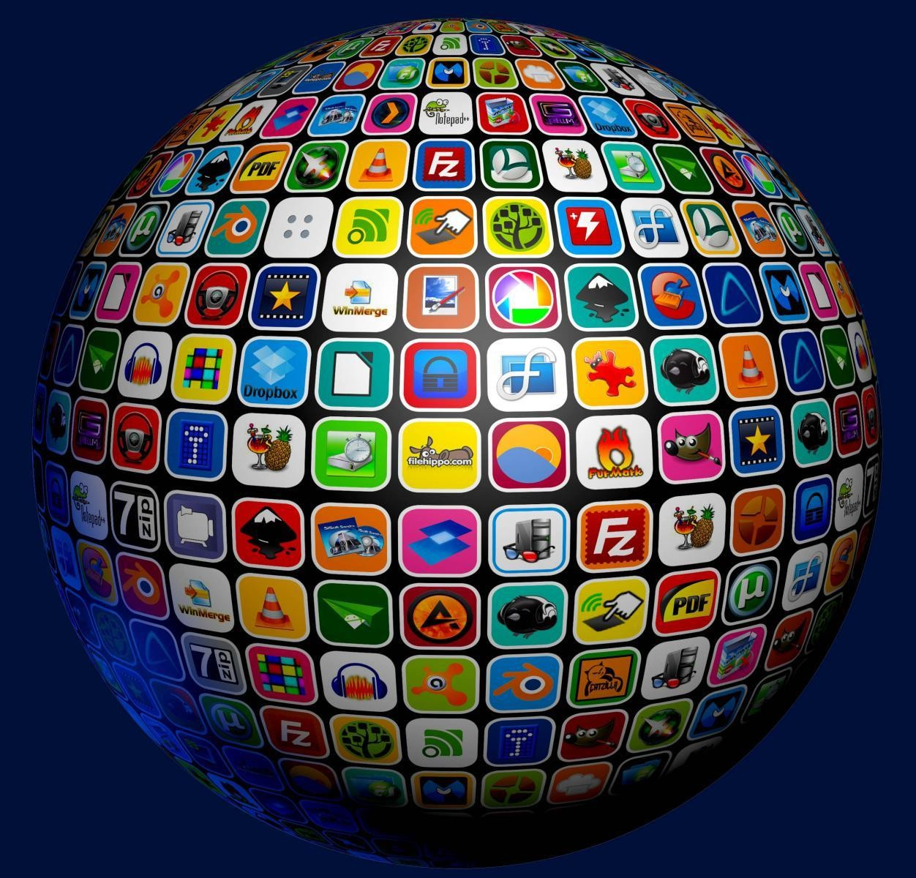
Software - product of critical thinking skills
Figure:The world of Software

Slide 11
Along with the power of computing, software too became versatile and powerful.
There are plenty of software out there; Today software is synonymous with technology.
Software technologies were possible due to both power of computing and critical thinking skills.
This course is about computational thinking skills.

Slide 12
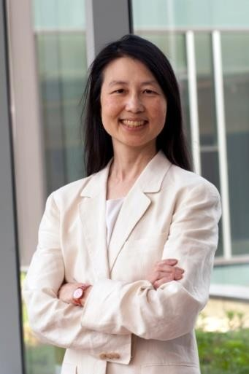
Computational Thinking is a term coined by Jeannette M.Wing of CMU.
Communications of ACM article authored by her introduced the tenets of Computational Thinking.
Computational Thinking is all about the ways to think like a computer scientist.

Slide 13
What is computer science all about?
Computer Science is the represent and manipulate
study of how to the information
inherent to natural, engineered, social and artistic systems.

Slide 14
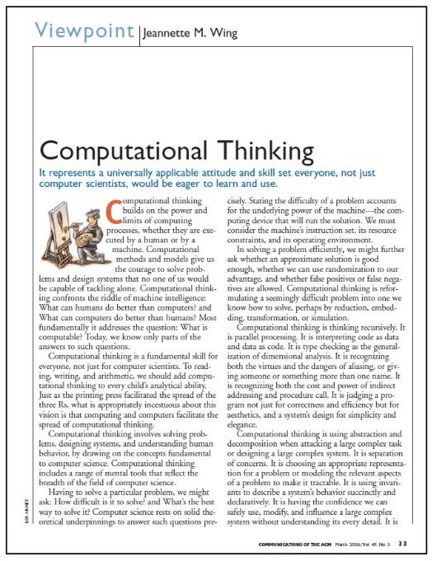
Figure: Jeannette’s Article

Slide 15
Computational Thinking
Computers can be used to help us solve problems.
However, before a problem can be tackled, the problem itself and the ways in which it could be solved need to be understood.
Computational thinking allows us to do this.
Computational thinking allows us to take a complex problem, understand what the problem is and develop possible solutions.
We can then present these solutions in a way that a computer, a human, or both, can understand.

Slide 16
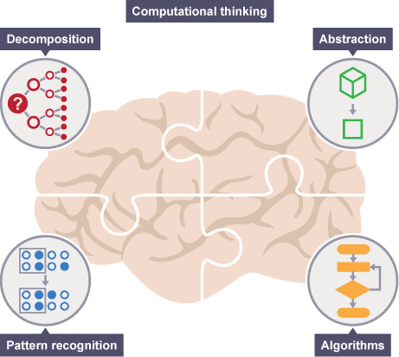

Slide 17
The four cornerstones
Decomposition - breaking down a complex problem or system into smaller, more manageable parts
Pattern recognition – looking for similarities among and within problems
Abstraction – focusing on the important information only, ignoring irrelevant detail
Algorithms - developing a step-by-step solution to the problem, or the rules to follow to solve the problem
Each cornerstone is as important as the others.
They are like legs of a table - if one leg is missing, the table will probably collapse.
Correctly applying all four techniques will help when programming a computer.

Slide 18
Programs
Human based computation
  Human beings were also given programs to follow:
    The instructions were just given in a language the humans could follow.
    When you do a long multiplication you are doing exactly this, following step-by-step rules you wrote as a child.
Computer programs are just step-by-step instructions for doing a given task, written in computer programming languages.

Slide 19
Algorithms
These step-by-step instructions are algorithms.
  An algorithm consists of the actions to do and the order to do them in.
Algorithms occur all over the place
  the instructions you learnt about how to do long division, find prime numbers, bake, brush your teeth etc…..
  the instructions of how to put together a DIY bookcase
  A set of instructions of how to solve a Rubik's Cube
    In fact there are a whole series of puzzles that involve devising algorithms to solve them of which a Rubik's cube is one of the most complex.

Slide 20
Computational Thinking in Practice
Before computers can be used to solve a problem, the problem itself and the ways in which it could be resolved must be understood.
Computational thinking techniques help with this.
Thinking computationally is not programming.
It is not even thinking like a computer, as computers do not, and cannot, think.
Simply put, programming tells a computer what to do and how to do it.
Computational thinking enables you to work out exactly what to tell the computer to do.

Slide 21
What CT is and is'nt?
Conceptualizing, not programming.
Fundamental, not rote skill.
A way that humans, not computers, think.
Complements and combines mathematical and engineering skills.
Ideas not artifact.
For everyone, everywhere.

Slide 22
Planning to meet friends
If you agree to meet your friends somewhere you have never been before, you would probably plan your route before you step out of your house.
You might consider the routes available and which route is ‘best’
- this might be the route that is the shortest, the quickest, or the one which goes past your favourite shop on the way.
You'd then follow the step-by-step directions to get there.
In this case, the planning part is like computational thinking, and following the directions is like programming.

Slide 23
Being able to turn a complex problem into one we can easily understand is a skill that is extremely useful.
In fact, it's a skill you already have and probably use every day.

Slide 24
Go out with a Group of friends
You need to decide what to do with your group of friends.
If all of you like different things, you would need to decide:
  what you could do
  where you could go
  who wants to do what
  what you have previously done that has been a success in the past
  how much money you have and the cost of any of the options
  what the weather might be doing
  how much time you have

Slide 25
From this information, you and your friends could decide more easily where to go and what to do – in order to keep most of your friends happy.
You could also use a computer to help you to collect and analyse the data to devise the best solution to the problem, both now and if it arose again in the future, if you wished.

Slide 26
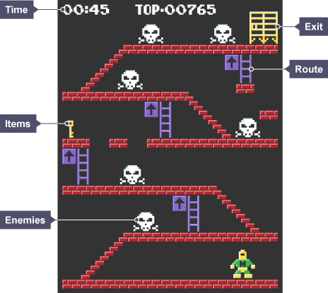
Playing a videogame

Slide 27
Playing a videogame
To complete a level you would need to know:
  what items you need to collect,
  how you can collect them, and
  how long you have in which to collect them
  where the exit is and the best route to reach it in the quickest time possible
  what kinds of enemies there are and their weak points
From these details you can work out a strategy for completing the level in the most efficient way.

Slide 28
each complex problem was broken down into several small decisions and steps: decomposition
only the relevant details were focused on:
abstraction
knowledge of previous similar problems was used: pattern recognition
to work out a step by step plan of action:
algorithms

Slide 29

If you were to create your own computer game, what are the types of questions you would need to think about and answer before you program your game?

Slide 30

What has been described?
Human based and Machine based computing
Data and information
Computational Thinking
Corner Stones of CT

