Slide 1

I.4
LOGIC
1
Department of CSE

Slide 2
Boolean Logic

Slide 3
Expressions
An expression is simply one or more variables and/or constants joined by
operators
An expression is evaluated and produces a result
The result of all arithmetic expressions are either integers or reals
An expression can also yield a result that is either true or false- BOOLEAN
Such an expression is called a relational expression
The result reflects how something "relates to” something else.
For example
"Is the value of x greater than the value of y?"
Note that the preceding poses a question.
Relational expressions are usually intended to answer yes/no, or true/false, questions.
Obviously, boolean values and boolean variables play an important role in relational expressions.
3
Department of CSE

Slide 4
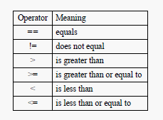

Operators
To build relational expressions, two types of operators are used,
relational operators and logical operators Relational operators
Logical operators
4
Department of CSE

Slide 5
Examples
Expression | Value of expression
3 < 4 | True
7.6 <= 9 | True
4 == 7 | False
8.3 != 2.1 | True
Initial values | Expression | Value of expression
a = 3 b=4 c=5 d=6 | a ==b c< d (a==b) && (c<d) (a==b) && (c<d) | False True False True
 | result = (a==b) && (c<d) !result | False true
5
Department of CSE

Slide 6
Truth assignment:True or False
Let,
(a < b || (a >= b && c == d)) be statement 1
(a < b || c == d) be statement 2
In the statements 1 and 2,
a < b , c == d, a >= b are conditions to be checked for TRUE or FALSE to determine the truth value of the entire expression

Slide 7
Logical expression
Let (a < b || (a >= b && c == d)) be statement 1
Let (a < b || c == d) be statement 2
# A. Let, a is less than b be True
We inspect the first of the two conditions (a < b) to see if it is true
It is true in both statements 1 and 2
TRUE is returned by both the statements

Slide 8
# B. Let, a is less than b be FALSE
In statement 1 :
We inspect the second of the two conditions
(a >= b && c == d) to see if it is true
We are asking whether both a >= b AND c == d are true
If a < b is false, then a >= b is of course true
Therefore whether true or false is returned entirely depends on the condition
c == d
  If c == d is true then true is returned [as it is understood a
>= b is true]
and as a < b is false, the statement 1 returns true
  If c == d is false and false is returned [as it is understood a >=
b is true]
  and as a < b is false, the statement 1 returns false

Slide 9
In statement 2 :
We inspect the second of the two conditions c == d
If c == d is true then true is returned and as a < b is false, the
statement 2 returns true
If c == d is false and false is returned and as a < b is false, the
statement 2 returns false

Slide 10
Proposition
Any statement that can have one of the truth values, TRUE or FALSE is called a
Proposition
The sentence "2+2 = 4" is a statement, since it can be either true or false. Since it happens to be a true statement, its truth value is T
The sentence "1 = 0" is also a statement, but its truth value is F
"It will rain tomorrow" is a proposition.
For its truth value we shall have to wait for tomorrow
"Solve the following equation for x" is not a statement It cannot be assigned any truth value whatsoever
It is an imperative, or command, rather than a declarative sentence
Department of CSE

Slide 11
Proposition Contd…
"The number 5" is not a proposition It is not even a complete sentence
"There is no planet called Mars“ is a proposition with truth value F
"Ode to Spring" is not a proposition
Department of CSE

Slide 12
Propositional logic
Propositional logic is a mathematical model that allows us to reason about the truth or falsehood of logical expressions
Propositional logic is a useful tool for reasoning….
Law of the excluded middle
States that there are only two truth values in a logical system
( TRUE , FALSE)

Slide 13

Which of the following statements are propositions? If the statement is a proposition, provide truth value.
The sum of any two prime numbers is even.
Come to class!
The moon is made of green cheese.
Is it raining?
Solution:-
The sum of any two prime numbers is even.
Proposition.Truth value if False (Eg:- 2+3=5, which is not even)
Come to class! Not a proposition
The moon is made of green cheese.
Proposition.Truth value if False
Is it raining? Not a proposition
13
Department of CSE

Slide 14
Propositional variable
Notice that, our reasoning about the two statements and 2 in the previous eg. did not depend on what a < b actually means
All we needed to know was that the conditions a < b and a >= b are complementary, that is, when one is TRUE the other is FALSE and vice versa
We may therefore, replace a statement by a single symbol known
as Propositional variable, since they can stand for any proposition

Slide 15
Example
a > b is a simple proposition
It can be represented by a propositional variable p
c==d is a simple proposition
It can be represented by a propositional variable q
Now,
The propositional variable p has truth assignment TRUE or FALSE depending on whether a is less than b is TRUE
Similarly, the propositional variable q has truth assignment TRUE or FALSE depending on whether c is equal to d is TRUE

Slide 16
Examples
“the moon is round” is a statement p: "the moon is round”
the propositional variable p, expresses the above statement
“I am a mammal” q: “I am a mammal”
the propositional variable q, expresses the above statement
“I am not a mammal” is the negation of q It is represented by NOT q
~q and !q all mean the same
q | ~q
T | F
F | T
Department of CSE

Slide 17
P1:Tanya is older than Eric. P2:Cliff is older than Tanya. P3:Eric is older than Cliff.
If the first two propositions are true, what is the truth value of the third proposition? Why?
Department of CSE

Slide 18
P1:Tanya is older than Eric. P2:Cliff is older than Tanya. P3:Eric is older than Cliff.
If the first two propositions are true, what is the truth value of the third proposition? Why?
Solution
P1 says Tanya is older than Eric. P2 says Cliff is older than Tanya. When P1 and P2 are true, we can come to the conclusion that Cliff is older than Eric. But P3 says otherwise. Hence truth value of P3 should be FALSE
Department of CSE

Slide 19
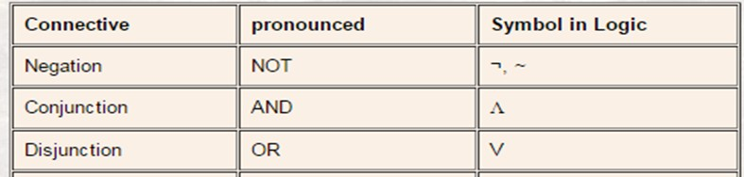
Compound proposition
A compound proposition is formed by combining simple propositions with logical connectives, also known as logical operators.
Basic logical connectives: AND, OR, NOT.
Figure: Notation and meaning of logical connectives

Slide 20
Logical expressions
In these expressions, p, q, and r are propositional variables.
NOT p
p AND (q OR r)
(q AND p) OR (NOT p)
Propositional variables , logical operators and the logical constants (TRUE and FALSE) form logical expressions
Let , E be a logical expression and F be another logical expression
E AND F is a logical expression.
The value of this expression is TRUE if both E and F are TRUE and FALSE otherwise.
E OR F is a logical expression.
The value of this expression is TRUE if either E or F or both are TRUE, and the value is FALSE if both E and F are FALSE
NOT E is a logical expression.
The value of this expression is TRUE if E is FALSE and FALSE if E is TRUE

Slide 21
Examples
Let, p denote a < b
Then NOT p denotes a >= b
Let, q denote c==d
Now consider the expression :
(a < b || (a >= b && c == d)) This expression can be written as:
p OR( (NOT p) AND q)
Similarly, the expression (a < b || c == d) can be written as (p OR q)
We have shown previously that both are equivalent, therefore we write p OR( (NOT p) AND q) ≡ (p OR q)

Slide 22

Symbolic logic is a modern extension of Aristotelian logic where symbols are represent statements of truth.
Boolean logic is a symbolic logic system that was created by a mathematician named George Boole around 1850.
Logical expressions are used to express logical thought.

Slide 23


Example #1
“I will take an umbrella with me if it is raining or the weather forecast is bad”
The above statement tells us that,
If Raining or Bad Weather Forecast, take umbrella
The OR logical connective denotes disjunction and can be used here

Slide 24
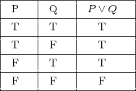

Let, p be the proposition Raining
q be the proposition Bad forecast
r be the proposition take umbrella
We have,
the compound proposition, p OR q
the proposition r ( which is p OR q ) takes the truth value TRUE or FALSE as follows:
Logical disjunction yields a value of FALSE only when both of
the inputs are FALSE
This result is intuitive since it closely follows the way we
informally use the term and when speaking
24

Slide 25
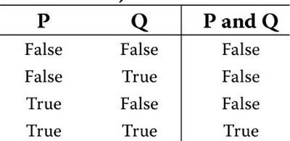
Example #2
“Take an umbrella if it is hot and sunny”
The above statement tells us that,
If Hot and Sunny, take umbrella
The AND logical connective denotes conjunction and can be used here
We have,
P = “It is hot.
Q = “It is sunny” U= “Take umbrella”
U is P && Q
Logical conjunction yields a value of TRUE only when both of the
inputs are TRUE
This result is intuitive since it closely follows the way we informally use the term and when speaking.

Slide 26
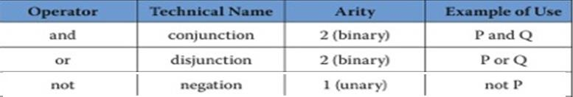
Arity of operators
An operator is something like a machine that accepts inputs, processes those values, and produces a single output value
The arity of an operator is the number of inputs into the operator

Slide 27
p: "This galaxy will ultimately wind up in a black hole" q: "2+2 = 4
What does p && q say?
What does p AND (~q) say?
Solution
"This galaxy will ultimately disappear into a black hole and 2+2=4," or the more astonishing statement: "Not only will this galaxy ultimately disappear into a black hole, but 2+2 = 4!"
This galaxy will ultimately disappear into a black hole and 2+2 4," or "Contrary to your hopes and aspirations, this galaxy is doomed to eventually disappear into a black hole; moreover, two plus two is decidedly different from four!"
Department of CSE

Slide 28
p is the statement "This topic is boring”
q is the statement "Logic is a boring subject,"
Express the statement "This topic is definitely not boring even though logic is
a boring subject" in logical form.
Solution
The first clause is the negation of p, so is ~p.
The second clause is simply stating the (false) claim that logic is a boring
subject, and thus amounts to q.
The phrase "even though" is a colorful way of saying that both clauses are true, and so the whole statement is just (~p) AND q.
Department of CSE

Slide 29
Let p: "This topic is boring,"
q: "This whole web site is boring“ r: "Life is boring."
Express the statement "Not only is this topic boring, but this whole web site is boring, and in fact life is boring (so there!)" in logical form.
Solution
The statement is asserting that all three statements p, q and r are true.
(Note that "but" is simply an emphatic form of "and.")
Department of CSE

Slide 30
Now we can combine them all in two steps:
  Firstly, we can combine p and q to get p AND q, meaning "This topic is boring and this web site is boring.“
  We can then conjoin this with r to get: (p AND q) AND r.
  This says: "This topic is boring, this web site is boring and life is boring."
On the other hand, we could equally well have done it the other way around:
  conjoining q and r gives "This web site is boring and life is boring."
  We then conjoin p to get p AND (q AND r), which again says: "This topic is boring, this web site is boring and life is boring.”
Department of CSE

Slide 31
p: "55 is divisible by 5,“
q: "676 is divisible by 11”
r: "55 is divisible by 11.“
Express the following statements in symbolic form:
  "Either 55 is not divisible by 11 or 676 is not divisible by 11."
  "Either 55 is divisible by either 5 or 11, or 676 is divisible by 11."
Solution
This is the disjunction of the negations of r and q, and is thus (~r) OR (~q).
This is the disjunction of all three statements, and is thus (p OR r) OR q
is true because ~q is true.
is true because p is true. Notice that r is also true.
If at least one of p, q, or r is true, the whole statement will be true.
Department of CSE

Slide 32
Write each sentence in symbols, assigning propositional variables to statements as follows:
P: It is hot. Q: It is sunny.
  It is neither hot nor sunny.
  It is not hot but it is sunny.
Department of CSE

Slide 33
Solution
Given that P: It is hot.
Q: It is sunny.
Negation of P and Q will be as follows It is not hot - ~P
It is not sunny - ~Q
  It is neither hot nor sunny.
It can be re-written as ‘It is not hot and It is not sunny’ Hence the statement can be represented as ~P AND ~Q
  It is not hot but it is sunny.
It can be re-written as ‘It is not hot and It is sunny’ Hence the statement can be represented as ~P AND Q
Department of CSE

Slide 34
Well formed proposition
These rules guarantee that the proposition has meaning and is not merely a jumble of nonsense.
The grammatical rules for writing a well-formed proposition are listed next.
Rule 1—Each of the following is a simple proposition.
  Any single letter.
  True.
  False.

Slide 35
Well formed proposition contd---
Rule 2—Let a box (□) stand for a proposition (either simple or compound). Assuming that each box is some proposition, then each of the following are also propositions.
  □ and □
  □ or □
  □ implies □
d. □ ≡ □
e. not □
f. (□)

Slide 36
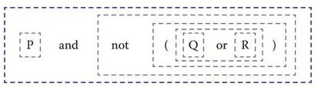
Example
Show that “P and not (Q or R)” is well formed Apply the rules to P and not (Q or R)
→ □ and not (□ or □)
→ □ and not (□)
→ □ and not □
→ □ and □
→ □
replace simple proposition in Rule 1 replace by Rule 2b
replace by Rule 2f
replace by Rule 2e replace by Rule 2a

Slide 37
Example
Consider reduction of P not Q
→ □ not □
→ □ □
replace simple proposition in Rule 1 replace by Rule 2e
STUCK !!!!!
Consider “P not Q” to be something like “I am hungry I am not cold.” is nonsensical or does not obey grammar rules.
This needs a connective or period or semicolon between the two proposition.
Corrected sentence: “I am hungry and I am not cold.”

Slide 38
Evaluation of propositions
Logical expressions can be evaluated to find its truth value
We have to construct the truth table for the expression and then evaluate its expression
Truth tables of expressions p and q, p or q , not p
p | q | p and q
T | T | T
T | F | F
F | T | F
F | F | F
p | q | p or q
T | T | T
T | F | T
F | T | T
F | F | F
p | ~ p
T | F
F | T

Slide 39
To construct a truth table for some proposition
Make a list of each logical variable (abbreviation) that appears in the proposition. If one variable occurs more than once in the proposition it should be included only once in your list.
Place a column in the truth table for every variable list your list. The column heading should be the variable itself.
For the heading of the last column you should write the entire proposition.
If there are N variables in your list, you must create 2^{N} rows. Each row represents a unique combination of values for the N variables.
For each row, determine the value of the proposition and place that value in the last column.

Slide 40
Examples
1. Construct the truth table for ~(p AND q)
p | q | p and q | ~(p and q)
T | T | T | F
T | F | F | T
F | T | F | T
F | F | F | T
2. Construct the truth table for p OR (p AND q)
p | q | p AND q | p OR (p AND q)
T | T | T | T
T | F | F | T
F | T | F | F
F | F | F | F
40
Department
of CSE

Slide 41
Construct Truth Table for the proposition : ~p AND (p OR q)
Solution
p | q | ~p | p AND q | ~p AND (p OR q)
T | T | F | T | F
T | F | F | T | F
F | T | T | T | T
F | F | T | F | F
Department of CSE

Slide 42
Construct the truth table for~(p AND q)AND (~r).
p | q | r | p and q | ~(p and q) | ~r | ~(Pand q)and (~r)
T | T | T | T | F | F | F
T | T | F | T | F | T | F
T | F | T | F | T | F | F
T | F | F | F | T | T | T
F | T | T | F | T | F | F
F | T | F | F | T | T | T
F | F | T | F | T | F | F
F | F | F | F | T | T | T
Department of CSE

Slide 43
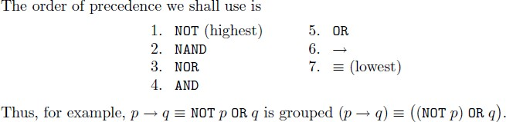
Order of precedence

Slide 44
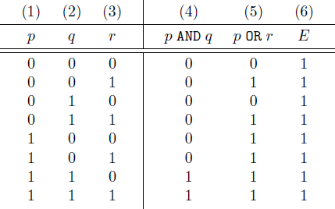
Computing truth Table of expressions

Slide 45
Example
P and not (Q or R)
The logical variables P, Q, and R are the only variables that occur and so our list contains only those three variables
We now construct a truth table that has one column for each of these variables
The final column corresponds to the whole proposition
  In order to determine the final column values include temporary columns for each of the logical operators to evaluate the value of the whole proposition
  These subparts should be arranged according to the order in which the operator will be evaluated

Slide 46
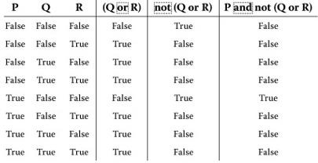
We now construct 2³ or 8 rows
Arrange the rows in some orderly fashion: rightmost column alternates repeatedly between True and False, then the next column in left alternates between True and False and so on...
Figure: P and not (Q or R) : Truth Table

Slide 47
Let, p AND (~q)
Let, NOTq be FALSE
What is the truth value of p AND (~q) ? Explain.
Solution:
~q is false
the whole statement p AND (~q) is FALSE(regardless of whether p is true or not).
47
Department of CSE

Slide 48


Revisit the logical expressions
(a < b || (a >= b && c == d)) be statement 1
(a < b || c == d) be statement 2
We have examined that,
# A. For a is less than b be True:
TRUE is returned by both the statements
# B. For a is less than b be FALSE
If c == d is TRUE then TRUE is returned by both the statements
If c == d is FALSE then FALSE is returned by both the statements
  Observe anything?

Slide 49
Statements 1 and 2 return TRUE
when a < b is TRUE or when c == d is TRUE
Statements 1 and 2 return FALSE
when a < b and c == d are both FALSE
Both the statements are equivalent !!
The simplified conditional expression in statement2 can be substituted
for the first with no change in the logic

Slide 50
The ≡ operator
≡ means “is equivalent to” or “has the same Boolean value as”
No matter what truth values are assigned to the propositional variables in the expression,
the left-hand side and right-hand side of the expression are either both TRUE or both FALSE.

Slide 51
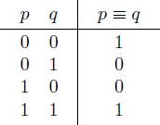
≡ means if and only if
p ≡ q is true when :
both p and q are true,
or when both are false,
but not otherwise.

Slide 52

Example revisited
Let, p denote a < b
Then NOT p denotes a >= b Let, q denote c==d
Consider, the two expressions: p OR( (NOT p) AND q)
(p OR q)
both are TRUE when p is TRUE or when q is TRUE
both are FALSE if p and q are both FALSE
Thus, we have a valid equivalence:
p OR( (NOT p) AND q) ≡ (p OR q)

Slide 53
Check whether the following pairs are equivalent or not
(P AND Q)AND R and P AND(Q AND R)
P OR (R OR Q) and (P OR R) OR Q
¬(P∨Q) and ¬P∧¬Q
4. P∨(Q∧R) and (P∨Q)∧(P∨R)
5. (P∧P) and P∨P
53
Department of CSE

Slide 54
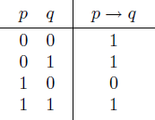

Implication
if p, then q
p implies q
The statement q→p is called the converse of the statement p→q
A conditional and its converse are not equivalent

Slide 55
a. Check if p→q ≡ (~p) OR q. b.What it say?
p | q | p→q | ~p | (~p) OR q
T | T | T | F | T
T | F | F | F | F
F | T | T | T | T
F | F | T | T | T
b. It expresses the equivalence between saying "if p is true, then q must be true" and
saying "either p is not true, or else q must be true"
Department of CSE

Slide 56
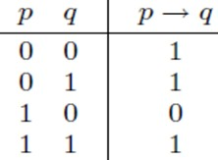
Understanding the implies operator
True Can't Imply False, therefore false
p is true and q is false, then p→q is false
(True Implies True) is True
If p and q are both true, then p→q is true
False Implies ????
If p is false, then p→q is true, no matter whether q is true or not
Department of CSE

Slide 57
Write the expression for the argument and check its truth table
If I love math, then I will pass this course.
I love math.
Therefore, I will pass this course.
Solution
p → q
p
Therefore, q
This is written as : [(p → q) and p] → q
Department of CSE

Slide 58
p | q | p and q | (p implies q) and p | [(p implies q) and p] implies q
T | T | T | T | T
T | F | F | F | T
F | T | T | F | T
F | F | T | F | T
Department of CSE

Slide 59
If roses are red and violets are blue, then sugar is sweet and so are you.
Roses are red and violets are blue.
Therefore, sugar is sweet and so are you. Express the given argument as proposition.
Solution
(p and q)→(r and s)
p and q
Therefore r and s
Department of CSE

Slide 60
Represent the following statements in propositional form
If we win the game we will get much money.
If the book is not in the library then it is in the bookstore.
Statement : If we win the game we will get much money.
Propositions:-
P:We win the game
Q :We will get much money
Representation:-
If P, then Q : P →Q
Statement : If the book is not in the library then it is in the bookstore. Propositions:-
P: Book is in library
Q : Book is in the bookstore Representation:-
If NOT P, then Q : ~P →Q
Department of CSE

Slide 61
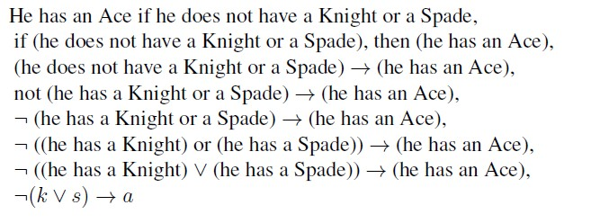
What does this say?

Slide 62
Sentence :
If the races are fixed or the gambling houses are crooked, then the tourist trade will decline.
If the races are fixed or the gambling houses are crooked, then the tourist trade will decline.
If(the races are fixed or the gambling houses are crooked), then (the tourist trade will decline)
(the races are fixed or the gambling houses are crooked) → (the tourist trade will decline)
(the races are fixed) or (the gambling houses are crooked) → (the tourist trade will decline)
5. (f ∨ c) → d
Sentence :
If the races are fixed or the gambling houses are crooked, then the tourist trade will decline.
Logical Formula :
(f ∨ c) → d

Slide 63
Sentence :
If the car has no fuel or it has no spark, then it will not start.
If the car has no fuel or it has no spark, then it will not start.
If the car has no fuel or car has no spark, then car will not start.
If (the car has no fuel or car has no spark), then (car will not start).
(the car has no fuel or car has no spark) → (car will not start)
(the car has no fuel ) or (car has no spark) → (car will not start)
NOT(car has fuel) or NOT(car has spark) → NOT(car will start)
7. (~f ∨ ~s) → ~t
Sentence :
If the car has no fuel or it has no spark, then it will not start.
Logical Formula :
(~f ∨ ~s) → ~t

Slide 64
Evaluate the following propositions
p AND (p OR q)
NOT p OR q
(p AND q) OR (NOT p AND NOT q)
(p → q) ≡ (NOT p OR q)
p → (q → (r OR NOT p))
(p OR q) → (p AND q)

Slide 65

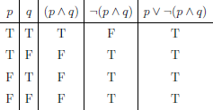
Tautology
A tautology is a proposition that is always true.

Slide 66
If the sky is blue and the moon is round, then (in particular)
the sky is blue
A. Write the given sentence as directed:
Argument form
Proposition form
B.Verify it for tautology
Solution A.
(1) The sky is blue and the moon is round. Therefore, the sky is blue.
(2)
p and q
Therefore p
(p and q) implies p
B. yes it is Tautology
66
Department of CSE

Slide 67
Contradiction/Contingency
A contradiction is a proposition that is always false.
A contingency is a proposition that is neither a tautology nor a contradiction.

Slide 68
Arguments and Validity
An argument is a list of statements called premises followed by a statement called the conclusion.
P₁ Premise P₂ Premise P₃ Premise
. . . . .. . . . .
P_{r} Premise
C Conclusion
The argument is said to be valid if the statement,
(P₁ and P₂ and. . . and P_{r}) implies C is a tautology.
In other words, validity means that if all the premises are true, then the conclusion must be true.
Department of CSE

Slide 69
Check whether the following are tautology or not
1. ¬P→(P→Q)
2. P ∨ ~P
Department of CSE

Slide 70
Example
To show the validity of the following argument
  a implies q
  b implies q
  Therefore, (a or b) implies q
we need to do is check that the statement,
[(a implies q) and (b implies q)] implies [(a or b) implies q] is a tautology
So to show that an argument is valid we need to construct a truth table, right?
Department of CSE

Slide 71

Case study time …..
71
Department of CSE

Slide 72
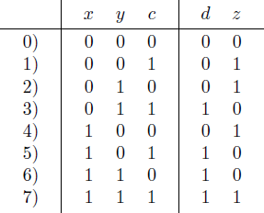
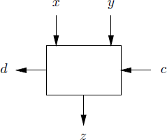
The one-bit adder
The one-bit adder sums two input bits x and y, and a carry-in bit c, to produce a carry-out bit d and a sum bit z.
The truth table tells us the value of the carry-out bit d and the sum- bit z, as a function of x, y, and c for each of the eight combinations of input values.

Slide 73
Observe the Truth Table
The carry-out bit d is 1 if at least two of x, y, and c have the value 1
d = 0 if only zero or one of the inputs is 1
The sum bit z is 1 if an odd number of x, y, and c are 1, and 0 if not
From rows 3 and 7, d is 1 if both y and c are 1.
From rows 5 and 7, d is 1 if both x and c are 1.
From rows 6 and 7, d is 1 if both x and y are 1.

Slide 74
Modeling the observations
Condition (1) can be modeled by the logical expression y AND c, because y AND c is true exactly when both y and c are 1
condition (2) can be modeled by x AND c
condition (3) can be modeled by x AND y
All the rows that have d = 1 are included in at least one of these three pairs of rows.
Thus we can write a logical expression that is true whenever one or more of the three conditions hold by taking the logical OR of these three expressions:
(y AND c) OR (x AND c) OR (x AND y)

Slide 75
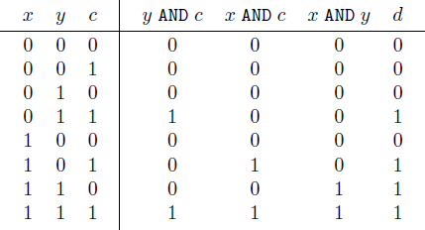
Check the correctness of this expression

Slide 76
Case study time …..
76
Department of CSE

Slide 77
Wason’s 4-card problem (the ‘selection’ task)
We will conduct an ‘experiment’ in relation to a specific phenomenon:
- you will see four cards - pretend they are real cards and you could turn them over
- each card has a number on one side and a letter on the other
Your task is to decide whether the following is true of the cards you are shown
– If there is a vowel on one side, there is an even number on the other
Department of CSE

Slide 78

The Experiment
The rule you are to check:
– If there is a vowel on one side, there is an even number on the other
Which card/cards do you turn over to check the rule?
- write down your choice of cards While you are fresh from making the choices, examine the reasons a little. Consider why you did or did not turn a card?
Department of CSE

Slide 79
Consider why you did or didn’t turn a card?
Most responses run a little like this:
  – I turned the A because if it has, say, a 4 on the back, then the rule is true of this card.
  – I didn’t turn the K because the rule isn’t about consonants.
  – I turned the 4 to see if there was an A, because that would support the rule.
  – I didn’t turn the 7, because the rule isn’t about odd numbers
Department of CSE

Slide 80
What is the norm (most frequent choices)?
Most people select the A
  A few select the K
  A few select the 4
  Few people select the 7
Wason says the ‘correct answer’ is:
  –Select A (which nearly everyone does)
  –Select 7 (which almost nobody does)
  – Leave K and 4 (which most people do)
Department of CSE

