Slide 1


2.9
Modularization

Slide 2


Objectives
To understand how algorithms are modularized.
To learn how smaller units can be made flexible through the use of formal parameters.
To understand the characteristics of well-defined modules.

Slide 3

Eg. Recipe book for Pizza
Let us consider a short recipe book for Pizza.
It might start with a contents page, that list all the recipes inside.
It then may have a series of recipes, each having a name, followed by a set of instructions, to make that recipe.
Suppose you wish to make Fiorentina Pizza, you would check where to find it in the contents, and then follow its instructions.
In doing so you might, part way through be referred to another recipe, for example, to make the pizza dough.

Slide 4
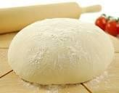
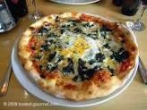
Making of Pizza
Pizza Dough
  Mix yeast and water, add flour and stir.
  Knead for 10 minutes.
  Leave to rise for 30 minutes.
  Roll out the dough.
  Place in a large round pizza tin.
Fiorentina Pizza
  Make the pizza dough following the recipe Pizza Dough, leaving to rise.
  Spread with tomato puree, and cheese and spinach.
  Crack an egg into the middle.
  Bake in oven for 25 minutes.

Slide 5

Making of Pizza contd---
3. Tomato and Chilli Pizza
Make the pizza dough following the recipe Pizza Dough, leaving to rise.
Fry the chilli pepper for 3 minutes, add onions and garlic and fry for further 5 minutes.
Add tomatoes and spread over the base.
Bake in oven for 25 minutes.

Slide 6

Perhaps we came across a pizza dough recipe that was easier to make.
We can change the instructions in just one place in the book and all the pizza recipes that use it now refer to the new version.
If the dough instructions had been written out in every single recipe then we would need to make the changes in all those sets of instructions.

Slide 7

contd---
Splitting up recipes (or algorithms for that matter) in this way can also make them easier to understand.
Each separate set of instructions in a recipe book is a recipe in its own right.
It is in fact an algorithm that does something distinct and worthwhile in its own right.

Slide 8
Advantages of such an approach
This way of structuring a recipe book or algorithm has several advantages.
It means that the same instructions do not need to be written out over and over again.
This saves space, but also reduces the chances of the different versions being different.
It also makes it easy to substitute one recipe or algorithm to do a particular thing in a different way for another.

Slide 9
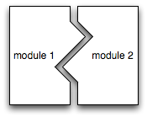
Modularization
Algorithms can be modularized by breaking them into independent subprocesses.
A module is a named subprocess.
It is an individual algorithm that should do something coherent in its own right.
  You do not just take a random set of instructions from an algorithm and turn them into a separate module.
Modularization is a vital element of programming that allows us to define new computable actions by assigning a name to some computable process.
Modules are vital when writing large algorithms that consist of many individual parts.

Slide 10
Syntactic pattern
Module NAME() is ACTIONS
endmodule
Figure: The syntactic pattern - naming a subprocess as a module
Here, NAME is the place holder for the name of the module (the subprocess).
For eg. Module average(), is understood to mean “execute the process named average.”

Slide 11
Eg. Grill a steak
Module grillSteak() is
steakTemp 75
while steakTemp < 135 do
a. steakTemp steakTemp + 13
endwhile
endmodule
Figure: The grillSteak module
The grillSteak module, shows how the steak grilling algorithm can be written as a module.
The name grillSteak is associated with the process of grilling a steak.
We can execute the subprocess by writing grillSteak().

Slide 12
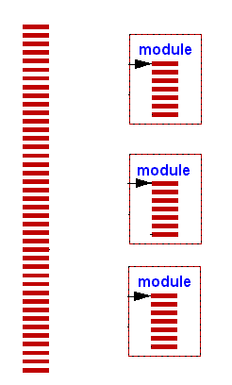
Eg. Making a dinner
Consider, for example, a grill chef who is making dinner for a small private party.
We might describe the entire process of making dinner as the execution of a series of modules that involve:
  baking a cake,
  fixing a salad,
  making lemonade, and
  grilling a steak.
Each of these modules can be understood as an individual, algorithemmer- defined computable action, and these actions can be invoked by simply referring to them by name.

Slide 13
A make dinner module
module makeDinner() is
bakeCake()
fixSalad()
makeLemonade()
grillSteak()
endmodule
Bake a cake
Fix a salad
Make lemonade Grill a steak
Figure: Making a dinner – a sequence of subprocesses
Since these modules have been elevated to the status of a computable action, we can also incorporate them into our flowchart notation.
Figure: Make dinner flowchart

Slide 14

Hosting a private party
Hosting a private party involves more than just making dinner.
The host must, for example, send out invitations, gather up the responses, purchase food, clean the house, and choose background music.
We can describe the process of hosting a private party as a module that is composed of these other submodules.
Write a module for hosting a private dinner party.

Slide 15
Well designed modules
Well-designed modules should meet several criteria. These criteria generally ensure that:
  the module can be used in a wide variety of larger processes.
  the module is self-contained.
  any errors caused by a module have a limited effect on any system that makes use of the module.
  the module can be used in a wide variety of contexts.

Slide 16
Criteria
Understandability: Every module is self-contained, which implies that it can be fully understood without any knowledge of actions that take place outside of the module itself.
Encapsulation: Every module affects only the data that it contains. Any errors that arise from a module are also contained within the module.
Composition: Every module can be incorporated into a larger module without special treatment.

Slide 17

Summarizing modularity
Modularity is an extremely powerful technique for designing complex algorithms.
Modules allow us to isolate smaller parts of a large process such that those smaller parts are much easier to understand and manage.
These smaller parts are self-contained, they can be easily inserted into other complex algorithms without needing to customize them or rewrite them.
Also, although we must understand precisely what a sub module does, we do not need to fully understand the details of how a sub module actually works.

Slide 18

Module flexibility
Modules should typically be flexible enough to be used in a variety of conditions.
Modules are made flexible by allowing users to feed input values into the algorithm.
The module can then respond differently depending on the input values provided by the user.
The number of inputs that a module accepts must be defined when a module is written.
The modules behavior then depends upon the initial value that is provided by the user.

Slide 19
Parameters of a module
The number of inputs that a module accepts must be defined when a module is written.
These are known as formal parameters.
A formal parameter is a variable where the initial value is bound to the values provided as input to the module.
The initial values provided by the module user are known as
arguments or actual parameter.

Slide 20
Formal parameters
Module NAME(V1,V2,….,Vn)is ACTIONS
endmodule
Figure: The syntactic pattern - formal parameters
The figure gives an expanded syntactic pattern for defining a module.
The formal parameters are listed within the parentheses associated with the name.
A formal parameter is simply a variable name and a module may have as many formal parameters as convenient for the module's function.
Of course, a module may have no formal parameters, as illustrated by all of the modules we have previously described.

Slide 21
One more look at the starting temperature of grill a steak algorithm ……..
To grill a steak, the steak has to have a starting temperature. It is the variable steakTemp in the algorithm.
While writing the process for grilling a steak,
  It may initially seem that we have to know the value of the
steakTemp variable.
All we have to know is that there is instruction to set a starting temperature!
Of course, if we are ever asked to grill an actual steak, we then need to obtain the starting steak temperature to actually carry out the process.

Slide 22
A flexible module for grill a steak
Remember that a module simply defines what actions should be taken to grill a steak.
We can make our grillSteak module flexible by making the starting temperature an input that is controlled from the outside of the module.
  Module grillSteak(steakTemp) is
  while steakTemp < 135 do
a. steakTemp steakTemp + 13
  endwhile
  endmodule
Figure: A flexible grillSteak module

Slide 23
Parameters of the flexible grill a steak module
The rewritten grillSteak module now has one
formal parameter.
This implies that if we ever need to use this module to grill a steak that we must supply
one actual parameter.
The actual parameter becomes the starting steak temperature for the steak grilling subprocess.
If, for example, we want to grill a steak from a starting temperature of 94 degrees because we are grilling on a scorching hot summer day from our back porch in Phoenix, Arizona, we would write grillSteak(94).
  Can you think of circumstances that might not hold in the flexible grillSteak module?
✓Can you to include the identified circumstances?

Slide 24
Can you think of any circumstances that might not hold?
There are two further circumstances that might not hold.
We might sometimes want to grill a rare steak and hence stop grilling when the steak reaches 130 degrees.
We might also want to grill a well-done steak and not stop grilling until the steak reaches perhaps 155 degrees.
Also, perhaps it is the case that we have a very thick steak on a slow- cooking grill such that the steak's temperature only increases by 2 degrees for every three minutes the steak is on the grill.
These observations imply that we can optimize the flexibility of our grillSteak module.
  How do we achieve this ?..........

Slide 25
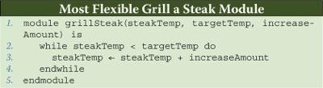
How to optimize the existing module ?
By adding two additional formal parameters:
  the target steak temperature
  the increase in temperature for every three minutes of grilling time.
Figure: An optimally flexible grillSteak module

Slide 26
How to use the revised module?
Three actual parameters for:
  starting temperature
  target steak temperature
  the amount by which the temperature of the steak will increase with every three minutes left on the grill.
Each of the following shows how we can use this grillSteak module to achieve very different outcomes under very different circumstances.
  grillSteak(65, 130, 2)
  grillSteak(94, 155, 13)
  grillSteak(94, 135, 5)

Slide 27

A print module
  Assume that a “print” module allows you to write text onto a computer screen.
  If, for example, you wanted to write the text “Computational Thinking” onto the computer screen, you would express this action as print(Computational Thinking).
Draw a flowchart to print the values 0, 3, 6, 9, and 12 to the computer screen.You must use a loop.
Write a module named “countBy3” that prints the values 0, 3, 6, 9, and 12 to the computer screen.

Slide 28

Who uses modular approach ?
Typical industry programming projects consist of thousands of lines of code or more.
One single large block of programming statements would be unmanageable, incomprehensible, difficult to design, write, debug, test, etc.
Modular Programming: Divide-and-Conquer approach to programming.
  Divide into sub-problems.
  Size of modules reduced to humanly comprehensible and manageable level.
Analogous developments: manufacturing a spacecraft, or a car.
  Manufacture individual components, test separately.
  Assemble into larger components, integrate and test.

Slide 29
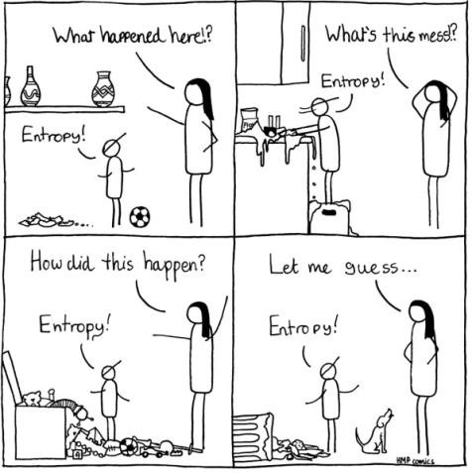
Entropy of software development
A monolithic algorithm is one that is a single large block of instructions.
A monolithic program is one that is a single large block of programming statements.
Where generally, fixing one bug or error always seemed to create additional new bugs or errors.
It is one which is increasingly interconnected, unreadable, and ultimately unreliable.
That is the entropy of software development.

Slide 30

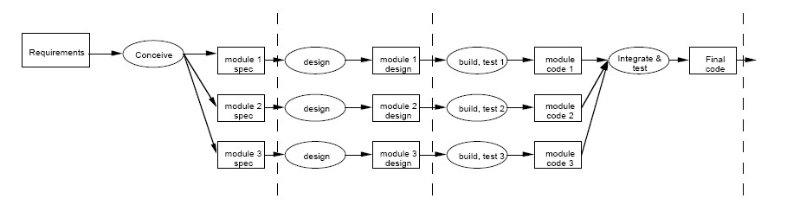
An overview of the development process
Analysis and Design
Implement

Slide 31

To design and implement a Robot
The Robot is based on user input from keyboard.
Requirements Specification:
  Develop a program that does the following:
    Display a menu of choices for robot motion.
    Read keyboard input.
    Move Robot based on keyboard input.
  Input can be any one of 4 arrows showing movement up, down, left, right.

Slide 32
Analysis and design
Analysis
  Input = A value for keyboard input.
  Output = Direction of robot movement.
Design
  Algorithm
    Display a menu of choices for Robot movement.
    Read request from the user.
    Move the robot for the request.

Slide 33
Divide into sub problems
Algorithm contains sub-problems
  Print menu.
  Read request.
  Move Robot.
Perform top-down stepwise refinement.
  Define algorithms for sub-problems.
  Refine them - may need to be broken down into sub-sub-problems.
  At lowest level, assign name to each module and combine named modules into higher level sub-problem algorithm.

Slide 34
Sub problem #1: Print Menu and Read request
print "This program moves the Robot based on user input."
print "Enter ⇑ to move Robot forward"
print "Enter ⇐ to move Robot left"
print "Enter ⇒ to move Robot right"
print "Enter ⇓ to move Robot backward"
read request
Sub problem #2: Move Robot
  If request is ⇑ move robot forward
  Else if request is ⇐ move robot left
  Else if request is ⇒ move robot right
  Else if request is ⇓ move robot backward.

Slide 35

Modularization characteristics
Manageable: Reduce problem to smaller, simpler, humanly comprehensible sub problems.
Divisible: Modules can be assigned to different teams/ programmers.
  Enables parallel work, reducing program development time.
  Facilitates programming, debugging, testing, maintenance.
Portable: Individual modules can be modified to run on other platforms.
Re-usable: Modules can be re-used within a program and across programs.

Slide 36

Value of this approach
Applications are getting more and more complicated (growing in size and functionality).
It is necessary to separate them into individual pieces (whether as “components,” “modules,” or “plugins”).
  No one is surprised anymore that operating systems are designed in a modular way.
  The final product is assembled from independently developed components.
Modularity is a mechanism to coordinate the work of many people around the world, manage interdependencies between their parts of the project, and assemble very complex systems in a reasonably reliable way.
It enables you to achieve and manage that complexity.
Not a silver bullet though…

Slide 37
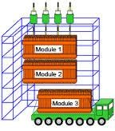

What has been described?
Modules as ways of expressing algorithms and computational processes.
How modules allow us to break large problems into smaller units.
How these smaller units can be made flexible through the use of formal parameters.
The importance of modular approach to software development.
Credits
Computing without computers, Paul Curzon; http://www.eecs.qmul.ac.uk/~pc/research/education/puzzles/reading/
web.mit.edu/16.070/www/year2001/Modular_Programming.pdf
The Benefits of ModularProgramming, Copyright Sun Microsystems, 2007
Google images

