Slide 1


Selection

Slide 2

Objectives
To understand the form and function of flowchart elements for selection.
To understand computational state of an algorithm.
To learn to write algorithms using selection statements.
To understand form and functional elements for selection.
To understand computational structure of selection in algorithms.

Slide 3

Robots are “dumb”…
What does a robot need to know how to do to solve a maze?
What commands and behaviors would be useful?

Slide 4
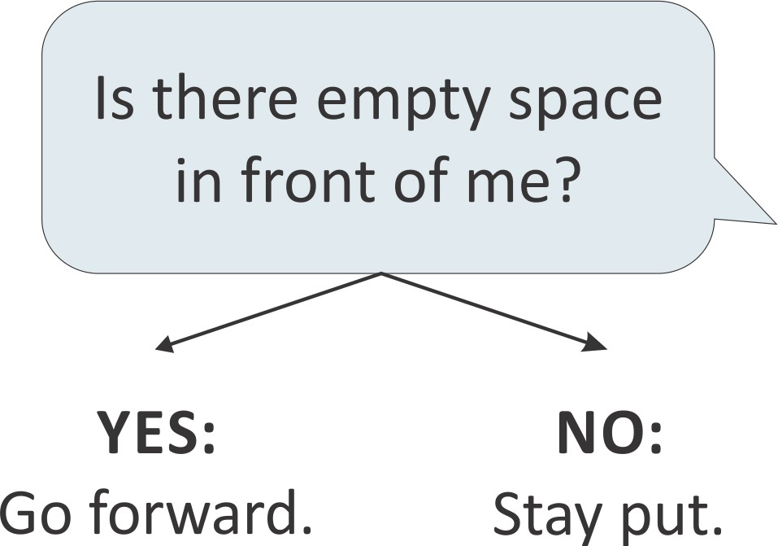
Department of CSE,Coimbatore

Slide 5
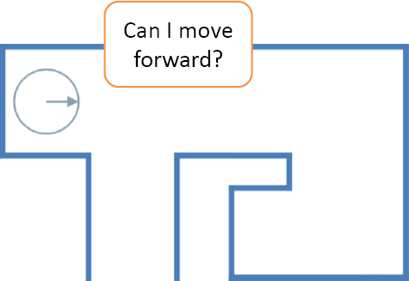

Slide 6
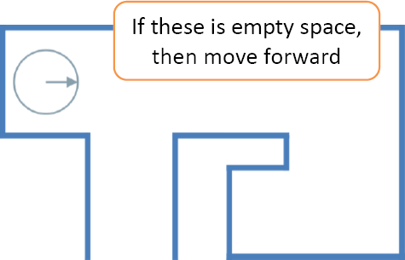

Slide 7
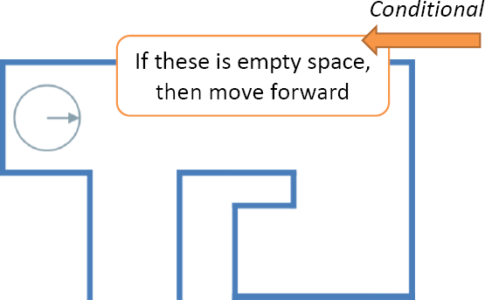

Slide 8
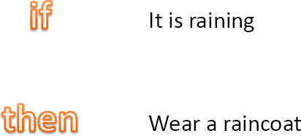
Conditionals

Slide 9
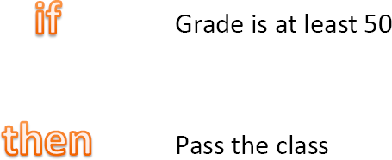

Slide 10
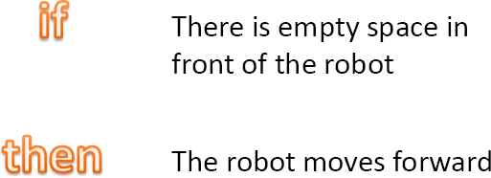

Slide 11
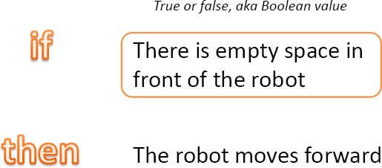

Slide 12
AND
Everything has to be true
true and true = true
true and false and true = false
false and false = false

Slide 13
OR
Only one thing has to be true
true or true = true
true or false or true = true
false or false = false

Slide 14
Exercise
What will the result of this expression be?
(true and (not false) or (true and not false))

Slide 15
Exercise
What will the result of this expression be?
((not false) or (false and (not true)) and false)

Slide 16

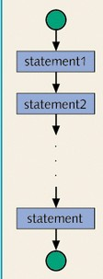

Normally, statements in a program are executed sequentially, in the order that they were written.
Many solutions feature several choices or decisions. These decisions lead to different paths . These paths represent the result of making a choice.
Often it is useful to transfer control in the middle of execution to another section of code—sort of like changing trains at the terminal.

Slide 17




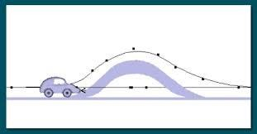
Try it yourself
Can you say how many choices are available for selection.

Slide 18
Try it yourself… Answer
Can you say how many choices are available for selection.
Multiple Choices
Two Choices
Multiple
Choices
One Choice

Slide 19

Selection Statements
Selection statement gives a program the ability to choose which
instruction(s) to next execute based on conditions.
Types
  1-Way selection (if statement).
  2-Way selection (if-else statement).
  Multi-Way selection (or n-way selection, switch/case).
Considerations
  What is the form and type of expression that controls the selection?
  How are clauses specified if at all?
  If nesting is allowed, how is it specified and implemented?

Slide 20

One-Way Selection
Can you identify the number of selection choices available?

Slide 21
One-Way Selection contd---
The if structure is a one-way selection structure.
When a control expression in an if statement is evaluated to be true, the statements associated with the structure are executed.
The flowchart for one-way selection is given in Figure: Flow Structure- One Way and the corresponding Syntactic structure is given in Figure: Selection - One Way.
If CONDITION then
ACTIONS
endif
condition
default action
Figure: Selection - One Way
Figure: Flow Structure - One Way

Slide 22

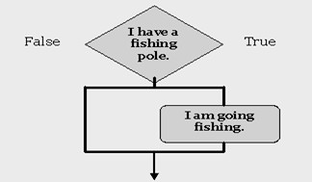
One-Way Selection contd---
Consider the following statement…
If (I have a fishing pole) then I am going fishing
Figure: An example for One -Way selection illustrates a One-Way selection for the above statement.
Figure: An example for One- Way selection

Slide 23
One-Way selection contd---
Given the specifications of an Order System (Figure: Order system)
OrderAmount
ShippingCost
If orderAmount < 40 then
ShippingCost 10
endif
ShopingCartTotal() 0
Figure: Order System
Can you identify the type of selection statement needed to model it?
Can you represent these computational states as flowchart?

Slide 24
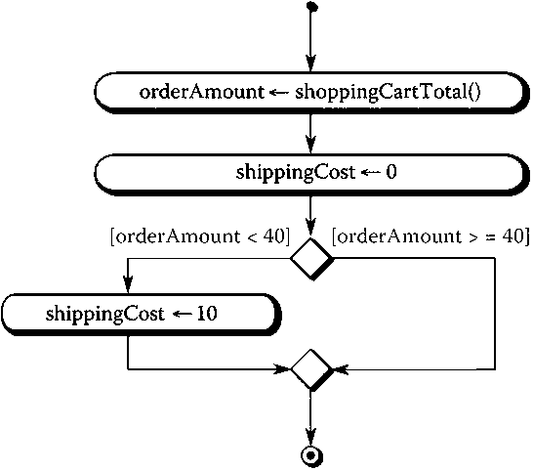
A flowchart for the Order System
Figure :Flow chart – Order System

Slide 25
Model the following using one-way selection structure:
  England will qualify for the quarter-finals with Portugal if they win or draw with Romania.
  If the shop has Croissants buy croissants and leave the shop.
  If you like salty food then add the amount of salt you prefer.

Slide 26
Answer
If England wins/draws with Romania then They will qualify for the quarter-finals with Portugal
If the shop has Croissants then buy Croissants
If you like salty food then
add the amount of salt you prefer

Slide 27

Two-Way Selection
Can you identify the number of selection choices available?

Slide 28

Two-Way Selection contd---
The if/else structure is a two-way selection structure.
If the control expression in the if statement evaluates to true, one block of statements is executed; otherwise (else), another block is executed.
The flowchart for one-way selection is given in Figure: Flow Structure - Two Way and the corresponding Syntactic structure is given in Figure: Selection - Two Way.
If CONDITION then
if-TRUE ACTIONS
Else
if- FALSE ACTIONS
endif
condition
Action a
Action b
Figure: Selection - Two Way
Figure: Flow structure -Two Way

Slide 29

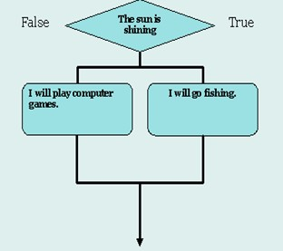

Two-Way selection contd---
Consider the following statements…
if (the sun is shining) then I will go fishing
else
I will play computer games.
Figure: An example for Two- Way selection
Figure: An example for Two-Way selection illustrates a Two-Way selection for the above statement.

Slide 30
Two-Way selection contd---
The algorithm for the Order System with two different shipping costs(10,0) based on OrderAmount can be written as given the Figure: Order System- two different shipping costs.
OrderAmount
ShippingCost
If orderAmount < 40 then
ShippingCost 10
Else
ShippingCost
endif
ShopingCartTotal()
0
0
Figure: Order System- two different shipping costs

Slide 31
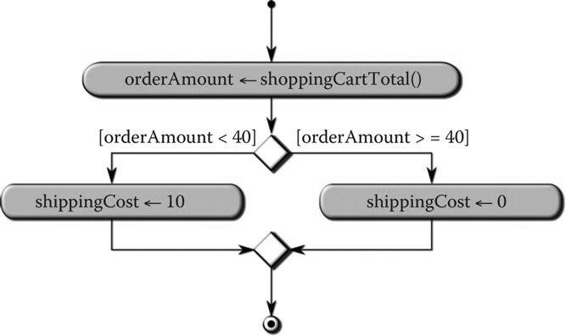
A flowchart for the modified Order System
Figure: Flowchart for the modified Order System

Slide 32
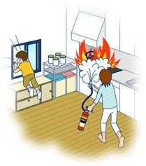
Model using Two-Way selection structure.
If there is a fire outside the door then Go to another exit
otherwise Remove the flap covering the handle, turn the handle, pull the door into
the plane and throw it out the doorway, as far away as possible.

Slide 33
If there is a fire outside the door then
1. Go to another exit.
else
Remove the flap covering the handle.
Turn the handle.
Pull the door into the plane
Throw it out the doorway, as far away as possible

Slide 34
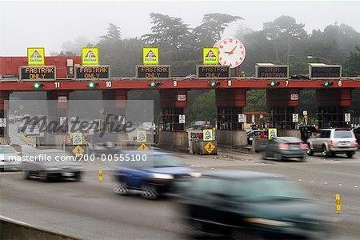
Multi-Way Selection
Can you identify the number of selection choices available?

Slide 35

Multi-Way Selection contd---
Multi-Way selection structure changes flow of control flow based upon a
value matching a selected criteria.
The flowchart for one-way selection is given in Figure: Flow structure - Multi-way selection
true
case action a
a
break
false
true
case
b
action b
Figure: Flow structure - Multi-way selection
break
false
case x
true
action x
break
false
default action

Slide 36

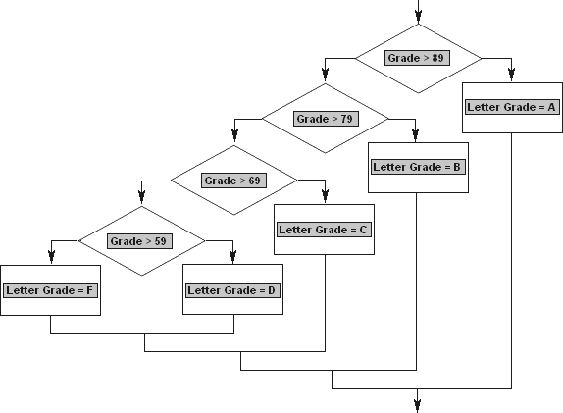
Selection from Multiple Choices
Consider the problem of determining a students letter grade given the numerical grade.
This can be modeled using a Multi-Way selection structure as shown in Figure: Selection -Multi-Way for student grades.
Figure: Selection -Multi-Way for student grades

Slide 37
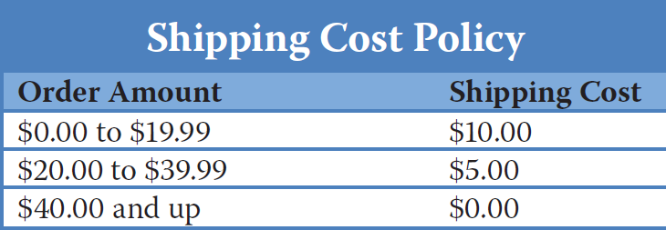
Multi-Way selection contd---
Consider the requirements for computing shipping cost based on the information given in table(ShippingCostsVs OrderAmount)
Table: ShippingCosts Vs OrderAmount

Slide 38
An algorithm for Multi-Way selection -Order System
The Figure: Algorithm - Multi-Way selection for Order System gives an algorithm
for the requirement given in table(ShippingCostsVs OrderAmount).
OrderAmount
ShippingCost
If orderAmount > 0 and orderAmount < 20 then
ShippingCost 10
ShopingCartTotal() 0
4. elseif orderAmount >= 20 and orderAmount < 40 then
ShippingCost
else
ShippingCost
endif
5
0
Figure: Algorithm -Multi-Way selection for Order System

Slide 39
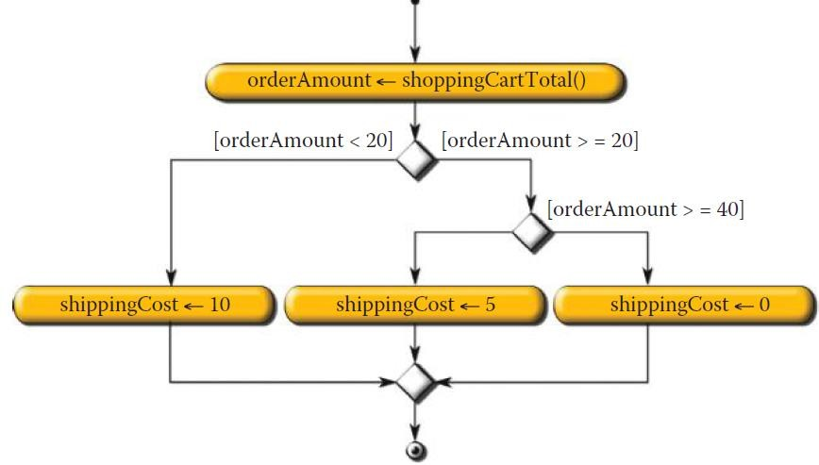
A flowchart for Multi-Way selection -Order System
The Figure: Flow structure -Multi-Way selection for Order System gives the flow
chart for the requirement given in table(ShippingCostsVs OrderAmount).
Figure: Flow structure -Multi-Way selection for Order
System

Slide 40
Model using Multi-Way selection structure.
The phone systems giving you instructions in this form.The message will say something like this:
  If you wish to buy a ticket then press 1.
  If you wish to listen to some horrible tinny music then press 2.
  If you wish to listen to recorded information that is of no use to you then press 3.
  If you wish to speak to an operator then press 4.

Slide 41
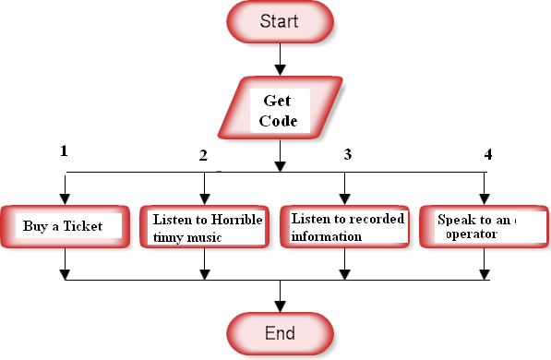
Answer

Slide 42
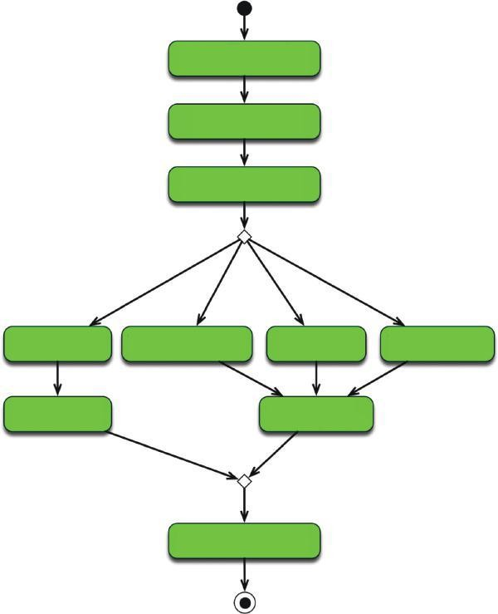

Complete the flow chart for Multi-card payment.

Slide 43
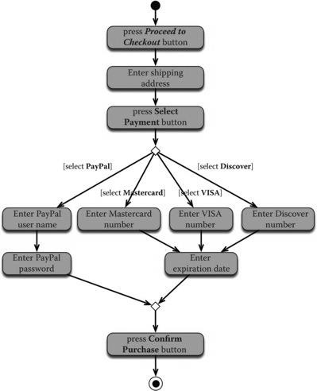
Answer

Slide 44

Model using appropriate selection structure.
  IF the user has struck the Confirm Purchase button,THEN initiate billing procedures.
  IF the camera sensor detects adequate exposure,THEN close the camera shutter.
  IF a song has just finished playing,THEN begin playing the next song in the playlist.
  Sort three characters and print them out in ascending order.

Slide 45
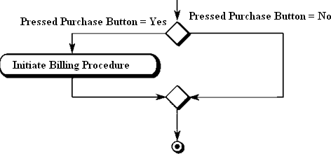
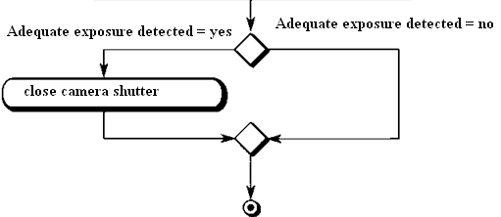
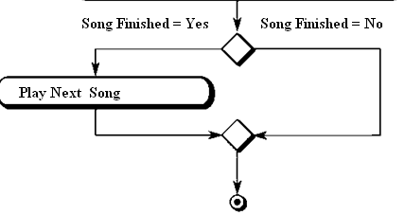
Answer

Slide 46
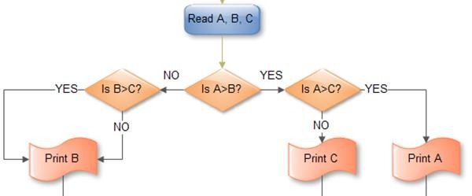
Answer

Slide 47
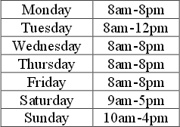
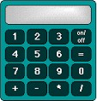
5. Shop opening timings
6. Which selection structure is suitable for allowing the users to perform basic operations(add, sub, mul, div, modulo division)?......Can you model it?.......Are there any alternate solutions?

Slide 48
Answer
if the day is Monday then the opening hours are 8am-8pm. elseif the day is Tuesday then the opening hours are 8am-12pm.
elseif the day is Wednesday then the opening hours are 8am-8pm.
elseif the day is Thursday then the opening hours are 8am-8pm. elseif the day is Friday then the opening hours are 8am-8pm. elseif the day is Saturday then the opening hours are 9am-5pm. Else the day is Sunday and the opening hours are 10am-4pm.

Slide 49
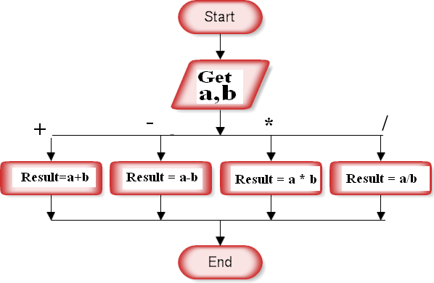
Answer

Slide 50
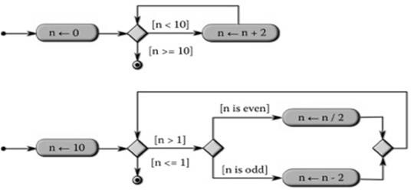
For each of the following flow of instructions, list each action that the computer takes and indicate the computational state that follows from each action.

Slide 51
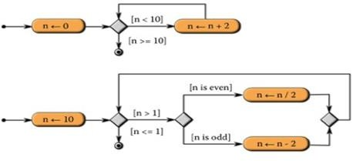
Answer
Variable | Initial | Final
n | 0 | 2
n | 10 | 5

Slide 52
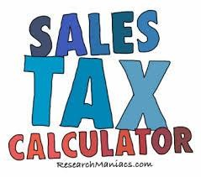
Calculate the sales tax and total amount due for different tax codes.
0: sales_tax = 0
1: sales_tax = purch_amt * 0.03
2: sales_tax = purch_amt * 0.05
3: sales_tax = purch_amt * 0.07

Slide 53
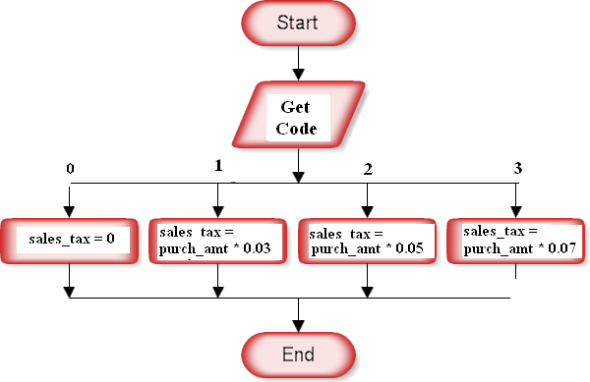
Answer

Slide 54
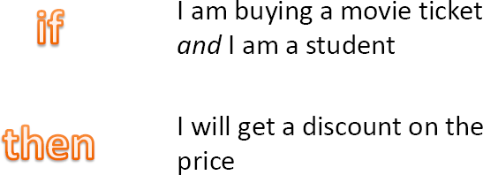
Complex Conditionals
Anything that results in true or false can go into the if part of a conditional

Slide 55
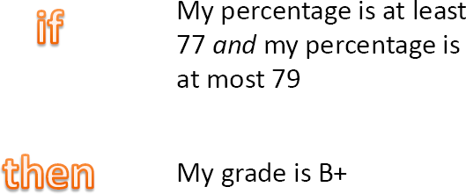

Slide 56
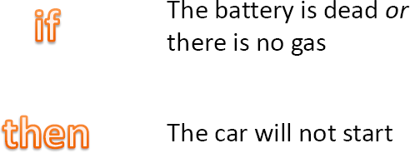

Slide 57
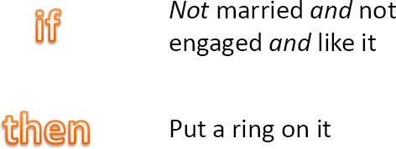

Slide 58
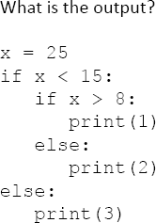
Predict the output

Slide 59

Case study time …..
59

Slide 60
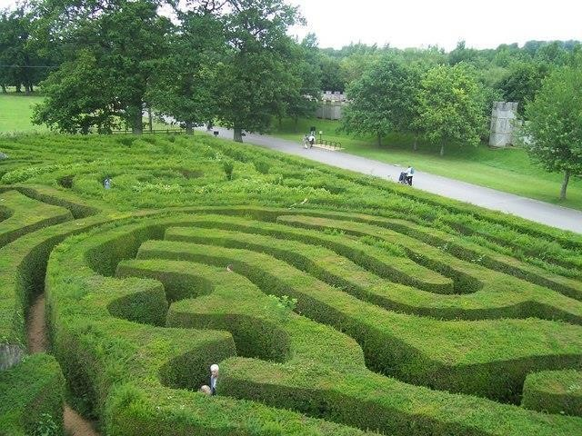
How would you find your way out of a maze?

Slide 61
One Move with Right-Hand Rule
1.If there is empty space to my right, then pivot right and step forward.
2.Otherwise, if there is empty space in front of me, then step forward.
3.Otherwise, if there is empty space to my left, then pivot left and step forward.
4.Otherwise pivot right without stepping forward.

Slide 62
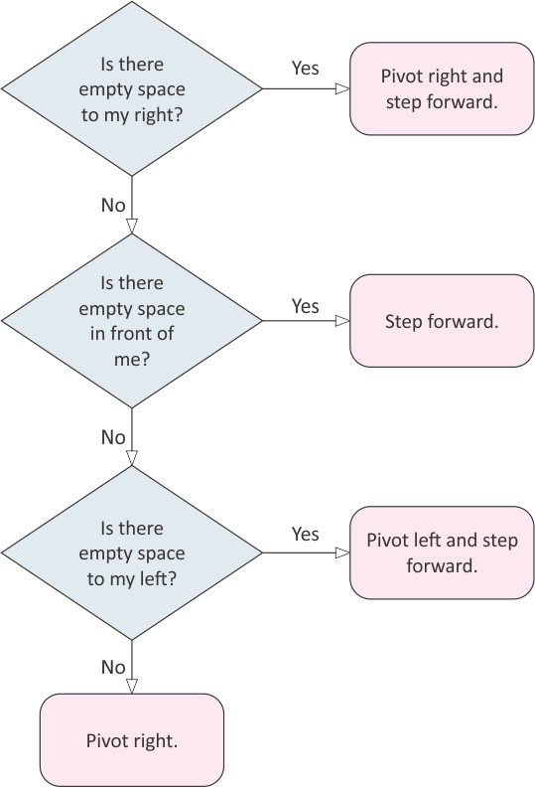
rtment of CSE,Coimbatore

Slide 63
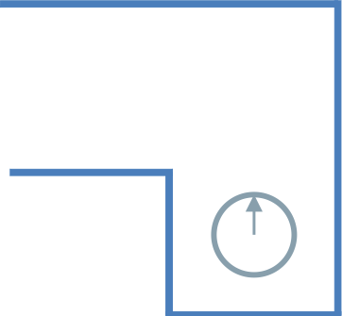

Slide 64
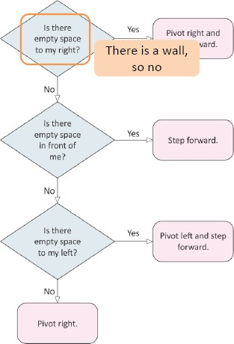
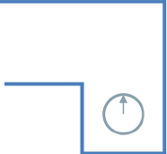

Slide 65
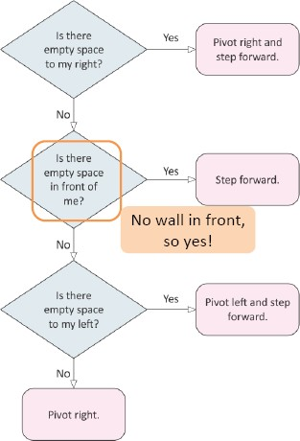

Slide 66
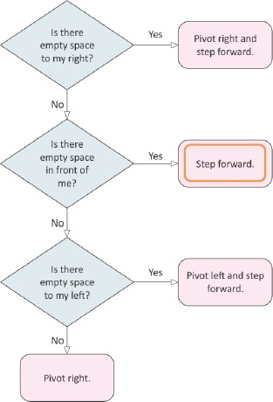
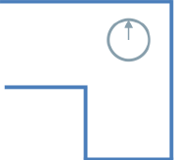

Slide 68
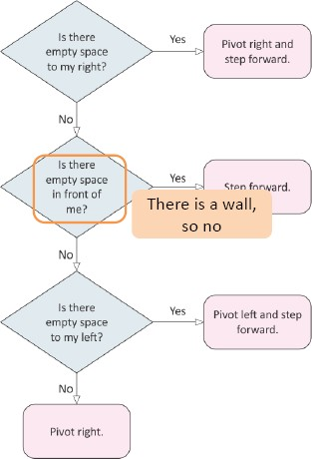

Slide 69
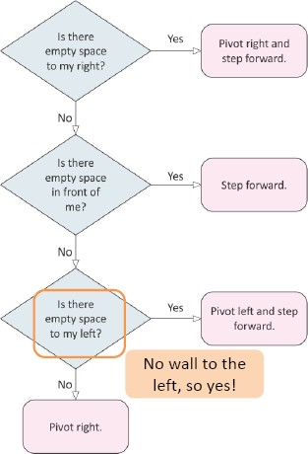

Slide 70
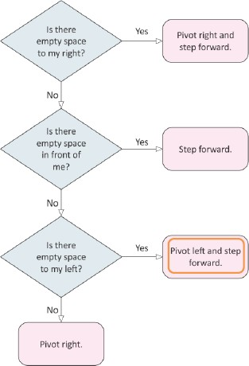
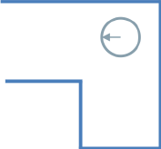

Slide 71


Slide 72

Exercise
Using the logic at right, suppose our robot decides to pivot left.Which of the following can be true?
(a)There is a wall only behind the robot and to its left.
(b)There is a wall only behind the robot.
(c)There is a wall to the left and right of the robot, but not in front.

Slide 73

What has been described?
Selection control structure and its various forms.
Using selection statement in algorithms and computational processes.
Form and function of flowchart elements for selection.
Credits
Programming Languages,2nd edition,Tucker and Noonan
www.cse.msu.edu/ Organization of Programming Languages-Cheng (Fall 2004)
Computing Without Computers,A Gentle Introduction to Computer
Programming,Data Structures and Algorithms,Version 0.15,Paul Curzon
Google images

