Slide 1

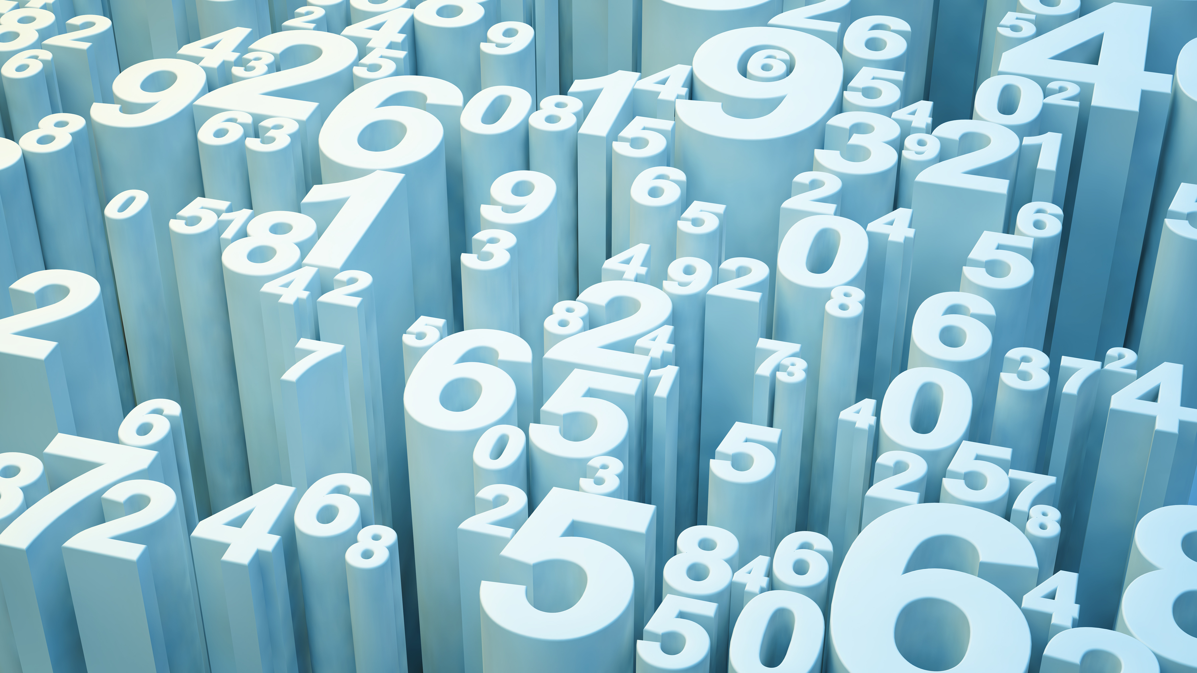
STOCK ANALYSIS USING EXCEL
BY: ABHINANDAN SHARMA(2K19/MC/005), CHETAN(2K19/MC/034)

Slide 2
OBJECTIVE
Our Main Goals are:
To study Correlation between Price and Volume for different stocks
To study Correlation between P/L of Nifty50, BSE_SENSEX and USD-INR Comparison and
To study about the past performance(mean, standard deviation, high and low) of various stocks.

Slide 3
STOCK INTRODUCTION
A stock (also known as equity) is a security that represents the ownership of a fraction of a corporation. This entitles the owner of the stock to a proportion of the corporation's assets and profits equal to how much stock they own. Units of stock are called "shares”.
"Stocks are bought and sold predominantly on stock exchanges, though there can be private sales as well, and are the foundation of many individual investors' portfolios. These transactions have to conform to government regulations which are meant to protect investors from fraudulent practices. Historically, they have outperformed most other investments over the long run.1﻿ These investments can be purchased from most online stock brokers. Stock investment differs greatly from real estate investment. .

Slide 4
STOCK PARAMETERS
VOLUME
PRICE
Profit/Loss(P/L)

Slide 5
NSE: NATIONAL STOCK EXCHANGE
NIFTY is a market index introduced by the National Stock Exchange. It is a blended word – National Stock Exchange and Fifty coined by NSE on 21st April 1996. NIFTY 50 is a benchmark based index and also the flagship of NSE, which showcases the top 50 equity stocks traded in the stock exchange out of a total of 1600 stocks.
These stocks span across 12 sectors of the Indian economy which include – information technology, financial services, consumer goods, entertainment and media, financial services, metals, pharmaceuticals, telecommunications, cement and its products, automobiles, pesticides and fertilizers, energy, and other services.

Slide 6
BSE: BOMBAY STOCK EXCHANGE
Bombay Stock Exchange is the oldest stock exchange in India as well as Asia. It is an integral component of the “$1 trillion” club, having the 11th largest market capitalization value at $2.2 trillion.
Financial transactions in BSE are done online through an electronic trading system. Market orders can be directly placed in BSE online, without the requirement of external specialists through direct market access. Due to the absence of such limit orders, focus is shifted from buyers/sellers to the total value of transactions in a day.
Trading in the BSE share market has to be done through a brokerage agency, against a stipulated charge. However, direct investment access is given to certain preferential investors making large transactions in the BSE stock market. BOLT-Bombay Online trading platform is used by this stock exchange for efficient trading.

Slide 7
INR: INDIAN RUPEE
The Currency of India is Rupee. It is generally compared with USD for value comparison. Current rate is 74.54 and it keeps fluctuating.
US dollar has been strengthening consistently in recent times and there has been a strong demand for the dollar among importers and banks. As a result, most Asian currencies are struggling against the dollar, including the Indian rupee.
The dollar also strengthened because of the consistent interest rate hike by the US Federal Reserve. These hikes make the US dollar more attractive in the global market, as other emerging economies struggle to keep up with the world’s primary reserve currency.
Due to the volatile economy of India, there has been a stagnancy in the market and low demand is pulling down the growth numbers as well as the Indian currency. Foreign players have been withdrawing from the Indian equity market and large outflows have contributed to the fall of the Indian rupee.

Slide 8
NIFTY50: PERFORMANCE
NIFTY | 2015 | 2016 | 2017 | 2018 | 2019
HIGHEST | 7979.299805 | 8968.700195 | 10552.40039 | 11760.2002 | 12293.90039
LOWEST | 7551.049805 | 6825.799805 | 8133.799805 | 9951.900391 | 10583.65039
MEAN(P/L)(PER DAY) | 34.09284329 | -4.821148115 | 23.96542604 | -10.68398072 | 9.447134231
STANDARD DEVIATION(per day) | 141.6963488 | 165.9511518 | 115.0547693 | 193.1857377 | 160.2036202

Slide 9
NIFTY50: PERFORMANCE

Slide 10
USD/INR: PERFORMANCE
USD/INR | 2015 | 2016 | 2017 | 2018 | 2019
HIGHEST | 68.901001 | 68.894997 | 65.889999 | 74.900002 | 77.754997
LOWEST | 65.940002 | 64.739998 | 63.209999 | 64.805 | 68.202301
MEAN(Variation)(PER DAY) | -0.145573 | -0.053673058 | 0.008840058 | 0.099147453 | 0.199525327
STANDARD DEVIATION(Per Day) | 0.723920727 | 0.356996645 | 0.29802906 | 0.618867651 | 0.543549888

Slide 11
USD/INR: PERFORMANCE

Slide 12
BSES(SENSEX): PERFORMANCE
BSE | 2015 | 2016 | 2017 | 2018 | 2019
HIGHEST | 26116.51953 | 29077.2793 | 36443.98047 | 38989.64844 | 42273.87109
LOWEST | 22600.39063 | 22494.60938 | 28419.26953 | 32483.83984 | 35714.16016
MEAN(P/L)(PER STOCK) | -382.9257811 | 46.63131012 | 41.37330969 | -47.76020775 | 26.90760215
STANDARD DEVIATION(p/l) | 725.7944245 | 470.4781139 | 415.7902213 | 601.9385933 | 575.1529153

Slide 13
BSES(SENSEX): PERFORMANCE

Slide 14
VOLUME AND (P/L) CORRELATION
VOLUME AND PRICE CORR. (Abs)
NSE | -0.071649797
BSE | -0.004209947
INR | NULL(As INR HAS NO VOLUME)

Slide 15
NIFTY50(VOL V/S P/L)

Slide 16
BSES(SENSEX)(VOL VS P/L)

Slide 17
CORRELATION BETWEEN NSE, BSE AND INR
CORRELATION COEFFICIENTS
NSE AND BSE(P/L) | 0.990180386
NSE AND INR(P/L) | -0.382421226
INR AND BSE(P/L) | -0.387964245

Slide 18
NIFTY50 AND BSES(SENSEX)

Slide 19
NIFTY50 AND INR

Slide 20
BSES(SENSEX) AND INR

Slide 21
CONCLUSION
From the previous discussions, we have concluded that:
The Correlation Coefficient between Volume and Price is very low(~0) which is why it is not related to the fluctuation in P/L of the stock
The Correlation Coefficient between NSE and BSE is very high(~1) which means that they are highly correlated positively. That means when NSE price increase, the price of BSE would increase.
The Correlation Coefficient between NSE and INR, and BSE and INR are approximately -0.3 which is negative but not perfect as it is closer to 0 which indicates that the USD v/s INR is less related to NSE and BSE Profit/Loss. But the value of Rupee increases when the price of NSE increases.

Slide 22
REFERENCES
finance.yahoo.com for data on the three stocks.

Slide 23
THANK YOU

