Slide 1
Code Innovation Series
JECRC University
CODE INNOVATION SERIES creates an open-source platform for 25+ colleges and students across India to ignite the passion amongst students to build a better world around us and support Open Source

Slide 2
PROBLEM STATEMENT:-
DOMAIN: FinTech
Deploy Technology and innovation to identify and mitigate patterns of money flows which are indicative of money laundering, terrorist financing, or other financial crime

Slide 3
What Is Fintech (Financial Technology)?
Financial technology (Fintech) is used to describe new tech that seeks to improve and automate the delivery and use of financial services. ​​​At its core, fintech is utilized to help companies, business owners and consumers better manage their financial operations, processes, and lives by utilizing specialized software and algorithms that are used on computers and, increasingly, smartphones. Fintech, the word, is a combination of "financial technology".

Slide 4

Fintech refers to the integration of technology into offerings by financial services companies in order to improve their use and delivery to consumers.
It primarily works by unbundling offerings by such firms and creating new markets for them. Startups disrupt incumbents in the finance industry by expanding final inclusion and using technology to cut down on operational costs.
Fintech funding is on the rise but regulatory problems abound.

Slide 5
OUR PROJECT IDEA:-
In our current time period, technologies have made a huge impact on human life. But with the increase in the online money transactions, there are also have been an increase in crimes like money laundering, terror funding, Carding (or Credit Card Fraud) etc. A lot of people have misused this technology and which in result have created a lot of chaos.
Our idea is to create a Machine Learning model which can be used to minimize this problem. To deal with Credit Card Fraud, we are trying to create a model which can be used to find any unusual money transaction that have done in a limited time period. For this, we have used credit card transaction data set with a fraud flag. our model will shortlist this bank account and track its record for furthermore time. So if in case we can send these information to the higher authorities.
Every banking institution tries to find out the future performance in order to take corrective measures at an early stage in case of any probable crisis in future. An investor looking to invest in the banking stocks tries to ensure that there won’t be any issue in future with its investment. The chances of such a potential crisis may be predicted by machine learning algorithms based on several available attributes in its dataset. So, our model can predict the crisis that a bank can face in future, based on its current and past data.

Slide 6


PROJECT WORKFLOW:-
Data
Neural Network Layer
Scaled and Refined Data for further Prediction

Slide 7
TECHNOLOGIES INVOLVED:-
MACHINE LEARNING-
K-MEANS CLUSTERING
K-means is a centroid-based algorithm, or a distance-based algorithm, where we calculate the distances to assign a point to a cluster. In K-Means, each cluster is associated with a centroid.
The main objective of the K-Means algorithm is to minimize the sum of distances between the points and their respective cluster centroid.
DECISION TREE ALGO
The general motive of using Decision Tree is to create a training model which can use to predict class or value of target variables by learning decision rules inferred from prior data(training data).
SVM CLASSIFIER
Support vector machines (SVMs) are particular linear classifiers which are based on the margin maximization principle. They perform structural risk minimization, which improves the complexity of the classifier with the aim of achieving excellent generalization performance.

Slide 8
REDHAT 8(OS) with Docker –
For running the machine learning model multiple times we will use this OS and also we will use a docker image so that we can use the most optimized systems.
FLUTTER-
After completing the framework we will create an app which will connect directly to the linux virtual machine and using that app we can see the accuracy of the model and check the suspicious bank account details.

Slide 9
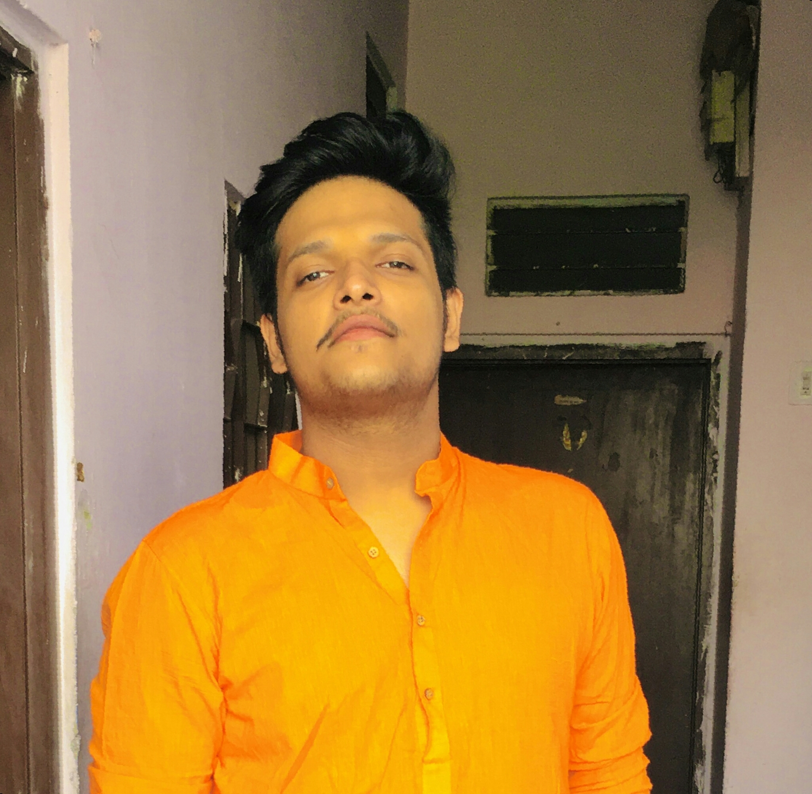


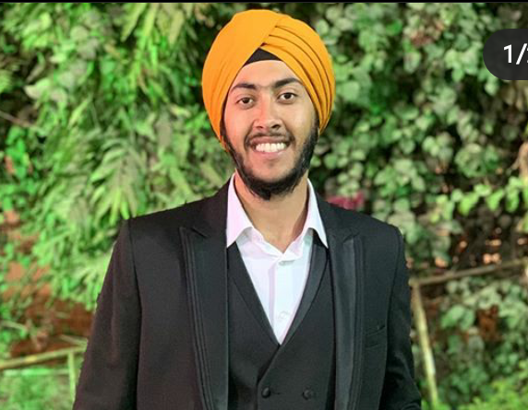
TEAM DARTH VADERS
Abhinav Sharma
Akshat Soni
Harkirat Singh
Akshat Sharma

Slide 10
THANK YOU

