Slide 1
flickmate.com
An Online Movie Ticket Booking Solution
PRESENTED BY
ABHINAND A S
ADHIL NOWFAL A

Slide 2
ABSTRACT
Flickmate is a specialized online movie ticket booking platform exclusively partnered with a single theater. Users can access a user-friendly interface to browse movie listings, select desired showtimes, and book tickets conveniently. The platform offers features like seat selection, loyalty points for discounts, IMDb ratings, and a responsive design for seamless accessibility across devices. Flickmate focuses on delivering a personalized and hassle-free movie booking experience catered to patrons of the partnered theater. With its exclusive partnership, Flickmate aims to streamline the ticket reservation process, making it a go-to platform for moviegoers seeking a convenient and enjoyable cinema experience at the designated theater.

Slide 3
Requirement Specification
HARDWARE CONFIGURATION:
Client Side
Server Side
Ram | 512 Mb
Hard Disk | 10 Gb
Processor | 1.0 Ghz
Ram | 1 Gb
Hard Disk | 20 Gb
Processor | 2.0ghz

Slide 4
Software Requirement
Client Side
Server Side
Web Browser | Google Chrome or any compatible browser With internet connection
Operating System | Windows or any equivalent OS
Web Server | Apache
Server Side Language | Php5.6 Or Above Version
Database Server | Mysql
Web Browser | Google Chrome Or Any Compatible Browser
Operating System | Windows Or Any Equivalent OS

Slide 5
MODULES
LOGIN AND REGISTERATION MODULE
TICKET SELECTION MODULE
LOYALITY POINT MODULE
MOVIE & SCHEDULE MODULE
PAYMENT MODULE

Slide 6
Login And Register Module
Allows users login and register in the website & allow admin to login into the admin panel

Slide 7
Ticket selection module
Allows users to select ticket for their desired seat exactly for their preferred movie using a graphical representationof the theater.

Slide 8
Loyalty Points Module
Manages loyalty points & adds discount for the ticket

Slide 9
Movie & Schedule Module
Stores and manages movie and its schedule details such as titles, ratings , starting date , ending date , price posters , etc.. enabling users to browse and select movies for booking

Slide 10
Payment Module
Calculates total ticket price and generates a booking confirmations with e-tickets.

Slide 11
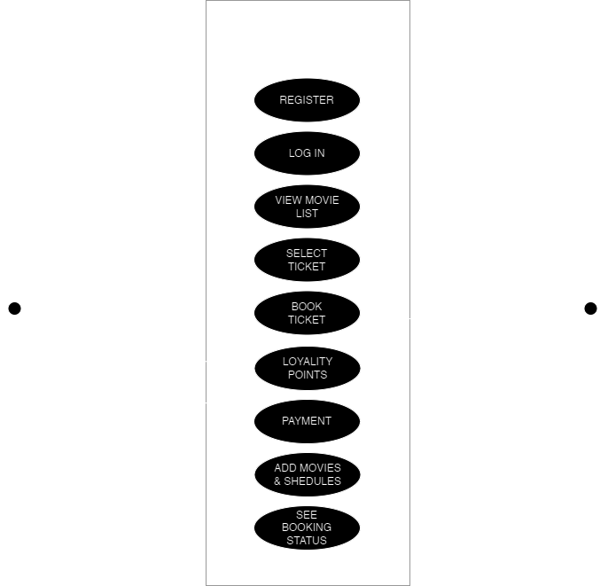
Use Case Diagram
A Use case is a description of set of sequence of actions. Graphically it is rendered as an ellipse with solid line including only its name. Use case diagram is a behavioural diagram that shows a set of use cases and actors and their relationship. It is an association between the use cases and actors. An actor represents a real-world object. Primary Actor – Sender, Secondary Actor Receiver.

Slide 12
Tables
FIELD | DATA STORED | DATATYPE | CONSTRAINTS
uID | USER ID | INT(255) | PRIMARY KEY
fpoints | FLICK POINTS | INT(255) | NOT NULL
pnumber | PHONE NUMBER | VARCHAR(255) | NOT NULL
password | PASSWORD | VARCHAR(255) | NOT NULL
SIGNIN TABLE

Slide 13
SHOW BOOKING
TABLE
FIELD | DATA STORED | DATATYPE | CONSTRAINTS
sid | SEAT ID | INT(255) | PRIMARY KEY
sno | SEAT NAME | VARCHAR(20) | NOT NULL
stype | SEAT TYPE | VARCHAR(1) | NOT NULL
uID | USER ID | INT(255) | FOREIGN KEY

Slide 14
PAYMENT
TABLE
FIELD | DATA STORED | DATATYPE | CONSTRAINTS
pid | PAYMENT ID | INT(255) | PRIMARY KEY
ptprice | TOTAL PRICE | INT(255) | NONE
s1 | SEAT 1 | VARCHAR(255) | NONE
s2 | SEAT 2 | VARCHAR(255) | NULL
s3 | SEAT 3 | VARCHAR(255) | NULL
s4 | SEAT 4 | VARCHAR(255) | NULL
s5 | SEAT 5 | VARCHAR(255) | NULL
s6 | SEAT 6 | VARCHAR(255) | NULL
s7 | SEAT 7 | VARCHAR(255) | NULL
s8 | SEAT 8 | VARCHAR(255) | NULL
s9 | SEAT 9 | VARCHAR(255) | NULL
s10 | SEAT 10 | VARCHAR(255) | NULL
uID | USER ID | INT(255) | FORIGN KEY
pdate | PAYMENT DATE | DATE | CURRENT_TIMESTAMP()
psdate | SHOW DATE | DATE | NONE
pstime | SHOW TIME | VARCHAR(255) | NONE
mid | MOVIE ID | INT(11) | FORIGN KEY

Slide 15
MOVIES TABLE
FIELD | DATA STORED | DATATYPE | CONSTRAINTS
mid | MOVIE ID | INT(11) | PRIMARY KEY
mname | MOVIE NAME | VARCHAR(250) | NONE
mdes | MOVIE DES | VARCHAR(1024) | NONE
mrating | MOVIE RATING | FLOAT | NONE
mtlink | MOVIE TRAILER LINK | VARCHAR(1024) | NONE
mdir | MOVIE DIRECTOR | VARCHAR(100) | NONE
mlang | MOVIE LANGUAGE | VARCHAR(100) | NONE
msd | MOVIE START DATE | DATE | NONE
med | MOVIE EDIT DATE | DATE | NONE
mpos | MOVIE POSTER | VARCHAR(500) | NONE
mssp | MOVIE SILVER PRICE | DOUBLE | NONE
mgsp | MOVIE GOLD PRICE | DOUBLE | NONE
mpsp | MOVIE PLATINUM PRICE | DOUBLE | NONE

Slide 16
Dataflow Diagrams (DFDs)
A Data Flow Diagram (DFD) is a traditional visual representation of the information flows within a system.
A neat and clear DFD can depict the right amount of the system requirement graphically. It can be manual, automated, or a combination of both.
It shows how data enters and leaves the system, what changes the information, and where data is stored.
The objective of a DFD is to show the scope and boundaries of a system as a whole.
It may be used as a communication tool between a system analyst and any person who plays a part in the order that acts as a starting point for redesigning a system. The DFD is also called as a data flow graph or bubble chart.

Slide 17
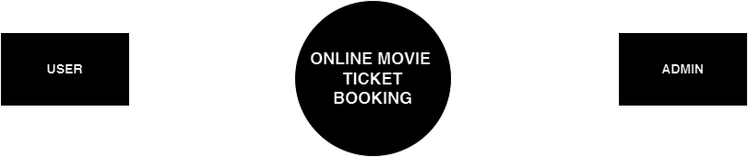
Zero Level Diagram

Slide 18
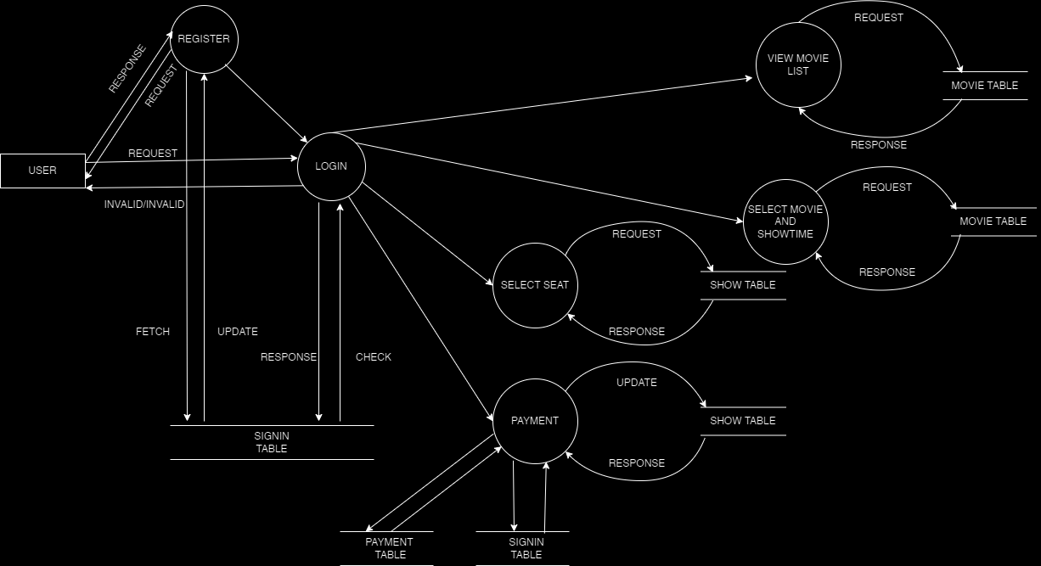
First Level Diagram (USER)

Slide 19
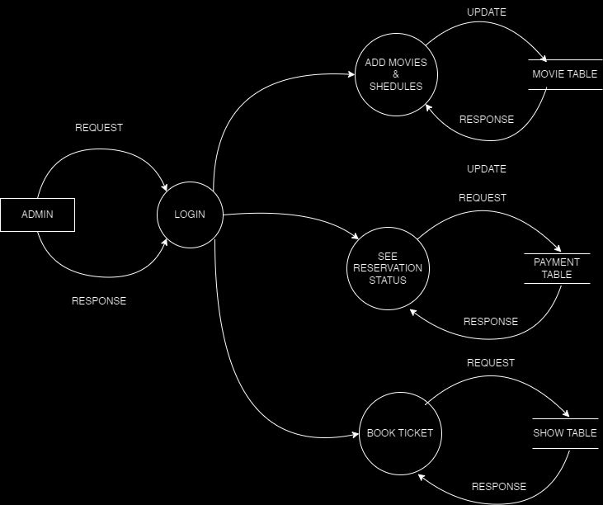
First Level Diagram (ADMIN)

Slide 20
THANKS

