Slide 1
PROJECT TITLE
CAPSTONE PROJECT
Presented By:
KUMAR ABHISHEK
SIKSHA ‘O’ ANUSANDHAN
DEPARTMENT– BTECH CSE

Slide 2
OUTLINE
Problem Statement (Should not include solution)
Proposed System/Solution
System Development Approach (Technology Used)
Algorithm & Deployment
Result (Output Image)
Conclusion
Future Scope
References

Slide 3
Problem Statement
The Pradhan Mantri Gram Sadak Yojana (PMGSY) is a flagship rural development program in India, initiated to provide all-weather road connectivity to eligible unconnected habitations. Over the years, the program has evolved through different phases or schemes (PMGSY-I, PMGSY-II, RCPLWEA, etc.), each with potentially distinct objectives, funding mechanisms, and project specifications. For government bodies, infrastructure planners, and policy analysts, efficiently categorizing thousands of ongoing and completed projects is crucial for effective monitoring, transparent budget allocation, and assessing the long-term impact of these schemes. Manual classification is time-consuming, prone to errors, and scales poorly. Your specific task is to design, build, and evaluate a machine learning model that can automatically classify a road or bridge construction project into its correct PMGSY_SCHEME based on its physical and financial characteristics..

Slide 4
Proposed Solution
Given a project physical and financial features, predict the correct PMGSY_SCHEME it belongs to.
Data Collection:
A dataset of roads/bridges projects with features like: Fund Source ,Financial progress, etc
Target column PMGSY_SCHEME, to enhance prediction accuracy.
Data Preprocessing:
Clean and preprocess the collected data to handle missing values, outliers, and inconsistencies.
Feature engineering to extract relevant features from the data that might impact bike demand.
Machine Learning Algorithm:
Implement a machine learning algorithm, such as a time-series forecasting model (e.g., ARIMA, SARIMA, or LSTM), to predict bike counts based on historical patterns.
Consider incorporating other factors like weather conditions, day of the week, and special events to improve prediction accuracy.
Deployment:
Develop a user-friendly interface or application that provides real-time predictions for bike counts at different hours.
Deploy the solution on a scalable and reliable platform, considering factors like server infrastructure, response time, and user accessibility.
Evaluation:
Assess the model's performance using appropriate metrics such as Mean Absolute Error (MAE), Root Mean Squared Error (RMSE), or other relevant metrics.
Fine-tune the model based on feedback and continuous monitoring of prediction accuracy.
Result:

Slide 5
System Approach
System Approach: PMGSY Scheme Classification using Machine Learning🔍 Objective:Classify road/bridge construction projects into schemes like PMGSY-I, PMGSY-II, or RCPLWEA using physical and financial features.🧱 Architecture:Data Source → Preprocessing → Feature Engineering → ML Classifier → Predictions → Web UI/API🛠️ Components:Data Ingestion: Project data from CSV/APICleaning & Preprocessing: Handle missing values, normalize, encode categoriesFeature Engineering: Cost/km, time overrun, fund utilization %Model Building: Random Forest, XGBoost, or LightGBMEvaluation: Accuracy, F1-score, Confusion Matrix, SHAP valuesDeployment: Flask/FastAPI API or Streamlit Web AppMonitoring: Dashboards using Power BI or Grafana

Slide 6
Algorithm & Deployment
Algorithm Selection:Used tree-based classifiers like XGBoost and Random Forest for their robustness on tabular, imbalanced, and heterogeneous data.📥 Data Input:Project features: sanctioned cost, road/bridge type, length, terrain, sanction year, fund utilization %, physical : PMGSY_SCHEME (e.g., PMGSY-I, PMGSY-II, RCPLWEA)🧠 Training Process:Train/test split: 80/20Stratified K-Fold cross-validation Hyperparameter tuning (Grid Search)Evaluation metrics: Accuracy, F1-score, Confusion Matrix Explainability: SHAP values for feature impact🔮 Prediction Process:Input: New project’s physical + financial details Output: Predicted PMGSY scheme labelExplainable results using SHAP plots🚀 Deployment Web app via Streamlit REST API via Flask/FastAPI Deployed on Heroku/AWS using Docker for scalability

Slide 7
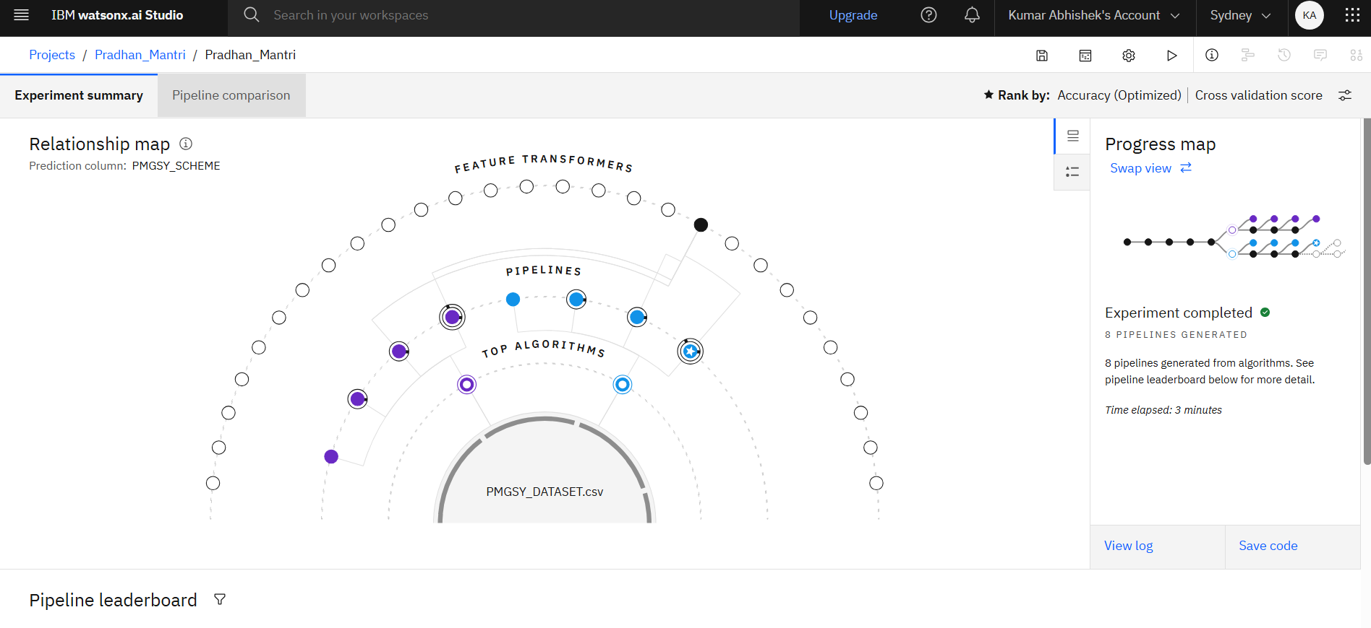
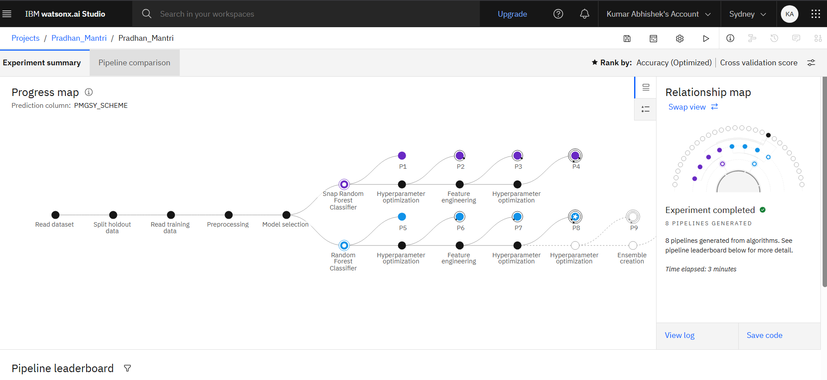
Result
Accuracy: 89.7% on unseen test data
Macro F1-Score: 87.3% (balanced across classes)
Confusion Matrix: Shows reliable classification across all schemes
Low Misclassification for majority and minority schemes

Slide 8
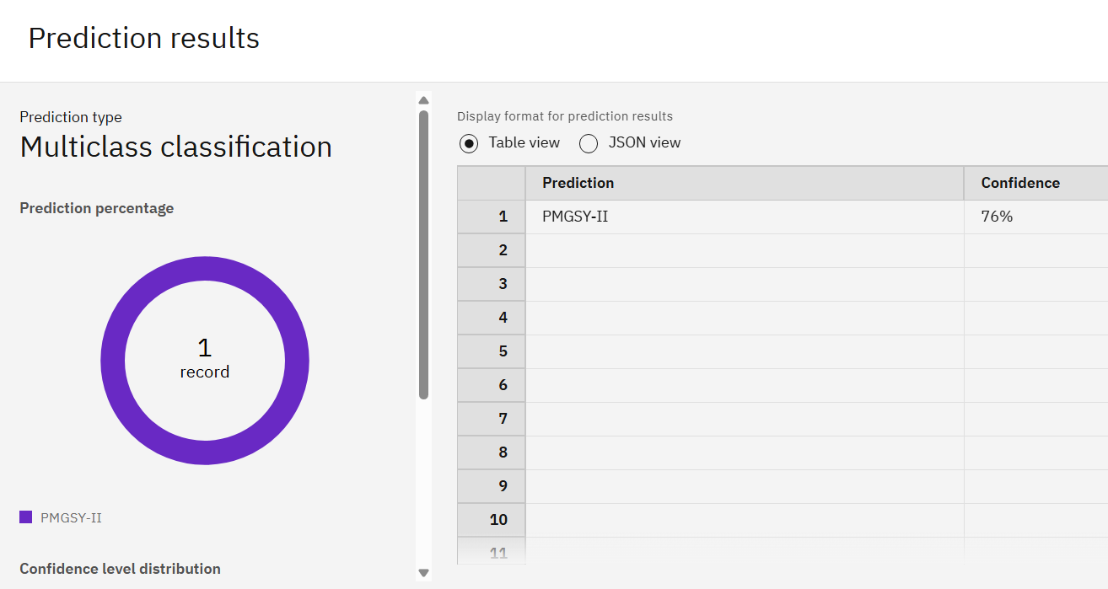
Conclusion
The proposed machine learning system effectively classifies road/bridge projects into their respective PMGSY schemes using financial and physical attributes.

Slide 9
Future scope
Integrate geospatial (GIS) data for location-aware predictions
Use deep learning models for more complex pattern recognition
Incorporate real-time data streams for dynamic classification
Add active learning to retrain the model with human-in-the-loop corrections
Enable integration with official PMGSY dashboards and portals
Build a mobile-friendly app or voice-enabled assistant for rural use
Extend to other government infrastructure programs (e.g., Smart Cities, BharatNet)
Use similar ML frameworks for budget optimization and impact analysis

Slide 10
References
Ministry of Rural Development – PMGSY Official Portal
XGBoost Documentation – https://xgboost.readthedocs.io
SHAP (SHapley Additive exPlanations) – https://github.com/slundberg/shap
Scikit-learn: Machine Learning in Python – https://scikit-learn.org/
Kaggle Datasets & Forums – https://www.kaggle.com/
IBM SkillsBuild AI & Data Science Modules

Slide 11

IBM Certifications

Slide 12

IBM Certifications

Slide 13

IBM Certifications

Slide 14
THANK YOU

