Slide 1
RetainIQ: Customer Intelligence & Revenue Optimization ENGINE
Identifying high-value customers to maximize business impact
Abhishek Kumar Gond
Data Science & Analytics (ML)

Slide 2
THE PROBLEM
Not all customers contribute equally to revenue.
Marketing budgets are limited.
Targeting the wrong customers leads to wasted spend.
How do we identify the right customers to maximize revenue efficiently?
Designed by Abhishek Kumar Gond

Slide 3
THE APPROACH
Understand Customer Behavior
Analyze engagement
Purchase patterns
Activity levels
Predict Future Actions
Estimate each customer’s likelihood to:
Churn
Purchase
Make Targeting Decisions
Rank customers based on expected value
Select top customers within budget constraints
Data → Predictions → Decisions
Designed by Abhishek Kumer Gond

Slide 4
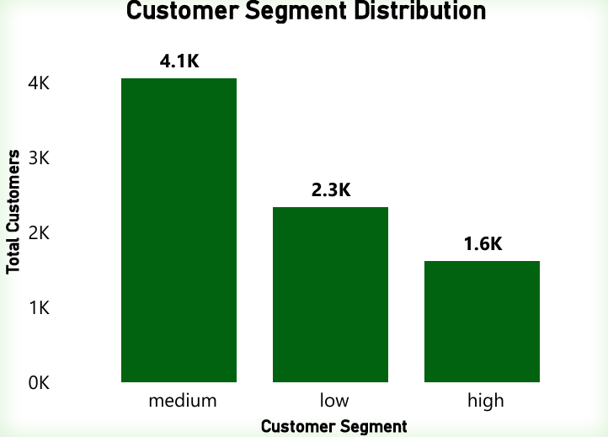
THE PROBLEM
Customer Value is Uneven
A small group of customers contributes significantly more value
High-value customers show more consistent behavior
Engagement Drives Purchases
Customers with higher interaction levels are more likely to buy
Low engagement is a strong indicator of inactivity
Inactivity Signals Churn Risk
Customers with long inactivity periods are more likely to churn
Recent engagement reduces churn likelihood
Designed by Abhishek Kumar Gond

Slide 5
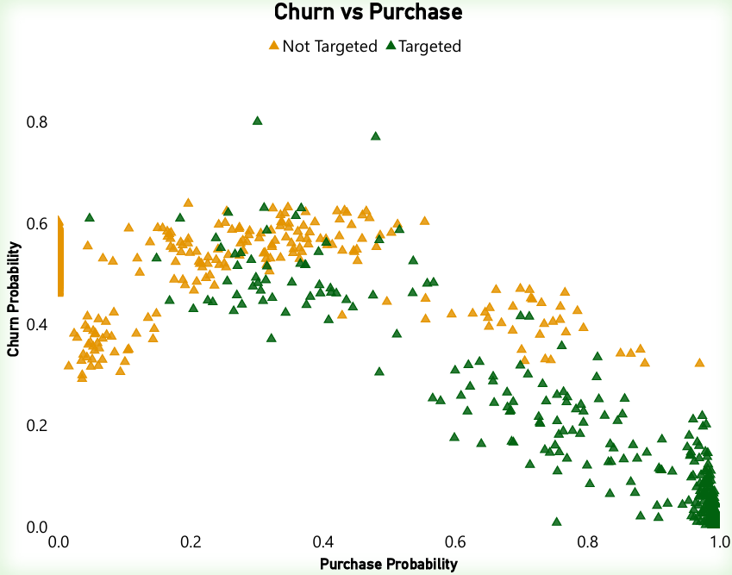
CUSTOMER TARGETING STRATEGY
Key Idea:
Customers were evaluated based on:
Likelihood to purchase
Risk of churn
Decision Logic:
Prioritized customers with:
High purchase likelihood
Manageable churn risk
Designed by Abhishek Kumar Gond

Slide 6
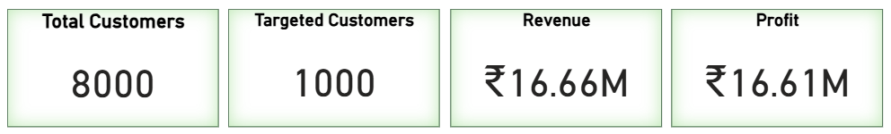
BUSINESS IMPACT
Key Outcome:
Targeting a small subset of customers drives significant revenue
Efficiency Insight:
Focused campaigns maximize returns with minimal cost
A data-driven targeting strategy delivers high impact with low investment.
Designed by Abhishek Kumar Gond

Slide 7
THANK YOU
RetainIQ: Customer Intelligence & Revenue Optimization Engine
Abhishek Kumar Gond

