Slide 1


AI TECH AGENCY
INFOGRAPHICS
By Abhi Jindal, Daaksha Arun, Khoi Thai, Adam Schuler, Jesse Kinsmann

Slide 2
Business Problem — Why This Study Matters
Goal:
Understand how skills, salaries, AI adoption, and geography impact student career readiness
Students as Key Stakeholders:
Need accurate, unbiased, forward-looking insights
What We Examine:
Technology preferences by experience
Salary disparities across roles & skills
Growing role of AI
Value to Students:
Turns industry trends into actionable career guidance
Outcome:
Supports better decisions on coursework, specialization, and job paths
Notes:
Today, our team is presenting a project that explores how AI, programming skills, and industry trends are shaping student career readiness. We combined real-world developer data with enterprise AI adoption insights to understand one simple question — what skills actually matter for students entering today’s job market? This study is designed to turn industry trends into practical guidance for students planning their future careers.”

Slide 3
Motivation — Why We Chose This Topic
Students must understand that AI is Reshaping the Job Market
How professionals actually use AI
Which skills are rising in value
Purpose of This Study:
Help students:
Build high-impact technical skills
Stay competitive in hiring
Prepare for an AI-driven workforce
Personal Academic Relevance:
Directly supports our own career planning & skill development
Notes:
“Here’s a quick overview of what we’ll be covering today. I’ll begin with our introduction and dataset overview, followed by our teammate who will explain how we scraped and extracted the data. Then we’ll walk through the ER diagram, which shows how the data is structured. After that, we’ll present our dashboards that highlight AI adoption and programming trends. Finally, we’ll wrap up with key limitations, risks, and takeaways from our study.”

Slide 4
Executive Summary — What We Analyzed & Found
Dataset: 2023 Stack Overflow Developer Survey
Focus Areas:
Compensation, Experience, Programming Languages, AI Tool Usage
Data Quality Handling:
70%+ missing values addressed via removal & imputation
Core Stack Still Dominates:
Python, JavaScript, SQL, HTML/CSS, Java, C#, C++, PHP
Emerging Languages Rising:
Go, Rust, Kotlin
AI is Now Commonplace:
High AI usage across roles & company sizes
Strong U.S. representation
Key Insight:
Core skills + Emerging tools + AI literacy = Career readiness
Caution:
Salary & regional insights limited by missing data
Notes:
The main goal of our project is to understand how skills, salaries, AI adoption, and geography impact student career readiness. Students are our main stakeholders because they need accurate and forward-looking insights to make confident career decisions. We analyzed technology preferences across experience levels, salary differences across skills and roles, and the rapid growth of AI in the workplace. In simple terms, this study helps students understand what to learn, what skills pay off, and how to prepare for an AI-driven future.”

Slide 5

We Used Agentic AI to Extract Additional Data
Used Mckinsey State of AI reports
Defined extraction instructions for ChatGPT Agent
Analyze Charts
Read Tables
Outputted matching graphs to tables
Validated through human review

Slide 6
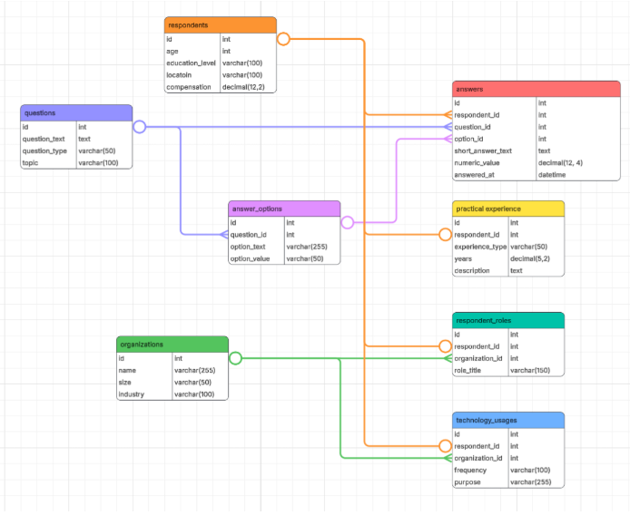
ER Diagram
Central Hub – Respondents:
Stores Age, Education, Location, Compensation
Connects to all behavioral, career, and technology data
Survey Structure:
Questions → Answer_Options → Answers
Supports multiple-choice, numeric, and text responses
Enables clean capture of skills, AI usage, salaries, and preferences
Career & Experience Layer:
Practical_Experience → internships, projects, work years
Respondent_Roles + Organizations → job titles, company size, industry
Technology_Usages → frequency & purpose of tech usage at work

Slide 7
DASHBOARD 1: AI Adoption Trends
This dashboard shows where AI and tech skills are most in demand. It highlights the tools developers use, how AI is shaping coding, and what skills drive career opportunities. The core message: students need strong programming fundamentals plus practical AI skills to stay competitive.
Global Demand: AI and tech skills vary by region, revealing where opportunities are strongest.
Tech Trends: Core languages remain essential, while emerging tools gain adoption.
AI in Workflows: AI supports coding, testing, learning, and documentation.
Career Readiness: Students need solid fundamentals plus exposure to new tech.
Competitive Edge: Adaptability to AI tools is key to staying marketable.

Slide 8
DASHBOARD 2: Programming & Developer Trends
This dashboard shows shifting demand towards different languages, and how salary is shaped by experience, role, and language choice. It also shows how company size affects remote-work flexibility, helping students match skills and expectations to real career paths.
Language Trends: Developers increasingly prefer modern languages over legacy ones.
Salary Factors: Pay varies by experience, role, and language — skill choices matter.
Beyond Degrees: Hands-on projects and internships drive practical readiness.
Remote Work: Flexibility differs by company size, influencing job expectations.
Student Guidance: Focus on high-impact skills, realistic roles, and suitable work environments.

Slide 9
Student Career Impact
Sampling Bias: Insights reflect developers active on Stack Overflow; other student populations or regions may differ.
Data Constraints: McKinsey survey required manual extraction from PDF charts, and could not be directly joined with Stack Overflow data.
Correlation, Not Causation: Salary premiums and adoption patterns show association—not guaranteed outcomes.
Rapid Change: AI tools evolve quickly; findings may become outdated within short periods.
Confidence & Trust: A U-shaped trust pattern shows students must vet AI outputs instead of relying blindly.
Notes:
“So overall, what this analysis shows is that today’s industry trends—especially in AI, skill demand, and salary structures—are directly shaping what students need to focus on as they prepare for technical careers. One of the biggest takeaways is that there’s often a gap between the tools developers use today and the skills they actually want to use in the future. Understanding that gap helps students plan smarter and stay ahead. We also clearly see that AI-related skills like machine learning, data science, and cloud computing come with higher salary potential, which makes them especially important to include in academic learning.

Slide 10
Challenges, Risks & Limitations
Dataset Integration Challenge: Stack Overflow + McKinsey AI Survey had structural mismatches.
Unstructured Data Risk: McKinsey data came from PDFs, requiring AI-based extraction.
Sampling Bias: Results mainly reflect active developers, not all students globally.
Correlation ≠ Causation: AI skills and salary links are patterns, not guarantees.
Rapid Tech Change: AI evolves fast, insights can become outdated quickly.
Trust in AI: U-shaped trust pattern shows risk of over-reliance on automation.
Notes:
“While our findings are meaningful, there were several challenges in building this analysis. The first was combining two very different datasets—the Stack Overflow Developer Survey and the McKinsey State of AI Survey. Another major challenge was that the McKinsey data came in the form of a PDF, not a clean dataset. We had to use Agentic AI instead of LLM models to extract and structure that information before analysis. In terms of limitations, the survey mainly represents developers who are active online, which means the results may not reflect all students or regions equally.

Slide 11
Next Steps & Overall Takeaways
AI Literacy is Essential: AI skills now = career advantage + higher earning potential.
Skill Progression Path: Start with core languages, grow into cloud & enterprise tools.
Portfolio > Degrees Alone: Projects, internships, and hands-on learning matter most.
Communities Drive Learning: Stack Overflow, GitHub, Kaggle, YouTube remain critical.
Responsible AI Use: Strong critical thinking, validation, and ethics are required.
Opportunity + Risk: Early AI adoption gives advantages—but also requires awareness of bias, ethics, and access gaps.
Notes:
“Looking ahead, there are a few clear directions for students. First, it’s important to continuously track how technical skills evolve over time so learning stays relevant. Second, students should explore more advanced coursework in AI, machine learning, cloud, and data engineering, since these areas consistently show high demand. Finally, students need to use AI responsibly—by developing strong critical thinking skills, verifying output, and being aware of bias and ethical concerns. The biggest takeaway is that while AI creates huge opportunities for early career growth, success truly depends on how responsibly and strategically students adapt to it.”

