Slide 1

Predicting Monthly Liquor Sales in Iowa
Team12
Abhi Jindal, Arshdeep Singh Oberoi, Mokhinur Talibzhanova, Shi Qiu

Slide 2

Agenda
01 Problem Statement
02 Dataset Description
03 Descriptive Analysis
04 Methodology & Modeling Setup
05 Key Insights & Conclusion

Slide 3
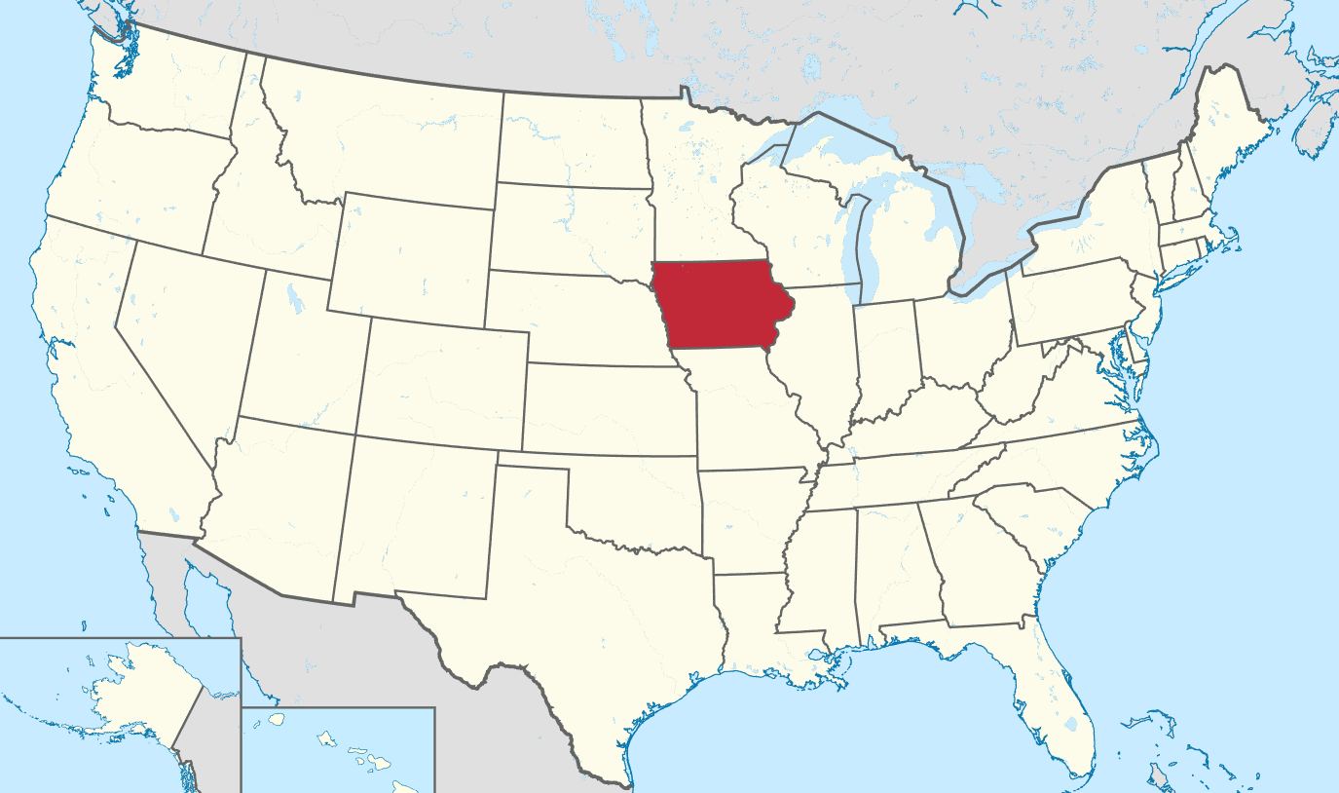
What Problem Are We Solving?
Liquor sales in Iowa vary significantly across stores, product categories, and seasons, making demand planning difficult.
This project develops a predictive model that:
Forecasts monthly liquor sales at the store level
Uses historical statewide transaction data
Highlights key factors influencing purchasing trends

Slide 4




Who Cares & Why
Distributors / Suppliers
Data Scientists & Business Analysts
Need better demand forecasts to plan production and logistics
Real-world case of using public data + ML for demand forecasting
Retailers (Liquor stores)
Want to optimize stock levels, avoid stockouts and overstock
Policy Makers (Iowa ABD / State Government)
Monitor consumption patterns and tax revenues at regional level

Slide 5
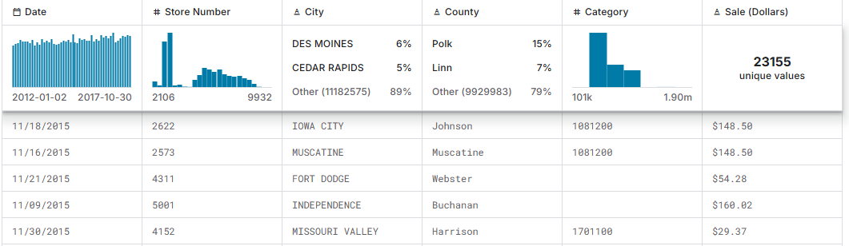
Dataset Description
Source: Kaggle, collected by the Iowa Department of Commerce – Alcoholic Beverages Division
Raw data: ≈ 25M transactions, from 2012 to recent years.
Each row: date, store, city/county, product category, volume, prices, sale_dollars.
For ML, we aggregate to store-month level and predict next month’s total sales (dollars) for each store.

Slide 6
Descriptive Analysis

Slide 7
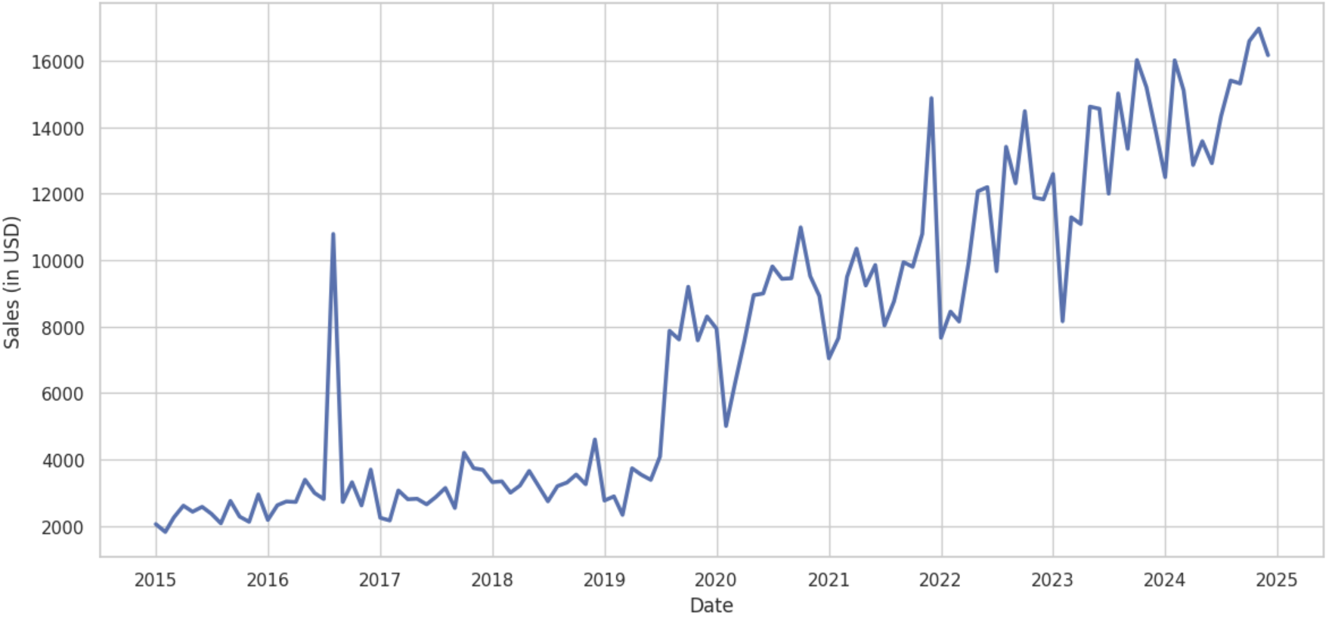
How Have Liquor Sales in Iowa Evolved Over Time?
01
Steady Growth Over Time
Liquor Sales Trend in Iowa (2015–2025)
Monthly sales increased from roughly $2,000–$3,000 in early 2015 to $15,000+ by 2024.
Sales grew by more than 500% over this period.
02
Noticeable Seasonal Peaks
Repeated spikes above $14,000–$16,000, especially near year-end, indicating strong seasonal demand.
Peak months were often $4,000–$6,000 higher than off-season months.
03
Post-2020 Acceleration
After 2020, monthly averages rose sharply from around $6,000–$8,000 to consistently above $12,000.
This shift represents an increase of roughly $5,000 per month on average.

Slide 8
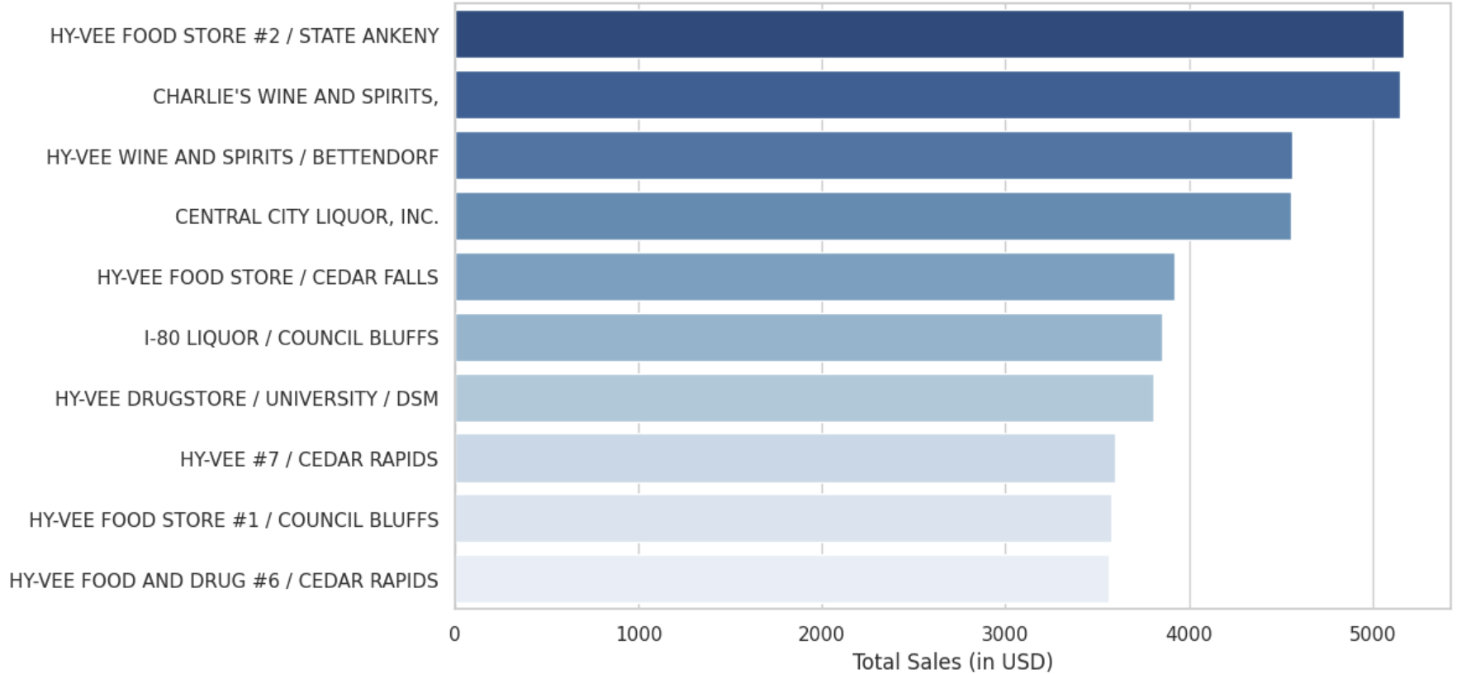
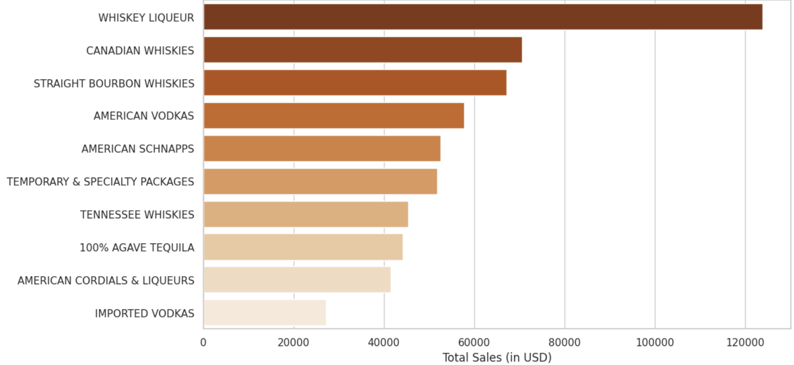
Which Stores and Liquor Categories Lead in Sales?
Highest Revenue Stores
1
Revenue Concentrated in Hy-Vee Urban Stores
Hy-Vee locations make up 7 of the top 10 stores, with the Ankeny and Council Bluffs branches each generating around $4,500–$5,000 in sales.
Top stores are clustered in larger cities such as Ankeny, Bettendorf, Cedar Rapids, Cedar Falls, Council Bluffs, and Des Moines.
2
Whiskey Segments Dominate Category Sales
Highest-Selling Liquor Categories
Whiskey Liqueur leads with roughly $125K in sales, followed by Canadian and Straight Bourbon whiskies at about $70K–$65K.
Whiskey-related categories account for well over half of sales among the top 10 categorie.
3
Vodkas, Schnapps & Tequila as Second Tier
American Vodkas, American Schnapps, and 100% Agave Tequila each generate around $50K–$60K in sales, showing good potential for targeted promotions.

Slide 9
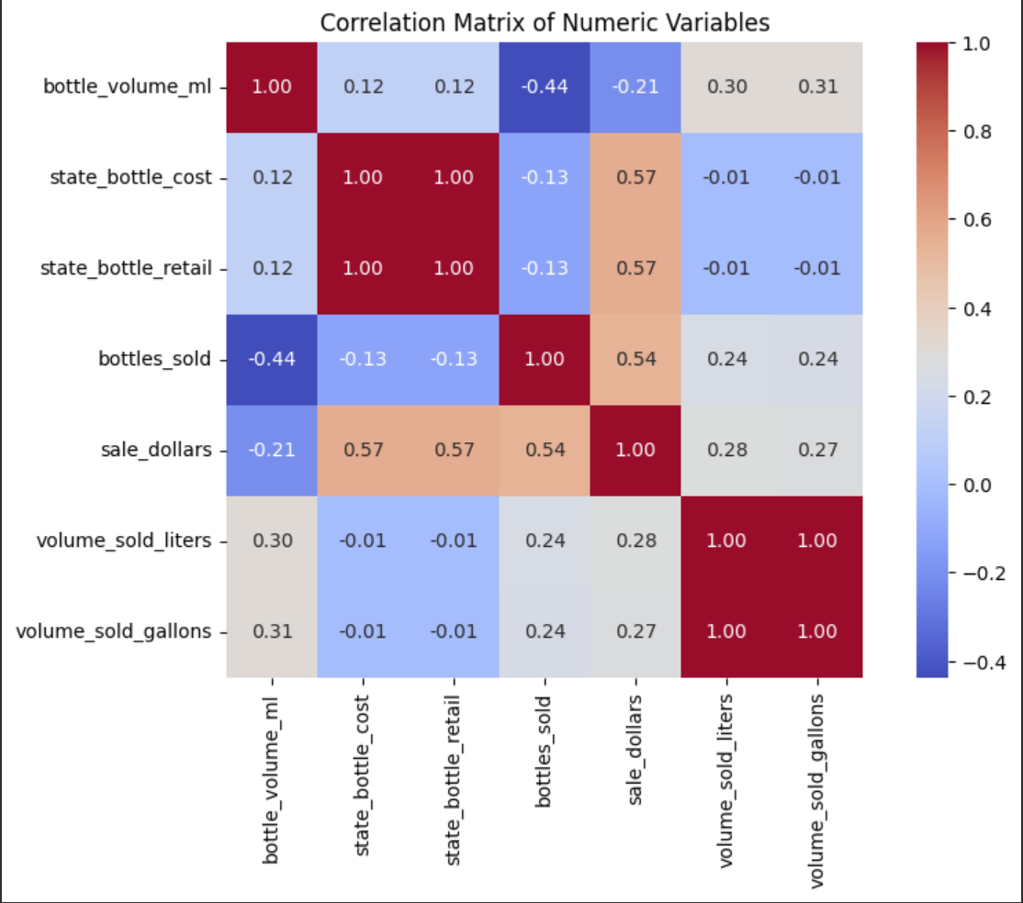
What Relationships Exist Among Key numeric features?
Correlation Analysis of Key Variables
01
Price and Cost Move Together
A perfect correlation (1.00) between state cost and retail price indicates consistent mark-up with no price variation or discount strategies across stores.
02
Revenue Rises With Units Sold
Sale dollars show a stronger correlation with price (0.57) than with bottles sold (0.54), meaning revenue increases more through higher-priced products than simply selling more units.
03
Larger Bottles Reduce Purchase Frequency
Bottle volume correlates negatively with bottles sold (–0.44) and weakly with revenue (–0.21), indicating smaller bottles sell more often.

Slide 10
Methodology & Modeling Setup

Slide 11



Modeling Workflow and Setup
Model performance is evaluated using RMSE and MAE to measure prediction accuracy, and R² to determine how much of the variation in sales is explained.
Data Preparation
Feature Engineering
Modeling Approach
Aggregated transaction-level records into monthly store-level data
Filtered key variables: store information, category, pricing, sales metrics
Encoded categorical fields: store, county, category
Created temporal features using lagged values and rolling averages
Target: Monthly store-level sales
Predictors developed:
Lagged sales: 1-month and 3-month history
Category share: percentage of revenue by category
Average selling price at store level
Models evaluated: Ridge Regression, Random Forest, XGBoost
Train-test strategy: time-based split (historical → future)
Model selection based on RMSE, MAE, and R²
Hyperparameter tuning applied using cross-validation
Notes:
Core Message: It details the rigorous end-to-end process we followed—from aggregating raw data to tuning advanced algorithms—to ensure our model is reliable.
Speaker Notes:
"Moving into our technical approach, this slide outlines the workflow we designed to build an accurate predictive model.
First, Data Preparation: We didn't just use the raw transaction data. We aggregated everything to the store-month level, which aligns with our business goal of forecasting monthly inventory needs. We also filtered for the most relevant variables like store info and pricing.
Second, Feature Engineering: we added intelligence to the data. We created 'Lagged Sales'—looking at 1-month and 3-month history—because past performance is often the best predictor of the future. We also calculated 'Category Share' to understand if a store is a 'Whiskey store' or a 'Vodka store'.
Finally, Modeling Approach: We tested three distinct models: Ridge Regression, Random Forest, and XGBoost. Crucially, we used a time-based split for training and testing. This is essential for forecasting because we can't use future data to predict the past. We then tuned these models using cross-validation to find the optimal settings."

Slide 12
Which Model Produces the Most Accurate Forecasts?
Model | RMSE | MAE | R² | Performance
Ridge Regression | 73.324040 | 33.505739 | 0.033935 | Lowest
Lasso | 73.347614 | 33.602128 | 0.033314 | Mid-Range
XGBoost | 73.016865 | 32.797429 | 0.042012 | Highest
Interpretation
XGBoost achieved the lowest RMSE and MAE and highest R², indicating it captures patterns in the data better than Ridge Regression and Lasso.
Ridge Regression performed the weakest across all metrics, suggesting linear regularization alone is insufficient for modeling the underlying relationships.
Lasso showed only marginal improvement over Ridge, implying that feature selection alone does not significantly enhance predictive performance for this dataset.
Notes:
Core Message: This slide presents the quantitative results, identifying XGBoost as the clear winner that outperformed the linear baselines.
Speaker Notes:
"So, how did the models perform? This table ranks them based on three key metrics: RMSE, MAE, and R-squared.
The Winner: XGBoost emerged as the top performer. It achieved the lowest RMSE (73.02) and the highest R-squared (0.042). While that R-squared might seem low, in high-variance retail data, it represents a significant signal capture compared to the noise.
The Linear Baselines: Ridge and Lasso performed very similarly to each other but were noticeably weaker than XGBoost.
Interpretation: The key takeaway here is that XGBoost captured patterns the others missed. The fact that linear models (Ridge/Lasso) underperformed suggests that the relationships in our data—like seasonal spikes or geographic clusters—are non-linear. A simple straight line couldn't fit the data, but XGBoost's decision trees could."

Slide 13
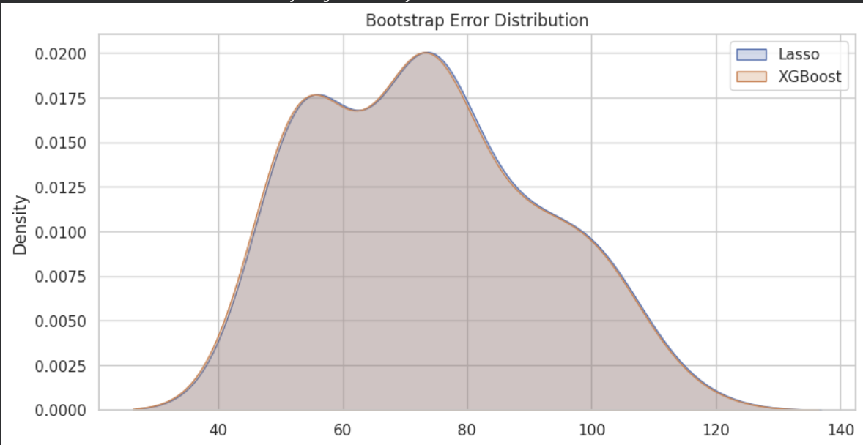
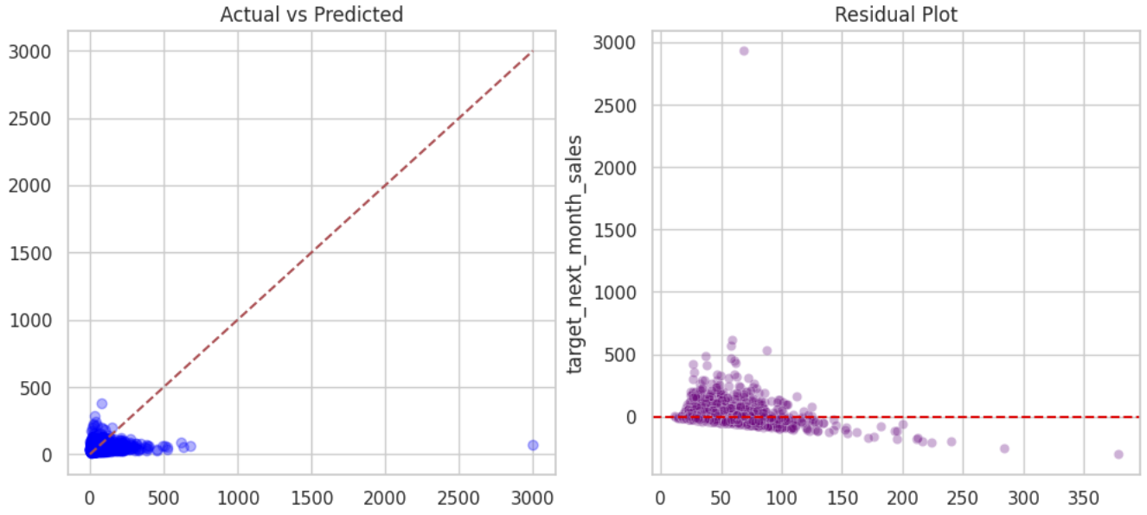
Model Performance Comparison: XGBoost is the Optimal Predictor
Error Distribution:
XGBoost’s curve is slightly shifted lower than Lasso, showing smaller errors overall.
The distributions overlap, but XGBoost has a tighter spread, indicating more consistent performance.
This confirms that XGBoost produces fewer large prediction errors compared to the linear baseline.
Actual vs. Predicted & Residuals(XGBoost):
Most points align close to the diagonal line, showing strong agreement between predictions and actual sales.
Residuals cluster tightly around zero, indicating minimal systematic bias.
Larger errors occur only for uncommon high-value cases, which are rare in the dataset.
Notes:
Core Message: This slide visualizes why XGBoost is better, showing that it is more consistent and unbiased than the baseline.
Speaker Notes:
"We wanted to go beyond just average scores and look at the distribution of errors.
Error Distribution graph compares the prediction errors of Lasso (Blue) and XGBoost (Orange). You can see the XGBoost curve is narrower and shifted slightly to the left. This means it produces smaller errors on average and is more consistent—it has fewer massive 'misses' than the linear model.
Bottom Left (Actual vs. Predicted): Here, we see the predictions plotted against actual sales. The points cluster tightly along the diagonal line, which indicates strong agreement. The model isn't just guessing; it's tracking the actual sales volume effectively.
Bottom Right (Residual Plot): This is our quality check. The residuals (or errors) are clustered around zero, which is exactly what we want. We don't see any major patterns or curves, which means the model has minimal systematic bias. It handles both small and large transactions fairly well."

Slide 14
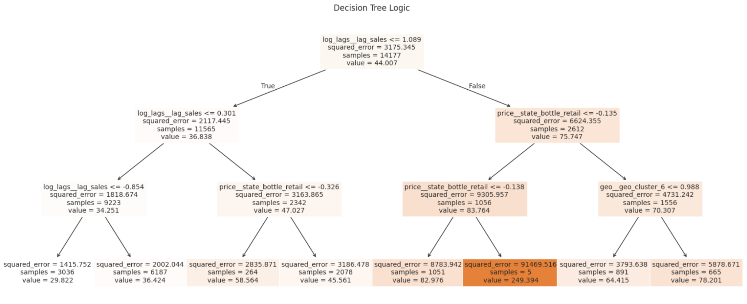
What the Decision Tree Reveals?
This visual highlights how momentum, pricing, and location interact to influence store-level forecasts.
The tree first separates stores based on recent sales levels, showing that past performance drives the largest shift in revenue outcomes.
Pricing differences help separate lower-revenue stores when recent sales are weak.
Geographic clusters explain why stores in similar regions show different revenue ranges.
Notes:
Core Message: This slide peers inside the "black box" of the model to understand the logic it uses—Momentum, Price, and Location—to make predictions.
Speaker Notes:
"Finally, we visualized a single Decision Tree to understand the logic driving our forecasts.
The Root Cause: The very first split at the top is based on 'log_lags_sales'. This confirms our hypothesis that Momentum is King—a store's recent past performance is the single most important factor in predicting its future.
Price Sensitivity: Moving down the tree, we see splits based on 'price_state_bottle_retail'. This helps the model differentiate between stores that sell high-volume cheap liquor versus those selling premium products.
Location Matters: Further down, you see a split for 'geo_cluster'. This allows the model to adjust its predictions based on specific regions, capturing those local geographic trends we discussed earlier.
Summary: This tree validates that our model is making decisions based on sensible business drivers: Momentum, Price, and Location."

Slide 15
Key Insights & Conclusion

Slide 16
Key Insights
What the Results Demonstrate?
The modeling process confirmed that momentum, seasonality, and geographic patterns are key predictors of store-level revenue, and that advanced models deliver meaningful gains over linear baselines.
Demand Momentum
Model Improvement
Forecast Reliability
Past sales consistently emerged as the strongest predictor of future revenue, showing that store-level demand patterns remain relatively stable over time.
Advanced tree-based models demonstrated clear improvements over linear baseline models, particularly when accounting for nonlinear interactions and seasonal effects.
The final XGBoost model provided consistently accurate predictions across future periods, making it suitable for forward-looking planning at the store level.

Slide 17

Recommendations and Limitations
Reccomendations
Extend the model to forecast demand at the SKU level to support more precise inventory decisions
Integrate external event and weather data to better capture seasonal demand variation.
Continuously retrain the model as new monthly data is collected to maintain prediction stability and relevance.
Deploy the model through a dashboard for direct monthly forecasting use.
Limitations
The model only predicts total sales per store, so it cannot guide ordering decisions for specific product types.
Some models were trained on reduced samples due to computing limits, restricting full evaluation.
The model only predicts in the short term, making it difficult to plan several months ahead.
The model does not include external factors like holidays, competition, or weather, which can influence sales changes.
Expand forecasting depth by incorporating SKU-level data, external demand drivers, larger training samples, and longer time horizons to improve performance and planning usefulness.

Slide 18
Thank You
Notebook link
Notes:
Our analysis showed a very clear "heartbeat" pattern with sales peaking consistently in November and December 3. These holiday spikes are significantly higher—often $4,000 to $6,000 more—than off-season months4, which is why including the "Month" as a feature was so critical for the model.

