Slide 1

Air Ticket Price Prediction Model
By,
Abhishek Narayanan

Slide 2

—Clive James
“It is only when they go wrong that machines remind you how powerful they are.”

Slide 3
Table of Contents
01
02
03
04
The Problem
05
Shortlist Promising Models
Get the Data
06
Fine-tune the System
Explore the Data
07
Present the Solution
Prepare the Data
08
Launch the System

Slide 4
01
02
03
04
Air Ticket Price Prediction Model
The Problem
The objective is to build a model that predicts air ticket prices.
Get the Data
Supervised Regression problem with Price as the target variable.
Explore the Data
Mean Absolute Error will be used as a performance measure.
Prepare the Data

Slide 5
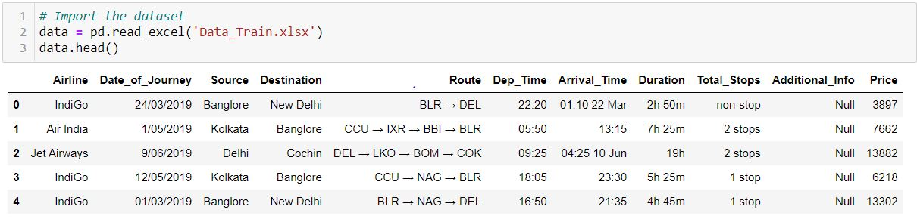
01
03
04
Air Ticket Price Prediction Model
The Problem
The data was read in the .xlsx format.
Quick Look at the Data Structure
02
Get the Data
Explore the Data
Prepare the Data

Slide 6
01
03
04
Air Ticket Price Prediction Model
The Problem
The data was read in the .xlsx format.
Quick Look at the Data Structure
02
Get the Data
Airline | Name of the Airline
Date_of_Journey | Date on which the journey happened
Source | City of the departure of the flight
Destination | City of the arrival of the flight
Route | Route of the flight
Dep_Time | Departure time of the flight
Arrival_Time | Arrival time of the flight
Duration | Duration of the flight
Total_Stops | Number of stops during the journey
Additional_Info | Additional information about the journey
Price | Price of the ticket for a single journey
Explore the Data
Prepare the Data

Slide 7
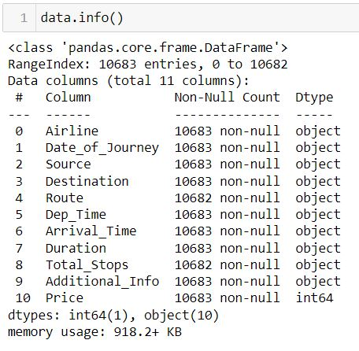
01
03
04
Air Ticket Price Prediction Model
The Problem
The data was read in the .xlsx format.
Quick Look at the Data Structure
02
Get the Data
Explore the Data
Prepare the Data

Slide 8
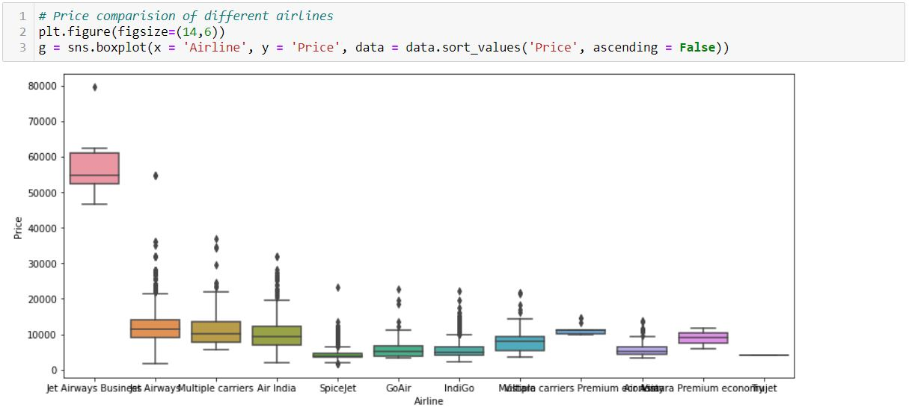
01
02
03
04
Air Ticket Price Prediction Model
The Problem
The following is a Box Plot of ticket prices of different airlines.
Get the Data
Explore the Data
Prepare the Data

Slide 9
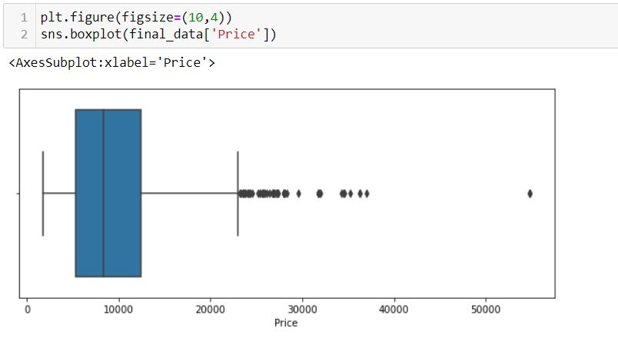
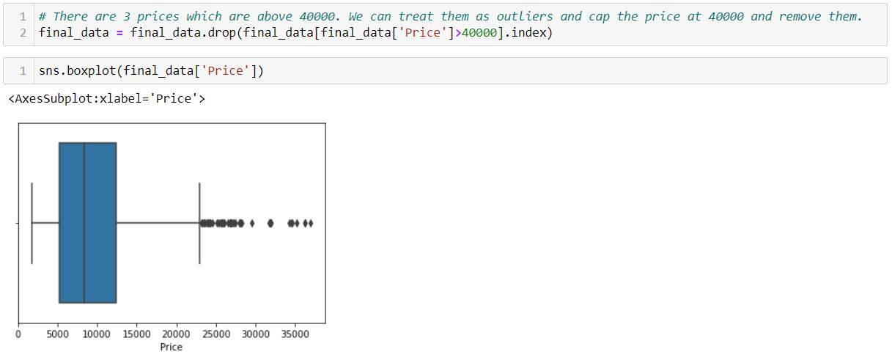
01
02
03
04
Air Ticket Price Prediction Model
The Problem
DATA CLEANING
Fix or remove outliers
Get the Data
Explore the Data
Prepare the Data

Slide 10
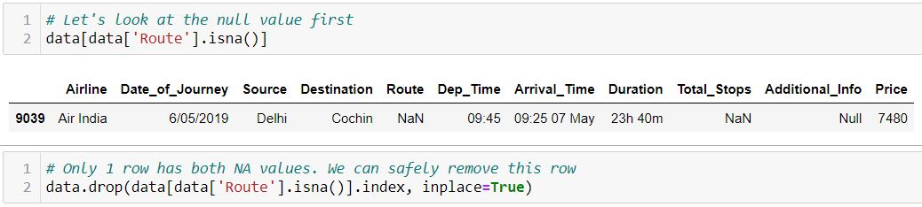
01
02
03
04
Air Ticket Price Prediction Model
The Problem
DATA CLEANING
Fill in missing values or drop their rows
Get the Data
Explore the Data
Prepare the Data

Slide 11
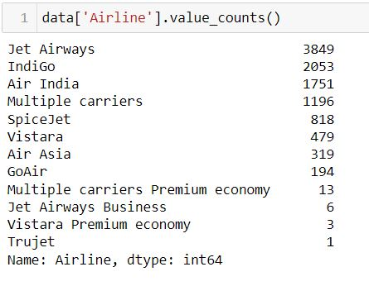
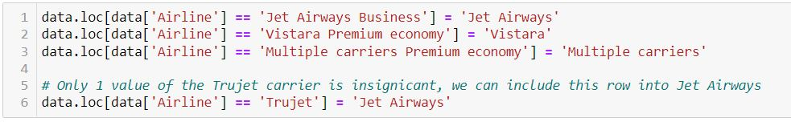
01
02
03
04
Air Ticket Price Prediction Model
The Problem
DATA CLEANING
Merge similar Airline classes
Get the Data
Explore the Data
Prepare the Data

Slide 12
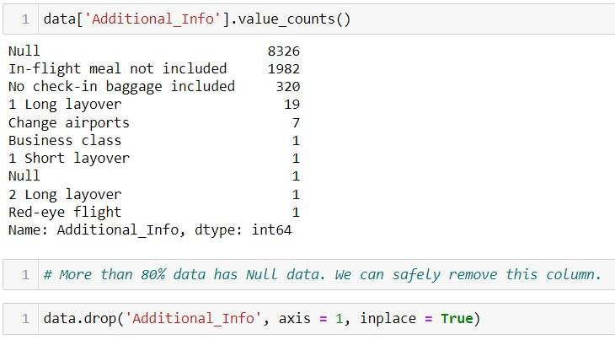
01
02
03
04
Air Ticket Price Prediction Model
The Problem
FEATURE SELECTION
Drop the useless attributes
Get the Data
Explore the Data
Prepare the Data

Slide 13
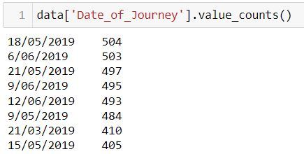
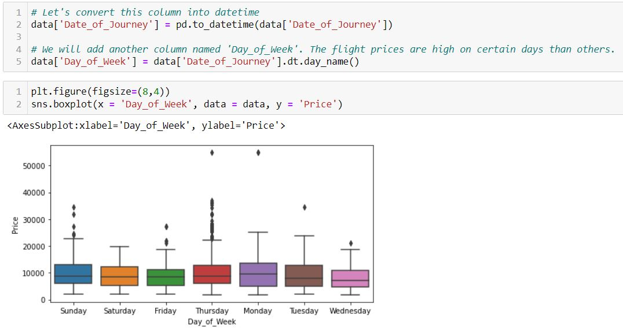
01
02
03
04
Air Ticket Price Prediction Model
The Problem
FEATURE ENGINEERING
Extract the day from Date_of_Journey column and visualize its relation to Price
Get the Data
Explore the Data
Prepare the Data

Slide 14
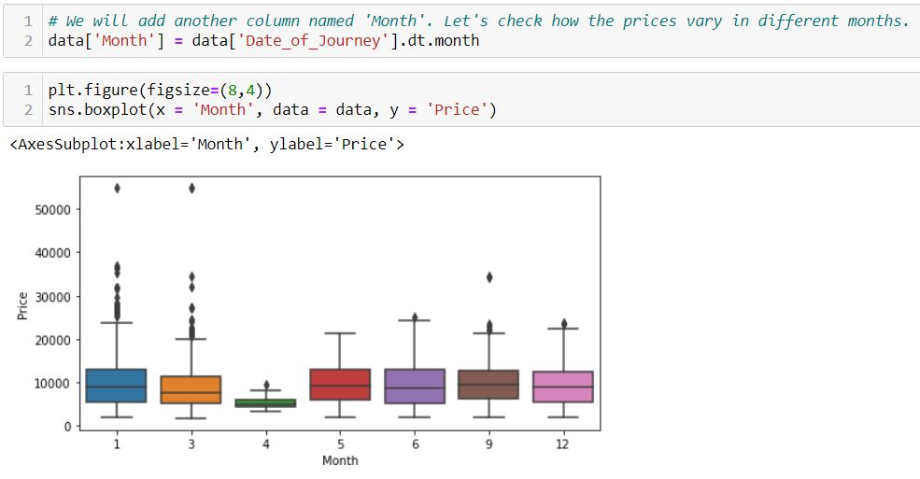
01
02
03
04
Air Ticket Price Prediction Model
The Problem
FEATURE ENGINEERING
Extract the month from Date_of_Journey column and visualize its relation to Price
Get the Data
Explore the Data
Prepare the Data

Slide 15
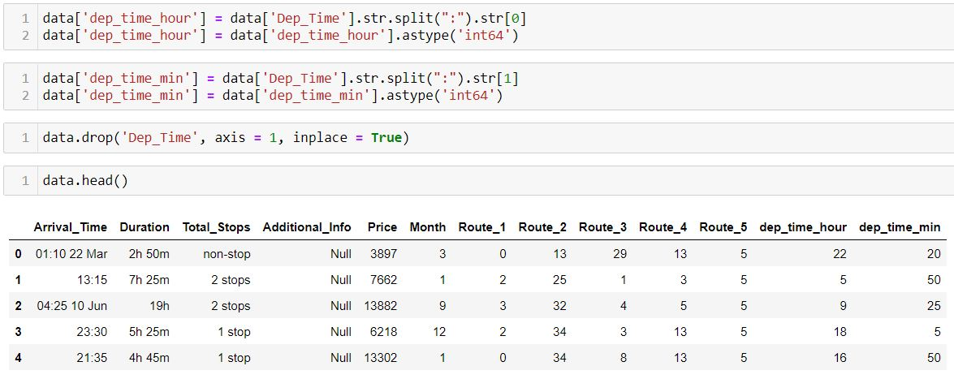
01
02
03
04
Air Ticket Price Prediction Model
The Problem
FEATURE ENGINEERING
Extract the hour and minutes from the Dep_Time column
Get the Data
Explore the Data
Prepare the Data

Slide 16
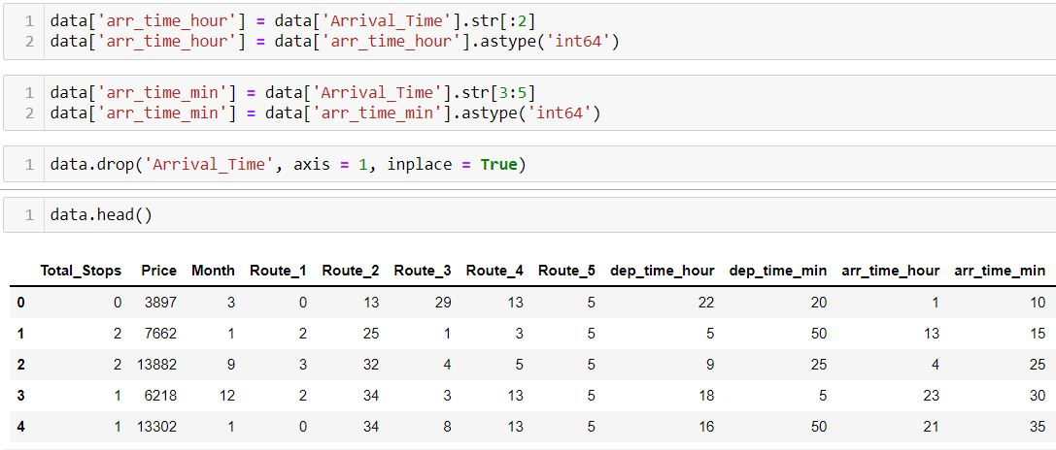
01
02
03
04
Air Ticket Price Prediction Model
The Problem
FEATURE ENGINEERING
Extract the hour and minutes from the Arrival_Time column
Get the Data
Explore the Data
Prepare the Data

Slide 17
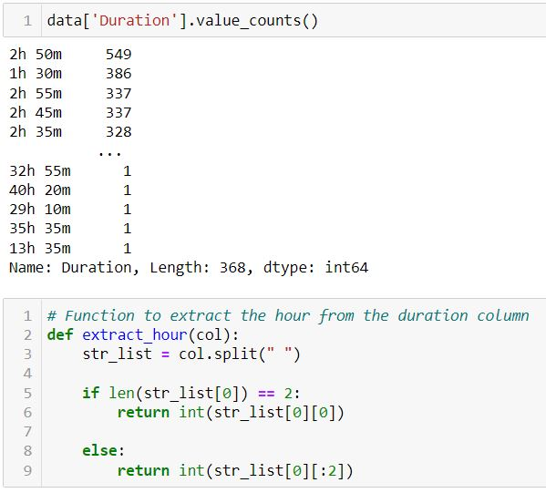
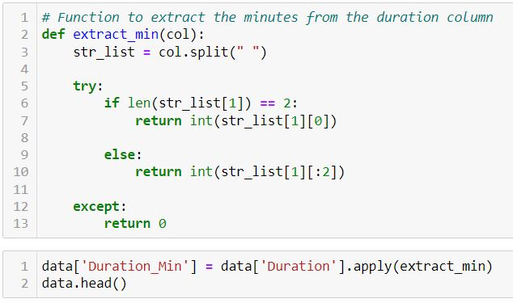
01
02
03
04
Air Ticket Price Prediction Model
The Problem
FEATURE ENGINEERING
Extract the hour and minutes from the Duration column
Get the Data
Explore the Data
Prepare the Data

Slide 18
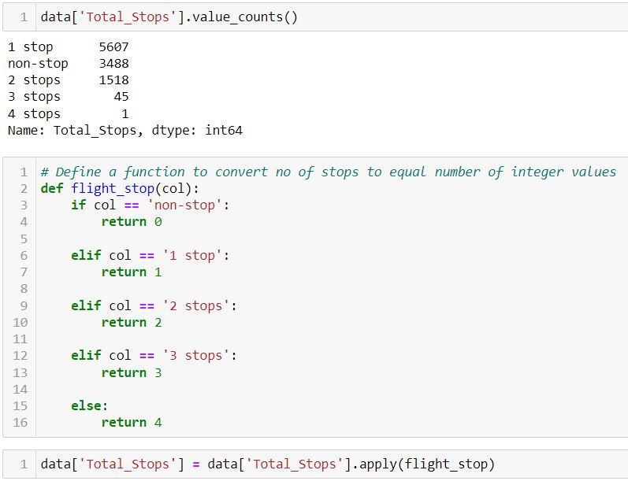
01
02
03
04
Air Ticket Price Prediction Model
The Problem
Handling Text and Categorical Attributes
Converting the Total_Stops column to integer values
Get the Data
Explore the Data
Prepare the Data

Slide 19
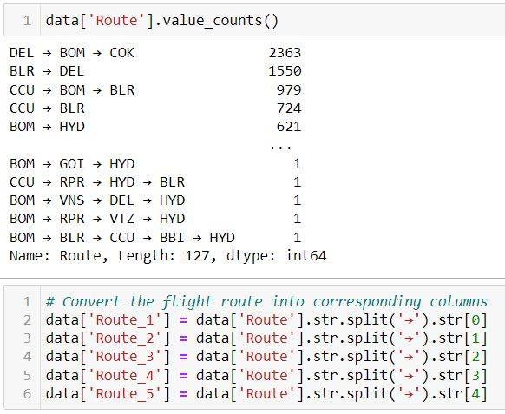
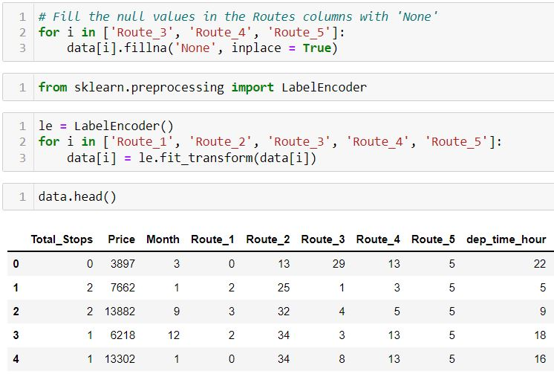
01
02
03
04
Air Ticket Price Prediction Model
The Problem
Handling Text and Categorical Attributes
Converting the Route column to integer values
Get the Data
Explore the Data
Prepare the Data

Slide 20
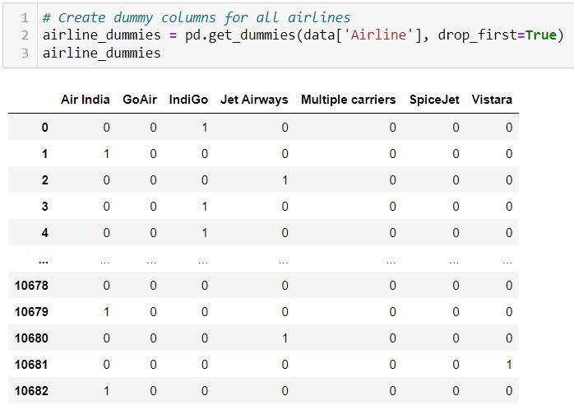
01
02
03
04
Air Ticket Price Prediction Model
The Problem
Handling Text and Categorical Attributes
Creating dummy variables for remaining text attributes
Get the Data
Explore the Data
Prepare the Data

Slide 21
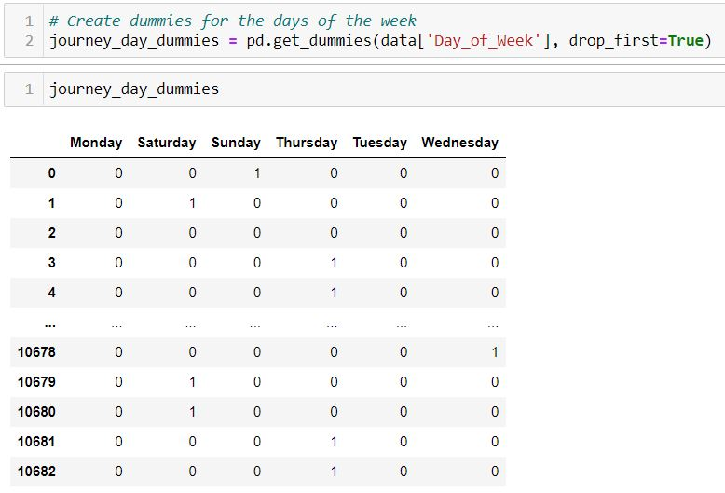
01
02
03
04
Air Ticket Price Prediction Model
The Problem
Handling Text and Categorical Attributes
Creating dummy variables for remaining text attributes
Get the Data
Explore the Data
Prepare the Data

Slide 22
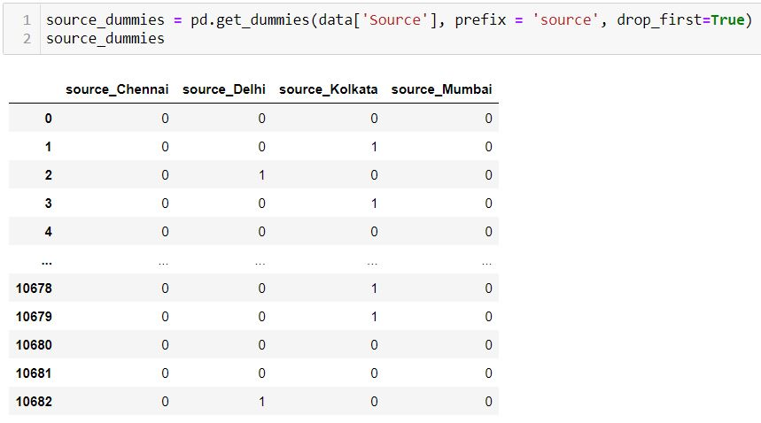
01
02
03
04
Air Ticket Price Prediction Model
The Problem
Handling Text and Categorical Attributes
Creating dummy variables for remaining text attributes
Get the Data
Explore the Data
Prepare the Data

Slide 23
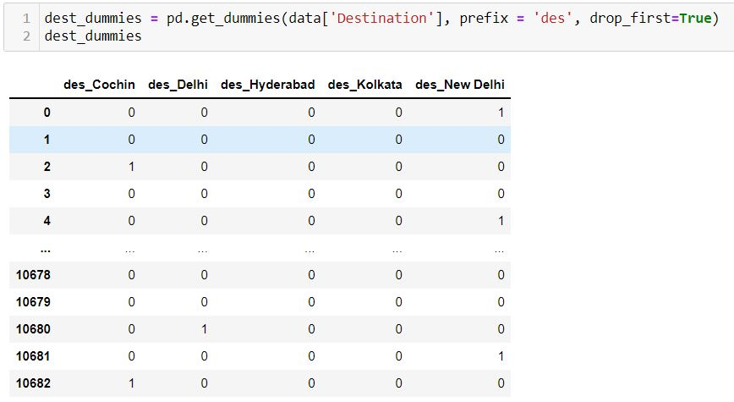
01
02
03
04
Air Ticket Price Prediction Model
The Problem
Handling Text and Categorical Attributes
Creating dummy variables for remaining text attributes
Get the Data
Explore the Data
Prepare the Data

Slide 24
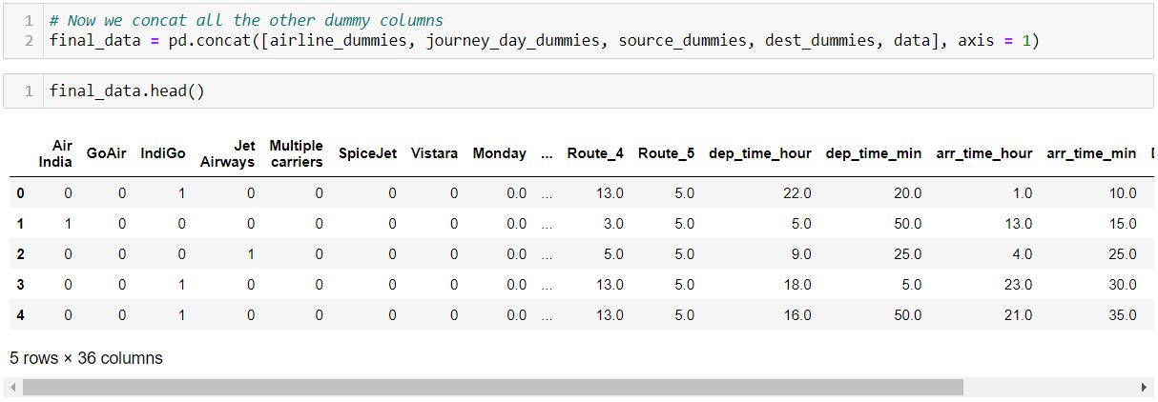
01
02
03
04
Air Ticket Price Prediction Model
The Problem
Final Model Data
Concatenate all the dummy variables to the main data
Get the Data
Explore the Data
Prepare the Data

Slide 25
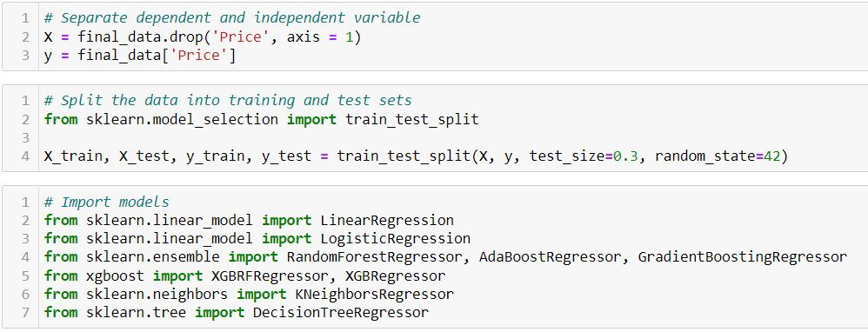
05
Air Ticket Price Prediction Model
Split the data and import different models
Shortlist Promising Models
06
Fine-tune the System
07
Present the Solution
08
Launch the System

Slide 26
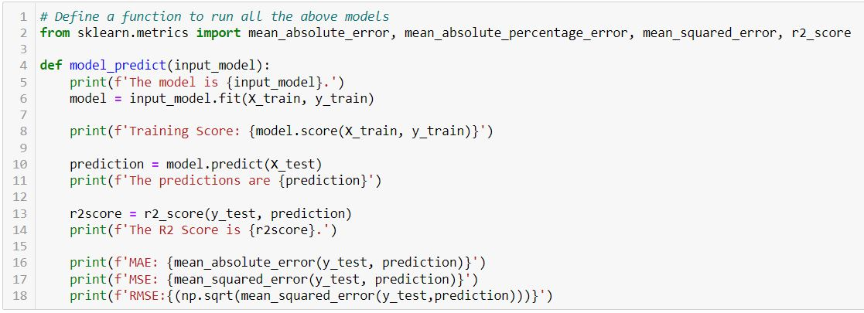
05
Air Ticket Price Prediction Model
Define a function to run the models
Shortlist Promising Models
06
Fine-tune the System
07
Present the Solution
08
Launch the System

Slide 27
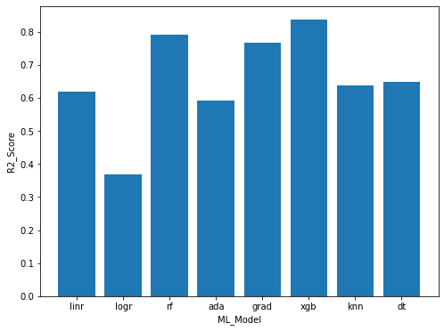
05
Air Ticket Price Prediction Model
Train the models and predict on test set
Shortlist Promising Models
06
Fine-tune the System
07
Present the Solution
08
Launch the System

Slide 28
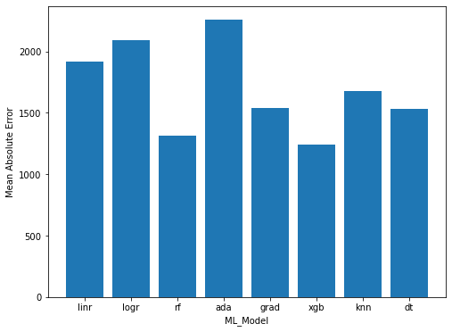
05
Air Ticket Price Prediction Model
Train the models and predict on test set
Shortlist Promising Models
06
Fine-tune the System
07
Present the Solution
08
Launch the System

Slide 29
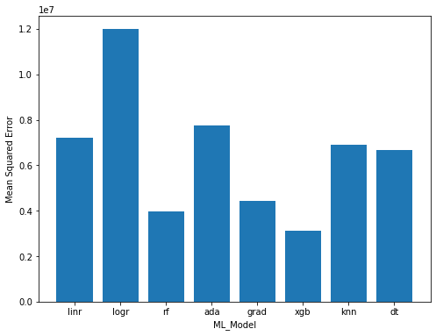
05
Air Ticket Price Prediction Model
Train the models and predict on test set
Shortlist Promising Models
06
Fine-tune the System
07
Present the Solution
08
Launch the System

Slide 30
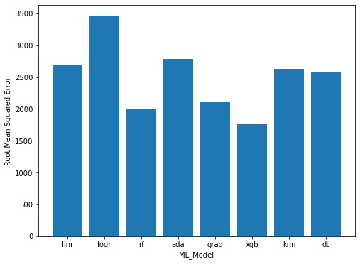
05
Air Ticket Price Prediction Model
Train the models and predict on test set
Shortlist Promising Models
06
Fine-tune the System
07
Present the Solution
08
Launch the System

Slide 31
05
0.93
Air Ticket Price Prediction Model
XGBoost Regressor
Random Forest
Shortlist Promising Models
0.95
Training Score
Training Score
06
Fine-tune the System
0.836
0.790
R2 Score
R2 Score
1239.3
1314.3
Present the Solution
07
MAE
MAE
3103353.1
3980998.2
MSE
MSE
08
Launch the System
1761.6
1995.2
RSME
RSME

Slide 32
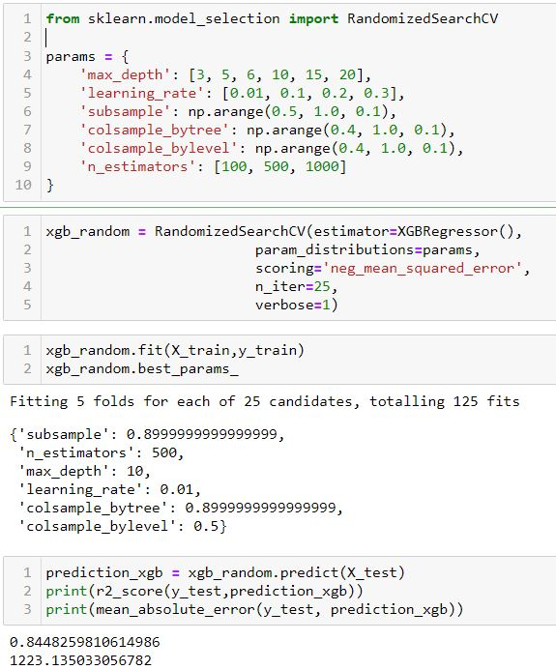
06
Air Ticket Price Prediction Model
Hyper-parameter Tuning (XG Boost)
05
Shortlist Promising Models
Fine-tune the System
07
Present the Solution
08
Launch the System

Slide 33
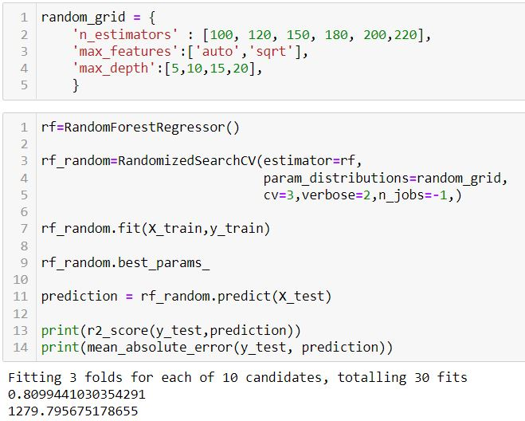
06
Air Ticket Price Prediction Model
Hyper-parameter Tuning (Random Forest)
05
Shortlist Promising Models
Fine-tune the System
07
Present the Solution
08
Launch the System

Slide 34
07
Air Ticket Price Prediction Model
XGBoost Regressor
05
Shortlist Promising Models
0.845
R2 Score
1223.1
06
Fine-tune the System
MAE
Present the Solution
08
Launch the System

Slide 35
Thanks!
Do you have any questions?
myselfabhishekn@gmail.com
+91 8082141785

