Slide 1

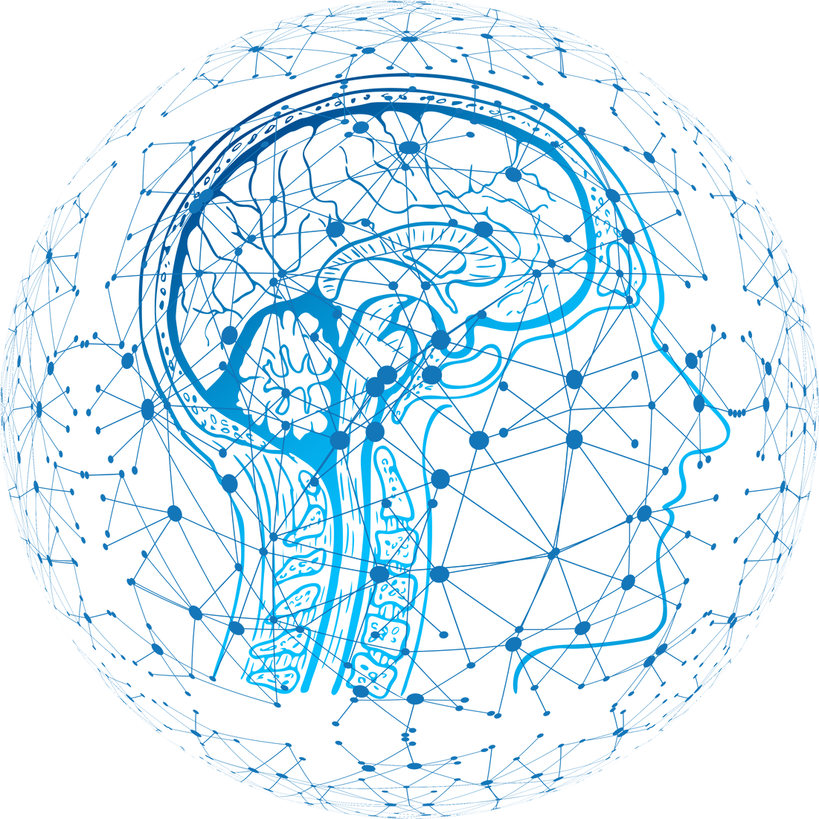
GenAI
Hackathon
Team : Autogen Coders
01

Slide 2
TransLingua: Al-Powered
Multi-Language Translator
02

Slide 3
Description:
TransLingua is a cutting-edge web application designed to harness the power of advanced Al to provide seamless language translation services. Built using Streamlit and Google's Generative Al, TransLingua offers an intuitive and user-friendly interface for translating text between multiple languages. By simply inputting text and selecting the desired source and target languages, users can instantly receive accurate translations powered by the latest Al models. This tool is ideal for anyone needing reliable and fast translations, whether for personal, educational, or professional purposes.
02

Slide 4
Expected Solution:
A company planning to expand its market reach to non-English speaking regions needs to translate business documents, marketing materials, and customer communications into multiple languages. TransLingua enables the company to quickly translate promotional content and technical documents, ensuring consistency and accuracy across different languages. This helps the company effectively communicate with a broader audience and tailor its messaging to local markets.
02

Slide 5
Applications:
1. Business Expansion: Companies can use it to translate marketing materials, business documents, and communications to expand into non-English-speaking regions.
2. Education: Educational institutions can use it for translating textbooks, learning materials, and lectures to reach a wider audience.
3. Travel & Tourism: Travelers can use it for real-time translation of signs, menus, and directions in fore
1. Business Expansion: Companies can use it to translate marketing materials, business documents, and communications to expand into non-English-speaking regions.
2. Education: Educational institutions can use it for translating textbooks, learning materials, and lectures to reach a wider audience.
3. Travel & Tourism: Travelers can use it for real-time translation of signs, menus, and directions in foreign languages.
4. Healthcare: Medical professionals can use it to communicate with non-native patients, translating medical documents and prescriptions.
5. Government Services: For translating legal, governmental, or community service documents to ensure they reach all citizens, regardless of language barriers.
ign languages.
4. Healthcare: Medical professionals can use it to communicate with non-native patients, translating medical documents and prescriptions.
5. Government Services: For translating legal, governmental, or community service documents to ensure they reach all citizens, regardless of languag
e barriers.
02

Slide 6
Uniqueness:
1. Multimodal Input and Output: Unlike many translators that work only with text, TransLingua handles text, audio, and documents, and provides output in text, audio, and downloadable documents (PDF, DOCX, TXT).
2. Generative AI Technology: Uses cutting-edge AI models (like Google’s Generative AI) to produce more accurate and context-aware translations compared to traditional machine translation tools.
3. Customizable Translations: Users can select the language pair and adjust the tone or style of translation, making it more flexible for different contexts (business, casual, technical).
4. Real-Time Audio Translation: Users can get audio translations immediately, helping in dynamic conversations or meetings, a feature not widely available in many existing translators.
5. File Translation Support: The ability to translate entire documents (PDF, DOCX, TXT) while preserving their formatting and structure is a major advantage over other systems.
02

Slide 7
ThankYou
M.Abhinov 1602-22-735-001
K.Akash Ram 1602-22-735-002
G.Dheekshith 1602-22-735-014
P.Gopi Krishna 1602-22-735-015
M.Harika 1602-22-735-016
02

