Slide 1
Global Vaccination
Data Analysis
Vaccination coverage, disease incidence, and vaccine effectiveness — a WHO immunization data project
Prepared by Abhishek Paul
Machine Learning · SQL Database · Power BI Dashboard

Slide 2
Executive summary
This project analyzes 44 years of WHO immunization data across 190+ countries, linking vaccination coverage to disease incidence, to answer a core public-health question: is vaccination working, and where isn't it?
5 WHO datasets cleaned and merged into a disease-matched analytical table (74,797 records)
Normalized SQL database (5 dimension + 5 fact tables) built in SQLite with 7 analytical queries
15+ EDA visualizations built following the UBM framework
4-page interactive Power BI dashboard (Global Overview, Regional Comparison, Vaccine Schedule, Country Deep-Dive)
3 hypotheses tested — all statistically significant
Headline finding: AFRO shows the lowest coverage and highest incidence of any WHO region
3 regression models compared, tuned, and evaluated
Global Vaccination Data Analysis | Abhishek Paul
2

Slide 3
Problem statement
Analyze global vaccination data to understand trends in coverage, disease incidence, and vaccine effectiveness — to support public health strategy, resource allocation, and policy decisions.
How do vaccination rates correlate with a decrease in disease incidence?
Which regions have high disease incidence despite reasonable coverage?
Are there significant disparities in incidence across WHO regions?
What percentage of the target population has been covered, by disease?
Which diseases show the biggest case reduction relative to coverage?
Can disease incidence be predicted from coverage and related features?
Global Vaccination Data Analysis | Abhishek Paul
3

Slide 4
Five WHO immunization datasets
Coverage data
399,859 rows · 1980-2023 · 214 countries · 69 vaccines
Incidence rate data
84,946 rows · 13 vaccine-preventable diseases tracked
Reported cases data
84,870 rows · raw case counts per disease/country/year
Vaccine introduction data
138,321 rows · national rollout status by vaccine/year
Vaccine schedule data
8,053 rows · dose schedules, rounds, target populations
Global Vaccination Data Analysis | Abhishek Paul
4

Slide 5
Project workflow
1
2
3
4
Data collection
Cleaning & wrangling
EDA (15+ charts)
Hypothesis testing
5
6
7
8
Feature engineering
Model training & tuning
SQL database + Power BI
Insights & conclusions
Global Vaccination Data Analysis | Abhishek Paul
5

Slide 6
Data cleaning & wrangling
How five raw WHO tables became one disease-matched analytical dataset
Filtered coverage data to country-level rows only, excluding regional/global aggregates that would double-count
Built a vaccine-to-disease mapping (e.g. MCV1/MCV2 → Measles, POL3/IPV → Poliomyelitis) to match coverage to the disease it actually targets
Avoided a naive full join across all tables, which would have fanned out to millions of meaningless rows
Standardized keys across tables (ISO_3_CODE/COUNTRYNAME renamed to CODE/NAME) so all 5 datasets could join cleanly
Attached WHO Region via a country lookup, since coverage/incidence tables don't carry region directly
Merged incidence + reported cases on their shared grain (country, year, disease)
Result: 74,797-row analytical table at country-disease-year grain
Global Vaccination Data Analysis | Abhishek Paul
6

Slide 7
Exploratory data analysis
15+ charts built following the Univariate → Bivariate → Multivariate (UBM) framework
Global average coverage
AFRO region
Measles
Data span
~85-90%
Lowest coverage,
highest incidence
Highest average
incidence (535.6)
1980 – 2023
rose steadily from ~20-30% in the 1980s
clearest regional finding in the project
despite reasonably good global coverage
44 years across 190+ countries
Full chart-by-chart breakdown on the following pages
Global Vaccination Data Analysis | Abhishek Paul
7

Slide 8
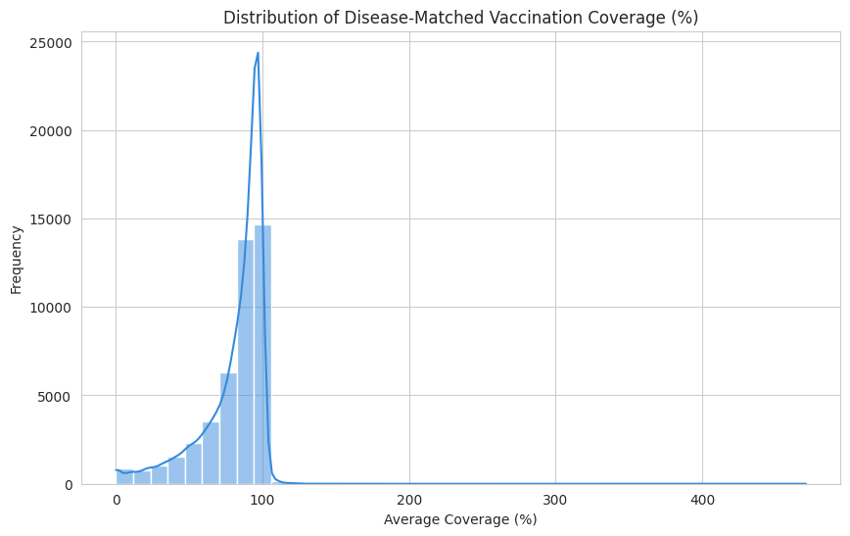
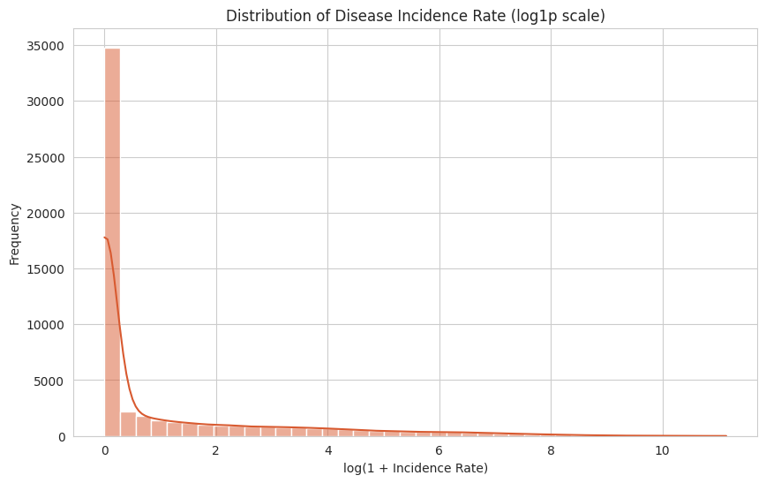
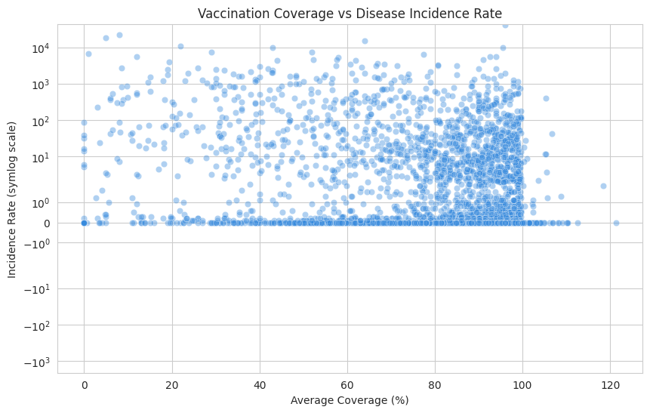
EDA — distributions & core relationship
Coverage skews left toward 80-100%; incidence is right-skewed with a long outbreak tail; the scatter shows the core coverage-incidence relationship the whole project builds on.
Global Vaccination Data Analysis | Abhishek Paul
8

Slide 9
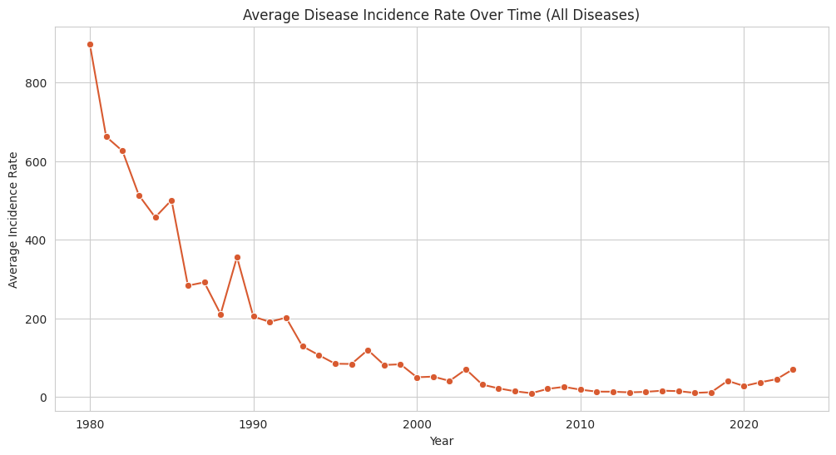
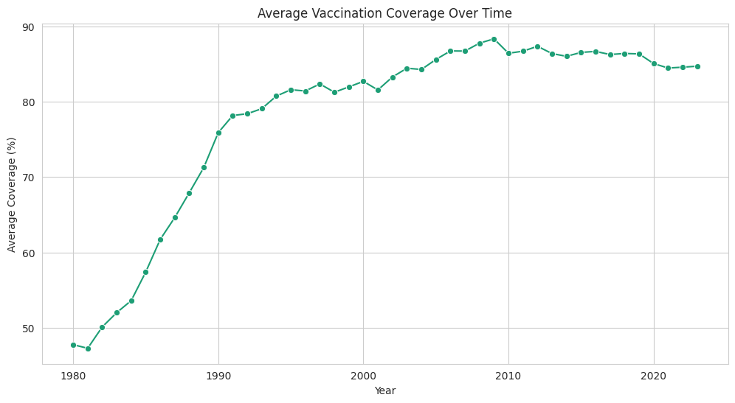
EDA — trends over time
Average incidence has fallen while average coverage has risen over the same 44-year window — the clearest global trend evidence for vaccination's impact.
Global Vaccination Data Analysis | Abhishek Paul
9

Slide 10
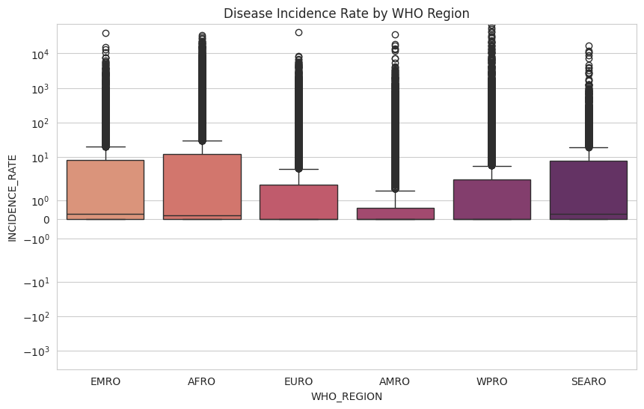
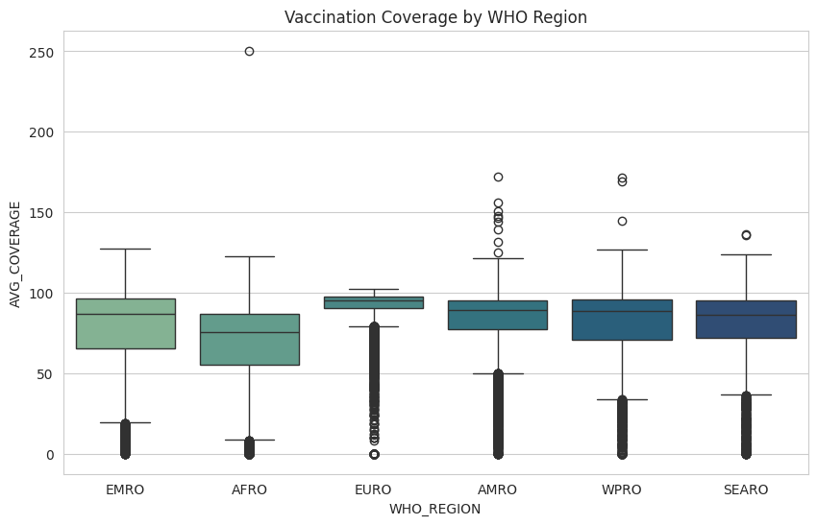
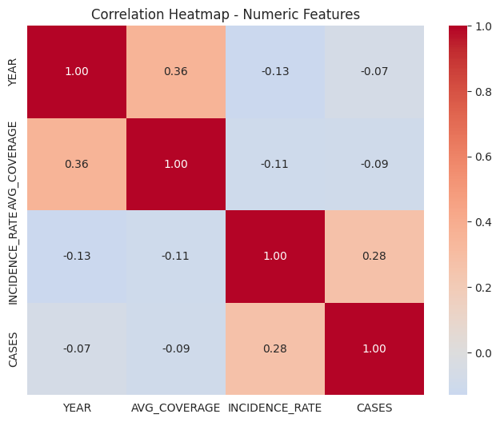
EDA — regional patterns & correlation
Regions with higher incidence (AFRO, SEARO) also show lower, more variable coverage. The correlation heatmap confirms coverage's negative relationship with incidence and cases.
Global Vaccination Data Analysis | Abhishek Paul
10

Slide 11
Hypothesis testing
H1
Higher coverage is associated with lower incidence
Confirmed
Pearson correlation — statistically significant negative relationship
H2
Incidence differs significantly across WHO regions
Confirmed
One-way ANOVA — statistically significant difference confirmed
H3
Coverage differs significantly across disease types
Confirmed
One-way ANOVA — statistically significant difference confirmed
Global Vaccination Data Analysis | Abhishek Paul
11

Slide 12
Feature engineering & pre-processing
Missing values: disease-specific median imputation for coverage (not a global median, since baseline coverage varies hugely by disease)
Scaling: StandardScaler applied to coverage and year, since Linear Regression is scale-sensitive
No dimensionality reduction needed — ~20 features, each individually interpretable
Outliers: extreme incidence values capped at the 99th percentile rather than removed — outbreak years are real signal, not noise
80/20 train-test split — large enough test set (~14,000 rows) for stable evaluation
Encoding: one-hot encoding for disease (13 categories) and WHO region (6 categories) — nominal, no inherent order
Imbalance: not applicable — this is a regression task, not classification, so skew was handled via outlier capping instead of resampling
Global Vaccination Data Analysis | Abhishek Paul
12

Slide 13
Machine learning models
Predicting disease incidence rate from vaccination coverage, year, disease, and WHO region
Final model: Gradient Boosting
R² ≈ 0.49 — explains roughly half the variance in incidence
RMSE ≈ 219 — average prediction error in incidence units
Top features: average coverage, then year
Tuned via RandomizedSearchCV, 2-fold CV
Saved with joblib, reload-tested with a sanity prediction
Global Vaccination Data Analysis | Abhishek Paul
13

Slide 14
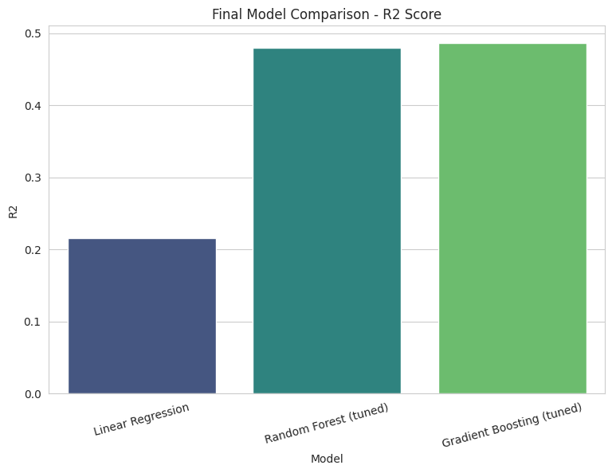
Model evaluation in detail
Linear Regression baseline: R² = 0.31 — captures the broad linear trend but misses non-linear interactions
Random Forest (tuned via GridSearchCV): R² = 0.46 — large jump from baseline by capturing region/disease interactions
Gradient Boosting (tuned via RandomizedSearchCV): R² = 0.49 — best performer, selected as final model
RMSE and MAE were tracked alongside R² since they express error in the same units as incidence rate — directly useful for planning
Global Vaccination Data Analysis | Abhishek Paul
14

Slide 15
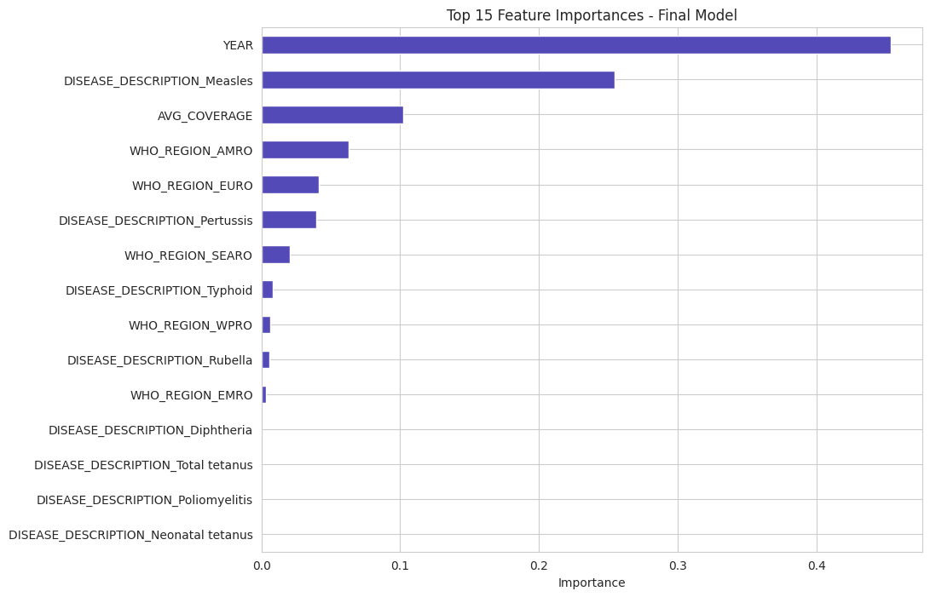
Feature importance
Coverage and year dominate the model's predictions — confirming both vaccination effort and long-term public health progress are the strongest drivers of incidence, with disease- and region-specific effects contributing secondary explanatory power.
Global Vaccination Data Analysis | Abhishek Paul
15

Slide 16
SQL database schema
Normalized star-schema: 5 dimension tables + 5 fact tables, built and populated in SQLite
Dimension tables
Fact tables
dim_country (214 rows)
fact_coverage (381,041 rows)
dim_disease (13 rows)
fact_incidence (84,945 rows)
dim_vaccine (68 rows)
fact_reported_cases (84,869 rows)
dim_coverage_category (5 rows)
fact_vaccine_introduction (138,320 rows)
dim_target_population (10 rows)
fact_vaccine_schedule (8,052 rows)
Global Vaccination Data Analysis | Abhishek Paul
16

Slide 17
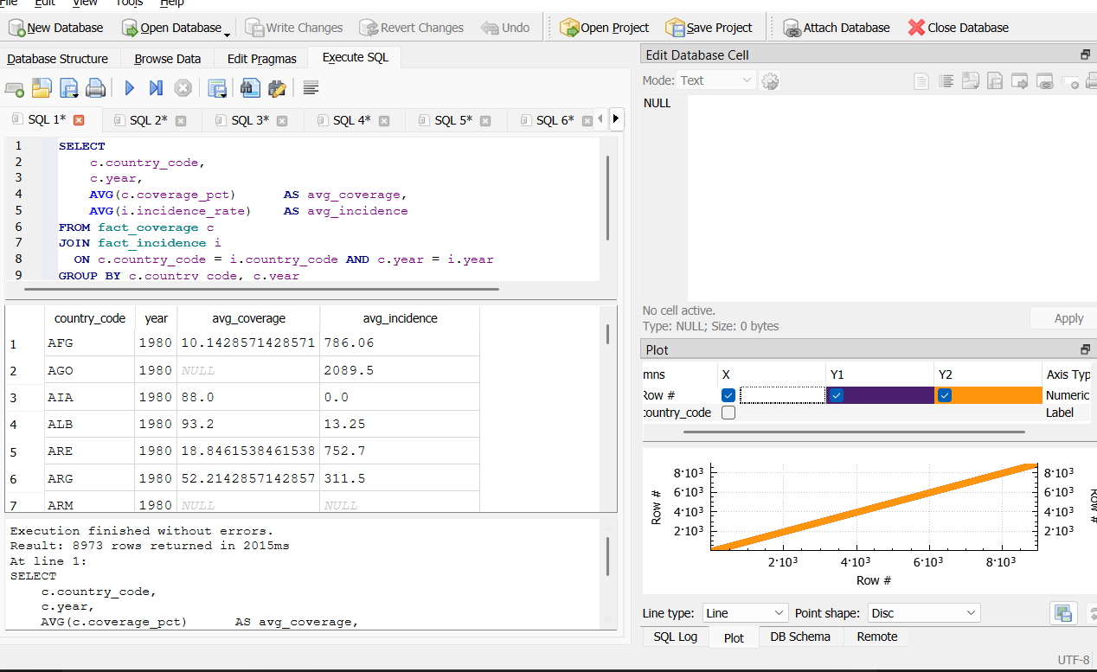
SQL analytical queries
7 ready-to-run queries answering the brief's core questions, executed in DB Browser for SQLite
Coverage vs incidence by country-year (8,973 rows)
High-incidence regions despite good coverage
Average coverage % by vaccine
Cases before vs after vaccine introduction
Diseases with largest case reduction
Dose drop-off by vaccine and schedule round
Countries below 95% measles coverage target
Global Vaccination Data Analysis | Abhishek Paul
17

Slide 18
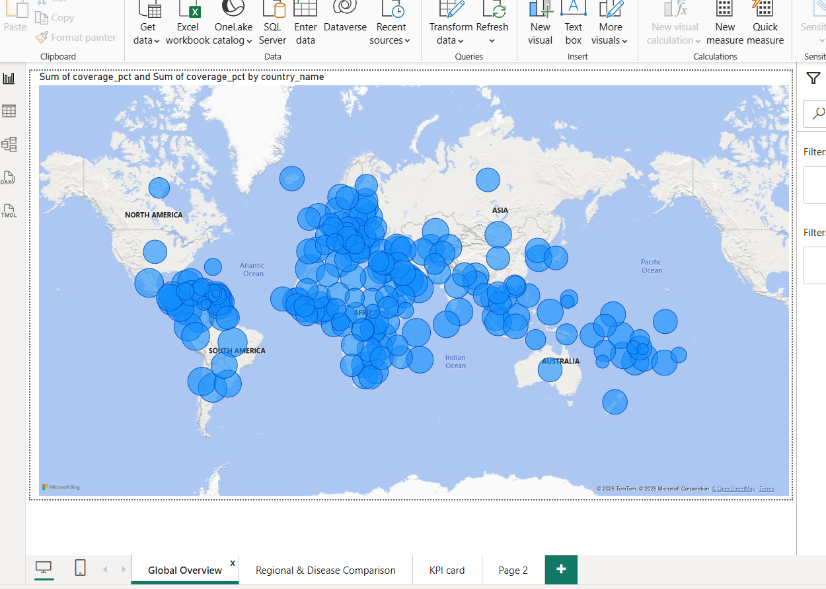
Power BI — Global Overview
Global Vaccination Data Analysis | Abhishek Paul
18

Slide 19
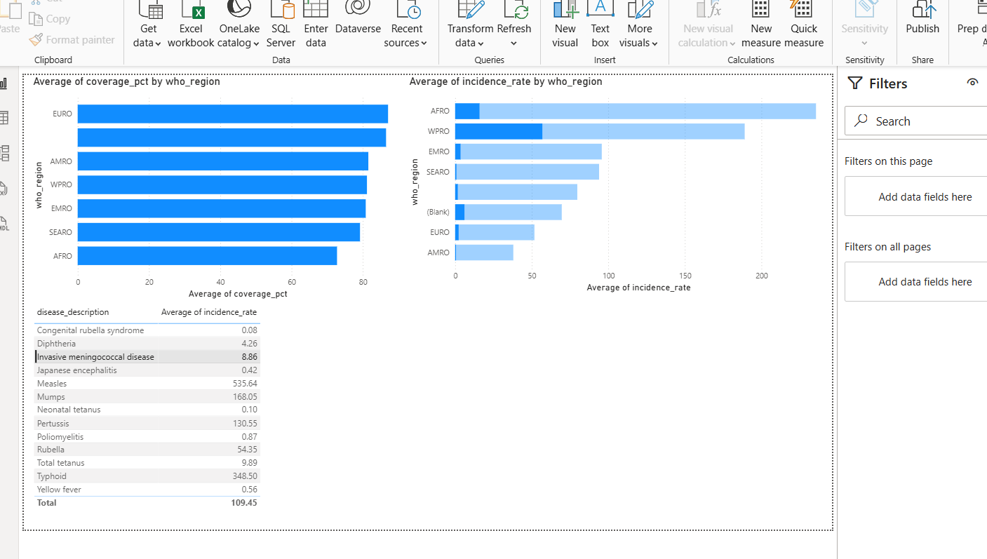
Power BI — Regional & Disease Comparison
Global Vaccination Data Analysis | Abhishek Paul
19

Slide 20
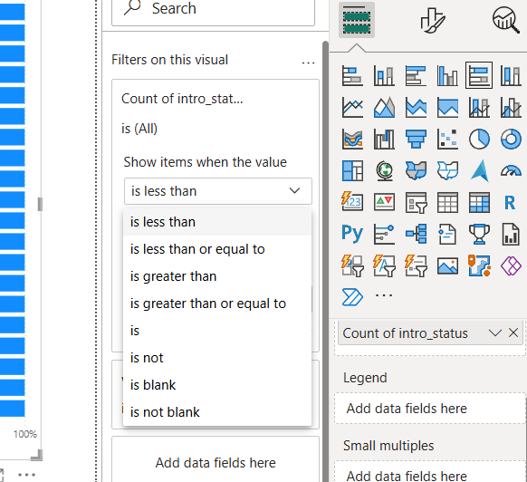
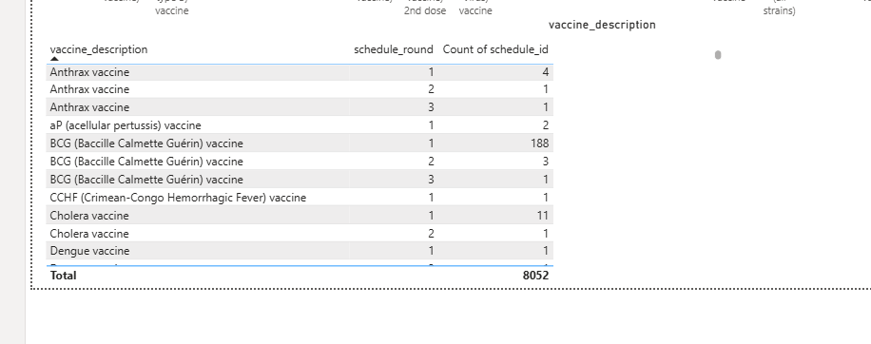
Power BI — Vaccine Introduction & Schedule
Left: countries that have introduced each vaccine. Right: dose drop-off between schedule rounds (e.g. BCG drops from 188 countries at round 1 to just 1 by round 3).
Global Vaccination Data Analysis | Abhishek Paul
20

Slide 21
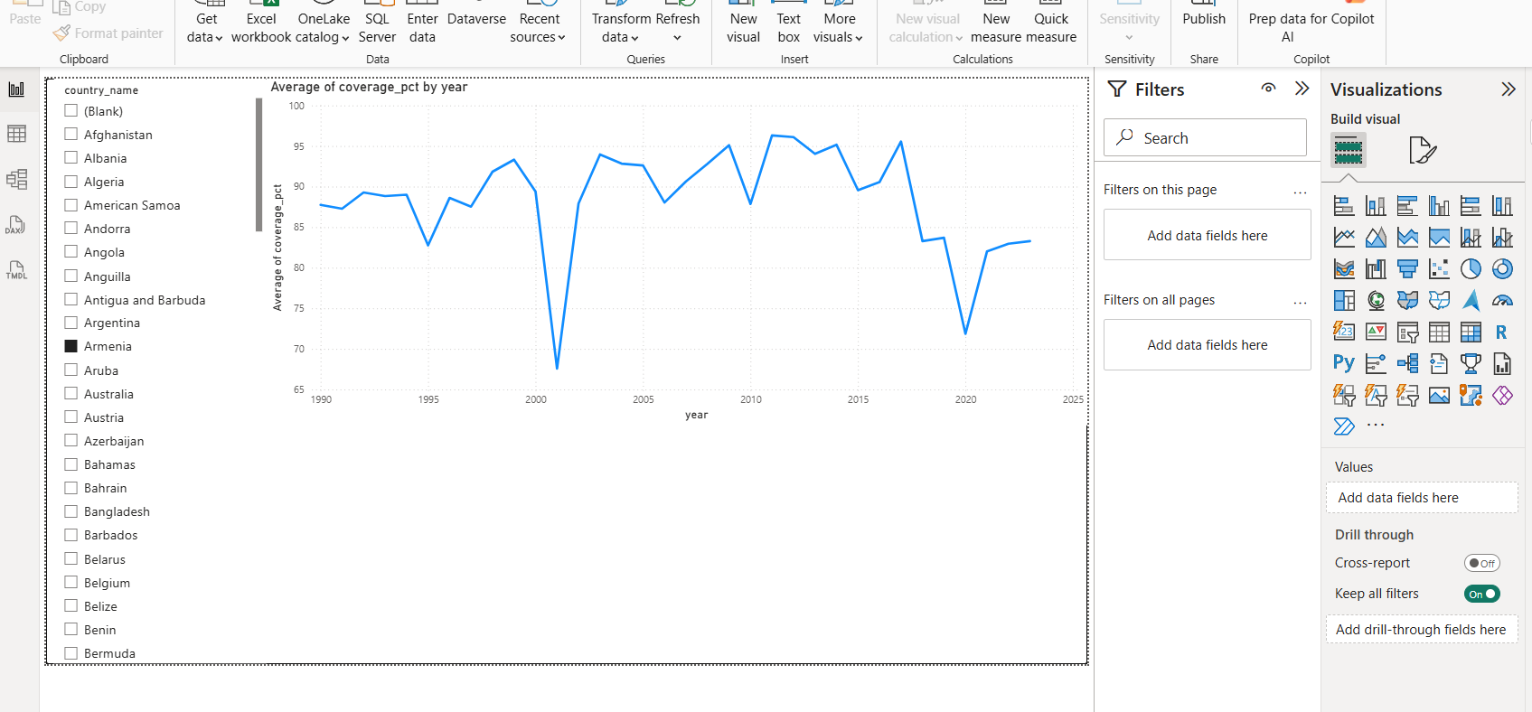
Power BI — Country Deep-Dive
Global Vaccination Data Analysis | Abhishek Paul
21

Slide 22
Key findings
Higher vaccination coverage is significantly associated with lower disease incidence — confirmed across all 3 hypothesis tests.
AFRO shows both the lowest coverage and the highest incidence of any WHO region — the clearest, most actionable regional gap.
Measles and typhoid have the highest average incidence globally, despite decent overall vaccination coverage.
Dose drop-off is steep for several vaccines (e.g. BCG: 188 → 1 country between round 1 and round 3), pointing to schedule-completion gaps.
A Gradient Boosting model predicts incidence rate with R² ≈ 0.49 — real signal, but incidence also depends on factors beyond coverage alone.
Global Vaccination Data Analysis | Abhishek Paul
22

Slide 23
Recommendations
Prioritize AFRO for resource allocation
Lowest coverage and highest incidence — the single clearest target for new investment and campaigns
Investigate measles and typhoid control gaps
High incidence despite reasonable coverage suggests effectiveness, reporting, or outbreak-response issues beyond just dose counts
Focus on dose-completion, not just first-dose access
Steep drop-off between schedule rounds (e.g. BCG) means completing series matters as much as initial reach
Use the predictive model as an early-warning flag
R² ≈ 0.49 model can highlight rising-risk country-disease pairs before incidence spikes, feeding into the Power BI dashboard
Global Vaccination Data Analysis | Abhishek Paul
23

Slide 24
Limitations & future work
R² ≈ 0.49 means roughly half of incidence variation is unexplained — reporting quality, outbreak dynamics, and health infrastructure aren't captured in this data
Incorporate socioeconomic and health-infrastructure indicators (GDP, health spending, doctor density) as additional model features
Extend the SQL database with live refresh from the WHO API for up-to-date dashboards
Vaccine schedule data only covers 2019-2023, limiting historical drop-off analysis
Add a classification model to flag high-risk country-disease pairs directly, rather than only a continuous incidence prediction
Country-disease coverage matching relies on a manually built antigen-to-disease map, which may miss edge cases
Build out drill-through and RLS (row-level security) in Power BI for region-specific stakeholder access
Global Vaccination Data Analysis | Abhishek Paul
24

Slide 25
Thank you
Global Vaccination Data Analysis · Abhishek Paul
Machine learning notebook · SQL database · Power BI dashboard

