Slide 1

UE21CS390A – Capstone Project Phase – 1
Project Progress Review #2
(Project Requirements Specification and Literature Survey)
Divide and compute: Distributed Model offloading for Computation
Project ID : PW24_PKA_04
Project Guide : Dr. Prafullata K Auradkar
Project Team with SRN :
Akhilesh M K PES1UG21CS059
Abhinav R Bharadwaj PES1UG21CS020
Nandan N Prabhu PES1UG21CS362
Abhiram H A PES1UG21CS024
1
Notes:
Title of the Project

Slide 2
Divide and compute: Distributed Model offloading and Computation
Abstract
In the fast-changing world of Machine Learning (ML) and the Internet of Things (IoT), a tricky challenge pops up where powerful deep learning models like AlexNet, VGG-16, YOLOv2, and GoogleNet want to squeeze onto small IoT devices. These devices struggle to handle the fancy algorithms on their own.
AKHILESH.M.K, ABHINAV R BHARADWAJ , ABHIRAM.H.A , NANDAN N PRABHU
3
Notes:
Title of the Project

Slide 3
Divide and compute: Distributed Model offloading and Computation
Suggestions from Review - 1
Checking the hardware feasibility
Mention the feasibility on the same showing the progress.
AKHILESH.M.K, ABHINAV R BHARADWAJ , ABHIRAM.H.A , NANDAN N PRABHU
4
Notes:
Title of the Project

Slide 4
Divide and compute: Distributed Model offloading and Computation
Constraints / Dependencies / Assumptions / Risks
The models are assumed to be pretrained
We assume that the models are accurate and highly dependable.
We are taking only Neural Networks or Deep Learning models into considerations.
IoT devices must be able to communicate with each other.
We assume that Neural Networks can be split horizontally and vertically.
AKHILESH.M.K, ABHINAV R BHARADWAJ , ABHIRAM.H.A , NANDAN N PRABHU
5
Notes:
Title of the Project

Slide 5
Divide and compute: Distributed Model offloading and Computation
Functional Requirements
The model should be split horizontally and vertically keeping in mind the hardware constraints of the IoT devices available in the cluster.
Develop and implement optimization algorithms for Reinforcement Learning (RL) models to enhance performance.
Develop partitioning techniques to efficiently break down complex deep learning models for optimal distribution across IoT devices.
AKHILESH.M.K, ABHINAV R BHARADWAJ , ABHIRAM.H.A , NANDAN N PRABHU
6
Notes:
Title of the Project

Slide 6
Divide and compute: Distributed Model offloading and Computation
Non - Functional Requirements
Implement fault tolerance mechanisms in distributed models to ensure system reliability and robustness.
The system should ensure high performance and low latency in offloading and computation tasks.
Maximize resource utilization on IoT devices while maintaining model accuracy and responsiveness.
Network bandwidth for efficient communication.
AKHILESH.M.K, ABHINAV R BHARADWAJ , ABHIRAM.H.A , NANDAN N PRABHU
7
Notes:
Title of the Project

Slide 7
Divide and compute: Distributed Model offloading and Computation
Literature Survey
DISNET:
All the surveyed techniques and approaches aim to optimize DNN inference latency and energy consumption in IoT environments.
They emphasize the importance of distributed machine learning, fine-grained model partitioning, and collaborative inferencing to achieve efficient and energy-aware DNN inference.
8
AKHILESH.M.K, ABHINAV R BHARADWAJ , ABHIRAM.H.A , NANDAN N PRABHU
Notes:
Title of the Project

Slide 8
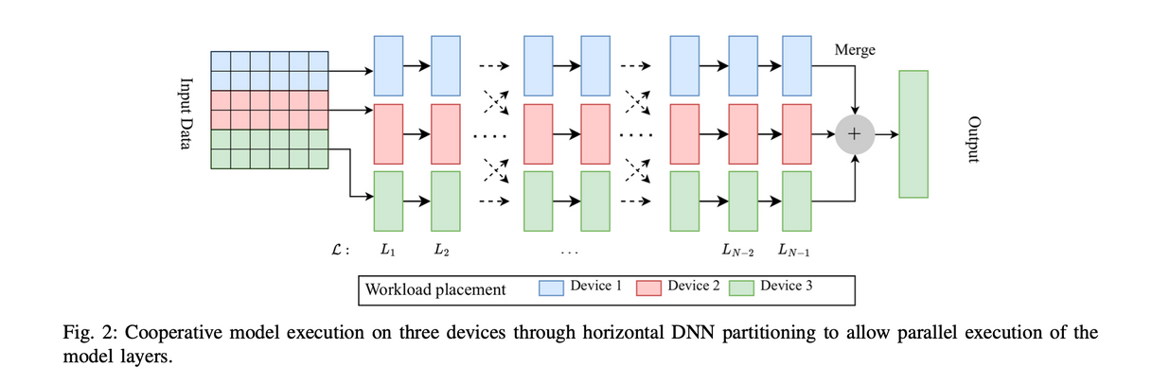
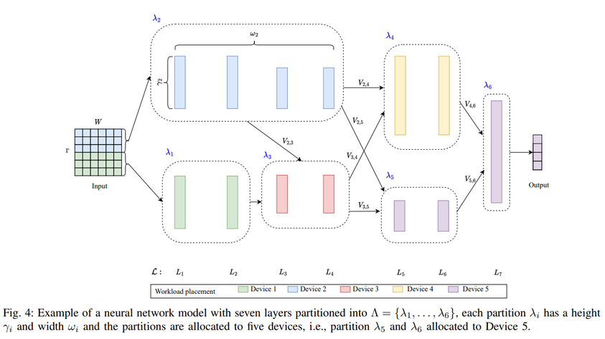
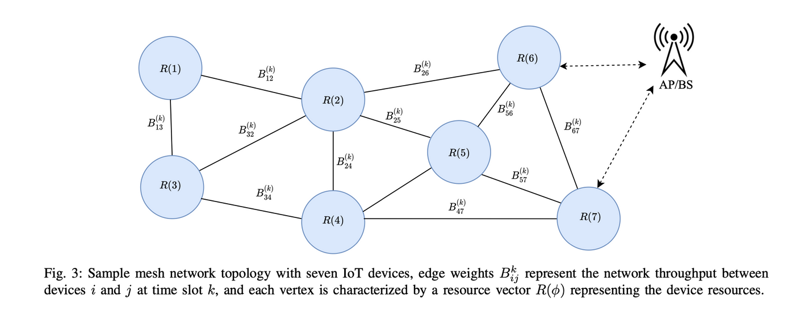
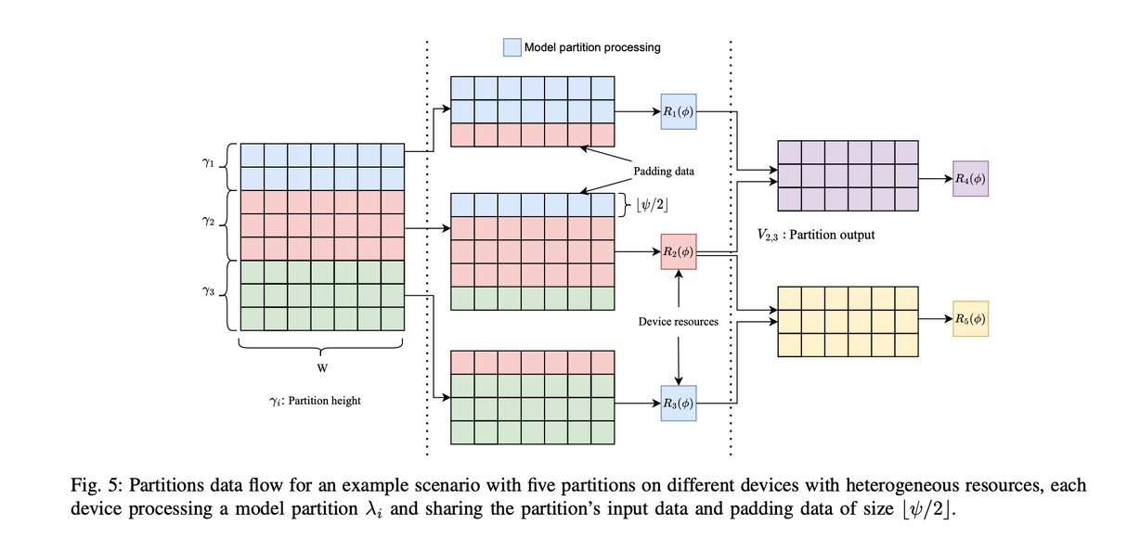
Divide and compute: Distributed Model offloading and Computation
Disnet: Distributed micro-split deep learning in heterogeneous dynamic iot
AKHILESH.M.K, ABHINAV R BHARADWAJ , ABHIRAM.H.A , NANDAN N PRABHU
Notes:
Title of the Project

Slide 9
Divide and compute: Distributed Model offloading and Computation
Literature Survey
DISNET:
While the surveyed techniques address the challenges of limited computing capability and dynamic IoT environments, there may be limitations in scalability and adaptability to diverse IoT applications and devices.
RESEARCH GAPS:
Heterogeneous IoT Environments:This includes understanding the variability in computing capabilities, communication resources, and energy constraints across different IoT devices and how these factors impact cooperative DNN inference.
Dynamic Network Conditions: The paper acknowledges the highly dynamic nature of IoT network conditions. However, further research is needed to develop adaptive and resilient cooperative DNN inference strategies that can effectively respond to dynamic changes in network conditions, such as varying communication paths, network throughput, and device availability.
8
AKHILESH.M.K, ABHINAV R BHARADWAJ , ABHIRAM.H.A , NANDAN N PRABHU
Notes:
Title of the Project

Slide 10
Divide and compute: Distributed Model offloading and Computation
Literature Survey
RESEARCH GAPS:
3.Privacy and Security: The paper briefly mentions the risk of privacy loss associated with existing approaches for cooperative DNN inference. Further research is needed to address the privacy and security concerns related to sharing data outside the edge network in IoT environments, especially when dealing with sensitive and private data collected from IoT devices.
4.Real-World Deployment: The paper envisions the deployment of DISNET in various IoT environments, such as smart homes, industrial IoT, and the Internet of medical things. Further research is needed to validate the practical deployment of DISNET in real-world scenarios and to assess its performance and scalability in diverse application domains.
8
AKHILESH.M.K, ABHINAV R BHARADWAJ , ABHIRAM.H.A , NANDAN N PRABHU
Notes:
Title of the Project

Slide 11
Divide and compute: Distributed Model offloading and Computation
Literature Survey
DeeperThings:
1. DeeperThings optimizes memory, computation, and communication demands by distributing layer information across multiple edge devices and using feature and weight partitioning with communication-aware layer fusion.
2. Key contributions of DeeperThings compared to DeepThings include weight partitioning, improved communication optimization, and achieving fully distributed inference without the need for a central powerful gateway edge device.
3. Experimental results show performance improvements in terms of memory footprint reduction, communication optimization, and run time speed-up achieved by DeeperThings on real-world hardware setups running different CNN models.
8
AKHILESH.M.K, ABHINAV R BHARADWAJ , ABHIRAM.H.A , NANDAN N PRABHU
Notes:
Title of the Project

Slide 12
Divide and compute: Distributed Model offloading and Computation
Literature Survey
DeepThings:
The document introduces the DeepThings framework, which focuses on partitioning and distributing early stage convolutional layers on IoT edge clusters with a lightweight memory footprint.
DeepThings achieves memory reduction by partitioning convolutional layers, which reduces the input/output data memory footprint while keeping the weights the same.
The DeepThings framework handles communication overhead by considering redundant input data overlap between partitions, which increases the amount of transmitted data.
DeepThings is able to execute otherwise infeasible CNN inference tasks with significantly improved performance in IoT edge clusters under various dynamic application environments.
8
AKHILESH.M.K, ABHINAV R BHARADWAJ , ABHIRAM.H.A , NANDAN N PRABHU
Notes:
Title of the Project

Slide 13
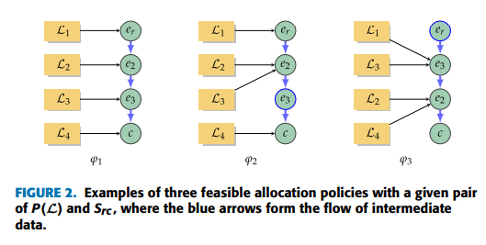
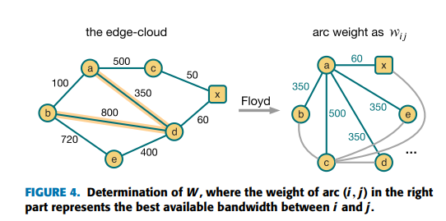
Divide and compute: Distributed Model offloading and Computation
CoEdge:
The algorithm iteratively examines each node e in, determining a partition P(L) and an allocation policy φ to minimize the total latency.
Allocation policy involves determining which node in the edge-cloud system will be responsible for processing each segment of the DNN.
Dynamic adjustments based on real-time conditions such as network congestion, node availability, and workload distribution.
8
AKHILESH.M.K, ABHINAV R BHARADWAJ , ABHIRAM.H.A , NANDAN N PRABHU
Notes:
Title of the Project

Slide 14
Divide and compute: Distributed Model offloading and Computation
CoEdge:
The allocation policy in CoEdge follows a greedy policy to iteratively determine the optimal allocation of DNN layers over the subset of nodes.
Exploit the high-speed connections and computing capacity available in the edge environment to enhance the overall performance of deep learning tasks.
8
AKHILESH.M.K, ABHINAV R BHARADWAJ , ABHIRAM.H.A , NANDAN N PRABHU
Notes:
Title of the Project

Slide 15
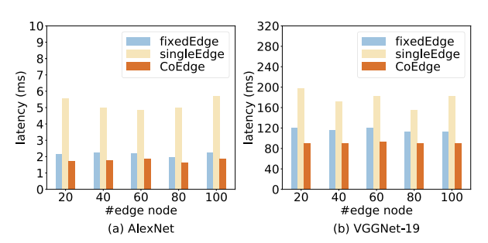
Divide and compute: Distributed Model offloading and Computation
CoEdge:
Setup: Four different nodes with different bandwidth resources and computing capacities.
DNN Models: The AlexNet and VGGNet-19 models are used for image classification experiments.
Evaluation Metrics: The CoEdge algorithm and the two baseline algorithms are evaluated in terms of latency under various experimental cases.
8
AKHILESH.M.K, ABHINAV R BHARADWAJ , ABHIRAM.H.A , NANDAN N PRABHU
Notes:
Title of the Project

Slide 16
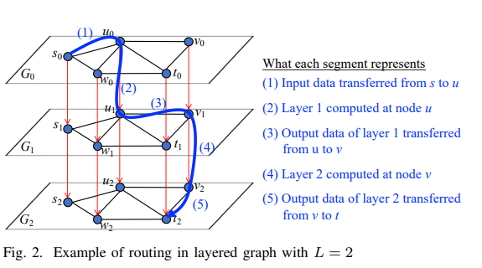
Divide and compute: Distributed Model offloading and Computation
Optimization Framework for Splitting DNN Inference Jobs over Computing Networks:
Layered graph model is used to simplify the problem of selecting nodes for computation and paths for data transfer in the context of splitting DNN inference jobs over computing networks.
AKHILESH.M.K, ABHINAV R BHARADWAJ , ABHIRAM.H.A , NANDAN N PRABHU
Notes:
Title of the Project

Slide 17
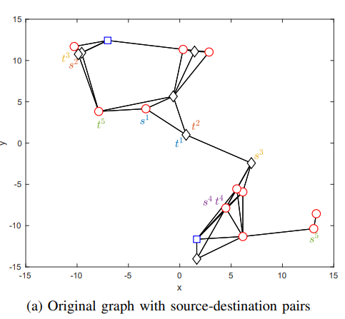
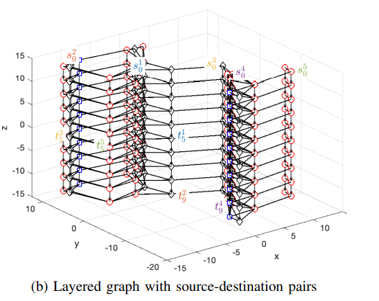
Divide and compute: Distributed Model offloading and Computation
Optimization Framework for Splitting DNN Inference Jobs over Computing Networks
AKHILESH.M.K, ABHINAV R BHARADWAJ , ABHIRAM.H.A , NANDAN N PRABHU
Notes:
Title of the Project

Slide 18
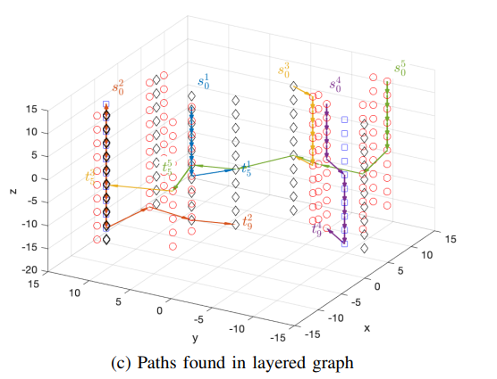
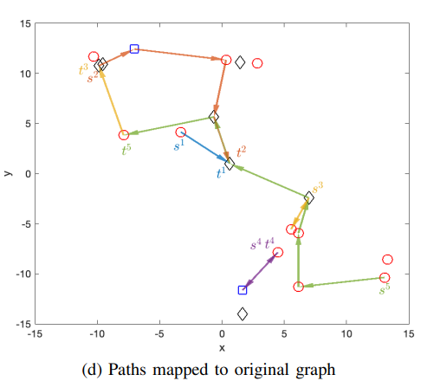
Divide and compute: Distributed Model offloading and Computation
Optimization Framework for Splitting DNN Inference Jobs over Computing Networks
AKHILESH.M.K, ABHINAV R BHARADWAJ , ABHIRAM.H.A , NANDAN N PRABHU
Notes:
Title of the Project

Slide 19
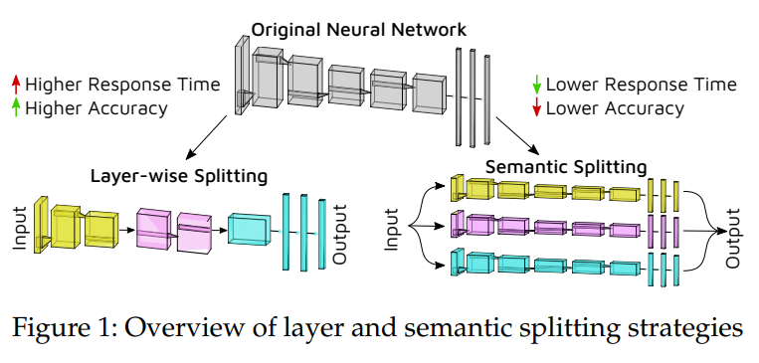
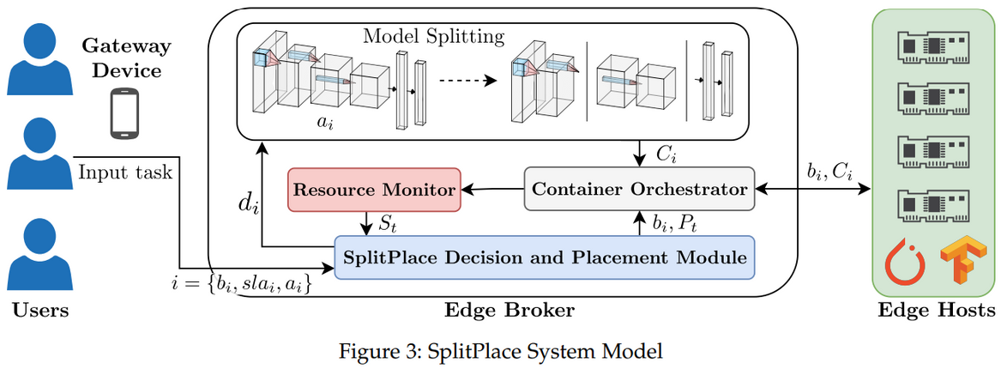
Divide and compute: Distributed Model offloading and Computation
SplitPlace:
AKHILESH.M.K, ABHINAV R BHARADWAJ , ABHIRAM.H.A , NANDAN N PRABHU
Notes:
Title of the Project

Slide 20
Divide and compute: Distributed Model offloading and Computation
Scission: Context-aware and Performance-driven Edge-based Distributed Deep Neural Networks
The research paper "Scission: Context-aware and Performance-driven Edge-based Distributed Deep Neural Networks" introduces Scission, a tool designed for automated benchmarking of Deep Neural Networks (DNNs) to determine optimal partition configurations for maximizing performance in distributed environments. The motivation behind Scission is based on practical observations, including the need to account for multiple resource tiers in the cloud-edge continuum and the importance of basing partitioning decisions on empirical data rather than estimates.
The paper discusses the architecture of Scission, its benchmarking approach, context-aware decision-making process, and querying capability. Experimental studies on 18 different DNNs demonstrate the effectiveness of Scission in achieving context-aware and performance-efficient distributed DNNs. The tool aims to maximize distributed DNN performance while accommodating user-defined objectives and constraints.
AKHILESH.M.K, ABHINAV R BHARADWAJ , ABHIRAM.H.A , NANDAN N PRABHU
Notes:
Title of the Project

Slide 21
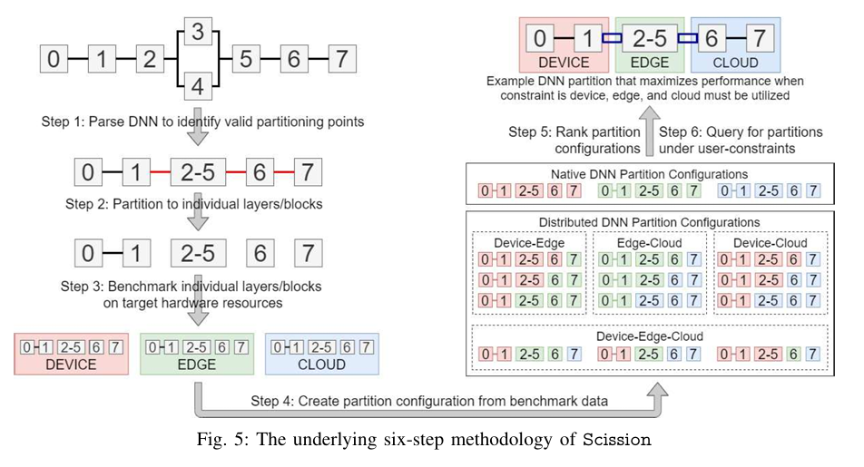
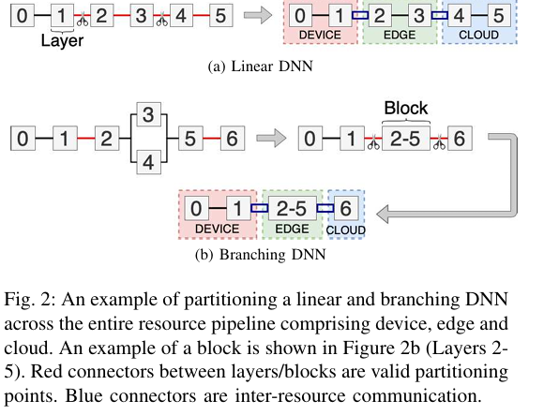
Divide and compute: Distributed Model offloading and Computation
Scission: Context-aware and Performance-driven Edge-based Distributed Deep Neural Networks
AKHILESH.M.K, ABHINAV R BHARADWAJ , ABHIRAM.H.A , NANDAN N PRABHU
Notes:
Title of the Project

Slide 22
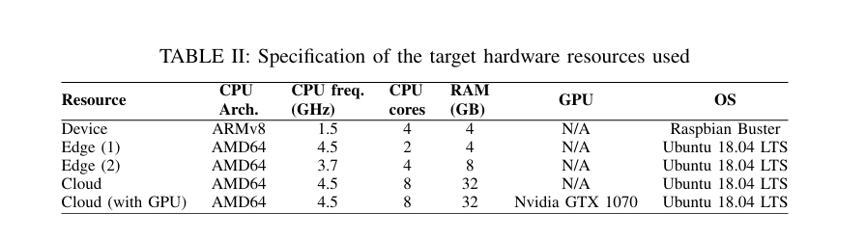
Divide and compute: Distributed Model offloading and Computation
Scission: Context-aware and Performance-driven Edge-based Distributed Deep Neural Networks
AKHILESH.M.K, ABHINAV R BHARADWAJ , ABHIRAM.H.A , NANDAN N PRABHU
Notes:
Title of the Project

Slide 23
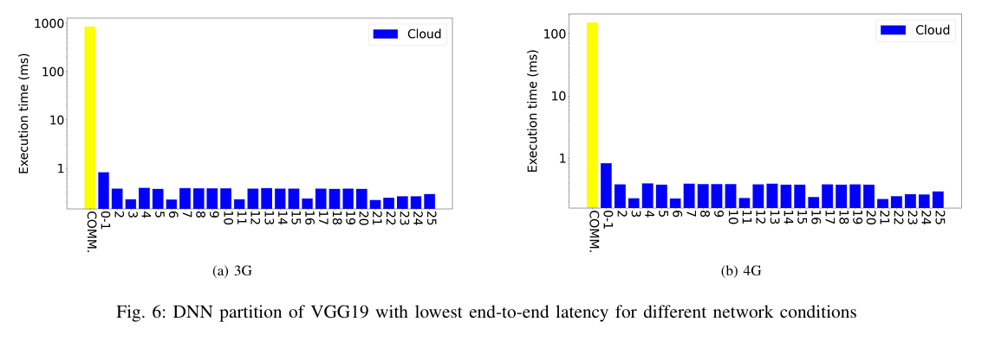
Divide and compute: Distributed Model offloading and Computation
Scission: Context-aware and Performance-driven Edge-based Distributed Deep Neural Networks
AKHILESH.M.K, ABHINAV R BHARADWAJ , ABHIRAM.H.A , NANDAN N PRABHU
Notes:
Title of the Project

Slide 24
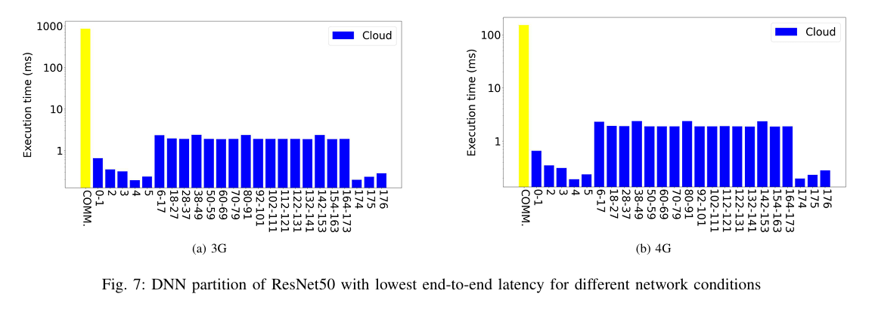
Divide and compute: Distributed Model offloading and Computation
Scission: Context-aware and Performance-driven Edge-based Distributed Deep Neural Networks
AKHILESH.M.K, ABHINAV R BHARADWAJ , ABHIRAM.H.A , NANDAN N PRABHU
Notes:
Title of the Project

Slide 25
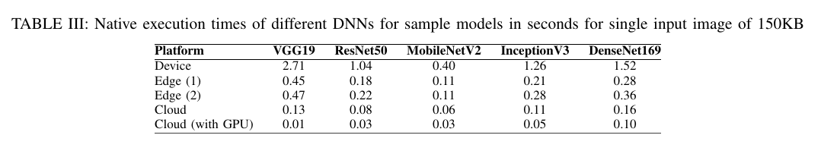
Divide and compute: Distributed Model offloading and Computation
Scission: Context-aware and Performance-driven Edge-based Distributed Deep Neural Networks
AKHILESH.M.K, ABHINAV R BHARADWAJ , ABHIRAM.H.A , NANDAN N PRABHU
Notes:
Title of the Project

Slide 26
Divide and compute: Distributed Model offloading and Computation
Convergence of Edge Computing and Deep Learning: A Comprehensive Survey
Explores the integration of edge computing and deep learning to enable real-time, resource-efficient, and privacy-aware intelligent services. It discusses the challenges and opportunities associated with integrating these technologies, as well as the potential impact on various application scenarios. The paper delves into the fundamentals of edge computing, deep learning, and their applications, as well as the optimization of deep learning models for edge deployment. Additionally, it highlights the importance of tailored edge frameworks for efficient matching of edge platforms and DL models, exploitation of underlying hardware, and orchestration of DL services. The document also addresses the sharing of DL computation, horizontal collaboration, and communication efficiency in edge computing.
AKHILESH.M.K, ABHINAV R BHARADWAJ , ABHIRAM.H.A , NANDAN N PRABHU
Notes:
Title of the Project

Slide 27
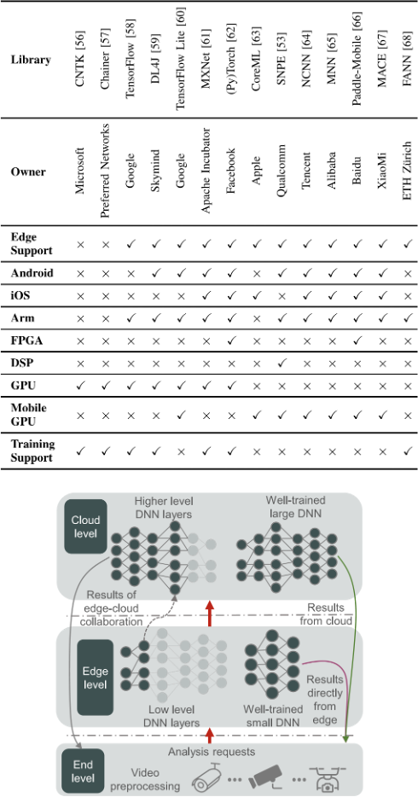
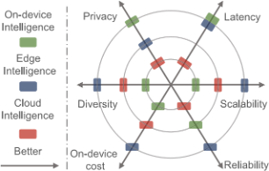
Divide and compute: Distributed Model offloading and Computation
Convergence of Edge Computing and Deep Learning: A Comprehensive Survey
AKHILESH.M.K, ABHINAV R BHARADWAJ , ABHIRAM.H.A , NANDAN N PRABHU
Notes:
Title of the Project

Slide 28
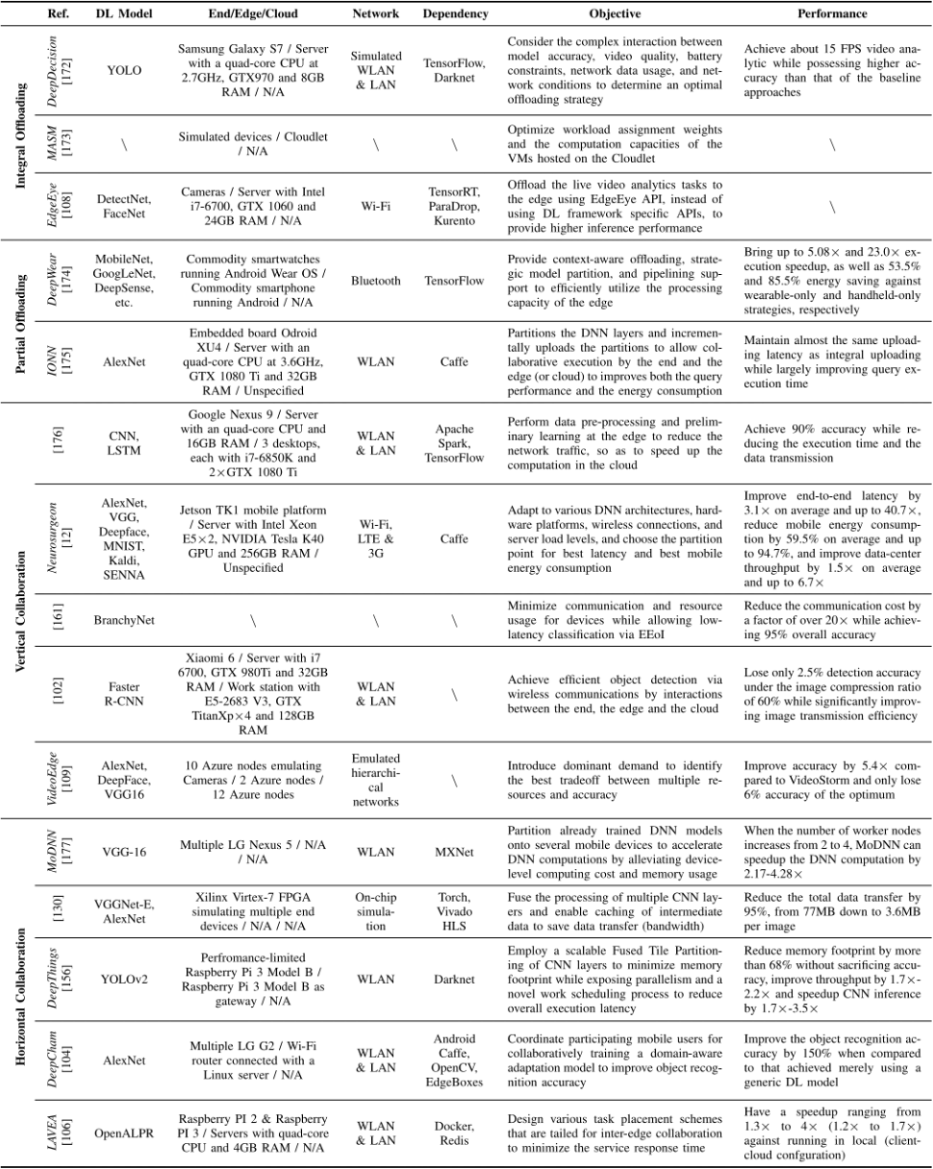
AKHILESH.M.K, ABHINAV R BHARADWAJ , ABHIRAM.H.A , NANDAN N PRABHU
Notes:
Title of the Project

Slide 29
Divide and compute: Distributed Model offloading and Computation
Convergence of Edge Computing and Deep Learning: A Comprehensive Survey
AKHILESH.M.K, ABHINAV R BHARADWAJ , ABHIRAM.H.A , NANDAN N PRABHU
Notes:
Title of the Project

Slide 30
Divide and compute: Distributed Model offloading and Computation
Summary of Literature Survey
papers | Datasets | Experimental set up | deep learning models | Results
Samikwa, E., Di Maio, A. and Braun, T., 2023. Disnet: Distributed micro-split deep learning in heterogeneous dynamic iot. IEEE internet of things journal. | image classification dataset | Raspberry Pi and NVIDIA Jetson Nano with low power settings. | VGG16 | The experiment conducted in the document evaluates the performance of three schemes, namely DISNET, DeepSlicing, and MoDNN, under varying network throughput between devices over time. The three schemes are then computed for 50 inference epochs, observing the inference latency and energy consumption for each set value of the maximum throughput.
Stahl, R., Hoffman, A., Mueller-Gritschneder, D., Gerstlauer, A. and Schlichtmann, U., 2021. DeeperThings: Fully distributed CNN inference on resource-constrained edge devices. International Journal of Parallel Programming, 49, pp.600-624. |  | six Raspberry Pi4 devices | YOLOv2, AlexNet, VGG-16, GoogLeNet derivative | DeeperThings approach successfully optimized memory, computation, and communication demands for fully distributed CNN inference, leading to improved memory footprint balancing, reduced communication demands, and enhanced run time speed-up compared to traditional partitioning methods.
Zhao, Z., Barijough, K.M. and Gerstlauer, A., 2018. Deepthings: Distributed adaptive deep learning inference on resource-constrained iot edge clusters. IEEE Transactions on Computer-Aided Design of Integrated Circuits and Systems, 37(11), pp.2348-2359. |  | The experiments were conducted on a set of IoT devices in a WLAN, consisting of up to six edge devices and a single gateway device, all using Raspberry Pi 3 Model B (RPi3) platforms | YOLOv2 object detection framework with its C-based Darknet neural network library | The DeepThings framework was applied to the first 16 layers in YOLOv2, which contributed more than 49% of the computation and 86.6% of the memory footprint to the overall inference.
Lee, A., Chen, P.J., Wang, C., Gu, J., Popuri, S., Ma, X., Polyak, A., Adi, Y., He, Q., Tang, Y. and Pino, J., 2021. Direct speech-to-speech translation with discrete units. arXiv preprint arXiv:2107.05604. |  |  | speech encoder-decoder, HuBERT | the experiment results suggest that the direct S2ST system with discrete units is effective for speech translation and offers advantages in terms of efficiency and translation quality.
AKHILESH.M.K, ABHINAV R BHARADWAJ , ABHIRAM.H.A , NANDAN N PRABHU
9
Notes:
Title of the Project

Slide 31
Divide and compute: Distributed Model offloading and Computation
Any other information
Provide any other information you wish to add on.
Note: Changes can be made in the template, with the consent of the guide for inclusion of any other information.
AKHILESH.M.K, ABHINAV R BHARADWAJ , ABHIRAM.H.A , NANDAN N PRABHU
10
Notes:
Title of the Project

Slide 32
Divide and compute: Distributed Model offloading and Computation
Conclusion
State the conclusion of your work.
AKHILESH.M.K, ABHINAV R BHARADWAJ , ABHIRAM.H.A , NANDAN N PRABHU
11
Notes:
Title of the Project

Slide 33
Divide and compute: Distributed Model offloading and Computation
References
Provide references pertaining to your research according to IEEE format.
Example:
G. Eason, B. Noble, and I. N. Sneddon, “On certain integrals of Lipschitz-Hankel type involving products of Bessel functions,” Phil. Trans. Roy. Soc. London, vol. A247, pp. 529–551, April 1955. (references)
AKHILESH.M.K, ABHINAV R BHARADWAJ , ABHIRAM.H.A , NANDAN N PRABHU
12
Notes:
Title of the Project

Slide 34

Divide and compute: Distributed Model offloading and Computation
...Thank You
AKHILESH.M.K, ABHINAV R BHARADWAJ , ABHIRAM.H.A , NANDAN N PRABHU
13
Notes:
13
Title of the Project

