Slide 1
Explainable Artificial Intelligence (XAI)
Presented By
Abhiragh A R(MCC21CS005)
Abhinav R(MCC21CS004)
Alfin Muhammed N S (MCC21CS012)
Aswathy M L (MCC21CS021)
Guided By
Mrs Labeeba Vahid
Asst. Professor
Dept of CSE

Slide 2
As AI plays an increasingly significant role in our lives, understanding its decision-making processes becomes crucial.Explainable Artificial Intelligence (XAI) focuses on enhancing the transparency and interpretability of AI models, making their decision-making processes understandable to humans. This project aims to explore various techniques and methodologies for implementing XAI in practical AI systems. By making AI models more explainable, we can improve trust, accountability, and acceptance of AI technologies across various domains , this project strives to pave the way for a future where AI is harnessed responsibly for the betterment of society.
Abstract

Slide 3
Key Objectives:
Investigating different XAI techniques such as model interpretability, feature importance analysis and generating human-understandable visualisations.
Implementing XAI methods into existing AI models to make their decision-making processes more transparent and interpretable.
Evaluating the effectiveness of XAI solutions in enhancing trust and usability in real-world applications.

Slide 4
Applications
Transparency: XAI empowers individuals to understand how AI affects them, promoting informed participation in AI-driven decisions.
Healthcare: XAI can explain medical diagnoses and treatment recommendations, promoting patient trust and better decision-making.
Autonomous Systems: XAI helps understand how self-driving cars make decisions, ensuring safety and public trust.
Personalized Recommendations: XAI can explain why a recommender system suggests a particular product or service, improving user experience and trust in the system.

Slide 5
Modules:
1. Data Collection and Preprocessing:
Explore and select datasets for: House Price Prediction & Titanic Survival Prediction
Handle missing values in both datasets.
Handle categorical features (convert text labels to numerical values)
Normalize numerical features
2. Model Building and Training:
Models Chosen : House Price Prediction & Titanic Survivor Prediction
Choose a suitable model.
Linear Regression For House Price Prediction
Random Forest Classification For Titanic Survivor Prediction
Train the chosen model on the training data.

Slide 6
Modules:
3. Explainable AI (XAI) Integration:
Use LIME to explain why a passenger was predicted to survive/not survive on the Titanic.
Use SHAP to identify the most important features influencing house price predictions.
Develop clear and informative visualizations to present explanations.
4. Website Development and Deployment:
Utilize Streamlit, a web app development framework, to convert model functionalities into a user-friendly web interface.
Website Hosting: Deploy the Streamlit web application to a suitable platform to make it accessible online.

Slide 7
Literature Survey
Serial No | Title | Author | Limitations | Proposed Improvements
1. 2. 3. | Interpretable Matrix Factorization for Recommender Systems Explainable Recommendation Systems: Survey and Challenges Towards User-Centric Explainable Recommendation Systems | Steffen Rendle et al Bartosz Wilk et al Lei Xu et al | Pre-defined features struggle to capture user preferences and changing tastes over time. Focuses heavily on model centric explanations neglecting user preferences and feedback Primarily focuses on explaining individual recommendations. | Integrate user feedback and dynamic updates to capture evolving preferences and provide more tailored recommendations Incorporate user preferences and feedback into the explanation process. Provide explanations for potential biases within the model, promoting transparency and trust.

Slide 8
Serial No | Title | Author | Limitations | Proposed Improvements
4. 5. | Interpretable Neural Collaborative Filtering for Explainable Recommendation Systems Human-Centered Explainable AI: A Survey | Xiangnan He et al Sameer Singh et al | Focus on specific interaction data: The model relies on user-item interactions (ratings, clicks) Limited focus on technical details and user centricity. | Incorporate additional user data: Explore ways to integrate user reviews Focus on specific XAI techniques that align well with user-centricity

Slide 9
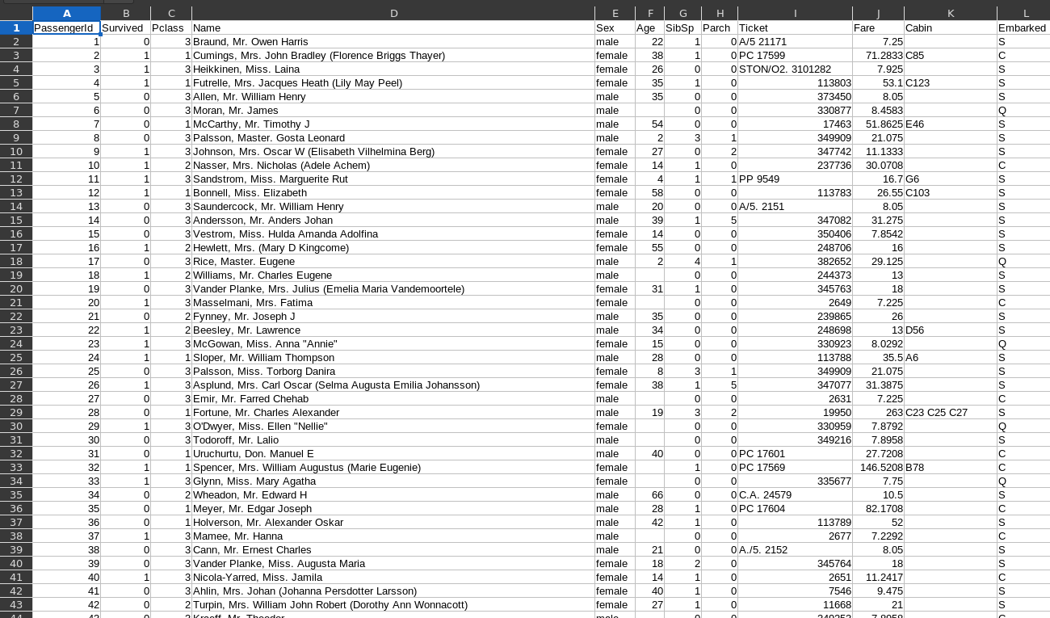
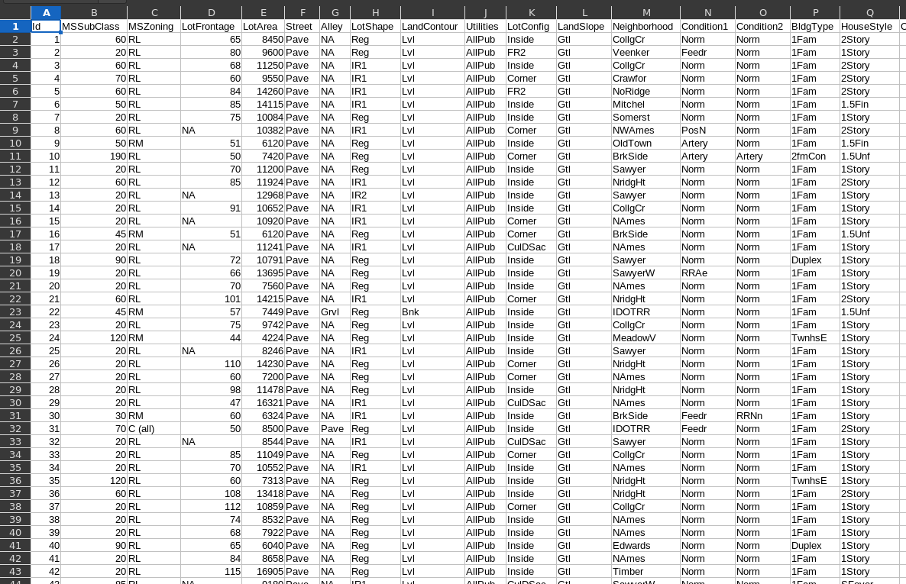
Module 1 : Data Collection and Preprocessing
House Price Prediction
Titanic Survivor Prediction

Slide 10
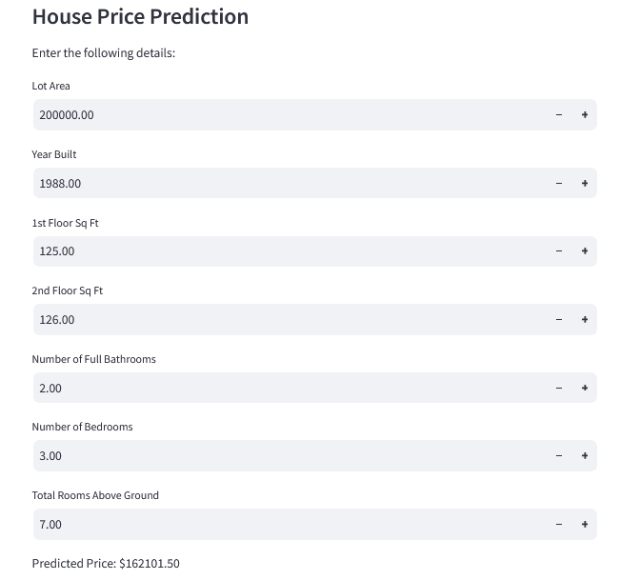
Module 2 : Model Building and Training
House Price Prediction Model

Slide 11
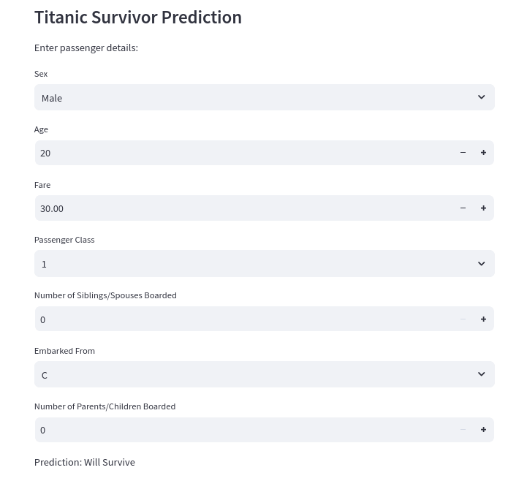
Module 2 : Model Building and Training
Titanic Survivor Prediction Model

Slide 12
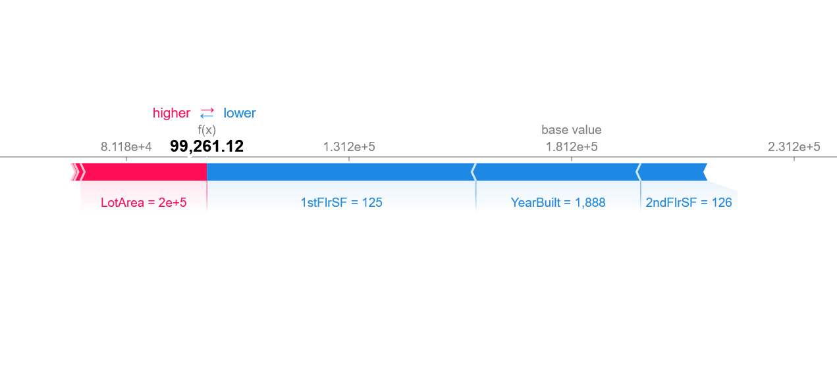
Module 3 : Explainable AI (XAI) Integration
House Price Prediction

Slide 13
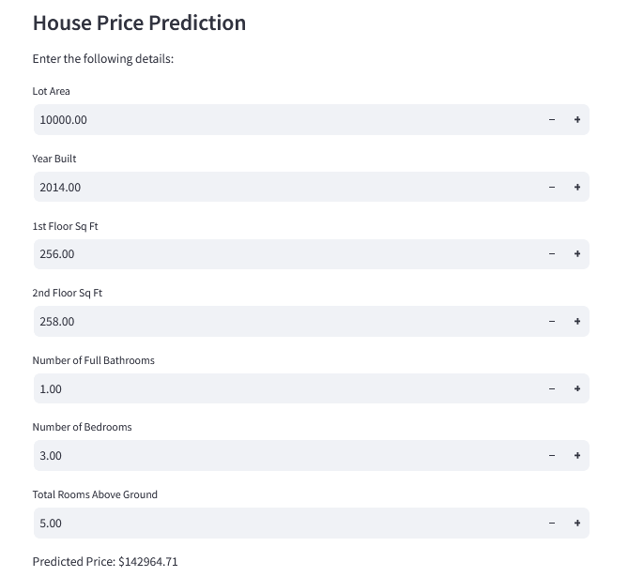
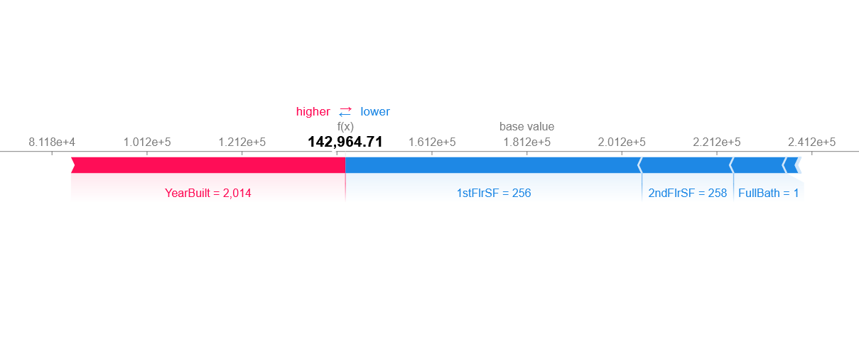
Module 3 : Explainable AI (XAI) Integration
House Price Prediction

Slide 14
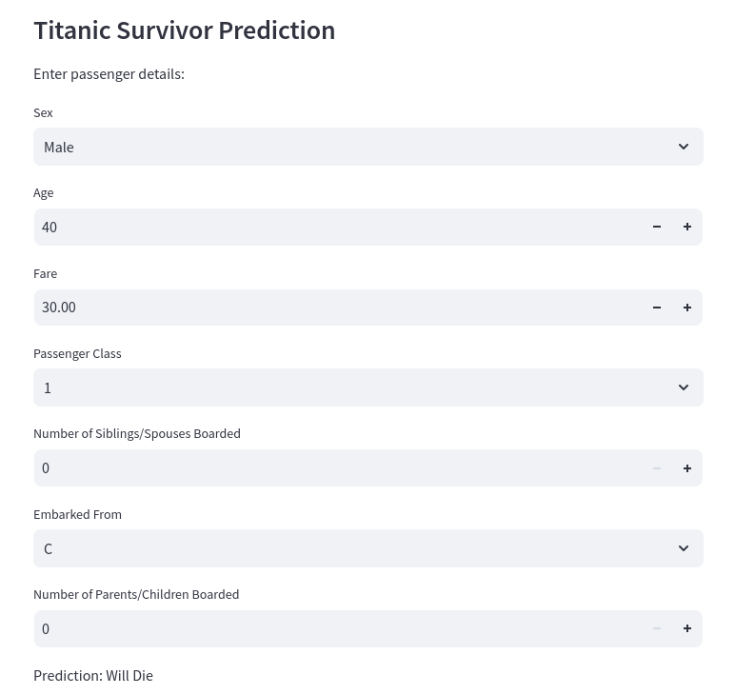
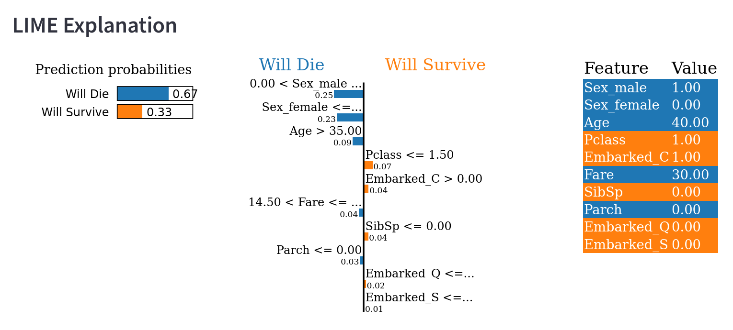
Module 3 : Explainable AI (XAI) Integration
Titanic Survivor Prediction

Slide 15
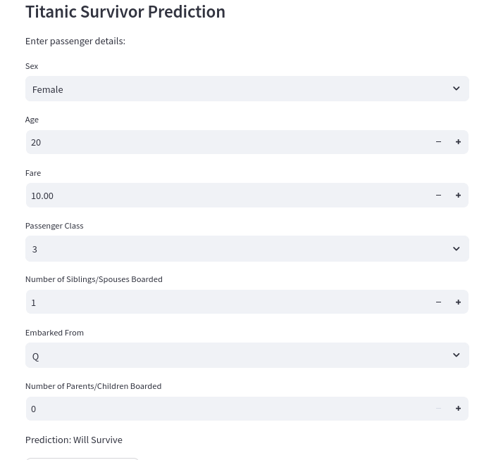
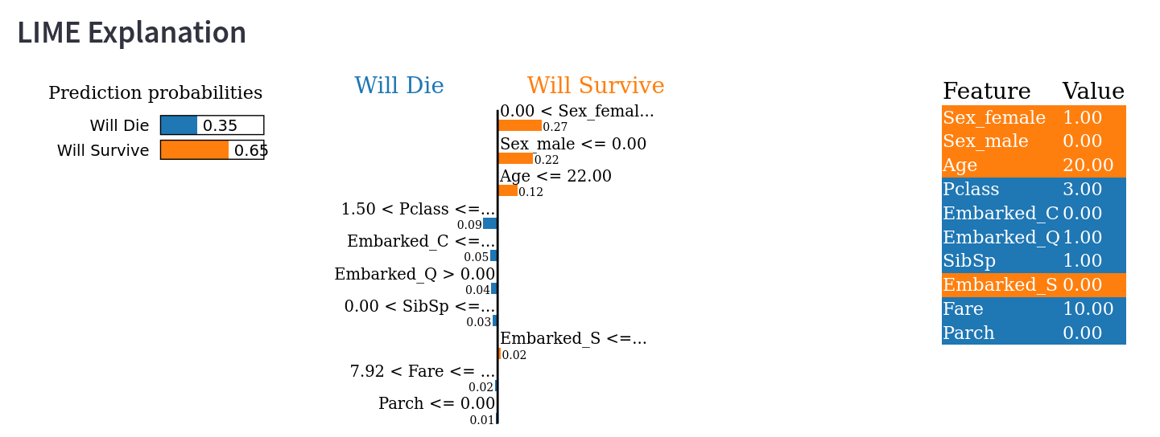
Module 3 : Explainable AI (XAI) Integration
Titanic Survivor Prediction

Slide 16
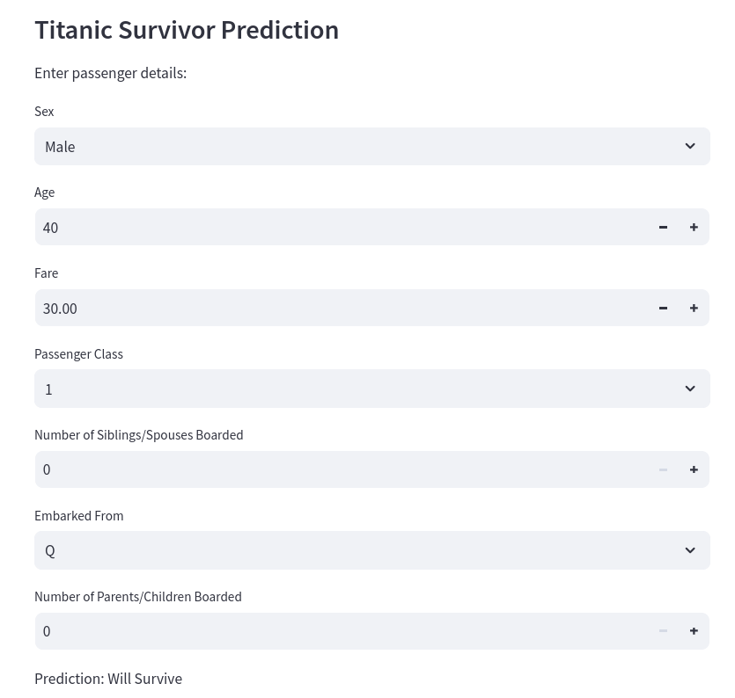
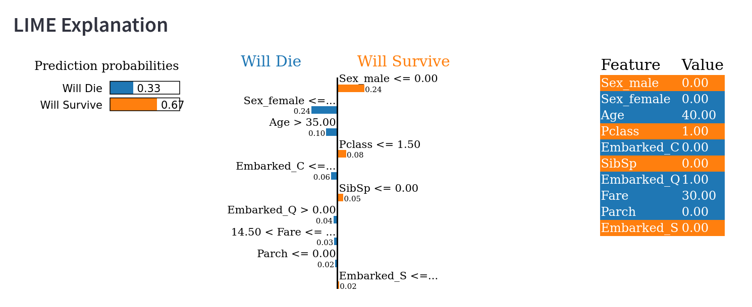
Module 3 : Explainable AI (XAI) Integration
Titanic Survivor Prediction

Slide 17
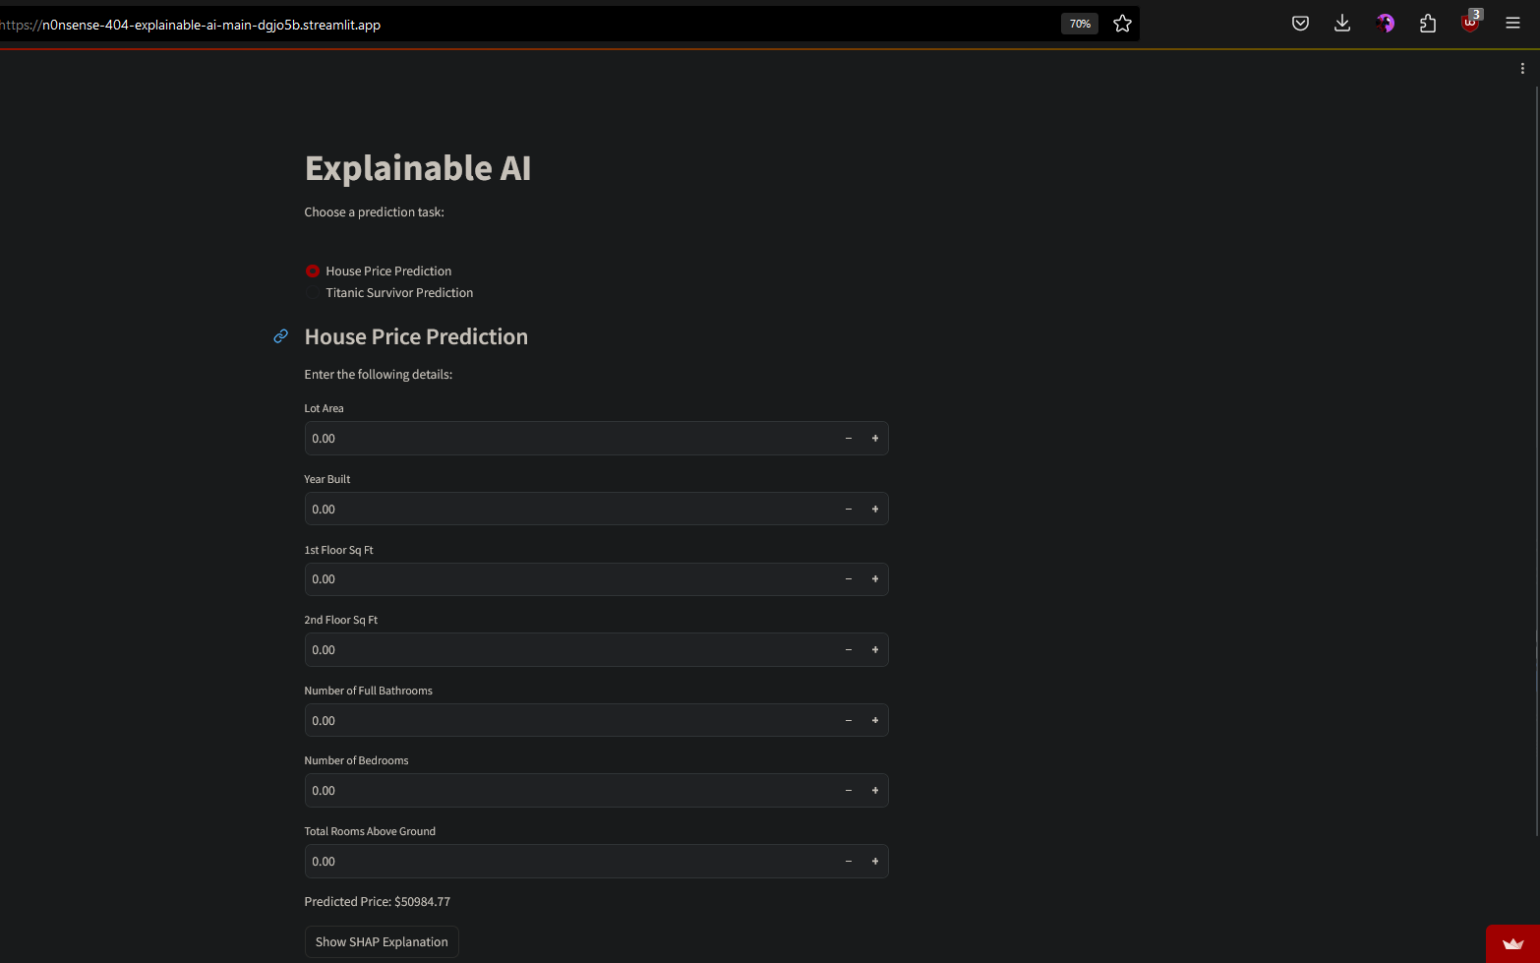
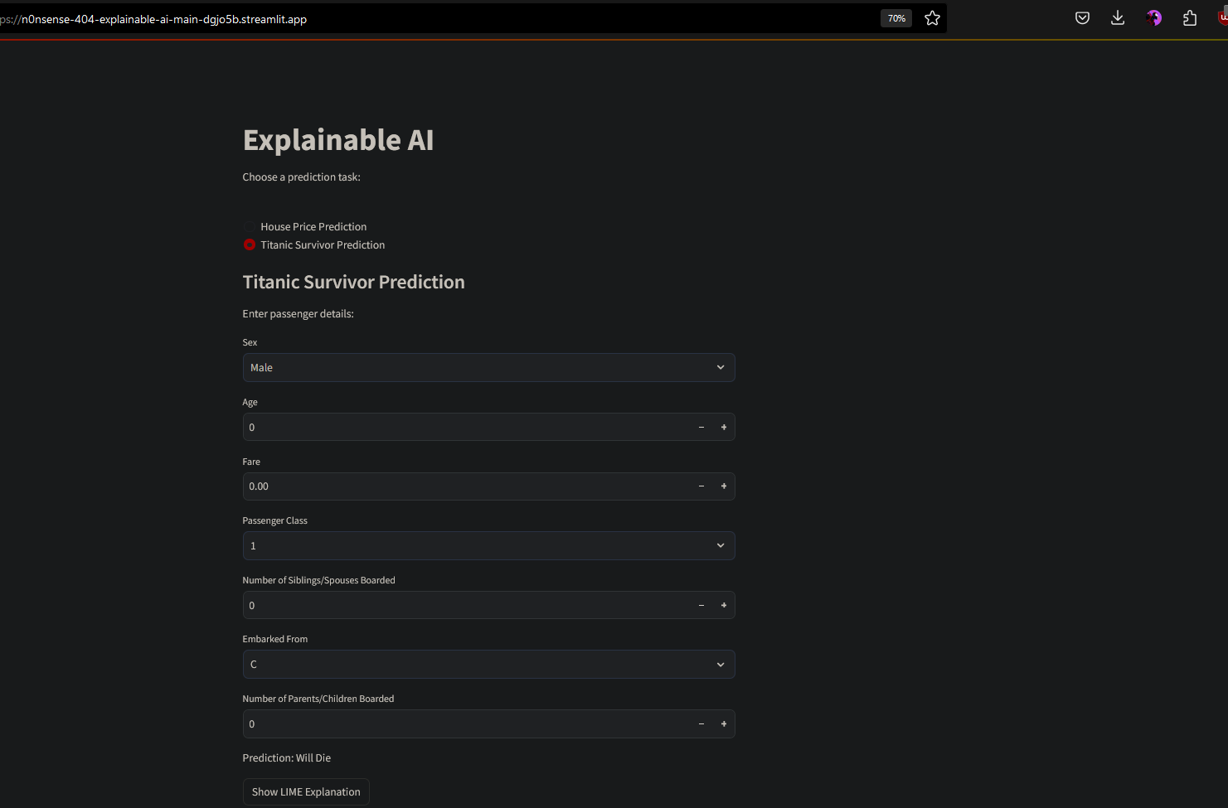
Module 4 : Website Development

Slide 18
Future Scopes:
Beyond Simple Models:
- Explore complex datasets for prediction tasks.
- Integrate advanced techniques like natural language processing for text-based analysis and computer vision for image and video recognition.
- Implement reinforcement learning for decision-making in dynamic environments.
Real-World Applications:
- Develop XAI-powered systems for medical diagnosis, fraud detection, or personalized recommendations.
- Foster human-AI collaboration in areas like scientific discovery or creative content generation.

Slide 19
CONCLUSION:
This project served as a springboard into the exciting world of machine learning and Explainable AI (XAI). We successfully built and explained models for house price prediction and Titanic survival prediction, showcasing the capabilities of AI. Looking ahead, XAI unlocks the potential to delve into intricate datasets, integrate advanced techniques like natural language processing and computer vision, and even implement reinforcement learning for dynamic environments. With XAI guiding the way, responsible and impactful AI applications are on the horizon, fostering trust and collaboration between humans and machines in a multitude of fields.

Slide 20
THANK YOU

