Slide 1
Diabetes Prediction
(Capstone Project)

Slide 2
Predicting Diabetes is valuable for hospitals
Initial screening of patients with diabetes helps-
save a lot of time
Is crucial for treatment of serious problems

Slide 3
Data acquisition and cleaning
The data used has been collected from various hospitals across New York. The dataset comprises of various features like Age, insulin, Blood pressure, Skin Thickness, BMI, glucose etc. for the patients and I trained various classifier Algorithms based on the dataset so that it could predict, given new data, whether a patient is diabetic or not.
Initial data consisted of records for 769 patients

Slide 4
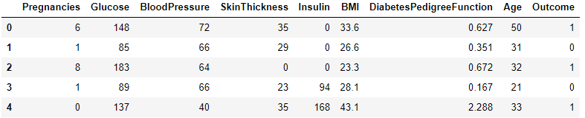
Dataset and its features

Slide 5
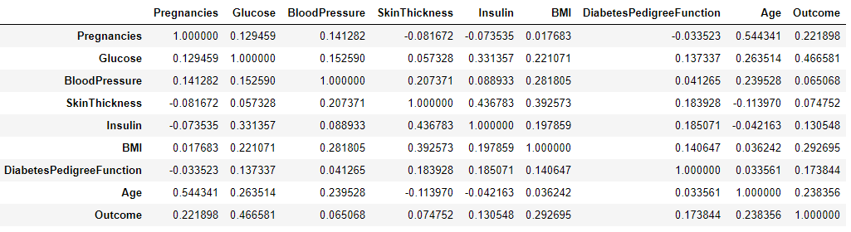
Correlations between features

Slide 6
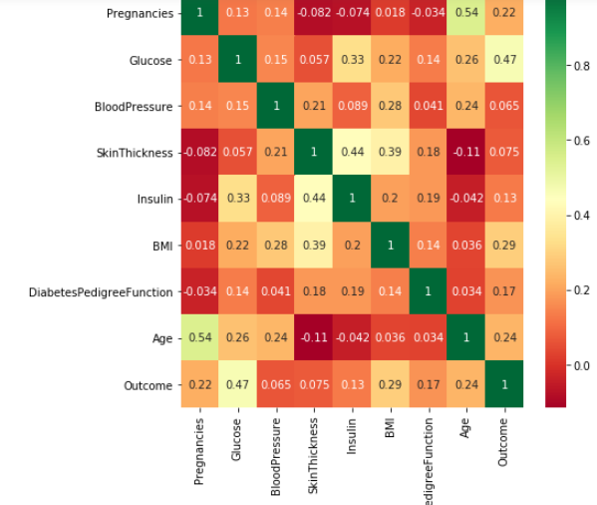
Heatmap

Slide 7

Random forest classifier-
Accuracy= 0.727

Slide 8
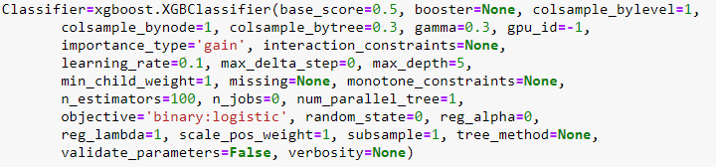
Xgboost with parameter optimisation-
Accuracy=0.763

Slide 9
Conclusion
This test will work efficiently in providing initial screening of diabetes patients
Although few steps can be taken to improve the accuracy-
Data collection- Data could have been more accurate as many entries in different columns were zeroes. If better dataset were given accuracy would be higher.
Skewness of the data- If the outcome column was more balanced we could have got higher accuracy.

