Slide 1
Age and Gender Detection System
“An AI-powered solution for predicting age and gender from images”
Submitted by:
Abhishek Rawal
Section: E2
Roll No.: 07

Slide 2
Introduction
What is an Age and Gender Detection System?
- A computer vision application that predicts the age and gender of individuals from images.
Why is it important?
- Applications in security, marketing, user personalization, and more.

Slide 3
Objective
To design a GUI-based system that can:
- Accept an input image.
- Predict the age of the person in the image.
- Predict the gender of the person in the image.

Slide 4
Tools and Languages Used
Programming Language: Python
- Easy to use with extensive libraries for machine learning and GUI development.
Tools:
- Jupyter Notebook for model training
- Visual Studio Code for GUI development

Slide 5
Libraries Used
1. TensorFlow/Keras: Model creation and loading
2. NumPy: Handling numerical computations and image arrays
3. Pillow (PIL): Image processing and manipulation
4. Tkinter: GUI development
5. OpenCV (Optional): For additional image preprocessing tasks

Slide 6
Workflow of the System
1. Load the pre-trained deep learning model.
2. Preprocess the input image (resize to 48x48, normalize pixel values).
3. Predict age and gender using the model.
4. Display results on the GUI.

Slide 7
GUI Interface
User-friendly interface developed using Tkinter:
- Upload button to select an image.
- 'Detect Image' button to process the image.
- Displays predicted age and gender.

Slide 8
Model Details
Model Architecture:
- Deep Neural Network (DNN) with convolutional layers.
- Trained on labeled datasets of faces with age and gender annotations.
Input: 48x48 RGB images
Output: Predicted age and gender.

Slide 9
Advantages of the System
1. Automates age and gender detection.
2. Scalable for applications in marketing, surveillance, retail, and more.
3. Simple GUI for user interaction.

Slide 10
Limitations of the System
1. Accuracy depends on the quality of the dataset used for training.
2. Performance may vary across different ethnicities or age groups due to dataset bias.
3. Requires preprocessing and specific input dimensions (48x48).

Slide 11
Future Enhancements
1. Improve model accuracy using diverse datasets.
2. Add emotion detection as an additional feature.
3. Real-time video stream support.
4. Deploy the system as a web or mobile application.

Slide 12
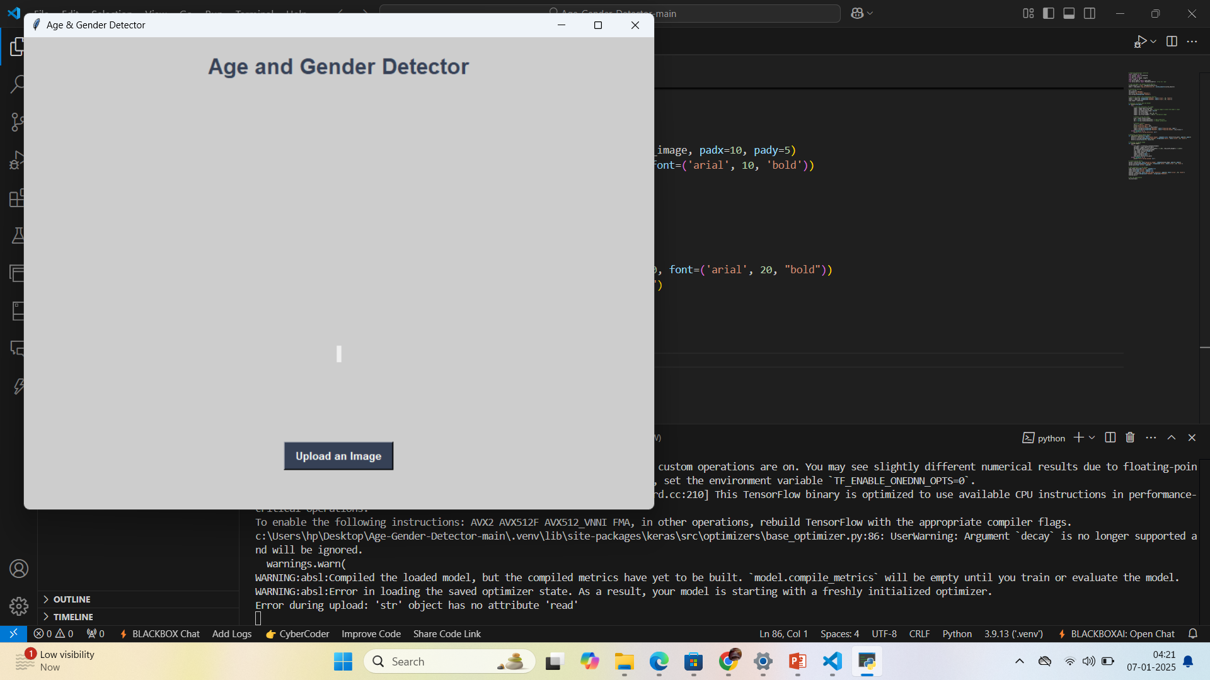
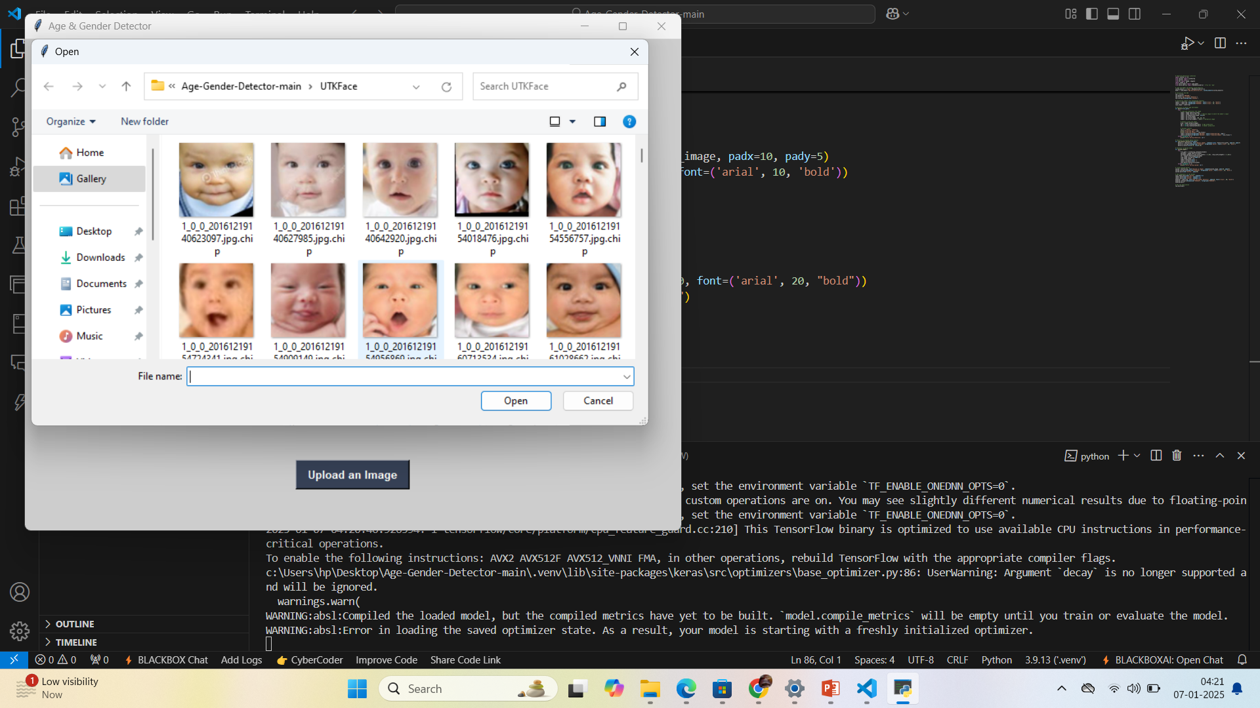
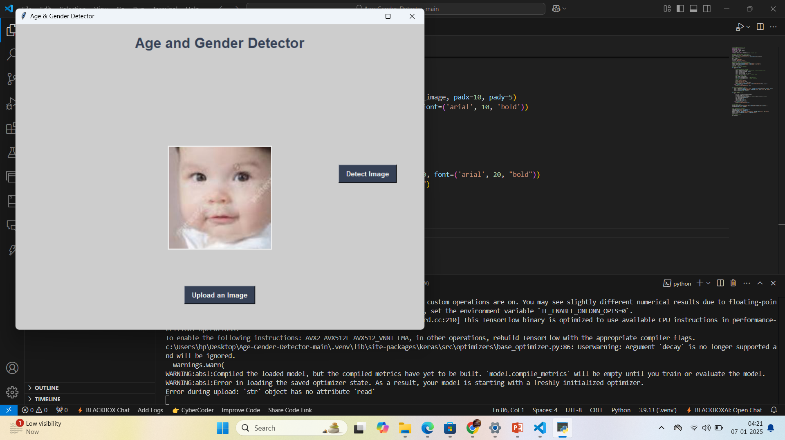
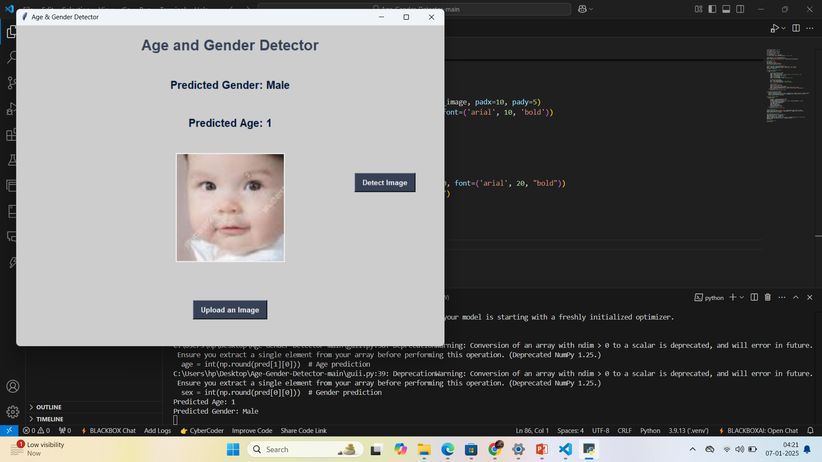
Output Screenshots

Slide 13
Key Challenges:
1. Handling diverse datasets with variations in lighting, pose, and quality.
2. Balancing model accuracy and computational efficiency.
3. Addressing ethical concerns related to privacy,
4. Input image constraints,
5. Real-Time processing,
6. Interpretability of Predictions.

Slide 14
Conclusion
Summary:
- The system predicts age and gender accurately given sufficient training data.
- Potential real-world applications include marketing, security, and retail.
Future Scope:
- Focus on improving model inclusivity and real-time performance.

Slide 15
References
1. TensorFlow Documentation
2. Keras Tutorials
3. Pillow Documentation
4. Relevant machine learning resources

