Slide 1
Age-Gender Detection System Project Report
Age-Gender Detection System
A Comprehensive Guide to Implementation, Advantages, and Limitations
Prepared by: Abhishek Rawal
Course : B-Tech CSE(5th sem)
Section: E2
Roll No. : 07
Date: 05/01/2025

Slide 2
Age-Gender Detection System Project Report
Abstract
This report provides an in-depth look into the Age-Gender Detection System. The project employs
deep learning techniques and computer vision libraries to accurately determine the age group and gender of individuals based on facial images. The report outlines the system's architecture, implementation, and real-world applications.
1. Introduction
Age and Gender Detection is an essential part of computer vision systems with applications in marketing,
healthcare, and security. It involves identifying a person's demographic features using facial images.
The increasing demand for personalized experiences has made this a vital tool in AI and machine learning.
2. Problem Statement
The key challenges in Age and Gender Detection include variability in facial features, lighting conditions,
and cultural differences. Addressing these challenges with robust models ensures accuracy and real-time applicability.
3. Technologies Used
- **Programming Language**: Python

Slide 3
Age-Gender Detection System Project Report
**Libraries**:
OpenCV: For image processing.
TensorFlow/Keras: For deep learning models.
NumPy and Pandas: For data handling and preprocessing.
Matplotlib: For data visualization.
**Tools**: Jupyter Notebook/VS Code
4. Dataset Overview
Datasets such as Kagle and Adience provide labeled images for training age and gender models.
Preprocessing
steps include resizing, normalization, and augmentation to enhance the dataset's quality and generalization.
5. System Architecture
The system involves several stages:
Input Image
Preprocessing
Feature Extraction using CNN
Age-Gender Classification
Output Display

Slide 4
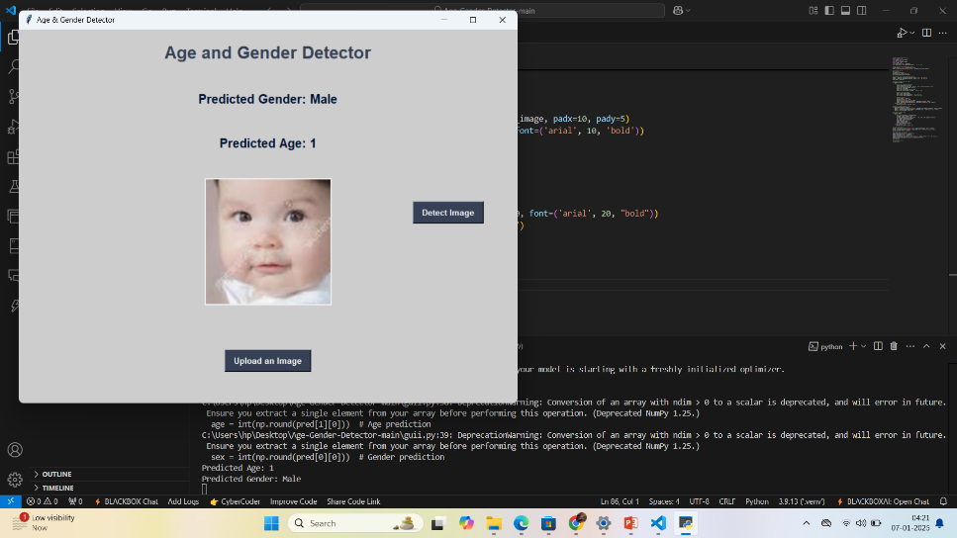
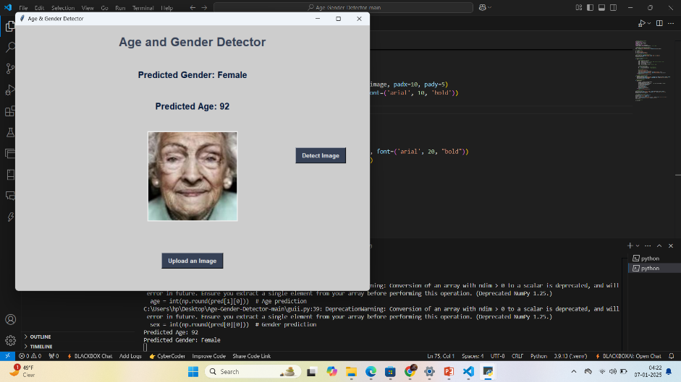
Age-Gender Detection System Project Report
6. Implementation Details
**Data Preprocessing**: Images are resized, normalized, and augmented.
**Model Selection**: Pre-trained models like MobileNet or VGGFace are utilized.
**Training and Evaluation**: The model is trained with a categorical cross-entropy loss and Adam optimizer.
**Testing**: The model is evaluated on unseen test data.
CODE SNIPPETS
7. Results and Analysis
The model achieved high accuracy on the test dataset. Metrics such as precision, recall, and F1-score
demonstrate the system's reliability.
OUTPUT:
8. Advantages
Fast and accurate detection of age and gender.
Real-time application capability.
Usable in diverse industries such as marketing, security, and healthcare.

Slide 5
Age-Gender Detection System Project Report
9. Limitations
High dependency on high-quality datasets.
Computationally expensive for real-time processing.
Sensitive to variations in lighting and occlusion.
10. Conclusion
The Age-Gender Detection System successfully detects demographic features with high accuracy.
Future improvements can focus on reducing computational requirements and addressing dataset biases.
11. References
IMDB-WIKI Dataset: https://data.vision.ee.ethz.ch/cvl/rrothe/imdb-wiki/
OpenCV Documentation: https://opencv.org/
TensorFlow Documentation: https://www.tensorflow.org/

