Slide 1

JIT Compiler with GUI using LLVM and Python
To- Ms Stuti Bhatt - Abhishek Rawal and Vicky
B .Tech CSE, Graphic Era Hill University
Project Based Learning (PBL)

Slide 2
Abstract
This project implements a Just-In-Time (JIT) compiler in Python.
It parses arithmetic expressions, loops and simple programs.
Generates LLVM IR and executes using llvmlite JIT engine.
Includes a GUI for user input and real-time output.
Supports variables, loops, and basic control flow.

Slide 3
Problem Statement
Traditional interpreters are slow; compilers are less interactive.
JIT compilers combine the best of both: speed and flexibility.
We aim to create an educational and interactive JIT compiler.
Helps students understand parsing, IR, and real-time execution.

Slide 4
Objectives
Build a JIT compiler backend using llvmlite.
Support basic programming features: variables, loops, arithmetic.
Provide a simple syntax using Lark grammar.
Create a user-friendly GUI for input and results.
Visualize LLVM IR and result for educational clarity.

Slide 5
Tools and Technologies Used
Python 3.x
Lark Parser (for grammar and AST)
llvmlite (IR generation and JIT execution)
LLVM IR (Intermediate Representation)
customtkinter (modern GUI design)

Slide 6
System Architecture
User inputs code in GUI
Lark parser generates Abstract Syntax Tree (AST)
Compiler module generates LLVM IR
IR is executed using JIT engine
Result and IR are displayed in GUI

Slide 7
Grammar Design (grammar.lark)
Supports expressions: +, -, *, /
Supports assignment: x = 5 + 3;
Supports loops: while x < 5 { x = x + 1; }
Supports conditionals and print statements

Slide 8
AST and Parsing
Lark parses input and generates parse tree
ASTBuilder transforms parse tree into AST
AST is a simplified tree structure for code logic
Compiler walks the AST to generate IR

Slide 9
LLVM IR Generation
IR is built using llvmlite.ir module
Each node in AST is converted into IR instruction
Handles arithmetic, assignments, conditionals
Loops and variables use blocks and memory

Slide 10
JIT Execution with llvmlite
Uses llvmlite.binding to compile IR at runtime
IR is verified, optimized, and executed
Execution result is returned to GUI
Fast and efficient execution in memory

Slide 11
GUI Design and Features
Modern GUI using customtkinter
Light/Dark mode toggle
Tabbed output: IR, Result, Errors
Load/Save code, Clear output
Status bar for compile status

Slide 12
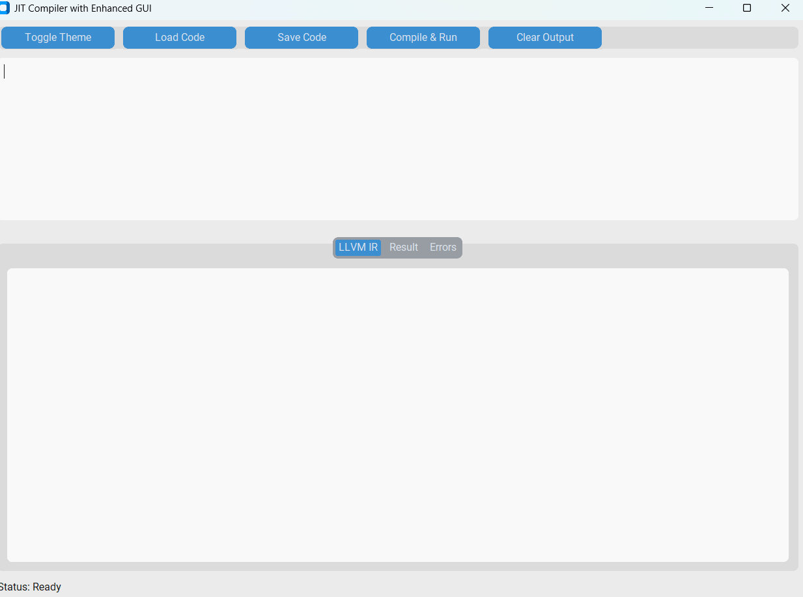
Initial Output:

Slide 13
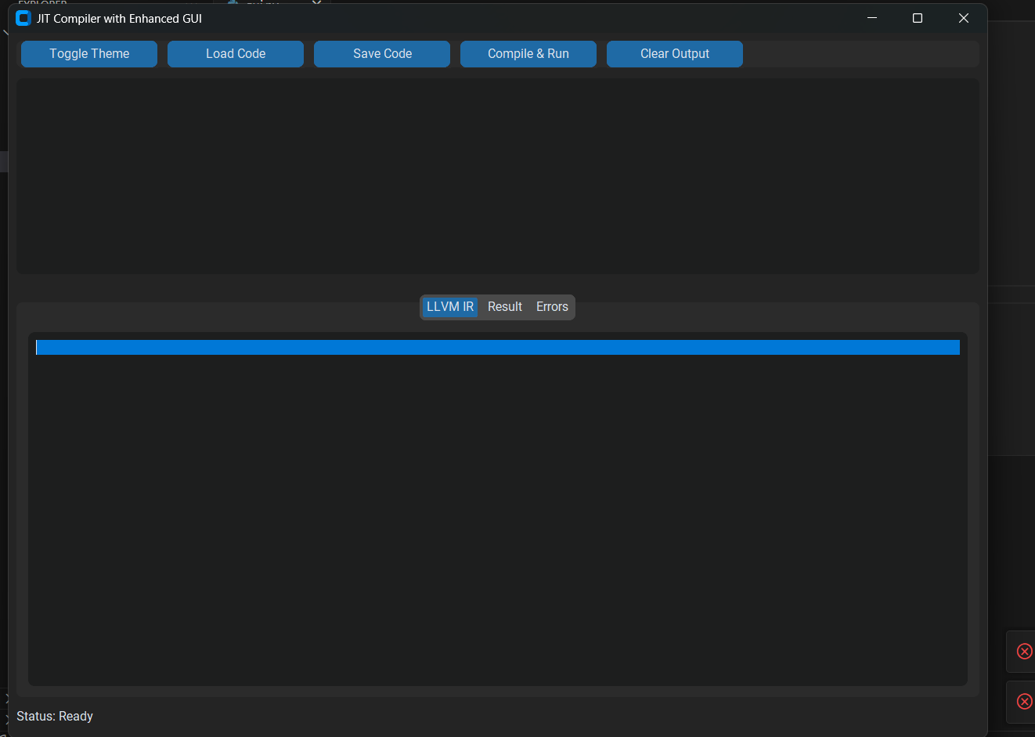
Output: 1

Slide 14
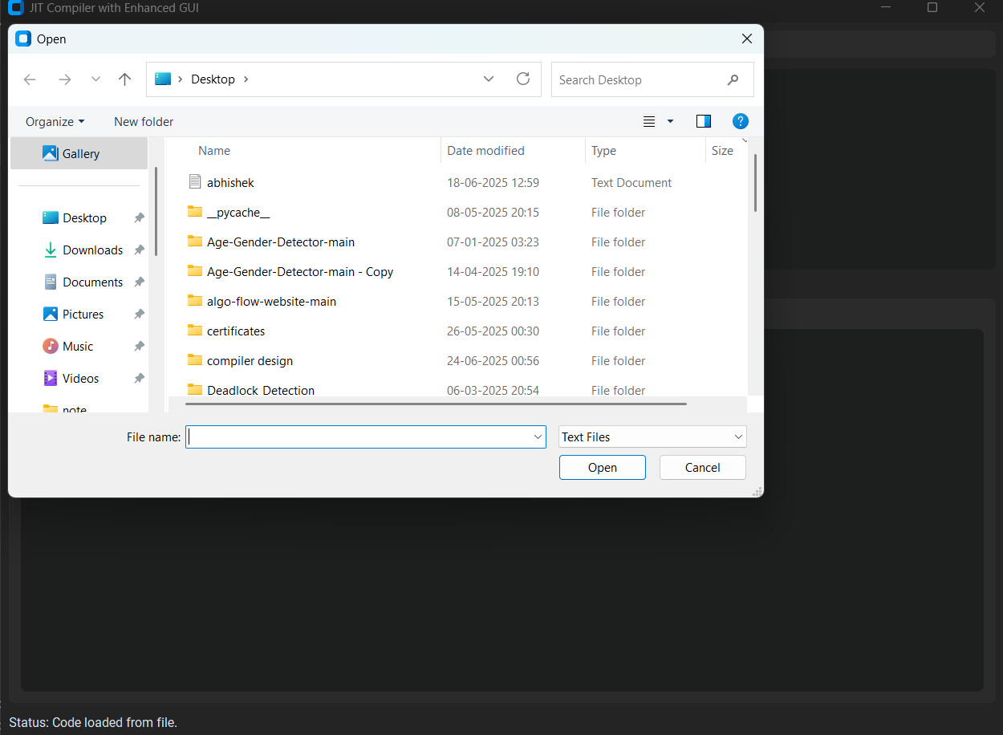
Output:2

Slide 15
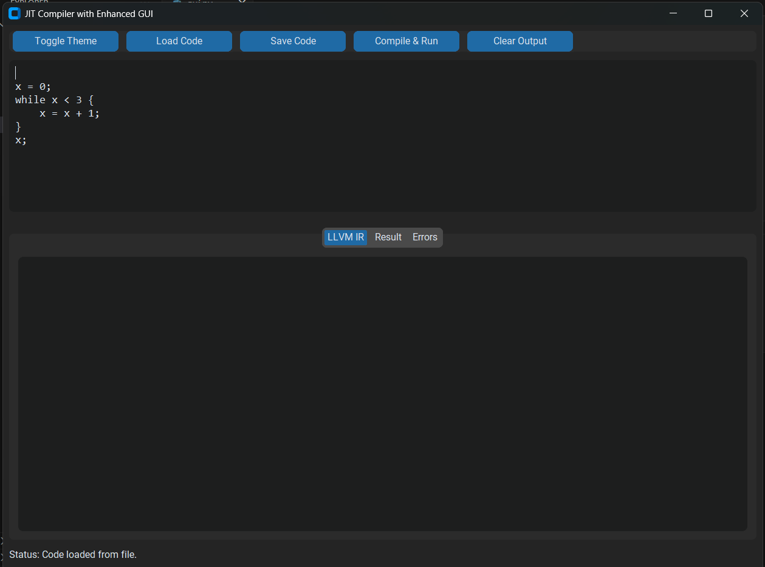
Output 3:

Slide 16
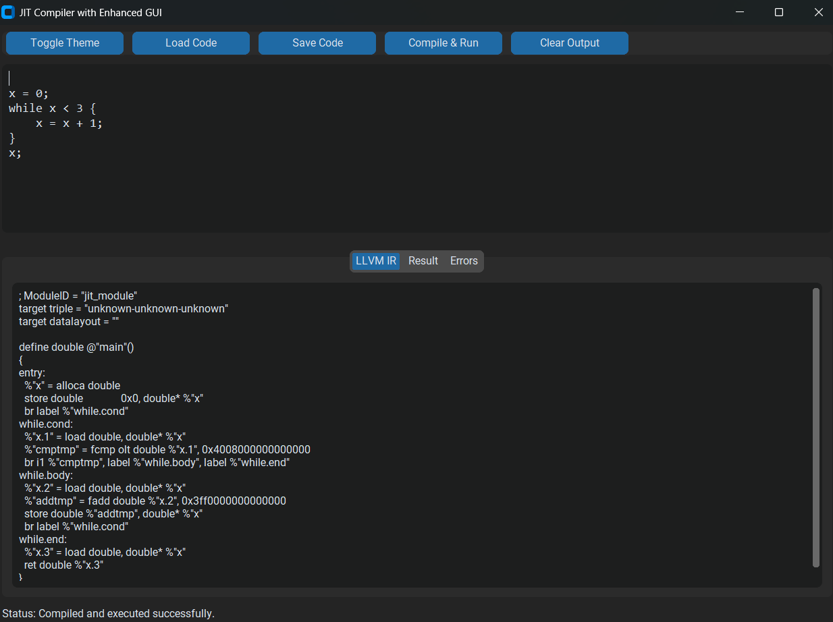
Output 4:

Slide 17
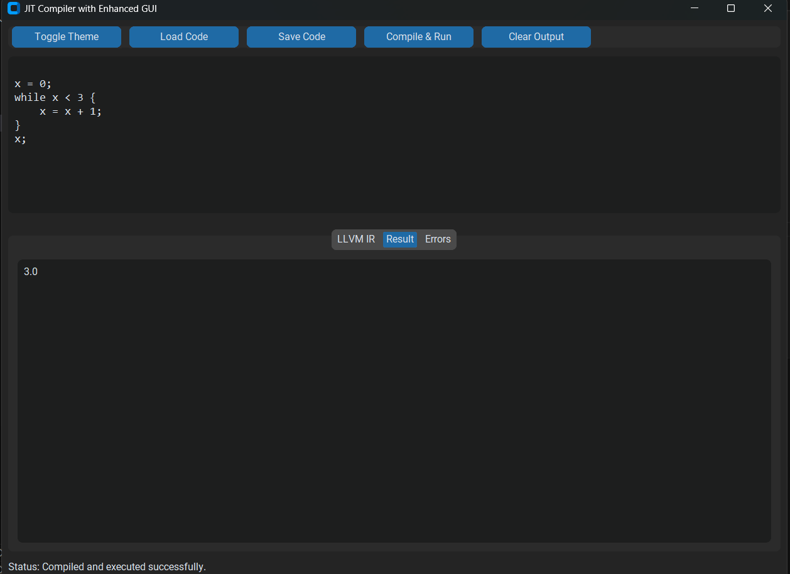
Output 5:

Slide 18
Key Features Implemented
Lark-based grammar and AST transformer
LLVM IR code generator
JIT engine for runtime execution
Syntax highlighting-ready GUI
Supports variables, print, and while loops

Slide 19
Testing and Validation
Tested for valid/invalid expressions
Multiple statements and nesting tested
Valid loops and conditionals return correct result
IR output verified manually

Slide 20
Challenges and Solutions
Understanding and using LLVM IR correctly
Managing memory and control flow for loops
Integrating GUI with backend compiler
Ensuring error handling and GUI responsiveness

Slide 21
Conclusion and Future Scope
The JIT compiler is functional and educational.
Provides clear understanding of IR and runtime compilation.
Future scope includes:
- Adding if-else, functions, and input handling
- Exporting IR to file and adding IR optimization

