Slide 1
Machine Learning assisted Propeller Design
Authors : Harsh Vardhan, Peter Volgyesi, Janos Sztipanovits
(Institute for Software Integrated Systems, Vanderbilt University, Nashville, TN, USA)
Project Presentation, CS637A, 2021-22, Sem-I
Instructor:- Dr. Indranil Saha (CSE, IITK)
Group 7
Abhishek Dnyaneshwar Revskar(21111003)
Jegan Balaji B S(21111404)
Research Paper:-
https://dl.acm.org/doi/10.1145/3450267.3452001

Slide 2
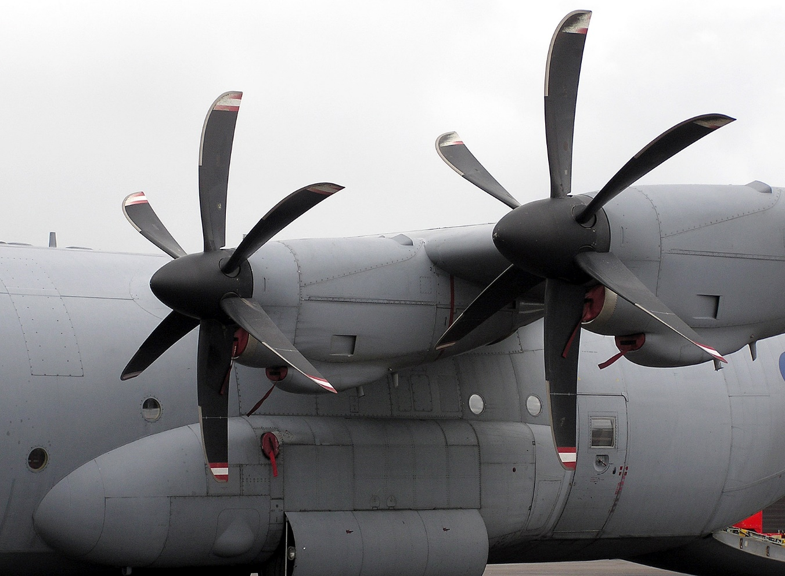
PROPELLER
Propeller is a device which consists of a central hub that connects two or more blades and connects them to the engine shaft.
It converts rotary motion from an engine or other power source into a swirling slipstream thereby making the aircraft move forward through the air.

Slide 3
AIM
Arriving at the optimal application-specific geometry of propellers is still a herculean task.
The main aim presented in the paper is to develop and evaluate machine learning models for the parametric design of propellers when provided with application-specific constraints.

Slide 4
PROPELLER PERFORMANCE
Physical Parameters
Thrust coefficient
Power coefficient
Geometric Characteristics
Number of blades
Chord radial distribution
Propeller’s diameter
Pitch radial distribution
Hub diameter
Advance ratio

Slide 5
Propeller Design Problem
Given some thrust requirements at well-defined operational points (e.g. cruising speed and the actuator’s spinning rate (𝑅𝑃𝑀)), the goal of a designer is to search for the optimal geometric characteristics than can fulfill these requirements at maximum efficiency (𝐸).

Slide 6
Performance Criterion
The performance criteria for a design is the efficiency of propeller.
The main objective is to maximize efficiency as much as possible.
We define a design to be valid if its performance metric efficiency (𝐸) is greater than 50 %. This threshold of 50% is derived from domain knowledge as the lowest acceptable efficiency of propellers in large cargo ships is around 50%.
Propellers used in subsonic airplanes can reach efficiency up to 80-90%.

Slide 7
Data Generation And Model Training
After collecting all valid design points by storing the requirement values(𝑅) with the corresponding geometric design values (𝐺) and resulting efficiency (𝐸), the goal is to learn a function 𝑓 : 𝑅 ↦ 𝐺, 𝐸.
A random forest regression model on the dataset is created with the requirements as inputs and the geometric design parameters and efficiency metric as outputs.

Slide 8
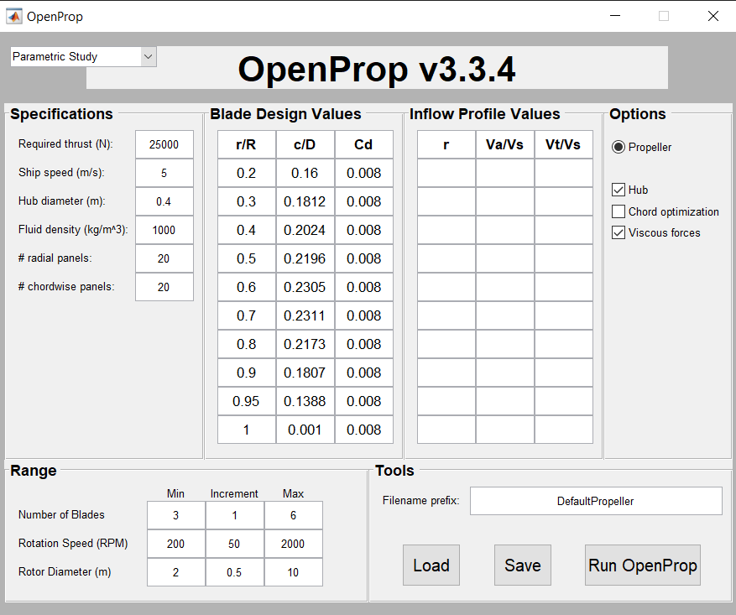
PARAMETRIC STUDY INPUT PARAMETERS

Slide 9
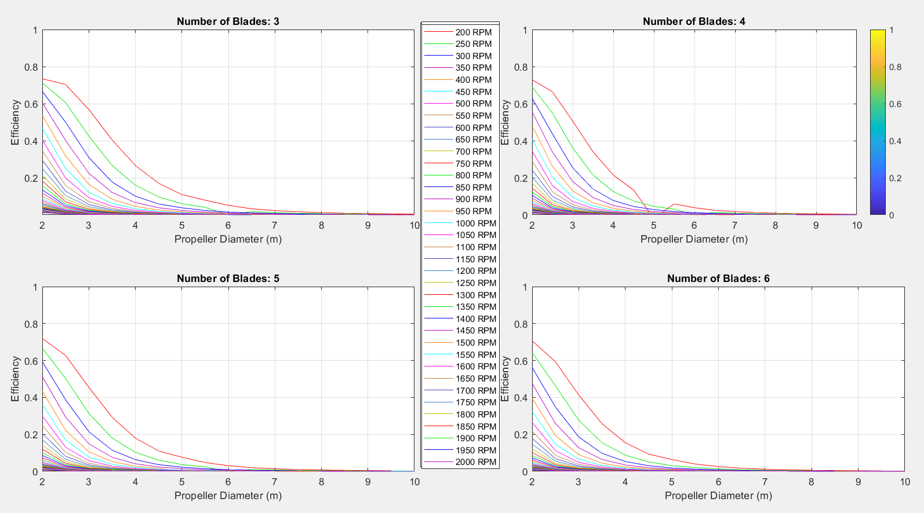
VARIOUS efficiency plots

Slide 10
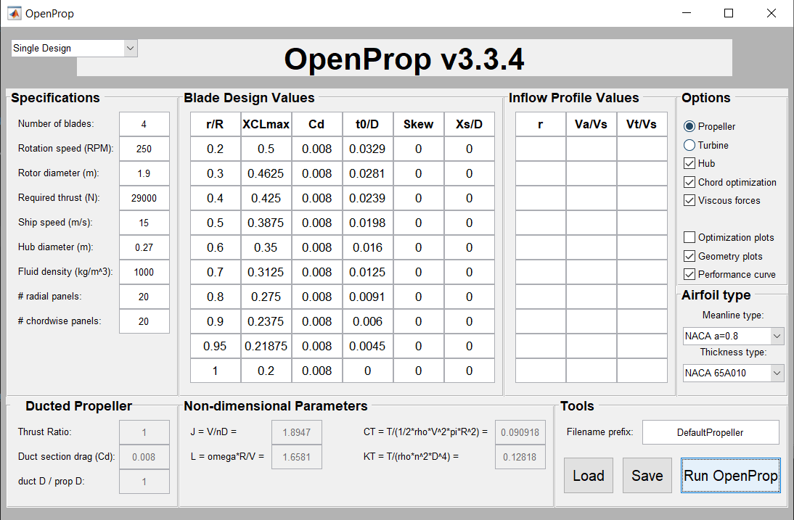
SINGLE DESIGN INPUT PARAMETERS

Slide 11
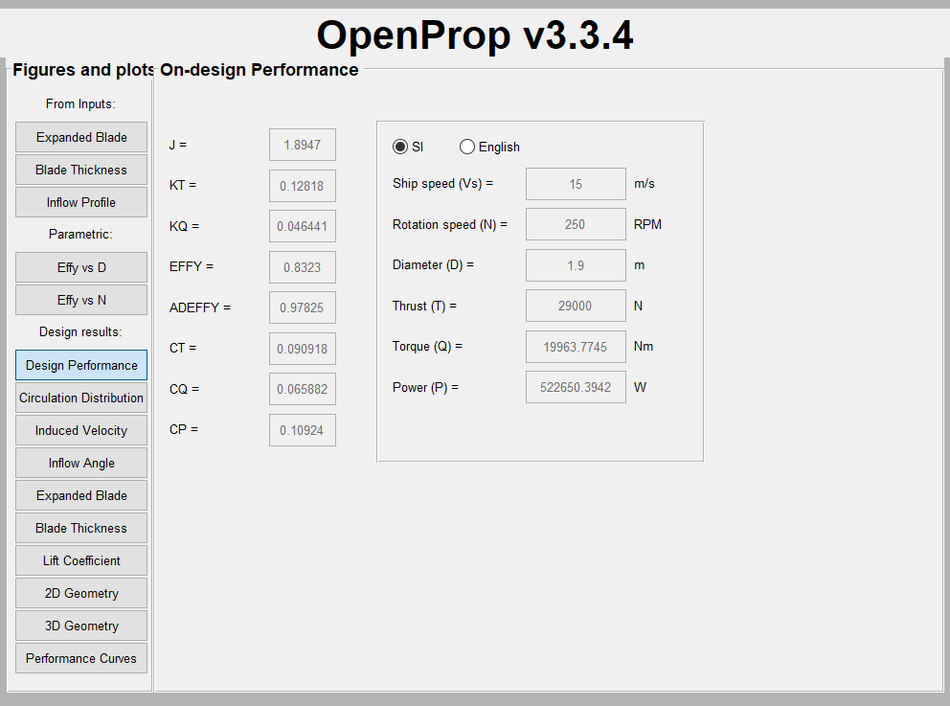
DESIGN PERFORMANCE FOR SINGLE DESIGN

Slide 12
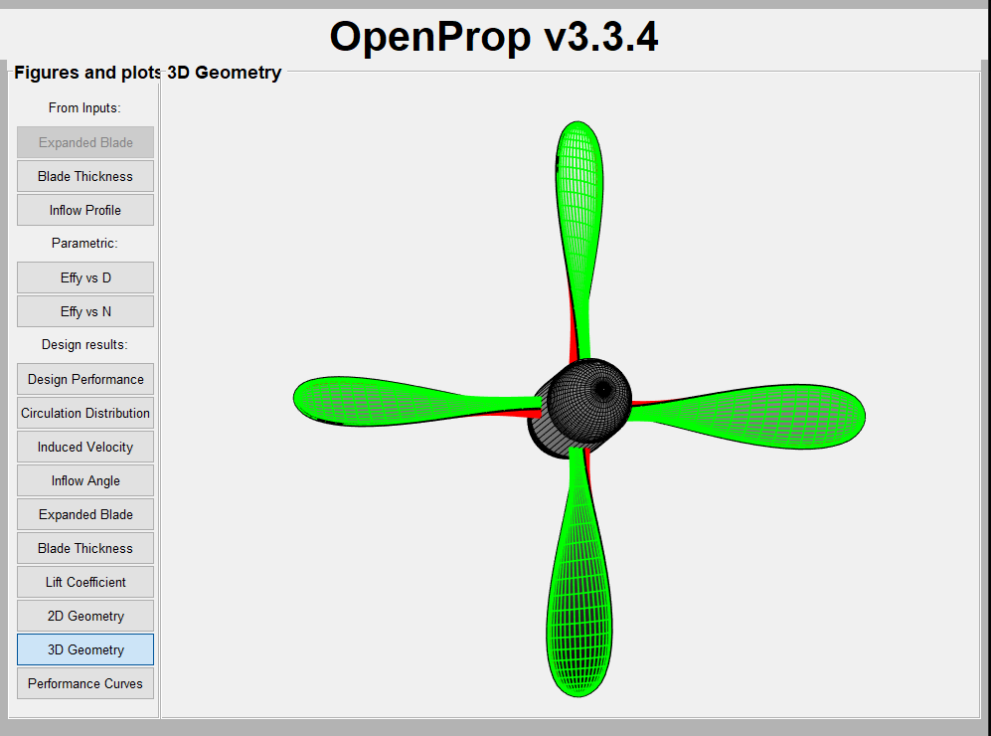
3D MODEL OF PROPELLER

Slide 13
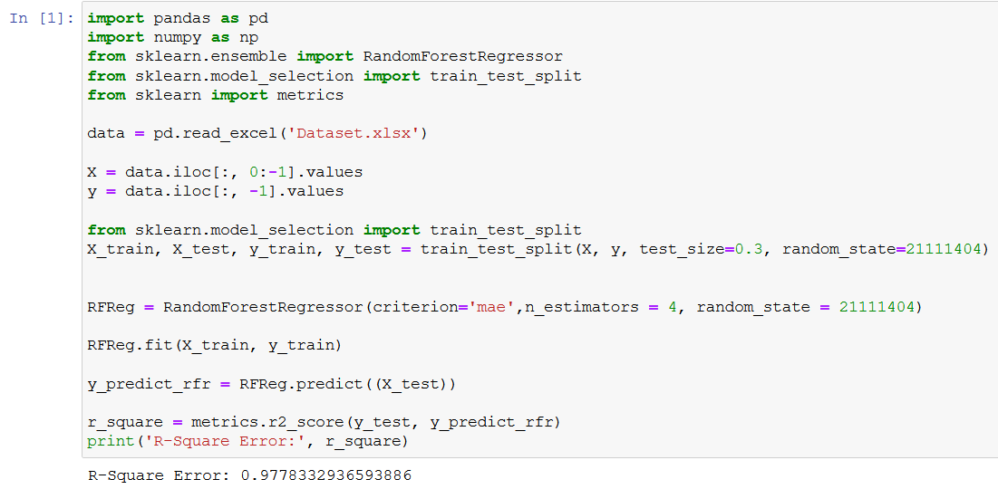
RANDOM FOREST IMPLEMENTATION(CRITERION = “MeAN ABSOLUTE ERROR”)

Slide 14
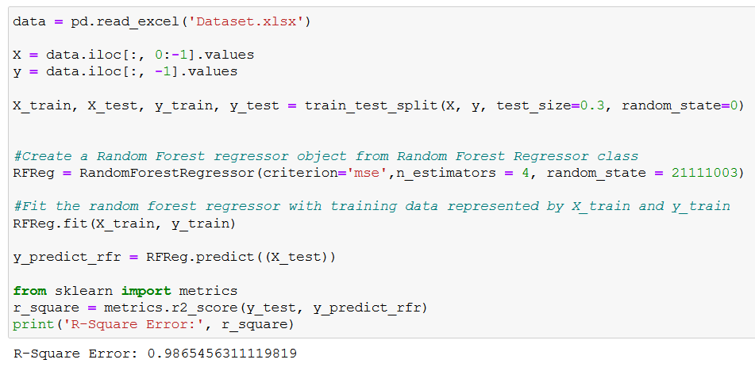
RANDOM FOREST IMPLEMENTATION(CRITERION = “MEAN SQUARED ERROR”)

Slide 15
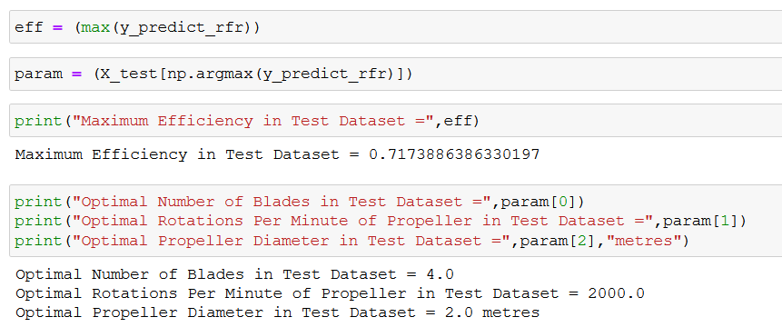
OPTIMAL PARAMETERS OBTAINED FROM RANDOM FOREST

Slide 16
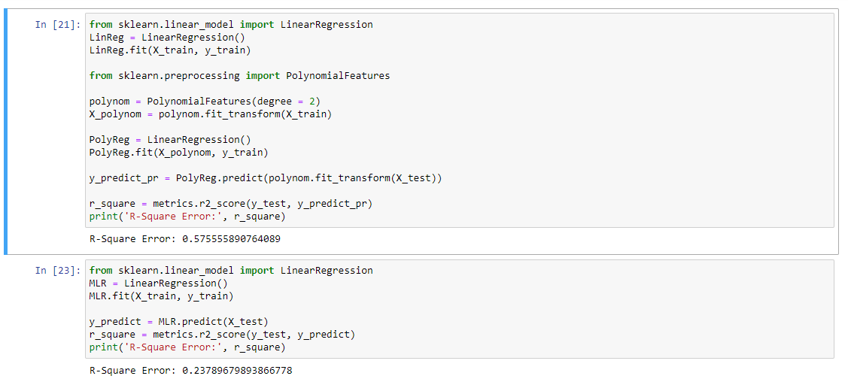
OTHER IMPLEMENTATIONS(POLYNOMIAL REGRESSION AND MULTIPLE LINEAR REGRESSION)

Slide 17
INFERENCES
We implemented Multiple Linear Regression and Polynomial Regression in addition to the Random Forest Regression but they gave poor accuracy.
Efficiency is inversely proportional to the number of blades, propeller diameter and Rotations Per Minute of the propeller.
Efficiency is directly proportional to the Thrust and ship velocity.
As a future work, decreasing the production cost in addition to increasing the efficiency can be made as the problem statement.
We reached efficiency of 83.23% in our design(This is shown in slide 11).
Note : Inorder to get optimal parameters for design, user must replace “X_test” in the code with a range of parameters and predict the efficiency and choose the corresponding parameters pertaining to the highest efficiency.

Slide 18
References
Harsh Vardhan, Peter Volgyesi, Janos Sztipanovits : Machine Learning Assisted Propeller Design
2019. ShipPropulsion. https://spain.mandieselturbo.com/docs/librariesprovider10/sistemas-propulsivos-marinos/basic-principles-of-ship-propulsion.pdf
Leo Breiman. 2001. Random forests. Machine learning 45, 1 (2001), 5–32.
Brenden Epps, Julie Chalfant, Richard Kimball, Alexandra Techet, Kevin Flood, and Chrysssostomos hryssostomidis. 2009. OpenProp: An open-source parametric design and analysis tool for propellers. In Proceedings of the 2009 grand challenges in modeling & simulation conference. 104–111.
Michael A Gelbart, Jasper Snoek, and Ryan P Adams. 2014. Bayesian optimization with unknown constraints. arXiv preprint arXiv:1403.5607 (2014).
Frank Hitchens. 2015. Propeller aerodynamics: the history, aerodynamics & operation of aircraft propellers. Andrews UK Limited.

Slide 19


