Slide 1

Directory
Name | Role | Email | Mobile
Anika Szabo | Group CRO | a.szabo@cadence.example | +1 (555) 0142
Mateo Lindahl | Head of TPRM | m.lindahl@cadence.example | +1 (555) 0157
Yusra Chaudry | Risk analyst | y.chaudry@cadence.example | +48 6015550 193

Slide 2
RACI
Activity | A. Szabo | M. Lindahl
Approve vendor | A | R

Slide 3
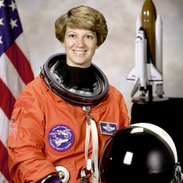
Committee
Chair: Anselm Kittredge
Notes:
Speaker notes: confirm with Wilma Castellanos.

