Slide 1

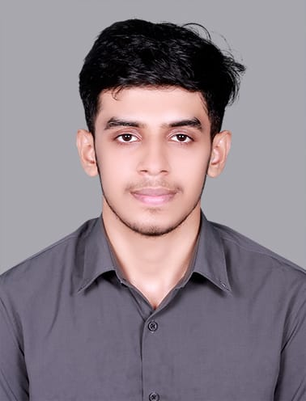
Professional Overview
Experience Highlights
Technical Experience: 2 years of experience as an individual contributor in Quality Assurance and Software Testing. Skilled in developing test automation scripts for web applications using Selenium Webdriver and Core Java with TestNG Framework. Involved in Functional, Integration and Regression testing of different applications in Agile environment.
Project Experience:
Project: Life Sciences Domain – Accenture (Mar 2025 – Present) NEAT
Developed Automation Scripts using Selenium WebDriver and Core Java using Page Object Design pattern and TestNG
Ran the Automation pack in Azure DevOps Pipeline using yaml file
Created automation scripts for each sprint which ensured same issues faced were not reproducible
Executed Smoke, Integration and Regression Testing to ensure the proper working of various features
Involved in functional Testing.
Project: Life Sciences Domain – Accenture (Jan 2025 – Feb 2025) 1P1R
Developed Automation Scripts using Selenium WebDriver and Core Java using Page Object Design pattern and TestNG
Ran the Automation pack in Azure DevOps Pipeline using yaml file
Performed Data Driven Testing using Apache POI
Executed Smoke, Integration and Regression Testing to ensure the proper working of various features
Involved in functional Testing.
Project: Life Sciences Domain –Accenture India (Jan 2024– Dec 2024) VERVE
Involved in functional Testing.
Executed Smoke, Integration and Regression Testing to ensure the proper working of various features
Worked closely with developers, business analysts, and other team members to maintain quality throughout the software development lifecycle.
Documented test results and reported bugs.
Photo
Abhinav Shaji
Quality Engineer Associate
Ph No: 6282867740
I am a dedicated Software Test Engineer with hands-on experience in both manual testing and automation testing using Selenium with Java. I’ve been actively involved in test planning, execution, and reporting, ensuring high-quality deliverables across various projects. With a strong focus on accuracy and efficiency, I aim to contribute to delivering robust and reliable software products.
RELEVANT Skills
Selenium Webdriver
Java
TestNG
POM Design pattern
Functional Testing
Regression Testing
Github
Agile and scrums methodologies
Azure DevOps
JavaScript
Achievement:
Merit holder in Tech Expressway Program
Industry Exposure
Life Science Domain

