Slide 1



Welcome to Horizon

Slide 2
ML Bootcamp

Slide 3
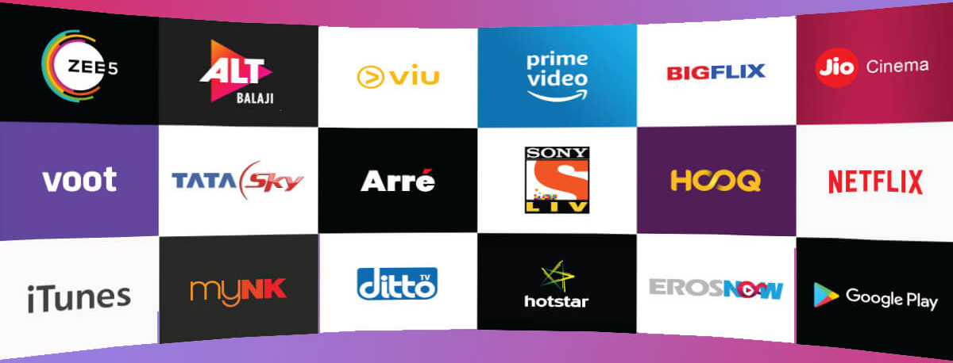
ICE BREAKING
What’s your favorite OTT platform?

Slide 4
SCHEDULE
Time | Topic
10am – 10:30am | Intro to project
10:30am – 12pm | Set up + Implementation
12pm – 2pm | Break
2pm – 4pm | Coding + Deploying
4:30pm – 5pm | Quiz
7pm – 8pm | Speaker Session

Slide 5
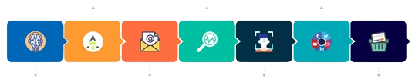
INTRO TO ML
The goal of machine learning generally is to understand the structure of data and fit that data into models that can be understood and utilized by people.
Auto-Pilot Mode
Predictive Search
Social Media Platforms
Virtual Assistance
Answer Prompts in Emails
Face Detection Mode
Shopping

Slide 6
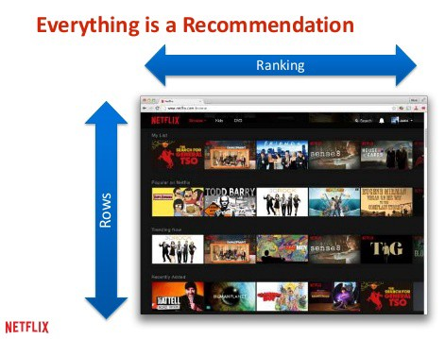
What Is Recommendation System?
Over 80% of what people watch is recommendations
It is an algorithm that suggests relevant items to users.
Example: In the case of Netflix which movie to watch, in the case of e-commerce which product to buy, or in the case of kindle which book to read, etc.

Slide 7
Recommender systems
Content-based methods
Collaborative filtering methods
Hybrid methods
Model -based
Memory-based
User-based
Item-based

Slide 8
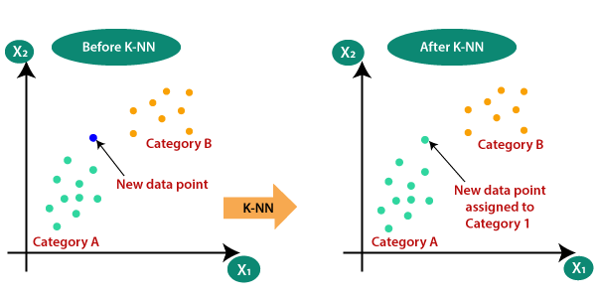
K-Nearest Neighbour
Before KNN
After KNN
Category B
Category B
New data point
New data point assigned to Category 1
Category A
Category A
Divides the data into classes of similar features
Distance of New data point calculated from the classes
New Data Point assigned to the nearest class

Slide 9
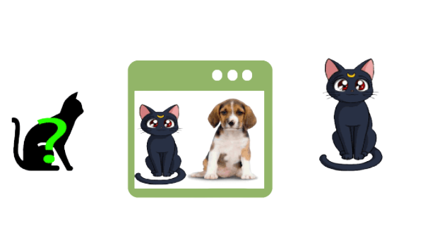
Input value
KNN Model
Predicted Output
KNN algorithm works on a similarity measure.
Finds the similar features of the new data set to the cats and dogs images
Output is predicted as a cat

Slide 10
TF-IDF
Calculation of how relevant a word in a series is to a text
Number of occurrence of particular word in sentence
Tf =
Total Number of words in that sentence
(Term Frequency)
Number of Sentences
Idf =
Number of sentences Containing That Word
(Inverse Document Frequency)

Slide 11
Sentence 1 : ISTE horizon Sentence 2 : ISTE technica Sentence 3 : horizon technica ISTE
Words | Frequency
ISTE | 3
horizon | 2
technica | 2
2)
TF
 | Sent 1 | Sent 2 | Sent 3
ISTE | 1/2 | 1/2 | 1/3
horizon | 1/2 | 0 | 1/3
technica | 0 | 1/2 | 1/3
1)

Slide 12
3)
4)
Words | IDF
ISTE | log(3/3) = 0
horizon | log(3/2)
technica | log(3/2)
 | ISTE | horizon | technica
Sent 1 | 0 | 1/2 * log(3/2) | 0
Sent 2 | 0 | 0 | 1/2 * log(3/2)
Sent 3 | 0 | 1/3 * log(3/2) | 1/3 * log(3/2)

Slide 13
Cosine Similarity
Metric used to determine how similar the documents are irrespective of their size
Cosine Similarity measures the cosine of the angle between two vectors projected in a multi-dimensional space
hi
“hi world”
hello
world
“hello world”

Slide 14
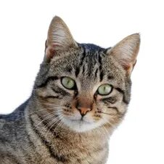
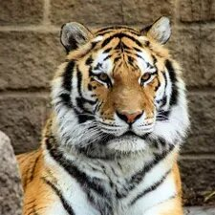
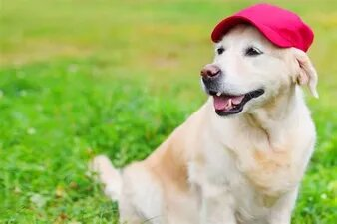
x
A
Q
α
B
β
y

Slide 15
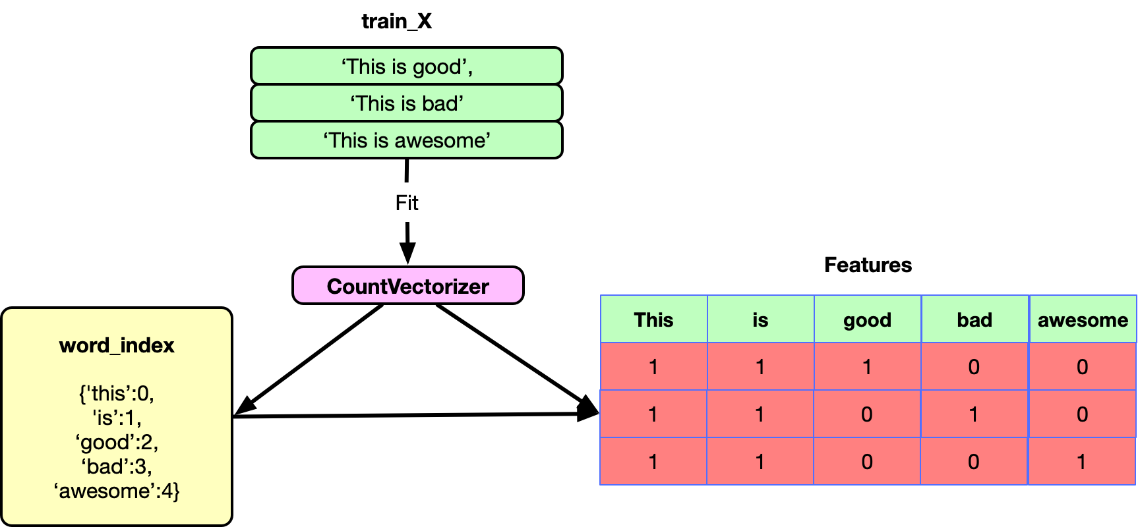
Count Vectorizer
Count Vectorizer is a method to convert text to numerical data
Count vectorizer makes it easy for text data to be used directly in machine learning and deep learning models.
Example: Text classification
train_X
Features

Slide 16
Let’s take the book title
doc = [“One cent, Two Cents, Old Cent, New Cent : All About Money”]
This text is transformed to a sparse matrix as shown below
 | about | all | cent | cents | money | new | old | one | two
doc | 1 | 1 | 3 | 1 | 1 | 1 | 1 | 1 | 1
In theory
Index | 0 | 1 | 2 | 3 | 4 | 5 | 6 | 7 | 8
doc | 1 | 1 | 3 | 1 | 1 | 1 | 1 | 1 | 1
In Practice

Slide 17





Connect with us!
iste_vit_vellore
“You can have data without information but you cannot have information without data”
- Daniel Keys Moran
ISTE.VIT
indian-society-for-technical-education
ISTE-VIT
For more information:
https://horizon.istevit.in/

Slide 18
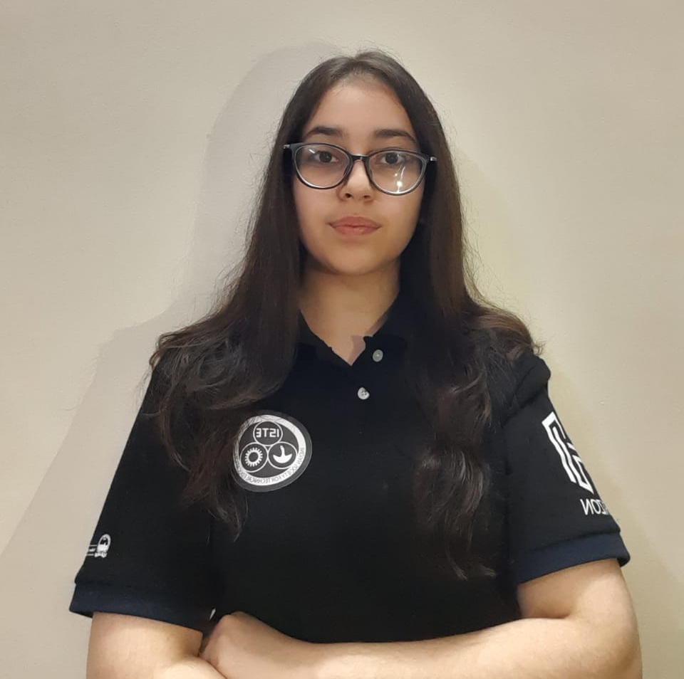
Connect with me!
khushboonijhawann
khushboonijhawan
KhushbooNijhawan
For more information:
https://horizon.istevit.in/

Slide 19
Thank You!

