Slide 1
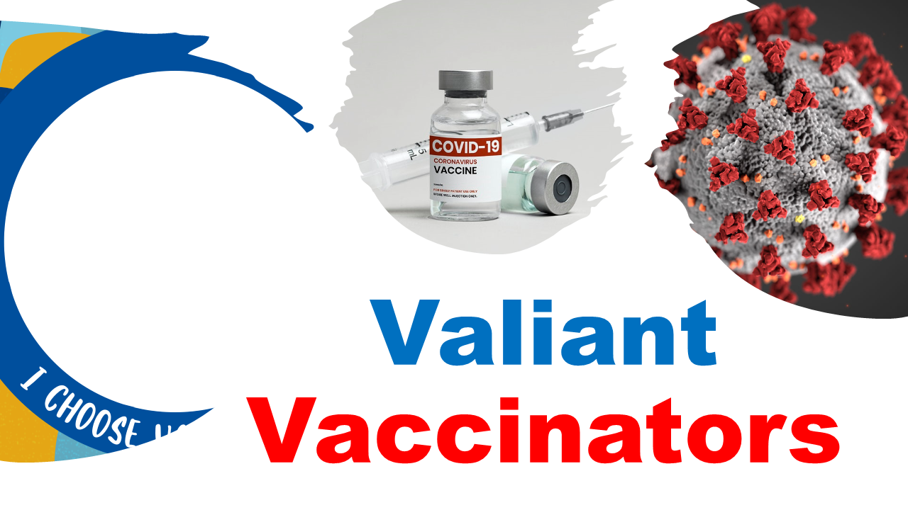


Slide 2
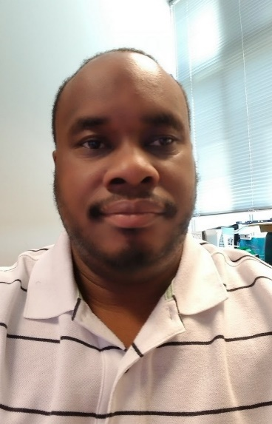
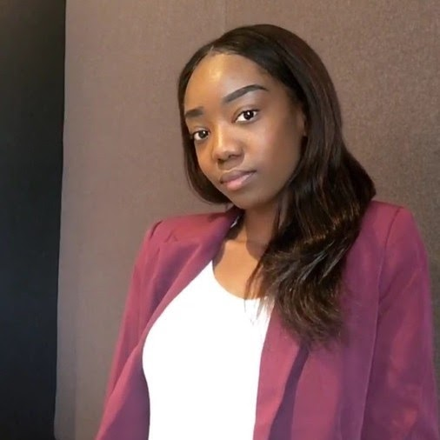
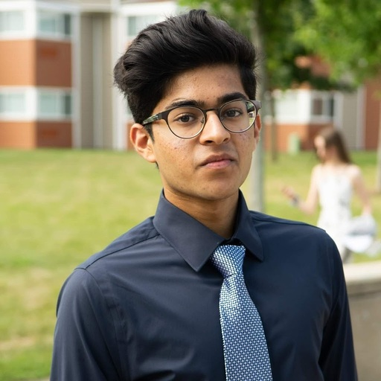
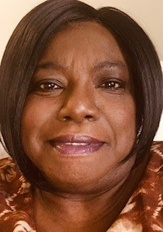
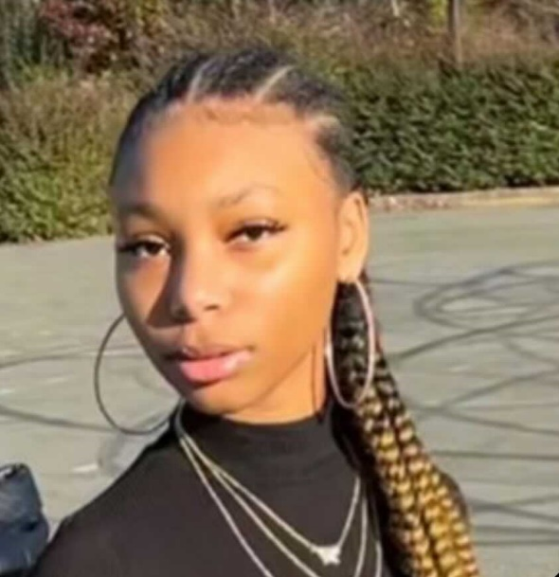
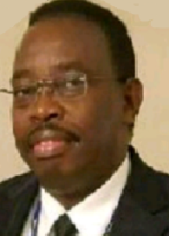

James Belton
Jasmine Trapier
Abhi Vinnakota
Meet the team!
Rebecca Caldwell
Nia Blake
Munene Kanampiu

Slide 3

Goal
To explore the correlation between Covid-19 vaccination rates to death and infection rates in the United States

