Slide 1
Database Systems
Introduction to PL/SQL

Slide 2
What is PL/SQL?
Procedural programming language
  Uses detailed instructions
  Processes statements sequentially
Combines SQL commands with procedural instructions
Used to perform sequential processing using an Oracle database

Slide 3
PL/SQL Variables
Variable names must follow the Oracle naming standard
  Can use reserved words (BEGIN, NUMBER) and table names for variable names, but is not a good practice
Make variable names descriptive
Use lower-case letters, and separate words with underscores
  Example: current_s_id

Slide 4
Declaring PL/SQL Variables
PL/SQL is a strongly-typed language
  All variables must be declared prior to use
Syntax for declaring a variable:
variable_name data_type_declaration;
Example:
current_s_id NUMBER(6);

Slide 5
Scalar Data Types
Database scalar data types:
    VARCHAR2
    CHAR
    DATE
    LONG
    NUMBER

Slide 6
PL/SQL Program Structure
DECLARE
  Variable declarations
BEGIN
  Program statements
EXCEPTION
  Error-handling statements
END;
Variable Declarations
Body
Exception
Section

Slide 7
PL/SQL Program Lines
May span multiple text editor lines
Each line ends with a semicolon
Text is not case sensitive

Slide 8
Comment Statements
Block of comments are delimited with /* */
  /* <comment that spans more than one line of code> */
Single comment line starts with 2 hyphens
-- comment on a single line

Slide 9
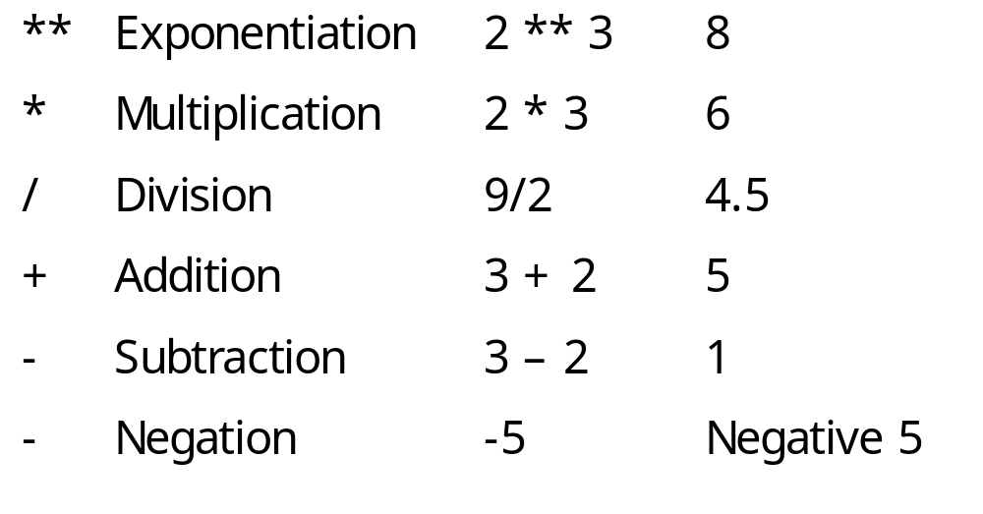
Arithmetic Operators
Example
Result

Slide 10
Assignment Statements
Assignment operator: :=
Variable being assigned to a new value is on left side of assignment operator
New value is on right side of operator
  student_name := ‘John Miller’;
  student_name := current_student;

Slide 11
Displaying PL/SQL Output in SQL*Plus
Command to activate memory buffer in SQL*Plus to enable output from PL/SQL programs:
  SQL> SET SERVEROUTPUT ON SIZE buffer_size;
  SQL> SET SERVEROUTPUT ON SIZE 4000;

Slide 12
Displaying PL/SQL Program
Output in SQL*Plus
Command to output data from a PL/SQL program in SQL*Plus:
  DBMS_OUTPUT.PUT_LINE(‘output string’);
  DBMS_OUTPUT.PUT_LINE(‘Current Output:’);

Slide 13
Executing a PL/SQL Program in SQL*Plus
Copy program code from Notepad to SQL Plus
Type / to execute

Slide 14
PL/SQL Selection Structures
IF/THEN
IF/END IF:
IF condition THEN
  program statements
END IF;
IF/ELSE/END IF:
IF condition THEN
  program statements
ELSE
  alternate program statements
END IF;

Slide 15
PL/SQL Selection Structures
IF/ELSIF:
IF condition1 THEN
  program statements;
ELSIF condition2 THEN
alternate program statements;
ELSIF condition3 THEN
alternate program statements;
. . .
ELSE
alternate program statements;
END IF;

Slide 16
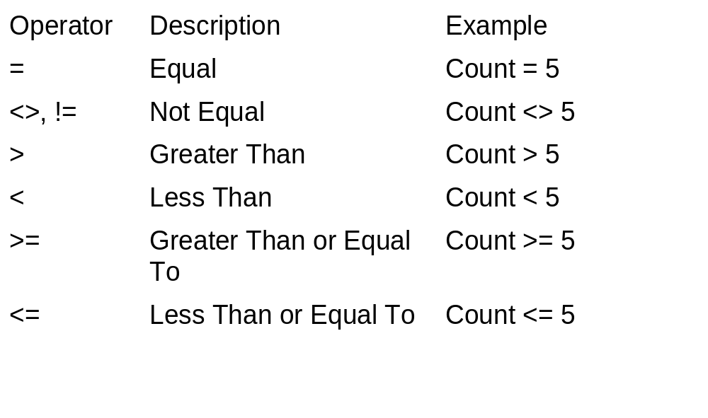
PL/SQL Comparison Operators

Slide 17
Evaluating NULL Conditions in IF/THEN Structures
If a condition evaluates as NULL, then it is FALSE
How can a condition evaluate as NULL?
  It uses a BOOLEAN variable that has not been initialized
  It uses any other variable that has not been initialized

Slide 18
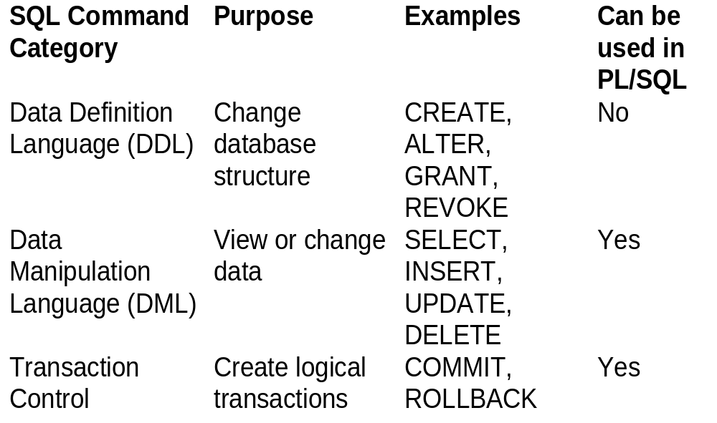
Using SQL Commands in PL/SQL Programs

Slide 19
PL/SQL Loops
Loop: repeats one or more program statements multiple times until an exit condition is reached
  Pretest loop: exit condition is tested before program statements are executed
  Posttest loop: exit condition is tested after program statements are executed

Slide 20
LOOP … EXIT Loop
LOOP … EXIT
LOOP
  program statements
  IF condition THEN
  EXIT;
  END IF;
  more program statements
END LOOP;
Pretest
OR Posttest

Slide 21
LOOP … EXIT WHEN Loop
LOOP
  program statements
  EXIT WHEN condition;
END LOOP;
Posttest

Slide 22
WHILE Loop
WHILE condition
LOOP
  program statements
END LOOP;
Pretest
WHILE … LOOP

Slide 23
Numeric FOR Loop
FOR counter_variable
IN start_value .. end_value
LOOP
program statements
END LOOP;
Preset number of iterations

Slide 24
Sequential Control
GOTO <code block name>
The entry point into such a block of code is marked by using the tags<<userdefinedname>>

Slide 25
Cursors
The oracle engine uses a work area for its internal processing in order to execute an SQL statement.This work area is private to SQLs operation
Contains information about a SQL command in a PL/SQL program
The data that is stored in the cursor is called the active data set

Slide 26
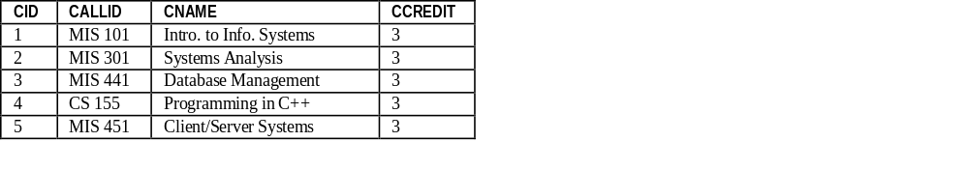
Cursors
Database Server Memory
Cursor
Number of rows processed
Parsed command
statement
context
area
active set

Slide 27
Types of Cursors
Implicit
  Opened by the oracle engine for its internal processing
Explicit
  Userdefined cursor opened on demand by the PL/SQL

Slide 28
Oracle processing of SQL statements
Reserves a private SQL area in memory
Populates this area with the data requested in the SQL statement
Processes the data in this memory as required.
Frees the memory area when the processing of data is complete

Slide 29
Implicit Cursors
Created automatically every time you use an INSERT, UPDATE, DELETE, or SELECT command
Doesn’t need to be declared
Can be used to access information about the status of last insert, delete, update or single row select statement
Can be used to assign the output of a SELECT command to one or more PL/SQL variables
Can only be used if query returns one and only one record

Slide 30
Cursor Attributes
cursorname%ROWCOUNT Rows returned so far
cursorname%FOUND One or more rows retrieved
cursorname%NOTFOUND No rows found
Cursorname%ISOPEN Is the cursor open
For implicit cursor attributes, cursor name is SQL
The value of cursor attributes always refer to the most recently executed SQL statement

Slide 31
Implicit Cursor example
Update employee set branchno=&branchno where empno=&empno;
If sql%found then
dbms_output.put_line (‘employee successfully transferred’)
endif

Slide 32
The HRD manager decides to raise the salary of employees working as ‘analyst’ by 0.15. Write a cursor to update the salary of the employees. Display appropriate message based on the existence of the record in the employee table.
Employee(empcode,empname,job,salary)
declare
rowsaff number;
begin
update employee set salary=salary + (salary*0.15)where job='analyst';
rowsaff:=SQL%rowcount;
if SQL%rowcount>0 then
dbms_output.put_line(rowsaff||'employees updated');
else
dbms_output.put_line('no employees updated');
end if;
end;

Slide 33
Explicit Cursors
  Must be declared in program DECLARE section
  Can be used to assign the output of a SELECT command to one or more PL/SQL variables
  Can be used if query returns multiple records or no records

Slide 34
Using an Explicit Cursor
Declare the cursor
Open the cursor
Fetch the data from cursor result into PL/SQL program variables
Process the data as required using loop.
Exit from loop
Close the cursor

Slide 35
Declaring an Explicit Cursor
DECLARE
CURSOR cursor_name IS SELECT_statement;
The 3 commands used to control subsequently are open, fetch and close

Slide 36
Opening an Explicit Cursor
OPEN cursor_name;
Defines a private SQL area named after the cursor name
Executes a query associated with the cursor
Retrieves table data and populates the named private SQL area in memory(active data set)
Sets the cursor row pointer in the active data set to the first record

Slide 37
Fetching Explicit Cursor Records
FETCH cursor_name INTO variable_name(s);
Moves data held in the active data set to memory variables
Placed inside a Loop…EndLoop construct
Exiting of fetch loop is user controlled.

Slide 38
Closing an Explicit Cursor
CLOSE cursor_name;
Releases the memory occupied by the cursor and its active data set.

Slide 39
Processing an Explicit Cursor
LOOP ..EXIT WHEN approach:
OPEN cursor_name;
LOOP
FETCH cursor_name INTO variable_name(s);
EXIT WHEN cursor_name%NOTFOUND:
END LOOP;
CLOSE cursor_name;

Slide 40
Processing an Explicit Cursor
Cursor FOR Loop approach:
FOR variable_name(s) in cursor_name LOOP
additional processing statements;
END LOOP;

Slide 41
Using Reference Data Types in Explicit Cursor Processing
Declaring a ROWTYPE reference variable:
DECLARE
reference_variable_name cursor_name%ROWTYPE;
Referencing a ROWTYPE reference variable:
reference_variable_name.database_field_name

Slide 42
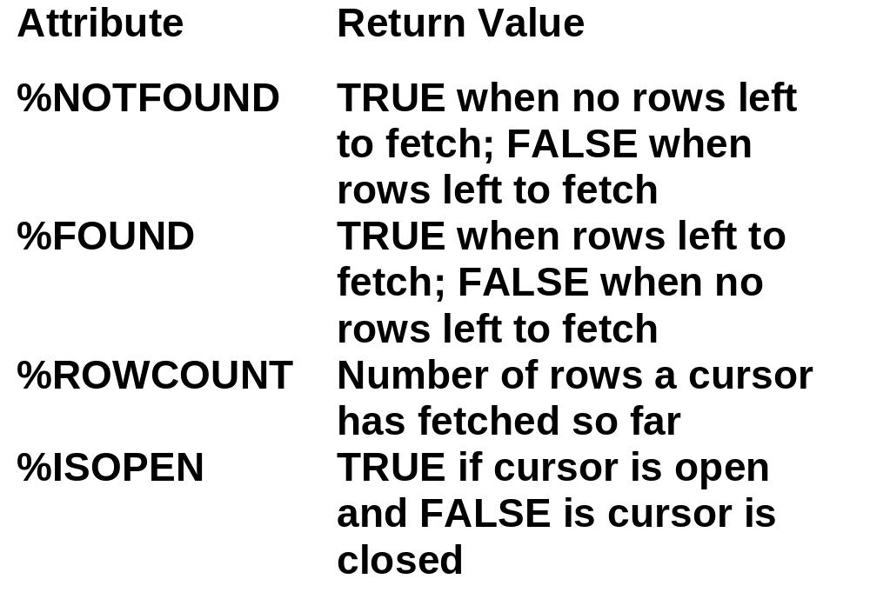
Explicit Cursor Attributes

Slide 43
Sample Cursor Program
DECLARE
CURSOR students_cursor IS
SELECT * from students;
v_student students_cursor%rowtype;
/* instead we could do v_student students%rowtype */
BEGIN
DBMS_OUTPUT.PUT_LINE ('******************');
OPEN students_cursor;
FETCH students_cursor into v_student;
WHILE students_cursor%found LOOP
DBMS_OUTPUT.PUT_LINE (v_student.last);
DBMS_OUTPUT.PUT_LINE (v_student.major);
DBMS_OUTPUT.PUT_LINE ('******************');
FETCH students_cursor into v_student;
END LOOP;
CLOSE students_cursor;
END;
/

Slide 44
Sample Cursor Program
(same program without composite variable)
DECLARE
CURSOR students_cursor IS
SELECT last, major from students;
v_Last students.last%type;
v_major students.major%type;
BEGIN
DBMS_OUTPUT.PUT_LINE ('******************');
OPEN students_cursor;
FETCH students_cursor into v_last, v_major;
WHILE students_cursor%found LOOP
DBMS_OUTPUT.PUT_LINE (v_last);
DBMS_OUTPUT.PUT_LINE (v_major);
DBMS_OUTPUT.PUT_LINE ('******************');
FETCH students_cursor into v_last, v_major;
END LOOP;
CLOSE students_cursor;
END;
/

Slide 45
Sample Cursors(Explicit)
Write an explicit cursor to display the name,department, salary of the first 5 employees getting the highest salary.
Employee(empcode,empname,job,salary)
declare
Cursor cur_emp is
select empname,salary from employee order by salary desc;
ename employee.empname%type;
sal employee.salary%type;
Begin
open cur_emp;
dbms_output.put_line('name salary');
Loop
Fetch cur_emp into ename,sal;
exit when cur_emp%rowcount=4 or cur_emp%notfound;
dbms_output.put_line(ename||' '||sal);
end loop;
close cur_emp;
end;

Slide 46
Question
  The HRD manager decides to raise the salary of employees working as ‘analyst’ by 0.15. Whenever any such raise is given to the employees, a record for the same is maintained in the emp_raise table. It includes the employee number, the date when the raise was given and actual raise.Write a PL/SQL block to update the salary of the employees and insert a record in the emp_raise table.
Emp_raise(empcode, raisedate,raise_amt)

Slide 47
PROCEDURES, FUNCTIONS & TRIGGERS
Bordoloi and Bock

Slide 48
PROCEDURES
A procedure is a module performing one or more actions; it does not need to return any values.
The syntax for creating a procedure is as follows:
    CREATE OR REPLACE PROCEDURE name
    [(parameter{IN,OUT,IN OUT}DATATYPE)[, parameter, ...])]
    AS
    [local declarations]
    BEGIN
    executable statements
    [EXCEPTION
    exception handlers]
    END [name];

Slide 49
PROCEDURES
A procedure may have 0 to many parameters.
Every procedure has two parts:
  The header portion, which comes before AS (sometimes you will see IS—they are interchangeable), keyword (this contains the procedure name and the parameter list),
  The body, which is everything after the IS keyword.
The word REPLACE is optional.
When the word REPLACE is not used in the header of the procedure, in order to change the code in the procedure, it must be dropped first and then re-created.

Slide 50
Example
CREATE OR REPLACE PROCEDURE Discount
AS
CURSOR c_group_discount
IS
SELECT distinct c.course_no,c.course_name FROM enrollment e, course c WHERE c.course_no = e.course_no
GROUP BY c.course_no,c.course_name HAVING COUNT(*) >=4;

Slide 51
Example
BEGIN
FOR r_group_discount IN c_group_discount
LOOP
UPDATE course SET cost = cost * .95 WHERE course_no = r_group_discount.course_no;
DBMS_OUTPUT.PUT_LINE('A 5% discount has been given to'||r_group_discount.course_no||' '||r_group_discount.course_name
);
END LOOP;
END;

Slide 52
Example
In order to execute a procedure in SQL*Plus use the following syntax:
EXECUTE Procedure_name
SQL> EXECUTE Discount

Slide 53
PARAMETERS
Parameters are the means to pass values to and from the calling environment to the server.
These are the values that will be processed or returned via the execution of the procedure.
There are three types of parameters:
IN, OUT, and IN OUT.

Slide 54
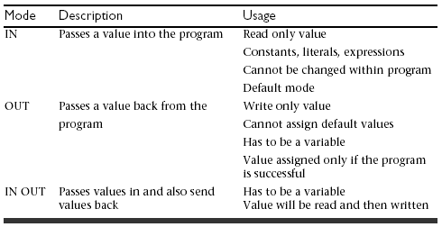
Types of Parameters

Slide 55
FORMAL AND ACTUAL PARAMETERS
Formal parameters are the names specified within parentheses as part of the header of a module.
Actual parameters are the values—expressions specified within parentheses as a parameter list—when a call is made to the module.
The formal parameter and the related actual parameter must be of the same or compatible data types.

Slide 56
MATCHING ACTUAL AND FORMAL PARAMETERS
Two methods can be used to match actual and formal parameters: positional notation and named notation.
Positional notation is simply association by position: The order of the parameters used when executing the procedure matches the order in the procedure’s header exactly.
Named notation is explicit association using the symbol =>
  Syntax: formal_parameter_name => argument_value
In named notation, the order does not matter.
If you mix notation, list positional notation before named notation.

Slide 57
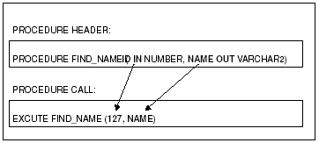
MATCHING ACTUAL AND FORMAL PARAMETERS

Slide 58
FUNCTIONS
Functions are a type of stored code and are very similar to procedures.
The significant difference is that a function is a PL/SQL block that returns a single value.
Functions can accept one, many, or no parameters, but a function must have a return clause in the executable section of the function.
The datatype of the return value must be declared in the header of the function.
A function is not a stand-alone executable in the way that a procedure is: It must be used in some context. You can think of it as a sentence fragment.
A function has output that needs to be assigned to a variable, or it can be used in a SELECT statement.

Slide 59
FUNCTIONS
The syntax for creating a function is as follows:
    CREATE [OR REPLACE] FUNCTION function_name
    (parameter list)
    RETURN datatype
    IS
    BEGIN
    <body>
    RETURN (return_value);
    END;

Slide 60
FUNCTIONS
The function does not necessarily have to have any parameters, but it must have a RETURN value declared in the header, and it must return values for all the varying possible execution streams.
The RETURN statement does not have to appear as the last line of the main execution section, and there may be more than one RETURN statement (there should be a RETURN statement for each exception).
A function may have IN, OUT, or IN OUT parameters. but you rarely see anything except IN parameters.

Slide 61
Example
    CREATE OR REPLACE FUNCTION show_description
    (i_course_no number)
    RETURN varchar2
    AS
    v_description varchar2(50);
    BEGIN
    SELECT description
    INTO v_description
    FROM course
    WHERE course_no = i_course_no;
    RETURN v_description;
    EXCEPTION
    WHEN NO_DATA_FOUND
    THEN
    RETURN('The Course is not in the database');
    WHEN OTHERS
    THEN
    RETURN('Error in running show_description');
    END;

Slide 62
Making Use Of Functions
In a anonymous block
    SET SERVEROUTPUT ON
    DECLARE
    v_description VARCHAR2(50);
    BEGIN
    v_description := show_description(&sv_cnumber);
    DBMS_OUTPUT.PUT_LINE(v_description);
    END;
In a SQL statement
    SELECT course_no, show_description(course_no) FROM course;

Slide 63
TRIGGERS
A database trigger is a stored PL/SQL program unit associated with a specific database table. ORACLE executes (fires) a database trigger automatically when a given SQL operation (like INSERT, UPDATE or DELETE) affects the table. Unlike a procedure, or a function, which must be invoked explicitly, database triggers are invoked implicitly.

Slide 64
TRIGGERS
You can associate up to 12 database triggers with a given table. A database trigger has three parts: a triggering event, an optional trigger constraint, and a trigger action.
When an event occurs, a database trigger is fired, and an predefined PL/SQL block will perform the necessary action.

Slide 65
TRIGGERS
SYNTAX:
CREATE [OR REPLACE] TRIGGER trigger_name
{BEFORE|AFTER} triggering_event ON table_name
[FOR EACH ROW]
[WHEN condition]
DECLARE
Declaration statements
BEGIN
Executable statements
EXCEPTION
Exception-handling statements
END;

Slide 66
TRIGGERS
The trigger_name references the name of the trigger.
BEFORE or AFTER specify when the trigger is fired (before or after the triggering event).
The triggering_event references a DML statement issued against the table (e.g., INSERT, DELETE, UPDATE).
The table_name is the name of the table associated with the trigger.
The clause, FOR EACH ROW, specifies a trigger is a row trigger and fires once for each modified row.
A WHEN clause specifies the condition for a trigger to be fired.
Bear in mind that if you drop a table, all the associated triggers for the table are dropped as well.

Slide 67
Classification Of Triggers
Triggers can be classified based on the following parameters.
Classification based on the timing
  BEFORE Trigger: It fires before the specified event has occurred.
  AFTER Trigger: It fires after the specified event has occurred.
  INSTEAD OF Trigger: used with complex Views
Classification based on the level
  STATEMENT level Trigger: It fires one time for the specified event statement.
  ROW level Trigger: It fires for each record that got affected in the specified event. (only for DML)
Classification based on the Event
  DML Trigger: It fires when the DML event is specified (INSERT/UPDATE/DELETE)

Slide 68
Classification based on the timing
Triggers may be called BEFORE or AFTER the following events:
  INSERT, UPDATE and DELETE.
The before/after options can be used to specify when the trigger body should be fired with respect to the triggering statement. If the user indicates a BEFORE option, then Oracle fires the trigger before executing the triggering statement. On the other hand, if an AFTER is used, Oracle fires the trigger after executing the triggering statement.

Slide 69
Classification based on the level
A trigger may be a ROW or STATEMENT type. If the statement FOR EACH ROW is present in the CREATE TRIGGER clause of a trigger, the trigger is a row trigger. A row trigger is fired for each row affected by a triggering statement.
A statement trigger, however, is fired only once for the triggering statement, regardless of the number of rows affected by the triggering statement

Slide 70
Example: statement trigger
CREATE OR REPLACE TRIGGER mytrig1 BEFORE DELETE OR INSERT OR UPDATE ON employee
BEGIN
IF (TO_CHAR(SYSDATE, 'day') IN ('sat', 'sun')) OR (TO_CHAR(SYSDATE,'hh:mi') NOT BETWEEN '08:30' AND '18:30') THEN RAISE_APPLICATION_ERROR(-20500, 'table is secured');
END IF;
END;
/
The above example shows a trigger that limits the DML actions to the employee table to weekdays from 8.30am to 6.30pm. If a user tries to insert/update/delete a row in the EMPLOYEE table, a warning message will be prompted.

Slide 71
Example: ROW Trigger
CREATE OR REPLACE TRIGGER mytrig2
AFTER DELETE OR INSERT OR UPDATE ON employee
FOR EACH ROW
BEGIN
IF DELETING THEN
INSERT INTO xemployee (emp_ssn, emp_last_name,emp_first_name, deldate)
VALUES (:old.emp_ssn, :old.emp_last_name,:old.emp_first_name, sysdate);
ELSIF INSERTING THEN
INSERT INTO nemployee (emp_ssn, emp_last_name,emp_first_name, adddate)
VALUES (:new.emp_ssn, :new.emp_last_name,:new.emp_first_name, sysdate);
ELSIF UPDATING('emp_salary') THEN
INSERT INTO cemployee (emp_ssn, oldsalary, newsalary, up_date)
VALUES (:old.emp_ssn,:old.emp_salary, :new.emp_salary, sysdate);
ELSE
INSERT INTO uemployee (emp_ssn, emp_address, up_date)
VALUES (:old.emp_ssn, :new.emp_address, sysdate);
END IF;
END;
/

Slide 72
Example: ROW Trigger
The previous trigger is used to keep track of all the transactions performed on the employee table. If any employee is deleted, a new row containing the details of this employee is stored in a table called xemployee. Similarly, if a new employee is inserted, a new row is created in another table called nemployee, and so on.
Note that we can specify the old and new values of an updated row by prefixing the column names with the :OLD and :NEW qualifiers.

Slide 73
SQL> DELETE FROM employee WHERE emp_last_name = 'Joshi';
1 row deleted.
SQL> SELECT * FROM xemployee;
EMP_SSN EMP_LAST_NAME EMP_FIRST_NAME DELDATE
------------- ----------------------- -------------------------- -----------------
999333333 Joshi Dinesh 02-MAY-03

Slide 74
ENABLING, DISABLING, DROPPING TRIGGERS
SQL>ALTER TRIGGER trigger_name DISABLE;
SQL>ALTER TABLE table_name DISABLE ALL TRIGGERS;
To enable a trigger, which is disabled, we can use the following syntax:
SQL>ALTER TABLE table_name ENABLE trigger_name;
All triggers can be enabled for a specific table by using the following command
SQL> ALTER TABLE table_name ENABLE ALL TRIGGERS;
SQL> DROP TRIGGER trigger_name

Slide 75
Questions
  Consider the table Employee. Write PL/SQL statements to create a trigger when fired checks the operation performed on a table and based on the operation, a variable is assigned the value ‘update’ or ‘delete’. Previous values of the modified record of the table Employee are stored into the appropriate variables declared and inserted to the audit table AuditEmployee.
  Write PL/SQL statements to create a trigger which generates an error messages if the salary is below or beyond the valid range 0-5000 on the employee table. The triggering events are update and insert.

