Slide 1
The Structure and Functioning of the Internet

Slide 2
Introduction to the Internet
The Internet is a global system of interconnected computer networks that communicate with one another using a common suite of protocols, primarily the Transmission Control Protocol/Internet Protocol (TCP/IP).

Slide 3
Important characteristics of the Internet
Global connectivity: Connects devices and networks across geographical boundaries.
Decentralized structure: No single computer controls the entire Internet.
Packet switching: Information is divided into packets for transmission across networks.
Standard protocols: Devices communicate using protocols such as IP, TCP, UDP, HTTP, and DNS.
Scalability: New networks and devices can be added without redesigning the entire Internet.
Heterogeneity: Different hardware, operating systems, and network technologies can communicate.
Fault tolerance: Traffic can often be rerouted when a link or router fails.
Distributed services: Applications and resources are hosted across many systems worldwide.

Slide 4
Structure of the Internet
The Internet does not consist of a single network. It is a collection of interconnected networks that cooperate to deliver data from a source to a destination.
Its structure can be understood through end systems, access networks, Internet service providers, routers, backbone networks, and data centres.

Slide 5
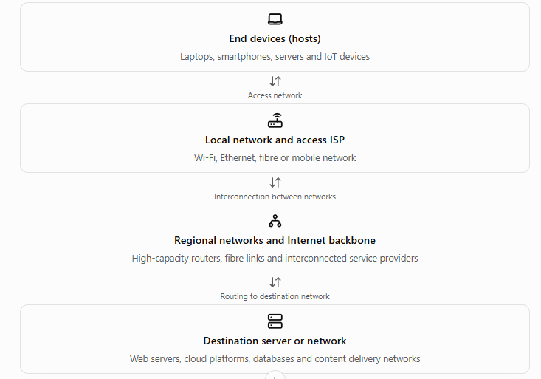
Structure of the Internet

Slide 6
Structure of the Internet
1. End systems (hosts)
An end system, also called a host, is a device that runs network applications and sends or receives data over the Internet.
Examples include:
Desktop computers and laptops.
Smartphones and tablets.
Web servers and email servers.
Cloud computing systems.
Internet-connected cameras and sensors.
Hosts are located at the edges of the network. They communicate through the underlying networking infrastructure.
Example: When a student accesses an online learning platform, the student's laptop is the client host, while the computer providing the learning website is the server host.

Slide 7
Access networks
An access network connects end devices to the first router or network that provides connectivity to the wider Internet.
Common access technologies include:

Slide 8
Access networks
Technology | Working principle | Example
Ethernet | Transfers frames over wired local network links | Desktop connected to a LAN
Wi-Fi | Uses radio waves for wireless local connectivity | Laptop connected to a wireless router
FTTH (fibre to the home) | Uses optical fibre to deliver broadband | Home fibre broadband
DSL | Uses telephone lines for digital data transmission | Traditional telephone-based broadband
Cable Internet | Uses cable television infrastructure | Cable broadband
Cellular network | Uses mobile radio access and cellular infrastructure | 4G or 5G mobile Internet
Satellite Internet | Uses satellite communication links | Internet access in remote locations

Slide 9
Internet Service Providers (ISPs)
An Internet Service Provider supplies connectivity to individuals, businesses, and other networks.
ISPs are often discussed in terms of their position and role in the Internet infrastructure.
Access ISPs: Connect homes, institutions, and businesses to the Internet.
Regional ISPs: Aggregate traffic from smaller networks and provide wider connectivity.
Transit providers: Carry traffic between networks and provide access to other parts of the Internet.
Large backbone networks: Carry substantial volumes of traffic over high-capacity links.
Content and cloud network operators: Operate networks to deliver services and content to users.
These categories describe common roles rather than a rigid hierarchy. Modern networks frequently connect directly with one another.

Slide 10
Internet backbone
The Internet backbone refers to high-capacity network infrastructure that carries large amounts of traffic between networks and geographical regions.
Its main components include:
High-speed fibre-optic links.
High-capacity routers.
Long-distance transmission systems.
Connections between major network operators.
Internet exchange points and data-centre interconnections.
The backbone supports communication between distant networks.
Example: A user in Kerala accessing a server in Europe may send packets through an access ISP, one or more intermediate networks, international links, and the destination network.
Not every packet follows the same path. Routing decisions and network conditions determine the path used.

Slide 11
Routers
A router is a network-layer device that forwards IP packets from one network to another.
Its major functions are:
Receiving an incoming packet.
Examining the destination IP address.
Consulting its forwarding table.
Selecting an appropriate outgoing interface or next hop.
Forwarding the packet toward its destination.
Routers use routing information to construct or update their forwarding tables.
Routing protocols such as OSPF and BGP help determine paths at different scopes within the Internet.

Slide 12
Servers and data centres
Servers provide network services to clients. They may host websites, databases, email systems, applications, files, and cloud resources.
Data centres contain large numbers of servers and network devices, together with supporting power, cooling, and security systems.
Modern Internet services also use Content Delivery Networks (CDNs), which distribute content across geographically dispersed servers. This can reduce latency and network congestion by serving users from a nearby location.

Slide 13
The Internet as a Network of Networks
A central idea in Tanenbaum's treatment of computer networks is that the Internet connects independently administered networks rather than functioning as one centrally managed network.
Each organization may operate its own network, use different technologies, and follow its own internal policies. Standard protocols allow these networks to communicate.

Slide 14
Autonomous Systems (AS)
An Autonomous System (AS) is a group of IP networks and routers administered under a common routing policy. In Internet routing, an AS is identified by an Autonomous System Number (ASN).
Examples include:
An Internet service provider's network.
A large university network.
A cloud service provider's network.
A large enterprise network.
An AS may contain many routers and subnets.

Slide 15
Interconnection of Autonomous Systems
Autonomous Systems exchange traffic through interconnection arrangements such as:
Peering: Two networks exchange traffic directly, often under a settlement-free or commercial agreement.
Transit: One network pays another network to carry traffic to other destinations.
Internet Exchange Points (IXPs): Facilities where multiple networks interconnect and exchange traffic.
The Border Gateway Protocol (BGP) is used to exchange reachability information between Autonomous Systems.

Slide 16
Internet Infrastructure: ISPs, IXPs, and Autonomous Systems

Slide 17
Introduction to Internet Infrastructure
The Internet infrastructure consists of the physical equipment, communication links, networking devices, organizations, and protocols that enable independent networks around the world to communicate with one another.
The Internet is not owned or operated by a single organization. Instead, it is formed by thousands of independently managed networks that cooperate through technical standards and commercial agreements.
The three important components of Internet infrastructure are:
Internet Service Providers (ISPs): Provide Internet connectivity and transport traffic between networks.
Internet Exchange Points (IXPs): Facilities where networks interconnect and exchange Internet traffic.
Autonomous Systems (ASes): Networks or groups of networks administered under a common routing policy.
These components work together to provide global connectivity.

Slide 18
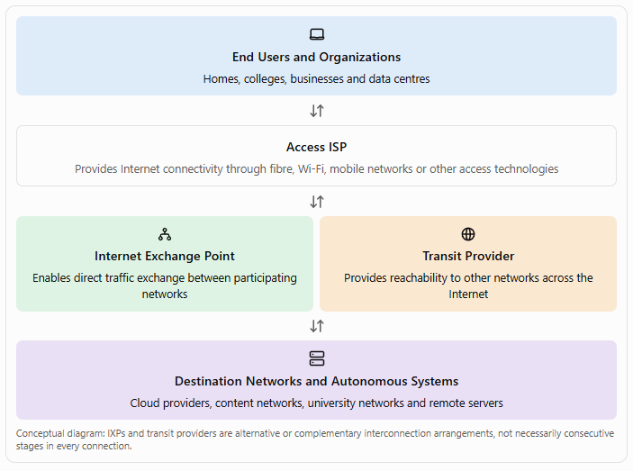
Overview of Internet Infrastructure

Slide 19
Internet Service Providers (ISPs)
An Internet Service Provider (ISP) is an organization that provides Internet connectivity to individuals, institutions, businesses, or other network operators.
An ISP connects customer networks to its own network and provides routes to destinations elsewhere on the Internet.
Examples of ISP services include:
Residential broadband connectivity.
Business Internet connections.
Mobile Internet access.
Dedicated leased-line connectivity.
IP transit for other network operators.
Managed networking and security services.

Slide 20
How does an ISP work?
An ISP establishes network connectivity between its customers and the wider Internet.
The general process is as follows:
Customer connection: A customer connects through fibre, Ethernet, Wi-Fi, cellular technology, or another access technology.
Access network: The ISP's access equipment receives and forwards the customer's traffic.
IP configuration: The customer's device or router obtains appropriate IP configuration, often using DHCP.
Routing: The ISP forwards packets toward the destination using its forwarding tables.
External connectivity: The ISP exchanges traffic with other networks through peering, transit, or other arrangements.
Destination delivery: Traffic reaches the network hosting the required server.
Return traffic: Response packets travel back to the customer, potentially along a different route.

Slide 21
ISP hierarchy: a simplified model
Traditional introductory networking material often explains Internet connectivity using a hierarchy of ISPs.
Tier 3: Commonly used informally for access-oriented providers that purchase upstream connectivity.
Tier 2: Commonly used for networks that combine peering with purchased transit.
Tier 1: Commonly used for large networks that can reach the entire global Internet through settlement-free peering with other Tier 1 networks, without purchasing IP transit.
These terms are industry conventions rather than a formal universal classification defined by the Internet Protocol.

Slide 22
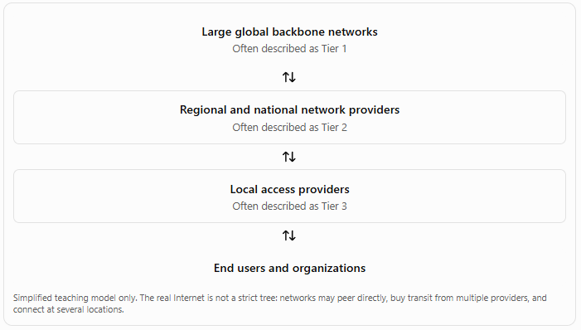
ISP hierarchy: a simplified model
A simplified arrangement is:

Slide 23
Important functions of an ISP
Function | Description
Internet access | Connects customer devices and networks to the Internet
IP address allocation | Assigns or delegates addresses to customers
Routing | Forwards packets and maintains routing information
DNS services | May provide DNS resolvers to customers
Traffic management | Manages capacity, congestion and network performance
Network security | May provide filtering, anti-DDoS protection and other safeguards
Customer support | Handles service configuration, faults and billing
Interconnection | Connects with other networks through peering and transit

Slide 24
Internet Exchange Points (IXPs)
An Internet Exchange Point (IXP) is a physical infrastructure through which multiple independent networks exchange Internet traffic.
An IXP usually provides a shared switching fabric, commonly implemented using Ethernet switches, along with facilities for participating networks to establish interconnections.
An IXP enables networks such as ISPs, content delivery networks, cloud providers, and enterprise networks to exchange traffic directly rather than sending all traffic through an upstream transit provider.
An IXP is not generally the organization that carries every packet between the participating networks. Instead, it supplies the interconnection infrastructure that allows those networks to exchange traffic.

Slide 25
Why are IXPs needed?
Without convenient local interconnection, two networks in the same region might have to send traffic through a distant upstream provider or international route.
An IXP can enable local traffic to remain local, depending on the networks' interconnection arrangements.
The major reasons for establishing IXPs are:
To reduce the cost of exchanging traffic.
To reduce unnecessary dependence on upstream transit providers.
To improve latency for locally exchanged traffic.
To increase the efficiency of network resource utilization.
To improve connectivity between participating networks.
To support a stronger local Internet ecosystem.

Slide 26
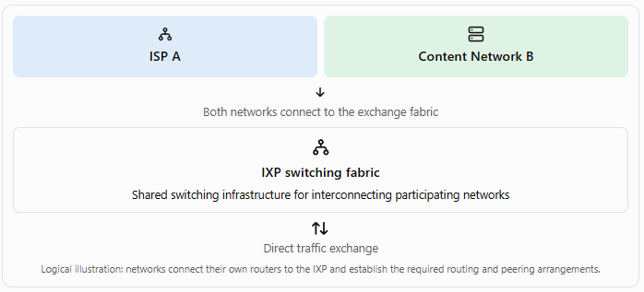
How does an IXP work?

Slide 27
How does an IXP work?
The process works as follows:
ISP A and Content Network B connect their routers to the IXP.
Each network establishes an appropriate interconnection with the other network, commonly using BGP.
The networks exchange routing information for the agreed prefixes.
When ISP A needs to deliver traffic to a destination reachable through Network B, it can use the direct interconnection.
The IXP switching fabric carries the frames between the participating networks.
Network B forwards the traffic toward the destination.
The direct path may avoid one or more intermediate transit networks.

Slide 28
Main components of an IXP
1. Switching fabric
  The switching fabric is the shared Layer 2 infrastructure through which connected networks exchange Ethernet frames.
2. Member ports
  Each participating network connects its router to a port provided by the exchange.
3. BGP sessions
  Border Gateway Protocol sessions allow participating networks to exchange route information. These sessions may be established directly between networks or through a route server.
4. Route server
  An optional route server simplifies the exchange of routing information among multiple participants. It distributes routes but is generally not in the data path for the actual traffic exchanged between participants.
5. Colocation facilities
  Many IXPs operate within data centres or other suitable facilities that provide space, power, cooling, and network connectivity.
6. Monitoring and operational systems
  IXPs may provide traffic statistics, port monitoring, route information, and operational support.

Slide 29
Autonomous Systems (AS)
An Autonomous System (AS) is a collection of IP networks and routers administered by one organization or under a common routing policy.
An AS may belong to an ISP, university, large enterprise, cloud provider, or content delivery network.
Each publicly identified Autonomous System is associated with an Autonomous System Number (ASN), which is used in inter-domain routing, especially with BGP.

Slide 30
Autonomous Systems (AS)
An AS may contain:
Multiple IP subnets.
Many routers.
Several data centres.
Connections to different ISPs.
Multiple Internet exchange connections.
Internal routing protocols.
An AS is a logical routing and administrative entity; it is not necessarily a single physical network or one building.

Slide 31
Why are Autonomous Systems necessary?
The Internet contains a very large number of networks. Maintaining a single, globally coordinated routing system for every individual internal network would be impractical.
Autonomous Systems help organize routing into manageable administrative domains.
They allow each organization to:
Manage its own internal network.
Use internal routing protocols.
Establish external connections to other ASes.
Advertise reachable IP prefixes to other networks.
Apply its own routing policies.
Participate in global inter-domain routing.

Slide 32
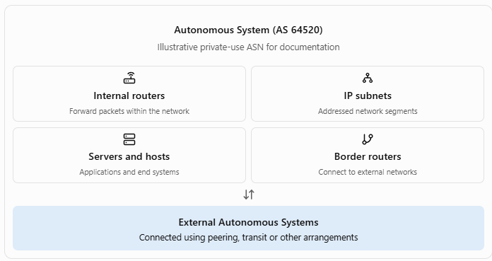
Structure of an Autonomous System

Slide 33
Types of Autonomous Systems
A useful introductory classification is based on how an AS connects to other networks.
1. Stub AS
A stub AS connects to one or more external networks but does not normally provide transit between unrelated external ASes.
Example: A university network that obtains Internet connectivity from an ISP and does not carry third-party traffic between other providers.
2. Multihomed AS
A multihomed AS connects to two or more external networks, often to improve resilience, performance, or routing flexibility.
Example: A large company connected to two different ISPs.
Multihoming does not automatically mean the AS provides transit traffic for other networks.
3. Transit AS
A transit AS carries traffic between other networks as part of its service or routing role.
Example: An ISP that transports traffic from customer networks to other Internet destinations.
These categories describe common roles rather than an exhaustive or mutually exclusive classification.

Slide 34
Internal and external routing
Routing within and between Autonomous Systems is handled differently.
Interior Gateway Protocol (IGP)
An IGP is used for routing within an AS.
Examples:
    RIP.
    OSPF.
    IS-IS.

Slide 35
Internal and external routing
Exterior Gateway Protocol (EGP)
An exterior routing protocol exchanges reachability information between Autonomous Systems.
In today's global Internet, the principal inter-domain routing protocol is BGP.

Slide 36
Cloud Computing and Content Delivery Networks (CDNs)

Slide 37
Introduction
Modern Internet services require computing resources, storage facilities, and efficient methods of delivering data to users around the world. Two important technologies that support these requirements are Cloud Computing and Content Delivery Networks (CDNs).
Cloud computing provides computing resources such as servers, storage, databases, networking, and software over a network. CDNs distribute copies of content across geographically distributed servers so that users can access content from a suitable nearby location.

Slide 38
Introduction
Although these technologies serve different purposes, they often work together to provide fast, scalable, and reliable Internet services.
  Cloud computing: Provides computing and storage resources on demand.
  CDN: Distributes content efficiently to users across different geographical locations.
For example, an online learning platform may use cloud computing to host its application and database, while a CDN delivers videos, images, CSS files, and JavaScript files to students.

Slide 39
Cloud Computing
Cloud computing is a model for providing convenient, on-demand network access to a shared pool of configurable computing resources, such as servers, storage, networks, applications, and services, that can be rapidly provisioned and released with minimal management effort.
Instead of purchasing and maintaining all the necessary hardware locally, an organization can rent computing resources from a cloud provider and access them over the Internet or a private network.
Examples of cloud platforms include Amazon Web Services (AWS), Microsoft Azure and Google Cloud.

Slide 40
Characteristics of Cloud Computing
The following characteristics are commonly associated with cloud computing.
On-demand self-service
  Users can provision computing resources when required without needing direct manual intervention from the provider for every request.
  Example: A developer creates a virtual machine through a cloud management portal.
Broad network access
  Cloud services can be accessed through standard network mechanisms using devices such as laptops, smartphones, and tablets.
  Example: A lecturer accesses lecture materials stored in cloud storage from a college computer or a mobile phone.
Resource pooling
  Cloud providers pool computing resources to serve multiple customers. Resources may be allocated dynamically according to demand.
  This is often supported by virtualization and multi-tenant infrastructure.
  Example: A cloud data centre hosts virtual machines belonging to several different organizations on shared physical hardware while keeping their workloads logically isolated.

Slide 41
Characteristics of Cloud Computing
Rapid elasticity
  Cloud resources can be increased or decreased according to workload requirements.
  Example: An online examination platform temporarily adds computing capacity when thousands of students log in simultaneously.
Measured service
  Cloud usage can be monitored and measured, allowing providers to bill customers according to factors such as computing time, storage consumption, network transfer, or service requests.
  Example: A cloud storage service charges according to the amount of data stored and other applicable usage charges.

Slide 42
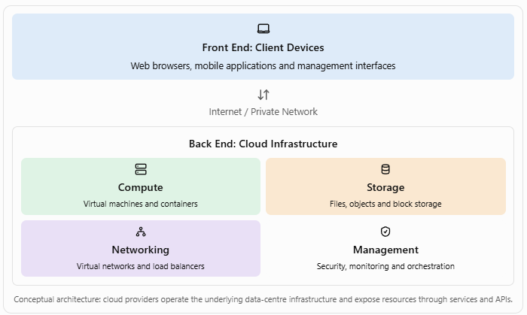
Architecture of Cloud Computing

Slide 43
Front end
The front end is the part through which users interact with cloud services.
It includes:
Client devices.
Web browsers.
Mobile applications.
User interfaces and dashboards.
Client-side software.

Slide 44
Back end
The back end contains the infrastructure and software that provide cloud services.
It includes:
Physical servers.
Virtual machines and containers.
Storage systems.
Databases.
Networking equipment.
Virtualization software.
Resource management and monitoring systems.
Security and access-control mechanisms.

Slide 45
Internet or network connection
The client communicates with the cloud infrastructure through a network connection.
Depending on the service, this connection may use HTTPS, APIs, secure tunnels, or private connectivity.
The network carries requests to the cloud service and returns the results to the client.

Slide 46
Service Models of Cloud Computing
Infrastructure as a Service (IaaS)
IaaS provides fundamental computing infrastructure, including virtual machines, storage, and virtual networking.
The customer typically manages the operating system, installed applications, and much of the application-level security configuration.
Examples: AWS EC2, Azure Virtual Machines, Google Compute Engine.
Use case: A college deploys its own web server on a cloud virtual machine.

Slide 47
Service Models of Cloud Computing
Platform as a Service (PaaS)
PaaS provides a managed environment for developing, deploying, and running applications without requiring the customer to manage most of the underlying server infrastructure.
The provider manages much of the runtime and platform maintenance.
Examples: Google App Engine, Azure App Service, Heroku.
Use case: A developer deploys a Django application without manually configuring and maintaining the underlying operating system.

Slide 48
Service Models of Cloud Computing
Software as a Service (SaaS)
SaaS delivers a complete application over a network. Users generally access it through a web browser or client application.
The provider manages the application and the underlying infrastructure.
Examples: Google Workspace, Microsoft 365, Salesforce.
Use case: Students use a browser-based learning or collaboration application without installing and maintaining its server software.

Slide 49
Deployment Models of Cloud Computing
Public cloud
A public cloud is provided by a cloud service provider for use by multiple customers.
Characteristics:
Infrastructure is operated by the provider.
Resources are accessed through networks.
Customers share the provider's underlying infrastructure through logical isolation.
Capacity can be provisioned as needed.
Examples: AWS, Microsoft Azure and Google Cloud.
Advantages: Rapid provisioning, broad service availability, and reduced need to operate physical infrastructure.
Limitations: Dependence on provider services, potential data-location concerns, and usage costs that require monitoring.

Slide 50
Deployment Models of Cloud Computing
Private cloud
A private cloud is dedicated to a single organization. It may be operated by that organization or by a third party.
Characteristics:
Resources are dedicated to one organization.
Greater control over configuration may be possible.
Security and governance can be tailored to organizational requirements.
Operating and maintaining the infrastructure may require significant expertise.
Example: A university operates a private cloud for research computing and internal administrative applications.

Slide 51
Deployment Models of Cloud Computing
Hybrid cloud
A hybrid cloud combines distinct cloud environments, such as a private cloud and a public cloud, with technology that enables data or applications to move between them.
Example: A hospital keeps certain sensitive systems in its private environment but uses public cloud resources for selected workloads.
Advantages include flexibility and the ability to place workloads in suitable environments. However, hybrid cloud management can introduce integration and security complexity.

Slide 52
Deployment Models of Cloud Computing
Community cloud
A community cloud is designed for use by organizations that share particular requirements, such as security policies, compliance obligations, or a common mission.
Example: Several research institutions share a cloud environment designed for their common research and governance needs.

Slide 53
Content Delivery Networks (CDNs)
A Content Delivery Network (CDN) is a geographically distributed system of servers and network infrastructure designed to deliver web content and other digital resources efficiently to users.
Instead of every user obtaining every resource directly from a single origin server, a CDN can cache copies of eligible content at multiple edge locations.
When a user requests content, the CDN attempts to serve it from an appropriate edge location. If the content is not cached or cannot be served from that location, the CDN may retrieve it from the origin server or another upstream cache.

Slide 54
Content Delivery Networks (CDNs)
CDNs commonly deliver:
Images and graphics.
CSS and JavaScript files.
Videos and audio.
Software downloads.
Web fonts.
Cacheable API responses.
Other static or dynamically generated content, depending on configuration.
Examples of CDN providers include Cloudflare, Akamai and Amazon CloudFront.

Slide 55
Why are CDNs needed?
Consider a website hosted on a server in Europe that is accessed by users in India, Australia, and North America.
If all users obtain large images and video files directly from the European server, the requests and responses may travel over long network paths. This can increase latency and place significant load on the origin server.
A CDN distributes cached copies of eligible resources to edge locations closer to users.

Slide 56
Why are CDNs needed?
The benefits may include:
Faster content delivery.
Lower load on the origin server.
Reduced bandwidth requirements on origin infrastructure.
Better handling of sudden traffic increases.
Improved availability through distributed delivery.
Additional security capabilities, depending on the CDN service.

Slide 57
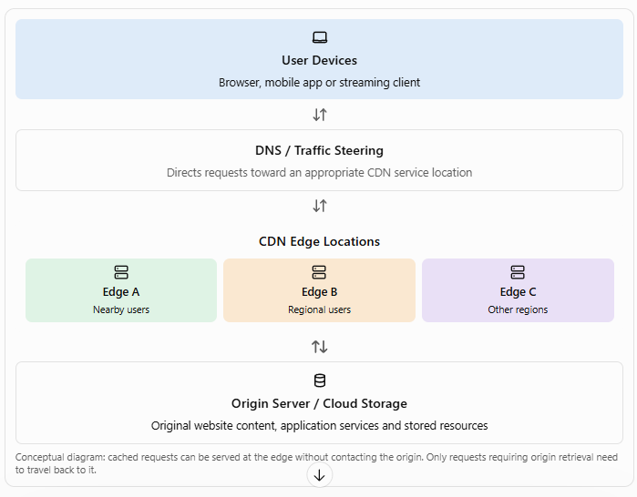
Architecture of a CDN

Slide 58
Origin server
The origin server contains the original version of the website's content or application resources.
It may host:
Website files.
Images and videos.
Application-generated content.
Downloadable documents.
API endpoints.
Data retrieved from a database or storage system.
The CDN retrieves content from the origin when needed and caches it according to the configured rules.

Slide 59
Edge servers
Edge servers are deployed at distributed locations to serve users from network locations that may be closer or more efficient to reach.
Their functions include:
Caching frequently requested content.
Responding to requests from nearby users.
Reducing repeated requests to the origin.
Applying supported security and traffic-management rules.
Delivering content over optimized network paths.

Slide 60
Point of Presence (PoP)
A Point of Presence (PoP) is a physical or network location where a CDN or network provider places equipment and establishes connectivity.
A CDN may operate many PoPs in different cities and regions. A PoP can contain multiple servers and network devices.
The nearest PoP geographically is not always the one selected for a request; network routing, availability, load, and traffic-steering policies can influence the selection.

Slide 61
Caching system
Caching temporarily stores copies of content so that repeated requests can be served without retrieving the same resource from the origin every time.
Caching behavior depends on:
Cache-control headers.
Time-to-live (TTL) values.
Resource type.
Cache keys.
Invalidation and purge rules.
Authentication and request parameters.
Provider-specific configuration.

Slide 62
Traffic steering
Traffic steering directs user requests to an appropriate CDN location.
Methods may include DNS-based routing, anycast routing, application-layer routing, and provider-specific traffic-management mechanisms.
The objective is to choose a suitable delivery path based on factors such as network reachability, load, performance, and availability.

Slide 63
How a CDN Works
Suppose a student opens an online course website and requests a lecture video.
The video is hosted on an origin server, while the CDN maintains edge servers in multiple locations.
The user requests content.
  The browser requests the lecture video through its URL.
The request reaches the CDN.
  DNS or another traffic-steering mechanism directs the request toward a suitable CDN service location.
The edge server checks its cache.
  The CDN determines whether the requested video segment is available and eligible to be served from the edge cache.

Slide 64
How a CDN Works
Cache hit or cache miss occurs.
  A cache hit means the edge server has a usable copy. A cache miss means the requested content is not available in the required cached form.
The CDN obtains content if necessary.
  If the request cannot be served from the cache, the CDN may retrieve the content from the origin or an upstream cache, subject to its configuration.
The content is delivered to the user.
  The edge server sends the requested content to the client and may retain a copy for later requests.

Slide 65
Types of Content Delivered by CDNs
Static content
Static content is stored as files and does not normally require a new application computation for every request.
Examples:
Images.
CSS files.
JavaScript files.
Fonts.
Public downloadable documents.
Static content is usually well suited to caching when appropriate freshness rules are configured.

Slide 66
Types of Content Delivered by CDNs
Dynamic content
Dynamic content is generated or customized according to a request, user, or current application state.
Examples:
Personalized dashboards.
Account balances.
Shopping cart details.
Frequently changing API responses.
CDNs may accelerate dynamic content through optimized routing, connection reuse, compression, TLS termination, or caching selected responses where safe and appropriate.
Dynamic content is not always cacheable. Personalized or sensitive responses must be handled according to suitable access-control and caching policies.

Slide 67
Types of Content Delivered by CDNs
Streaming media
CDNs are widely used for audio and video delivery.
Video platforms often divide media into small segments. The player requests successive segments as playback continues, and CDN edge locations deliver these segments.
This approach can support adaptive bitrate streaming, where the player selects a suitable video quality according to network conditions.

Slide 68
Types of CDN Delivery Architectures
CDN providers use different delivery models depending on the service and the type of content.
Pull CDN
In a pull CDN, an edge server obtains content from the origin when the content is first requested and not already cached.
Subsequent requests may be served from the cache until the resource expires or is invalidated.
Example: The first request for a public image triggers an origin fetch. Later requests may be served directly from the edge cache.

Slide 69
Types of CDN Delivery Architectures
CDN providers use different delivery models depending on the service and the type of content.
Push CDN
In a push CDN, content is uploaded or distributed to the CDN infrastructure before users request it.
This approach is useful when content owners want more control over what is distributed and when.
Example: A media organization distributes a large video file to CDN storage before announcing its release.

Slide 70
Advantages of Content Delivery Networks
Reduced latency
Serving content from a suitable edge location can reduce the network distance and response time.
Reduced origin load
Cached resources do not need to be retrieved from the origin for every request.
Improved scalability
Distributed edge servers can handle large numbers of requests for popular content.
Better availability
Distributed infrastructure may continue serving cached resources even when some components or routes experience problems, depending on the provider's architecture.

Slide 71
Advantages of Content Delivery Networks
Bandwidth efficiency
Caching can reduce repeated transfers from the origin server and its network connection.
Improved security capabilities
Some CDN services provide features such as:
Distributed Denial-of-Service (DDoS) mitigation.
Web Application Firewall (WAF) rules.
TLS certificate management.
Bot detection and rate limiting.
Traffic filtering.
These features depend on the service plan and configuration. A CDN is not a complete replacement for securing the origin server and application.
Better media delivery
CDNs can efficiently distribute large files and video segments to users in different regions.

