Slide 1


ST&P
Stock Tracker And Predictor
Abhishek Gupta
Dheeraj Rajput
Manish Vardhan
Palpal Kerai
Hasib Khan

Slide 2



Problem Statement
The project aims to develop an LSTM-based machine-learning solution for stock market prediction and tracking. The platform will provide investors with real-time market updates and a user-friendly, intuitive platform to track the performance of stocks and predict future stock prices to inform investment decisions.

Slide 3
Goals & Strategy
The goal of the stock market prediction project is to predict the future stock prices of various companies accurately. The project uses LSTM (Long Short-Term Memory) model in machine learning for the prediction.
The strategy of the project is to gather historical stock price data of the companies, train the LSTM model on this data, and then use the model to predict future stock prices. The project also includes a dashboard that displays the predicted prices along with news related to the company and other relevant information.

Slide 4
Introduction
This project aims to predict stock market trends using an LSTM model and display the data on a dashboard with features such as news, Nifty50 data, and contact information. The project aims to provide users with valuable insights into the stock market.
Its strategy involves using machine learning to
analyze past data and provide accurate predictions for future trends.

Slide 5






Tech Stack

Slide 6
Implementation
Register
Stock Data
Admin
Using Email & Password
Firebase as authenticator
API call to get
Real-time Data from NSE India for Nifty 50
Manage User
Managing API
Tweaking Model for better result.
Login
Predictor
Using Email and Password to get Various services offered by ST&P
Data fed into
LSTM ML model to get forecast for upcoming days
Charts and Notification implemented for Nifty 50 Companies

Slide 7
Use Case Diagram
Admin
Collect Data
User
Train the System using the collected data
Save trained model
View trade exchange
Companies Stock
View predicted outcome

Slide 8
Data Flow Diagram
Level 0:
Query Result
DB
Stock Tracker and Predictor
User
Query

Slide 9
Data Flow Diagram
Level 1:
Pre-processed
Data
Training
Data
Record
DB
Data Pre-processing
Data preparation
Model Training
Prepared
Model
User
Query
Pre-processed
Saved Model
Data Pre-processing
Query
Query Result

Slide 10

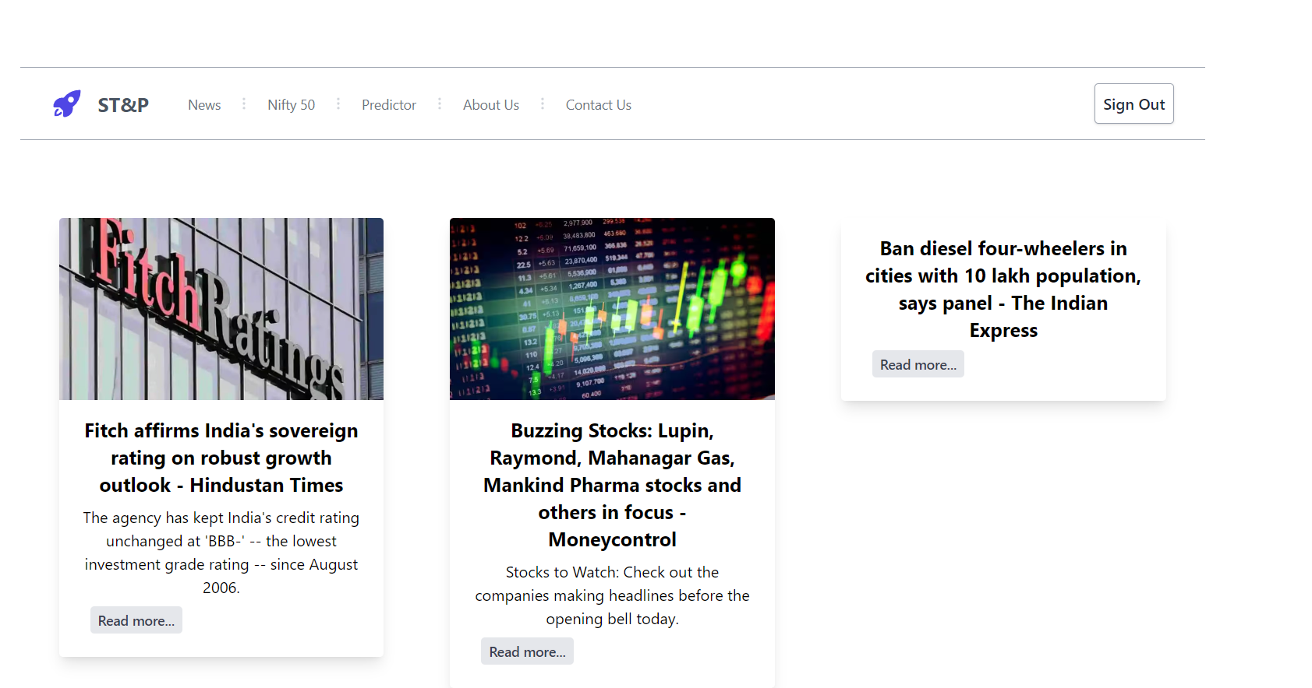

Front-end
Login Page
News Page

Slide 11
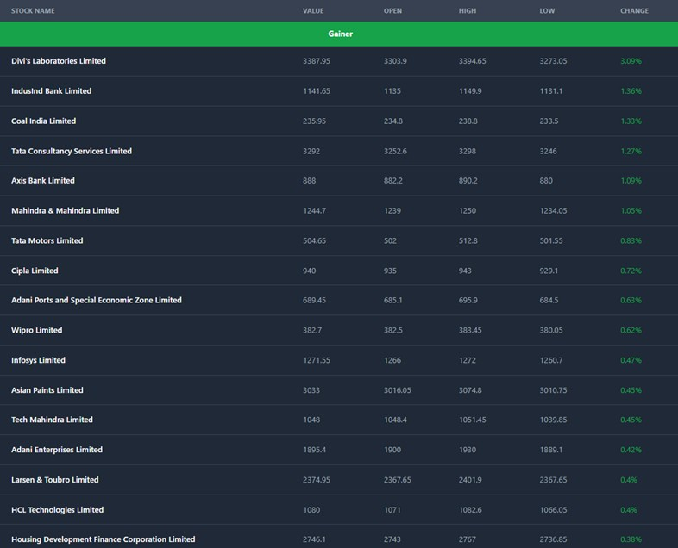
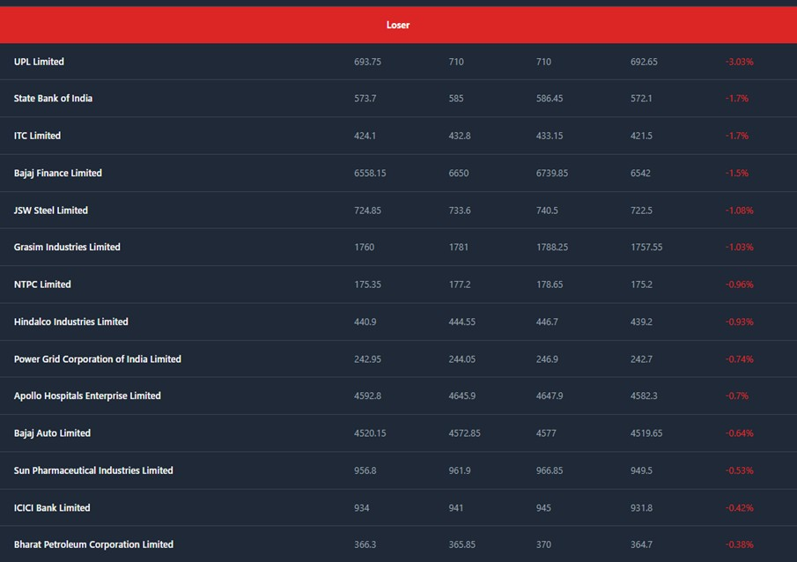
Front-end
Gainer:
Loser:

Slide 12
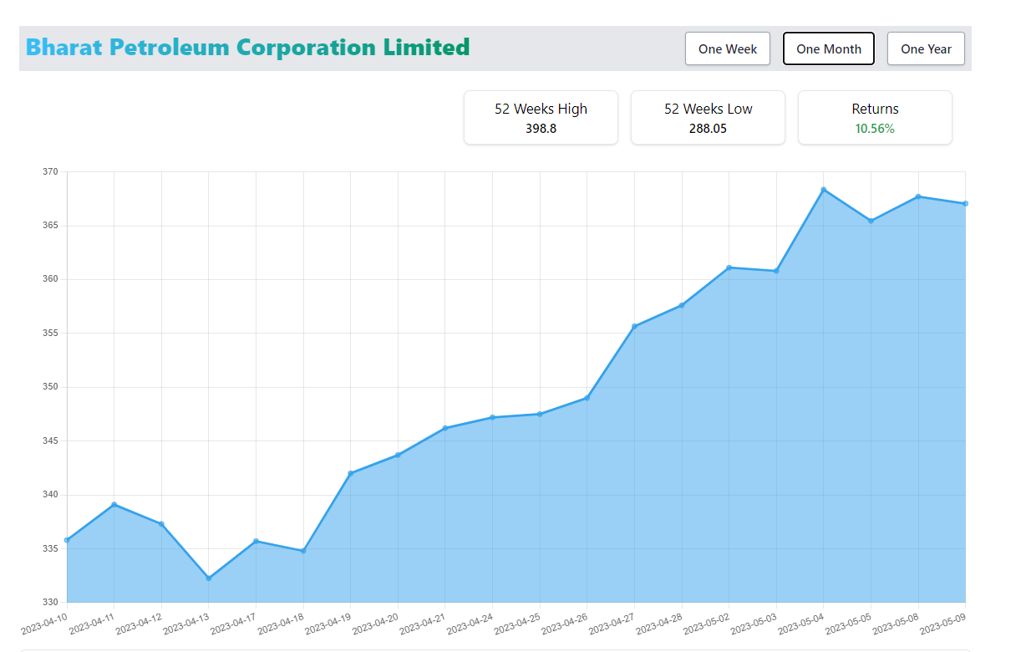
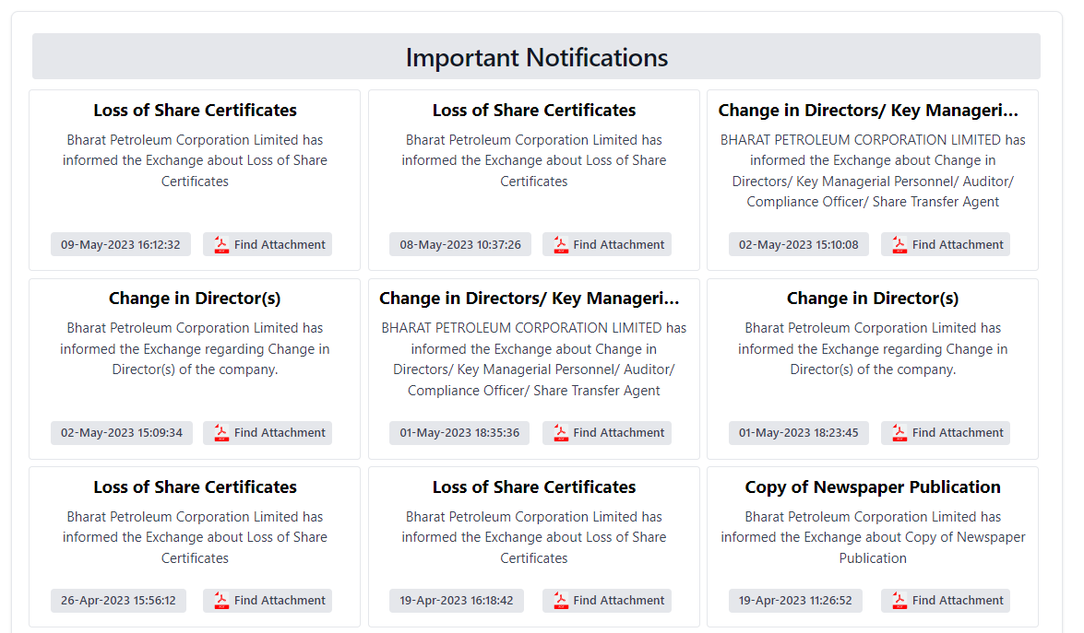
Front-end
Stock Chart
Notification Page

Slide 13

Machine Learning
Machine learning techniques can be applied to stock market prediction and tracking to help investors make informed decisions about buying and selling stocks. Machine learning algorithms can analyze large volumes of financial data and identify patterns and relationships that can be used to make predictions about future stock prices.
Models Used in the ML:-
Regression models
Classification models
Clustering models
Neural Network models

Slide 14
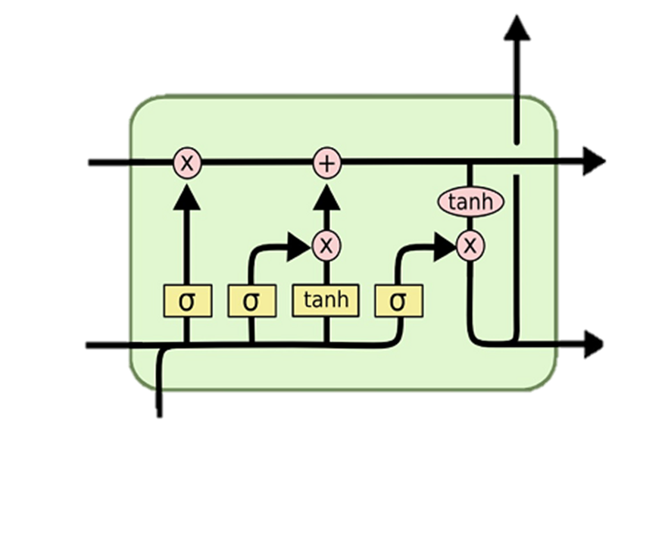
LSTM
LSTM stands for Long Short-Term Memory, it's a type of recurrent neural network (RNN) architecture that is designed to handle long-term dependencies and avoid the vanishing gradient problem often encountered in traditional RNNs. It is commonly used for sequence prediction tasks such as natural language processing and time-series forecasting.

Slide 15
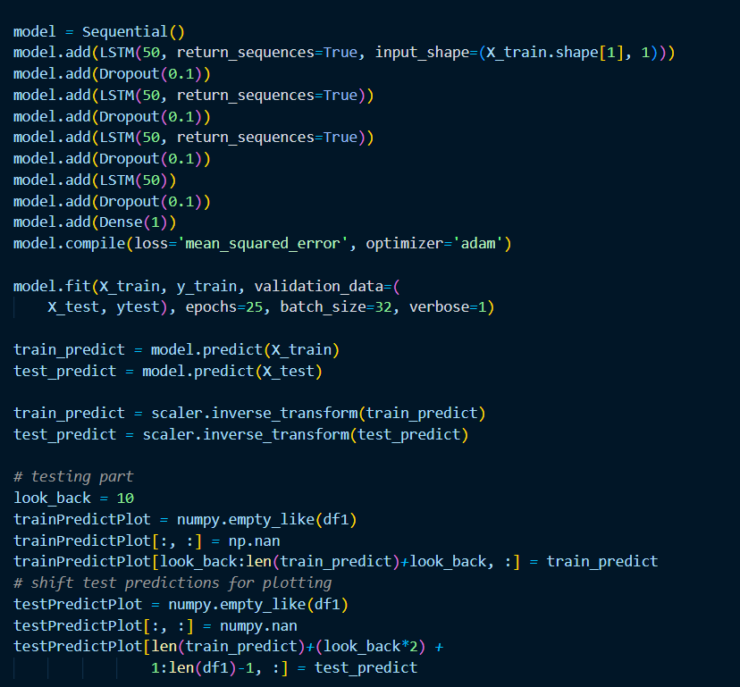
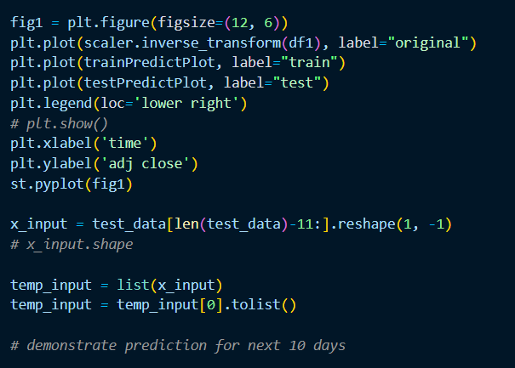
Model

Slide 16
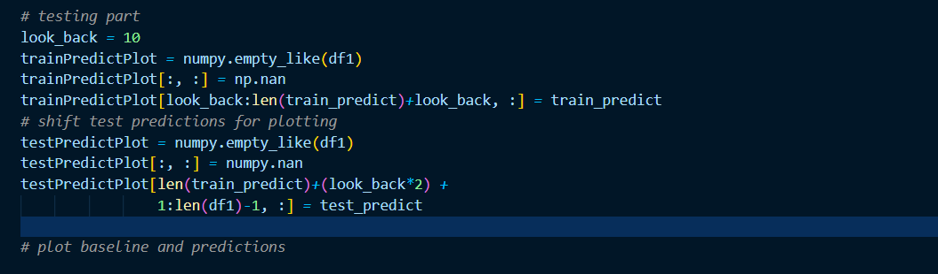
LSTM Model Testing
Testing an LSTM model involves evaluating its performance on a set of test data that the model has not seen during training. Here are the steps typically involved in testing an LSTM model:
Prepare test data Preprocess test data Evaluate the model Fine-tune the model. Repeat the process.

Slide 17
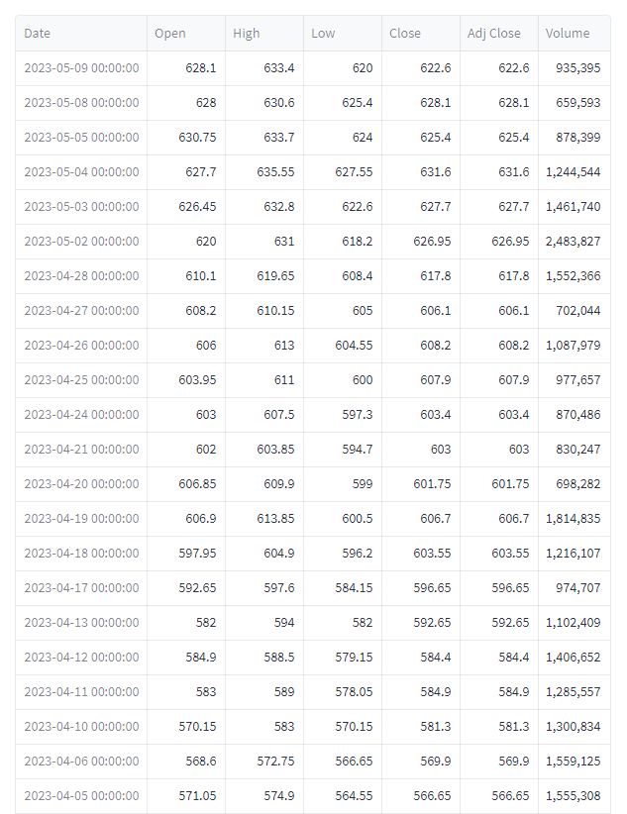
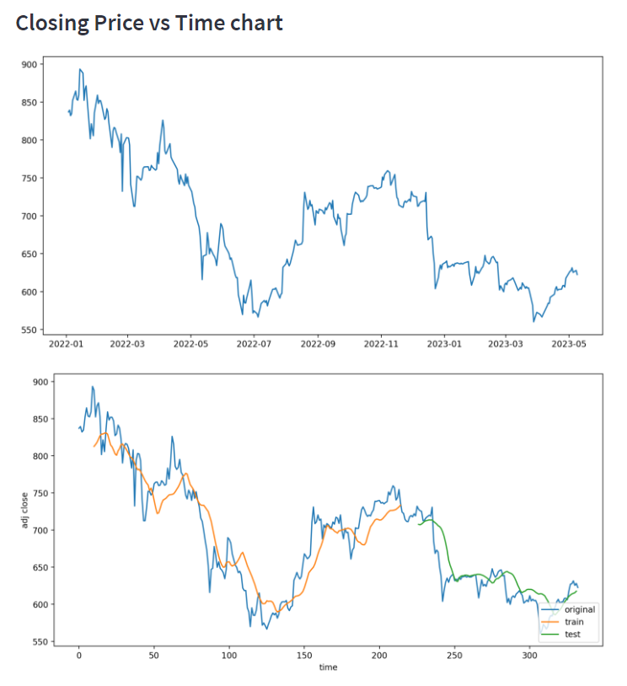
Predicted Graph

Slide 18
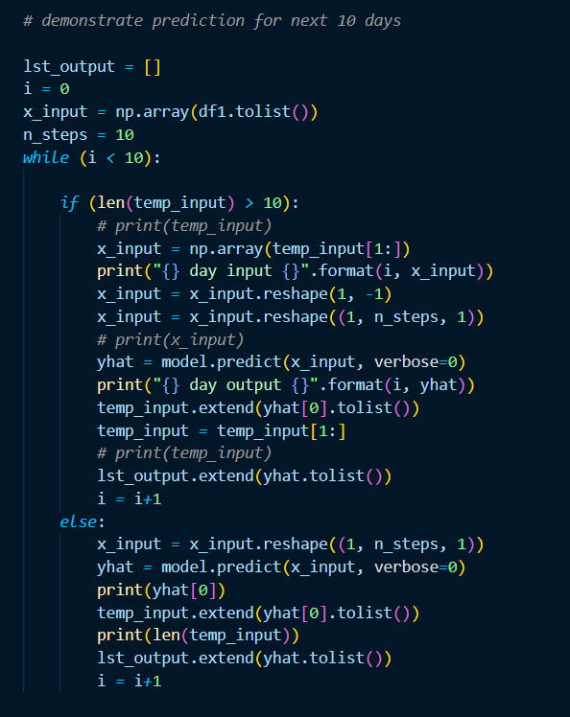
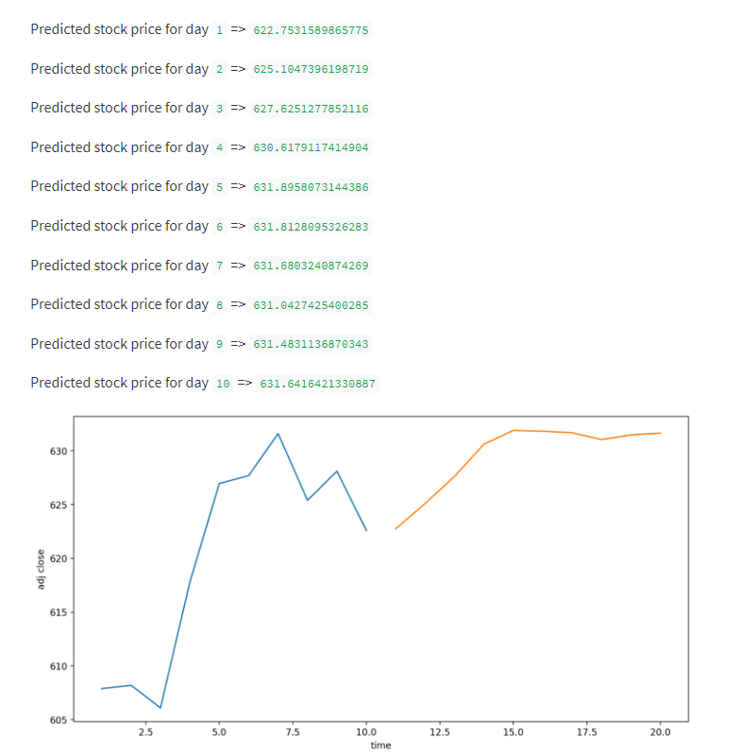
Prediction

Slide 19
Future Scope
Integration with other applications for more data sources
Integration of Twitter News with Sentimental Analysis
Development of a mobile application
Deployment on the cloud and collaboration with financial experts

Slide 20

Conclusion
The application uses historical stock data to train an LSTM model.
The trained model is used to predict the stock prices for the next 10 days. Various visualizations are provided to help users understand stock trends.
The application can be a useful tool for making informed investment decisions.
Predictions made by the model may not always be accurate and should be used as one of many factors when making investment decisions

Slide 21
References
[1] “React” [Online]. Available: https://reactjs.org/
[2] “Node.js” [Online]. Available: https://nodejs.org/
[3] “Express.js” [Online]. Available: https://expressjs.com/
[4] “Vite” [Online]. Available: https://vitejs.dev/
[5] “Firebase” [Online]. Available: https://firebase.google.com/docs/
[6] “Tailwind CSS” [Online]. Available: - https://tailwindcss.com/docs/
[7] “Python” [Online]. Available: https://www.python.org/

Slide 22
Thank You

