Slide 1

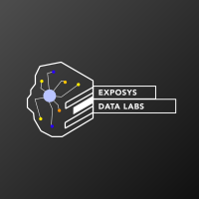
CUSTOMER SEGMENTATION
By- Abhinav Singh

Slide 2
INTRODUCTION
The purpose of this project was to implement customer segmentation on a mall customer dataset and visualize the gender and age distributions. Then analyze their annual incomes and spending scores, this was achieved using various libraries in python to manipulate, visualize data and later the K-means clustering algorithm was used to build the model for segmentation.
Malls or shopping complexes are often indulged in the race to increase their customers and hence making huge profits. To achieve this task machine learning is being applied by many stores already.

Slide 3
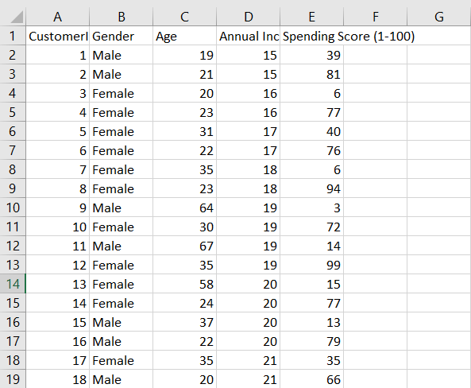
CUSTOMER SEGMENTATION DATA
Companies employing customer segmentation operate under the fact that every customer is different and that their marketing efforts would be better served if they target specific, smaller groups with messages that those consumers would find relevant and lead them to buy something. Companies also hope to gain a deeper understanding of their customers' preferences and needs with the idea of discovering what each segment finds most valuable to more accurately tailor marketing materials toward that segment.
1. CustomerID: It is the unique ID given to a customer
2. Gender: Gender of the customer
3. Age: The age of the customer
4. Annual Income (k$): It is the annual income of the customer
5. Spending Score: It is the score (out of 100) given to a customer by the mall authorities, based on the money spent and the behavior of the customer.

Slide 4

TOOLS AND TECHNOLOGIES USED
The project was implemented on Jupyter notebook using python 3.
The various libraries used were:
Numpy
Pandas
Matplotlib
Seaborn
Scikit-learn

Slide 5
K-MEANS ALGORITHM
K means clustering is one of the most popular clustering algorithms and usually the first thing practitioners apply when solving clustering tasks to get an idea of the structure of the dataset. The goal of K means is to group data points into distinct non-overlapping subgroups.
The approach K-means follows to solve the problem is called Expectation Maximization:
1. Specify number of clusters K.
2. Initialize centroids by first shuffling the dataset and then randomly selecting K data points for the centroids without replacement.

Slide 6
3. Keep iterating until there is no change to the centroids. i.e assignment of data points to clusters isn’t changing.
4. Compute the sum of the squared distance between data points and all centroids.
5. Assign each data point to the closest cluster (centroid).
6. Compute the centroids for the clusters by taking the average of the all data points that belong to each cluster.
Stopping Criteria for K-Means Clustering:
There are essentially three stopping criteria that can be adopted to stop the K-means algorithm:
· Centroids of newly formed clusters do not change
· Points remain in the same cluster
· Maximum number of iterations are reache

Slide 7
ELBOW METHOD FOR K VALUE
The Elbow method looks at the total WSS as a function of the number of clusters: One should choose a number of clusters so that adding another cluster doesn’t improve much better the total WSS.
The optimal number of clusters can be defined as follow:
Compute clustering algorithm (e.g., k-means clustering) for different values of k. For instance, by varying k from 1 to 10 clusters.
For each k, calculate the total within-cluster sum of square (wss).
Plot the curve of wss according to the number of clusters k.
The location of a bend (knee) in the plot is generally considered as an indicator of the appropriate number of clusters.

Slide 8
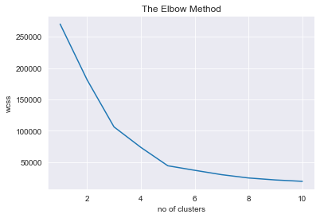

Slide 9
STEPS FOR IMPLEMENTATION
Various libraries were imported to manipulate, visualize and modeling data.
Certain components of the data are visualized for better insight.
Selecting the k value for the model.
Model implementation and obtaining the labels.
Plotting the Clusters on as 2D graph.

Slide 10
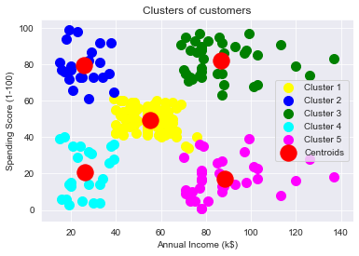

Slide 11
CONCLUSION
K-means clustering is an extensively used technique for data cluster analysis. However, its performance is usually not as competitive as those of the other sophisticated clustering techniques because slight variations in the data could lead to high variance, but for our project it has done exceptionally well.
we have visualized the gender distribution from the given dataset where the female population clearly outweighs the male counterpart. Then we tried to visualize the age distribution. Finally, using the K-means algorithm, we tried to analyze their annual incomes and spending scores and segmented the data into 5 groups.

Slide 12
THANK YOU

