Slide 1
Capstone Project
Telecom Churn Analysis

Slide 2
Content
Problem Statement:
Data Summary:
Visualization of frequency distribution:
Correlation among the variable:
Univariate Analysis:
Bivariate Analysis:
Trend of Churn among variable:
Conclusion:
z.

Slide 3
Problem Statement
The Orange Telecom's Churn Dataset, consists of cleaned customer activity data (features), along with a churn label specifying whether a customer cancelled the subscription.
Explore and analyze the data to discover key factors responsible for customer churn and come up with ways/recommendations to ensure customer retention.

Slide 4
Understanding problem
What exactly is Customer Churn?
What problem am I solving?
How many customers churn every given tenure?
What is the industry average for customer churn?
What is the profile of the customers churning?
What are all the reasons for customer churn?
When does a customer churn? Any trends?
What exactly is Customer Churn?

Slide 5
Data Summary
Data set name: The Orange Telecom's Churn Dataset including information on Cellular Usage dataset that consists of records of actual Cell Phone customers, and features that include specific features to a customer’s cell service.
Description Value
Records 3333
Features 20
Continuous 14
Categorical 6
Missing values 0
Features: State, International plan, Voice mail plan, Number of voice mail messages, Total day minutes, Total day charge, Total eve minutes, Total eve charge, Total night minutes, Total night charge, Total international minutes, Total international charge, Customer service calls, Churn.

Slide 6
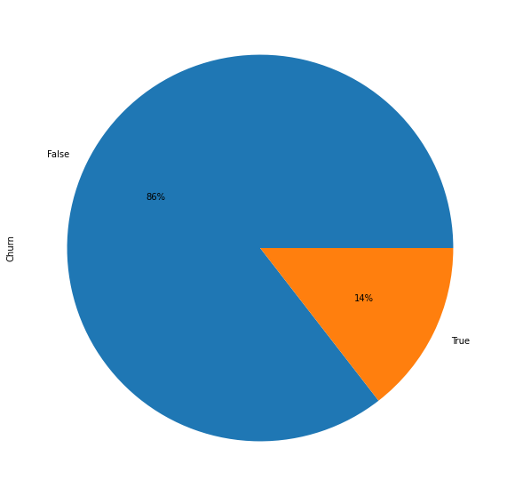
Churn rate of customer
False 2850 True 483
False 2850
True 483

Slide 7
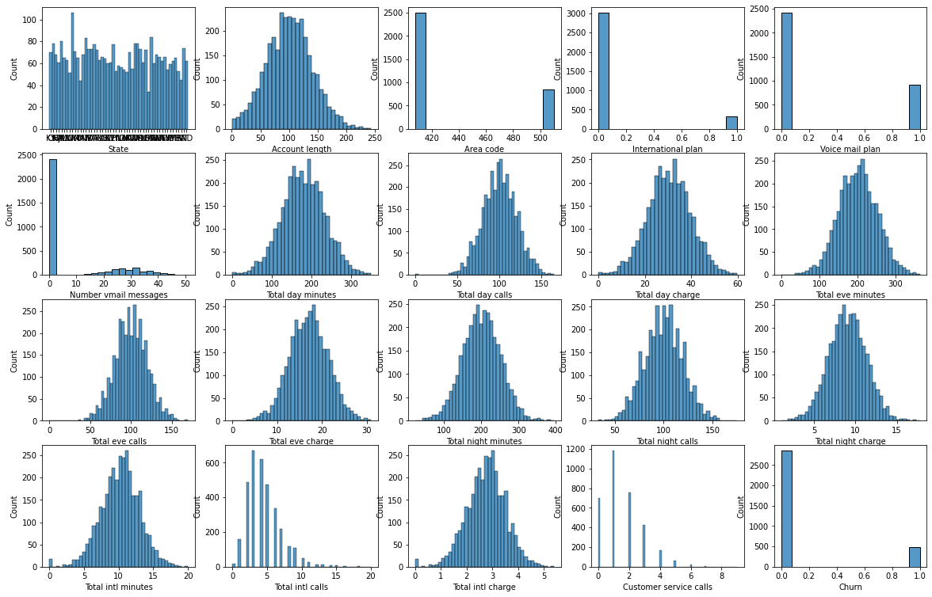
Visualization of frequency distribution of all variables

Slide 8
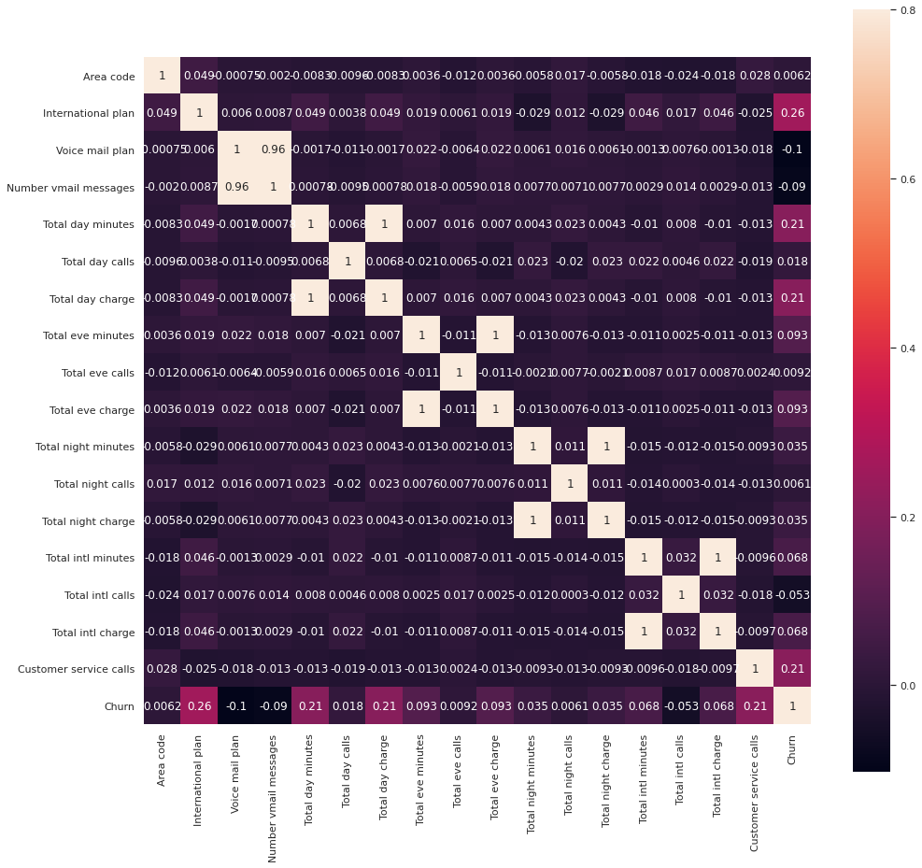
Correlation

Slide 9
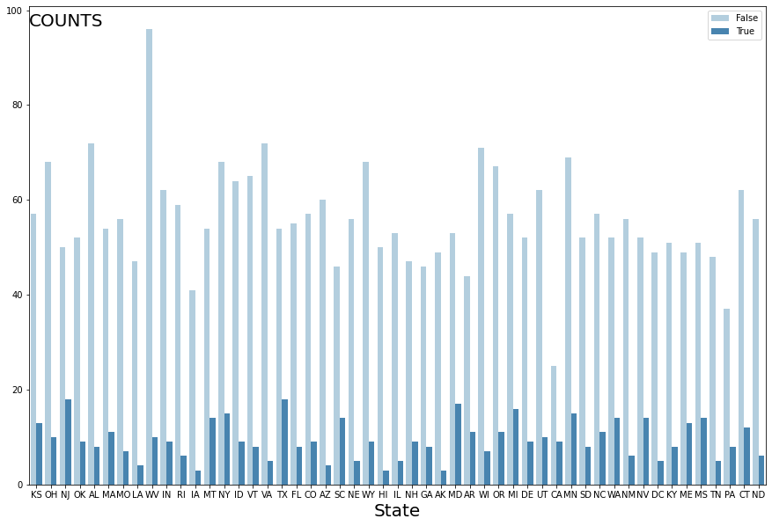
Analysis based on States
Churn According to States
Churn According to States

Slide 10
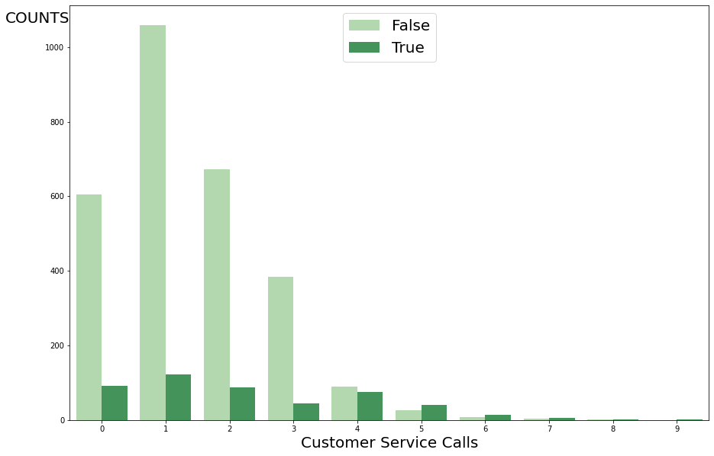
Churn according to customer service calls

Slide 11
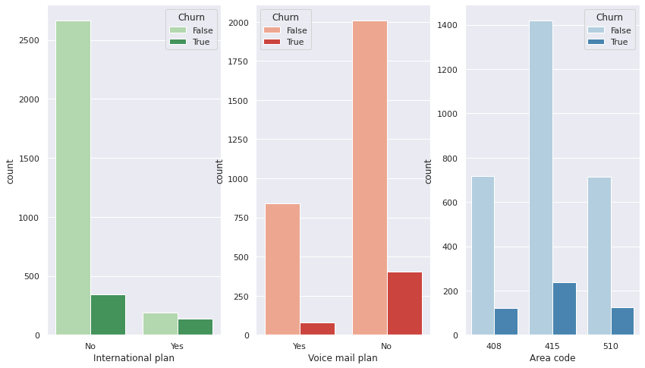
Analysis based on Voice mail plan, International plan and Area code

Slide 12
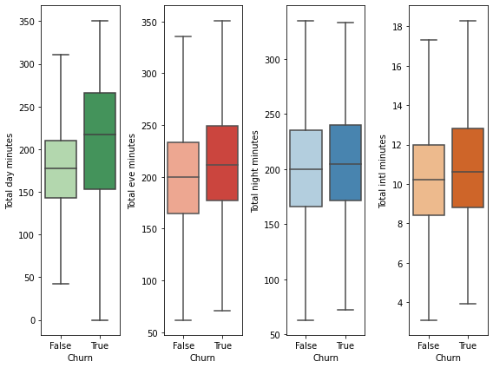
Analysis based on time of call duration

Slide 13
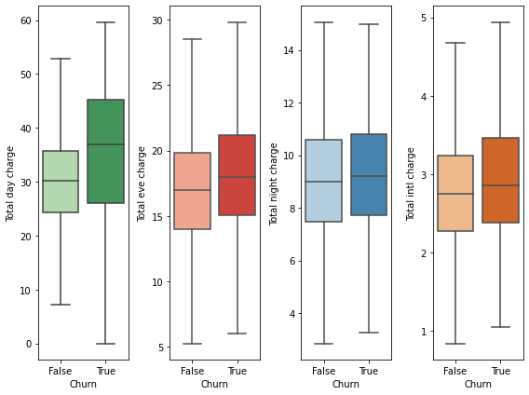
Analysis based on cost

Slide 14
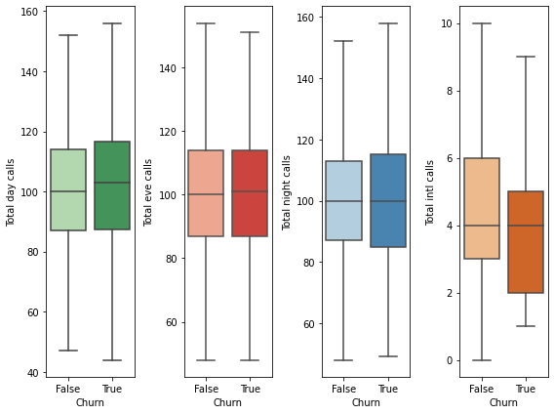
Analysis based on Total calls

Slide 15
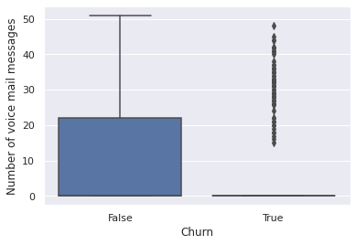
Analysis based on Number of voice mail messages

Slide 16
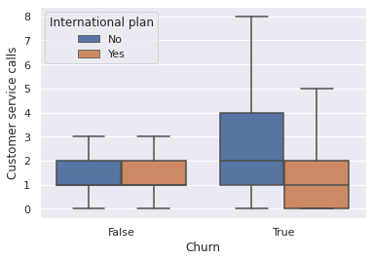
Combine effect of features variable on Churn

Slide 17
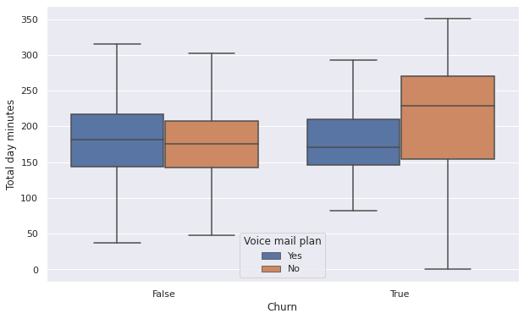
Analysis based on Total day minutes and Voice mail plan

Slide 18
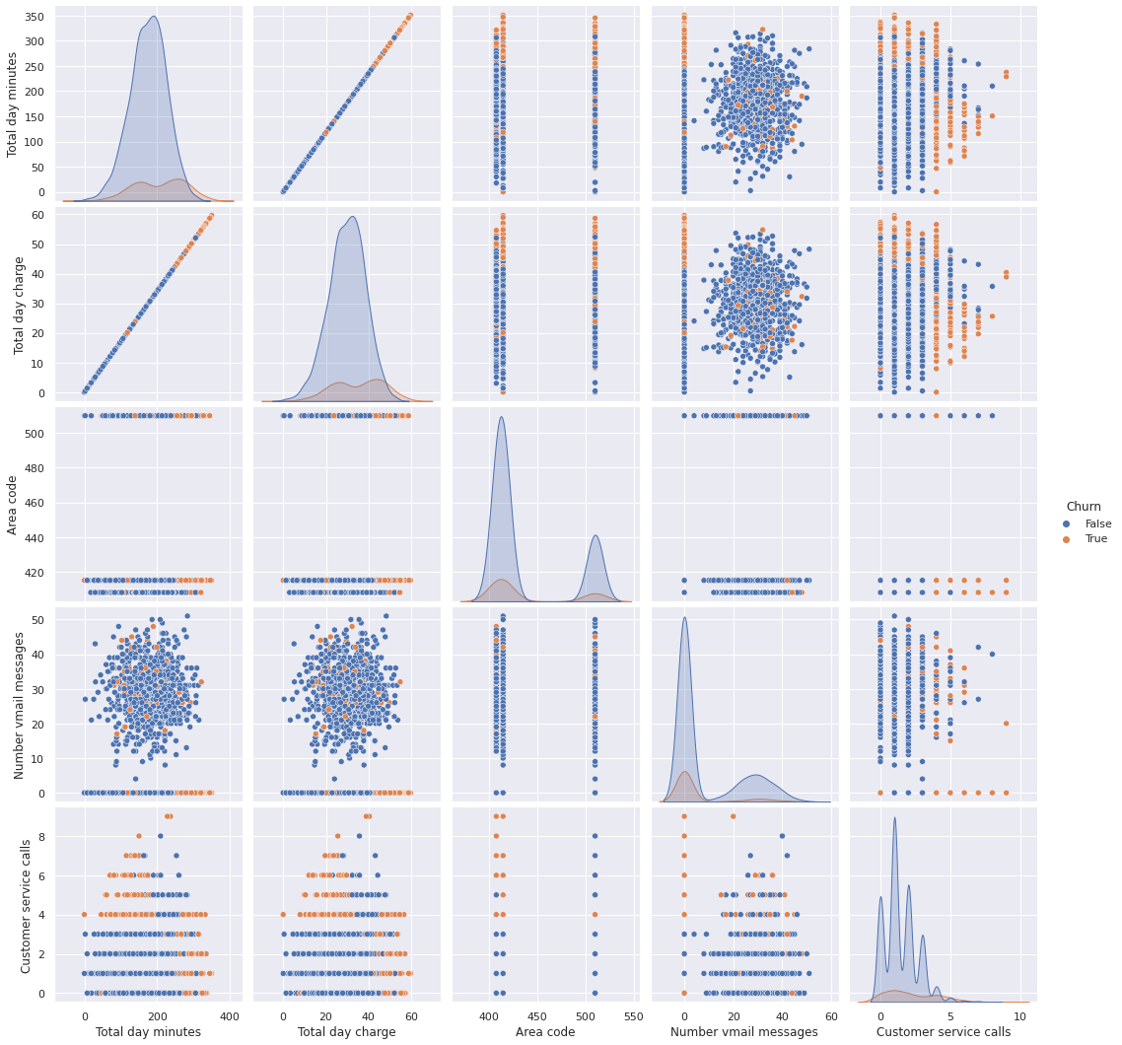
Trend of Churn among variable

Slide 19
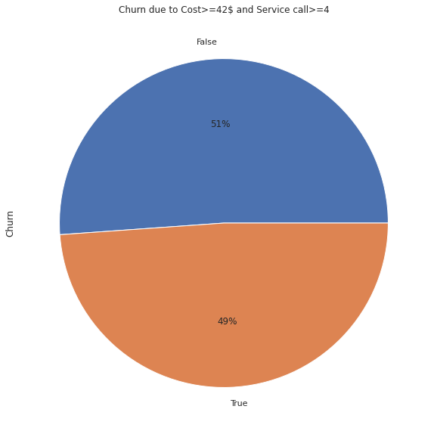
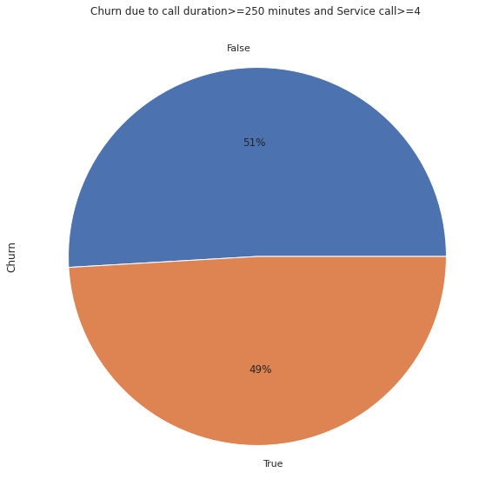
Initial Findings
False 317 True 303
False 303 True 292

Slide 20
Conclusion
The most significant variables are cost, time duration, voice mail messages, and customer service calls.
There is a perfect correlation between the cost and time duration of a call.
The important point to notice is that if we compare the cost and call durations during the day with the cost and call durations during evening and night then the data confirms that there is a very significant reduction in cost for evening and night call durations. And this helps the company to retain its customers.
The Company should reduce the cost for the customers who are making call more than 220 minutes duration during the day. These customers tend to churn.
The Company should also improve their management which looks after the customer’ complaint because the customers who are making more than 3 calls to customer service seem to be vulnerable.
The customers having an international plan makes less than or equal to two customer service calls have higher probability to churn.
The initial finding is that if we take the customers who have charged greater than or equal to 42$ and customers service calls are greater than or equal to four then we get a total of 620 observations. And out of which 303(49%) customers are label as churn. Therefore the company should focus on this segment.

Slide 21
Thank you Abhinandan Kumar

